Slide 1
Beyond Loose LP-relaxations: Optimizing MRFs by Repairing Cycles
Nikos Komodakis (University of Crete)
Nikos Paragios (Ecole Centrale de Paris)
TexPoint fonts used in EMF.
Read the TexPoint manual before you delete this box.: AA

Slide 2
Introduction

Slide 3





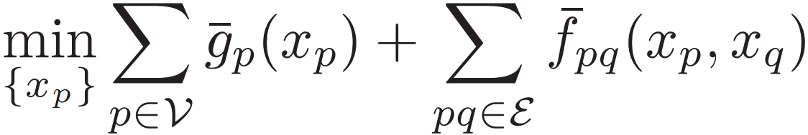
Discrete MRF optimization
Given:
  Objects from a graph
  Discrete label set
objects
edges
Assign labels (to objects) that minimize MRF energy:
unary potential
pairwise potential
MRF optimization ubiquitous in vision (and beyond)
  Stereo, optical flow, segmentation, recognition, …
  Extensive research for more than 20 years

Slide 4
MRFs and Linear Programming
Tight connection between MRF optimization and
Linear Programming (LP) recently emerged
E.g., state of the art MRF algorithms are now known to be directly related to LP:
  Graph-cut based techniques such as a-expansion:
generalized by primal-dual schema algorithms [Komodakis et al. 05, 07]
  Message-passing techniques:
generalized by TRW methods [Wainwright 03, Kolmogorov 05]
further generalized by Dual-Decomposition
[Komodakis et al. 07] [Schlesinger 07]
Above statement more or less true for almost all state-of-the-art MRF techniques

Slide 5
MRFs and Linear Programming
State-of-the-art LP-based methods for MRFs have two key characteristics in common:
  Make heavy use of dual information (dual-based algorithms)
OK
  Make use of a relaxation of the MRF problem, i.e., approximate it with an easier (i.e., convex) one
OK
NOT OK
  But:
  They all rely on the same LP-relaxation,
  called standard LP-relaxation hereafter

Slide 6
Importance of the choice of dual relaxation
resulting MRF energies
MRF energies away from optimum
lower bounds away from optimum
optimum
lower bounds (dual costs) from loose dual LP-relaxation

Slide 7
Importance of the choice of dual relaxation
MRF energies close to optimum
lower bounds close to optimum
resulting MRF energies
optimum
lower bounds from tight dual LP-relaxation

Slide 8
Contributions
Dynamic hierarchy of dual LP-relaxations
(goes all the way up to the exact MRF problem)
Dealing with particular class from this hierarchy called cycle-relaxations
  much tighter than standard relaxation
Efficient dual-based algorithm
  Basic operation: cycle-repairing
  Allows dynamic and adaptive tightening

Slide 9
Related work
MRFs and LP-relaxations
[Wainwright et al. 05] [Komodakis et al. 05, 07]
[Kolmogorov 05] [Weiss et al. 07] [Werner 07]
[Globerson 07] [Kohli et al. 08] [Schlesinger] [Boros]
LP relaxations vs alternative relaxations (e.g., quadratic, SOCP)
  LP not only more efficient but also more powerful [Kumar et al. 07]
Similar approaches concurrently with our work
[Kumar and Torr 08], [Sontag et al. 08], [Werner 08]

Slide 10
Building the dynamic hierarchy

Slide 11
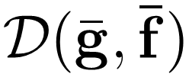
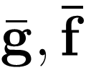
Dynamic hierarchy of dual relaxations
Starting point is the dual LP to the standard relaxation
Denoted hereafter by
  I.e., coefficients of this LP depend only on unary and pairwise MRF potentials
This is the building block as well as the relaxation at one end of our hierarchy

Slide 12
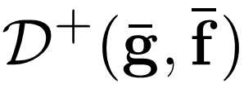
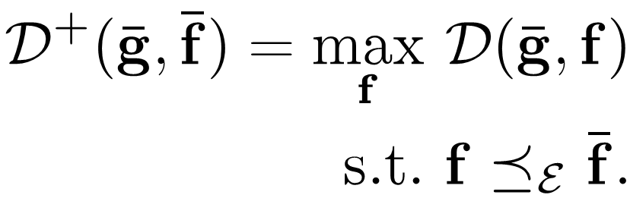


Dynamic hierarchy of dual relaxations
To see how to build the rest of the hierarchy, let us look at relaxation lying at the other end, denoted by
We are maximizing over
  Hence better lower bounds (tighter dual relaxation)
  In fact, is exact (equivalent to )

Slide 13
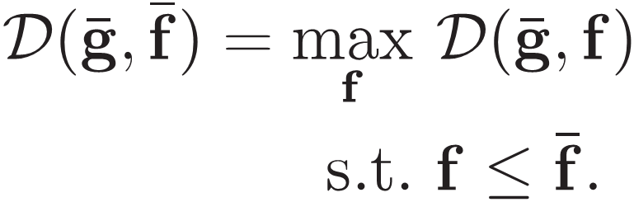


Dynamic hierarchy of dual relaxations
relies on:
Extra sets of variables f for set of all MRF edges
( virtual potentials on )
Extra sets of constraints through operator

Slide 14




Comparison operator
Generalizes comparison of pairwise potentials f, f’
  comparison between f, f’ done at a more global level than individual edges
Can be defined for any subset of the edges of the MRF graph (it is then denoted by ):
Standard operator ≤ results from

Slide 15

The two ends of the hierarchy
Relaxations and lie at opposite ends.
Relaxation :
  Tight (equivalent to )
  Inefficient (due to using operator )
Relaxation :
  Loose
  Efficient (due to using operator ≤)

Slide 16


Building the dynamic hierarchy
But many other relaxations in between are possible:
  simply choose subsets of edges
  for each subset C_{i} introduce an extra set of variables (virtual potentials) f_{i} , defined for all the edges in C_{i} and constrained by operator
This must be done in a dynamic fashion
(implicitly leads to a dynamic hierarchy of relaxations)

Slide 17



Building the dynamic hierarchy
Initially set f ^{cur} ←
Repeat
optimize
pick a subset C_{i}
f ^{next} ← { improve dual by adjusting virtual potentials f_{i} subject to }
f ^{cur} ← f ^{next}
until convergence

Slide 18
Building the dynamic hierarchy
Initially set f ^{cur} ←
Repeat
optimize
pick a subset C_{i}
f ^{next} ← { improve dual by adjusting virtual potentials f_{i} subject to }
f ^{cur} ← f ^{next}
until convergence

Slide 19
Building the dynamic hierarchy
Initially set f ^{cur} ←
Repeat
optimize
pick a subset C_{i}
f ^{next} ← { improve dual by adjusting virtual potentials f_{i} subject to }
f ^{cur} ← f ^{next}
until convergence

Slide 20
Building the dynamic hierarchy
Initially set f ^{cur} ←
Repeat
optimize
pick a subset C_{i}
f ^{next} ← { improve dual by adjusting virtual potentials f_{i} subject to }
f ^{cur} ← f ^{next}
until convergence

Slide 21
Building the dynamic hierarchy
Initially set f ^{cur} ←
Repeat
optimize
pick a subset C_{i}
f ^{next} ← { improve dual by adjusting virtual potentials f_{i} subject to }
f ^{cur} ← f ^{next}
until convergence

Slide 22
Building the dynamic hierarchy
Initially set f ^{cur} ←
Repeat
optimize
pick a subset C_{i}
f ^{next} ← { improve dual by adjusting virtual potentials f_{i} subject to }
f ^{cur} ← f ^{next}
until convergence
Many variations of the above basic scheme are possible

Slide 23
Cycle-relaxations
As special case, we considered choosing only subsets C_{i} that are cycles in the MRF graph
Resulting class of relaxations called
cycle-relaxations
Good compromise between efficiency and accuracy

Slide 24
Cycle-relaxations
Initially set f ^{cur} ←
Repeat
optimize
pick a subset C_{i}
f ^{next} ← { improve dual by adjusting virtual potentials f_{i} subject to }
f ^{cur} ← f ^{next}
until convergence

Slide 25
Cycle-relaxations
Initially set f ^{cur} ←
Repeat
optimize
pick a subset C_{i}
f ^{next} ← { improve dual by adjusting virtual potentials f_{i} subject to }
f ^{cur} ← f ^{next}
until convergence

Slide 26
Cycle-relaxations
Initially set f ^{cur} ←
Repeat
optimize
pick a cycle C_{i}
f ^{next} ← { improve dual by adjusting virtual potentials f_{i} subject to }
f ^{cur} ← f ^{next}
until convergence

Slide 27
Cycle-relaxations
Initially set f ^{cur} ←
Repeat
optimize
pick a cycle C_{i}
f ^{next} ← { improve dual by adjusting virtual potentials f_{i} subject to }
f ^{cur} ← f ^{next}
until convergence

Slide 28
Cycle-relaxations
Initially set f ^{cur} ←
Repeat
optimize
pick a cycle C_{i}
f ^{next} ← { improve dual by adjusting virtual potentials f_{i} subject to }
f ^{cur} ← f ^{next}
until convergence
cycle-repairing

Slide 29
Cycle-relaxations
Initially set f ^{cur} ←
Repeat
optimize
pick a cycle C_{i}
f ^{next} ← { improve dual by adjusting virtual potentials f_{i} subject to }
f ^{cur} ← f ^{next}
until convergence
cycle-repairing

Slide 30
Cycle-relaxations
Initially set f ^{cur} ←
Repeat
optimize
pick a cycle C_{i}
f ^{next} ← { improve dual by adjusting virtual potentials f_{i} subject to }
f ^{cur} ← f ^{next}
until no more cycles to repair
cycle-repairing

Slide 31


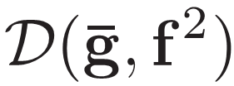

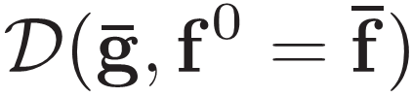
Cycle-repairing
Accuracy: relaxation tightening
Efficiency: reusing current dual information to optimize next tighter relaxation (i.e., no restarting from scratch)
energy
optimum
lower bound
repair cycles (tighten relaxation)
repair cycles (tighten relaxation)
repair cycles (tighten relaxation)
repair cycles (tighten relaxation)

Slide 32
What does cycle-repairing try to achieve?

Slide 33
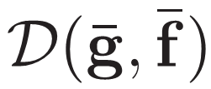
Back to relaxation
To get an intuition of what cycle-repairing tries to achieve, we need to take a look at relaxation
(the building block of our hierarchy)
Essentially, that relaxation is defined in terms of 2 kinds of variables:
  Heights
  Residuals

Slide 34
= maximize sum of minimal heights
subject to all residuals kept nonnegative
object p₂
non-minimal node
5ε
minimal node
heights
a
minimal height
ε
b
residuals
ε
ε
2ε
ε
or both of these residuals…
2ε
ε
0
0
node ( p₃,a)
5ε
0
a
a
b
0
We must lower either both of these residuals…
e.g, to raise this minimal height
0
0
0
0
tight link
But: for a height to go up, some residuals must go down

Slide 35
= maximize sum of minimal heights
subject to all residuals kept nonnegative
Deadlock reached:
dual objective cannot increase
But this is a “nice” deadlock: it happens at global optimum
5ε
a
ε
b
ε
ε
ε
0
0
0
6ε
0
a
a
b
0
0
0
But: for a height to go up, some residuals must go down

Slide 36
= maximize sum of minimal heights
subject to all residuals kept nonnegative
However, life is not always so easy…
This is a “bad” deadlock: not at global optimum
0
0
a
b
0
ε
ε
0
ε
0
0
ε
0
a
a
0
0
b
b
0
0
ε
ε
0
But: for a height to go up, some residuals must go down

Slide 37
= maximize sum of minimal heights
subject to all residuals kept nonnegative
inconsistent cycles: e.g., cycle p₁p₂p₃ w.r.t. node (p₁,a)
This is a “bad” deadlock: not at global optimum
However, life is not always so easy…
0
0
a
b
0
ε
ε
0
ε
0
0
ε
0
a
a
0
0
b
b
0
0
ε
ε
0
But: for a height to go up, some residuals must go down

Slide 38
What does cycle-repairing do?
Tries to eliminate inconsistent cycles
It thus allows escaping from “bad” deadlocks, and helps dual objective to increase even further
Cycle-repairing impossible when using
relaxation
Possible due to extra variables used in tighter relaxations (i.e., virtual potentials):
Allow heights to increase without reducing any residuals of tight links (i.e., zero residuals)

Slide 39
Results

Slide 40
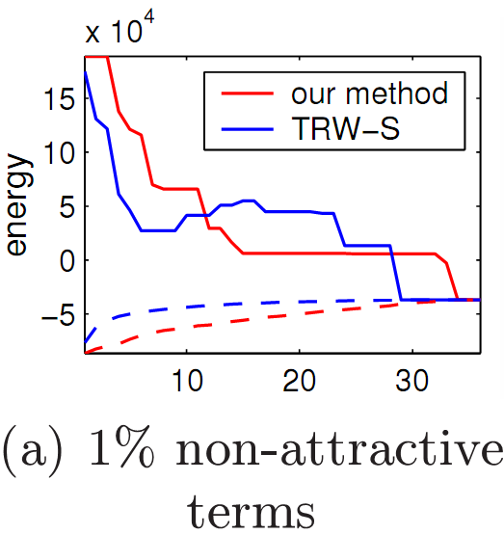
Results when standard relaxation is a good approximation

Slide 41
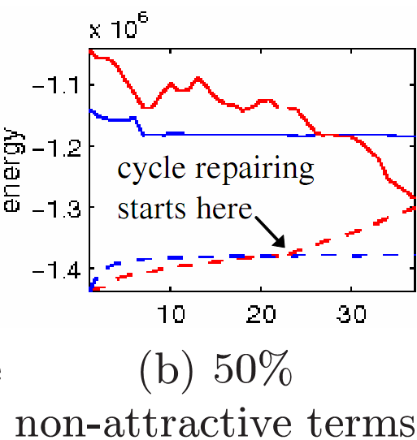
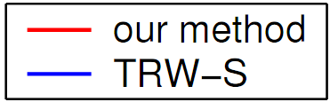
Results when standard relaxation is a bad approximation

Slide 42
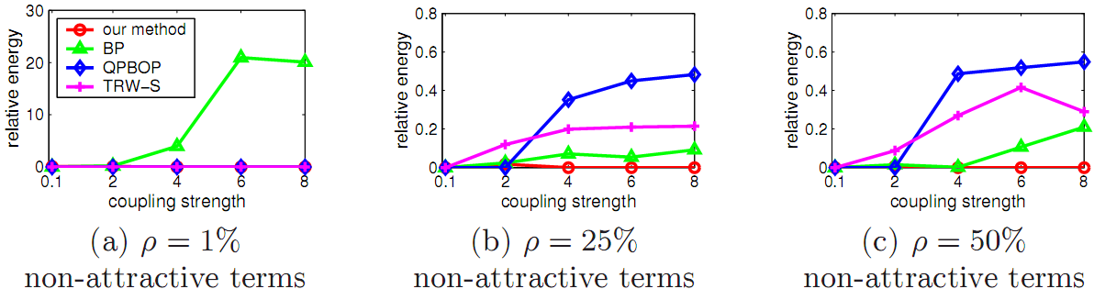
Further comparison results

Slide 43
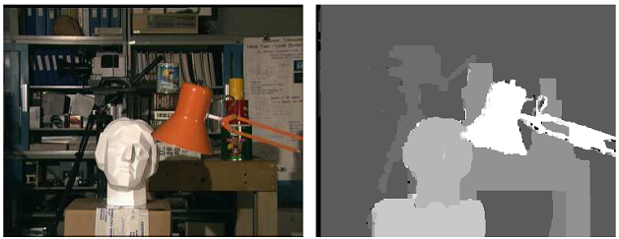
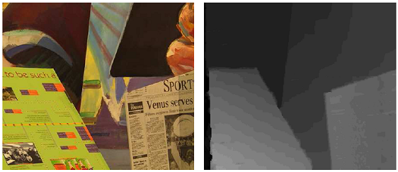
Middlebury MRFs

Slide 44
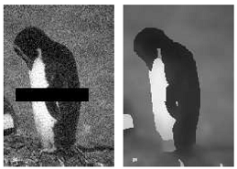
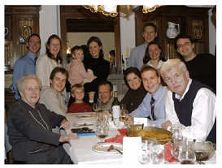
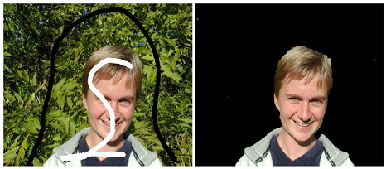
Middlebury MRFs

Slide 45
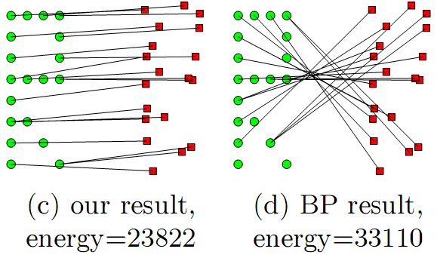
Deformable matching

Slide 46
So, LP-based MRF methods can be…
the fastest
Primal-dual schema
(Komodakis et al. 05, 07)
extremely general
Dual decomposition
(Komodakis et al. 07)
very accurate
Cycle-repairing
(beyond loose LPs)
NOTE: each green box may be linked to many red ones

Slide 47
Take home message:
LP and its duality theory provides:
Powerful framework for systematically tackling
the MRF optimization problem
Unifying view for the state-of-the-art
MRF optimization techniques

