Slide 1
Learning with Inference for Discrete Graphical Models
Nikos Komodakis
Pawan Kumar
Nikos Paragios
Ramin Zabih (presenter)

Slide 2
Schedule
9:30 - 10:00: Overview (Zabih)
10:10 - 11:10 Inference for learning (Zabih)
11:25 - 12:30 More inference for learning, plus software demos (Komodakis, Kumar)
14:30 - 16:00 Learning for inference (Komodakis)
16:15 - 17:45 Advanced topics (Kumar)
17:45 - 18:00 Discussion (all)

Slide 3
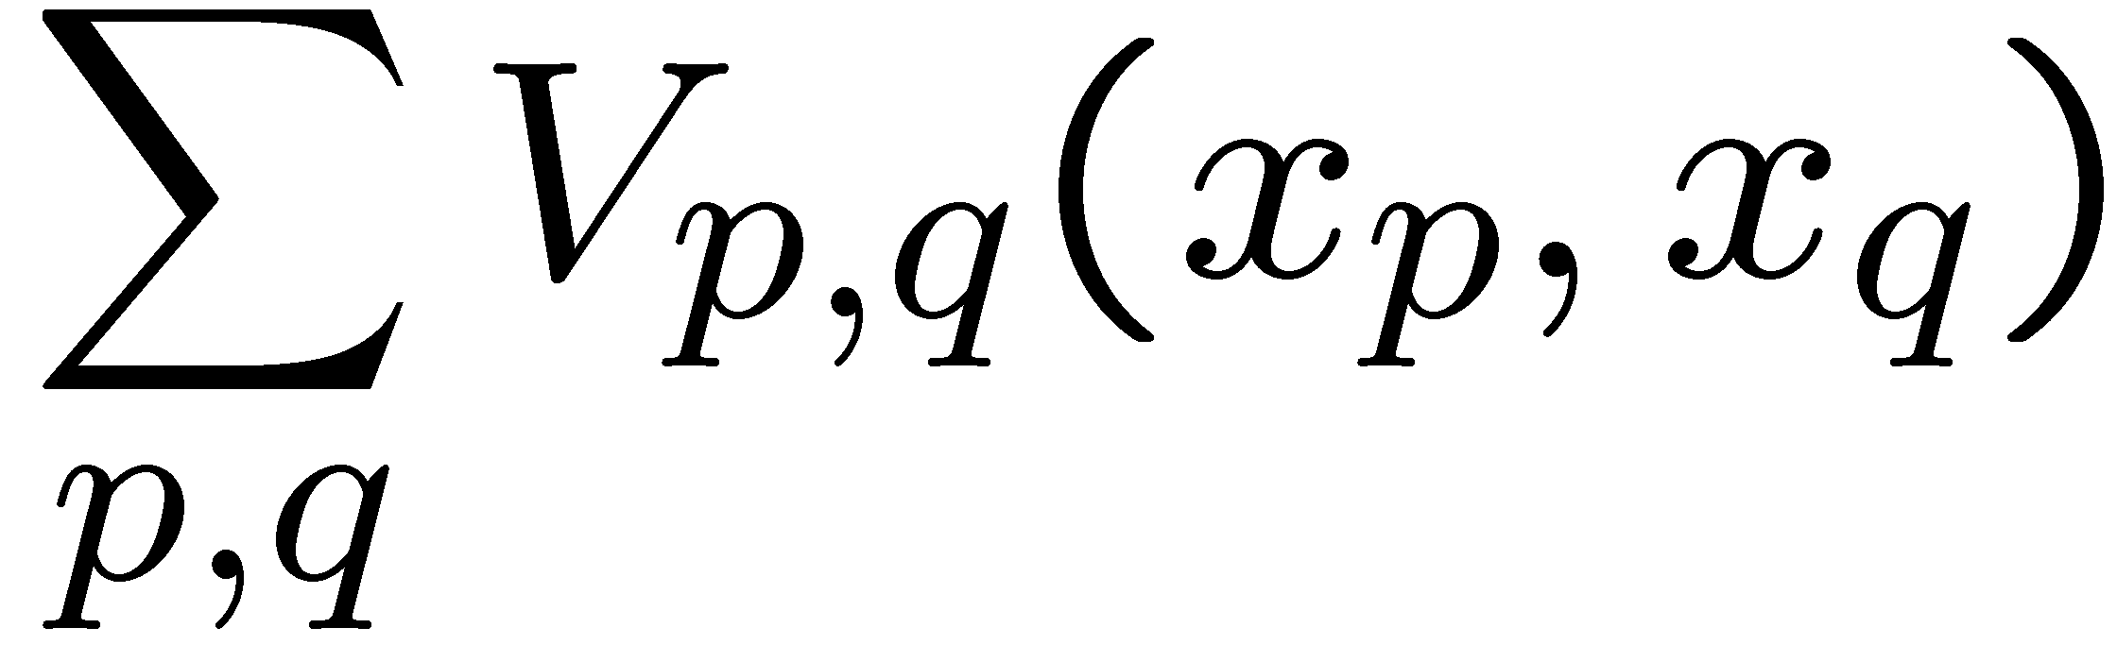
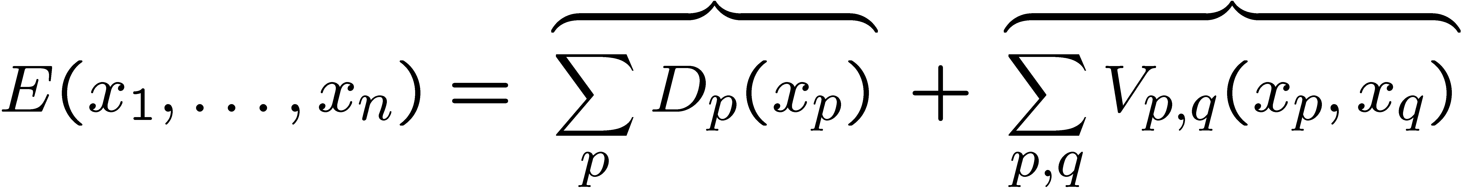
Recall: MAP-MRF energy function
Generalization of C2 is
  Think of V as the cost for two adjacent pixels to have these particular labels
  For binary images, the natural cost is uniform
Bayesian energy function:
Likelihood
Prior

Slide 4
Generalizations
Many vision problems have this form
The optimization techniques are specific to these energy function, but not to images
  See: [Kleinberg & Tardos JACM 02]

Slide 5
Network flow can help
For two labels, natural V is uniform
  Ising model
Can write this as a minimizing a quadratic polynomial over binary variables
Problem can be solved exactly using network flow (thanks to Ford-Fulkerson)
  Construction probably due to [Hammer et al. 65]
  First applied to images by [Greig et al. 86]
Classical Computer Science problem reduction
  Turn a new problem into a problem we can solve!

Slide 6
Important properties
Very efficient in practice
  Lots of short paths, so roughly linear
  Edmonds-Karp max flow algorithm finds augmenting paths in breadth-first order
Construction is symmetric (0 vs 1)
  Each terminal is a label
Specific to 2 labels
  Min cut with >2 terminals is NP-hard
  Almost ANY such graph problem is NP-hard
    One has to appreciate Ford-Fulkerson!

Slide 7
Can this be generalized?
NP-hard for Potts model [K/BVZ 01]
Two main approaches
  1. Exact solution [Ishikawa 03]
    Large graph, convex V (arbitrary D)
    Not the considered the right prior for vision
  2. Approximate solutions [BVZ 01]
    Solve a binary labeling problem, repeatedly
    Expansion move algorithm

Slide 8
Expansion move algorithm
Input labeling f
_{Green expansion move from f}
Make green expansion move that most decreases E
  Then make the best blue expansion move, etc
  Done when no α-expansion move decreases the energy, for any label α
  See [BVZ 01] for details

Slide 9
Local improvement vs. Graph cuts
Continuous vs. discrete
  No floating point with graph cuts
Local min in line search vs. global min
Minimize over a line vs. hypersurface
  Containing O(2^{n}) candidates
Local minimum: weak vs. strong
  Within 1% of global min on benchmarks!
  Theoretical guarantees concerning distance from global minimum
    2-approximation for a common choice of E

Slide 10

Binary sub-problem
Input labeling
Expansion move
Binary image

Slide 11
Expansion move energy
Goal: find the binary image with lowest energy
Binary image energy E(b) is restricted version of original E
  Depends on f,α

Slide 12
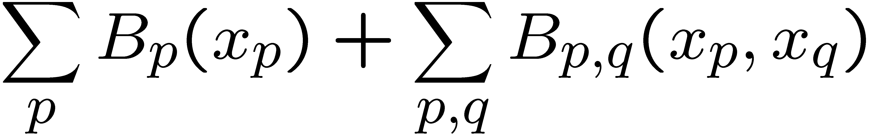
Regularity
The binary energy function
is regular [KZ 04] if
  Let’s all pretend this makes sense (for now)
Graph cuts solve regular functions!

Slide 13
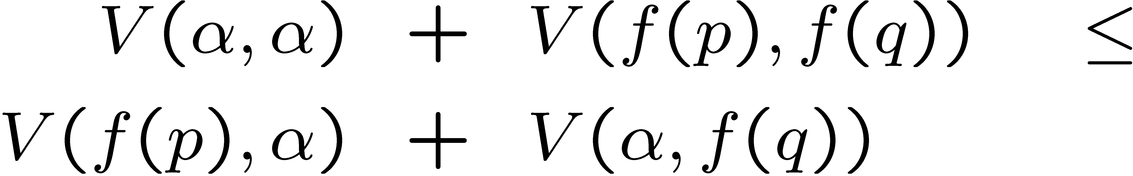
When is binary energy regular?
Can find cheapest α-expansion from f if
This is a Monge property
  It holds if V is a metric, plus a few other cases
With this assumption, can compute the optimal expansion move

Slide 14
What does regularity mean?
Close relationship to graph problems solvable in polynomial time
Consider a set U and a real-valued function f defined on subsets of U
  We say that f is submodular if:
  Equivalent definition:
There are (slow) polynomial algorithms for submodular function minimization

Slide 15
Submodularity and graphs
Let U be the nodes of a weighted graph and f be the sum of outgoing edges
  Called a cut function
Such a function is easily submodular
  Same holds if the graph has terminals
Result: min cut is in P (barely)!

Slide 16
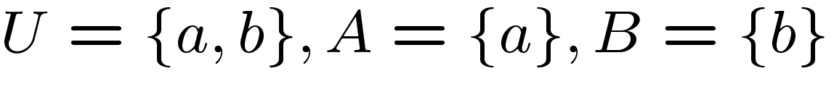
Submodularity and regularity
Consider the simplest non-trivial example
  What does submodularity mean?
Now represent subsets as binary vectors
  Regularity is simplest case of submodularity
    Not equivalent [Zivny], or we’d have a faster algorithm to minimize submodular functions

Slide 17
What is a regular QUBO?
Suppose we have a regular energy function. What does it look like as a polynomial?
Pick two pixels, write their variables
What is the cost involving these variables?
Regular if and only if quadratic term ≤ 0

Slide 18
Graph cuts and relaxations
Much current work uses relaxations to create better methods
  Draws on work by P. Hammer and E. Boros, and their collaborators
    Quadratic Unconstrained Binary Optimization (QUBO) problems

Slide 19
The roof duality relaxation
Hammer, Boros et al solution
  Graph construction called “roof duality” due to [Hammer et al 84] [Boros & Hammer 02]
  Introduced into computer vision by V. Kolmogorov in early 2005
    Efficient implementation often called QPBO
Relaxation with a very nice property
  Lots of useful information even if it doesn’t compute the optimal expansion move
  Partial optimality!
    Right answers at some pixels

Slide 20
Partial optimality is hard!
Opt (y=2)
False Opt (y=1)

Slide 21
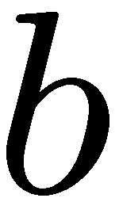
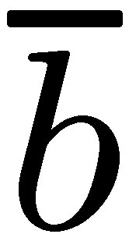
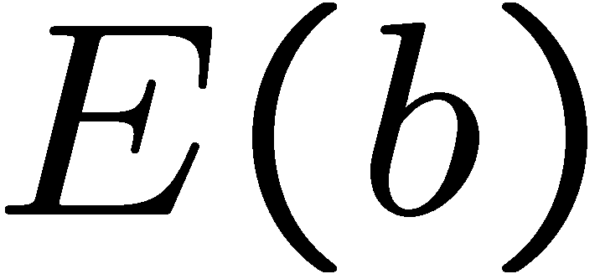
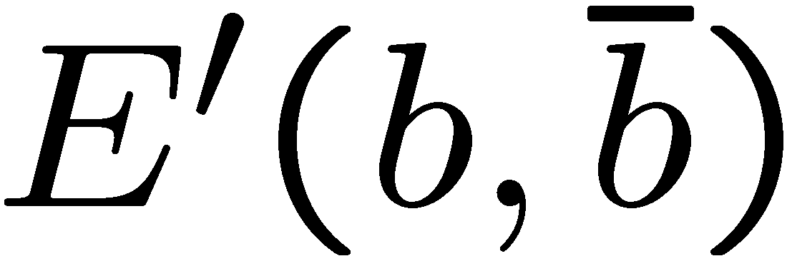
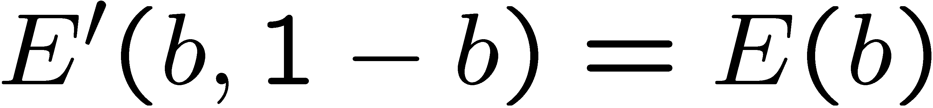
Roof duality relaxation
Alternate encoding of expansion moves
Can’t use graph cuts to minimize
But we can minimize the relaxation
  Note:

Slide 22
Partial optimality
[Hammer et al 84][Boros & Hammer 02] show this relaxation has an amazing property
  Strong persistency: all consistent pixels have the correct label
  If there are no inconsistent pixels (or very few), this is great
    Which happens often in MR!
?

Slide 23
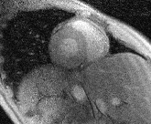
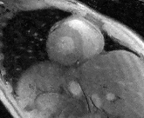
Recent MRI results
SENSE
(= LS)
Graph cuts

Slide 24
How to get partial optimality?
We’re trying to minimize an arbitrary binary function (NP-hard)
  How to find some values at global min?
Suppose we could always decrease the energy by setting (binary) variable a=1
  Then we know a=1 in global min
    Or we could go there, then decrease energy!
  Use max flow to find such a partial assignment
    Typically on multiple variables

Slide 25

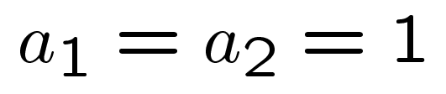
Posiforms
Can rewrite our function so that all (non-constant) coefficients are positive
  Always pay K. Pay 2 if a₁=1. Pay 4 if a₂=0…
How can we find a partial assignment that always reduces the cost?
  Generalization of “pure literal rule”
Max flow finds such partial assignments!

Slide 26
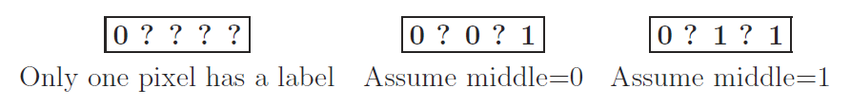
Probing
Invented by Boros et al, introduced into vision by Rother et al CVPR07
Another use of “consensus”, aka resolution
  (A ⇒ B) ∧ (-A ⇒ B) ⇒ B

Slide 27
Higher order priors?
Problem: We can solve quadratic binary energy functions, but we need to reduce non-quadratic priors to quadratic ones
Ishikawa [TPAMI10] gave the first practical algorithm to do this in all cases
  Previously could only handle negative terms (Freedman & Drineas, generalizing [Kolmogorov & Zabih TPAMI04])

Slide 28
Recent progress
“A Graph Cut Algorithm for Higher-order Markov Random Fields”, A. Fix, A. Gruber, E. Boros, & R. Zabih, ICCV11 poster
Significantly improve Ishikawa’s results
Characterizes a class of problems where our performance is even better
  shows that some common computer vision problems are in this class

Slide 29
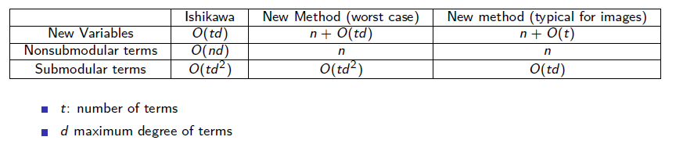
ICCV11 poster preview
Positive terms are the hard case
Ishikawa does them one at a time, we do a different reduction for groups sharing a common variable
  Works especially well on vision problems

Slide 30
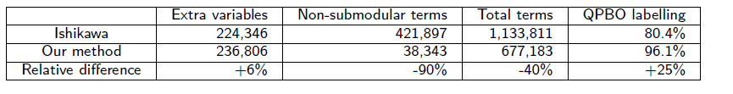
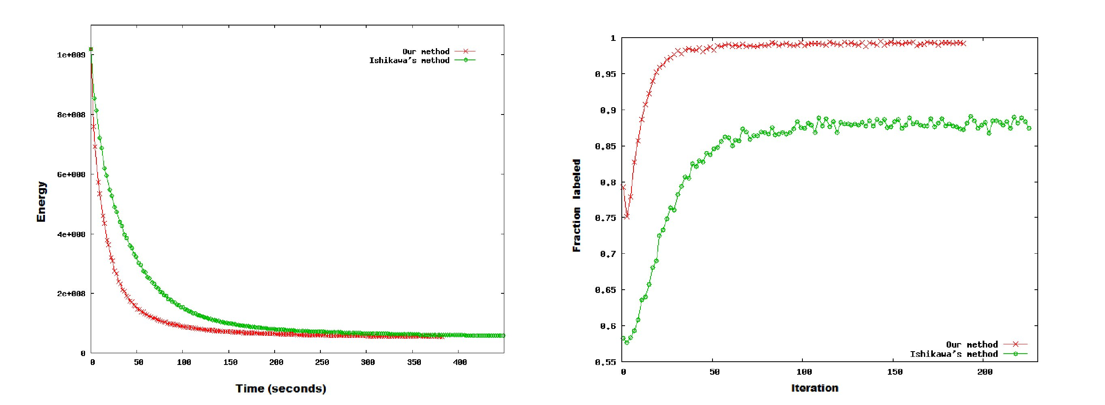
Results

Slide 31
Conclusions
Flow-based algorithms (“graph cuts”) are powerful tools for MAP estimation of MRF’s
  Common in computer vision, and elsewhere
Lots of interest in using these methods for even broader classes of problems
Graph cuts can give strong results for linear inverse systems with discontinuities
  There are many of these (in MR and beyond)

