Slide 1

Max-Margin Learning with
Latent Variables

Slide 2
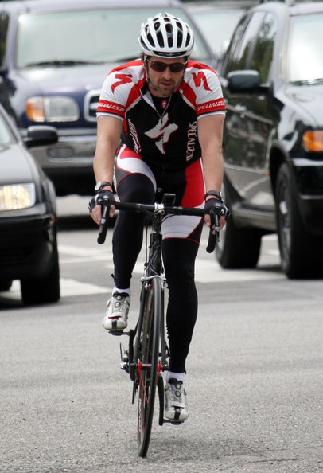
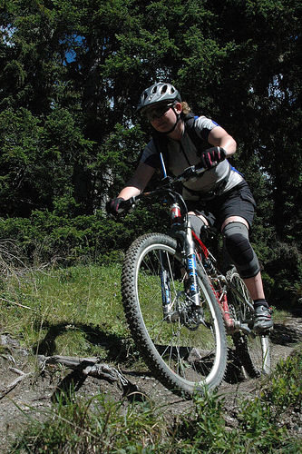
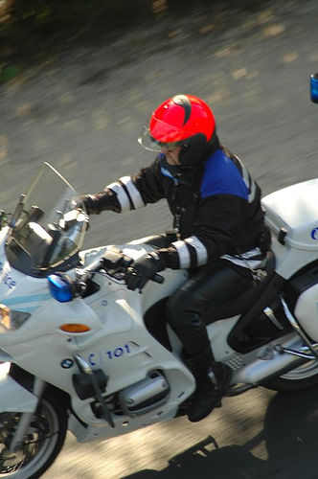
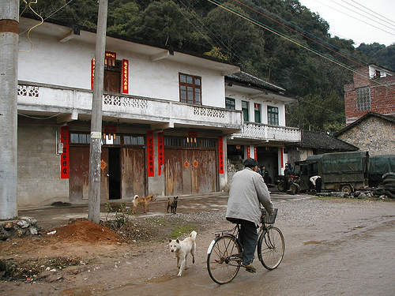
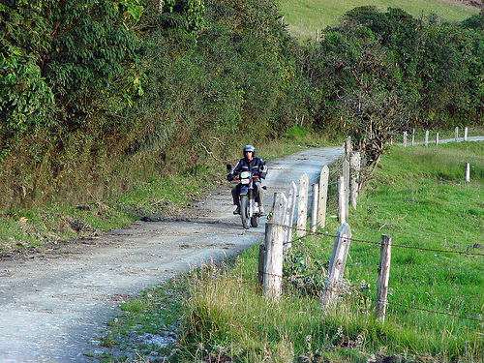
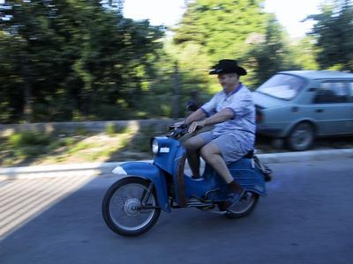
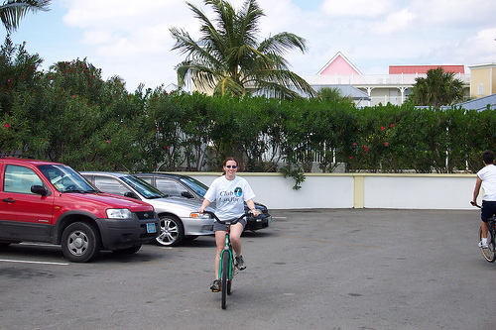
Why Latent Variables?
Mismatch between desired output and available annotations
Training Data
“Riding
Bike”
“Riding Bike”
“Riding Bike”
“Tom”
“Mary”

Slide 3
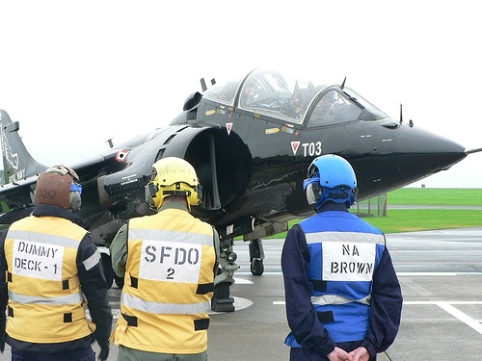

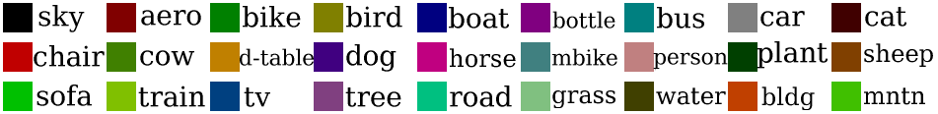
Why Latent Variables?
Mismatch between desired output and available annotations

Slide 4

Why Latent Variables?
Mismatch between desired output and available annotations
PASCAL VOC Segmentation Datasets

Slide 5
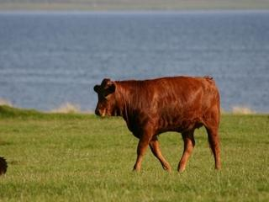
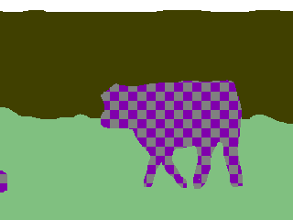
Why Latent Variables?
Mismatch between desired output and available annotations
Stanford Background Datasets

Slide 6
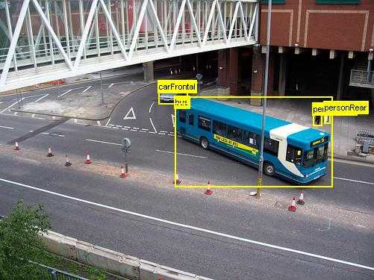
Why Latent Variables?
Mismatch between desired output and available annotations
PASCAL VOC
Detection Datasets
Thousands of images

Slide 7
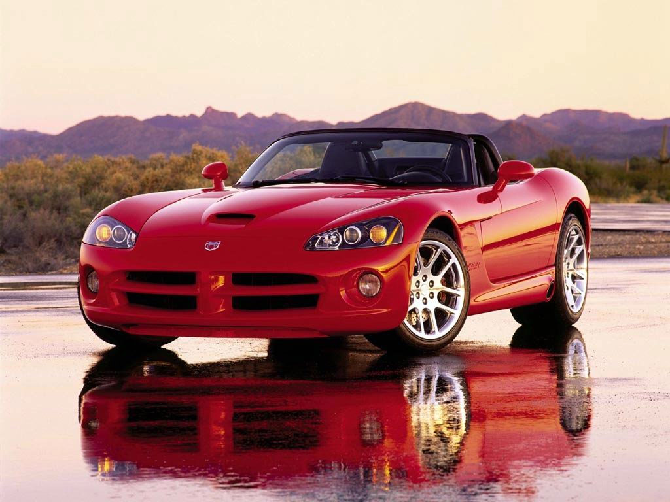
Why Latent Variables?
Mismatch between desired output and available annotations
“Car”
ImageNet,
Caltech…
Thousands of images

Slide 8
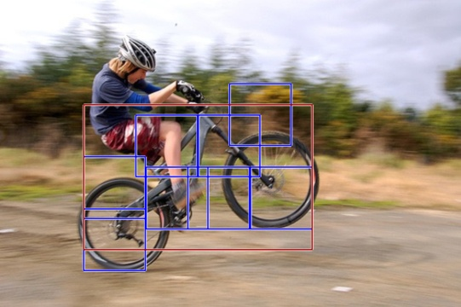
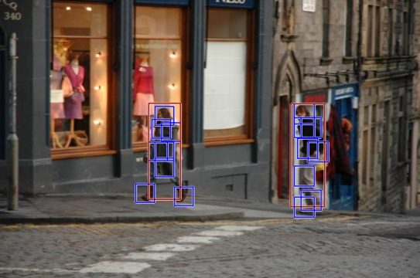
Why Latent Variables?
Mismatch between desired output and possible annotations
P. Felzenszwalb, D. McAllester and D. Ramanan
A Discriminatively Trained, Multiscale, Deformable Part Model.
CVPR 2008

Slide 9
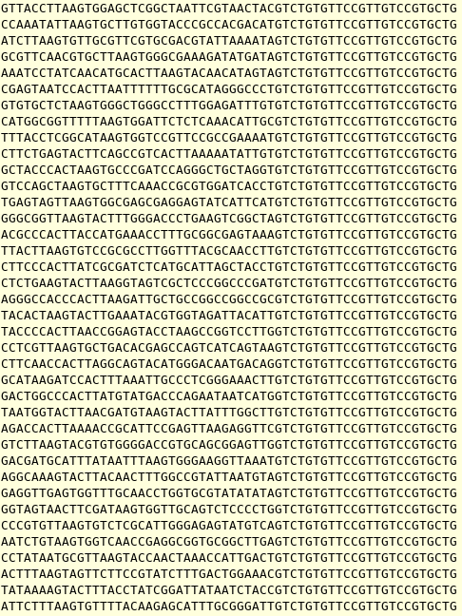
Why Latent Variables?
Mismatch between desired output and possible annotations
unknown
Contain motif
+1
^
unknown
Don’t contain motif
^
-1

Slide 10
Learning with Latent Variables
Handles missing information
Learn with large, freely available, diverse data
Traditional methods like expectation-maximization (EM)
New max-margin formulations

Slide 11
Max-Margin Learning with
Latent Variables
Latent SVM
Andrews et al., 2001, Smola et al., 2005,
Felzenszwalb et al, 2008, Yu and Joachims, 2009

Slide 12
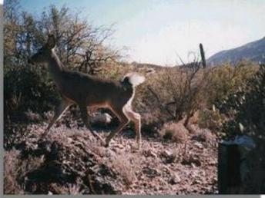
Latent SVM
Input x
Output y ∈ Y
Hidden Variable
h ∈ H
“Deer”
Y = {“Bison”, “Deer”, ”Elephant”, “Giraffe”, “Llama”, “Rhino” }

Slide 13
Latent SVM
Feature Ψ(x,y,h)
(HOG, BoW)
Parameters w
(y(w),h(w)) = max_{y∈Y,h∈H} w^{T}Ψ(x,y,h)

Slide 14
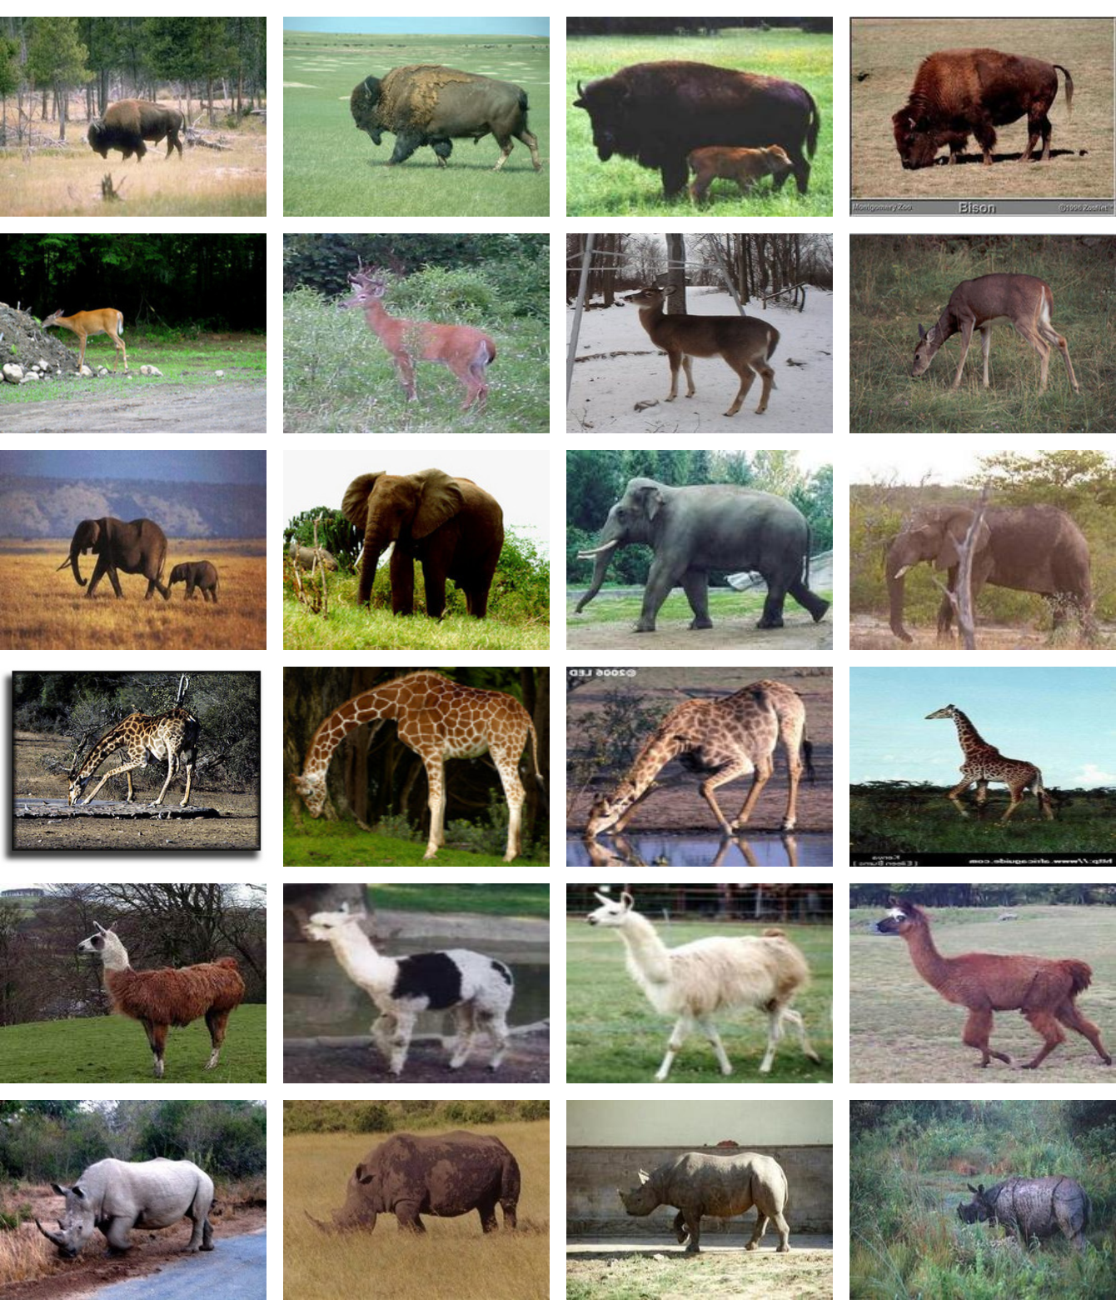
Latent SVM
Training samples x_{i}
Ground-truth label y_{i}
Loss Function
Δ(y_{i}, y_{i}(w))
0/1 Loss

Slide 15
Latent SVM
(y(w),h(w)) = max_{y∈Y,h∈H} w^{T}Ψ(x,y,h)
w^{T}Ψ(x,y(w),h(w)) +
Δ(y_{i}, y_{i}(w))
- w^{T}Ψ(x,y(w),h(w))
“Very” non-convex

Slide 16
Latent SVM
(y(w),h(w)) = max_{y∈Y,h∈H} w^{T}Ψ(x,y,h)
w^{T}Ψ(x,y(w),h(w)) +
Δ(y_{i}, y_{i}(w))
- max_{hi} w^{T}Ψ(x,y_{i},h)
Upper Bound

Slide 17
Latent SVM
(y(w),h(w)) = max_{y∈Y,h∈H} w^{T}Ψ(x,y,h)
max_{y,h}
w^{T}Ψ(x,y,h) +
Δ(y_{i}, y)
- max_{hi} w^{T}Ψ(x,y_{i},h)
Upper Bound

Slide 18
Latent SVM
(y(w),h(w)) = max_{y∈Y,h∈H} w^{T}Ψ(x,y,h)
min ||w||² + C∑_{i} ξ_{i}
max_{hi}w^{T}Ψ(x_{i},y_{i},h_{i}) - w^{T}Ψ(x_{i},y,h)
≥ Δ(y_{i}, y) - ξ_{i}
So is this convex?

Slide 19
Latent SVM
(y(w),h(w)) = max_{y∈Y,h∈H} w^{T}Ψ(x,y,h)
Convex
max_{y,h}
w^{T}Ψ(x,y,h) +
Δ(y_{i}, y)
- max_{hi} w^{T}Ψ(x,y_{i},h)
Convex
Difference-of-convex !!

Slide 20
Concave-Convex Procedure (CCCP)
+
Linear upper-bound of concave part
Yuille and Rangarajan, 2003

Slide 21
Concave-Convex Procedure (CCCP)
+
Linear upper-bound of concave part
Yuille and Rangarajan, 2003

Slide 22
Concave-Convex Procedure (CCCP)
+
Until Convergence
Yuille and Rangarajan, 2003

Slide 23
Latent SVM
(y(w),h(w)) = max_{y∈Y,h∈H} w^{T}Ψ(x,y,h)
max_{y,h}
w^{T}Ψ(x,y,h) +
Δ(y_{i}, y)
- max_{hi} w^{T}Ψ(x,y_{i},h)
Linear upper bound at w_{t}
Ψ(x,y_{i},h_{i}*)
h_{i}* = argmax_{hi} w_{t}^{T}Ψ(x,y_{i},h_{i})

Slide 24
Latent SVM
(y(w),h(w)) = max_{y∈Y,h∈H} w^{T}Ψ(x,y,h)
min ||w||² + C∑_{i} ξ_{i}
max_{hi}w^{T}Ψ(x_{i},y_{i},h_{i}) - w^{T}Ψ(x_{i},y,h)
≥ Δ(y_{i}, y) - ξ_{i}
Solve using CCCP

Slide 25
CCCP for Latent SVM
Start with an initial estimate w₀
Update
h_{i}* = argmax_{hi∈H} w_{t}^{T}Ψ(x_{i},y_{i},h_{i})
Update w_{t+1} by solving a convex problem
min ||w||² + C∑_{i} ξ_{i}
w^{T}Ψ(x_{i},y_{i},h_{i}*) - w^{T}Ψ(x_{i},y,h)
≥ Δ(y_{i}, y) - ξ_{i}

Slide 26
Image Classification
Input x - Image
Output y ∈ Y
Latent h - Box
Δ - 0/1 Loss
Y = {“Bison”, “Deer”, ”Elephant”, “Giraffe”, “Llama”, “Rhino” }
Feature Ψ(x,y,h) - HOG

Slide 27
Image Classification
Mammals Dataset
271 images, 6 classes
90/10 train/test split
4 folds

Slide 28
Image Classification
Objective value
Test error

Slide 29
Object Detection
Input x - Image
Output y ∈ Y
Latent h - Parts
Δ - 0/1 Loss
Y = Object Category and Bounding Box
Feature Ψ(x,y,h) – HOG + Spatial Relationship
Belief Propagation

Slide 30
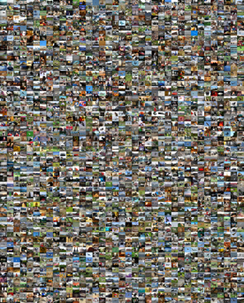
Object Detection
PASCAL VOC Dataset
20 classes
Fixed train/test split

Slide 31
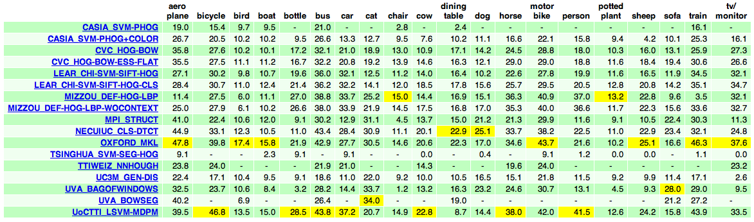
Object Detection
Joint winner of PASCAL VOC 2009 challenge

Slide 32
Motif Finding
Input x - DNA Sequence
Output y ∈ Y
Y = {0, 1}
Latent h - Motif Location
Δ - 0/1 Loss
Feature Ψ(x,y,h) - Ng and Cardie, ACL 2002

Slide 33
Motif Finding
UniProbe Dataset
40,000 sequences
50/50 train/test split
5 folds

Slide 34
Motif Finding
Objective Value

Slide 35
Motif Finding
Test Error

Slide 36
Action Classification
Is the person
in the image
riding a bike?
Input Image x
Output (y,h)
Feature Vector Ψ(x,y,h)
“Riding Bike”

Slide 37
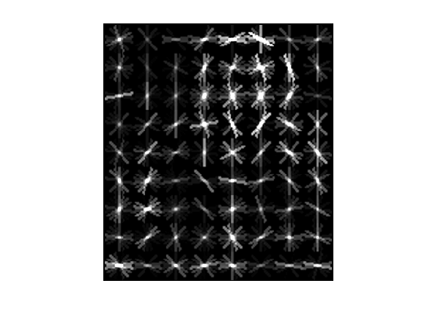
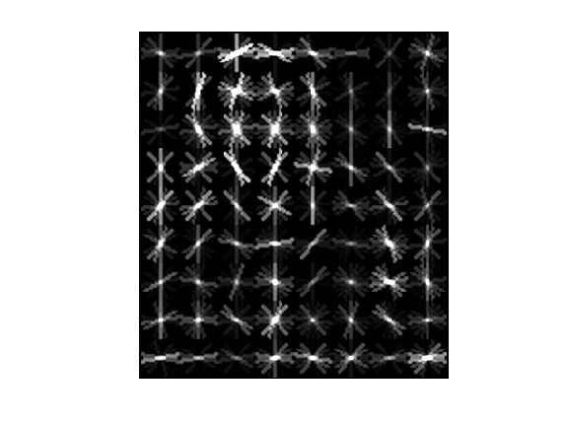
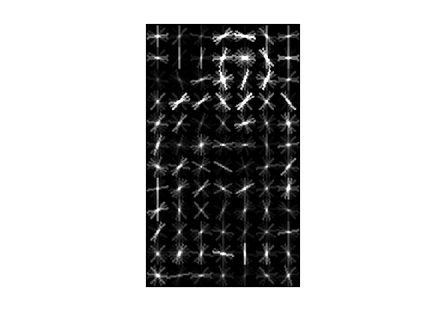
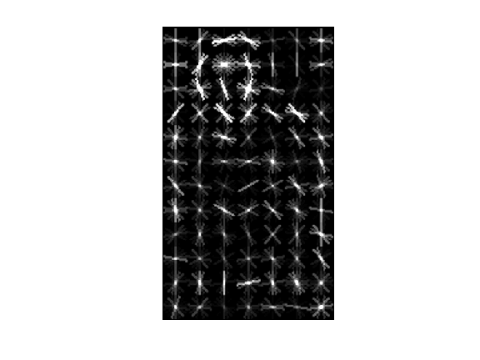
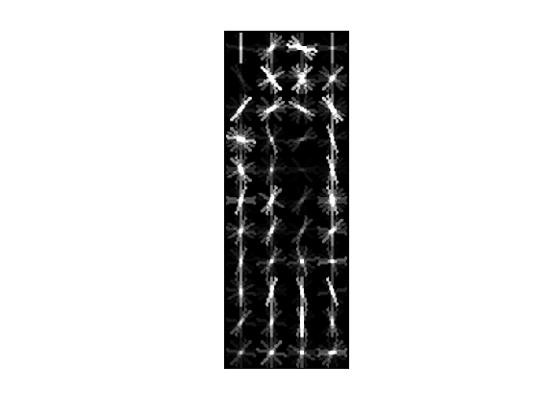
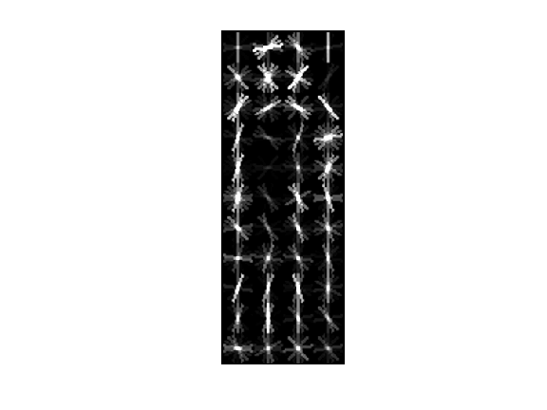
“Person” Features
Scores using
“person” mixture model
“Riding Bike”

Slide 38
“Person” Features
Captures “person” pose
“Riding Bike”

Slide 39
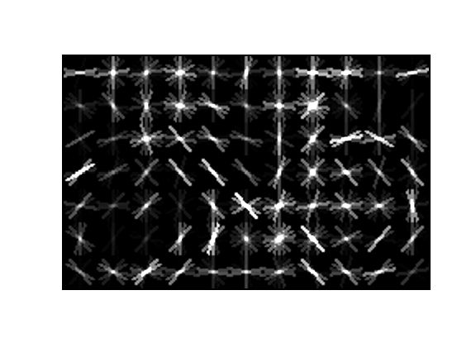
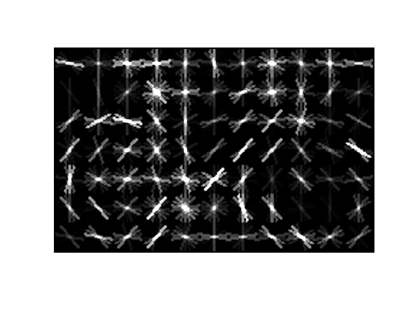
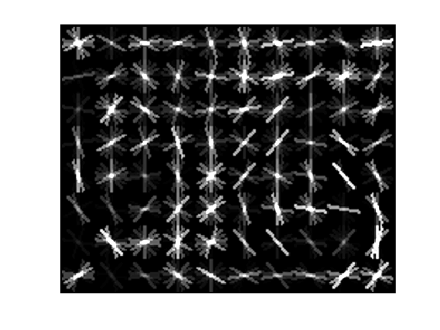
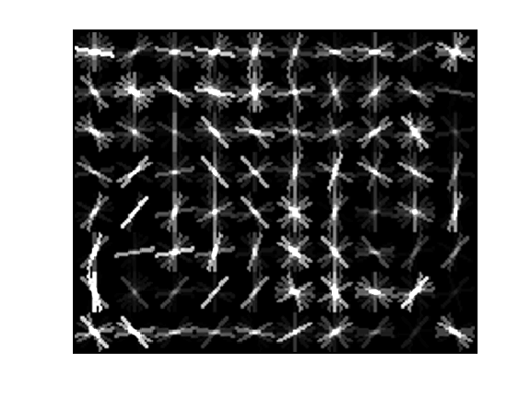
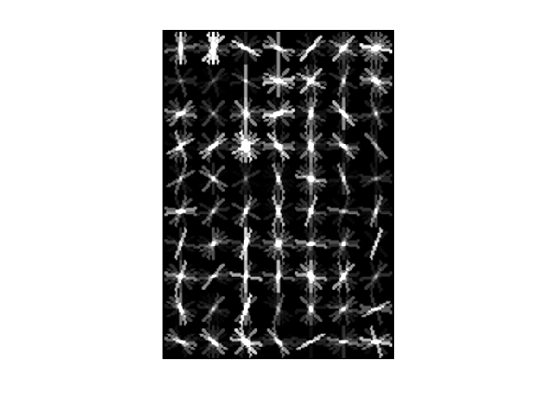
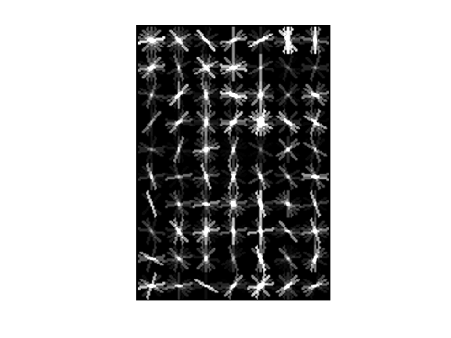
“Bicycle” Features
Scores using
“bicycle” mixture model
“Riding Bike”

Slide 40
“Bicycle” Features
Captures “bicycle” presence
and “bicycle” pose
“Riding Bike”

Slide 41
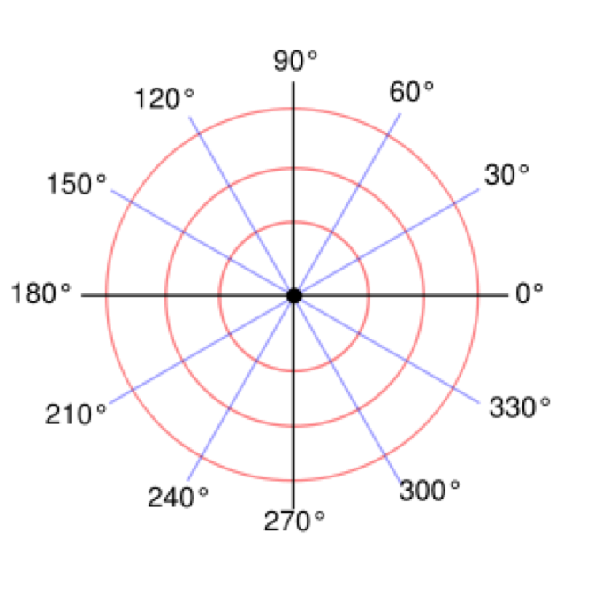
Spatial Relationship Features
“Riding Bike”

Slide 42
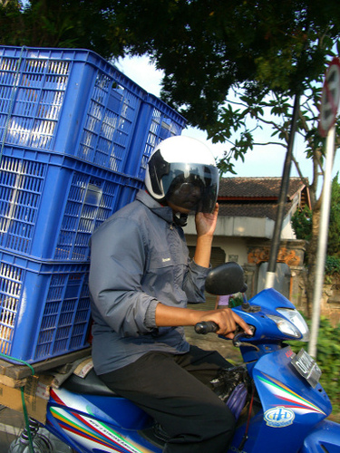
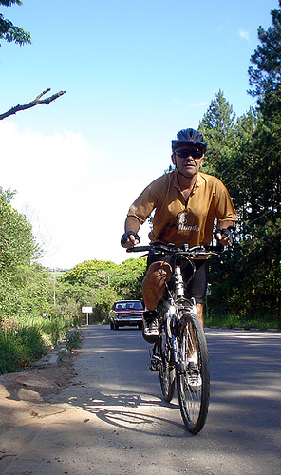
Data
VOC 2010
Google Images
“Riding Bike”
“Riding Bike”

Slide 43
Results
“Riding Horse”
VOC: Trained on only VOC 2010 data
CCCP: Trained on VOC 2010 and Google Images data

Slide 44
Results
“Riding Bike”
VOC: Trained on only VOC 2010 data
CCCP: Trained on VOC 2010 and Google Images data

Slide 45
Results
“Using Computer”
VOC: Trained on only VOC 2010 data
CCCP: Trained on VOC 2010 and Google Images data

Slide 46
Semantic Segmentation
Image x
Desired Output (y,h)
Feature Ψ(x,y,h) – Gould et al., 2009

Slide 47
Semantic Segmentation
PASCAL VOC Segmentation Datasets

Slide 48
Semantic Segmentation
Stanford Background Datasets

Slide 49
Semantic Segmenation
PASCAL VOC
Detection Datasets
Thousands of images

Slide 50
Semantic Segmenation
“Car”
ImageNet,
Caltech…
Thousands of images

Slide 51
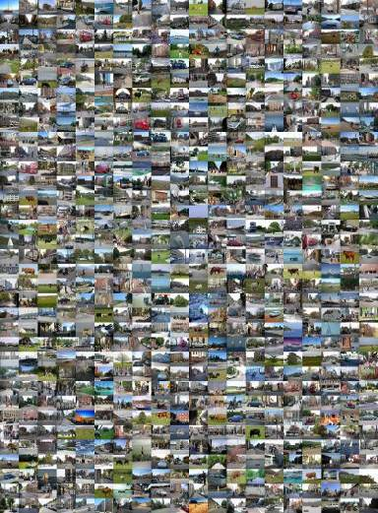
Semantic Segmentation
PASCAL VOC 2009
Stanford Background
+
Train - 1274 images
Validation - 225 images
Test - 750 images
Train - 572 images
Validation - 53 images
Test - 90 images

Slide 52
Semantic Segmentation
VOC Detection 2009
ImageNet
+
Bounding Box Data
Image-Level Data
Train - 1564 images
Train - 1000 images

Slide 53
Semantic Segmentation
Difference (CCCP-Baseline)
CCCP
53.8%
Baseline
(Gould et al., 2009)
53.1%
Classes
Difference (CCCP-Baseline)
CCCP
24.7%
Baseline
(Gould et al., 2009)
24.7%
Classes

Slide 54
Latent SVM
Extends structural SVMs for latent variables
Allows learning from weak or diverse supervision
CCCP converges; Gives local minimum solutions
Sometimes does more harm than good !!

Slide 55
Max-Margin Learning with
Latent Variables
Self-Paced Learning
Kumar, Packer and Koller, NIPS 2010

Slide 56
Latent SVM
Input x
Output y ∈ Y
Hidden Variable
h ∈ H
“Deer”
Y = {“Bison”, “Deer”, ”Elephant”, “Giraffe”, “Llama”, “Rhino” }

Slide 57

Motivation
Math is for
losers !!
1 + 1 = 2
1/3 + 1/6
= 1/2
e^{iπ}+1 = 0
FAILURE … BAD LOCAL MINIMUM

Slide 58
Motivation
Euler was
a Genius!!
1 + 1 = 2
1/3 + 1/6
= 1/2
e^{iπ}+1 = 0
SUCCESS … GOOD LOCAL MINIMUM

Slide 59
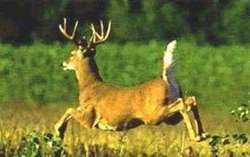
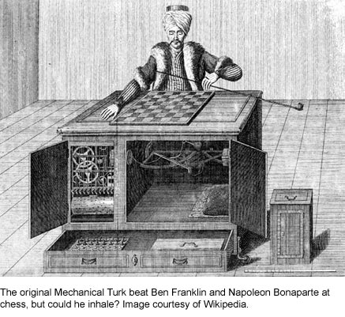
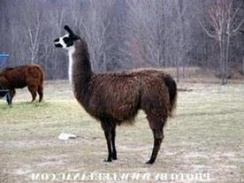
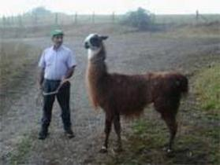

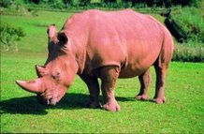
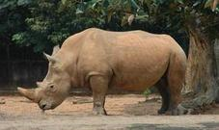
Motivation
Start with “easy” examples, then consider “hard” ones
Simultaneously estimate easiness and parameters
Easiness is property of data sets, not single instances
Easy vs. Hard
Expensive
Easy for human
≠ Easy for machine

Slide 60
CCCP for Latent SVM
Start with an initial estimate w₀
Update
h_{i}* = argmax_{hi∈H} w_{t}^{T}Ψ(x_{i},y_{i},h_{i})
Update w_{t+1} by solving a convex problem
min ||w||² + C∑_{i} ξ_{i}
w^{T}Ψ(x_{i},y_{i},h_{i}*) - w^{T}Ψ(x_{i},y,h)
≥ Δ(y_{i}, y) - ξ_{i}

Slide 61
Self-Paced Learning
min ||w||² + C∑_{i} ξ_{i}
w^{T}Ψ(x_{i},y_{i},h_{i}*) - w^{T}Ψ(x_{i},y,h)
≥ Δ(y_{i}, y, h) - ξ_{i}
Notes:
61

Slide 62
Self-Paced Learning
v_{i} ∈ {0,1}
min ||w||² + C∑_{i} v_{i}ξ_{i}
w^{T}Ψ(x_{i},y_{i},h_{i}*) - w^{T}Ψ(x_{i},y,h)
≥ Δ(y_{i}, y, h) - ξ_{i}
Trivial Solution
Notes:
62

Slide 63
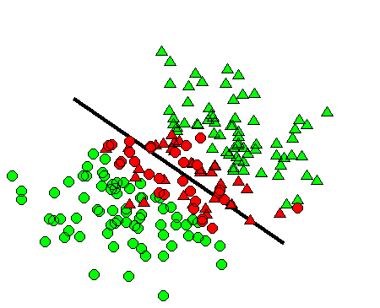
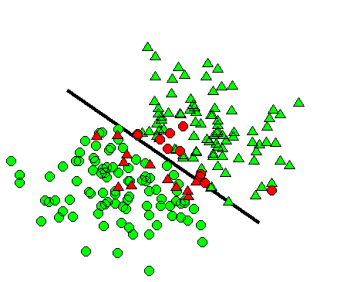
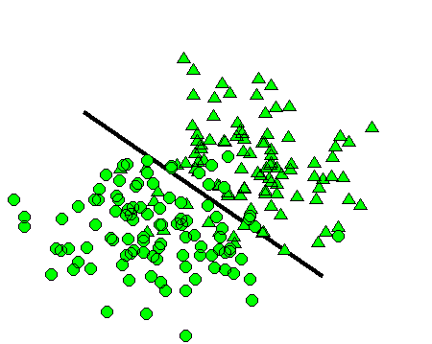
Self-Paced Learning
v_{i} ∈ {0,1}
min ||w||² + C∑_{i} v_{i}ξ_{i} - ∑_{i}v_{i}/K
w^{T}Ψ(x_{i},y_{i},h_{i}*) - w^{T}Ψ(x_{i},y,h)
≥ Δ(y_{i}, y, h) - ξ_{i}
Large K
Medium K
Small K
Notes:
63

Slide 64
Self-Paced Learning
Alternating
Convex Search
Biconvex
Problem
v_{i} ∈ [0,1]
min ||w||² + C∑_{i} v_{i}ξ_{i} - ∑_{i}v_{i}/K
w^{T}Ψ(x_{i},y_{i},h_{i}*) - w^{T}Ψ(x_{i},y,h)
≥ Δ(y_{i}, y, h) - ξ_{i}
Large K
Medium K
Small K
Notes:
64

Slide 65
SPL for Latent SVM
Start with an initial estimate w₀
Update
h_{i}* = argmax_{hi∈H} w_{t}^{T}Ψ(x_{i},y_{i},h_{i})
Update w_{t+1} by solving a convex problem
min ||w||² + C∑_{i} ξ_{i} - ∑_{i} v_{i}/K
w^{T}Ψ(x_{i},y_{i},h_{i}*) - w^{T}Ψ(x_{i},y,h)
≥ Δ(y_{i}, y) - ξ_{i}
Decrease K ← K/μ

Slide 66
Image Classification
Input x - Image
Output y ∈ Y
Latent h - Box
Δ - 0/1 Loss
Y = {“Bison”, “Deer”, ”Elephant”, “Giraffe”, “Llama”, “Rhino” }
Feature Ψ(x,y,h) - HOG

Slide 67
Image Classification
Mammals Dataset
271 images, 6 classes
90/10 train/test split
4 folds

Slide 68
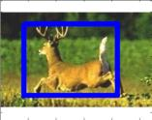
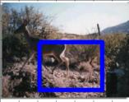
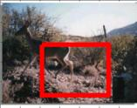
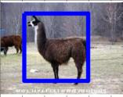
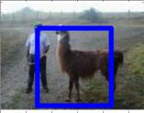




Image Classification
CCCP
Self-Paced

Slide 69


Image Classification
CCCP
Self-Paced

Slide 70


Image Classification
CCCP
Self-Paced

Slide 71

Image Classification
CCCP
Self-Paced

Slide 72
Image Classification
Objective value
Test error

Slide 73
Motif Finding
Input x - DNA Sequence
Output y ∈ Y
Y = {0, 1}
Latent h - Motif Location
Δ - 0/1 Loss
Feature Ψ(x,y,h) - Ng and Cardie, ACL 2002

Slide 74
Motif Finding
UniProbe Dataset
40,000 sequences
50/50 train/test split
5 folds

Slide 75




Motif Finding
Average Hamming Distance of Inferred Motifs
SPL
SPL
SPL
SPL

Slide 76
Motif Finding
Objective Value

Slide 77
Motif Finding
Test Error

Slide 78
Action Classification
VOC 2010
Google Images
“Riding Bike”
Liu, Master’s Thesis
Stanford University, 2011
“Riding Bike”

Slide 79
Results
“Riding Horse”
VOC: Trained on only VOC 2010 data
CCCP and SPL : Trained on VOC 2010 and Google Images data

Slide 80
Results
“Riding Bike”
VOC: Trained on only VOC 2010 data
CCCP and SPL : Trained on VOC 2010 and Google Images data

Slide 81
Results
“Using Computer”
VOC: Trained on only VOC 2010 data
CCCP and SPL : Trained on VOC 2010 and Google Images data

Slide 82
Semantic Segmentation
Image x
Desired Output (y,h)
Kumar, Turki, Preston and Koller. ICCV 2011

Slide 83
Semantic Segmentation
Difference (SPL-CCCP)
No Improvement
with CCCP
CCCP
53.8%
SPL
55.3%
Classes
Difference (SPL-CCCP)
SPL is
Essential!!
CCCP
24.7%
SPL
28.8%
Classes

Slide 84
Self-Paced Learning
Inspired by human learning
Automatic algorithm. Learner selects examples.
SPL converges; Gives local minimum solutions
Empirically outperforms CCCP !!

Slide 85
Max-Margin Learning with
Latent Variables
Self-Paced Multiple Kernel Learning
Kumar, Packer and Koller, In Submission

Slide 86
Motivation
1 + 1 = 2
Integers
1/3 + 1/6
= 1/2
Rational
Numbers
Imaginary
Numbers
e^{iπ}+1 = 0
USE A FIXED MODEL

Slide 87
Motivation
1 + 1 = 2
Integers
1/3 + 1/6
= 1/2
e^{iπ}+1 = 0
USE A FIXED MODEL

Slide 88
Motivation
1 + 1 = 2
Integers
1/3 + 1/6
= 1/2
Rational
Numbers
Imaginary
Numbers
e^{iπ}+1 = 0
ADAPT THE MODEL COMPLEXITY

Slide 89



Model Selection
Linear
Cubic
Quintic
Which kernel should I use?
Expressive kernel that can fit decision boundary?
  Overfits in early iterations to “wrong” latent variables
Simple, low-variance kernel?
  Give inferior results when used in later iterations with “correct” latent variables.

Slide 90
Latent SVM
Minimize_{w,ξ} ||w||² + C∑_{i} ξ_{i}
max_{hi}w^{T}Ψ(x_{i},y_{i},h_{i}) - w^{T}Ψ(x_{i},y,h)
≥ Δ(y_{i}, y, h) - ξ_{i}
∀ y, h
Original Problem

Slide 91
Kernelized Latent SVM
Adapt the kernel at each iteration
Minimize_{w,ξ} ||w||² + C∑_{i} ξ_{i}
max_{hi}w^{T}φ_{a}(x_{i},y_{i},h_{i}) - w^{T}φ_{a}(x_{i},y,h)
≥ Δ(y_{i}, y, h) - ξ_{i}
∀ y, h
New Problem
φ_{a}(x,y,h) = √a₁Ψ₁(x,y,h)
K = Σ_{i} a_{i}K_{i}
Kernel weights a_{i} ≥ 0
√a₂Ψ₂(x,y,h)
…

Slide 92
Self-Paced Multiple Kernel Learning
Start with an initial estimate w₀, a₀
Update
h_{i}* = argmax_{hi∈H} w_{t}^{T}φ_{at}(x_{i},y_{i},h_{i})
Update w_{t+1} and a_{t+1} by solving a convex problem
Block coordinate descent on w and a
Minimize_{w,a,ξ} ||w||² + C∑_{i} ξ_{i}
w^{T}φ_{a}(x_{i},y_{i},h_{i}*) - w^{T}φ_{a}(x_{i},y,h)
≥ Δ(y_{i}, y, h) - ξ_{i}
∀ y, h
Notes:
Pseudo-code.

Slide 93
Self-Paced Multiple Kernel Learning
Fix a and optimize w
Representer Theorem: w = Σα_{i} φ_{a}(s_{i})
Dual variables
Support vectors
We can solve the dual efficiently
Minimize_{w,a,ξ} ||w||² + C∑_{i} ξ_{i}
w^{T}φ_{a}(x_{i},y_{i},h_{i}*) - w^{T}φ_{a}(x_{i},y,h)
≥ Δ(y_{i}, y, h) - ξ_{i}
∀ y, h
Notes:
Standard kernelized SVM. Representer theorem allows us to solve for w in terms of dual variables \alpha and support vectors s.

Slide 94
Self-Paced Multiple Kernel Learning
Fix w and optimize a
||w||² = Σ_{k} a_{k}t_{k}
t_{k} = Σ_{i} (α_{i} φ_{k}(s_{i}))^{T}(α_{i} φ_{k}(s_{i}))
||w||² minimization favors simple kernels
Minimize_{w,a,ξ} ||w||² + C∑_{i} ξ_{i}
w^{T}φ_{a}(x_{i},y_{i},h_{i}*) - w^{T}φ_{a}(x_{i},y,h)
≥ Δ(y_{i}, y, h) - ξ_{i}
∀ y, h
Notes:
More interesting step. ||w|| minimization favors simple kernels.

Slide 95
Self-Paced Multiple Kernel Learning
||w||² = Σ_{k} a_{k}t_{k}
α₁ = 1, s₁ = (0.8, 1.0)^{T}
Minimize_{w,a,ξ} ||w||² + C∑_{i} ξ_{i}
w^{T}φ_{a}(x_{i},y_{i},h_{i}*) - w^{T}φ_{a}(x_{i},y,h)
≥ Δ(y_{i}, y, h) - ξ_{i}
∀ y, h
Notes:
Simple example, with one support vector (0.8,1.0) with alpha = 1, t_k increases with increasing kernel complexity

Slide 96
Self-Paced Multiple Kernel Learning
||w||² = Σ_{k} a_{k}t_{k}
Low penalty for simple kernels
Minimize_{w,a,ξ} ||w||² + C∑_{i} ξ_{i}
w^{T}φ_{a}(x_{i},y_{i},h_{i}*) - w^{T}φ_{a}(x_{i},y,h)
≥ Δ(y_{i}, y, h) - ξ_{i}
∀ y, h
Notes:
Simple example, with one support vector (0.8,1.0) with alpha = 1, t_k increases with increasing kernel complexity

Slide 97
Self-Paced Multiple Kernel Learning
||w||² = Σ_{k} a_{k}t_{k}
High penalty for complex kernels
Minimize_{w,a,ξ} ||w||² + C∑_{i} ξ_{i}
w^{T}φ_{a}(x_{i},y_{i},h_{i}*) - w^{T}φ_{a}(x_{i},y,h)
≥ Δ(y_{i}, y, h) - ξ_{i}
∀ y, h
Notes:
Simple example, with one support vector (0.8,1.0) with alpha = 1, t_k increases with increasing kernel complexity

Slide 98
Self-Paced Multiple Kernel Learning
Minimize_{w,a,ξ} ||w||² + C∑_{i} ξ_{i}
max_{hi}w^{T}φ_{a}(x_{i},y_{i},h_{i}) - w^{T}φ_{a}(x_{i},y,h)
≥ Δ(y_{i}, y, h) - ξ_{i}
∀ y, h
Early iterations:
h_{i} are incorrectly imputed
ξ_{i} are large even for complex kernels
Simple kernels are preferred to minimize ||w||²
Notes:
Initial iterations: \sum_i \xi_i cannot be pushed down by a large value since h_i are “incorrect”. So the method chooses a simple kernel.
Later iterations: \sum_i \xi_i can be pushed down significantly by resorting to a more complex kernel.
\lambda is fixed for all the iterations .. no need for annealing etc.

Slide 99
Self-Paced Multiple Kernel Learning
Minimize_{w,a,ξ} ||w||² + C∑_{i} ξ_{i}
max_{hi}w^{T}φ_{a}(x_{i},y_{i},h_{i}) - w^{T}φ_{a}(x_{i},y,h)
≥ Δ(y_{i}, y, h) - ξ_{i}
∀ y, h
Later iterations:
h_{i} are correctly imputed
ξ_{i} are small for complex kernels
Complex kernels are preferred to minimize ∑_{i} ξ_{i}
Notes:
Initial iterations: \sum_i \xi_i cannot be pushed down by a large value since h_i are “incorrect”. So the method chooses a simple kernel.
Later iterations: \sum_i \xi_i can be pushed down significantly by resorting to a more complex kernel.
\lambda is fixed for all the iterations .. no need for annealing etc.

Slide 100
Image Classification
Input x - Image
Output y ∈ Y
Latent h - Box
Δ - 0/1 Loss
Y = {“Bison”, “Deer”, ”Elephant”, “Giraffe”, “Llama”, “Rhino” }
Feature Ψ(x,y,h) - HOG

Slide 101
Image Classification
Mammals Dataset
271 images, 6 classes
90/10 train/test split
4 folds

Slide 102

Image Classification
Iteration 1
CUBIC
SPMKL

Slide 103


Image Classification
Iteration 2
CUBIC
SPMKL

Slide 104


Image Classification
Iteration 3
CUBIC
SPMKL

Slide 105

Image Classification
Iteration 5
CUBIC
SPMKL

Slide 106
Image Classification
At convergence
CUBIC
SPMKL

Slide 107

Image Classification
A
B
Area of Intersection of A and B
Score =
Area of A
Notes:
Average over all 6 classes, all 5 folds. Difference between Cubic and SPMKL is more pronounced, since SPMKL does much better and Cubic does slightly worse.

Slide 108

Image Classification
Complexity of kernels used by algorithm
automatically adapts over iterations
Σa_{k}r_{k}
Rademacher complexity
of k^{th} kernel
Notes:
Average Rademacher L1 norm for SPL

Slide 109
Image Classification

Slide 110

Motif Finding
Test Accuracy
INPUT x
LATENT h
OUTPUT y = {+1,-1}
UniProbe Dataset
40000 sequences
50/50 split
5 folds
Latent variables model
unknown motif position
Notes:
Best baseline test accuracy = 67.7%
SPMKL test accuracy = 69.1%. Difference between baseline and SPMKL is more pronounced.

Slide 111
Self-Paced Multiple Kernel Learning
Inspired by human learning
Adapt the kernel according to current latent variables
SPMKL converges; Gives local minimum solutions
Empirically outperforms “SPL alone” !!

Slide 112
Max-Margin Learning with
Latent Variables
Max-Margin Min-Entropy Models
Miller, Kumar, Packer, Goodman and Koller, In Submission

Slide 113
Latent SVM
Pr(y,h|x) = exp( w^{T}Ψ(x,y,h))
Z(x)
Pr(y₁,h|x)
0.00 | 0.00 | 0.25
0.00 | 0.25 | 0.00
0.00 | 0.00 | 0.25

Slide 114
Latent SVM
Pr(y,h|x) = exp( w^{T}Ψ(x,y,h))
Z(x)
MAP Inference max_{y,h} Pr(y,h|x)
Pr(y₁,h|x)
Pr(y₂,h|x)
0.00 | 0.00 | 0.25
0.00 | 0.00 | 0.01
0.00 | 0.25 | 0.00
0.00 | 0.24 | 0.00
0.00 | 0.00 | 0.25
0.00 | 0.00 | 0.00

Slide 115
Latent SVM
Pr(y,h|x) = exp( w^{T}Ψ(x,y,h))
Z(x)
Value of latent variable?
Pr(y₁,h|x)
Pr(y₂,h|x)
0.00 | 0.00 | 0.25
0.00 | 0.00 | 0.01
0.00 | 0.25 | 0.00
0.00 | 0.24 | 0.00
0.00 | 0.00 | 0.25
0.00 | 0.00 | 0.00

Slide 116
Latent SVM
“Deer”
Pr(y,h|x) = exp( w^{T}Ψ(x,y,h))
Z(x)
For many tasks we want a “peaky” h distribution
Not only image classification
But also object detection

Slide 117
Max-Margin Min-Entropy Models
Pr(y,h|x) = exp( w^{T}Ψ(x,y,h))
Z(x)
Minimum Entropy Inference
min_{y} (Renyi Entropy of Generalized Distribution of y)

Slide 118
Max-Margin Min-Entropy Models
Pr(y,h|x) = exp( w^{T}Ψ(x,y,h))
Z(x)
Minimum Entropy Inference
min_{y} H_{α}(Q(y; x, w))
Q(y; x, w) = Set of all {Pr(y,h|x)}
1
Σ_{h}Pr(y,h|x)^{α}
H_{α}(Q(y; x, w)) =
log
1- α
Σ_{h}Pr(y,h|x)

Slide 119
Max-Margin Min-Entropy Models
Pr(y,h|x) = exp( w^{T}Ψ(x,y,h))
Z(x)
Minimum Entropy Inference
min_{y} H_{α}(Q(y; x, w))
Q(y; x, w) = Set of all {Pr(y,h|x)}
H_{α}(Q(y; x, w)) = -log Pr(y|x) + H_{α}(Pr(h|y,x))
Maximize probability of output

Slide 120
Max-Margin Min-Entropy Models
Pr(y,h|x) = exp( w^{T}Ψ(x,y,h))
Z(x)
Minimum Entropy Inference
min_{y} H_{α}(Q(y; x, w))
Q(y; x, w) = Set of all {Pr(y,h|x)}
H_{α}(Q(y; x, w)) = -log Pr(y|x) + H_{α}(Pr(h|y,x))
Minimize entropy of hidden variables

Slide 121
Max-Margin Min-Entropy Models
Pr(y,h|x) = exp( w^{T}Ψ(x,y,h))
Z(x)
Minimum Entropy Inference
min_{y} H_{α}(Q(y; x, w))
Q(y; x, w) = Set of all {Pr(y,h|x)}
H_{α}(Q(y; x, w)) = -log Pr(y|x) + H_{α}(Pr(h|y,x))
A family of models parameterized by α ∈ (0,∞]

Slide 122
Learning M3E
min ||w||² + C∑_{i} ξ_{i}
H_{α}(Q(y; x, w))- H_{α}(Q(y_{i}; x, w)) ≥ Δ(y_{i}, y) - ξ_{i}
ξ_{i} ≥ 0
Similar to latent SVM
minimizes upper bound on risk Δ(y_{i}, y_{i}(w))
In fact, when α = ∞...

Slide 123
Learning M3E
min ||w||² + C∑_{i} ξ_{i}
max_{h}w^{T}Ψ(x,y_{i},h)-max_{h}w^{T}Ψ(x,y,h) ≥ Δ(y_{i}, y) - ξ_{i}
ξ_{i} ≥ 0
Similar to latent SVM
minimizes upper bound on risk Δ(y_{i}, y_{i}(w))
In fact, when α = ∞...
Latent SVM

Slide 124
Learning M3E
min ||w||² + C∑_{i} ξ_{i}
H_{α}(Q(y; x, w))- H_{α}(Q(y_{i}; x, w)) ≥ Δ(y_{i}, y) - ξ_{i}
ξ_{i} ≥ 0
M3E adds a new dimension to your work …
... Literally !!! The α dimension !!!
is
The choice of α = ∞ may be non-optimal
As our experiments will show

Slide 125
Optimization
Initialize w₀
Update
min ||w||² + C∑_{i} ξ_{i} + μ||w-w_{t}||²
H’_{α}(Q(y; x, w))- H’_{α}(Q(y_{i}; x, w)) ≥ Δ(y_{i}, y) - ξ_{i}
ξ_{i} ≥ 0
Linear approximation. First-order Taylor’s series at w_{t}
Trust region.
Convex Structured SVM.
As easy to optimize as Latent SVM

Slide 126
Image Classification
Mammals Dataset
271 images, 6 classes
90/10 train/test split
5 folds

Slide 127

Image Classification

Slide 128

Image Classification

Slide 129

Image Classification

Slide 130
Motif Finding
UniProbe Dataset
40,000 sequences
50/50 train/test split
5 folds

Slide 131

Motif Finding
Notes:
Averaged over all proteins, folds (best objective function over 4 seeds)

Slide 132
Max-Margin Min-Entropy Models
Family of max-margin models
Latent SVM is a special case
“Peaky” distributions; efficient optimization
Empirically outperforms Latent SVM !!

