Slide 1
FastPD: MRF inference via the primal-dual schema
Nikos Komodakis
Tutorial at ICCV
(Barcelona, Spain, November 2011)

Slide 2

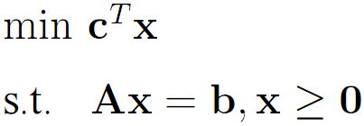
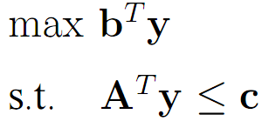
The primal-dual schema
Say we seek an optimal solution x* to the following integer program (this is our primal problem):
(NP-hard problem)
To find an approximate solution, we first relax the integrality constraints to get a primal & a dual linear program:
primal LP:
dual LP:

Slide 3
The primal-dual schema
Goal: find integral-primal solution x, feasible dual solution y such that their primal-dual costs are “close enough”, e.g.,
dual cost of
solution y
cost of optimal
integral solution x*
primal cost of
solution x
Then x is an f*-approximation to optimal solution x*

Slide 4
The primal-dual schema
The primal-dual schema works iteratively
sequence of dual costs
sequence of primal costs
…
…
unknown optimum
Global effects, through local improvements!
Instead of working directly with costs (usually not easy), use RELAXED complementary slackness conditions (easier)
Different relaxations of complementary slackness Different approximation algorithms!!!

Slide 5
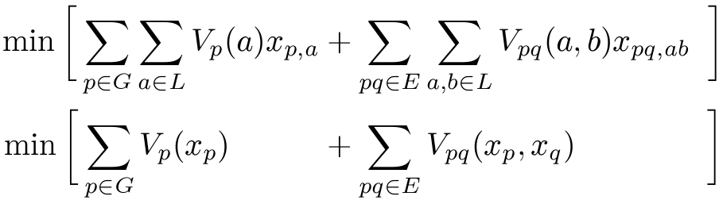
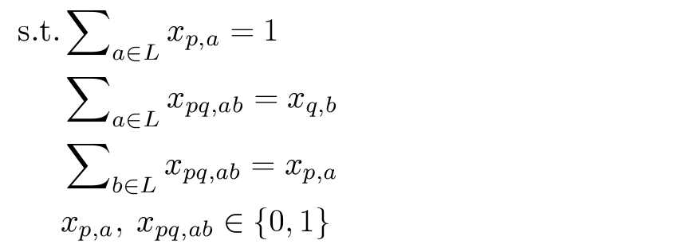


FastPD: primal-dual schema for MRFs
[Komodakis et al. 05, 07]
(only one label assigned per vertex)
enforce consistency between variables x_{p,a,} x_{q,b} and variable x_{pq,ab}
Binary
variables
x_{p,a}=1 label a is assigned to node p
x_{pq,ab}=1 labels a, b are assigned to nodes p, q

Slide 6
FastPD: primal-dual schema for MRFs
Regarding the PD schema for MRFs, it turns out that:
each update of primal and dual variables
solving max-flow in appropriately constructed graph
Resulting flows tell us how to update both:
  the dual variables, as well as
  the primal variables
for each iteration of primal-dual schema
Max-flow graph defined from current primal-dual pair (x^{k},y^{k})
  (x^{k},y^{k}) defines connectivity of max-flow graph
  (x^{k},y^{k}) defines capacities of max-flow graph
Max-flow graph is thus continuously updated

Slide 7
FastPD: primal-dual schema for MRFs
Very general framework. Different PD-algorithms by RELAXING complementary slackness conditions differently.
E.g., simply by using a particular relaxation of complementary slackness conditions (and assuming V_{pq}(·,·) is a metric)
THEN resulting algorithm shown equivalent to a-expansion!
[Boykov,Veksler,Zabih]
PD-algorithms for non-metric potentials V_{pq}(·,·) as well
Theorem: All derived PD-algorithms shown to satisfy certain relaxed complementary slackness conditions
Worst-case optimality properties are thus guaranteed

Slide 8
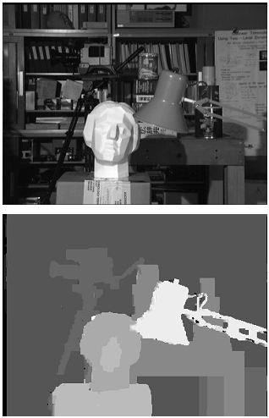
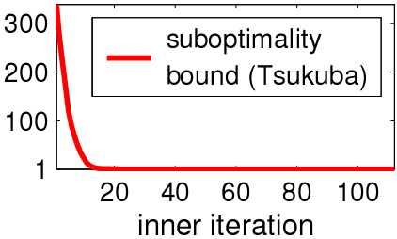
Per-instance optimality guarantees
Primal-dual algorithms can always tell you (for free) how well they performed for a particular instance
per-instance approx. factor
per-instance upper bound
…
…
unknown optimum
per-instance lower bound
(per-instance certificate)

Slide 9
Computational efficiency
MRF algorithm only in the primal domain (e.g., a-expansion)
STILL BIG
Many augmenting paths per max-flow
fixed dual cost
primal costs
gap_{k}
…
dual₁
primal_{k}
primal_{k-1}
primal₁
MRF algorithm in the primal-dual domain (Fast-PD)
SMALL
Few augmenting paths per max-flow
dual costs
primal costs
gap_{k}
…
…
dual₁
dual_{k-1}
dual_{k}
primal_{k}
primal_{k-1}
primal₁
Theorem: primal-dual gap = upper-bound on #augmenting paths
(i.e., primal-dual gap indicative of time per max-flow)

Slide 10
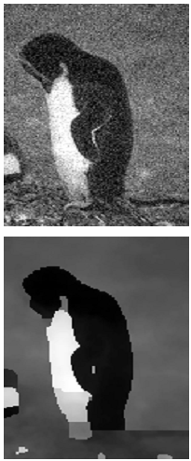
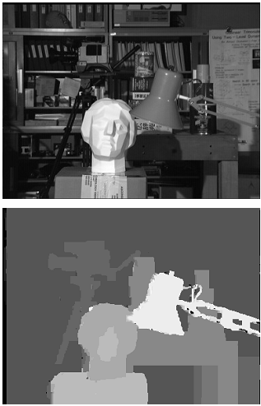
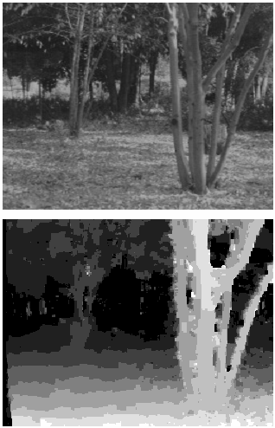
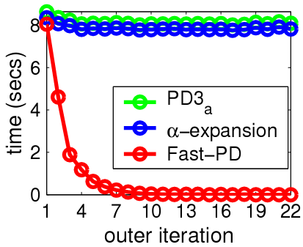
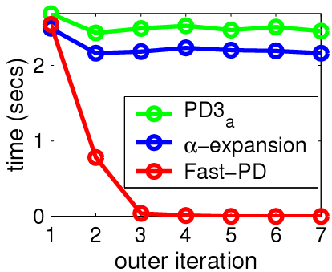
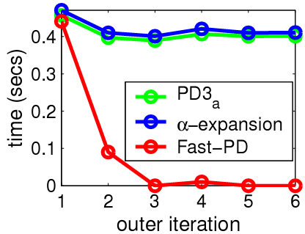
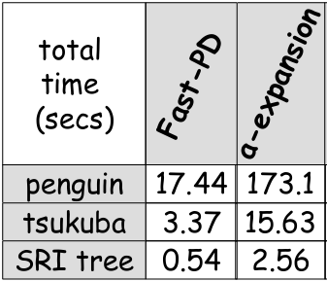
Computational efficiency (static MRFs)
penguin
Tsukuba
SRI-tree
almost constant
dramatic decrease

Slide 11
New theorems
- New insights into
existing techniques
- New view on MRFs
Handles wide class of MRFs
primal-dual
framework
Significant speed-up
for dynamic MRFs
Approximately
optimal
solutions
Significant speed-up
for static MRFs
Theoretical guarantees AND
tight certificates
per instance

Slide 12
Demo session with FastPD

Slide 13
Demo session with FastPD
FastPD optimization library
  C++ code
  (available from http://www.csd.uoc.gr/~komod/FastPD)
  Matlab wrapper

Slide 14
Demo session with FastPD
In the demo we will assume an energy of the form:

Slide 15
Calling FastPD from C++
Step 1: Construct an MRF optimizer object
CV_Fast_PD pd( numpoints, numlabels, unary, numedges, edges, dist, max_iters, edge_weights );

Slide 16
Calling FastPD from C++
Step 2: do the optimization
pd.run();

Slide 17
Calling FastPD from C++
Step 3: get the results
for( int i = 0; i < numpoints; i++ )
{
printf( "Node %d is assigned label %d\n",
i, pd._pinfo[i].label );
}

Slide 18
Calling FastPD from Matlab
Use Matlab wrapper for FastPD
labeling = …
FastPD_wrapper( unary,
edges,
edge_weights,
dist,
max_iters );

Slide 19
Run FastPD demo

