Slide 1
Learning with Inference for Discrete Graphical Models
Nikos Komodakis
Pawan Kumar
Nikos Paragios
Ramin Zabih (presenter)

Slide 2
Schedule
9:30 - 10:00: Overview (Zabih)
10:10 - 11:10 Inference for learning (Zabih)
11:25 - 12:30 More inference for learning, plus software demos (Komodakis, Kumar)
14:30 - 16:00 Learning for inference (Komodakis)
16:15 - 17:45 Advanced topics (Kumar)
17:45 - 18:00 Discussion (all)

Slide 3
Overview

Slide 4
Motivating example
Suppose we want to find a bright object against a dark background
  But some of the pixel values are slightly wrong

Slide 5
Optimization viewpoint
Find best (least expensive) binary image
  Costs: C1 (labeling) and C2 (boundary)
C1: Labeling a dark pixel as foreground
  Or, a bright pixel as background
If we only had labeling costs, the cheapest solution is the thresholded output
C2: The length of the boundary between foreground and background
  Penalizes isolated pixels or ragged boundaries

Slide 6
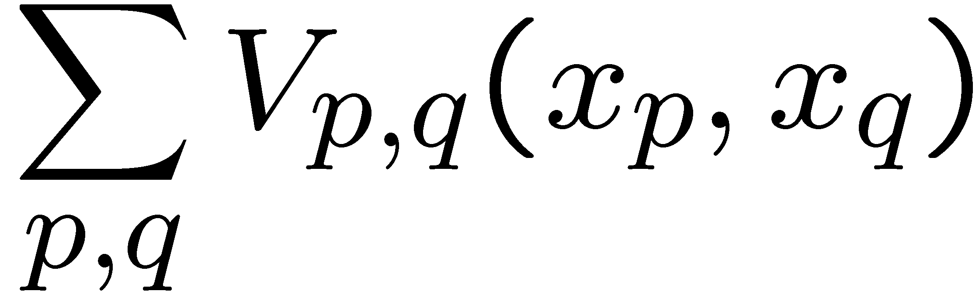
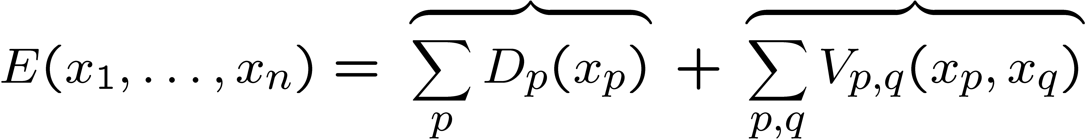
MAP-MRF energy function
Generalization of C2 is
  Think of V as the cost for two adjacent pixels to have these particular labels
  For binary images, the natural cost is uniform
Bayesian energy function:
Likelihood
Prior

Slide 7
Historical view
Energy functions like this go back at least as far as Horn & Schunk (1981)
The Bayesian view was popularized by Geman and Geman (TPAMI 1984)
Historically solved by gradient descent or related methods (e.g. annealing)
  Optimization method and energy function are not independent choices!
  Use the most specific method you can
    And, be prepared to tweak your problem

Slide 8
Discrete methods
Starting in the late 90’s researchers (re-) discovered discrete optimization methods
  Graph cuts, belief prop, dynamic programming, linear programming, semi-definite programming, etc.
These methods proved remarkably effective at solving problems that could not be solved before
Vision has lots of cool math –interest in this area is largely driven by performance!

Slide 9
Performance overview
Best summary: Szeliski et al. “A comparative study of energy minimization methods for Markov Random Fields with smoothness-based priors”, TPAMI 2008
  An updated version is a chapter in “Markov Random Fields for Vision and Image Processing”, 2011
LP-based methods compute lower bounds
  Use this to measure performance

Slide 10
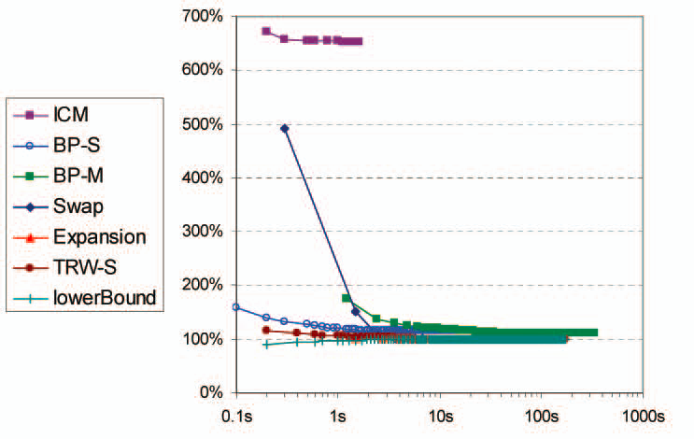
Typical results

Slide 11
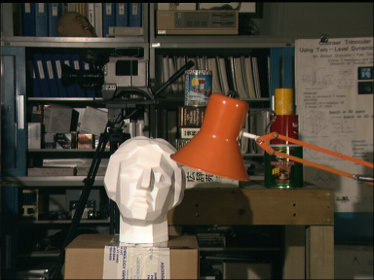
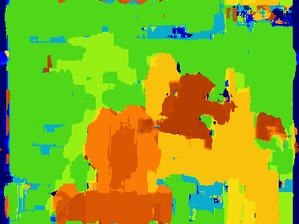
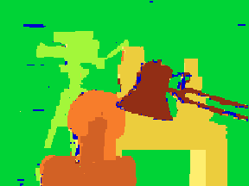
Stereo images
Right answers
Graph cuts
Correlation

Slide 12
Is vision solved?
Can we all go home now?
For many easy problems the technical problem of minimizing the energy is now effectively solved
  “Easy” = “submodular/regular, & first-order”
    We’ll define these terms later on
  “Technical problem” ≠ vision problem
  “The energy”? Is the right one obvious??
Still, this is vast progress in a relatively short period of time
  These “easy” problems were impossible in ‘97!

Slide 13
What is the right energy?
Sometimes we can find the global optimum fast
  Original example can be solved by graph cuts
Do we get what we want?
  How important is C1 (data) vs C2 (prior)?
  If C2 dominates, we get a uniform image
Important lessons
  Need to learn the right parameter values
  Prior is not actually strong enough

Slide 14
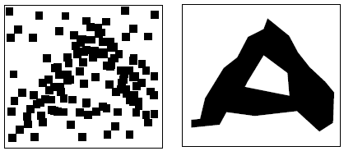
Better priors?
Original graph cuts example, from Greig et al 1989 (example from Olga Veksler)
No choice of the relative importance of C1 and C2 gives the letter A at global min!

Slide 15
How good is global min?
We can often get a solution whose energy is lower than the ground truth
  Folk theorem, first published in [Tappen & Freedman ICCV03], improved by [Meltzer, Yanover & Weiss ICCV05]
  Huge gap! Can easily be 40% or more
Lots of parameters in energy functions
  Need to learn them
  Pretty clear that priors with fast algorithms are just too weak for our purposes

Slide 16
Learning and inference
How does learning come into play?
  There are too many parameters to an energy function to tune by hand
    Example: Felzenszwalb deformable parts-based models have thousands of parameters
Two topics for this afternoon
  Parameter estimation can be formulated as an optimization problem
  We need methods that can learn parameters from real data, with all its imperfections

