Slide 1
Techniques for Event Detection
Kleisarchaki Sofia

Slide 2
N.E.D Versus Social E.D Techniques
Content Based
Clustering Algorithms
Graphs
Spatial/Temporal Models
Classification using Supervised Techniques
  Bayesian Networks
  SVM
  K-NN neighbours
Content Based
Clustering Algorithms
Graphs
Spatial/Temporal Models
Classification using Supervised Techniques
  Bayesian Networks
  SVM
  K-NN neighbours
Textual News Articles
Social Streams

Slide 3
N.E.D Versus Social E.D Techniques
Content Based
Content Based
Prevailing Technique: TF-IDF model & similarity metrics
Pre-process (stemming, stop-words etc)
Term Weighting
Similarity Calculation (usually cosine similarity metrics)
Making a Decision
Evaluation

Slide 4
N.E.D Versus Social E.D Techniques
Content Based
Content Based
Improvements
Better Distance Metrics [1]
  Hellinger Distance
Better representations of documents (feature selection) [5]
  Classify documents into different categories and then remove stop words with respect to the statistics within each category.
Usage of named entities [6, 9]
  Person, organization, location, date, time, money, percent

Slide 5
N.E.D Versus Social E.D Techniques
Content Based
Content Based
Improvements [1], [2]
Generation of source-specific models
  dfs,t (w): doc frequency for source s at time t
Term re-weighting
  To distinguish terms that characterize a particular ROI (high level of categorization), but not an event. [9]
Segmentation of documents
  Similarity calculation in a segment of l words
Citation relationship between documents
  Implicit citation

Slide 6
N.E.D Versus Social E.D Techniques
Content Based
Content Based
Similarity Metrics [7, 8]
Textual Features
  Author, title, description, tags, text
  Same Similarity Metrics (i.e cosine similarity)
Time/Date Features
  If t1-t2<year then sim(t1, t2) = 1 - |t1-t2|/y
  else sim(t1, t2) = 0, where t1, t2: minutes elapsed since the Unix epoch
  y: #of minutes in a year
Location
  Sim(L1, L2) = 1-H(L1, L2), where H: Havesian Distance, L=(long, lat)
  Kalmal & Particle Filters for location estimation

Slide 7
N.E.D Versus Social E.D Techniques
Clustering Algorithms
Clustering Algorithms
Problem Definition: Partition a set of documents into clusters such that each cluster corresponds to all documents that are associated with one event. [8]
Predefined Clusters Techniques
  K-means, EM
Threshold Based Techniques
  can be tuned using a training set
Hierarchical Clustering Techniques
  require processing a fully specified similarity matrix
Single Pass Online/Incremental Clustering
  new documents are continuously being produced
→Several Clustering Quality Metrics Exist (i.e Normalized Mutual Information (NMI))

Slide 8
N.E.D Versus Social E.D Techniques
Clustering Algorithms
Clustering Algorithms
Problem Definition: Partition a set of documents into clusters such that each cluster corresponds to all documents that are associated with one event. [8]
Predefined Clusters Techniques
  K-means, EM
Threshold Based Techniques
  can be tuned using a training set
Hierarchical Clustering Techniques
  require processing a fully specified similarity matrix
Single Pass Online/Incremental Clustering
  new documents are continuously being produced
→Several Clustering Quality Metrics Exist (i.e Normalized Mutual Information (NMI))

Slide 9
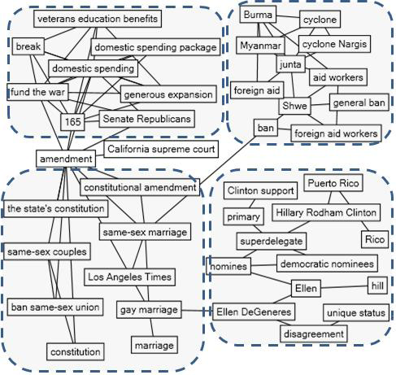
N.E.D Versus Social E.D Techniques
Graphs
Graphs
[4]
Create a keyword graph
  Documents describing the same event will contain similar sets of keywords and the graph of keywords for a document collection will contain clusters individual events
  Node: a keyword ki with high df.
  Edge: represent the co-occurrence of the two keywords (above a threshold →calculate p(kj | ki) )
Use community detection methods to discover events

Slide 10
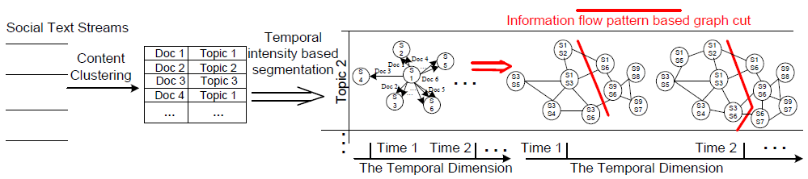
N.E.D Versus Social E.D Techniques
Graphs
Graphs
[10]
Multi – graphs: Represent social text streams
Node: Represent a social actor
Edge: Represent information flow between two actors
Detect Events:
Text-based Clustering
Temporal Segmentation
Information flow-based graph cuts of the dual graph of social networks

Slide 11
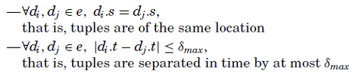

N.E.D Versus Social E.D Techniques
Spatial/Temporal Models
Spatial/Temporal Models
[11]
Discovers spatio-temporal events from the data
Use the events to build a network of associations among actors
Definition: A spatio-temporal event is a subset of tuples, e ⊆ D, meeting all of the following conditions. D: spatio-temporal database, δmax: time duration

Slide 12
N.E.D Versus Social E.D Techniques
Classification using Supervised Techniques
Classification using Supervised Techniques
SVM
  [7]
LSH / K-NN neighbours
  [12]
  Bayesian Networks
http://duckduckgo.com/c/Classification_algorithms
http://www.ecmlpkdd2010.org/tutorials/Tutorial_EvolvingData_6on1.pdf

Slide 13
Relevant Topics
Topic Detection
Trend Detection
Term Burstiness
Periodic/Aperiodic Event Detection
Analysis of Web Structure

Slide 14
References (1/3)
[1] A System for New Event Detection, Thorsten Brants, Francine Chen, Ayman Farahat
[2] Resource-Adaptive Real-Time New Event Detection, Gang Luo Chunqiang Tang Philip S. Yu
[3] A Probabilistic Model for Retrospective News Event Detection, Zhiwei Li, Bin Wang, Mingjing Li, WeiYing Ma
[4] Event Detection and Tracking in Social Streams, Hassan Sayyadi, Matthew Hurst and Alexey Maykov
[5] Topic conditioned Novelty Detection, Yiming Yang, Jian Zhang, Jaime Carbonell, Chun Jin

Slide 15
References (2/3)
[6] Nymble: a High-Performance Learning Name-finder, Daniel M. Bikei, Scott Miller, Richard Schwartz, Ralph Weischedel
[7] Earthquake Shakes Twitter Users: Real-time Event Detection by Social Sensors, Takeshi Sakaki, Makoto Okazaki, Yutaka Matsuo
[8] Learning Similarity Metrics for Event Identification in Social Media, Hila Becker, Mor Naaman, Luis Gravano
[9] Text Classification and Named Entities for New Event Detection, Giridhar Kumaran, James Allan

Slide 16
References (3/3)
[10] Temporal and Information Flow Based Event Detection From Social Text Streams, Qiankun Zhao, Prasenjit Mitra, Bi Chen
[11] STEvent: Spatio-Temporal Event Model for Social Network Discovery, Hady w. Lauw, Ee-Peng Lim and Hweehwa Pang, Teck-Tim Tan
[12] Streaming First Story Detection with application to Twitter, Sasa Petrovic, Miles Osborne, Victor Lavrenko

