Slide 1
Bibliography On Events Detection
Kleisarchaki Sofia

Slide 2
Contents
Events, Topics, Entities and Dynamics
Event Detection
Topic & Entity Extraction
Dynamics in Perception
Multimedia Topic & Entity Extraction
Opinion Mining
Opinion Mining from Text
Opinion Mining from Multimedia Objects
Intelligent Content Acquisition Support
Crawling the hidden Web
Focused and topical crawling
Information extraction in semi-structured Web pages
Social Web Mining and Massive Collaboration
Analyzing social network structure
Finding high-quality items and influential people in social media
Searching within a context
Massive Collaboration

Slide 3
Event Detection
TDT and NED
New Event Detection (NED): task for detecting stories about previously unseen events in a stream of news stories.
NED is one of the tasks in the Topic Detection and Tracking (TDT) program.
TDT: The TDT program seeks to develop technologies that search, organize and structure multilingual news-oriented textual materials from a variety of broadcast news media.
TF-IDF is the prevailing technique for document representation and term weighting.
TDT
NED
Notes:
NED is part of the general program of TDT (http://www.itl.nist.gov/iad/mig//tests/tdt/
). TDT detects and tracks events in news.
Event: some unique thing that happens at some point in time. The time is what distinguishes event from topic.
“The eruption of Pinatubo on June 15th, 1991”: event
“volcanic eruptions”: topic
Extension: location
Event identity: detects when two events are the same => TF/IDF
If the document did not trigger any previous query by exceeding
this particular threshold, it was marked as a new
event. The threshold model developed for the task incorporated
time information, the intuition being that documents
that are widely spaced apart in time are more likely to deal
with new (different) events.

Slide 4
Event Detection
NED Example – Sinking of an oil tanker
The first story on the topic would be the article that first reports the sinking of the tanker itself.
Other stories on the same topic would be those discussing the environmental damage, the salvaging efforts, the commercial impact and so on.
A good NED system would be one that correctly identifies the article that first reports the sinking as the first story.

Slide 5
Event Detection - Common Approach
On-line systems, computes the similarity between the incoming document and the known events.
They apply a threshold to make decision whether the incoming document is the first story of a new event or a story of some known event.
[Brants & Chen, 2003]: “A system for new Event Detection”

Slide 6
Modifications to Common Approach
Better representation of contents
-New distance metrics (i.e Hellinger)
-Classify documents into different categories
-Usage of named entities
-Re-weight of terms
Utilizing of time information
-Usage of chronological order of documents
-Usage of decaying functions to modify similarity metrics of the contents

Slide 7
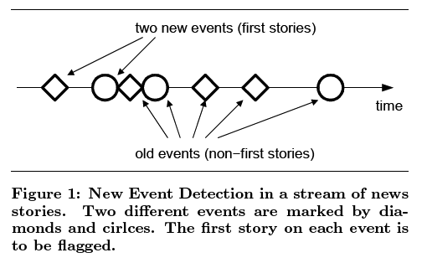
Event Detection [Brants & Chen, 2003]: “A system for new Event Detection”
Present a new method and system for performing the NED task, in one or multiple streams of news stories. All stories on a previously unseen (new) event are marked.
Incremental TF/IDF model.
Notes:
Common approach

Slide 8
Incremental TF-IDF Model
Pre-Processing step
df(w) are not static but change in time steps t
dft(w) = dft-1(w) + dfCt(w) (1), where dfCt(w) denote the document frequencies in the newly added set of documents Ct.
The initial document frequencies df0(w) are generated from a (possibly empty) training set.
Low frequency terms w tend to be uninformative. Use terms with: dft(w) >= θd
Notes:
For pre-processing, we tokenize the data, recognize abbreviations,
normalize abbreviations, remove stop-words, replace
spelled-out numbers by digits, add part-of-speech tags,
replace the tokens by their stems, and then generate term frequency
vectors.

Slide 9



Term Weighting
The document frequencies are used to calculate weights for the terms w in the documents d.
Or

Slide 10


Similarity Calculations
The vectors consisting of normalized term weights weightt are used to calculate the similarity between two documents d and q.
Or Hellinger distance

Slide 11
Making a decision
In order to decide whether a new document q that is added to the collection at time t describes a new event, it is individually compared to all previous documents d. We identify the document d∗ with highest similarity to q:
d∗ = argmaxd simt(q, d)
The value is used to determine whether a document q is about a new event
score(q) = 1 − simt(q, d∗)
if score(q) >= θs then YES else NO

Slide 12
Improvements
Documents in the stream of news stories may stem from different sources. Each of the sources might have somewhat different vocabulary usage.
dfs,t(w), for source s at time t.
The frequencies are updated according to equation (1), but only using those documents in Cn that are from the same source s.

Slide 13
Document Similarity Normalization
A high similarity of a broad topic document to some other document generally does not mean the same as a high similarity of a narrow topic document to some other document.
, the average similarity of the current document q to all previous documents in the collection.
Notes:
Documents that stem from the same source and that describe
the same event tend to have a higher similarity than
documents that stem from different sources and also describe
the same event because of vocabulary conventions
the sources adhere to.

Slide 14


Source-Pair Specific On-Topic Similarity Normalization
Documents that stem from the same source and that describe the same event tend to have a higher similarity than documents that stem from different sources and also describe the same event because of vocabulary conventions the sources adhere to.
,where a, b, and c from sources A, B, and C
Es(q),s(d) : average similarity of stories on the same event from the particular source pair that q and d are drawn from. S(q) and s(d) denote sources of q and d.

Slide 15

Using Inverse Event Frequencies of Terms
ROI (Rules of Interpretation): higher-level categorization of the events.
Terms (in the same ROI) that are highly informative about an event (e.g., Cardoso, the name of the former Brazilian president) should receive higher weights than others (e.g. Election).
where ef(r,w) is the number of events that belong to ROI r and that contain term w.

Slide 16
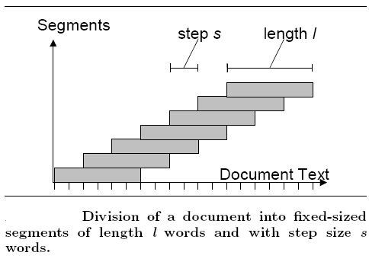

Matching Parts of Documents
Two documents may only partially overlap, even though they are on the same event.
We calculate the similarity score of each segment in one document to each segment in the other document.
,where s1, s2 are
the segments in q and d

Slide 17

Experiments
Data Sets
TDT3 (training set: TDT2)
TDT4 (training set: TDT2, TDT3)
Evaluation Metric
Results
The best system has a topic-weighted minimum normalized cost of 0.5783

Slide 18

Things That Did not Help
Look Ahead (deferral period - 1, 10, or 100 files)
Best results for deferral period = 1
Low df(w), high idf(w)
The lower weight of new terms hurts performance since new words are usually a good indicator of new events.
Using time information
The model uses a window on history of size m:
Notes:
In the IBM model, the time difference is measured
as the difference in time between the test story and the first
story about an event.
Another explanation is that as the system performance
improves, time becomes less useful.

Slide 19
Event Detection [Kumaran & Allan, 2004]: “Text Classification & Named Entities for New Event Detection”
False alarms are caused when an old story is assigned a low score.
Misses, which are more costly than false alarms, are caused when a new story is assigned a high score.
An in-depth look at misses revealed that it was important to isolate the named entities and treat them preferentially.

Slide 20
Event Detection
To understand the utility of named entities we present two examples.
1. Stories about different events can lead to high IDF, cause to common words. This can be avoided if, for example, we give greater attention to the location named entities.
2. Stories about different topics can lead to high similarity, cause to common location named entity.
Named entities are a double-edged sword, and deciding when to use them can be tricky.

Slide 21
Event Detection
α, β, γ: three vector representations of each document.
a: All terms in document
β: Named entities (Event, GPE, Language, Location, Nationality, Organization, Person, Cardinal, Ordinal, Date, and Time)
γ: Non named entity terms
Named entities were identified using BBN Identifinder. We considered only the Event, GPE, Language, Location, Nationality, Organization, Person, Cardinal, Ordinal, Date, and Time named entities to create β.

Slide 22
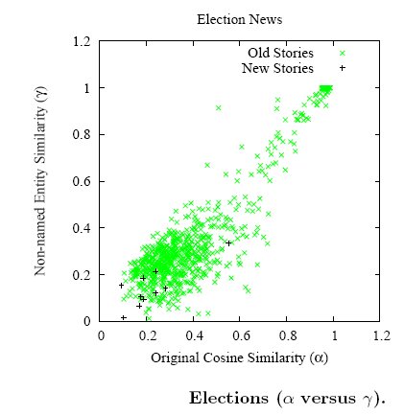
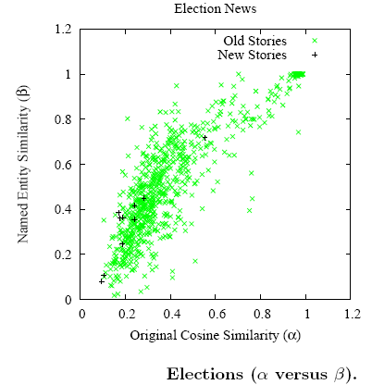
Event Detection
On an average it is not named entities that matter more in finally detecting new Election stories, but the rest of the terms.
Notes:
We see that a majority of the new stories (shown as black
’+’) have a γ score less than 0.2, while the β scores are
spread out among the slew of old stories (shown as light
colored ’X’). This leads to the intuition that we could use the
γ score as a way to confirm the status of the story (old/new)
as suggested by the α score.

Slide 23
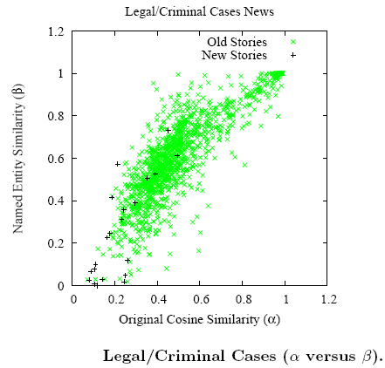
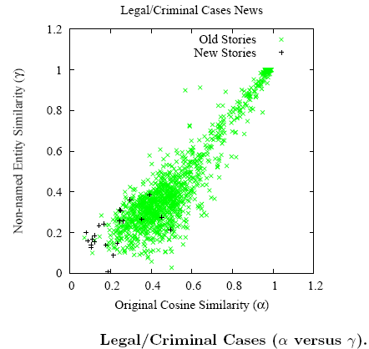
Event Detection
It is more useful to use the β score as an additional metric than the γ score.
Notes:
Here we observe that a β and γ score
less than 0.4 characterize most new stories. However there
are more old stories with γ score less than 0.4 than there
are with a similar β score. Hence it is more useful to use
the β score as an additional metric than the γ score, i.e.
considering named entities is a win over ignoring them.

Slide 24
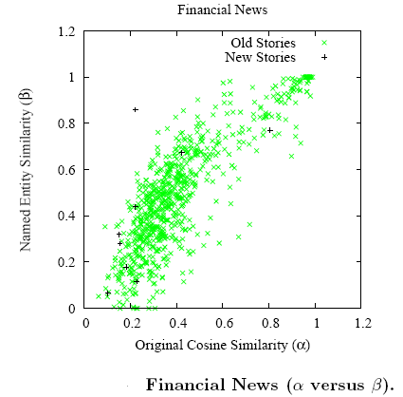
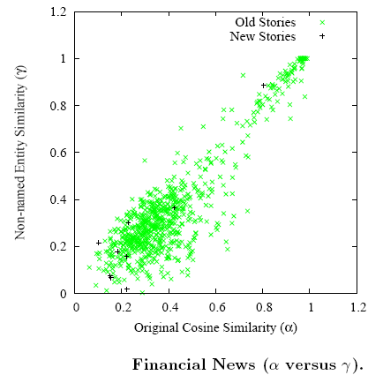
Event Detection
Unfortunately, making such clear cut decisions for all categories is not possible.
Notes:
Unfortunately, making such clear cut decisions for all categories
is not possible.
We see that it is impossible
to select between the β and γ scores. For such categories,
we currently proceed with the α scores as the only metric.

Slide 25
2. Opinion Mining
Opinion mining concerns the automatic identification and extraction of opinions, emotions, and sentiments from:
Text
Main activities: Analyzing product reviews, identifying opinionated documents, sentences and opinion holders.
Multimedia Objects
Current research in this area has investigated two areas in particular. Firstly, there has been work in the area of automatic facial expression recognition. Secondly, there has been some work on associating low-level image features with emotions and sentiments.

Slide 26
2. Opinion Mining
Research in the field of opinion mining has typically focused on methods for detecting sentiment in a generalized way, such as the overall polarity (negative or positive) of user sentiment.
Typical approaches use supervised machine learning methods trained on human-annotated data, co-occurrence statistics, lexicons of positive and negative words and numeric ratings of product reviews (e.g. stars).

Slide 27
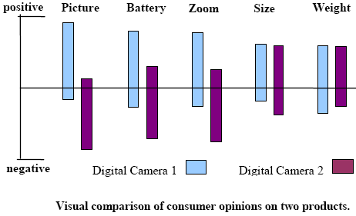
Opinion Mining from Text “Opinion Observer: Analyzing and Comparing Opinions on the Web”
Opinion Observer: an analysis system with a visual component to compare consumer opinions.

Slide 28
Technical Tasks
Identifying product features that customers have expressed their (positive or negative) opinions on.
For each feature, identifying whether the opinion from each reviewer is positive or negative.
Main Review Formats
Format (1) - Pros and Cons.
Format (2) - Pros, Cons and detailed review
Format (3) - free format

Slide 29
‘Algorithm’ Stages
Stage 1: Extracting & analyzing customer reviews in 2 steps:
Download reviews in database (update periodically)
All new reviews of every product are analyzed
Identify product features
Identify opinions
Stage 2: Users can visualize and compare opinions of different products using a user interface.

Slide 30
Problem Statement
P = {P1, P2, …, Pn}: a set of products
Each product Pi has a set of reviews Ri = {r1, r2, …, rk}
Each ri is a sequence of sentences rj = <sj1, sj2, …, sjm>
Definition (product feature): A product feature f in rj is an attribute/component of the product that has been commented on in rj. If f appears in rj, it is called an explicit feature in rj. If f does not appear in rj but is implied, it is called an implicit feature in rj.
“Battery life too short” (f=battery – explicit)
“This camera is too large” (f=size – implicit)

Slide 31
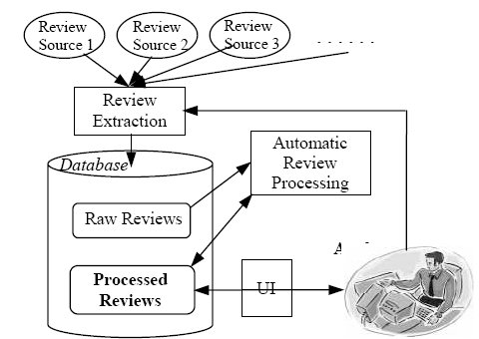
System Architecture
Review extraction: It extracts all reviews from the given URLs and put them in the database.
Raw reviews: these are the original reviews extracted from the user-supplied sources on the Web.
Processed reviews: These are reviews that have been processed by the automatic techniques and/or interactively tagged (corrected) by the analyst(s).
Analyst: corrects any errors
interactively using the UI.

Slide 32
4. Social Web Mining and Massive Collaboration
Analyzing social network structure
One key research topic is the search for regularities in the way social networks evolve over time.
Another current topic is community detection.

Slide 33
4. Social Web Mining and Massive Collaboration
Finding high-quality items and influential people in social media
The quality of user-generated content varies drastically from excellent to abuse and spam. The task of identifying high-quality content in sites based on user contributions - social media sites - becomes increasingly important.
Influence propagation.
Developing methodologies to assess the quality of content provided in user-generated sites.
Identify leaders and followers on a social network.

Slide 34
4. Social Web Mining and Massive Collaboration
Massive Collaboration
The idea of "social minds" has acquired fame and popularity these last five years under the concept of the "wisdom of crowds”, that applies to social tasks in general.
The power behind people is due to a combination of opinion diversity and independence plus a decentralized aggregation mechanism.

