Slide 1
Event Detection using a Clustering Algorithm
Kleisarchaki Sofia,
University of Crete,
kleisar@csd.uoc.gr

Slide 2
Contents
Problem Statement
Clustering Framework
Pre-process
Clusterer
Experimental Setup
Corpus
Training Methodology
Evaluation Methodology
Quality Metrics
Results
Future Work

Slide 3
Problem Statement (1/2)
Problem Definition: Consider a set of social media documents where each document is associated with an (unknown) event. Our goal is to partition this set of documents into clusters such that each cluster corresponds to all documents that are associated to one event. [1]
Definition: An event is something that occurs in a certain place at a certain time. [1]

Slide 4
Problem Statement (2/2)
Equivalent Problem: Find a clustering algorithm, where each cluster corresponds to one event and consists of all the social media documents associated with the event. Different clusters corresponds to different events.
Our algorithm has the following characteristics:
Single-pass
Incremental
Threshold-based
Supervised

Slide 5
Clustering Framework (1/3)
Pre-process Step
Term Weighting using Vector Space Model:
wij = fij*log(num of Docs/num of Docs with word i),
where fij is the frequency of word i in document (instance) j
No Stemming Applied
Stop words Removal
Kept topX words per dataset
Based on Weka Software (implemented in Java)

Slide 6

Clustering Framework (2/3)
Clusterer Step
Build mappings from documents to clusters.
Use textual information and a similarity metric.
Cosine Similarity Metric
Centroid-based Clusters
Average weight per term
Centroid is updated and maintained with low cost

Slide 7
Clustering Framework (3/3)
Algorithm
foreach tweet T in corpus do
foreach term t in T do
foreach tweet T’ that contains t do
compute cosine_similarity_distance(T, centroid(T’))
end
end
maxSimilarity = maxd’ { cosine_similarity_distance(T, centroid(T’)) }
end
if maxSimilarity > threshold then
add T to cluster T’
update cluster’s centroid
else
new cluster (T)
Experimentally defined: 0.2

Slide 8
Experimental Setup (1/4)
Corpus
Collection of twitter data
3079 time stamped tweets
Data was collected through Twitter’s streaming API
Training methodology
A simple graphical user interface was created for tweet labelling

Slide 9
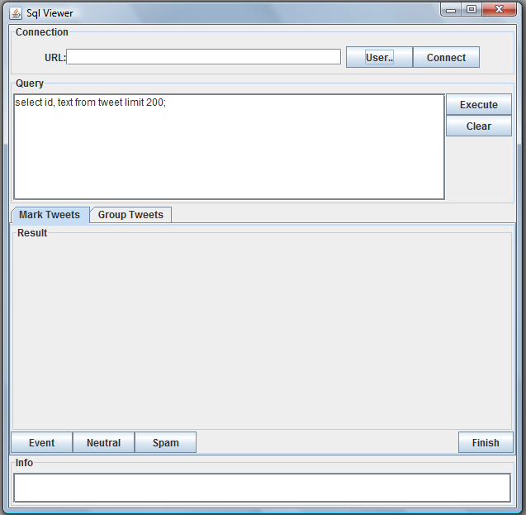
Experimental Setup (2/4)
Connection Options
Query Execution
Query Results
Information Panel

Slide 10
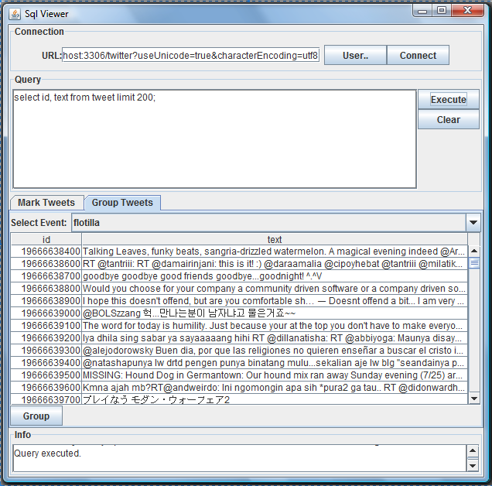
Experimental Setup (3/4)
Grouping tweets

Slide 11
Experimental Setup (4/4)
The “ground truth” dataset consists of 3 events, where each event is self-contained and independent of other events in the dataset.
Specifically,
Event | Tag | #of tweets
Kubica seriously hurt | Kupica | 931
Gary Moore dead | #GaryMoore | 930
Egypt | #egypt | 1218

Slide 12




Evaluation Methodology (1/2)
Quality Metrics
Normalized Mutual Information (NMI)
Measures how much information is shared between actual “ground truth” events and the clustering assignment.
C = {c1, .., cn} set of clusters.
E = {e1, .., en} set of events.

Slide 13



Evaluation Methodology (2/2)
Quality Metrics
Precision:
Recall:
F-Measure:

Slide 14
Results (1/4)
Performance of the algorithm over the given test set.
Stemmer | Threshold | WordsToKeep | #clusters | NMI
NullStemmer | 0.3 | 5 | 2 | 0.5454688377822853
NullStemmer | 0.3 | 10 | 6 | 0.38318653131729596
NullStemmer | 0.3 | 20 | 17 | 0.36193856132310614
NullStemmer | 0.3 | 30 | 28 | 0.3437578875357308
NullStemmer | 0.5 | 5 | 4 | 0.7965425154605168
NullStemmer | (0.35, 0.45) | 5 | 3 | 0.9229528826236639

Slide 15
Results (2/4)
Performance of the algorithm over the given test set.
Stemmer | Threshold | WordsToKeep | #clusters | NMI
NullStemmer | 0.3 | 5 | 2 | 0.5454688377822853
NullStemmer | 0.3 | 10 | 6 | 0.38318653131729596
NullStemmer | 0.3 | 20 | 17 | 0.36193856132310614
NullStemmer | 0.3 | 30 | 28 | 0.3437578875357308
NullStemmer | 0.5 | 5 | 4 | 0.7965425154605168
NullStemmer | (0.35, 0.45) | 5 | 3 | 0.9229528826236639
Egypt, #garymoore, http, kubica, rt

Slide 16

Results (3/4)
F-Measure per Cluster (WordsToKeep:5, thres:0.4)
kubica
garymoore
egypt
 | Event #1 | Event #2 | Event #3
Cluster #1 | 0.013435700575815737 | 0.001865671641791045 | 0.9934426229508196
Cluster #2 | 0.9674698795180723 | 0.0011627906976744186 | 0.0
Cluster #3 | 0.04314159292035399 | 0.9775160599571735 | 0.0
#egypt
kubica
#garymoore
Top word per cluster

Slide 17
Results (4/4)
Content of each cluster
Format: {..., [wordi: weight (#tweets containing wordi)], ... }
Cluster #1 (egypt) | Cluster #2 (kubica) | Cluster #3 (#garymoore)
{[kubica:1.3565369262896527 (10)], [http:1.0707019035945364 (471)], [rt:1.1075679986895262 (781)], [#egypt:0.941297057023443 (1203)]} | {[kubica:1.4379637915969599 (783)], [http:1.0115246749054336 (345)], [#garymoore:1.2233208418815211 (1)], [rt:1.0523581783591311 (213)]} | {[http:1.0513106899659193 (307)], [#garymoore:1.2260243133553097 (905)], [rt:1.0584485297411867 (153)], [#egypt:0.938955522055734 (1)]}

Slide 18
Future Work
Improve:
Pre-process Step
Term Representation
Feature Extraction - Not only textual features
Clusterer
Similarity Metrics
Cluster Representation
Extend Quality Metrics
B-Cubed

Slide 19

Questions?

Slide 20
References
Streaming First Story Detection with Application to Twitter
Learning Similarity Metrics for Event Identification in Social Media
On-line New Event Detection and Tracking
More can be found: www.csd.uoc.gr/~kleisar

