Slide 1
An implementation of
WaveNet
March 2023
Vassilis Tsiaras
Computer Science Department
University of Crete

Slide 2
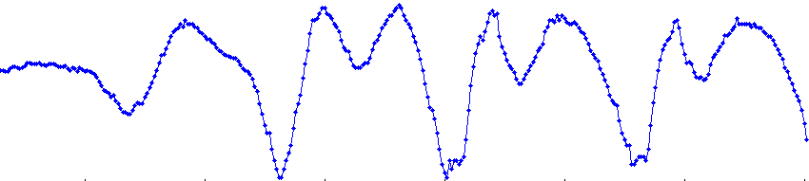
Introduction
In September 2016, DeepMind presented WaveNet.
Wavenet is an ARM with dilated, causal, 1d convolutions.
Wavenet out-performed the best TTS systems (parametric and concatenative) in Mean Opinion Scores (MOS).
Before wavenet, all Statistical Parametric Speech Synthesis (SPSS) methods modelled parameters of speech, such as cepstra, F0, etc.
WaveNet revolutionized our approach to SPSS by directly modelling the raw waveform of the audio signal.
DeepMind published a paper about WaveNet, but it did not reveal all the details of the network.
Here an implementation of WaveNet is presented, which fills some of the missing details.

Slide 3
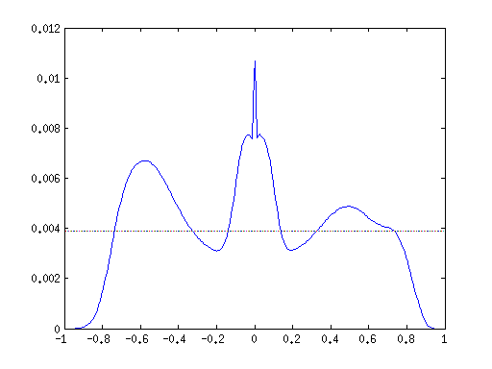
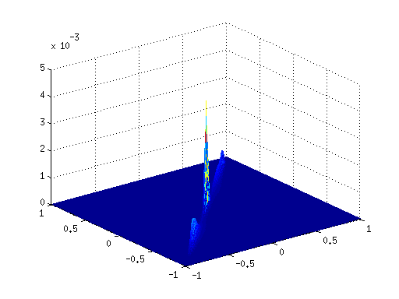
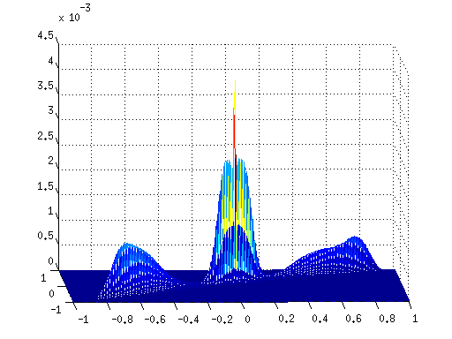
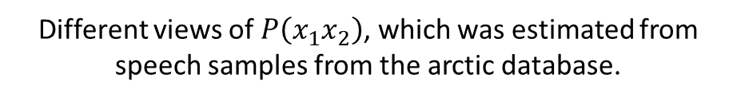
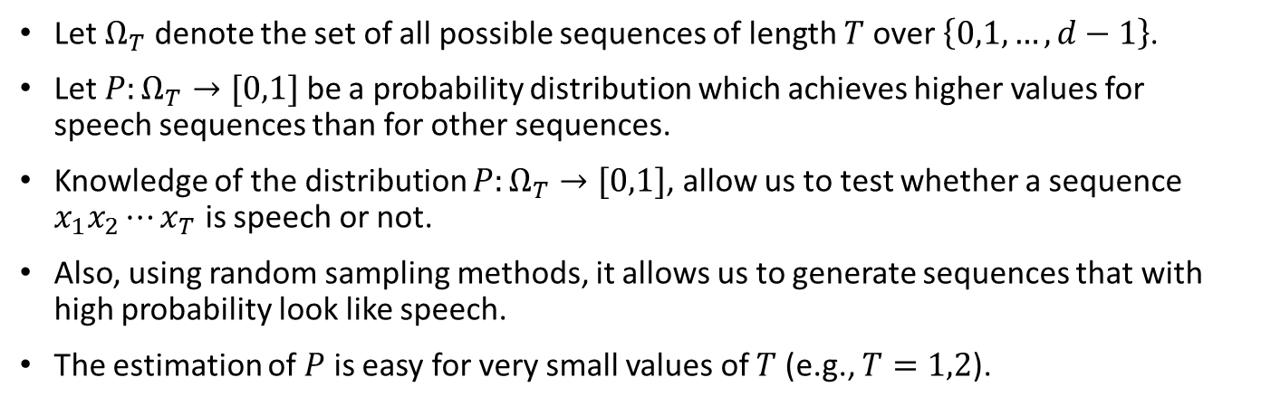
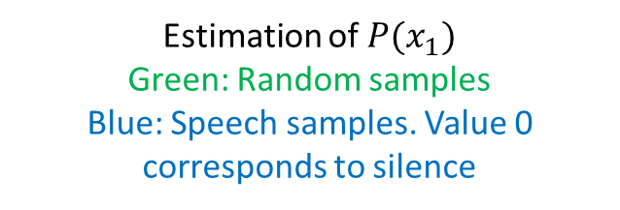
Probability of speech segments
Let $Ω_{T}$ denote the set of all possible sequences of length $T$ over $\left\{0,1,…,d−1\right\}$.
Let $P:Ω_{T}→[0,1]$ be a probability distribution which achieves higher values for speech sequences than for other sequences.
Knowledge of the distribution $P:Ω_{T}→[0,1]$, allow us to test whether a sequence $x_{1}x_{2}⋯x_{T}$ is speech or not.
Also, using random sampling methods, it allows us to generate sequences that with high probability look like speech.
The estimation of $P$ is easy for very small values of $T$ (e.g., $T=1,2$).
Estimation of $P(x_{1})$
Green: Random samples
Blue: Speech samples. Value 0 corresponds to silence
Different views of $P\left(x_{1}x_{2}\right)$, which was estimated from speech samples from the arctic database.

Slide 4
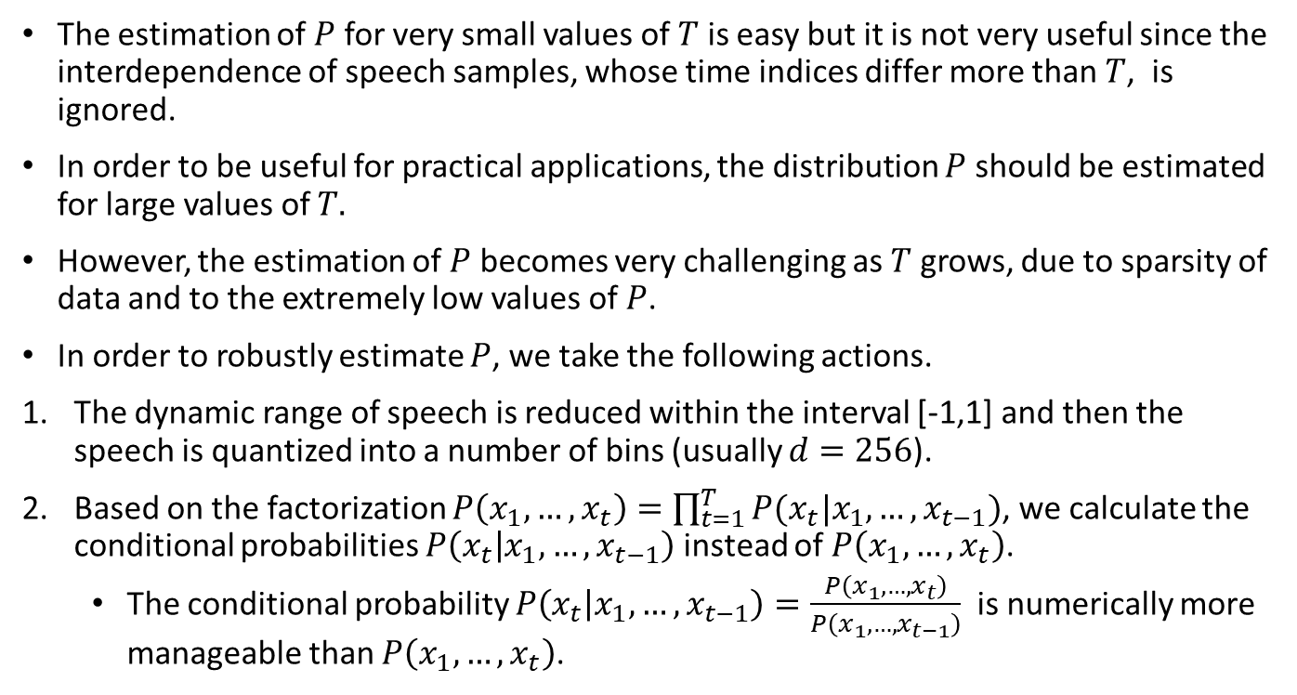
Probability of speech segments
The estimation of $P$ for very small values of $T$ is easy but it is not very useful since the interdependence of speech samples, whose time indices differ more than $T$, is ignored.
In order to be useful for practical applications, the distribution $P$ should be estimated for large values of $T.$
However, the estimation of $P$ becomes very challenging as $T$ grows, due to sparsity of data and to the extremely low values of $P$.
In order to robustly estimate $P$, we take the following actions.
The dynamic range of speech is reduced within the interval [-1,1] and then the speech is quantized into a number of bins (usually $d=256$).
Based on the factorization $P\left(x_{1},…,x_{t}\right)=\prod_{t=1}^{T}{P(x_{t}|x_{1},…,x_{t−1})}$, we calculate the conditional probabilities $P\left(x_{t} | x_{1},…,x_{t−1}\right)$ instead of $P\left(x_{1},…,x_{t}\right)$.
  The conditional probability $P\left(x_{t} | x_{1},…,x_{t−1}\right)=\frac{P\left(x_{1},…,x_{t}\right)}{P\left(x_{1},…,x_{t−1}\right)}$ is numerically more manageable than $P\left(x_{1},…,x_{t}\right)$.

Slide 5
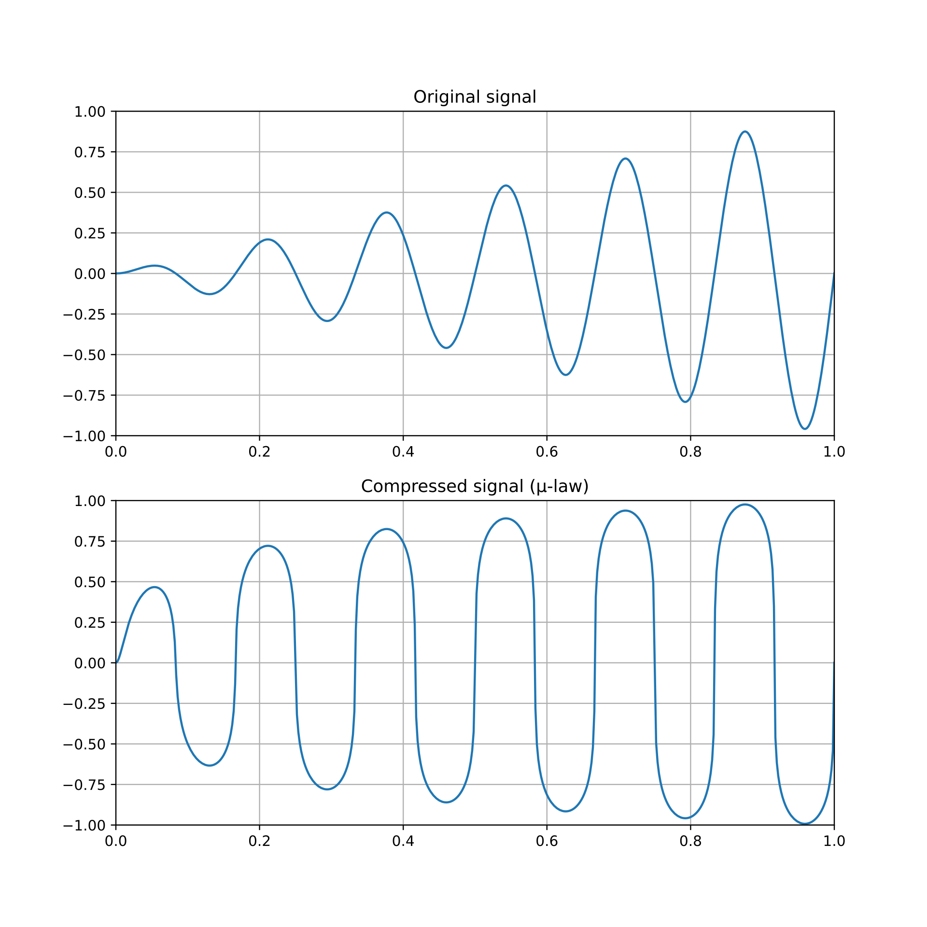
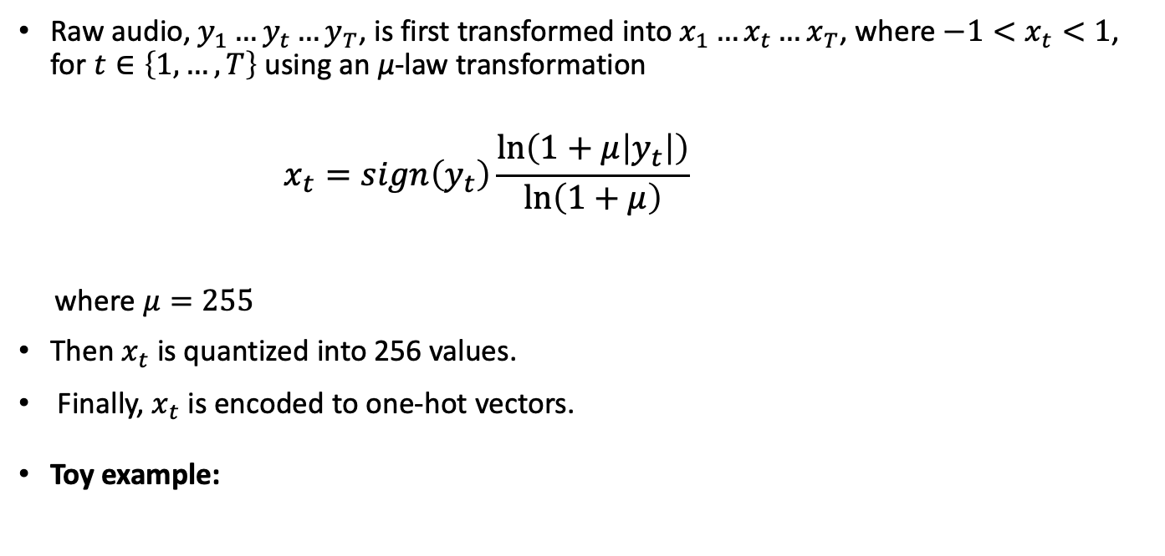


Dynamic range compression and Quantization
Raw audio, ${y_{1}…y}_{t}…y_{T}$, is first transformed into ${x_{1}…x}_{t}…x_{T}$, where $−1<x_{t}<1$, for $t∈\left\{1,…,T\right\}$ using an μ-law transformation
$$x_{t}=sign\left(y_{t}\right)\frac{\ln\left(1+μ\left|y_{t}\right|\right)}{\ln\left(1+μ\right)}$$
where $μ=255$
Τhen $x_{t}$ is quantized into 256 values.
Finally, $x_{t}$ is encoded to one-hot vectors.
Toy example:
$−2.2, −1.43, −0.77, −1.13, −0.58, −0.43, −0.67$, …
$−0.7, −0.3, 0.2, −0.1, 0.4, 0.6, 0.3$, …
signal
μ-law transformed
bin 0
1
0
0
0
0
0
0
$$0, 1, 2, 1, 2, 3, 2, …$$
bin 1
0
1
0
1
0
0
0
…
Input to WaveNet
quantized into 4 bins
bin 2
0
0
1
0
1
0
1
bin 3
0
0
0
0
0
1
0
one-hot vectors

Slide 6
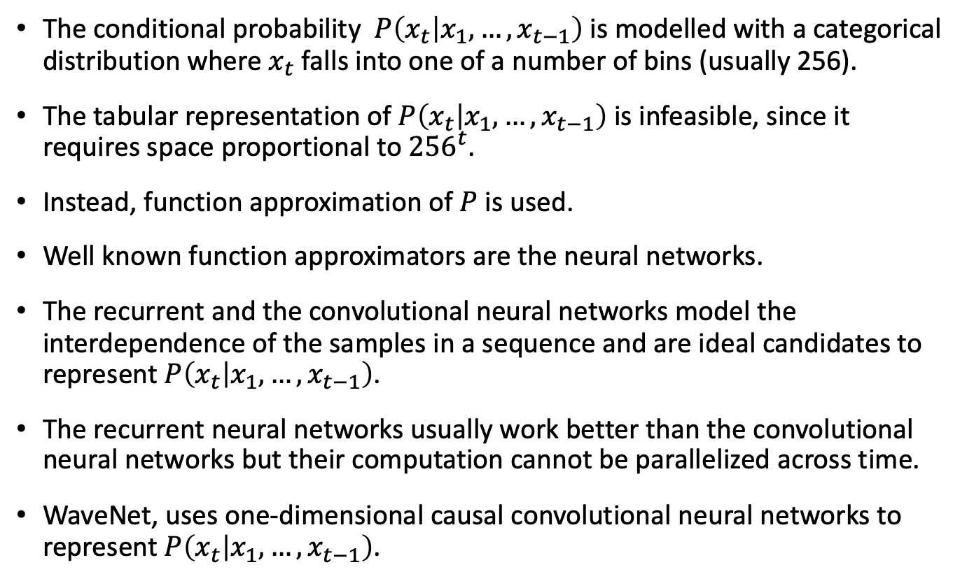
The conditional probability
The conditional probability $P\left(x_{t} | x_{1},…, x_{t−1}\right)$ is modelled with a categorical distribution where $x_{t}$ falls into one of a number of bins (usually 256).
The tabular representation of $P\left(x_{t} | x_{1},…, x_{t−1}\right)$ is infeasible, since it requires space proportional to ${256}^{t}$.
Instead, function approximation of $P$ is used.
Well known function approximators are the neural networks.
The recurrent and the convolutional neural networks model the interdependence of the samples in a sequence and are ideal candidates to represent $P\left(x_{t} | x_{1},…, x_{t−1}\right)$.
The recurrent neural networks usually work better than the convolutional neural networks but their computation cannot be parallelized across time.
WaveNet, uses one-dimensional causal convolutional neural networks to represent $P\left(x_{t} | x_{1},…, x_{t−1}\right)$.

Slide 7

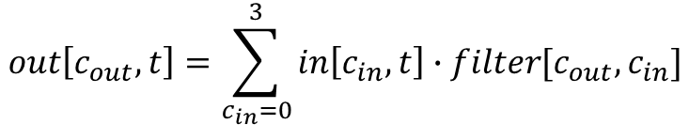

WaveNet architecture – 1×1 Convolutions
1×1 convolutions are used to change the number of channels. They do not operate in time dimension.
They can be written as matrix multiplications.
Example of a 1×1 convolution with 4 input channels, and 3 output channels
Input signal
Filters
1
0
0
0
0
0
0
1
8
0
1x1 convolution
0
1
0
1
0
0
0
…
3
3
4
Input channels
Input channels
2
0
0
1
0
1
0
1
4
1
0
0
0
0
0
1
0
5
2
1
Width - time
Output channels
Transposed Filters
Input signal
Output signal
1
3
4
5
1
0
0
0
0
0
0
$$∙$$
0
1
0
1
0
0
0
$$=$$
1
3
4
3
4
5
4
8
3
1
2
Input channels
…
Output channels
Output channels
0
0
1
0
1
0
1
8
3
1
3
1
2
1
0
4
2
1
0
0
0
0
0
1
0
0
4
2
4
2
1
2
Width - time
Width - time
Input channels
$$out\left[c_{out},t\right]=\sum_{c_{in}=0}^{3}{in\left[c_{in},t\right]∙filter[c_{out},c_{in}]}$$

Slide 8
Causal convolutions
Example of a convolution
Many machine learning libraries avoid the filter flipping.
For simplicity, we will also avoid the filter flipping.
Causal convolutions do not consider future samples. Therefore all values of the filter kernel that correspond to future samples are zero.
Filters of width 2 are causal
Input signal
Filter
Filter flipped
1
2
0
3
2
0
1
4
2
1
1
2
4
1
2
Width = 3
1
4
2
1
4
2
1
4
2
1
4
2
4
5
14
14
7
6
Filter of a causal convolution
4
2
0
4
2
past
present

Slide 9
Dilated convolutions
Example of a dilated convolution, with dilation=2
Equivalent filter of a dilated convolution, with dilation=4
Dilated convolutions have longer receptive fields.
Efficient implementations of dilated convolutions do not consider the equivalent filter with the filled zeros.
Input signal
Filter
Equivalent filter
1
2
0
3
2
0
1
4
2
1
4
0
2
0
1
4
0
Width = 3
Width = 5
4
2
0
4
0
2
0
1
0
2
1
0
1
6
14
5
Filter
Equivalent filter
4
2
1
4
0
0
0
2
0
0
0
1
Width = 3
Width = 9 = (Filter_width-1)*dilation + 1

Slide 10

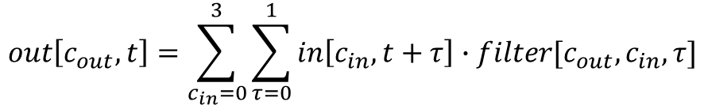



Causal convolutions - Matrix multiplications
Example of a causal convolution of width 2, 4 input channels, and 3 output channels
Input signal
Filters
1
0
0
0
0
0
0
1
2
8
7
0
1
0
1
0
1
0
0
0
…
3
1
3
0
4
9
Input channels
Input channels
2
1
0
0
1
0
1
0
1
4
6
1
4
0
0
0
0
0
1
0
5
1
2
9
1
0
Width - time
Width
Width
Width
Output channels
1
3
4
5
1
0
0
0
0
0
2
1
6
1
0
0
0
0
0
0
8
3
1
2
$$∙$$
0
1
0
1
0
0
$$+$$
7
0
4
9
$$∙$$
1
0
1
0
0
0
$$=$$
0
0
1
0
1
0
0
1
0
1
0
1
0
4
2
1
0
0
0
0
0
1
1
9
1
0
0
0
0
0
1
0
Output signal
2
9
5
9
5
11
Output channels
8
7
1
7
10
6
$$out\left[c_{out},t\right]=\sum_{c_{in}=0}^{3}{\sum_{τ=0}^{1}{in\left[c_{in},t+τ\right]∙filter[c_{out},c_{in},τ]}}$$
9
5
11
5
2
2
Width - time

Slide 11
Causal convolutions - Embedding
Example of a causal convolution of width 2, 4 input channels, and 3 output channels
Input signal
Filters
1
0
0
0
0
0
0
1
2
8
7
0
1
0
1
0
1
0
0
0
…
3
1
3
0
4
9
Input channels
Input channels
2
1
0
0
1
0
1
0
1
4
6
1
4
0
0
0
0
0
1
0
5
1
2
9
1
0
Width - time
Width
Width
Width
Output channels
1
3
4
5
1
0
0
0
0
0
2
1
6
1
0
0
0
0
0
0
8
3
1
2
0
1
0
1
0
0
$$+$$
7
0
4
9
1
0
1
0
0
0
$$=$$
0
0
1
0
1
0
0
1
0
1
0
1
0
4
2
1
0
0
0
0
0
1
1
9
1
0
0
0
0
0
1
0
Output signal
2
9
5
9
5
11
Output channels
8
7
1
7
10
6
$$out\left[c_{out},t\right]=\sum_{c_{in}=0}^{3}{\sum_{τ=0}^{1}{in\left[c_{in},t+τ\right]∙filter[c_{out},c_{in},τ]}}$$
9
5
11
5
2
2
Width - time

Slide 12



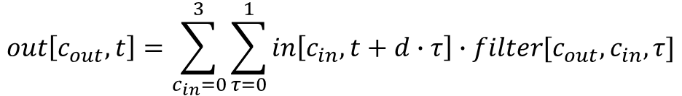


Dilated convolutions – Matrix Multiplications
Example of a causal dilated convolution of width 2, dilation 2, 4 input channels, and 3 output channels. Dilation is applied in time dimension
Input signal
Filters
1
0
0
0
0
0
0
1
2
8
7
0
1
0
1
0
1
0
0
0
…
3
1
3
0
4
9
Input channels
Input channels
2
1
0
0
1
0
1
0
1
4
6
1
4
0
0
0
0
0
1
0
5
1
2
9
1
0
Width - time
Width
Width
Width
Output channels
1
3
4
5
1
0
0
0
0
2
1
6
1
0
0
0
0
0
8
3
1
2
$$∙$$
0
1
0
1
0
$$+$$
7
0
4
9
$$∙$$
0
1
0
0
0
$$=$$
0
0
1
0
1
1
0
1
0
1
0
4
2
1
0
0
0
0
0
1
9
1
0
0
0
0
1
0
Output signal
7
4
10
4
10
dilation
$$d=2$$
Output channels
12
3
5
12
5
$$out\left[c_{out},t\right]=\sum_{c_{in}=0}^{3}{\sum_{τ=0}^{1}{in\left[c_{in},t+d∙τ\right]∙filter[c_{out},c_{in},τ]}}$$
1
13
3
4
3
Width - time

Slide 13


Dilated convolutions – Matrix Multiplications
Example of a causal dilated convolution of width 2, dilation 4, 4 input channels, and 3 output channels. Dilation is applied in time dimension
Input signal
Filters
1
0
0
0
0
0
0
1
2
8
7
0
1
0
1
0
1
0
0
0
…
3
1
3
0
4
9
Input channels
Input channels
2
1
0
0
1
0
1
0
1
4
6
1
4
0
0
0
0
0
1
0
5
1
2
9
1
0
Width - time
Width
Width
Width
Output channels
1
3
4
5
1
0
0
2
1
6
1
0
0
0
8
3
1
2
$$∙$$
0
1
0
$$+$$
7
0
4
9
$$∙$$
0
0
0
$$=$$
0
0
1
1
0
1
0
4
2
1
0
0
0
1
9
1
0
0
1
0
Output signal
7
4
10
dilation
$$d=4$$
Output channels
12
12
5
1
4
3
Width - time

Slide 14
WaveNet architecture – Dilated convolutions
WaveNet models the conditional probability distribution $p\left(x_{t} | x_{1},…,x_{t−1}\right)$ with a stack of dilated causal convolutions.
Output
dilation = 8
Hidden layer
dilation = 4
Hidden layer
dilation = 2
Hidden layer
dilation = 1
Input
Visualization of a stack of dilated causal convolutional layers
Stacked dilated convolutions enable very large receptive fields with just a few layers.
The receptive field of the above example is (8+4+2+1) + 1 = 16
In WaveNet, the dilation is doubled for every layer up to a certain point and then repeated: 1, 2, 4, ..., 512, 1, 2, 4, ..., 512, 1, 2, 4, ..., 512, 1, 2, 4, …, 512, 1, 2, 4, …, 512

Slide 15
WaveNet architecture – Dilated convolutions
Example with dilations 1,2,4,8,1,2,4,8
d=8
d=4
d=2
d=1
d=8
d=4
d=2
d=1

Slide 16



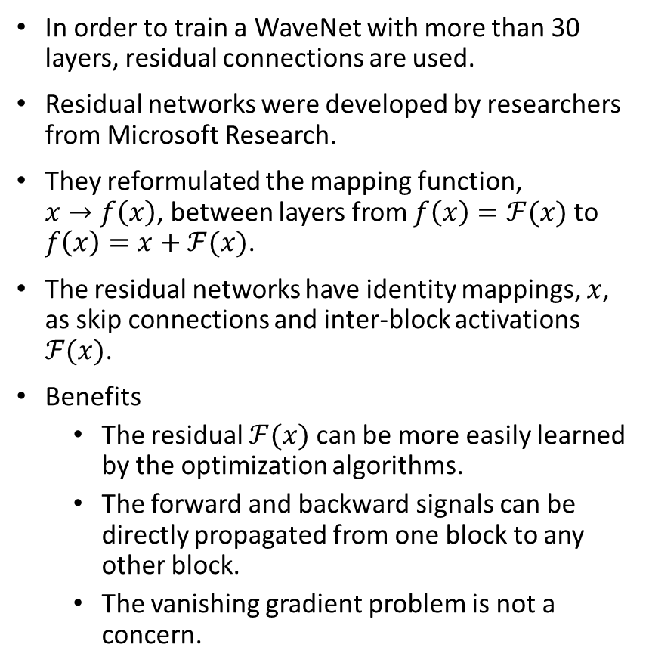




WaveNet architecture – Residual connections
In order to train a WaveNet with more than 30 layers, residual connections are used.
Residual networks were developed by researchers from Microsoft Research.
They reformulated the mapping function, $x→f\left(x\right)$, between layers from $f\left(x\right)=ℱ(x)$ to $f\left(x\right)=x+ℱ(x)$.
The residual networks have identity mappings, $x$, as skip connections and inter-block activations $ℱ(x)$.
Benefits
  The residual $ℱ(x)$ can be more easily learned by the optimization algorithms.
  The forward and backward signals can be directly propagated from one block to any other block.
  The vanishing gradient problem is not a concern.
$x+ℱ(x)$+$𝒢(x+ℱ(x))$
+
Weight layer
identity
$$x+ℱ(x)$$
$$𝒢(x+ℱ(x))$$
Weight layer
$$x+ℱ(x)$$
+
Weight layer
identity
$$x$$
$$ℱ(x)$$
Weight layer
$$x$$

Slide 17
WaveNet architecture – Experts & Gates
WaveNet uses gated networks.
For each output channel an expert is defined.
  Experts may specialize in different parts of the input space
The contribution of each expert is controlled by a corresponding gate network.
The components of the output vector are mixed in higher layers, creating mixture of experts.
×
tanh
σ
expert
gate
Dilated convolution
Dilated convolution

Slide 18
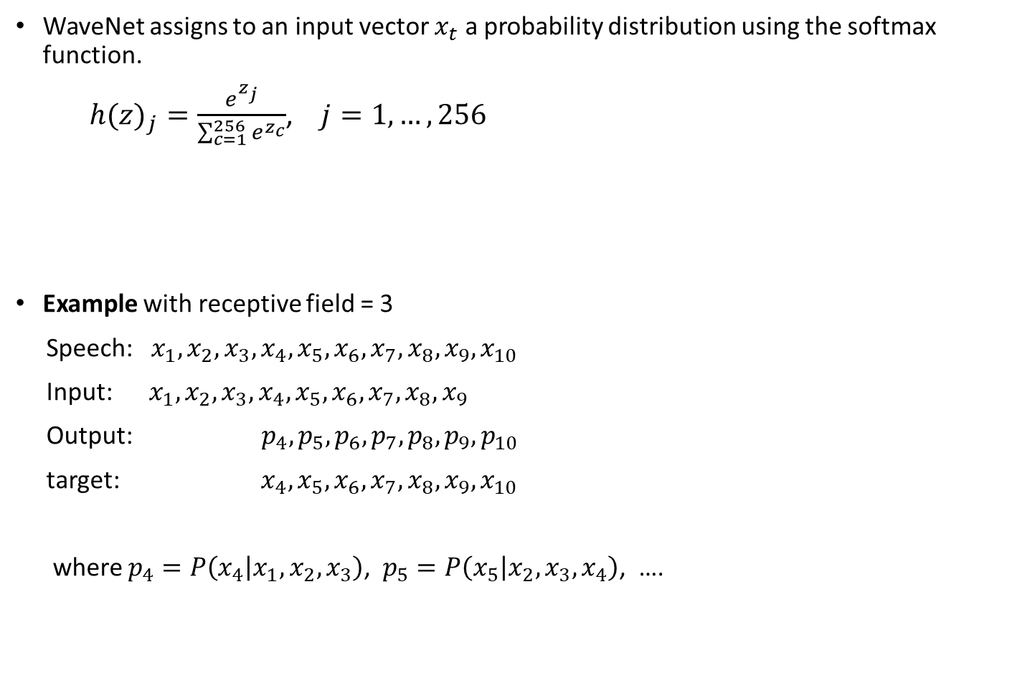
WaveNet architecture – Output
WaveNet assigns to an input vector $x_{t}$ a probability distribution using the softmax function.
${h(z)}_{j}=\frac{e^{z_{j}}}{\sum_{c=1}^{256}{e^{z_{c}}}}$, $j=1, …, 256$
Example with receptive field = 3
Speech: $x_{1},x_{2},x_{3},x_{4},x_{5},x_{6},x_{7},x_{8},x_{9},x_{10}$
Input: $x_{1},x_{2},x_{3},x_{4},x_{5},x_{6},x_{7},x_{8},x_{9}$
Output: $p_{4},p_{5},p_{6},p_{7},p_{8},p_{9},p_{10}$
target: $x_{4},x_{5},x_{6},x_{7},x_{8},x_{9},x_{10}$
where $p_{4}=P\left(x_{4} | x_{1},x_{2}, x_{3}\right)$, $p_{5}=P\left(x_{5} | x_{2},x_{3}, x_{4}\right)$, ….
.6
.2
.1
.1
0
.2
.5
.1
.6
.1
Channels
.1
.2
.7
.2
.1
.1
.1
.1
.1
.8
time
WaveNet output: probabilities from softmax

Slide 19
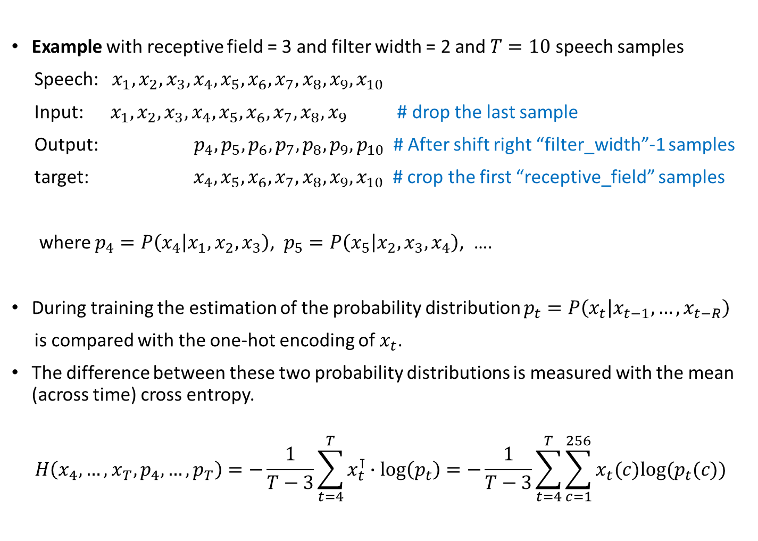
WaveNet architecture – Loss function
Example with receptive field = 3 and filter width = 2 and $T=10$ speech samples
Speech: $x_{1},x_{2},x_{3},x_{4},x_{5},x_{6},x_{7},x_{8},x_{9},x_{10}$
Input: $x_{1},x_{2},x_{3},x_{4},x_{5},x_{6},x_{7},x_{8},x_{9}$ # drop the last sample
Output: $p_{4},p_{5},p_{6},p_{7},p_{8},p_{9},p_{10}$ # After shift right “filter_width”-1 samples
target: $x_{4},x_{5},x_{6},x_{7},x_{8},x_{9},x_{10}$ # crop the first “receptive_field” samples
where $p_{4}=P\left(x_{4} | x_{1},x_{2}, x_{3}\right)$, $p_{5}=P\left(x_{5} | x_{2},x_{3}, x_{4}\right)$, ….
During training the estimation of the probability distribution $p_{t}=P\left(x_{t} | x_{t−1},…, x_{t−R}\right)$
is compared with the one-hot encoding of $x_{t}$.
The difference between these two probability distributions is measured with the mean (across time) cross entropy.
$$H\left(x_{4},…,x_{T}, p_{4},…,p_{T}\right)=−\frac{1}{T−3}\sum_{t=4}^{T}{x_{t}^{⊺}∙\log\left(p_{t}\right)}=−\frac{1}{T−3}\sum_{t=4}^{T}{\sum_{c=1}^{256}{x_{t}(c)log⁡(p_{t}(c))}}$$

Slide 20
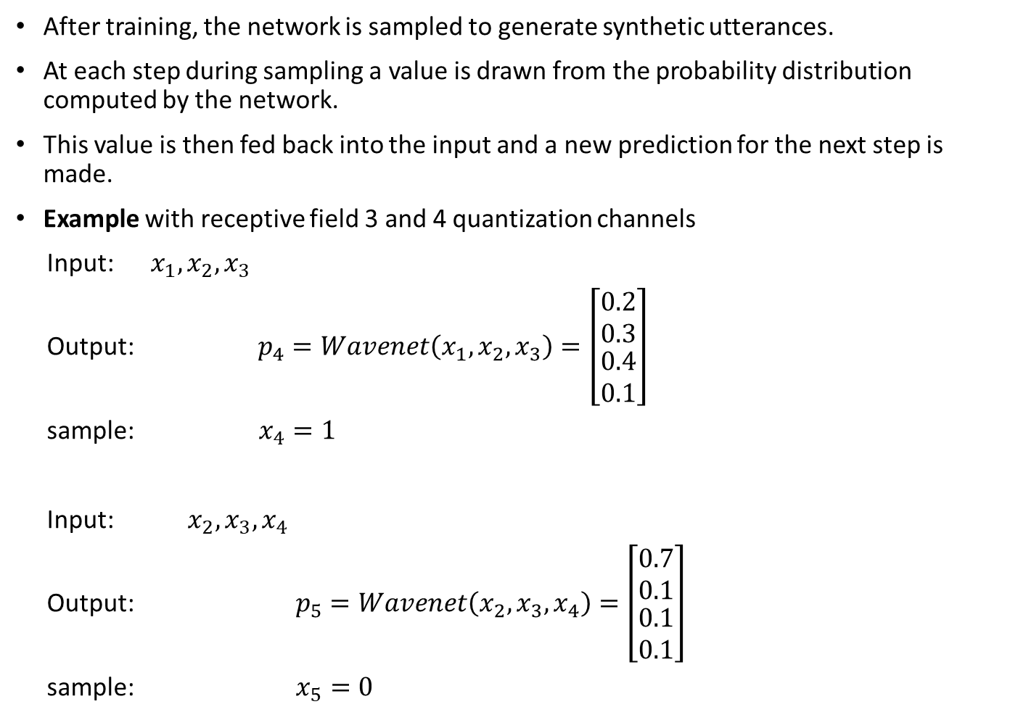
WaveNet – Audio generation
After training, the network is sampled to generate synthetic utterances.
At each step during sampling a value is drawn from the probability distribution computed by the network.
This value is then fed back into the input and a new prediction for the next step is made.
Example with receptive field 3 and 4 quantization channels
Input: $x_{1},x_{2},x_{3}$
Output: $p_{4}=Wavenet\left(x_{1},x_{2}, x_{3}\right)=\left[\begin{matrix}0.2 \\ 0.3 \\ \begin{matrix}0.4 \\ 0.1\end{matrix}\end{matrix}\right]$
sample: $x_{4}=1$
Input: $x_{2},x_{3},x_{4}$
Output: $p_{5}=Wavenet\left(x_{2},x_{3}, x_{4}\right)=\left[\begin{matrix}0.7 \\ 0.1 \\ \begin{matrix}0.1 \\ 0.1\end{matrix}\end{matrix}\right]$
sample: $x_{5}=0$
Probability distribution over the symbols 0,1,2,3

Slide 21

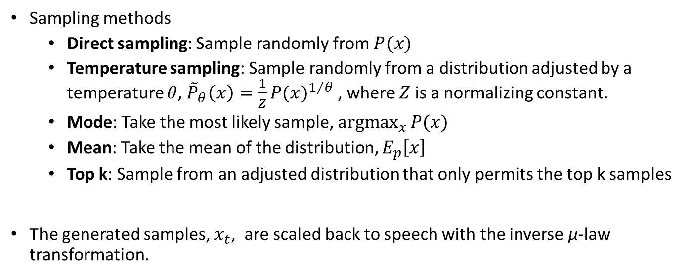


WaveNet – Audio generation
Sampling methods
  Direct sampling: Sample randomly from $P(x)$
  Temperature sampling: Sample randomly from a distribution adjusted by a temperature $θ$, ${\tilde{P}}_{θ}\left(x\right)=\frac{1}{Z}{P(x)}^{1/θ}$ , where $Z$ is a normalizing constant.
  Mode: Take the most likely sample, $\underset{x}{\text{arg}max}{P(x)}$
  Mean: Take the mean of the distribution, $E_{p}\left[x\right]$
  Top k: Sample from an adjusted distribution that only permits the top k samples
The generated samples, $x_{t}$, are scaled back to speech with the inverse μ-law transformation.
$$u=2\frac{x}{μ}−1$$
Convert from $x∈\left\{0,1,2,…, 255\right\}$ to $u∈\left[−1,1\right]$
speech$=\frac{sign(u)}{μ}\left({\left(1+μ\right)}^{u}−1\right)$
Inverse μ-law transform

Slide 22
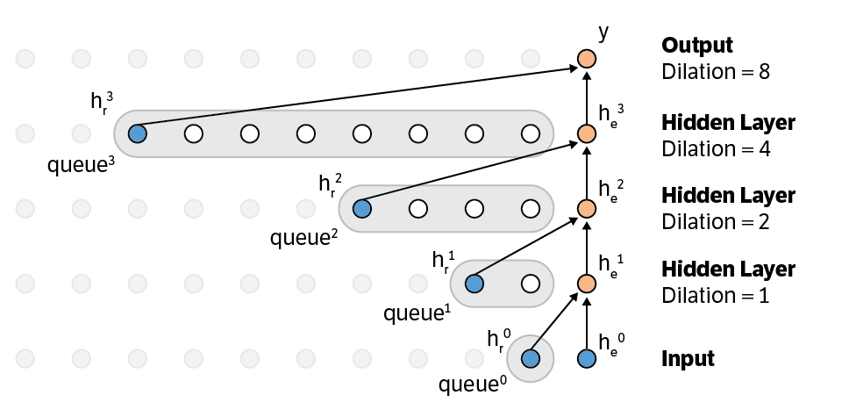
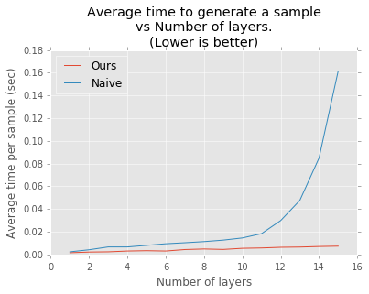
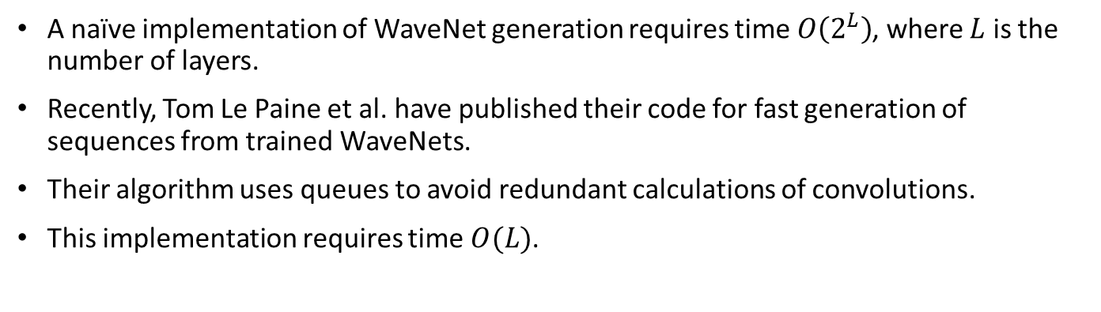
Fast WaveNet – Audio generation
A naïve implementation of WaveNet generation requires time $O\left(2^{L}\right)$, where $L$ is the number of layers.
Recently, Tom Le Paine et al. have published their code for fast generation of sequences from trained WaveNets.
Their algorithm uses queues to avoid redundant calculations of convolutions.
This implementation requires time $O(L)$.
Fast

Slide 23



Basic WaveNet architecture
$$p\left(x_{t}|x_{t−R},…,x_{t−1}\right)$$
Res. block
1X1
256
512
Σ
512
256
Res. block
1X1
256
512
30
512
256
256
256
256
Res. block
1X1
ReLU
1X1
ReLU
1X1
Softmax
512
512
256
Res. block
1X1
512
512
256
Res. block
1X1
512
512
1X1 conv
1X1 conv
$$x_{t−2}$$
$$x_{t−1}$$
256

Slide 24
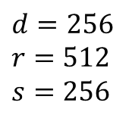
Basic WaveNet architecture
Identity mapping
+
Loss
Output
Conv 1×1, r-chan
Skip connection
k^{th} residual block dilation = 512
Conv 1×1 s-chan
Softmax
tanh
×
σ
Conv 1×1, d-chan
Dilated convolution
Dilated convolution
ReLU
Conv 1×1, d-chan
Identity mapping
+
ReLU
Conv 1×1 r-chan
Skip connection
1st residual block dilation = 1
Conv 1×1 s-chan
+
tanh
×
σ
Post-processing
Dilated convolution
Dilated convolution
Parameters of the original Wavenet
Causal conv, r-chan
One hot, d-chan
$$d=256$$
$$r=512$$
$$s=256$$
channels
Pre-processing
Input (speech)
30 residual blocks

Slide 25












WaveNet architecture – Global conditioning
$$p\left(x_{t}|x_{t−R},…,x_{t−1},g\right)$$
Res. block
Embedding channels
$$W_{5}$$
$$E$$
Res. block
Speaker embedding vector
$$W_{4}$$
Res. block
Speaker id, $g$
$$W_{3}$$
Res. block
$$W_{2}$$
Res. block
Res. block
$$W_{1}$$
$$x_{t−4}$$
$$x_{t−3}$$
$$x_{t−2}$$
$$x_{t−1}$$

Slide 26
WaveNet architecture – Global conditioning
$$p\left(x_{t}|x_{t−R},…,x_{t−1},g\right)$$
Res. block
Residual channels
$$E$$
Res. block
Speaker embedding vector
Res. block
Speaker id
Res. block
Res. block
Res. block
$$x_{t−4}$$
$$x_{t−3}$$
$$x_{t−2}$$
$$x_{t−1}$$

Slide 27


WaveNet architecture – Local conditioning
$$p\left(x_{t}|x_{t−R},…,x_{t−1},h_{t}\right)$$
Linguistic features
Res. block
$$W_{5}$$
Upsampling
Res. block
$$W_{4}$$
Res. block
$$h_{t}$$
$$W_{3}$$
Res. block
$$W_{2}$$
Res. block
Res. block
$$W_{1}$$
$$x_{t−4}$$
$$x_{t−3}$$
$$x_{t−2}$$
$$x_{t−1}$$

Slide 28

WaveNet architecture – Local conditioning
$$p\left(x_{t}|x_{t−R},…,x_{t−1},h_{t}\right)$$
Linguistic features
Res. block
Res. block
Embedding at time t
Res. block
$$h_{t}$$
Res. block
Res. block
Res. block
$$x_{t−4}$$
$$x_{t−3}$$
$$x_{t−2}$$
$$x_{t−1}$$

Slide 29



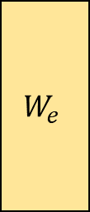





WaveNet architecture – Local conditioning
$$p\left(x_{t}|x_{t−R},…,x_{t−1},h_{t}\right)$$
Acoustic features
Res. block
$$W_{5}$$
Upsampling
Res. block
$$tanh$$
$$W_{4}$$
$$W_{e}$$
Res. block
$$h_{t}$$
$$W_{3}$$
Res. block
$$W_{2}$$
$$tanh$$
Res. block
Res. block
$$W_{1}$$
$$x_{t−4}$$
$$x_{t−3}$$
$$x_{t−2}$$
$$x_{t−1}$$

Slide 30







WaveNet architecture – Local and global conditioning
$$p\left(x_{t}|x_{t−R},…,x_{t−1},h_{t},g_{t}\right)$$
Acoustic features
Res. block
Upsampling
$$W_{5}$$
$$W_{l}$$
$$W_{g}$$
Res. block
$$tanh$$
$$W_{4}$$
$$h_{t}$$
Res. block
$$W_{3}$$
$$W_{g}$$
Res. block
$$g_{t}$$
$$W_{2}$$
$$tanh$$
Res. block
Res. block
Upsampling
$$W_{1}$$
Speaker id
$$x_{t−4}$$
$$x_{t−3}$$
$$x_{t−2}$$
$$x_{t−1}$$

Slide 31
WaveNet architecture for TTS
Identity mapping
+
Loss
Skip connection
Output
Conv 1×1, r-chan
Conv 1×1, d-chan
tanh
σ
Softmax
×
+
+
Conv 1×1, d-chan
Dilated conv
Conv 1×1
Conv 1×1
Dilated conv
ReLU
Conv 1×1, d-chan
Identity mapping
+
Skip connection
ReLU
Conv 1×1, r-chan
Conv 1×1, d-chan
tanh
σ
+
×
+
+
Post-processing
Dilated conv
Conv 1×1
Conv 1×1
Dilated conv
Causal conv, r-chan
One hot, d-chan
Up-sampling
Pre-processing
Input (labels)
Input (speech)

Slide 32
WaveNet architecture -Improvements
$$p\left(x_{t}|x_{t−R},…,x_{t−1}\right)$$
Res. block
1X1
256
512
Σ
512
256
Res. block
1X1
256
512
30
512
256
256
256
256
Res. block
1X1
ReLU
1X1
ReLU
1X1
Softmax
512
512
256
Res. block
1X1
512
512
256
Res. block
1X1
512
512
1X1 conv
1X1 conv
$$x_{t−2}$$
$$x_{t−1}$$
256

Slide 33
WaveNet architecture - Improvements
$$p\left(x_{t}|x_{t−R},…,x_{t−1}\right)$$
Res. block
512
512
256
Res. block
512
30
512
Concatenate
512 x 30
256
256
256
Res. block
1X1
ReLU
1X1
ReLU
1X1
Softmax
512
512
Res. block
512
512
Res. block
512
512
Up to 10% increase in speed
1X1 conv
1X1 conv
$$x_{t−2}$$
$$x_{t−1}$$
256

Slide 34
WaveNet architecture - Improvements
Identity mapping
+
Loss
Output
Conv 1×1, r-chan
Skip connection
k^{th} residual block dilation = 512
Conv 1×1 s-chan
Softmax
tanh
×
σ
Conv 1×1, d-chan
Dilated convolution
Dilated convolution
ReLU
Conv 1×1, d-chan
Identity mapping
+
ReLU
Conv 1×1 r-chan
Skip connection
1st residual block dilation = 1
Conv 1×1 s-chan
+
tanh
×
σ
Post-processing
Dilated convolution
Dilated convolution
Parameters of the original Wavenet
Causal conv, r-chan
One hot, d-chan
$$d=256$$
$$r=512$$
$$s=256$$
channels
Pre-processing
Input (speech)
30 residual blocks

Slide 35
WaveNet architecture - Improvements
Identity mapping
+
Loss
Output
Conv 1×1, r-chan
Skip connection
k^{th} residual block dilation = 512
Softmax
tanh
×
σ
Conv 1×1, d-chan
2x1 Dilated conv, 2r-chan
ReLU
Concatenate
Conv 1×1 s-chan
Conv 1×1, d-chan
Identity mapping
+
ReLU
Conv 1×1 r-chan
Skip connection
1st residual block dilation = 1
+
tanh
×
σ
Post-processing
2x1 Dilated conv, 2r-chan
Parameters of the original Wavenet
Causal conv, r-chan
One hot, d-chan
$$d=256$$
$$r=512$$
$$s=256$$
channels
Pre-processing
Input (speech)
30 residual blocks

Slide 36
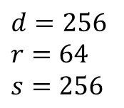
WaveNet architecture - Improvements
Identity mapping
+
Loss
Output
Skip connection
k^{th} residual block dilation = 512
Softmax
tanh
×
σ
Conv 1×1, d-chan
2x1 Dilated conv, 2r-chan
ReLU
Concatenate
Conv 1×1 s-chan
Conv 1×1, d-chan
Identity mapping
+
ReLU
Skip connection
1st residual block dilation = 1
+
tanh
×
σ
Post-processing
2x1 Dilated conv, 2r-chan
Parameters of improved Wavenet
Causal conv, r-chan
One hot, d-chan
$$d=256$$
$$r=64$$
$$s=256$$
channels
Pre-processing
Input (speech)
40 to 80 residual blocks

Slide 37
WaveNet architecture -Improvements
In order to increase the receptive field of WaveNet, we may use filter width 3 instead of 2 in dilated causal convolutions.
Signal
Filter of width 2 and dilation 2
Signal
Filter of width 3 and dilation 2

Slide 38
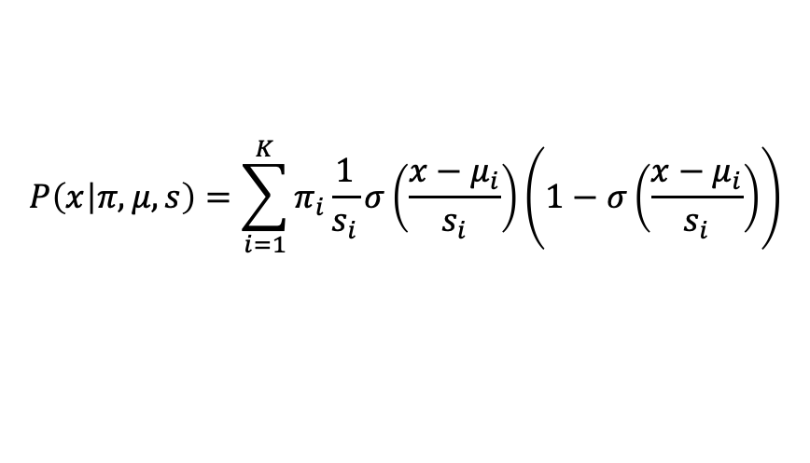

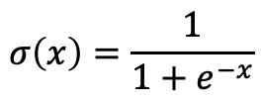
WaveNet architecture -Improvements
ReLU
1X1
ReLU
1X1
Softmax
$$p\left(x_{t}|x_{t−R},…,x_{t−1}\right)$$
Post-processing in the original WaveNet
8-bit quantization
ReLU
1X1
ReLU
1X1
Parameters of mixture of logistics
Post-processing in new Wavenet
16-bit quantization
$$P\left(x | π,μ,s\right)=\sum_{i=1}^{K}{π_{i}\frac{1}{s_{i}}σ\left(\frac{x−μ_{i}}{s_{i}}\right)\left(1−σ\left(\frac{x−μ_{i}}{s_{i}}\right)\right)}$$
$$σ\left(x\right)=\frac{1}{1+e^{−x}}$$

Slide 39

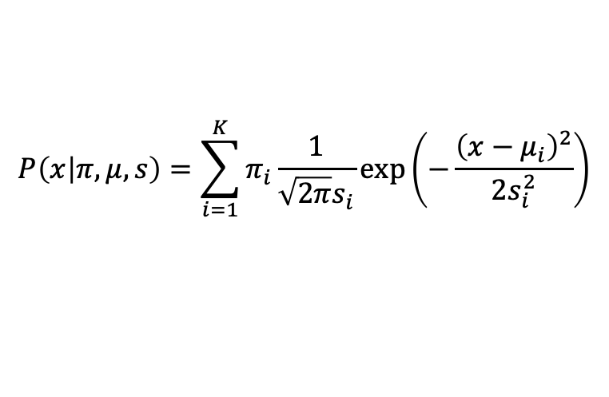
WaveNet architecture -Improvements
ReLU
1X1
ReLU
1X1
Softmax
$$p\left(x_{t}|x_{t−R},…,x_{t−1}\right)$$
Post-processing in the original WaveNet
8-bit quantization
ReLU
1X1
ReLU
1X1
Parameters of mixture of Gaussians
Post-processing in new Wavenet
16-bit quantization
$$P\left(x | π,μ,s\right)=\sum_{i=1}^{K}{π_{i}\frac{1}{{\sqrt{2π}s}_{i}}\exp\left(−\frac{{\left(x−μ_{i}\right)}^{2}}{2s_{i}^{2}}\right)}$$

Slide 40
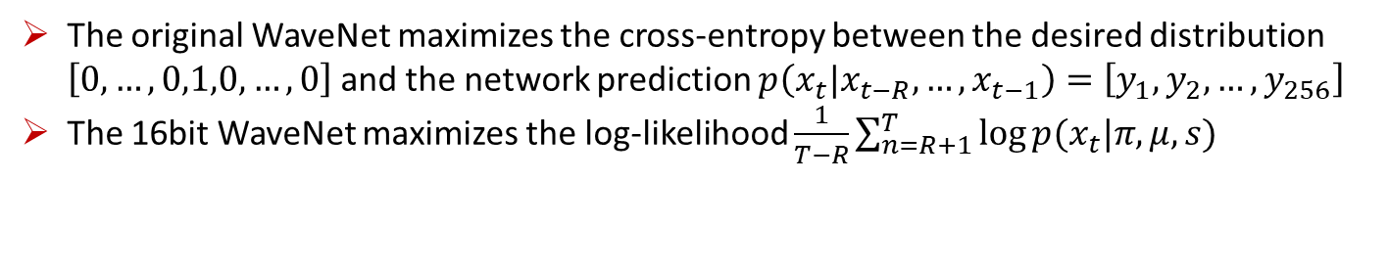
WaveNet architecture -Improvements
ReLU
1X1
ReLU
1X1
Softmax
$$p\left(x_{t}|x_{t−R},…,x_{t−1}\right)$$
Post-processing in the original WaveNet
8-bit quantization
ReLU
1X1
ReLU
1X1
Parameters of mixture of logistics
Post-processing in 16bit WaveNet (high fidelity WaveNet)
16-bit quantization
The original WaveNet maximizes the cross-entropy between the desired distribution $\left[0,…,0,1,0,…,0\right]$and the network prediction $p\left(x_{t}|x_{t−R},…,x_{t−1}\right)=\left[y_{1},y_{2},…,y_{256}\right]$
The 16bit WaveNet maximizes the log-likelihood $\frac{1}{T−R}\sum_{n=R+1}^{T}{\log{p(x_{t}|π,μ,s)}}$

Slide 41

Generated audio samples for the original WaveNet
Basic WaveNet Model trained with the cmu_us_slt_arctic-0.95-release.zip database (~40 min, 16000 Hz)
WaveNet model with local conditioning TTS linguistic labels, trained with an American English female speaker database (~5 hours, 16000 Hz).
Front end
Statistical model
Waveform generator
text
waveform
WaveNet used as a statistical model and as a vocoder

Slide 42
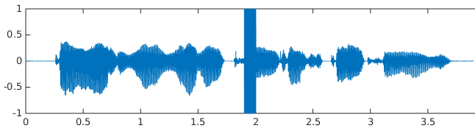
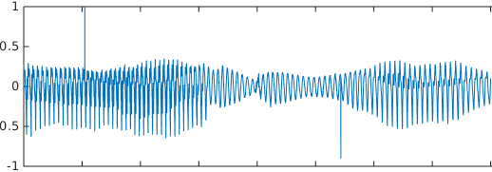
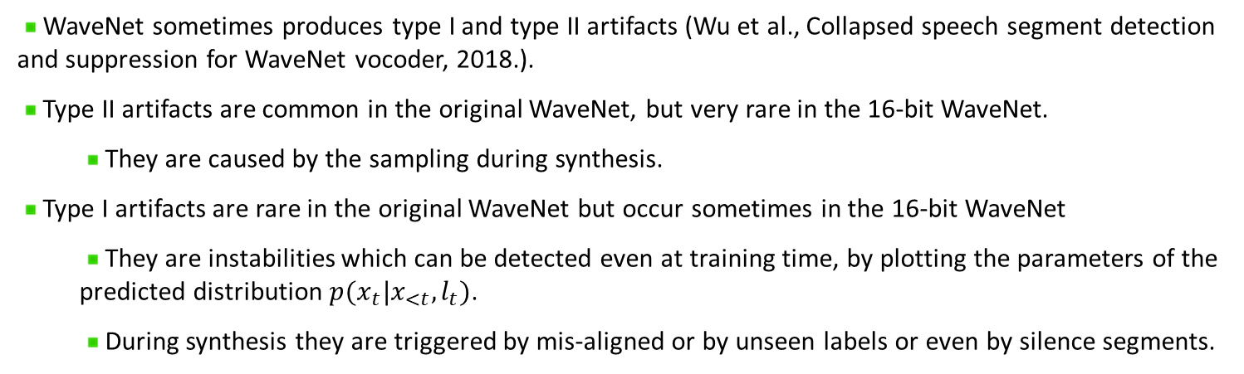
WaveNet – Known Problems
WaveNet sometimes produces type I and type II artifacts (Wu et al., Collapsed speech segment detection and suppression for WaveNet vocoder, 2018.).
Type II artifacts are common in the original WaveNet, but very rare in the 16-bit WaveNet.
  They are caused by the sampling during synthesis.
Type I artifacts are rare in the original WaveNet but occur sometimes in the 16-bit WaveNet
  They are instabilities which can be detected even at training time, by plotting the parameters of the predicted distribution $p(x_{t}|x_{<t},l_{t})$.
  During synthesis they are triggered by mis-aligned or by unseen labels or even by silence segments.
Type I artifats
Type II artifats

Slide 43
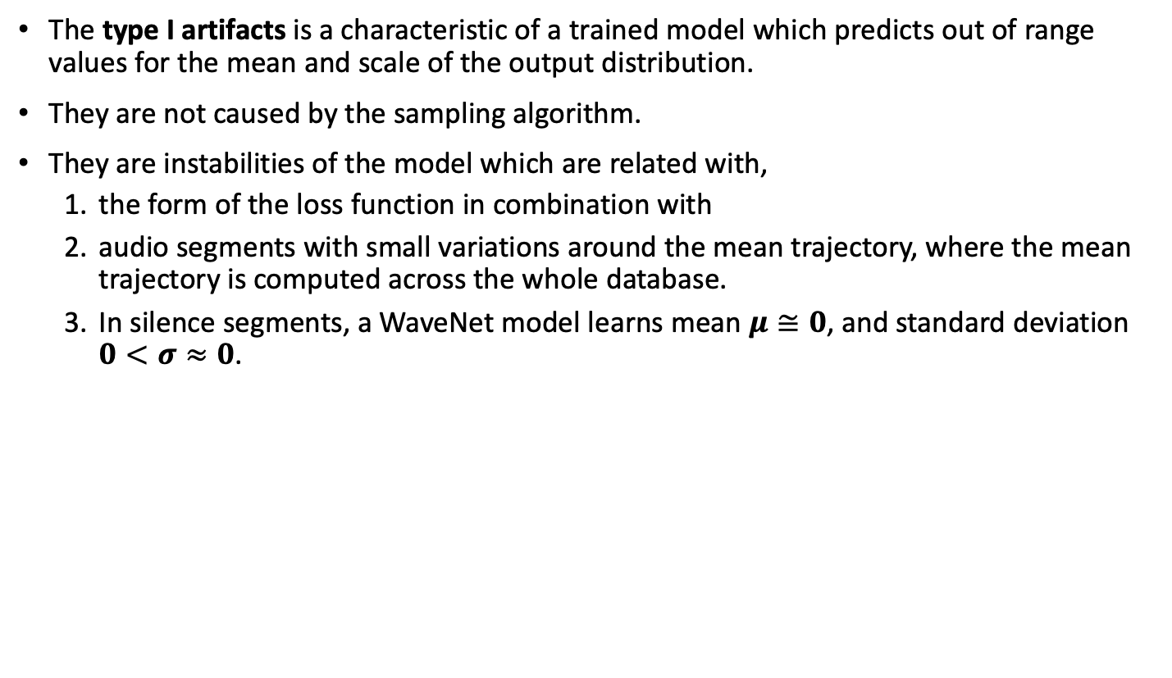
The source of type I artifacts
The type I artifacts is a characteristic of a trained model which predicts out of range values for the mean and scale of the output distribution.
They are not caused by the sampling algorithm.
They are instabilities of the model which are related with,
  the form of the loss function in combination with
  audio segments with small variations around the mean trajectory, where the mean trajectory is computed across the whole database.
  In silence segments, a WaveNet model learns mean $μ≅0$, and standard deviation $0<σ≈0$.

Slide 44
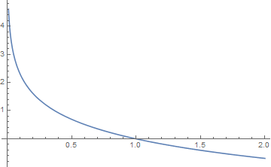
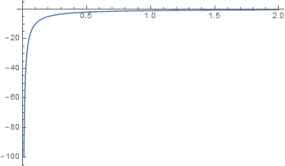






The cross entropy loss function
The cross entropy between two discrete distributions $p$ and $q$ is given by
$H\left(p,q\right)=−p_{1}\log{q_{1}}−p_{2}\log{q_{2}}−…−p_{k}\log{q_{k}}$
In the original WaveNet with the softmax output the distribution $p$ is the one-hot encoding of the current audio sample $x_{t}$, which belongs to class $i$
Therefore: $H\left(p,q\right)=−\log{q_{i}}$ and $\frac{∂H}{∂q_{i}}=−\frac{1}{q_{i}}$
When $q_{i}≥ε$, then $0≤H≤−\log{ε}$ and $−\frac{1}{ε}≤\frac{∂H}{∂q_{i}}≤−1$
$$Η$$
$$σ$$
$$σ$$
$$\frac{∂H}{∂q_{i}}$$
H penalizes the small $q_{i}$’s
PlotRange: 0.01 < σ < 2

Slide 45
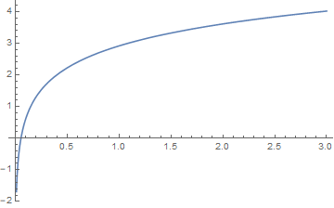
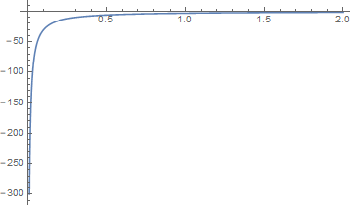




The negative log-likelihood loss function
The negative log-likelihood of a Gaussian distribution $𝒩(0,σ^{2})$ is
$$L\left(σ\right)=−\log{p\left(x\right)}=\frac{1}{2}\log{2π}+\log{σ}+\frac{1}{2}\frac{x^{2}}{σ^{2}}$$
And its derivative is
$$\frac{∂L(σ)}{∂σ}=\frac{1}{σ}−\frac{x^{2}}{σ^{3}}$$
For samples $x$ that are within a few standard deviations (e.g., $x=2σ$) from zero, the term $\text{log} σ$ dominates
In silence segments $\left|x\right|≈0⇒\left|x\right|<σ$ and $σ$ tends to become very small.
$$σ$$
$$L$$
$$σ$$
$$\frac{∂L}{∂σ}$$
PlotRange: 0.01 < σ < 2
H rewards the small σ’s

Slide 46
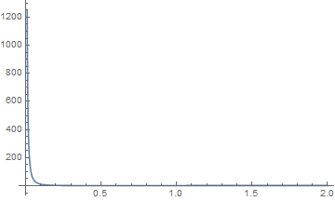
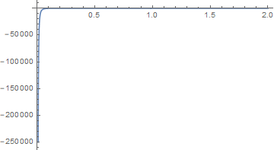

The negative log-likelihood loss function
The negative log-likelihood of a Gaussian distribution $𝒩(0,σ^{2})$ is
$$L\left(σ\right)=−\log{p\left(x\right)}=\frac{1}{2}\log{2π}+\log{σ}+\frac{1}{2}\frac{x^{2}}{σ^{2}}$$
And its derivative is
$$\frac{∂L(σ)}{∂σ}=\frac{1}{σ}−\frac{x^{2}}{σ^{3}}$$
For outlier samples with $|x|≫σ$ (e.g., $σ=0.5$), the term $\frac{1}{2}\frac{x^{2}}{σ^{2}}$ dominates
After a silence segment, $σ$ is very small and when a sample $x$ is far away from zero, the derivative takes extremely large absolute values.
$$σ$$
$$L$$
H penalizes the small σ’s
$$\frac{∂L}{∂σ}$$
$$σ$$
PlotRange: 0.01 < σ < 2

Slide 47







The negative log-likelihood loss function
$$L\left(σ\right)=−\log{p\left(x\right)}=\frac{1}{2}\log{2π}+\frac{1}{2}\frac{x^{2}}{σ^{2}}+\log{σ}$$
$${∆w}_{t+1}$$
$${∆w}_{t}$$
$$\left|x_{t+1}−μ\right|≫σ$$
$$\left|x_{t}−μ\right|<σ$$

Slide 48
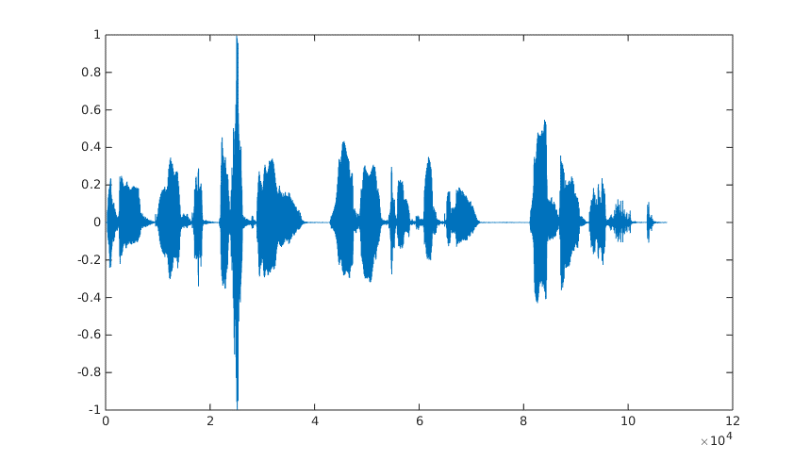

Cross-entropy loss vs negative log-likelihood loss
We will compare the stability of the two loss functions using the LJ Speech Dataset 1.1, created by Keith Ito.
This dataset contains audio clippings and long silence segments between words.
The network architecture is similar in both tests. Only the output layers and the losses differ.
  The output layer is a 256 softmax and the loss is cross-entropy
  The ouput layer predicts the two parameters $σ$ and $μ$ of a Gaussian distribution with loss the negative log-likelihood

Slide 49
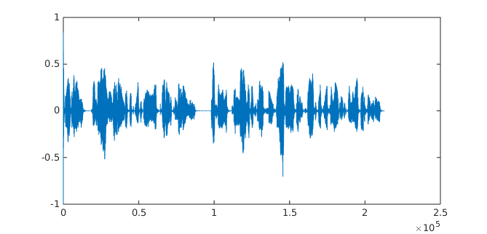
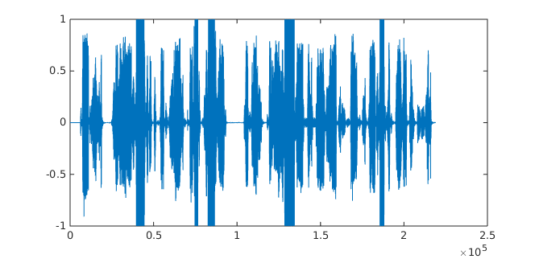
Cross-entropy loss vs negative log-likelihood loss
The following images show the utterance LJ001-0001 synthesized by a model trained with cross-entropy and a model trained with negative log-likelihood.
Figure a): Cross-entropy
Figure b): negative log-likelihood

Slide 50
Heuristic solutions to avoid type I artifacts
Using bigger and cleaner databases
  This is the classic machine learning approach, which, as expected, it also reduces the type I artifacts.
  However, depending on the application, having a bigger or a cleaner database is not always feasible.
Reduce the silence regions
  All publicly available implementations of WaveNet remove the silence regions at the beginning and at the end of each utterance. And this simple mechanism greatly improves their stability.
  However, not all silence regions can be removed (e.g., the silence regions between words).
Adding small noise to the data
  This is effective to avoid type I artifacts in WaveNet, but the noise during training affects the quality of the synthesized speech.
  Also, this technique does not significantly helps with Parallel WaveNet.
Using dropout
  Dropout helps the convergence of a model, especially when the training database is small or has noise.
  Dropout, is absolutely necessary in speech recognition.
  However, dropout may slightly affect the quality of the synthesized speech.
  Also, dropout reduces but it does not completely eliminate the type I artifacts.

Slide 51
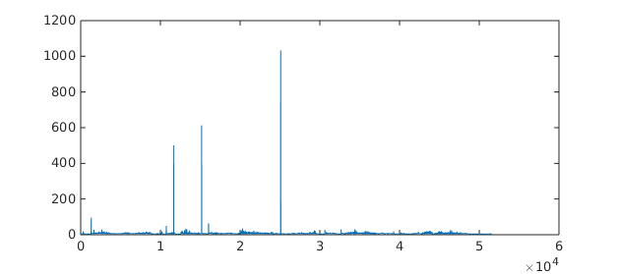
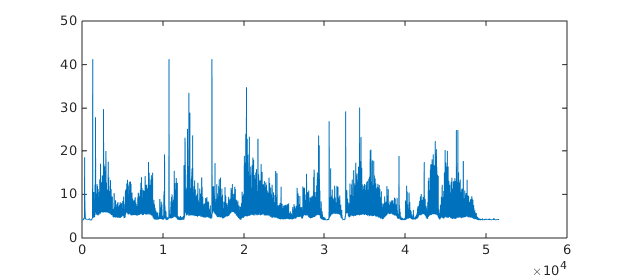


Heuristic solutions to avoid type I artifacts
Clipping the gradients (e.g., tf.clip_by_value(gradient, min_value, max_value) ).
  This mechanism does not help significantly when there are outliers with extremely large values (e.g., $\log{{loss}_{t}}={10}^{12}$).
    Due to memory and time constraints, the gradient clipping is applied after the averaging across time (tf.reduce_mean(loss)).
  For example, in Figure a) a few outliers affect the mean loss of Wavenet.
Clipping the values of the outliers in the loss function (e.g. loss = tf.maximum(loss, max_loss_value)). This is shown in Figure b) . Then average the loss across time (tf.reduce_mean(loss)).
  The influence of the outliers is reduced and kept under control.
$$\log{loss}$$
Figure a)
Figure b)

Slide 52
Heuristic solutions to avoid type I artifacts
Clipping the variance parameter predicted from the network to values above a threshold (e.g., log_scale = tf.maximum(log_scale, log_scale_min).
  This mechanism is used in all publicly available implementations of WaveNet and it works.
  However, it does not prevent the network to keep producing very small variance parameters, since no feedback signal that is propagated back to the network.
  Unfortunately, very small variances are also associated with out of range mean values.
Adding a term to the loss function that penalizes the small variances.
Using weight normalization (Tim Salimans, Diederik P. Kingma, Weight Normalization: A Simple Reparameterization to Accelerate Training of Deep Neural Networks, 2016).
Use large batch_size.

Slide 53


Heuristic solutions to avoid type I artifacts
Example from the LJ Speech dataset:
a) Natural
b) Cross-entropy
c) Negative log-likelihood
d) Negative log-likelihood with combinations of the heuristics

Slide 54
References
van den Oord, Aaron; Dieleman, Sander; Zen, Heiga; Simonyan, Karen; Vinyals, Oriol; Graves, Alex; Kalchbrenner, Nal; Senior, Andrew; Kavukcuoglu, Koray, WaveNet: A Generative Model for Raw Audio, arXiv:1609.03499
Arik, Sercan; Chrzanowski, Mike; Coates, Adam; Diamos, Gregory; Gibiansky, Andrew; Kang, Yongguo; Li, Xian; Miller, John; Ng, Andrew; Raiman, Jonathan; Sengupta, Shubho; Shoeybi, Mohammad, Deep Voice: Real-time Neural Text-to-Speech, eprint arXiv:1702.07825
Arik, Sercan; Diamos, Gregory; Gibiansky, Andrew; Miller, John; Peng, Kainan; Ping, Wei; Raiman, Jonathan; Zhou, Yanqi, Deep Voice 2: Multi-Speaker Neural Text-to-Speech, eprint arXiv:1705.08947
Le Paine, Tom; Khorrami, Pooya; Chang, Shiyu; Zhang, Yang; Ramachandran, Prajit; Hasegawa-Johnson, Mark A.; Huang, Thomas S., Fast Wavenet Generation Algorithm, eprint arXiv:1611.09482
Ramachandran, Prajit; Le Paine, Tom; Khorrami, Pooya; Babaeizadeh, Mohammad; Chang, Shiyu; Zhang, Yang; Hasegawa-Johnson, Mark A.; Campbell, Roy H.; Huang, Thomas S., Fast Generation for Convolutional Autoregressive Models, eprint arXiv:1704.06001
Wavenet implementation in Tensorflow. Found in https://travis-ci.org/ibab/tensorflow-wavenet (Author: Igor Babuschkin et al.).
Fast Wavenet implementation in Tensorflow. Found in https://github.com/tomlepaine/fast-wavenet (Authors: Tom Le Paine, Pooya Khorrami, Prajit Ramachandran and Shiyu Chang)
Aäron van den Oord et al., Parallel WaveNet: Fast High-Fidelity Speech Synthesis, arXiv:1711.10433
Tim Salimans, Andrej Karpathy, Xi Chen, Diederik P. Kingma, PixelCNN++: Improving the PixelCNN with Discretized Logistic Mixture Likelihood and Other Modifications

