Slide 1
Generic Attacks on Secure Outsourced Databases by Kellaris, Kolios, Nissim o’Neil
Vangelis Markatos

Slide 2
What is the problem?
Users outsource their IT to the cloud
They store their data on the cloud
Because the cloud provides
24/7 support
Fast access
very low cost.
Good! Now, WHAT IS THE PROBLEM?
The cloud provider can see all the data and find information
Banks – bank accounts of customers, balance, etc.
Hospitals – medical information of patients
Matchmaking services – who dates whom, etc.

Slide 3
Solution!
Encrypt all data on the cloud!!!!
GREAT!
The cloud provider can not see the data
Because they are encrypted
BUT…
How do does the client access them?
You can search data with encrypted arguments
E.g. SELECT * from TABLE where key = 0x32137183ABCFFDEE53621321
You get back encrypted results

Slide 4
So, what is the problem now?
If the data are stored encrypted
If the data are searched encrypted
If the results are returned encrypted
The cloud provider can not find any information. Right?
Right?
Right?
….
….
….

Slide 5
Let us take a step back
Before we describe what the cloud provider can find
Let us describe what we have
We have a database:
Name | Age | Salary
John | 25 | 1000
Alice | 35 | 1200
Bob | 37 | 1400
Malory | 42 | 1600

Slide 6
Let us take a step back
We can ask queries to the database
SELECT * from TABLE where Age = 0x6576ABFFF7678888
SELECT * from TABLE where
Age > 0x6576ABFFF7678888 AND Age < 0x5675867AFFBFDDEF67868987
Range Queries
So:
Data are encrypted
Queries are encrypted
Query results are encrypted
The user issues Range Queries

Slide 7
What is the problem?
The attacker tries to find information leaks
The attacker can not see the plaintext values
He observes the (encrypted) computation
Leaks: Assume that the attacker is able to see the
Volume of query result
Does the query return a lot of data? (Finding: probably large range)
SELECT * from TABLE where Age > 0 AND Age < 100
Does the query return little data? (Finding: probably short rage query)
SELECT * from TABLE where Age > X AND Age < X+1

Slide 8
What is the problem?
Leaks: Assume that the attacker is able to see the
Access pattern of query result
SELECT * from TABLE where Age > 0x567856ABB AND Age < 0x5567877BDFAB
returns 0xABCB, 0XABBCD, 0x66789ABCDFFD
SELECT * from TABLE where Age > 0x43246ABB AND Age < 0x465467BDFAB
returns 0xABCB, 0XA6769BBCD
Finding: These queries must overlap!!

Slide 9
Attacker: Can we find the order of the elements?
By observing query results?
That return encrypted database elements?
Let us assume that we observe for enough time
So as to see all results of all queries
Let us assume that we know the minimum element (say 0xAB)
Find a query result that contains all elements
Find a query result that contains all elements apart from
(1) 0xAB and (2) one other one (say 0xAC)
The, that other one (0xAC) is the second smallest element

Slide 10
Can we find the order of the elements?
Find a query result that contains all element apart from 0xAB, 0xAC and one other one (say 0xAA)
That other one (0xAA) is the third smallest element
So the order is 0xAB, 0xAC, 0xAA, etc.
And so on and so forth…
After O(N) repetitions you will know the order of all elements

Slide 11
Find the order of the elements
Assume that the database contains elements
1, 3, 5, 7, 9
Assume that they are encrypted as
enc(1), enc(3), enc(5), enc(7), enc(9)
Assume that the attacker knows that enc(1) is the smallest element
Assume that the attacker has seen all query results.
These include the following query results
{enc(1), enc(3), enc(5), enc(7), enc(9)}
{enc(1)} and {enc(3), enc(5), enc(7), enc(9)}
{enc(1), enc(3} and {enc(5), enc(7), enc(9)}
{enc(1), enc(3), enc(5)} and {enc(7), enc(9)}
{enc(1), enc(3), enc(5), enc(7)} and {enc(9)}

Slide 12
Summary
The attacker found the order of the elements.
He knows that their order is
enc(1), enc(3), enc(5), enc(7), enc(9)
Although he does not know that “enc(1)” corresponds to “1”
enc(1) is still encrypted
The attacker does not know that enc(1) is 1.

Slide 13
Can we find the values that exist in the database?
i.e. we have found the order of the encrypted values of the elements
E.g. we have found that the elements and their order is:
enc(20,000) , enc(40,000), enc(70,000), and enc(80,000)
Can we find that the elements are:
20,000 , 40,000, 70,000, and 80,000 ?
Assumption of the attacker:
The client issues queries uniformly at random
Note: any other query distribution would suit as well

Slide 14
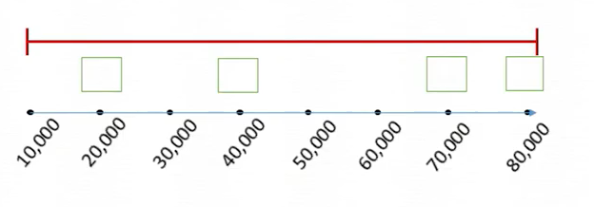
This is our database
It is a salary database with points at
20,000 , 40,000, 70,000, and 80,000
The attacker sees query results that contain
enc(20,000) , enc(40,000), enc(70,000), and enc(80,000)

Slide 15
How many queries contain X results?
Number of Results | # of distinct Queries that produce this result | Queries
0 | 5 | (10,10), (30,30), (50,50), (50,60), (60,60)
1 | 14
3 | 4
4 | 2 | (10,80), (20,80)

Slide 16
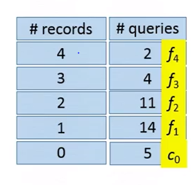
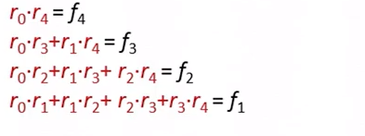
Reconstruct
$$r_{o}$$
$$r_{1}$$
$$r_{2}$$
$$r_{3}$$
$$r_{4}$$
Solve the equations to find r0, r1, r2, etc.
$r_{o}\left(r_{o}−1\right)+r_{1}\left(r_{1}−1\right)+r_{2}\left(r_{2}−1\right)+r_{3}\left(r_{3}−1\right)+r_{4}\left(r_{4}−1\right) =c_{0}$
r0=2, r1=2, r2=3, r3=1, r4=1

Slide 17
Summary
Data in the cloud stored encrypted
Database allows range queries
Attackers observes (encrypted) range query results
He is able to find
Order of database elements
Actual values of the records in the database…

