Slide 1

Bitcoin
Bitcoin: A Peer-to-Peer Electronic Cash System
  Satoshi Nakamoto
A Fistful of Bitcoins: Characterizing Payments Among Men with No Names
  Sarah Meiklejohn, Marjori Pomarole, Grant Jordan, Kirill Levchenko Damon, McCoy,Geoffrey M. Voelker, Stefan Savage
Eirini Degkleri CS 558

Slide 2
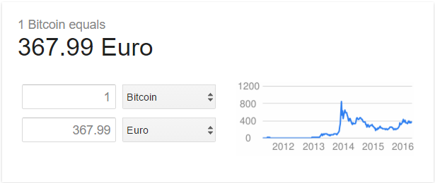
Bitcoin general info
What is a bitcoin?
Bitcoin is a purely online virtual currency.
How many bitcoins are out there and where can someone get them ?
At this very moment, 10.71 million Bitcoins are in existence
‘Mining’
Currency exchange via bitcoin provider services
Who accepts bitcoins ?
WordPress.com
Overstock.com
Amazon
Target – An American retailing company
CVS – A pharmacy shop
Subway
etc

Slide 3
Bitcoin: A Peer-to-Peer Electronic Cash System - 2009
Goal:
Online payments directly from one party to another without going through a financial institution.
Problem:
Digital signatures provide part of the solution, but the main benefits are lost if a trusted third party is still required to prevent double-spending.
Solution:
A peer-to-peer network.
Notes:
The problem of course is the payee can't verify that one of the owners did not double-spend the coin. A common solution is to introduce a trusted central authority, or mint, that checks every transaction for double spending ~> the fate of the entire money system depends on the company running the mint, with every transaction having to go through them, just like a bank

Slide 4
Background
We need
electronic payment system based on cryptographic proof instead of trust, so that any two willing parties can transact directly without the need for a trusted third party.
Transactions that are computationally impractical to reverse would protect sellers from fraud, and routine escrow mechanisms could easily be implemented to protect buyers.

Slide 5
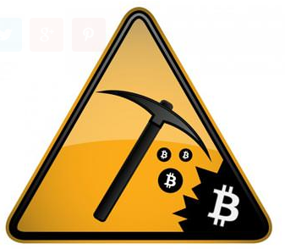
What is mining ?
Bitcoin doesn't have a central government.
Miners use special software to solve math problems and are issued a certain number of bitcoins in exchange.
This provides a smart way to issue the currency and also creates an incentive for more people to mine.

Slide 6
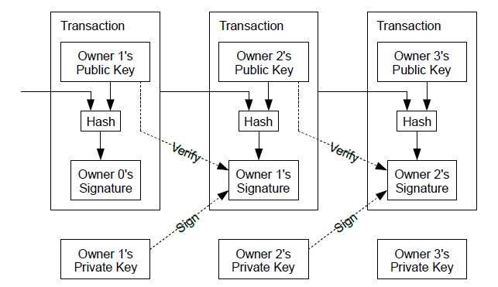
Transactions
An electronic coin can be defined as a chain of digital signatures.
Each owner transfers the coin to the next by digitally signing a hash of the previous transaction and the public key of the next owner and adding these to the end of the coin.

Slide 7
Transactions
To make sure that the system works without a trusted party:
  transactions must be publicly announced.
  a system in which participants agree on a single history of the order in which coins were received.
  the payee needs proof that at the time of each transaction, the majority of nodes agreed it was the first received
    Timestamp server
Notes:
The problem of course is the payee can't verify that one of the owners did not double-spend the coin. A common solution is to introduce a trusted central authority, or mint, that checks every transaction for double spending ~> the fate of the entire money system depends on the
company running the mint, with every transaction having to go through them, just like a bank

Slide 8
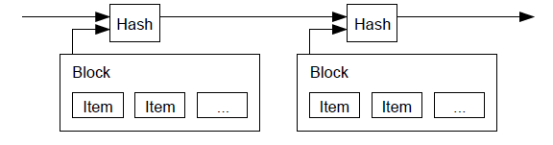
Timestamp Server
A timestamp server works by taking a hash of a block of items to be timestamped and widely publishing the hash.
The timestamp proves that the data must have existed at the time, obviously, in order to get into the hash.
Each timestamp includes the previous timestamp in its hash, forming a chain, with each additional timestamp reinforcing the ones before it.

Slide 9
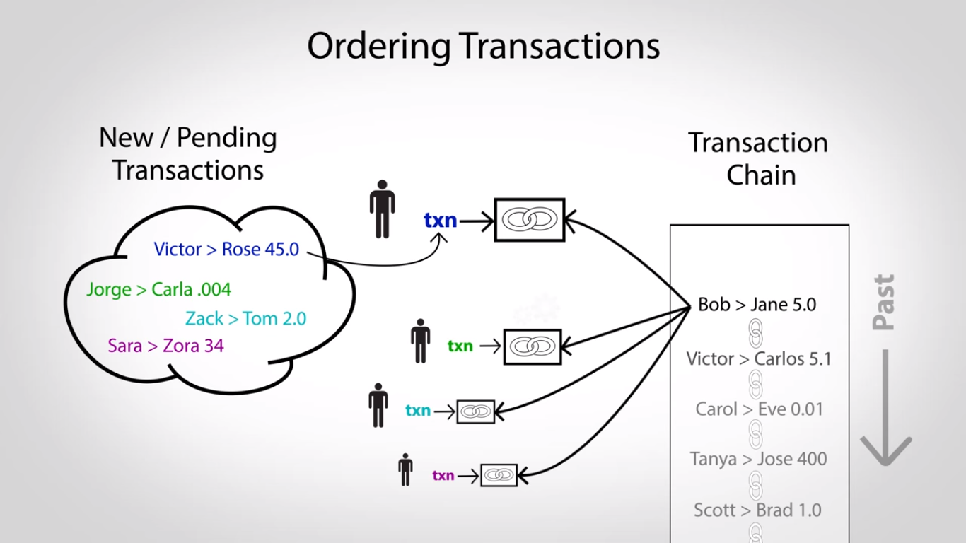
Ordering of transactions
Once the CPU effort satisfies the proof-of-work, the block cannot be changed without redoing the work.
It also solves the problem of determining representation in majority decision making.
Notes:
The average work required is exponential in the number of zero bits required and can be verified by executing a single hash.
It is implemented by incrementing a nonce in the block until a value is found that gives the block's hash the required zero bits.

Slide 10
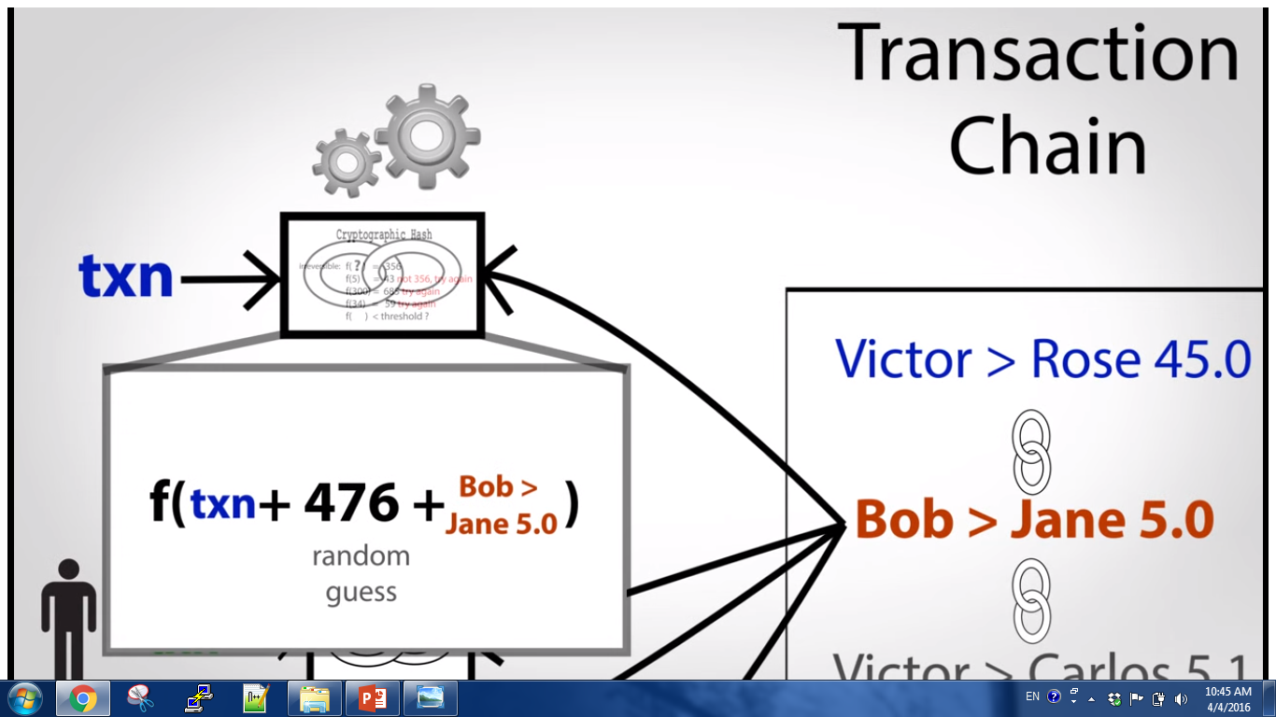

Slide 11
Proof-of-Work
Proof-of-work is essentially one-CPU-one-vote.
The majority decision is represented by the longest chain, which has the greatest proof-of-work effort invested in it.
  If a majority of CPU power is controlled by honest nodes, the honest chain will grow the faster and outpace any competing chains.
  To modify a past block, an attacker would have to redo the proof-of-work of the block and all blocks after it and then catch up with and surpass the work of the honest nodes.
Notes:
The whole world can decide which transaction is next and the math behind it makes sure that everyone agrees on the history of transactions.
If there are many versions of the transaction list then to determine the right one people can vote .

Slide 12
Network
The steps to run the network are as follows:
New transactions are broadcast to all nodes.
Each node collects new transactions into a block.
Each node works on finding a difficult proof-of-work for its block.
When a node finds a proof-of-work, it broadcasts the block to all nodes.
Nodes accept the block only if all transactions in it are valid and not already spent.
Nodes express their acceptance of the block by working on creating the next block in the chain, using the hash of the accepted block as the previous hash.
Notes:
- New transactions broadcasts do not necessarily need to reach all nodes. As long as they reach many nodes, they will get into a block before long.
- Block broadcasts are also tolerant of dropped messages. If a node does not receive a block , it will request In when it receives the next and realizes it missed one.

Slide 13
Reclaiming Disk Space
Once the latest transaction in a coin is buried under enough blocks, the spent transactions before it can be discarded to save disk space.
To facilitate this without breaking the block's hash, transactions are hashed in a Merkle Tree, with only the root included in the block's hash.
Old blocks can then be compacted by stubbing off branches of the tree. The interior hashes do not need to be stored.

Slide 14
Privacy
Privacy can be maintained by keeping public keys anonymous.
The public can see that someone is sending an amount to someone else, but without information linking the transaction to anyone.
As an additional firewall, a new key pair should be used for each transaction to keep them from being linked to a common owner.
Some linking is still unavoidable with multi-input transactions, which necessarily reveal that their inputs were owned by the same owner.
  if the owner of a key is revealed, linking could reveal other transactions that belonged to the same owner.

Slide 15
Security
Let’s assume that an attacker trying to generate an alternate chain faster than the honest chain.
Even if this is accomplished,
it does not throw the system open to arbitrary changes, such as creating value out of thin air or taking money that never belonged to the attacker.
nodes are not going to accept an invalid transaction as payment, and honest nodes will never accept a block containing them.
an attacker can only try to change one of his own transactions to take back money he recently spent.

Slide 16
Conclusion
A solution to the double-spending problem using a peer-to-peer network.
The network itself requires minimal structure.
  Messages are broadcast on a best effort basis,
  nodes can leave and rejoin the network at will,
  accepting the longest proof-of-work chain as proof of what happened while they were gone.

Slide 17
Questions ?

Slide 18
A Fistful of Bitcoins: Characterizing Payments Among Men with No Names - CCS13
Bitcoin transactions do not explicitly identify the payer or the payee.
Each network participant must maintain the entire transaction history of the system,
    currently amounting to over 3GB of compressed data.
    12 million public keys

Slide 19
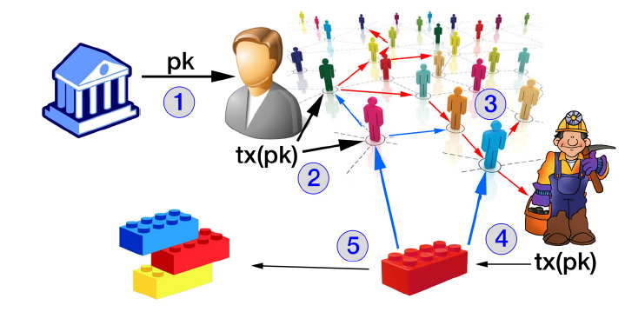
The main players in the Bitcoin landscape
(1) a user wishing to deposit bitcoins into a bank receives a public key, or address, belonging to the bank.
(2) the user incorporates both his own public key and the one sent to him by the bank into a transaction, which he then broadcasts to his peers.
(3) the transaction floods the network.
(4) the transaction is eventually received by a miner, who works to incorporate the transaction into a block.
(5) this block is then flooded through the network, and in this way is incorporated into the global block chain.
The bitcoins now belong to the public key of the bank, and thus have been successfully deposited.

Slide 20
Popular services and “bad” actors
Mining pools
Wallets
Gambling sites
    dice games i.e. Satoshi Dice
Exchanges
Vendors
etc
Illegal online marketplaces
Pump-and-dump schemes
Shady crypto exchanges
etc

Slide 21
Bitcoin network statistics
Authors used the bitcoind client to download the block chain.
Observations:
the size of transactions;
  i.e., the number of bitcoins sent in a transaction.
how quickly bitcoins were spent
Notes:
To completely understand how bitcoin system works they used the network graph of transactions.

Slide 22
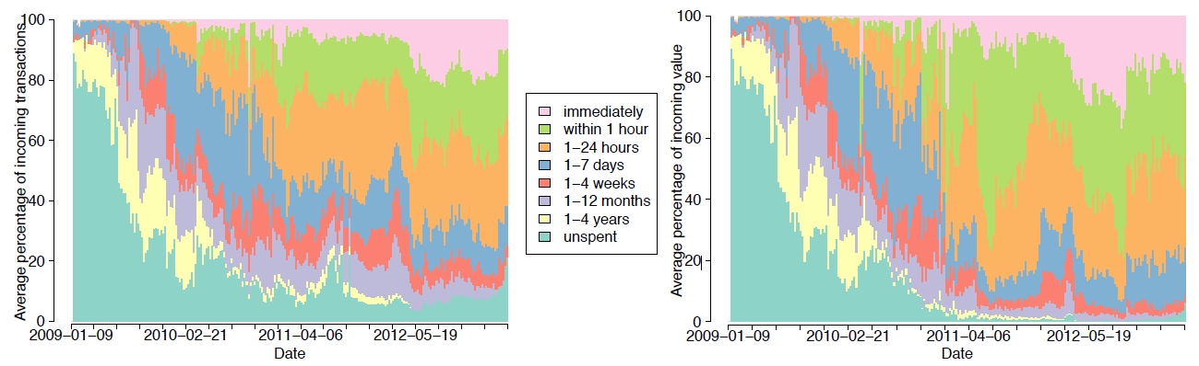
Bitcoin network statistics
The trend, over time and averaged weekly, of how long public keys hold on to the bitcoins received. The plot on the left shows the percentage over all public keys, and the plot on the right shows the percentage over all value transacted.

Slide 23
Data Collection
To identify public keys,
Cluster users
  No ground truth data
“Tag” as many addresses as possible
  transacted with them and then observing the addresses they used
  collected known (or assumed) addresses, found in various forums and other Web sites.
Notes:
Tag : i.e., label an address as being definitively controlled by some known real-world user (e.g., Mt. Gox or Instawallet).

Slide 24
Account Clustering Heuristics
Two heuristics for linking addresses controlled by the same user.
treat different public keys used as inputs to a transaction as being controlled by the same user
  exploits an inherent property of the Bitcoin protocol.
based on so-called change addresses
  exploits a current idiom of use in the Bitcoin network rather than an inherent property.
  it is less robust in the face of changing patterns within the network, but it provides insight into the current Bitcoin network.

Slide 25
Heuristic 1.
Ιf two (or more) public keys are used as inputs to the same transaction, then we say that they are controlled by the same user.
The effects of this heuristic are transitive and extend well beyond the inputs to a single transaction;
e.g., if we observed one transaction with addresses A and B as inputs, and another with addresses B and C as inputs, then we conclude that A, B, and C all belonged to the same user.

Slide 26
Heuristic 2.
The one-time change address is controlled by the same user as the input addresses.
The change address is created internally by the Bitcoin client and never re-used;
a user is unlikely to give out this change address to other users
  (e.g., for accepting payments)
if we can identify change addresses, we can potentially cluster not only the input addresses for a transaction (according to Heuristic 1) but also the change address and the input user.

Slide 27
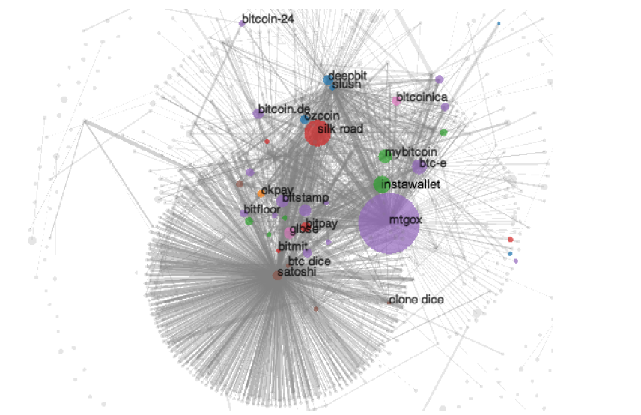
- For an edge between two nodes -> at least 200 transactions between them.
- Blue nodes are mining pools; orange are fixed-rate exchanges; green are wallets; red are vendors; purple are (bank) exchanges; brown are gambling; pink are investment schemes; and grey are uncategorized
Notes:
A visualization of the user network. The area of the cluster represents the external incoming value

Slide 28
Conclusion
The approach is based on the availability of the Bitcoin block chain:
  a replicated graph data structure that encodes all Bitcoin activity, past and present, in terms of the public digital signing keys party to each transaction.
Authors developed a new clustering heuristic based on change addresses, allowing us to cluster addresses belonging to the same user.
Using a small number of transactions labeled through empirical interactions with various services, they identify major institutions and the interactions between them.

Slide 29
Questions ?

Slide 30
References
https://bitcoin.org/bitcoin.pdf
https://cseweb.ucsd.edu/~smeiklejohn/files/imc13.pdf
http://www.bitcoinvalues.net/who-accepts-bitcoins-payment-companies-stores-take-bitcoins.html#sthash.SxGgtv9O.dpuf
http://www.coindesk.com/information/what-can-you-buy-with-bitcoins/
https://www.youtube.com/watch?v=l9jOJk30eQs

