Slide 1


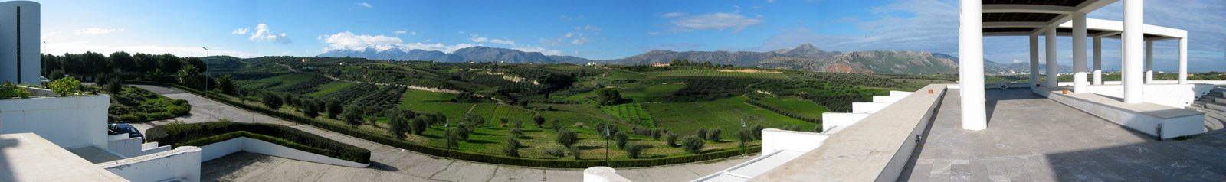
UNIVERSITY OF CRETE
Quality of Experience for Internet Services
Main focus on Video Streaming
Maria Papadopouli
Professor
University of Crete
Foundation for Research & Technology – Hellas (FORTH)
http://www.ics.forth.gr/mobile
.
Notes:
1

Slide 2
Quality of Experience (QoE)
Definition “The degree of delight or annoyance of a person whose experiencing involves an application, service, or system. It results from the evaluation of the user fulfilment of the expectations and needs with respect to the utility and/or enjoyment in the light of the user context, personality and current state”
Kjell Brunnström, Sergio Ariel Beker, Katrien de Moor, Ann Dooms, Sebastian Egger, et al. “Qualinet White Paper on Definitions of Quality of Experience” 2013.
User-centric & contextual aspects
Various techno-socio-economic-cultural-psychological parameters, such as:
  user preferences with respect to QoE & price
  willingness-to-pay, intrinsic indicators towards a service provider (e.g., band name, perceived value, reliability)
  its content (e.g., richness, diversity, searching mechanisms)
  integration with other popular services (e.g., social networking apps)

Slide 3
1. Introduction
Dramatic growth of mobile data, streaming services, telepresence
Networks experience periods of severe impairments (PSIs) due to various reasons, such as contention, handovers, channel impairment, outages, congestion
The network degradations affect user engagement & satisfaction
For churn prevention, providers need to understand QoE
To better adapt & monetize a service, QoE prediction is needed

Slide 4
Growth opportunities for services & new markets
Trends that cause this growth:
  mobile device capacity growth
  advances in networks
  cloud services
  user-generated content
  mobile services
  virtualization
Larger, more complex & heterogeneous markets are formed
Service oriented technologies
Complex service systems modeling & simulation
Service quality of experience
Business aspects of service composition
People in services
Service innovation management

Slide 5
User engagement
Characterizes the time spent using their service
Can be quantified using parameters such as number of downloads, clicks, pauses, FF/RW, revisits, abandonments, session duration, number of active processes running in parallel
Use of other measurements to capture the user attention (e.g., eye-trackers)
1. C. Moldovan and F. Metzger, "Bridging the Gap between QoE and User Engagement in HTTP Video Streaming"28th International Teletraffic Congress (ITC 28), 2016.
2. M. Seufert et al., "Unsupervised QoE field study for mobile YouTube video streaming with YoMoApp" IEEE 9th International Conference on Quality of Multimedia Experience (QoMEX), 2017.
3. S. Wassermann et al., "QoE in Cellular Networks through in-Smartphone Measurements"12th IFIP Wireless and Mobile Networking Conference (WMNC), 2019.
4. S. Krishnan and R. Sitaraman, "Video stream quality impacts viewer behavior: inferring causality using quasi-experimental designs" IEEE/ACM Transactions on Networking, 2013.

Slide 6
Business
Advertising & marketing
Vision
Monetize mobility & wireless service sessions
Booking
Smarter Commerce
Assess agreements
Pricing
Optimize value-generating mobility & wireless services
Technical
Smarter systems
Improved user satisfaction
Real-time QoE inference
Early-warning
Real-time statistics & trends
Smarter Network Management
…
Analytics & Big Data
Improved network performance
Rapidly roll-out new services
Reduce maintenance
…
Support of augmented reality & virtual reality services
Convenience
Time
Customer Satisfaction
Money

Slide 7
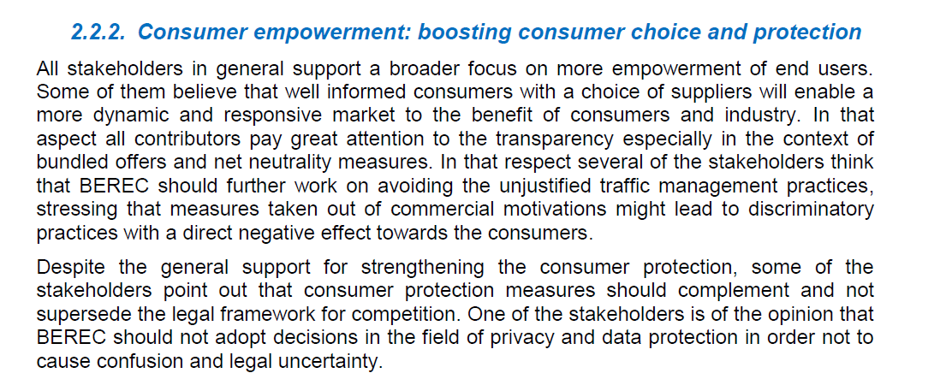
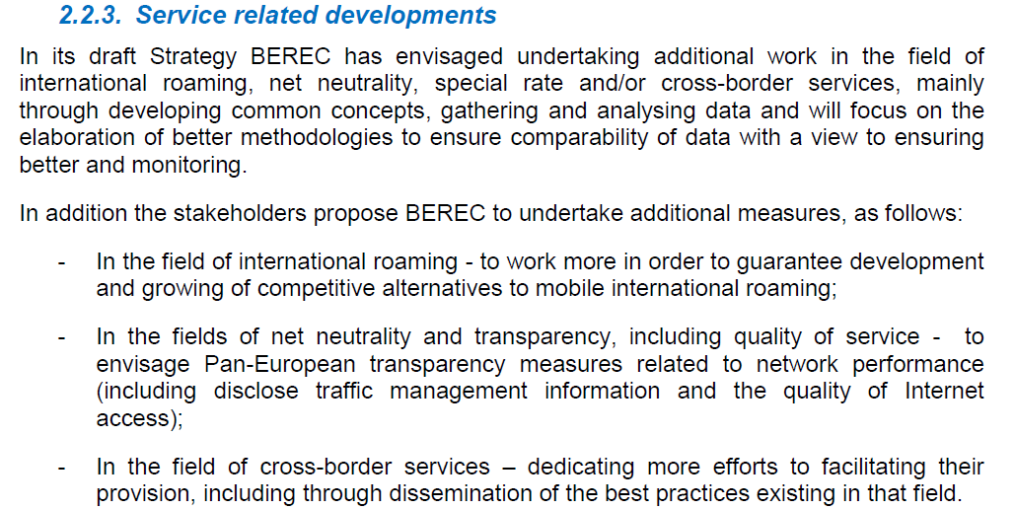


Slide 8
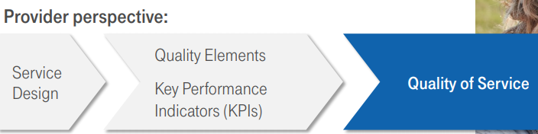
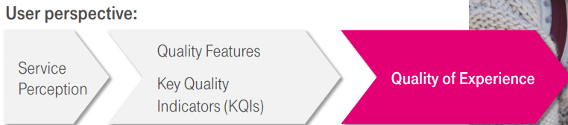
QoS vs. QoE
QoS
QoE

Slide 9
QoE Metrics
Network level
  packet loss
  buffer state
  throughput
  jitter
  retransmission
  SNR
Application level
  startup delay
  rebufferings
  resolution changes
  advertisements
  skips
  downloaded %
  screen mode
  location
  context
Chunk level
(for encrypted traffic due to HTTPs)
  start time
  time to first byte
  download time
  slack time
  chunk duration
  chunk size

Slide 10
How do users perceive the network?
Network QoS
Throughput, delay, packet loss, number of resource units,…
Application QoS
Startup delay, rebuffering events, bitrate changes, video resolution, termination status, …
User engagement
Fast forward, rewind, pause, abandonment, watching dur. %, revisit …
Keyboard activity, applications running, …
Subjectivity & techno-socio-economic-psychological aspects
Willingness-to-pay, preference on QoS vs. price, intrinsic indicators towards a provider (e.g., popularity among peers, reliability)

Slide 11
Categories of Measurement Studies
“Out in the wild” participatory studies
  Diverse conditions
  Relatively small costs, larger scales
  Limited contextual knowledge
Controlled field studies
  Homogenous fixed conditions
  Large cost & overhead, relatively small scale
  Often not reaching representative conditions
Explicit feedback vs. Inferring data from measurements
Subjective feedback vs. objective measurements
  Subjectivity vs. objectivity ─ Reliability
  Intrusiveness vs. Non-interfering ─ Privacy ─ Reliability

Slide 12
Classification based on the Time of QoE estimation
Real-time estimation (while the session takes place)
  LSTMs (to model system dynamics)
  Chunk based approach (per second activity from the IP header)
  Deep learning approach (per second aggregated activity)
Post-data collection estimation (after the completion of the sessions)
  Analysis of the session characteristics (e.g., rebufferings, startup delay, bitrate changes)
  Use of statistical tests to find interactions of impairments
  Use of ML techniques to predict the QoE or the user engagement of session characteristics
1. N. Eswara et al., “Streaming Video QoE Modeling and Prediction: A Long Short-Term Memory Approach”, IEEE Transactions on Circuits and Systems for Video Technology, 2019.
2. C. Gutterman et al., “Requet: real-time QoE detection for encrypted YouTube traffic”10th ACM Multimedia Systems Conference (MMSys '19).
3. S. Wassermann et al., “QoE in Cellular Networks through in-Smartphone Measurements”, 12th IFIP Wireless & Mobile Networking Conference (WMNC), 2019.

Slide 13
Explicit QoE: through opinion scores
  After or while watching a video, the participants are asked to rate the video
  Absolute Category Ratings (ACR)
Implicit QoE: inferred by the QoS information
  No exact knowledge about what the user liked or not
  Use the available network- & application-level information
  & models of QoS → QoE
1. C. Moldovan and F. Metzger, “Bridging the Gap between QoE and User Engagement in HTTP Video Streaming”, In 28th International Teletraffic Congress (ITC 28), 2016.
2. V. Menkovski et al., “Predicting quality of experience in multimedia streaming.”, In Proceedings of the 7th International Conference on Advances in Mobile Computing and
Multimedia. ACM, 2009.

Slide 14
Absolute Category Rating (ACR)
A test method used in quality tests
The levels of the scale are, sorted by quality:
  Excellent (5)
  Good (4)
  Fair (3)
  Poor (2)
  Bad (1)
A single test condition (generally an image or a video sequence) is presented to the viewers once only. They should then give a quality rating on an ACR scale.
Test conditions should be presented in a random order per test person.
Mean opinion score: the average numeric score over all experiment participants, for each test condition that was shown
Used for telephony voice quality to give a mean opinion score.

Slide 15
Examples of Crowdsourcing Systems Developed at FORTH/UoC
Dataplan & telecom provider selection and QoE measurements for telecom services (e.g., VoIP, video streaming)
Assessment of quality of water

Slide 16










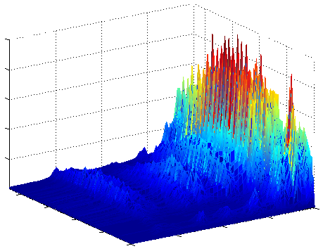
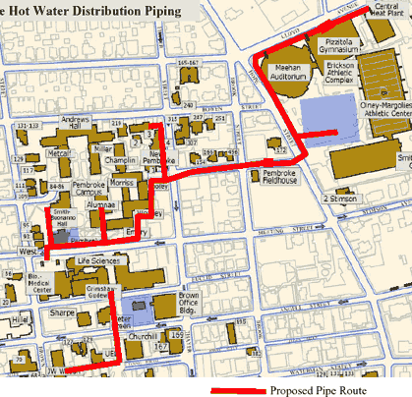
Providers,
regulators
receive alerts, reports
Data
center
Customers
u-map
server
Wireless
Base Station
u-map client
Wireless sensor
Data analytics & modeling
Organizations
Resident customers
1. Monitor infrastructure & upload objective measurements on server
2. Customers upload their feedback using u-map clients on smartphones
3. Analysis of objective measurements & subjective feedback
4. Recommendations, alerts, and reports are sent to all stakeholders

Slide 17
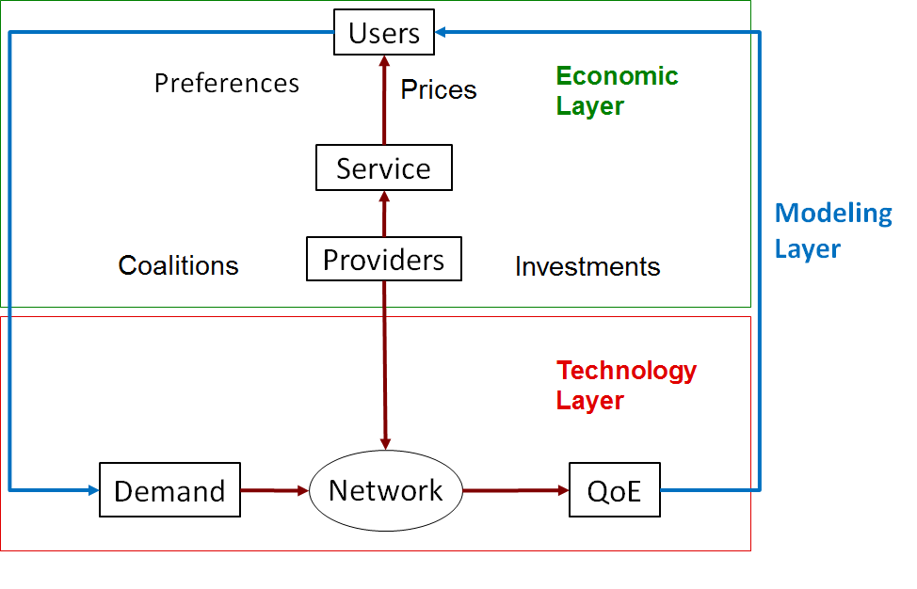
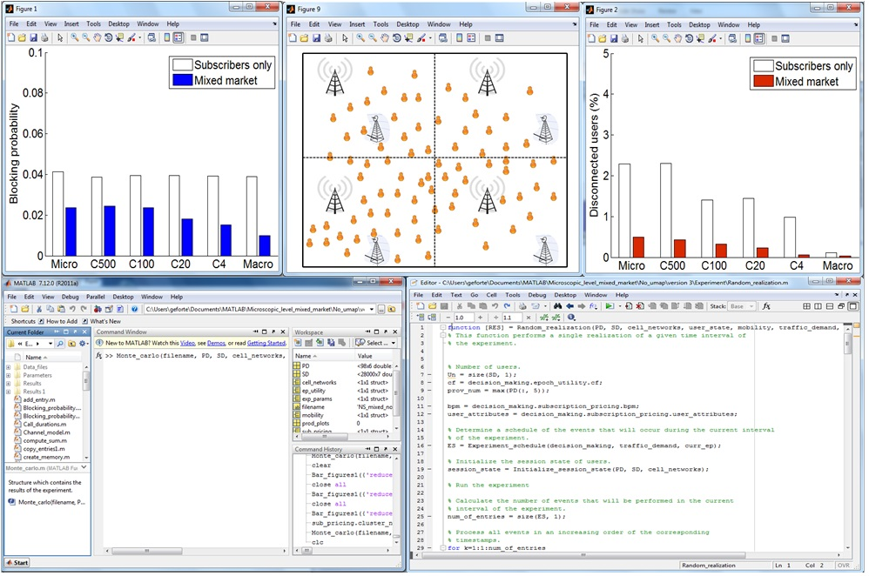
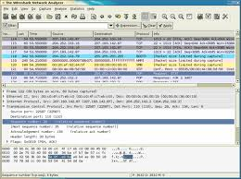

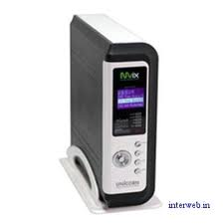
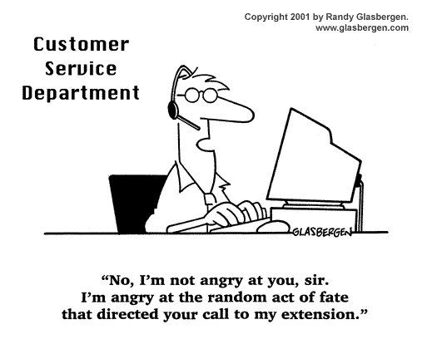
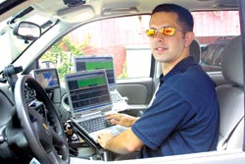
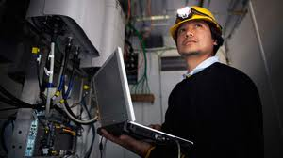
u-map client
Network
Customers
Data center
u-map server
Reduces overhead, administrative support & results in faster responses, better resource management, with lower cost
No extra cost for monitoring

Slide 18
u-map: user-centric QoE geo-database for recommendations & feedback
Client-to-Server architecture
u-map clients on smart-phones
  Collect network measurements, opinion scores, customer feedback and store them locally
  Upload traces to u-map server
  Query u-map server
u-map server
  Collects traces & stores them in spatio-temporal geo-DB
  Responds to queries sent by users/customers & service/content providers
Can be designed according to different business models:
  e.g., provider-driven or a third-party
Strong access control that applies privacy rules
Provision of incentives
improved QoE in services
reputation, altruism,
payment (e.g., free SMS, calls)

Slide 19
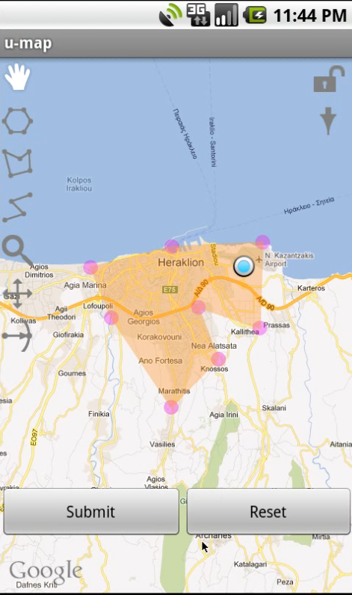
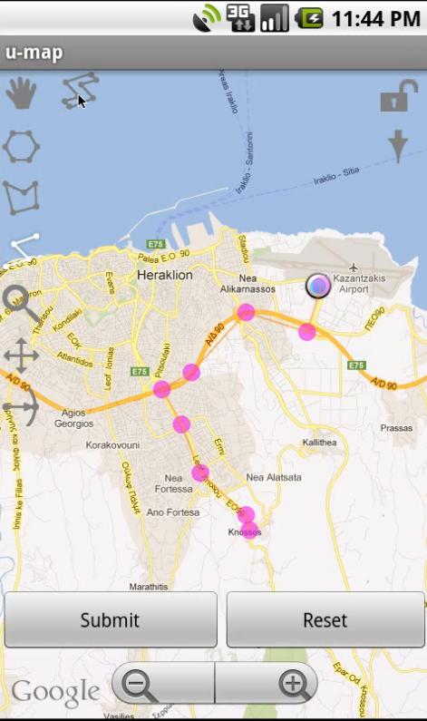
U-map runs a localization system, which positions the user at a Google map.
There are pre-determined regions for the queries (e.g., entire city, island) or
the user can indicate the region of interest using the GUI/ touch screen
and “drawing” a polygong or a path.

Slide 20
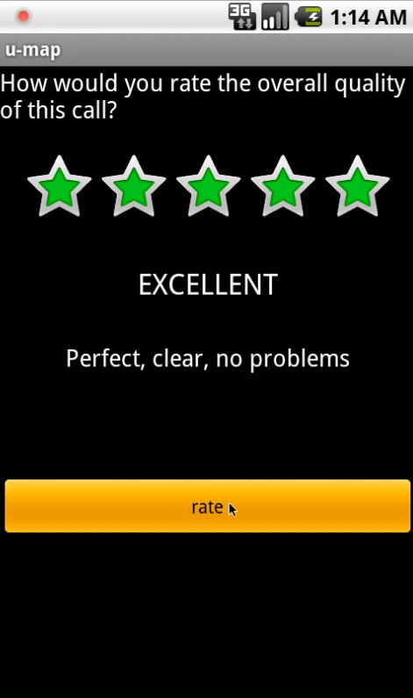
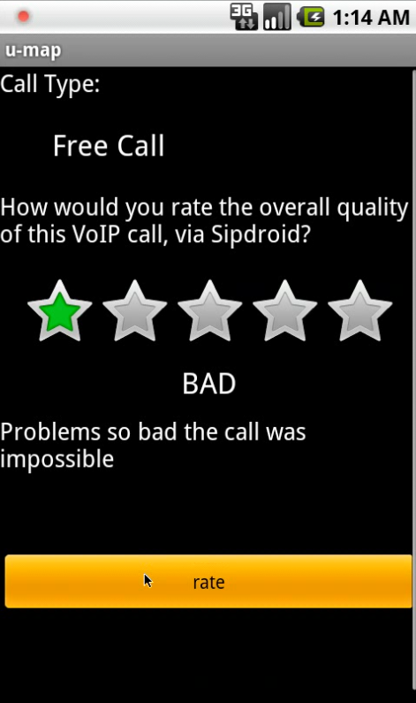
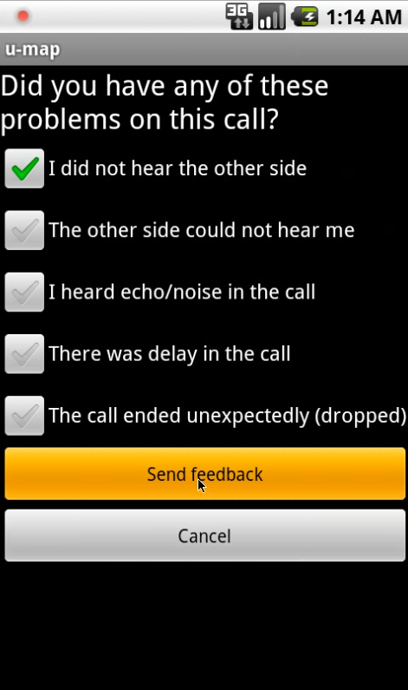
20

Slide 21
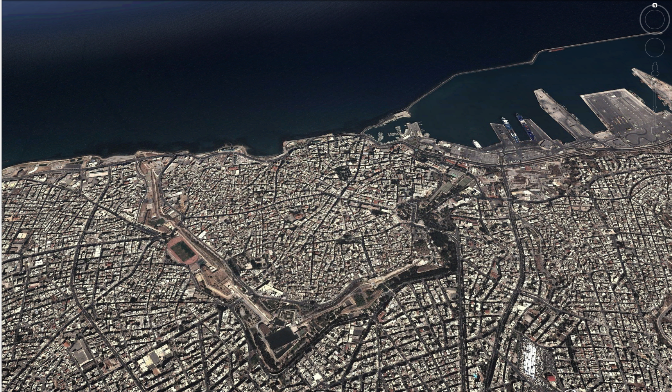

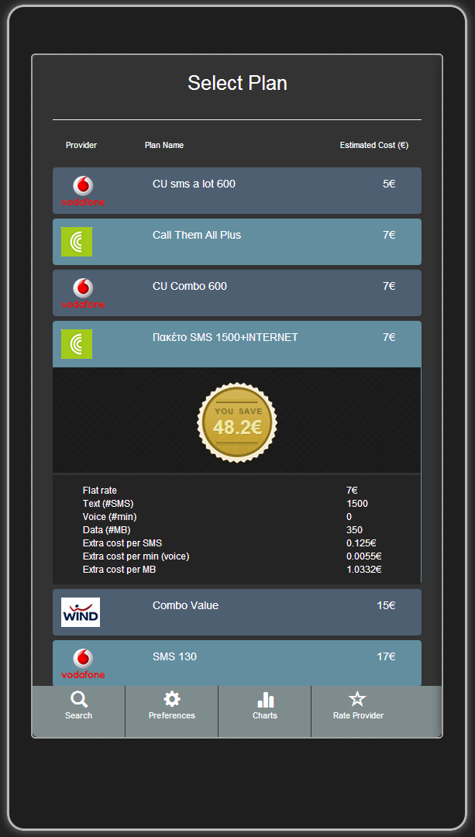
u-map finds the best plans/tariffs based
on demand & user preference
FORTH-Confidential & Proprietary

Slide 22
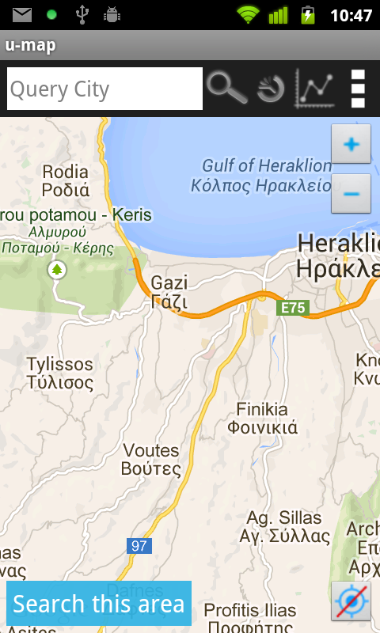
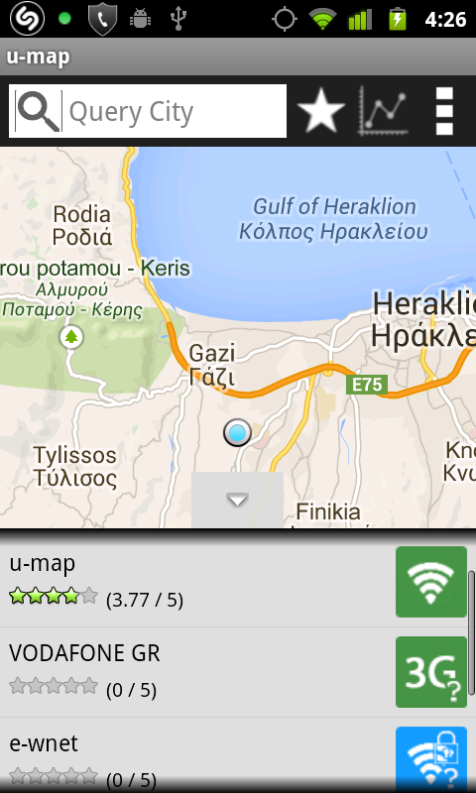
Evolution

Slide 23
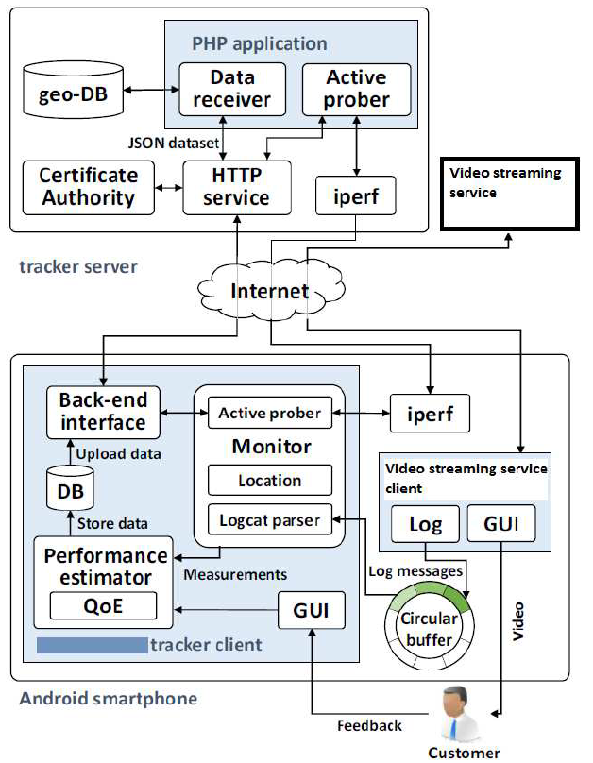
QoE tracker
Network-QOS Measurements
Active prober (iperf)

Slide 24

u-map feeds the analysis platform with real customer data, so the business-driven assessment becomes more accurate, relevant, faster.
CoRLAB
u-map client
Network
Data center
u-map server
Users

Slide 25
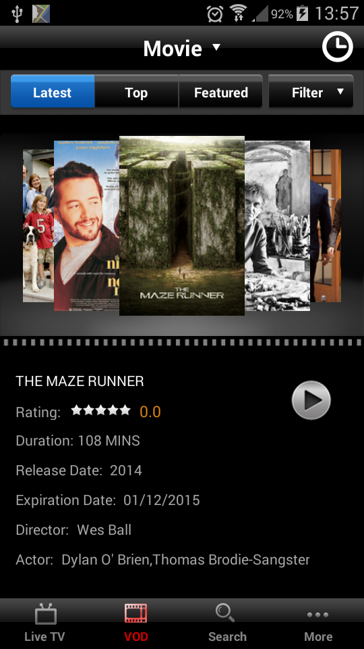
Case 1: Field study – completely uncontrolled
3. Background – 1st Field Study
Duration: 56 days
Volunteers: 20 customers
20 with ≥ 1 labeled video session
13 with > 5 labeled video sessions
Their devices vary in terms of manufacturer, model, display size & Android version
Volunteers free to
select any videos of their video streaming service
move & connect via wireless APs
view the video

Slide 26
Sessions with higher startup delay, buffering ratio & lower network performance have lower QoE
3. Background – 1st Field Study

Slide 27
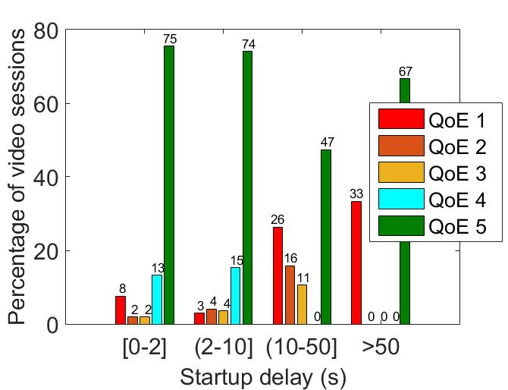
3. Background – 1st Field Study
Users perceive the degradation for startup delay ≥ 10 sec
Startup delay above 2 sec causes viewers to abandon the video [Krishnan 13]
Our speculation: smartphone users are more tolerant

Slide 28
Improving the data rate adaptation (e.g., reducing the resolution) could potentially reduce the buffering ratio
Poor connectivity
Videos with high resolution & high buffering duration ratio, terminated due to poor connectivity

Slide 29
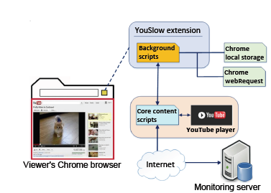
Session info
Analysis of two large youtube datasets
470,090 sessions per year
for two consecutive years
ISP, date & time, city & region, country , latitude & longitude
Type of abandonment, video resolutions, total viewing duration, initial Buffering, video duration, # of FWD & BWD skips, rebuffering events

Slide 30


Case 2: Controlled study
Scenarios of different types of impairment
4 reference videos of high quality
Each video consists of 4 chunks and lasts 5sec
50 playback video parameterized based on
Startup delay
Buffering events
Video resolution
20 participants viewed all videos
using the same device in a controlled environment

Slide 31
3. Background – 2nd Field Study
Three types of prominent impairments
large startup delay
number of buffering events
low resolution
Depending on the type of impairment:
some users are consistently more tolerant/strict than others
some users are more tolerant to some types of impairment & more strict to others
statistically significant difference of the scores of users for the various types of impairment

Slide 32
Modeling QoE for Video Streaming
Mathematical models using QoS parameters
  Weber Fehner Law (WFL), IQX hypothesis
  ITU-T.P1202 based on log-logistic models (based on initial delays and stalling)
  ITU-T.P1203
  https://www.itu.int/rec/dologin_pub.asp?lang=e&id=T-REC-P.1203-201710-I!!PDF-E&type=items
Signal processing techniques (e.g., using PESQ, PSNR)
  Compare two video signals & estimate the perceptual difference between them
  Need for reference files
Data-mining algorithms, such as:
Decision Trees, Support Vector Regression, Artificial Neural Networks, Gaussian Naïve Bayes, Random Forests

Slide 33
Depending on the Availability of Source Signal
No-Reference (NR), Reduced-Reference (RR) &Full-Reference (FR) models
FR models compare the source signal with the received one
e.g., an automated telephone call that was recorded both at the source & receiving end
  Data transfer of the signals is often required
  Impractical to be used at remote ends, especially when large video traffic has to be inspected
To reduce the amount of information needed, RR & NR models typically operate on the client side only
  RR models receive an auxiliary channel of information
  NR models only inspect received signals

Slide 34
Signal-based models work on the level of pixels & samples only
  They assume full access to data and decoding capabilities
Hybrid models combine signal information with bit-stream-level information, such as packet headers
Parametric models only operate on transmitted packet-level or bitstream-level information
A model with access to more information (e.g., decoded video frames instead of just packet headers) should provide a more accurate estimation of the quality, but in practice, the amount of information accessible is often influenced by several extrinsic factors beyond control of the ISP

Slide 35
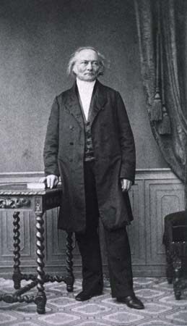
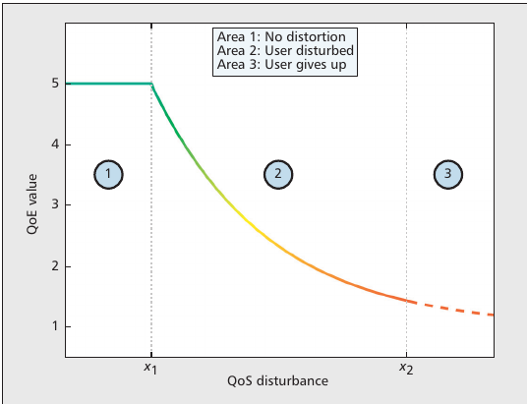

Weber-Fechner Law: as an actual stimulus increases linearly, the intensity of our perception increases only logarithmically.
Notes:
Elements of psychophysics. Perceived loudness/brightness is proportional to logarithm of the actual intensity measured with an accurate nonhuman instrument. The eye senses brightness approximately logarithmically over a moderate range (but more like a power law over a wider range), and stellar magnitude is measured on a logarithmic scale.^{[14]} This magnitude scale was invented by the ancient Greek astronomer Hipparchus in about 150 B.C. He ranked the stars he could see in terms of their brightness, with 1 representing the brightest down to 6 representing the faintest, though now the scale has been extended beyond these limits; an increase in 5 magnitudes corresponds to a decrease in brightness by a factor of 100. There is a new branch of the literature on public finance hypothesizing that the Weber–Fechner law can explain the increasing levels of public expenditures in mature democracies

Slide 36

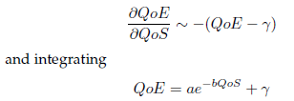
Mathematical models of QoE
Weber-Fechner Law
IQX
The QoE of video streaming has a logarithmic dependence on bitrate
A logarithmic dependence also exists between QoE & startup delay for video streaming
The logarithmic dependence in the Weber-Fechner law: the perception is proportional to the relative change of the stimulus [Reichl2010]

Slide 37
  ITU-T.P1203
For adaptive- & progressive-download-type media streaming
Can be deployed both in end-point locations & at mid-network monitoring points
Cannot provide a comprehensive evaluation of user perceived transmission quality because its scores reflect the perceived impairments due to coded audiovisual media data being transmitted with certain performance & does not include specific terminal devices or user info
The scores reflect average perceptual impairments
Benchmarking of different service implementations. However, it cannot be used for direct benchmarking of different encoder implementations.
Effects such as those due to audio levels, signal noise and effects due to source generation (e.g., video shake, certain colour properties) and other impairments related to the payload are not reflected in the scores.

Slide 38
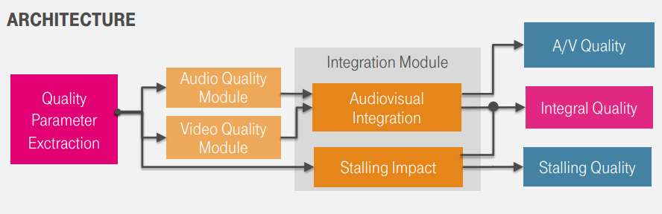
ITU-T RECOMMENDATION P.1203 (2017)
First standardized QoE model for HAS
Predicts Mean Opinion Scores for sequences up to 5 min length

Slide 39
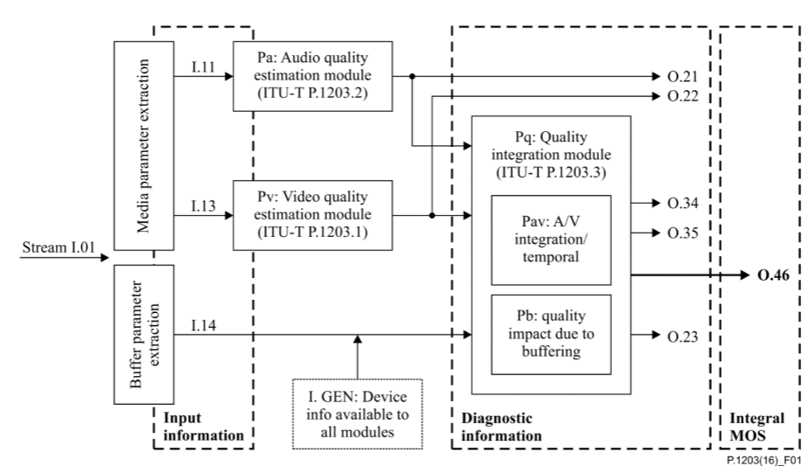
Video Quality Score per interval
Audiovisual stream composed of multiple non-overlapping segments
temporal integration of input features
per output sampling interval
Sliding measurement window for the input data acquisition & output score calculation

Slide 40
Pv, Pa, Pq Modules
Pv (Pa): one video (audio) quality score per output sampling interval, respectively
Pq: the temporal integration of input features or output scores
Pv & Pa apply a sliding measurement window for the input data acquisition & output score calculation
Measurement window (def): audio or video information of one or more segments of a specific media quality level, used as input to the Pv or Pa module at output time ts
At any output time ts, Pv & Pa use info from the measurement window [𝑡𝑠 − 𝑇/2,𝑡𝑠 + 𝑇/2], T = 20 s, to generate the output sample according to the output sampling interval

Slide 41
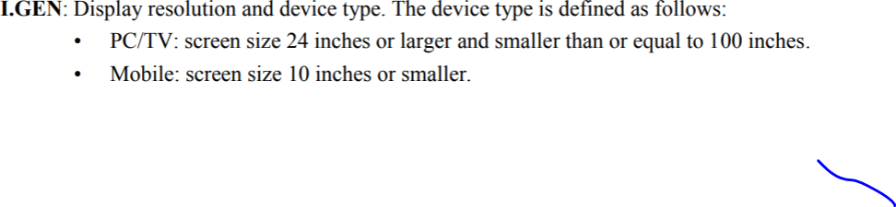

Slide 42
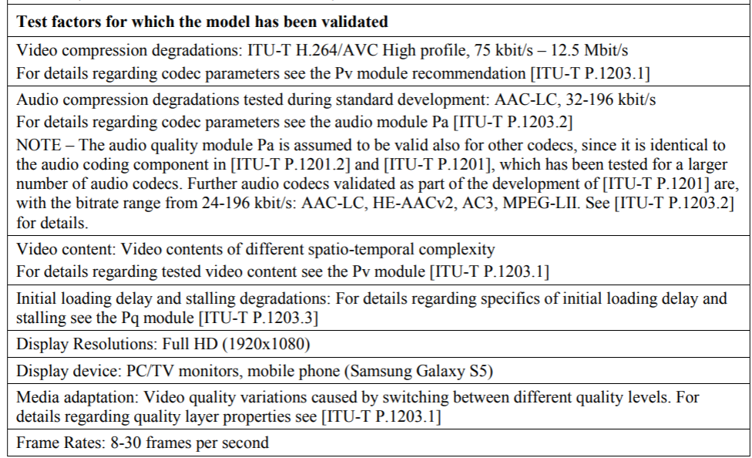

Slide 43
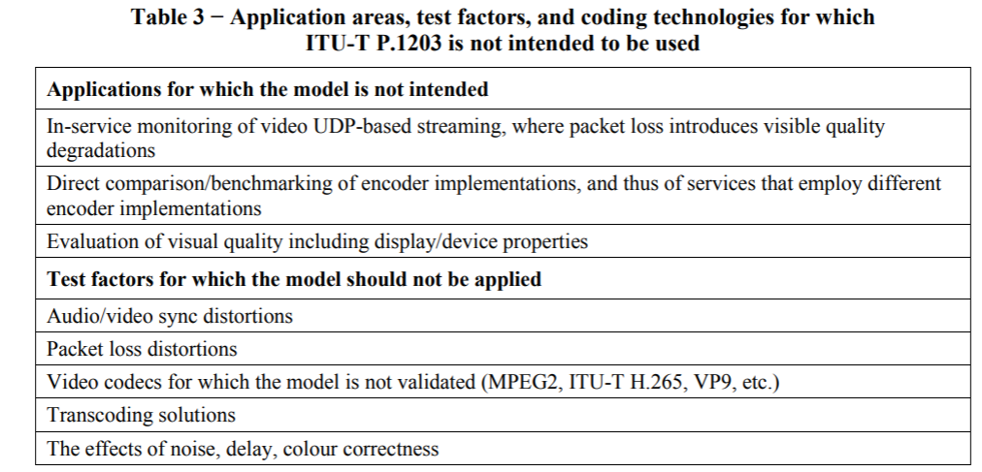

Slide 44
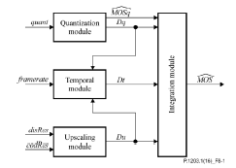

Slide 45
Probes
Devices that extract and process information sent over a network (e.g., counting and forwarding packets)
May implement quality models but can also be exclusively used for simple network traffic monitoring
Active and passive
  Active probes initiate data transfer
  Passive probes inspect traffic that passes through them without interfering & not generating additional media traffic

Slide 46
Platforms with Dedicated Probes
Hardware probes are able to gather round-the-clock measurements, while software measurements are more susceptible to resource contention from other applications and are harder to calibrate have lower distribution costs
SamKnows, BISmark, RIPE Atlas are platforms that deploy dedicated hardware-based probes
Dasu, Netradar, Portolan, perfSONAR rely on software installations for some hardware systems

Slide 47
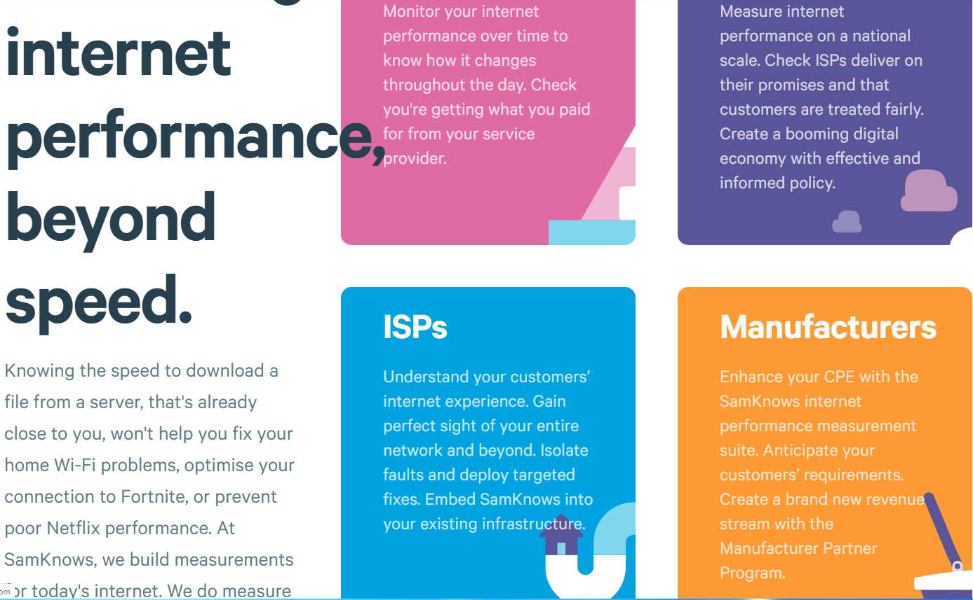
SamKnows (Company)

Slide 48
SamKnows
For ISPs to use accurate, third-party data to help them see what was going on, both inside and outside of their networks.
Includes our full range of measurement agents for fixed and cellular internet
Global test infrastructure and cloud-based platform
Securely stores and visualises performance data in real-time

Slide 49
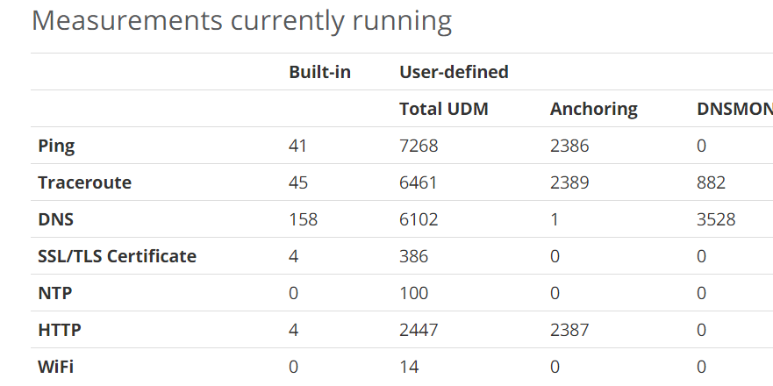
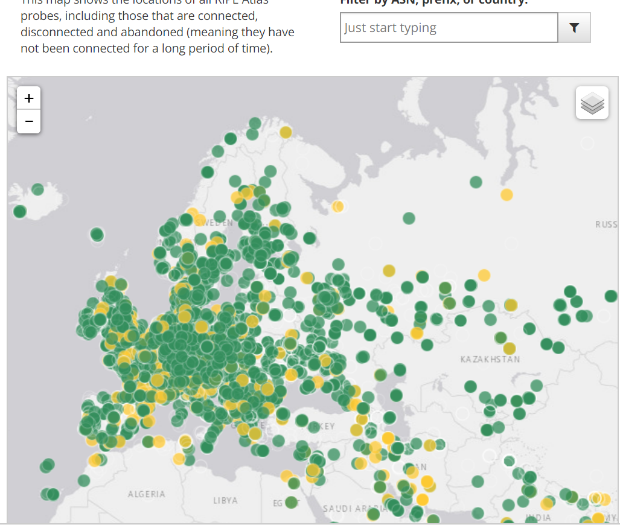
RIPE ALTAS
Not-for-profit membership association,supporting the Internet through technical coordination.
Aims to build the largest Internet measurement network ever made
Employs a global network of probes that measure Internet connectivity & reachability in real time
Probes are small, USB-powered hardware devices that connect to an Ethernet port on their router. They perform active measurements, e.g., ping, traceroute, DNS, SSL/TLS, NTP
The aggregated measurements are made publicly available

Slide 50
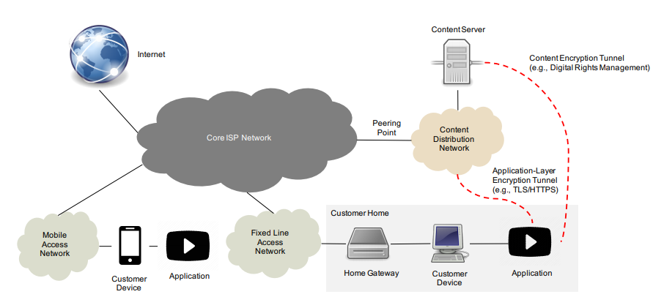
OTT providers have switched to application-level encryption to offer better privacy to their users, such as with the use of SSL/TLS for HTTP or RTP.
E.g., YouTube force-redirects most of its users to a HTTPS version of their portal. Their mobile transmissions are mostly encrypted, too.

Slide 51
Sprint communication: Epitiro 4150 probe
measure QoE for Ethernet, Wi-Fi & LTE
  with a single probe for fixed & mobile users
help enterprises & service providers capable to measure parameters which affect the QoE, the performance of commercial services & applications e.g., Gmail, Facebook, YouTube
network parameters, e.g., latency and speed in LTE, Wi-Fi, Ethernet

Slide 52
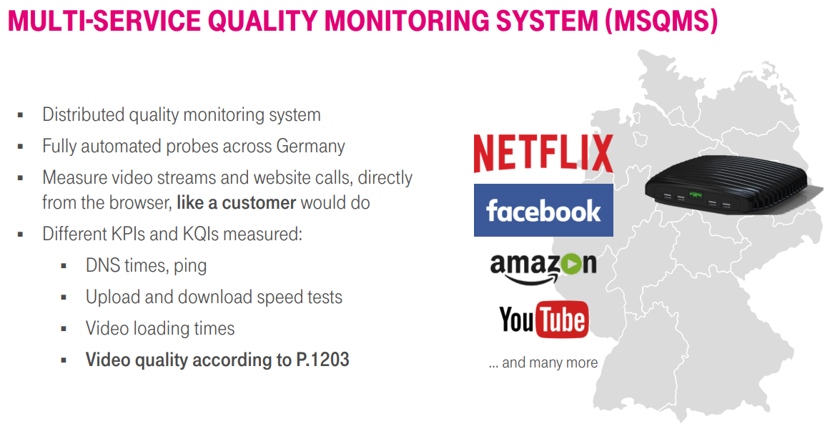

Slide 53

Toolbox
Apply machine learning and data mining algorithms for prediction
e.g., Decision Trees, Support Vector Regression, Artificial Neural Networks, Gaussian Naïve Bayes, Random Forests
Feature discovery: determine the parameters with the most predictive power using Bayesian networks, regression
Train the models based on empirical measurements collected from real-world studies

Slide 54
Our approach for predicting the QoE:
Develop user-centric, service-oriented models based on network metrics
Apply machine learning and data mining algorithms, such as:
Decision Trees, Support Vector Regression, Artificial Neural Networks, Gaussian Naïve Bayes
Find the set of predictors that minimizes the mean absolute error of a model (feature selection)
Train the models based on empirical measurements collected from field studies
We have demonstrated this methodology for VoIP, audio & video streaming

Slide 55
Main aspects of MLQoE
User-centric
Training the models based on collected network measurements & user feedback
Automatic selection of the best algorithm & parameter tuning for predicting QoE
Robustness on the number of dominant factors for predicting QoE
Conservative bound on its future performance (using nested cross-validation)
Performs dimensionality reduction using feature selection algorithms
Addresses the over-fitting

Slide 56
youslow plugin over Chrome browser developed by Nam and Schulzrinne
Data collection
Over 1,400,000 youtube views from more than 1,000 viewers located in more than 110 countries
Two studies:
February 2015 and July 2016 and
January 2017 and July 2017
Youtube Measurement Studies

Slide 57
Session info
Analysis of two large youtube datasets
470,090 sessions per year
for two consecutive years
ISP, date & time, city & region, country , latitude & longitude
Type of abandonment, video resolutions, total viewing duration, initial Buffering, video duration, # of FWD & BWD skips, rebuffering events

Slide 58
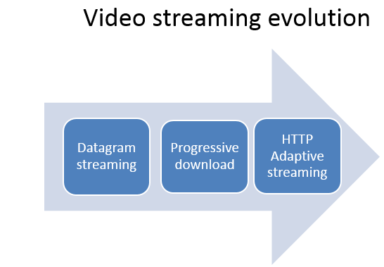
Popular Streaming Technologies
Real Time Messaging Protocol (RTMP) / Real Time Streaming Protocol (RTSP)
Progressive download
ABR streaming

Slide 59
RTMP/RTSP chunk based delivery
A series of video chunks and a Flash player consumes the content instantly without any local caching
The streaming server using dynamic RTMP contains multiple bitrates for a single video file & allows the player to automatically change the bitrates during playback based on the network conditions
RTMP/ RTSP streaming requires a special Flash-based media server.

Slide 60
Progressive Download
A video is delivered by a regular web server using HTTP (no streaming server)
No quality adjustment
Easy to setup and cost-effective
Upon a video request, an HTTP server pushes the video content as quickly as it can
The playback starts as soon as enough content has been downloaded
FF or skipping ahead is only possible for the downloaded content
There is a security concern since the player caches the video content on the viewer’s device

Slide 61
Adaptive Bitrate Streaming (ABR)
Popular video streaming services, e.g., YouTube, Netflix, HBO GO, BBC, use it
Automatic quality switching and ease of delivery over HTTP
Popular ABR technologies:
Apple’s HTTP Live Streaming (HLS), Microsoft’s Smooth Streaming (SS)
Adobe’s HTTP Dynamic Streaming (HDS), 3GPP/MPEG DASH
A video server contains multiple bitrates encoded for a single video object
Each bitrate file is split into small segments
A segment size is measured in seconds (not bytes), typically 2-10 sec
A video player dynamically adjusts bitrates based on estimated network conditions, buffer occupancy, hardware specifications of viewers’ devices (e.g., distinguishing smartphones from desktops)

Slide 62
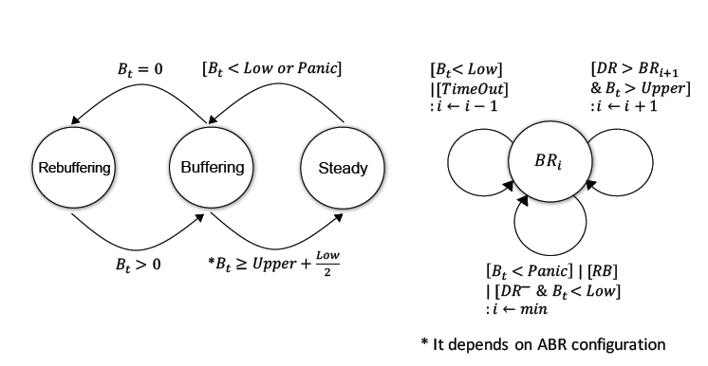
Finite state machine (FSM) of state change & bitrate switching behavior of Microsoft’s SS players
While the video is being played, the state of player can be Buffering, Steady or Rebufferring
BRi : the video bitrate (in kb/s) selected by a player during playback
Bt: how much video content is currently left in the playout buffer (in sec).

Slide 63
Buffering state: the player aggressively downloads video content into its playout buffer. The player requests the next segment right after it completely downloads the current segment (back-to-back HTTP requests) so that the buffer can be filled as quickly as possible.
Steady state: the player tries to keep the buffer full, instead of increasing the playout buffer level by downloading the segments back-to-back. Request one segment for every segment duration.
When the playout buffer is running low, the state will switch to Buffering again.
Rebuffering: no video content available in the playout buffer during playback.
Rebuffering: no video content

Slide 64
DR: current downloading data rate measured by a bandwidth estimator in an ABR player
DR-: available bandwidth in the network is decreasing
BRi : the video bitrate (in kb/s) selected by a player during playback
Bt: how much video content is currently left in the playout buffer (in sec).
TimeOut: The timer is set to estimate network conditions. It activates when the elapsed time for downloading a requested segment is longer than expected. In such case, the bitrate is decreased for the next request.

Slide 65
Selecting the Best Available Bitrate during Playback
Real-time available network bandwidth
Amount of video remaining in the playout buffer during playback
Screen resolution & video rendering capabilities of viewers’ devices
Frame rate & viewers’ interactive actions (e.g., resizing the browser window) during playback
A player may experience frequent frame drops when a system is running multitasking that requires significant RAM & CPU
Under a large number of frame dropped:
the player flushes its buffer
re-downloads the discarded segments at lower playback rates to provide a good video quality

Slide 66
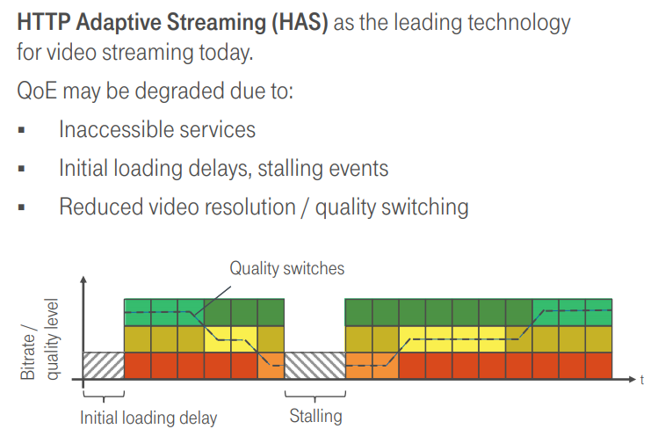

Slide 67
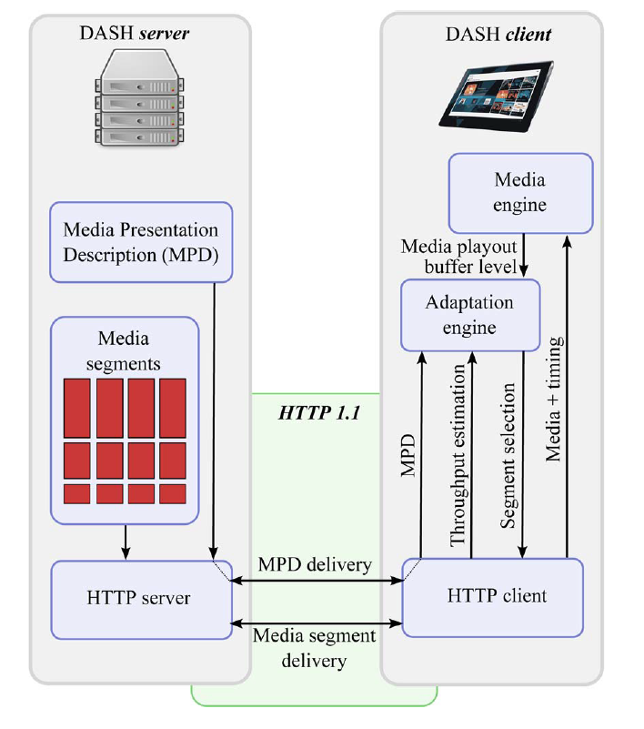
HTTP Adaptive streaming
Video chunks in different bitrate at the server
Client selects bitrate based on throughput & buffer availability
Impairments:
  Start-up delay
  Rebuffering events
  Positive & negative BR changes
  Low video resolutions
[Seufert et al., “A Survey on Quality of Experience of HTTP Adaptive Streaming”, IEEE Communication Surveys & Tutorials, 2014]

Slide 68
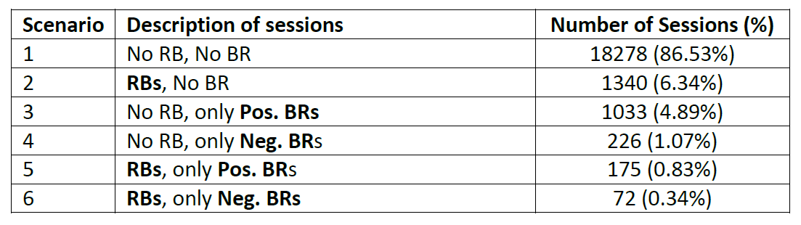
Youtube Measurement Studies
RB: rebuffering
BR: bitrate change
Pos. BR: increase of the bitrate
Neg. BR: decrease of the bitrate

Slide 69
Key Findings of QoE for Video Streaming (Related Work)
Rebufferings (RB) are critical:
  Duration & Number of the events
Startup delay > 2 sec has negative impact
Bitrate changes (BR) are important:
  Negative BR -> poor QoE specially after long periods of high quality
  Positive BR -> can also dissatisfy users
  Same average BR is perceived differently, depending on the level fluctuation patterns
  The annoyance of staying at low quality grows exponentially with the duration it is maintained
1. T. Hoßfeld et al. , “Pippi Longstocking calculus for temporal stimuli pattern on YouTube QoE: 1 + 1 = 3 and 1 ∗ 4 ≠ 4 ∗ 1.” 5th Workshop on Mobile Video. ACM, 2013.
2. S. Krishnan and R. Sitaraman, “Video stream quality impacts viewer behavior: inferring causality using quasi-experimental designs”, IEEE/ACM Transactions on Networking, 2013.
3. A. Moorthy et al., “Video Quality Assessment on Mobile Devices: Subjective, Behavioral and Objective Studies”, IEEE Journal of Selected Topics in Signal Processing, 2012.
4. Y. Liu et al., “Deriving and Validating User Experience Model for DASH Video Streaming”, IEEE Transactions on Broadcasting, 2015.
5. B. Lewcio et al., “Video quality in next generation mobile networks - Perception of time-varying transmission”, 2011 IEEE International Workshop Technical Committee on Communications Quality and Reliability (CQR), 2011.

Slide 70
QoE on Different Devices
Mobile phones/tablets
  Higher impact of stallings than image quality on MOS
  BR- after a long period of high quality results to poor QoE
  Users of mobile devices more tolerant to startup delay compared to desktops users
  The environmental context is important for entertainment & information ratings
Desktop computers/laptops
  Users are more likely to abandon videos with multiple rebufferings compared to a single re-buffering event although the rebuffering ratio is the same.
  Users are more likely to abandon a video when startup delay larger than 2 sec
1. A. Moorthy et al., “Video Quality Assessment on Mobile Devices: Subjective, Behavioral and Objective Studies”, IEEE Journal of Selected Topics in Signal Processing, 2012.
2. H. Nam et al., “QoE matters more than QoS: Why people stop watching cat videos”, In IEEE Infocom, 2016.
3. P. Casas et al., "Next to You: Monitoring Quality of Experience in Cellular Networks From the End-Devices", IEEE Transactions on Network and Service Management, 2016.
4. S. Wassermann et al., "QoE in Cellular Networks through in-Smartphone Measurements", 12th IFIP Wireless and Mobile Networking Conference (WMNC), 2019.
5. S. Jumisko-Pyykkö and M. Hannuksela, "Does context matter in quality evaluation of mobile television?", In Proceedings of the 10th international conference on Human computer interaction with mobile devices and services, 2008.

Slide 71
Should I stay or should I go:
Analysis of the Impact of
Application QoS on User Engagement in YouTube
Maria Plakia ², Evripides Tzamousis ², Thomais Asvestopoulou ^{1,2}, Giorgos Pantermakis ², Nick Filippakis ², Henning Schulzrinne ³, Yanna Kane-Esrig and Maria Papadopouli ^{1,2}
¹Department of Computer Science, University of Crete, Heraklion, Greece
²Institute of Computer Science, Foundation for Research and Technology-Hellas, Heraklion, Greece
³ Columbia University
Under Review in ACM Transactions on Modeling & Performance Evaluation of Computing Systems
https://arxiv.org/abs/1901.01603

Slide 72
Methodological Contributions
User engagement metrics
video watching duration ratio & abandonment ratio
time elapsed from the occurrence of an impairment to the end of the session
% of sessions that get abandoned within a certain time (e.g., 60 sec) after the occurrence of an impairment
Identified scenarios with specific types of impairments
Performance Analysis
Relationship among different types of impairments & user engagement metrics, considering covariates of sessions (e.g., video duration, mean data rate)

Slide 73
HTTP Adaptive streaming
Video chunks in different bitrate at the server
Client selects bitrate based on throughput & buffer availability
Impairments:
  Start-up delay
  Rebuffering events
  Positive & negative BR changes
  Low video resolutions
[Seufert et al., “A Survey on Quality of Experience of HTTP Adaptive Streaming”, IEEE Communication Surveys & Tutorials, 2014]

Slide 74
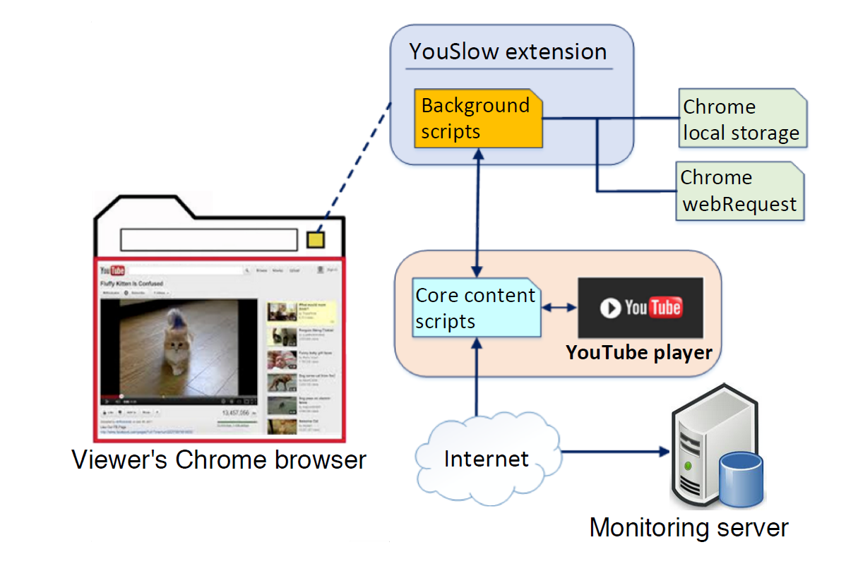
YouSlow
Google Chrome plug-in
H. Nam, K. Kim and H. Schulzrinne, "QoE matters more than QoS: Why people stop watching cat videos", IEEE INFOCOM 2016

Slide 75
Datasets
Each video session includes:
Date and location
Internet Service Provider
Played bitrates during the session
Video duration
Session Duration
Start-up delay: presence and duration
Rebuffering : time and duration
Abandonment
Desktop computers and laptops (no mobility)
Two datasets
  collected between February 2015 and July 2016
  collected between January 2017 and July 2017
More than 1,400,000 sessions
We performed dataset pre-processing and sanitization

Slide 76
Key Findings of Our Study
BR- has a severe negative impact on video watching percentage & abandonment ratio
BR+ in sessions with low initial resolution is not well-received
High RB ratio has even more prominent impact than BR-
Compared to startup delay, RBs have larger impact on the video watching percentage
Features with predictive power for the video watching percentage include the number of RBs, number of BR changes, number of negative BR changes, mean weighted bit rate
An impairment prior to a BR- increases the likelihood of abandonment

Slide 77
Scenarios Examined:
Thresholds considered:
No RB, no BR (baseline)
RBs, no BR
No RB, BR+
No RB, BR-
RBs, BR+
RBs, BR-
For video watching percentage:
[0, 100]
[20, 100]
[50, 100]
For mean weighted bitrate:
[0, 2.5] Mbps
[1, 8] Mbps
[2.5, 8] Mbps
[6, 8] Mbps

Slide 78
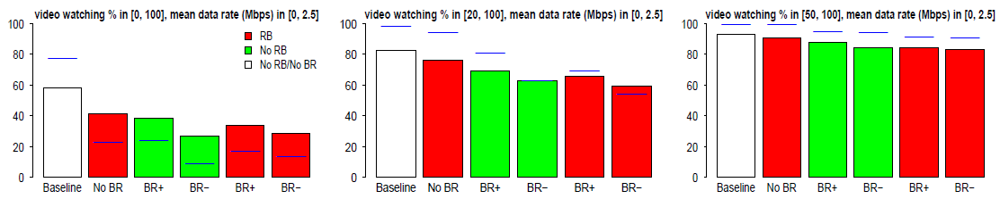
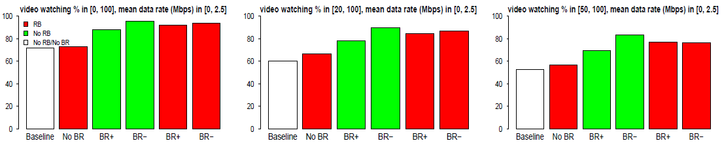
BR- has a severe negative impact on video watching percentage & abandonment ratio
BR+ in sessions with low initial resolution is not well-received
Mean Video Watching Percentage
Abandonment ratio

Slide 79
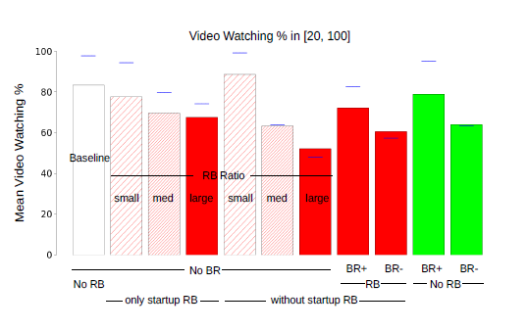

Compared to startup delay, RBs have larger impact on the video watching percentage

Slide 80


Features with predictive power for the video watching percentage include the number of RBs, number of BR changes, number of negative BR changes, mean weighted bit rate
Used LASSO regression to find the dominant features
As λ gets higher, a smaller number of features are taken into account
The dominant parameters are the ones with non-zero LASSO coefficients for λ in [0.4, 0.6].
Notes:
In our setting, the predicted value y is the video watching percentage, x i,j are the 37 parameters we use, and βj are the estimated coefficients. In practice, as λ gets higher, a smaller number of features are taken into account. We employed LASSO with 10-fold cross validation to estimate the parameter λ.
All coefficients β become zero for λ = 2.
We ran cross validation and estimated the value of λ that yields the smallest cross-validation error. For each iteration, we obtained a λ in [0.4, 0.6] when the smallest cross validation-error was met. After that, we examined the derived plot for λ in [0, 2] with step size of 0.05. The dominant parameters are the ones with non-zero LASSO coefficients for λ in [0.4, 0.6]. For the different values of λ in the aforementioned interval, the set of dominant parameters, namely the number of BR changes per video duration, starting time of first RB event per video duration, timestamp of first BR change per video duration, number of negative BR changes, number of rebufferings (RBs), remains the same.

Slide 81

An impairment prior to a BR- increases the likelihood of abandonment
Scenarios examined:
  Exactly one impairment being BR-
  Exactly two impairments the second being BR- , the first being RB or BR
Time margin between them ≥ 30 sec → they are perceived as different impairments
User that experiences a BR- as second impairment is more prone to abandon the session than when experiences a BR- for the first time
BR- more direct impact than RB

Slide 82
Conclusions
The "worst offenders" for the design of adaptation algorithm are:
the combination of BR- and RB
the large RB ratio
the combination of BR+ and low resolution
and the BR- change of two or more levels
Reporting average statistics, such as average bitrate per session, is not enough
We need to monitor RB and BR changes at the user level to quantify and improve the user engagement
per-user statistics about the revisit and viewing duration per video, info about the user device, context (e.g., time-of-the-day, position), content type to improve not only the adaptation but also caching
→ user-centric ABR player

Slide 83
Future Work
Collect and integrate information about:
the content type
the interest of the user in the video content
whether or not the user manually changed the bitrate during a playback
Also, specific cases with relatively small number of sessions or the presence of confounding variables , such as
early and late BR- sessions
sessions with RB larger than 20sec
sessions with one BR- in [1, 2]Mbps
do not allow us to draw definite conclusions

Slide 84
Key Findings in Our Recent Research
BR- has a severe negative impact on video watching percentage & abandonment ratio
BR+ in sessions with low initial resolution is not well-received
High RB ratio has even more prominent impact than BR-
Compared to startup delay, RBs have larger impact on the video watching percentage
Features with predictive power for the video watching percentage include the number of RBs, number of BR changes, number of negative BR changes, mean weighted bit rate
An impairment prior to a BR- increases the likelihood of abandonment

Slide 85

Web Browsing
Networking: Impact of network performance on waiting times resulting from page/element loading times
HCI & user experience studies addressed user preferences and experiences in relation to perceived usability & aesthetics of Web-related content

Slide 86
System Influence Factors
network-related: data transmission over a network (bandwidth, delay, jitter, loss, throughput, etc.),
content-related: content type and content reliability (specific temporal or spatial requirements, colour depth, texture)
device-related: display resolution, quality of touchscreen
media-related: encoding, resolution, sampling rate, frame rate

Slide 87
Information Quality in the Web
Usefulness of content and adequacy of information
  Value (relevancy & clearness)
  reliability (accuracy, dependability, & consistency)
  currency (timeliness and continuous update),
  accuracy (degree to which the system information is free of error)
  extent of completeness of information, since Web sites need to provide information to facilitate user’s content understanding

Slide 88


Slide 89
Cloud computing
Provides computing resources like CPU resources, operating system environment & application development, which are broadly distributed over the Internet
QoS: technical parameters that determine the quality of processing, storage and network used for transferring data from cloud to client but does not take the customer into consideration
QoE defines the performance of cloud processing, storage & network from the customer perspective
manage & provide services according to customer’s demand

Slide 90
Mobile Cloud Gaming Framework
Shift mobile user load to cloud server due to the inherent hardware constraint of mobile devices (memory and graphics processing)
Objective factors that impact on the QoE :
cloud server, source video, wireless network & client
subjective QoE:
Game Mean Opinion Score (GMOS) for measurement of end user’s QoE

Slide 91

Fog & Edge Computing
Supernodes, closed to end users & connected to clouds
EdgeCloud uses servers in the nearby location to clients to improve delay but the long distance of users to cloud is still a major problem

Slide 92
QoE for AR/VR Services
Physiological data, e.g., eye measurements, electrodermal activity (EDA), EEG, heart-rate
Characteristics of the perceptual and cognitive processes, such as effort required, response time, errors, and interaction
No agreed methods or benchmarks for accessing the QoE in AR (G.QoE-AR, ITU-T work program)
Borrowed aspects from ITU-T standards, integrating physiological measurements

Slide 93
Additional References
https://www.researchgate.net/profile/Arslan_Ahmad3/publication/331013590_QoE--aware_Multimedia_Service_Management_and_Monitoring_through_OTT_and_ISP_Collaboration/links/5c61455292851c48a9c98a46/QoE--aware-Multimedia-Service-Management-and-Monitoring-through-OTT-and-ISP-Collaboration.pdf
https://link.springer.com/content/pdf/10.1007%2Fs11213-018-9471-x.pdf
https://link.springer.com/article/10.1007/s41233-017-0009-2

