Slide 1

Wireless Networks & Mobile Computing
Lecture on IEEE802.11 MAC Layer
Prof. Maria Papadopouli
University of Crete
ICS-FORTH
http://www.ics.forth.gr/mobile

Slide 2
IEEE 802.11 Family
IEEE802.11b:
Direct Sequence Spread Spectrum (DSSS) or Frequency Hopping (FH), operates at 2.4GHz, 11Mbps bitrate
IEEE802.11a: between 5GHz and 6GHz uses orthogonal frequency-division multiplexing (OFDM), up to 54Mbps bitrate
IEEE802.11g: operates at 2.4GHz up to 54Mbps bitrate
All have the same architecture & use the same MAC protocol

Slide 3
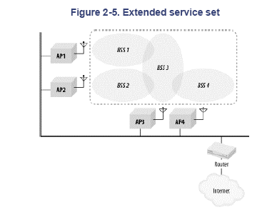
Networks of Arbitrarily Large size
Chain BSSs together with a backbone network
Several APs in a single area may be connected to a single hub or switch or they can use virtual LAN if the link=layer connection
APs act as bridges
Basic Service Set:
the network
around one AP
APs are configured
to be part of the ESS
Backbone network is a layer 2 (link layer) connection

Slide 4
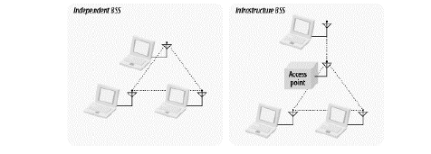
Modes of Operation of IEEE 802.11 Devices
Infrastructure: A special STA, the Access Point (AP), mediates all traffic mediates all traffic
Independent: Stations speak directly to one another
(ad hoc networks)

Slide 5
Inter-Access Point Communication
If a client is associated with one AP, all the other APs in the ESS need to learn about that client
If a client associated with an AP sends a frame to a station associated with a different AP, the bridging engine inside the first AP must send the frame over the backbone Ethernet to the second AP so it can be delivered to its ultimate destination
No standardized method for communication
  Major project in the IEEE802.11 working group the standardization of the IAPP

Slide 6
A Network of Socialites
Our 802.11 station (STA) would like to
Join the community (i.e., a network)
Chat for a while (send and receive data)
Take a nap (rest, then wake up)
Take a walk (“roam” to a new area)
Leave the network
Note: the word “roam” is using in a non-technical way.
In wireless networks, roaming is the handoff between base stations of
different providers/operators.

Slide 7
Steps to Join a Network
Discover available networks (aka BSSs)
Select a BSS
Authenticate with the BSS
Associate

Slide 8
Discovering Networks
Each AP broadcasts periodically beacons announcing itself
Beacon includes:
AP’s MAC address
AP’s clock
Beacon interval (100ms typical)
Network Name (SSID); eg “UoC-1”

Slide 9
Associations
Exclusive:
A device can be associated with only one AP
Client-initiated:
The client initiates the association process
AP may choose to grant or deny access based on the content of the association request

Slide 10
Reasons to Deny Access
Memory
Traffic load

Slide 11
Infrastructure Mode: Handoff
Re-association
When a station leaves one BSS and enters another BSS, it can re-associate with a new AP
Re-association request is like association plus:
  Previous AP MAC address
  Old association id
New AP can contact old AP to get buffered frames

Slide 12
Infrastructure mode:
Leaving the network
If a station is inactive, AP may disassociate it automatically; 30 seconds is typical
Station may indicate its de-association politely

Slide 13
Coordination Functions for Channel Access
Distributed Coordination function
  Contention-based access
  DIFS (ms) sensing channel
  4-way handshaking protocol for data transmissions
  Backoff process
Point Coordination function
  Contention-free access

Slide 14
Infrastructure Mode: Joining a network
1. Discovering Networks (active)
Instead of waiting for beacon, clients can send a probe request which includes
STA MAC address
STA’s supported data rates
May specify a SSID to restrict search
AP replies with proble response frame

Slide 15
Infrastructure Mode: Joining a network
2. Choosing a Network
The user selects from available networks; common criteria:
  User choice
  Strongest signal
  Most-recently used
OS Driver indicates this selection to the STA

Slide 16
Infrastructure Mode: Joining a network
3. Authentication
Open-system ‘authentication’; no password required
Often combined with MAC-address filtering

Slide 17
Infrastructure Mode: Joining a network
3. Authentication
Shared-key ‘ authentication’ called “Wired Equivalency Protection”, WEP

Slide 18
Infrastructure Mode: Joining a network
4. Association
Station requests association with one AP
Request includes includes
  STA MAC address
  AP MAC address
  SSID (Network name)
  Supported data rates
  Listen Interval (described later)

Slide 19
We have now joined the network …
Next: sending data

Slide 20
Carrier-Sensing Functions
IEEE 802.11 to avoid collisions
Carrier Sense Multiple Access/Collision Avoidance (CSMA/CA)
MAC layer
  RTS, CTS, ACK
  Network allocation vector (NAV) to ensure that atomic operations are not interrupted
  Different types of delay
  Short Inter-frame space (SIFS):
  highest priority transmissions (RTS, CTS, ACK)
  DCF inter-frame space (DIFS):
  minimum idle time for contention-based services
  EIFS: minimum idle time in case of “erroneous” past transmission

Slide 21

RTS/CTS Clearing
(1) RTS
Node3
Node 1
Node 2
Node 1
(3) Frame
(2) CTS
RTS
Time
(4) ACK
CTS
Node 2
frame
ACK
RTS: reserving the radio link for transmission
RTS, CTS: Silence any station that hear them

Slide 22

Positive Acknowledgement of Data Transmission
Node 1
Node 2
Time
frame
ACK
IEEE 802.11 allows stations to lock out contention during atomic operation so that atomic sequences are not interrupted by other
hosts attempting to use the transmission medium

Slide 23
Sending a Frame
Request to Send – Clear to send
Used to reserve the full coverage areas of both sender and receiver
Send frame
Get acknowledgement

Slide 24
Infrastructure mode: Sending Data
1. RTS/CTS
RTS announces the intent to send a pkt; it includes:
  Sender’s MAC address
  Receiver’s MAC address
  Duration of reservation (ms)
CTS inidcates that medium is available; includes:
  Receiver’s MAC address
  Duration of reservation remaining (ms)

Slide 25
Infrastructure mode: Sending Data
2. Transmit frame
Normal ethernet frame has two addresses: sender and receiver
802.11 data frame has four possible addresses:
  Sender (SA) originated the data
  Destination (DA): should ultimately receive the data
  Receiver (RA): receives the transmission from the sender
  Transmitter (TA) transmits the frame
Data frame includes also
  Duration remaining in fragment burst
  More-fragments ? Indicator
  Data

Slide 26
Using the NAV for virtual carrier sensing
(eg 4-8KB)
(e.g.10μs)
RTS
Frame
Sender
SIFS
SIFS
CTS
ACK
(e.g.50μs)
Receiver
SIFS
DIFS
NAV (RTS)
NAV
NAV(CTS)
Access to medium deferred
Contention
Window
NAV is carried in the headers of CTS & RTS
Notes:
Carrier-sensing functions

Slide 27
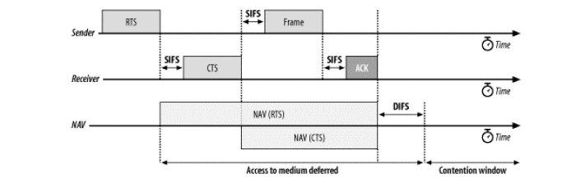
Using the NAV for Virtual Carrier Sensing
Every host that receives the NAV differs the access,
even if it is configured to be in a different network

Slide 28
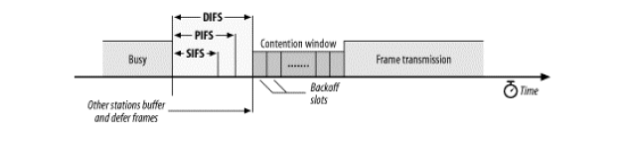
Inter-frame Spacing
Create different priority levels for different types of
traffic
The higher the priority the smaller the wait time after
the medium becomes idle
Minimum medium idle time for contention-based services
PCF (contention-free) access
Preempt any contention-based traffic
Short interframe space
Notes:
SIFS is used for ACKs, RTS/CTS frames

Slide 29
Interframe Spacing & Priority
Atomic operations start like regular transmissions
  They must wait for the DIFS before they can begin
  However the second and any subsequent steps in an atomic operation take place using SIFS rather than DIFS
  Second and subsequent parts of the atomic operation will grab the medium before another type of frame can be transmitted.
By using the SIFS and the NAV stations can seize the medium as long as necessary

Slide 30
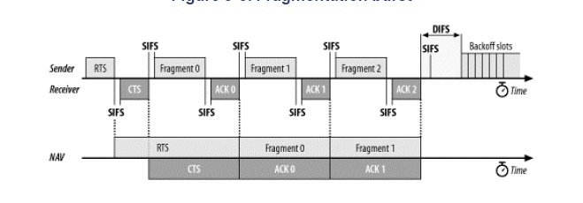
Fragmentation burst

Slide 31
Data sent …
Next: Take a nap

Slide 32
IEEE802.11
Point Coordination Function (PCF)
Provides un-contended access via arbitration by a Point Coordinator which resides at the AP
☞ Guarantees a time-bounded service
Distributed Coordination Function (DCF)
Uses CSMA/CA to share channel in a “fair way”:
☞ Guarantees long-term channel access probability to be equal among all hosts
  Note:
  there is short-term and long-term fairness
  Fairness in the long-term probability for accessing the channel

Slide 33
IEEE802.11 Media Access Protocol with DCF (1/2)
Coordinates the access & use of the shared radio frequency
Carrier Sense Multiple Access protocol with collision avoidance (CSMA/CA)
Physical layer monitors the energy level on the radio frequency to determine whether another station is transmitting and provides this carrier-sensing information to the MAC protocol
☞ If channel is sensed idle for DIFS, a station can transmit
When receiving station has correctly & completely received a frame for which it was the addressed recipient, it waits a short period of time SIFS and then sends an ACK

Slide 34
IEEE802.11 Media Access Protocol with DCF (2/2)
If channel is sensed busy will defer its access until the channel is later sensed to be idle
Once the channel is sensed to be idle for time DIFS, the station computes an additional random backoff time and counts down this time as the channel is sensed idle
When the random backoff timer reaches zero, the station transmits its frame
Backoff process to avoid having multiple stations immediately begin transmission and thus collide

Slide 35
Distributed Coordination Function
(DCF)
A host wishing to transmit:
Senses the channel
Waits for a period of time (DIFS), and then
Transmits, if the medium is still free
Receiving host:
Sends ACK, after SIFS time period, if packet is correctly received
Sending host:
Assumes a collision, if this ACK is not received
Attempts to send the packet again, when the channel is free for DIFS period augmented of a random amount of time

Slide 36
Backoff with DCF
Contention (backoff) window follows DIFS
Window is divided in time slots
Slot length & window length are medium-dependent
Window length limited and medium-dependent
A host that wants to transmit a packet:
picks a random number with uniform probability from the contention window
(All slots are equally likely selections)
waits for this amount of time before attempting to access the medium
freezes the counter when it senses the channel busy
The host that picks the earlier number wins
Each time the retry counter increases, for a given host and packet (to be retransmitted), the contention window is doubled

Slide 37
Contention Window Size
Initial
Attempt
Previous
Frame
DIFS
31 slots
Slot time:20s
1st retransmission
Previous
Frame
DIFS
63 slots
2nd retransmission
DIFS
127 slots
Previous
Frame
3rd retransmission
255 slots
Previous
Frame
DIFS
The contention window is reset to its minimum size when frames are transmitted successfully, or the associated retry counter is reached and the frame is discarded

Slide 38
Simple Exercise
Compute the utilization of the wireless LAN
when there is only one transmitting device

Slide 39
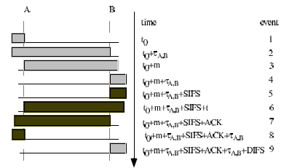
Sequence of Events (1/2)
sender
receiver
packet trx time
max propagation delay
Note, that in this example, the RTS/CTS messages are disabled.
In case that they were enabled, the total time should also include:
2xSIFS + τ_{RTS} + τ_{CTS}

Slide 40
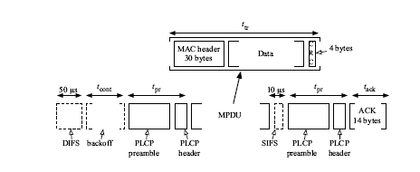
Successful transmission of a single frame

Slide 41



Performance of DCF
Overall Transmission time (T) :
Constant Overhead (t_{ov}) :
Proportion of useful throughput (p):
Note: to compute the throughput you estimate the ratio: message size/T

Slide 42


Performance of DCF
Assuming that multiple successive collisions are negligible,
Proportion of collisions (P_{c}(N)) experienced for each packet acknowledged successfully :
Proportion (p) of useful throughput obtained by a host:

Slide 43
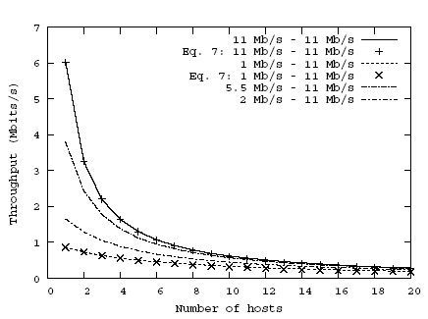
Throughput as a function of the number of hosts in the WLAN.
This is
the important
line

Slide 44
Metrics for characterizing the performance (QoS)
Delay
e.g., end-to-end, roundtrip, one-way
Jitter
measures the variance of the packet interarrival times
Packet loss
e.g., distribution, total number, burstiness, and position of these bursts in the session
Energy consumption

Slide 45
Point Coordination Function (PCF)
Point-coordinator cyclically polls all stations which are assigned to the network and added to the PC polling table
Assign a time slot to them in which they are exclusively allowed to send data
Resides in APs
☹ Drawbacks: Higher bandwidth waste under normal load
☞ Correction for reducing overhead for polling idle stations
Embedded Round Robin: dynamic classification of stations as busy or clear

Slide 46
Infrastructure mode: Saving Power
STA indicates power management mode is on to AP and waking interval
STA goes to sleep (turns off radio)
STA wakes later;
Listens for traffic conditions (e.g., first 10ms of the beacon interval)
STA may request buffered frames
AP sends buffered frames
Steps 2-5 repeat

Slide 47
Power Savings: Basic Principle
Whenever a wireless node has noting to send or receive it should fall asleep: turn off the MAC processor, the base-band processor, and RF amplifier to save energy
Easy in an infrastructure wireless network
APs responsible for timing synchronization (through beacons)

Slide 48
1. STA indicates
Most frames include power-management (PM) bit
PM=1 means STA is sleeping
STA indicates
Listen Interval & length of its naps (in beacon intervals)
Tradeoffs:
Larger listen interval requires more AP memory for buffering
Interactivity issues

Slide 49
Infrastructure Mode
2. Check for waiting traffic
Station wakes to listen for a beacon, which includes the Traffic-Indication Map (TIM)
TIM is 2,007-bit-long map;
TIM[j]=1 means that station with Associated ID=j has traffic buffered

Slide 50
Infrastructure Mode
3. Get buffered traffic
Station sends Power-Saving-Poll to indicate that it is awake and listening
AP sends buffered packets
Station stays awake until it has retrieved all buffered packets

Slide 51
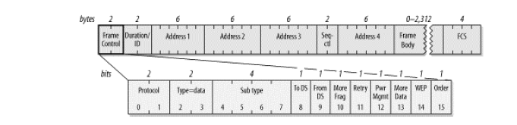
Frame Control Field
Indicates if the device is sleeping
AP indicates that there are more data available
and is addressed to a dozing station

Slide 52
Wireless network topologies can be controlled by
Data rate
Channel allocation: different devices communicate at different channels
In some cases, there is a channel dedicated for the control (management) and message exchange
Transmission power (power control)
Carrier sense threshold
Directional antennas
Cognitive intelligent radios & software defined radios
Node placement
Different network architectures/deployments (e.g., mesh networks, infrastructure-based, ad hoc)

Slide 53
Spectrum Utilization (1/2)
Studies have shown that there are frequency bands in the spectrum largely unoccupied most of the time while others are heavily used
Cognitive radios have been proposed to enable a device to access a spectrum band unoccupied by others at that location and time

Slide 54
Spectrum Utilization (2/2)
Cognitive radio: intelligent wireless communication system that is
    Aware of the environment
    Adapt to changes aiming to achieve:
      reliable communication whenever needed
      efficient utilization of the radio spectrum
Their commercialization has not yet been fully realized
  Most of them still in research & development phases
  Cost, complexity, and compatibility issues

Slide 55
Improvement at MAC layer
To achieve higher throughput and energy-efficient access, devices may use multiple channels instead of only one fixed channel
Depending on the number of radios & transceivers, wireless network interfaces can be classified:
Single-radio MAC
  Multi-channel single-transceiver
  Multi-channel multi-transceiver
Multi-radio MAC

Slide 56
Multiple Radio/Transceivers
Multi-channel single-transceiver MAC
  One tranceiver available at network device
  Only one channel active at a time in each device
Multi-channel multi-transceiver MAC
  Network device with multiple RF front-end chips & baseband processing modules to support several simultaneous channels
  Single MAC layer
  controls & coordinates the access to multiple channels
Multi-radio MAC
  network device with multiple radios
  each with its own MAC & physical layer

Slide 57
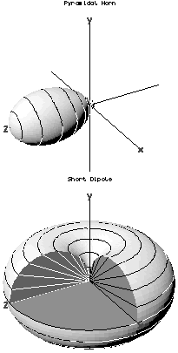
Directional antenna
a small pyramidal horn
the figure shows the directive pattern
κερατοειδείς κεραίες
Dipole:
the most common type of antenna
In its simplest case:
a small length of conductor carrying an alternating current
E= (60*π*Le*l*sinθ)/(λ*r)
E: ισχύς του μαγνητικού πεδίου
r: απόσταση, Le: μήκος κεραίας
Ι: ενταση του ρεύματος, θ γωνία άξονα καλωδίου & διεύθυνση μέγιστης ακτινοβολίας
Omnidirectional pattern of a
dipole antenna

Slide 58
Antenna diversity
Based on the fact that signals received from uncorrelated antennas have independent fading:
high probability that at least one good signal can be received @ receiver
The antenna uncorrelation is achieved through
(A) space, polarization, pattern diversity,
(B) processing technologies for diversity
I nclude switch diversity, equal gain, and maximum ratio combining
Notes:
Polarization (waves), the ability of waves to oscillate in more than one direction

Slide 59
Antenna diversity (cont’)
The signal is reflected along multiple paths before finally being received. Each of these bounces can introduce phase shifts, time delays, attenuations, and distortions that can destructively interfere with one another at the aperture of the receiving antenna.
Antenna diversity is especially effective at mitigating these multipath situations: multiple antennas offer a receiver several observations of the same signal.
Each antenna will experience a different interference environment.
Thus, if one antenna is experiencing a deep fade, it is likely that another has a sufficient signal. Collectively such a system can provide a robust link.

Slide 60
Beamforming
Signal processing techniques for directional signal transmission or reception
Combining elements in a phased array
Signal at particular angles experience constructive interference while others experience destructive interference
Used at both the transmitting & receiving ends to achieve spatial selectivity
Change the directionality:
a beamformer controls the phase and relative amplitude
of the signal at each transmitter

Slide 61
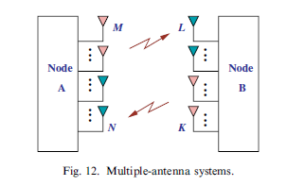
Beamforming
  Beamforming: method to create the radiation pattern of the antenna array by adding constructively the phases of the signals in the direction of the targets/mobiles desired,
  and nulling the pattern of the targets/mobiles that are undesired/interring targets

Slide 62
Adaptive antenna array processing
Shape the antenna beamform to enhance the desired signals while to nullify the interfering signals
Algorithms that identify spatial signal signature (e.g., direction of arrival) and use it to calculate beamforming vectors
to track and locate the antenna beam on the mobile/target

Slide 63
Antenna diversity (con’td)
Complexity & cost  such antennas are used in BS of cellular networks
Mechanically or electronically steerable or switched directional antennas tuned to certain direction
Using directional transmission, interference between nodes can be mitigated  improve network capacity

Slide 64
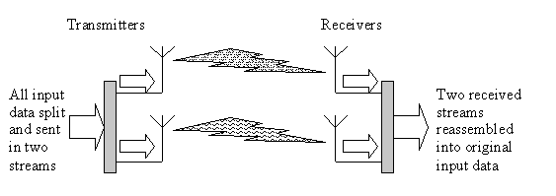
802.11n
Motivation: higher data transfer rates (54M-600Mbps)
Couples MIMOs and wider bandwidth
  Channel width of 40MHz (vs. 20MHz in 802.11b)
  Multiple antennas to coherently resolve more information than possible using a single antenna
  e.g., using Spatial division multiplexing: multiplexes multiple independent data streams (i.e., independent & separately encoded data signals), transferred simultaneously within one spectral channel of bandwidth
  Each spatial stream requires a discrete antenna at both the transmitter & receiver
in simple words: receivers “work together”, each one is synchronized to its own signal, one receiver’s reception can be used to counter phase or nullify its component of the signal for the opposite receiver and therefore improve the overall quality of the reception

Slide 65
Spectral efficiency: The number of bits per second and per Hz
that can be transmitted over the wireless channel
The practical multiplexing gain can be limited by spatial correlation, which means that some of the parallel streams may have very weak channel gains
The performance of wireless communication systems can be improved by having multiple antennas at the transmitter and the receiver.
Main idea: if the propagation channels between each pair of transmit and receive antennas are statistically independent and identically distributed, then multiple independent channels with identical characteristics can be created by precoding and be used for either transmitting multiple data streams or increasing the reliability (in terms of bit error rate).

Slide 66
Spatial correlation
In practice, the channels between different antennas are often correlated and therefore the potential multi-antenna gains may not always be obtainable.
This can be interpreted as a correlation between a signal's spatial direction and the average received signal gain

Slide 67
On IEEE802.11
One transceiver, use of multiple channels
  One channel for control & remaining for data
    Dedicates a channel for control packets
    Uses the remaining channels for data packets
  All channels identical
When multiple transceivers available
  Multiple-transceivers with one transceiver per channel
  Use of common channel for all tranceivers
  Unlike the multi-transceiver case, a common transceiver operates on a single channel at any given point of time
Manufacturers (eg, Engim, D-Link), have launched APs that use multiple channels simultaneously
    claim to provide high-bandwidth wireless networks

Slide 68
Spectrum Division
Non-interfering disjoint channels using different techniques:
  Frequency division
    Spectrum is divided into disjoint frequency bands
  Time division
  channel usage is allocated into time slots
  Code division
    Different users are modulated by spreading codes
  Space division
    Users can access the channel at
      the same time
      the same frequency
      by exploiting the spatial separation of the individual user
Multibeam (directional) antennas
used to separate radio signals by pointing them along different directions

Slide 69
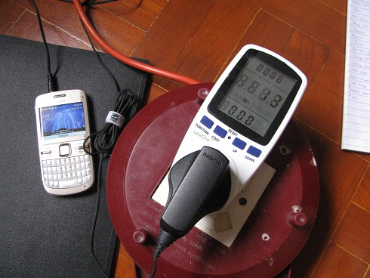
Power Consumption

Slide 70
Energy consumption of a wireless network interface in an ad hoc networking environment
Energy Metering Framework for Android Smartphones using AppScope

Slide 71
Lucent IEEE 802.11 DSSS PC Card Characteristics

Slide 72
Approach
Make measurements and report helpful results.
packet oriented
network oriented
Use numeric results as input to network simulations.
Precise values are less important than developing insights that are useful for protocol development.

Slide 73
Linear Model
Fixed component: channel acquisition
Incremental component: packet size
Linear regression is used to test the model and find
values for m and b.
Model ignores backoff and retransmissions, which are
better analyzed using a traffic and mobility model.

Slide 74
Incremental Consumption: 2Mbps

Slide 75
Incremental Consumption: 2Mbps

Slide 76
AppScope: Application Energy Metering Framework for Android Smartphones using Kernel Activity Monitoring

Slide 77
How can we estimate application energy?

Slide 78
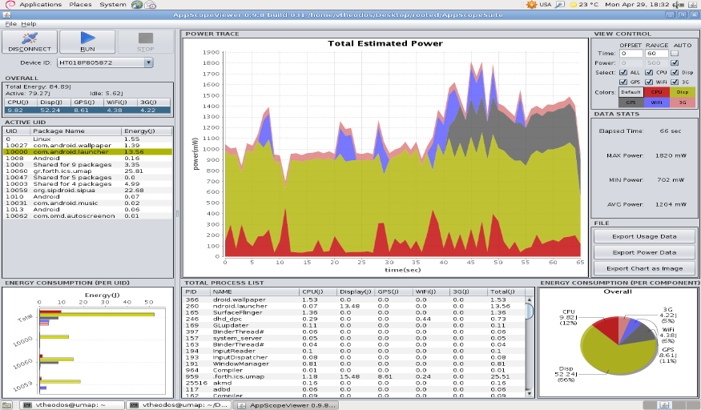
Testbed

Slide 79
Measurements

Slide 80
References
Feeney, Laura Marie, and Martin Nilsson. "Investigating the energy consumption of a wireless network interface in an ad hoc networking environment." INFOCOM 2001. Twentieth Annual Joint Conference of the IEEE Computer and Communications Societies. Proceedings. IEEE. Vol. 3. IEEE, 2001. (Slides: http://www.sics.se/~lmfeeney/publications/Files/infocom01_slides.pdf)
Yoon, Chanmin, et al. "Appscope: Application energy metering framework for android smartphone using kernel activity monitoring." USENIX ATC. 2012.
(Slides: https://www.usenix.org/sites/default/files/conference/protected-files/yoon_atc12_slides.pdf )

