Slide 1

Wireless Networks & Mobile Computing
Lecture on Physical Layer
Prof. Maria Papadopouli
University of Crete
ICS-FORTH
http://www.ics.forth.gr/mobile
<number>

Slide 2
From Signals to Packets
Analog Signal
“Digital” Signal
Bit Stream
0 0 1 0 1 1 1 0 0 0 1
Packets
0100010101011100101010101011101110000001111010101110101010101101011010111001
Header/Body
Header/Body
Header/Body
Packet
Transmission
Sender
Receiver
Note: there is no co-relation between the above figures. Each one is independent from the others.

Slide 3
Μοντέλο Τηλεπικοινωνιακών Συστημάτων
{από τη σκοπιά των σημάτων}
Ο δίαυλος επικοινωνίας μπορεί να είναι μια γραμμή μεταφορά (π.χ. τηλεφωνία, Ethernet), μια οπτική ίνα ή απλά ο ελεύθερος χώρος (όπου το σήματα εκπέμπεται σας ηλεκτρομαγνητικό κύμα).
<number>

Slide 4
Μετάδοση Σήματος
Κατά τη διάδοση του διαύλου το μεταδιδόμενο σήμα παραμορφώνεται λόγω μη γραμμικοτήτων και/ή ατελειών στην απόκριση συχνότητας του διαύλου
Άλλες πηγές υποβάθμισης είναι ο θόρυβος και οι παρεμβολές που συλλέγονται από το σήματα κατά τη διάρκεια της μετάδοσης μέσω του διαύλου.
Ο πομπός και ο δέκτης σχεδιάζονται ώστε να ελαχιστοποιούν τα αποτελέσματα του θορύβου και της παραμόρφωσης στη ποιότητα λήψης
Αναδημιουργώντας το αρχικό σήμα, χρησιμοποιώντας τη διαδικασία της από-διαμόρφωσης (demodulation)
Κύριοι πόροι: ισχύς εκπομπής (transmission power) & εύρος ζώνης (channel bandwidth)
<number>

Slide 5
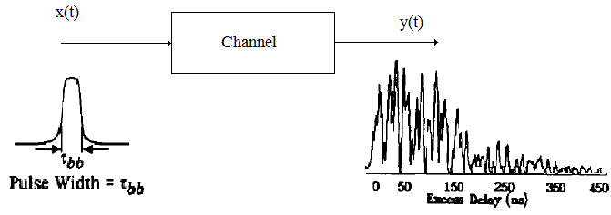
Βασικοί Όροι στα Σήματα
Σύστημα: φυσική διάταξη που παράγει ένα σήμα εξόδου σε απόκριση ενός σήματος εισόδου
Σήμα εισόδου: διέγερση (excitation)
Σήμα εξόδου: απόκριση (response)
<number>

Slide 6
Channel Model
The received signal can be modeled by a magnitude and phase, which represent the signal attenuation and delay from sender antenna to receiver antenna,
given a certain frequency, where the communication takes place
Devices use the transmission of a well-known training signal for the estimation of various parameters
<number>

Slide 7
Βασικοί Όροι στα Σήματα
Σε γραμμικά συστήματα ισχύει η αρχή της υπέρθεσης (superimposition):
Η απόκριση ενός γραμμικού συστήματος σε ένα αριθμό διεγέρσεων τα οποία εφαρμόζονται ταυτόχρονα είναι ίση με το άθροισμα των αποκρίσεων του συστήματος, όταν κάθε μια από αυτές τις διεγέρσεις εφαρμόζεται ξεχωριστά
Φίλτρο: διάταξη επιλογής συχνότητας που χρησιμοποιείται για να περιορίσει το φάσμα ενός σήματος σε μια ζώνη συχνοτήτων
Δίαυλος: μέσο μετάδοσης που συνδέει τον πομπό με τον δέκτη του συστήματος επικοινωνίας
Περιγραφή στο πεδίο χρόνου ή συχνότητας
<number>

Slide 8
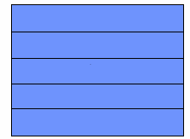
Internet – Network Layers -(TCP/IP stack)
Επίπεδο 5
Επίπεδο 4
Επίπεδο 3
Επίπεδο 2
Επίπεδο 1
application
transport
network
link
physical
Transmission of sequence of bits & signals across a link
Signal: “superimposition” of electromagnetic waves

Slide 9
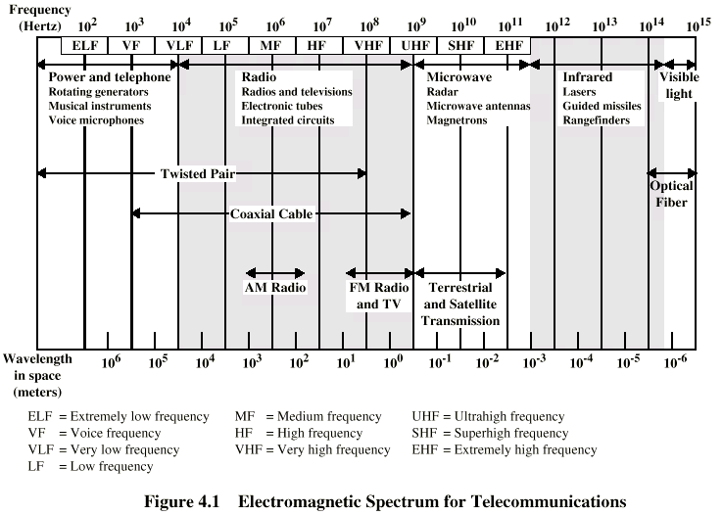
Spectrum
λ (meters) = 300 / freq in MHz

Slide 10
Transmitter & Radio Channel
Transmitter
Receiver
Transmitter
Fading
Receiver
+
Noise
<number>

Slide 11
Electromagnetic Waveforms
Two important properties
Propagate
They travel in the space from the sender to a receiver
Transfer energy
This energy can be used for data transmission
<number>

Slide 12
Antenna (1/2)
Made of conducting material
Radio waves hitting an antenna cause electrons to flow in the conductor and create current
Likewise, applying a current to an antenna creates an electric field around the antenna
As the current of the antenna changes, so does the electric field
A changing electric field causes a magnetic field, and
the wave is off …
<number>

Slide 13
Antenna (2/2)
Antenna gain
the extent to which it enhances the signal in its preferred direction
combines antenna directivity and electrical efficiency
Transmitting antenna: how well the antenna converts input power into radio waves headed in a specific direction.
Receiving antenna: how well the antenna converts the arriving waves from a specified direction into electrical power.
Isotropic antenna
radiates power with unit gain uniformly in all directions
Measured in dBi: decibels relative to an isotropic radiator
<number>
Notes:
<number>

Slide 14
What is dB?
Express a ratio in logarithmic scale based on transformation
The decibel offers a number of advantages, e.g., ability to
conveniently represent very large or small numbers, and
carry out multiplication of ratios by simple addition and subtraction.
Example:
Ratio
Ratio in dB
<number>
Notes:
<number>

Slide 15
What is dBm?
Express transmitted/received power in logarithmic scale based on transformation:
Example:
Power in mW
Power in dBm
P (mW)
P (dBm)
dBm (sometimes dBmW) is an abbreviation for the
power ratio in decibels (dB) of the
measured power referenced to one milliwatt (mW).
<number>
Notes:
<number>

Slide 16
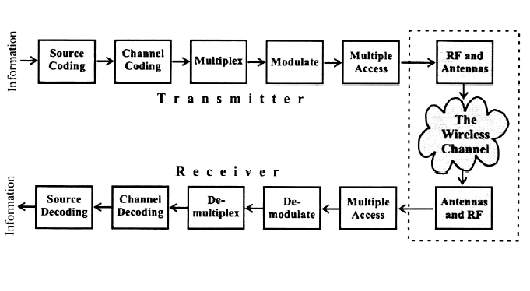
Conversion of a stream of bits into signal
Adds redundancy
Bits mapped to signal (analog signal waveform)
Conversion of a stream of bits into signal
noise
Interference
Fading
protects from interference
<number>
Notes:
<number>
The information is represented as a sequence of binary bits, the binary bits are then mapped (modulated) to analog signal waveforms and transmited over a communication channel. The communication channel introduces noise and interference to corrupt the transmitted signal. At the receiver, the channel corrupted transmitted signal is mapped back to binary bits.
The received binary information is estimate of the transmitted binary information.
Channel coding is often used in digital communication systems to protect the digital information from noise and interference and reduce the number of bit errors. Channel coding is mostly accomplished by selectively introducing redundant bits into the transmitted information stream. These additional bits will allow detection and correction of bit errors in the received data stream and provide more reliable information transmission.

Slide 17
Electromagnetic-Field Equations
In the far field, the electric & magnetic fields at any given location are:
perpendicular to both each other & to the direction of propagation from the antenna
proportional to each other (so it is sufficient to know only one of them)
In response to a transmitted sinusoid cos(2πft), the electric far field at time t can be expressed as:
E (f, t (r,θ,ψ)) = a_{s} (θ, ψ, f) * cos (2πf(t-r/c) ) / r
Point u (r,θ,ψ) in space @ which the electric field is being measured
Distance r from the transmit antenna to point u
Radiation pattern of the sending antenna @ frequency f & direction (θ,ψ)
<number>
Notes:
Χρησιμοποιούμε ημιτονοειδής συναρτήσεις λόγω της δυνατότητας επιλογής της κεντρικής συχνότητας που μπορούμε να μεταδώσουμε και λόγω των φασματικών χαρακτηριστικών που έχει αυτή η συνάρτηση (στο πεδίο της συχνότητας μια ημιτονοειδής συνάρτηση περιγράφεται από ένα Dirak). Αλλάζοντας τη διάρκεια συμβόλου (δηλ. πόσο χρόνο χρειάζεται να μεταδώσουμε ένα σύμβολο), μπορούμε να αλλάξουμε το bandwidth.
<number>

Slide 18
Wavelength of Electromagnetic Radiation
Frequency f
Wavelength λ
λ = c/f
where c is the speed of light c=3x10⁸ m/s
Example: cellular communication around 0.9GHz, 1.9GHz, and 5.8GHz → wavelength is a fraction of a meter
☞ To calculate the electromagnetic field equations at a receiver:
the locations of receiver, transmitter & obstructions need to be known with sub-meter accuracy
<number>

Slide 19

Signals
Amplitude (A) – Maximum value, peak deviation of the function
Frequency (f ): Rate, number of oscillations in a unit time interval, in cycles/sec ή Hertz (Hz)
Phase(φ) –Specifies the relative position in its cycle the oscillation begins
general wave formula s(t ) = A sin( 2π f t + φ )
Any waveform can be presented as a collection of
periodic analog signals (cosines) with different amplitudes, phases, and frequencies

Slide 20
Χρήση των ημιτονοειδή συναρτήσεων
Χρησιμοποιούμε ημιτονοειδής συναρτήσεις λόγω της δυνατότητας επιλογής της κεντρικής συχνότητας που μπορούμε να μεταδώσουμε, και
λόγω των φασματικών χαρακτηριστικών που έχει αυτή η συνάρτηση.
Στο πεδίο της συχνότητας μια ημιτονοειδής συνάρτηση περιγράφεται από ένα Dirac.
Αλλάζοντας τη διάρκεια συμβόλου (δηλ. πόσο χρόνο χρειάζεται να μεταδώσουμε ένα σύμβολο), μπορούμε να αλλάξουμε το bandwidth.

Slide 21
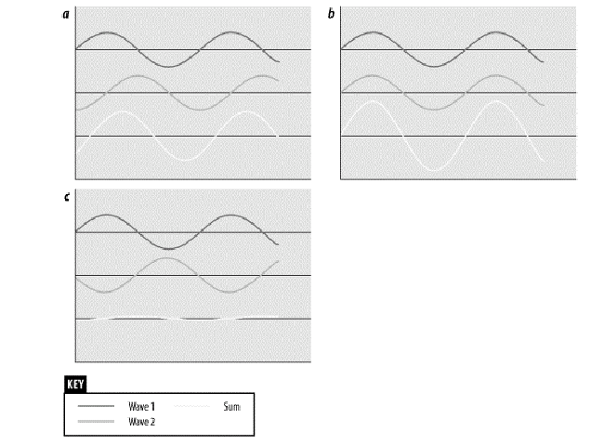
Wave “aggregation” by superposition
When multiple waves
converge on a point,
the total wave is simply
the sum of any component
waves
<number>

Slide 22
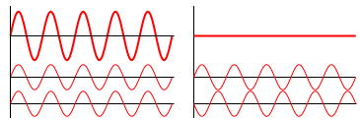
Wave “aggregation” by superposition
When two or more waves traverse the same space, the net amplitude at each point is the sum of the amplitudes of the individual waves
Destructive interference: when the summed variation has a smaller amplitude than the component variations (e.g., noise-cancelling headphones)
Constructive interference: when the summed variation will have a bigger amplitude than any of the components individually (e.g., Line Array)
<number>

Slide 23
Wireless channels
Operate through electromagnetic radiation from the transmitter to the receiver
In principle, one could solve the electromagnetic field equations, in conjunction with the transmitted signal to find the electromagnetic field impinging on the receiver antenna
☞ This would have to be done taking into account the obstructions caused by ground, buildings, vehicles, etc in the vicinity of this electromagnetic wave
Το σήμα φτάνει από διαφορετικές κατευθύνσεις, με διαφορετικές καθυστερήσεις (ακολουθώντας διαφορετικές διαδρομές)
Το σήμα που λαμβάνεται στον δέκτη αποτελείται δυνητικά από έναν αριθμό σημάτων με διαφορετική ένταση, φάση και γωνία άφιξης
<number>

Slide 24
Fundamentals
Impairments
Radio Propagation
Wireless channel model
Digital modulation and detection techniques
Error control techniques
<number>

Slide 25
Types of Impairments
  Noise: thermal (electronics at the receiver, λόγω της τυχαίας κίνησης των ηλεκτρονίων σε έναν αγωγό), human
Εξωτερικές πηγές (πχ ατμοσφαιρικός, γαλαξιακός, βιομηχανικός) & εσωτερικές πηγές (πχ στιγμιαίων διακυμάνσεων του ρεύματος ή τα τάσης στα ηλεκτρικά κυκλώματα) θορύβου
  Radio frequency signal path loss
  Fading at low rates
  Inter-Symbol interference (ISI)
  Shadow fading
  Co-channel interference
  Adjacent channel interference
<number>

Slide 26
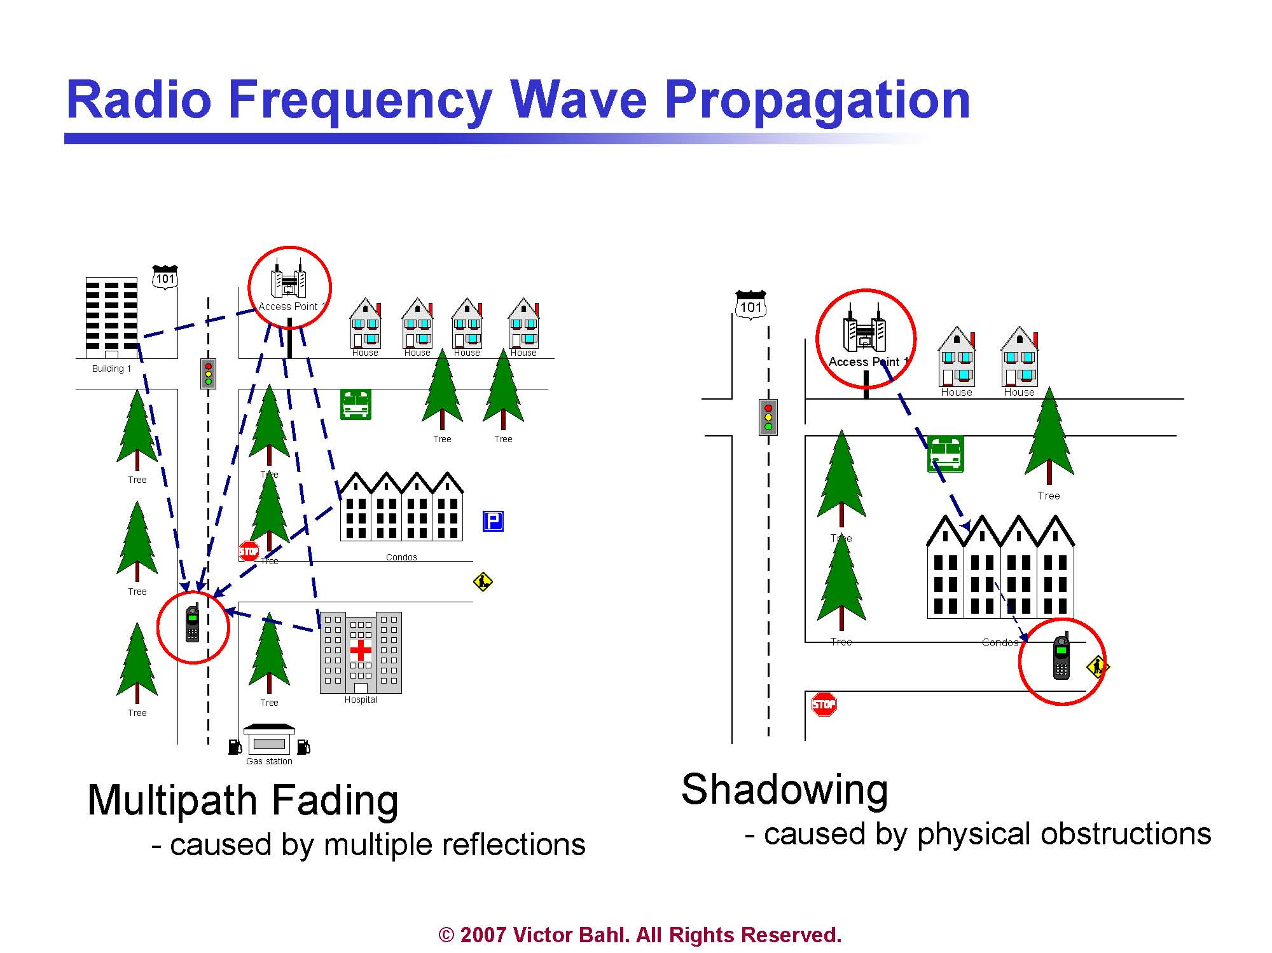

Slide 27
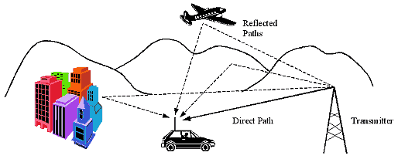
Multipath fading
Multipath: the propagation phenomenon that results in radio signals reaching the receiving antenna by two or more paths
Notes:
<number>

Slide 28
Channel impulsive response
Διάρκεια συμβόλου
By sending a pulse of very small duration to the channel, the impulsive response can be estimated
At the output, the duration of the pulse is extended due to multipath
Μπορούμε να θεωρήσουμε ότι το multi-path φαινόμενο έχει ως αποτέλεσμα το κανάλι να συμπεριφέρεται σαν φίλτρο στο πεδίο των συχνοτήτων: όπου ενισχύει άλλες συχνότητες, κι άλλες τις εξασθενεί
Notes:
Η έξοδος που παίρνομε όταν βάλομε ως είσοδο ένα παλμό Dirac.

Slide 29
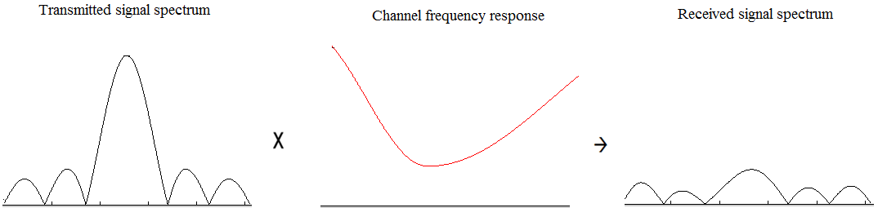
Frequency Selective Fading due to Multipath
The frequency response of a fading channel is not constant within the available bandwidth
  The channel gain may vary for different frequencies of the transmitted signal (e.g., due to multi-path)
  Channel gain: συντελεστής που εκφράζει την επίδραση στο μεταδιδόμενο σήμα
Square
distortion
H²(f): the square of channel frequency response
Το παραπάνω παράδειγμα δείχνει ένα κακής ποιότητας κανάλι, μια και παραμορφώνει σημαντικά τα φασματικά χαρακτηριστικά του μεταδιδόμενου σήματος (πχ κύριος λοβός
έχει σχεδόν εξαφανιστεί)
Notes:
<number>

Slide 30
Main issues in wireless communications
Fading: time variation of signal strength due to:
Small-scale effect of multipath fading
Larger-scale effects, such as
  Path loss via distance attenuation
  Shadowing via obstacles
Interference
Unlike the wired world, where transmitter-receiver pair can often be though of as an isolated point-to-point link, wireless users
communicate over the air & there is significant interference between them
<number>

Slide 31
Types of fading
Large-scale fading, due to path loss of signal as function of distance & shadowing by large objects (hills, buildings)
☞ This occurs as wireless devices move through a distance of the order of cell size and is typically frequency independent
  large transmitter-receiver distances
Small-scale fading, due to constructive & destructive interference of multiple signal paths between transmitter & receiver
  This occurs at the spatial scale of the order of the carrier wavelength and is frequency dependent
rapid fluctuations of the received signal strength over very short travel distances or short time durations (order of seconds)
<number>

Slide 32
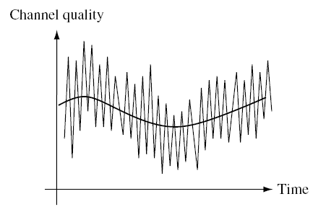
Channel quality varies over multiple time-scales
Signal strength changes over time and space
Stochastic processes to model signal strength
  Challenging task
  Environments with mobility and obstactles
Large-scale fading (“slow” scale):
due to shadowing, path-loss
Small-scale fading:
due to multipath effects
averaging
in this period
<number>

Slide 33
Large, medium & small-scale fading
Fading: fluctuation in the received signal power
Large-scale fading: average signal power attenuation/path loss due to motion over large areas.
Medium-scale fading: local variation in the average signal power around mean average power due to shadowing by local obstructions.
Small-scale: large variation in the signal power due to small changes in the distance between transmitter & receiver
Also called Rayleigh fading when no LOS availabe. It is called Rayleigh due to the fact that various multipaths at the receiver with random amplitude & delay add up together to render rayleigh PDF for total signal
<number>
Notes:
<number>

Slide 34
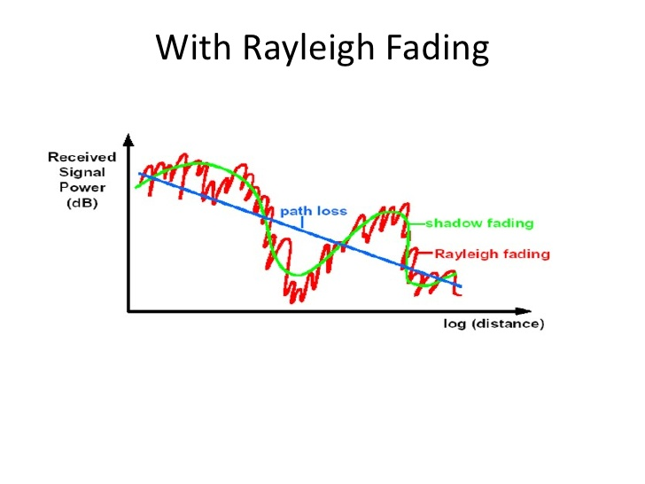
Thanks to Nitin Jain’s presentation
on intro to wireless fading slides
<number>

Slide 35
Multipath fading
Fluctuation in the received power due to
Variations in the received signal amplitude
Variation in the signal phase
Variations in the received signal angle of arrival (different paths travelling different distances may have different phases & angle of arrival)
There is signal superimposition …
<number>

Slide 36
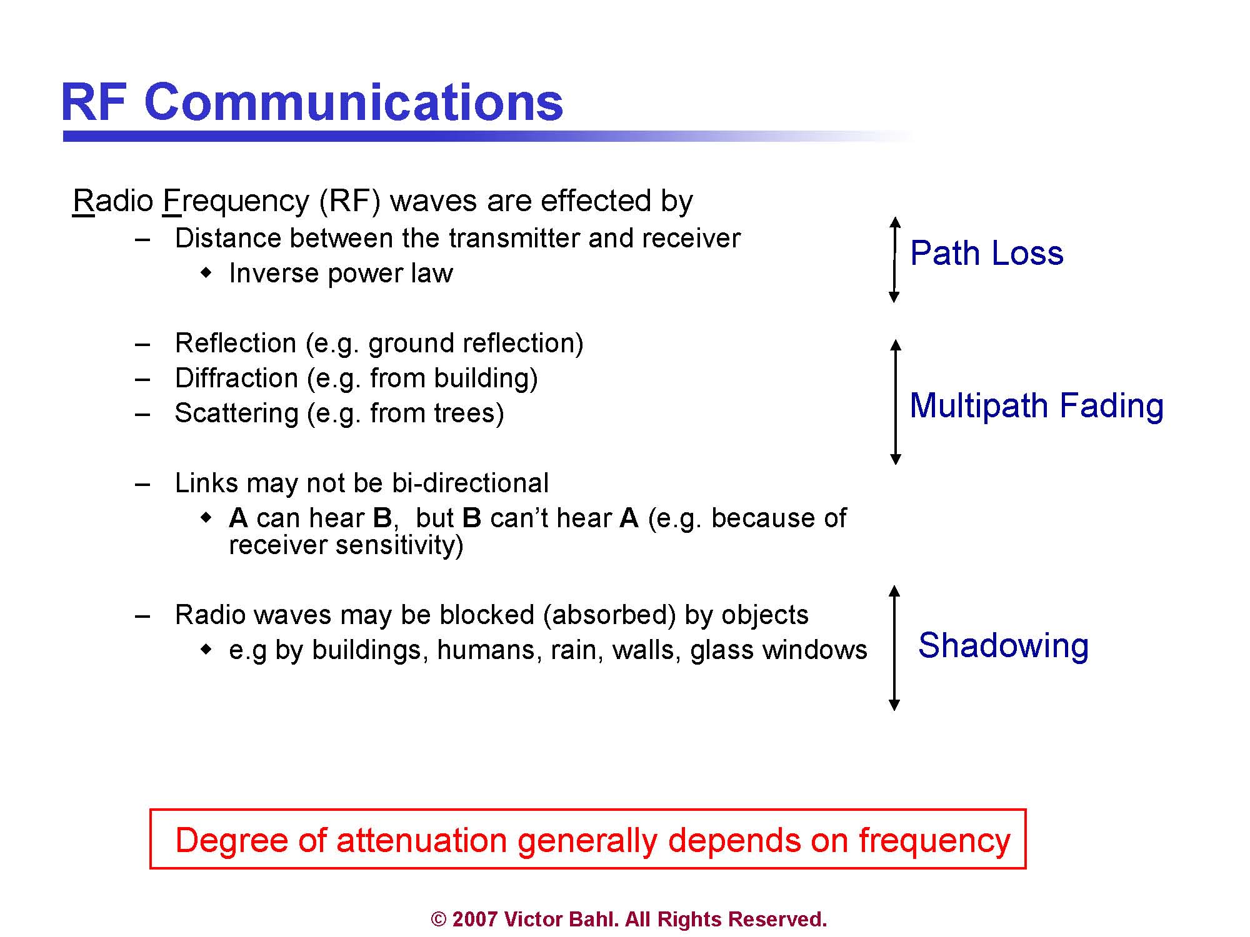
Related to the asymmetry in
wireless links network characteristics in one
direction may be different than
those in the opposite direction

Slide 37
Different types of fading
Wall
Scattering
Transmitter
Receiver
Cabinet
Diffraction (Shadow Fading)
Reflection
Wall
<number>
Notes:
Diffraction refers to various phenomena which occur when a wave encounters an obstacle. In classical physics, the diffraction phenomenon is described as the apparent bending of waves around small obstacles and the spreading out of waves past small openings.
<number>

Slide 38
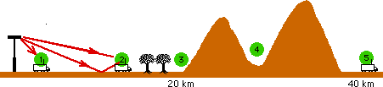
Example of multi-path effect
@ 1: free space loss likely to give an accurate estimate of path loss
@ 2: strong line-of-sight but ground reflections can significantly influence path loss
@3: significant diffraction losses caused by trees cutting into the direct line of sight
@ 4: simple diffraction model for path loss
@ 5: multiple diffraction, loss prediction fairly difficult & unreliable
<number>

Slide 39
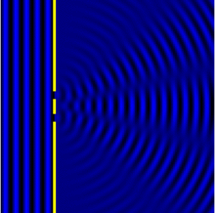
Diffraction
Diffraction refers to various phenomena which occur when a wave encounters an obstacle.
In classical physics, the diffraction phenomenon is described as the apparent bending of waves around small obstacles and the spreading out of waves past small openings.
<number>

Slide 40
Shadow Fading
Obstacles and their absorption behavior
Shadowing differs from multi-path fading
☞ Duration of shadow fade lasts for multiple seconds or minutes
a much slower time-scale compared to multi-path fading
<number>

Slide 41
Reflection
Wave impinges upon a large object when compared to the wavelength of the propagating wave
Reflections occur from the surface of
  The earth
  Buildings
  Walls
<number>

Slide 42
Scattering
Another type of reflection
Can occur in the atmosphere or in reflections from very rough objects
Very large number of individual paths
☞ Received waveform is better modeled as an
integral over paths with infinitesimally small differences in their lengths rather than as a sum
<number>

Slide 43
Multi-path Delay Spread
Time between the arrival of the first wavefront & last multi-path echo,
counting only the paths with significant energy
Longer delay spreads require more conservative coding
802.11b networks can handle delay spreads of < 500 ns
Performance is much better when the delay spread is low
When delay spread is large
cards may reduce transmission rate
<number>

Slide 44
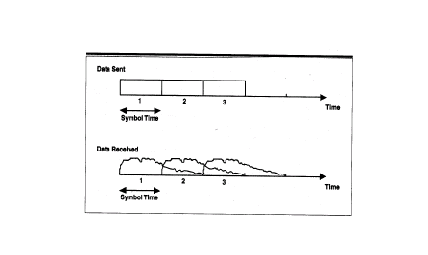
Inter-Symbol Interference (ISI)
Waves that take different paths from the transmitter to the receiver:
travel different distances
be delayed with respect to each other
Waves are combined by superposition but the effect is that the total waveform is garbled
Overflowing symbols
Παρατηρείστε ότι το σήμα εκτίνεται σε μεγαλύτερη διάρκεια από αυτή
του συμβόλου (και παρεμβάλλεται στα γειτονικά σύμβολα). Αυτό οφείλεται στο
multi-path φαινόμενο.
<number>

Slide 45
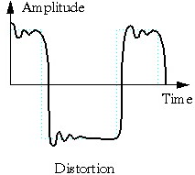
Distortion
Caused by the propagation speed & fading
Depends on the frequency (varies in different frequencies)
Different frequencies
suffer different attenuation
Frequency Selective Fading:
the channel gain varies for
different frequencies
of the transmitted signal

Slide 46
Frequency Selective Fading
The frequency response of a fading channel is not constant within the available bandwidth
  The channel gain may vary for different frequencies of the transmitted signal
Square
distortion
x-axis: frequency
H²(f): the square of channel frequency response
Notes:
<number>

Slide 47
Channel Impulse Response
If the channel is stationary over a small time interval the channel impulse response may be written as:
(κρουστική απόκριση)
α_{i} & θ_{i} : the amplitude & phase of the i^{th} multipath copy
t_{i} : time of arrival of the i^{th} copy
δ(t) is the Dirac function
Βλέπουμε ότι το h(t): άθροισμα από Dirac συναρτήσεις
Η συνάρτηση εξόδου είναι η συνέλιξη (convolution) του σήματος εισόδου και της κρουστικής απόκρισης του καναλιού.

Slide 48
Channel Impulse Response
If the channel is stationary over a small time interval the channel impulse response may be written as:
α_{i} & θ_{i} : the amplitude & phase of the i^{th} multipath copy
t_{i} : time of arrival of the i^{th} copy
δ(t) is the Dirac function
Channel frequency response H(f): Fourier transform of h(t)

Slide 49
Power Spectral Density of
the Received Signal
The power spectral density of the received signal (S_{r}) is equal to the power spectral density of the transmitted signal (S_{t})
multiplied by the
square of the amplitude of the channel frequency response

Slide 50
Doppler Effect
The Doppler effect is observed whenever the source of waves is moving with respect to an observer
It is the effect produced by a moving source of waves in which there is an apparent upward (downward) shift in frequency for observers towards whom the source is approaching (receding), respectively
The shift in frequency of the wave that is caused by the relative motion of the source of the wave (transmitter) and the observer (receiver)
<number>

Slide 51
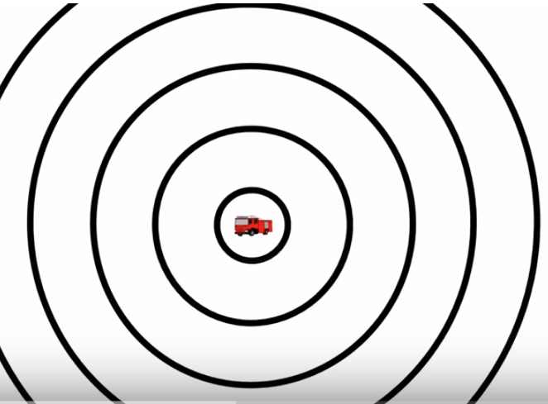
<number>

Slide 52
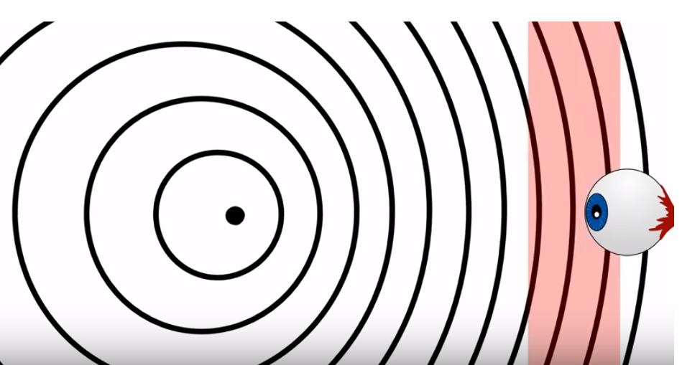
As the transmitter moves closer to the observer the wave is delivered in a higher “pitch” (frequency)
<number>

Slide 53
Doppler spread
When a sinusoidal pulse of frequency f_{c} is transmitted over a multi-path channel, the received spectrum will have components in the range f_{c}- f_{d} to f_{c}+ f_{d}
f_{d}: Doppler spread:
v: velocity of the receiver
θ: direction of arrival of the received signal
λ: wavelength

Slide 54
Coherence time
Definition:
The time interval over which the channel impulsive response is considered stationary
Typical assumption:
Doppler spread and coherence time are related by the formula:
K: constant in the range of 0.25 to 0.5

Slide 55
Time Variance: Fast Fading
The channel changes drastically many times while a symbol is propagating
Causing:
Severe distortion of baseband pulse leading to detection problems
Loss in SNR
Synchronization problems
<number>

Slide 56
Time Variance: Slow Fading
The channel does NOT change drastically during the symbol propagation
causing: Loss in SNR
<number>

Slide 57
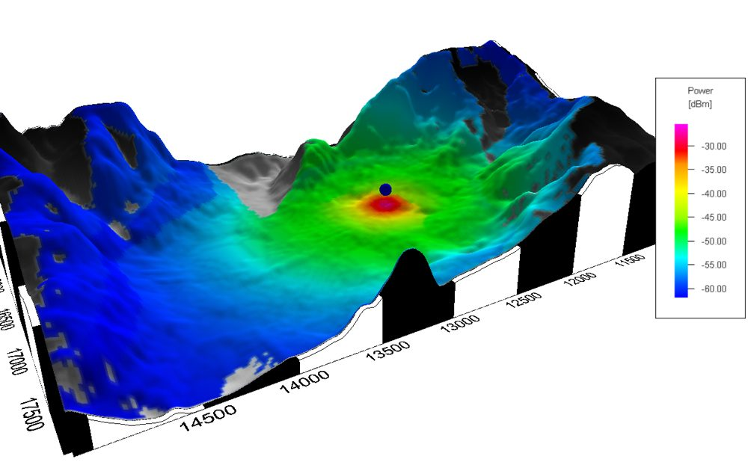
Propagation Models (Large-scale fading)
One of the most difficult part of the radio channel design
Done in statistical fashion based on measurements made specifically for an intended communication system or spectrum allocation
Predicting the average signal strength at a given distance from the transmitter
<number>

Slide 58
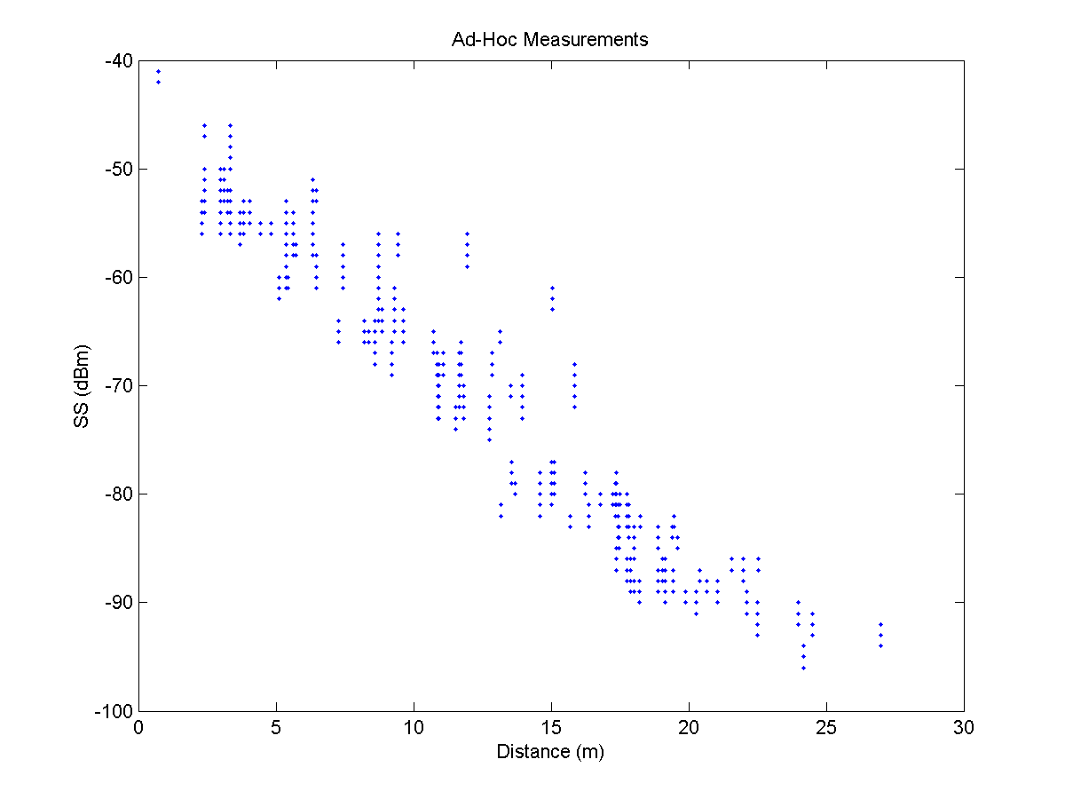
Some Real-life Measurements
<number>

Slide 59
Signal Power Decay with Distance
☹ A signal traveling from one node to another experiences fast (multipath) fading, shadowing & path loss
☞ Ideally, averaging RSS over sufficiently long time interval
excludes the effects of multipath fading & shadowing ⇨
general path-loss model:
P(d) = P₀ – 10n log₁₀ (d/d_{o})
n: path loss exponent
P(d): the average received power in dB at distance d
P₀ is the received power in dB at a short distance d₀
_
_
<number>

Slide 60
Signal Power Decay with Distance
In practice, the observation interval is not long enough to mitigate the effects of shadowing
☞ The received power is commonly modeled to include both path-loss & shadowing effects, the latter of which are modeled as a zero-mean Gaussian random variable with std deviation σ_{sh} in the logarithmic scale, P(d), in dB can be expressed:
P(d) ~ N (P(d), σ_{sh}²)
This model can be used in both line-of-sight (LOS) & NLOS scenarios
with appropriate choice of channel parameters
_
<number>

Slide 61
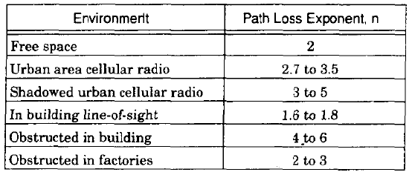
Path loss exponents for different environments

Slide 62
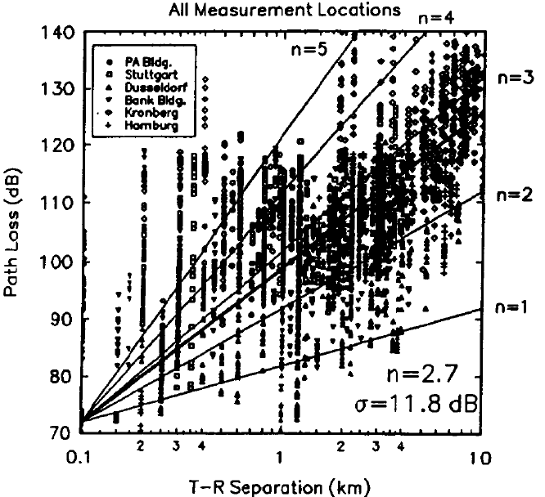
Path loss model
for various cities in Germany
Parameters
n=2.7
σ= 11.8 dB
correspond to all cities

Slide 63
Free-space Propagation Model
Assumes a single direct path between the base station and the mobile
Predicts received signal strength when the transmitter & receiver have a clear, unobstructed line-of-sight path between them
Typically used in an open wide environment
Examples: satellite, microwave line-of-sight radio links
<number>

Slide 64
Free-space Propagation Model
Derived from first principles: power flux density computation
Any radiating structure produces electric & magnetic fields:
its current flows through such antenna and
launches electric and magnetic fields
The electrostatic and inductive fields
decay much faster with distance than the radiation field
At regions far way from the transmitter:
the electrostatic & inductive fields become negligible and
only the radiated field components need be considered
<number>

Slide 65
Free-space Propagation Model
P_{r}(d)=P_{t}G_{t}G_{r}λ²/[(4π)²d²L]
P_{t},P_{r}: transmitter/receiver power
G_{t}, G_{r}: transmitter/receiver antenna gain
G = 4πA_{e}/λ²
L: system loss factor (L=1 no loss)
A_{e:} related to the physical size of the antenna
λ: wavelength in meters, f carrier frequency, c :speed of light
λ = c/f
<number>

Slide 66
Two-ray ground reflection model
T (transmitter)
P_{r}(d) = P_{t}G_{t}G_{r}h_{r}²h_{t}²/d⁴
R (receiver)
h_{t}
h_{r}
d
<number>

Slide 67
Two-ray Ground Reflection Model
Considers both the direct path & a ground reflected propagation path between transmitter and receiver
Reasonably accurate for predicting the large-scale signal strength
over distances of several km for mobile radio systems that use tall tower (heights which exceed 40m)
for line-of-sight micro-cell channels in urban environment
<number>

Slide 68
Multiple Reflectors
Use ray tracing
Modeling the received waveform as the sum of the responses from the different paths rather than just two paths
Finding the magnitudes and phases of these responses is not a simple task
<number>

Slide 69
Multi-path Delay Spread
Difference in propagation time between the
longest and shortest path,
counting only the paths with significant energy
<number>

Slide 70
Modeling Electromagnetic Field
In the cellular bands the wavelength is a fraction of meter
To calculate the electromagnetic field at the receiver, the locations of the receiver and the obstructions would have to be known with sub-meter accuracies.
<number>

Slide 71
Free space Fixed transmit & Receive Antennas
In the far field, the electric field and magnetic field at any given location are
perpendicular both to each other & to the direction of propagation from the antenna
proportional to each other
<number>

Slide 72
Free-space fixed transmit & receive antennas
In response to a transmitted sinusoid cos(2πft), the electric far field at time t can be expressed as:
E( f, t,( d, θ, ψ)) = a_{s}( θ, ψ, f) cos(2 π f (t-d/c)) / d
vertical & horizontal angles from the antenna to u
Radiation pattern of sending antenna at frequency f (incl. antenna loss)
point u in space @ which the electric field is being measured
d distance from the transmit to receive antennas
<number>

Slide 73

Physical-layer Model — Criterion for Successful Transmission
subset of nodes simultaneously transmitting at some time instance over a certain sub-channel.
Power level chosen by node X_{k}
ambient noise power level
minimum
Signal-to-interference ratio
Signal power decays with distance
<number>

Slide 74
Signal-to-noise ratio (SNR)
The ratio between the magnitude of background noise and the magnitude of un-distorted signal (meaningful information) on a channel
Higher SNR is better (i.e., cleaner)
It determines how much information each symbol can represent
<number>

Slide 75
Capacity of a channel
How many bits of information can be transmitted without error per sec over a channel with
bandwidth B
average signal power P
the signal is exposed to an additive, white (uncorrelated) noise of power N with Gaussian probability distribution
☞ provides the fundamental limit of communication achievable by any scheme
<number>

Slide 76
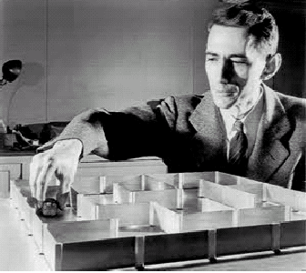
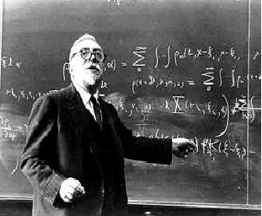
Limits of wireless channel
Shannon [1948] defined the capacity limit for communication channels
Shannon (1916-2001)
Norbert Wiener (1894-1964)
<number>

Slide 77
Shannon’s limit
For a channel without shadowing, fading, or ISI, the maximum possible data rate on a given channel of bandwidth B is
R=Blog₂(1+SNR) bps,
where SNR is the received signal to noise ratio
Shannon’s is a theoretical limit that cannot be achieved in practice but design techniques improve data rates to approach this bound
<number>

Slide 78
Digital Radio Communications
Data
In
Baseband
Modulation
Carrier
Radio
Channel
Transmitter
Conversion of a stream of bits into signal
Carrier
Bit &Frame
Sync
Detection
Decision
Data
Out
Receiver
Conversion of the signal to a stream of bits
<number>

Slide 79
Conversion of a stream of bits into signal
Adds redundancy
Bits mapped to signal (analog signal waveform)
Conversion of a stream of bits into signal
noise
Interference
Fading
protects from interference
<number>
Notes:
<number>
The information is represented as a sequence of binary bits, the binary bits are then mapped (modulated) to analog signal waveforms and transmited over a communication channel. The communication channel introduces noise and interference to corrupt the transmitted signal. At the receiver, the channel corrupted transmitted signal is mapped back to binary bits.
The received binary information is estimate of the transmitted binary information.
Channel coding is often used in digital communication systems to protect the digital information from noise and interference and reduce the number of bit errors. Channel coding is mostly accomplished by selectively introducing redundant bits into the transmitted information stream. These additional bits will allow detection and correction of bit errors in the received data stream and provide more reliable information transmission.

Slide 80
Adds redundancy to protect the digital information from noise and interference
Bits mapped to signal (analog signal waveform)
e.g., GFSK
e.g., TDMA,
CDMA
<number>
Notes:
<number>
The information is represented as a sequence of binary bits, the binary bits are then mapped (modulated) to analog signal waveforms and transmited over a communication channel. The communication channel introduces noise and interference to corrupt the transmitted signal. At the receiver, the channel corrupted transmitted signal is mapped back to binary bits.
The received binary information is estimate of the transmitted binary information.
Channel coding is often used in digital communication systems to protect the digital information from noise and interference and reduce the number of bit errors. Channel coding is mostly accomplished by selectively introducing redundant bits into the transmitted information stream. These additional bits will allow detection and correction of bit errors in the received data stream and provide more reliable information transmission.

Slide 81
Antenna (1/2)
Made of conducting material
Radio waves hitting an antenna cause electrons to flow in the conductor and create current
Likewise, applying a current to an antenna creates an electric field around the antenna
As the current of the antenna changes, so does the electric field
A changing electric field causes a magnetic field, and
the wave is off …
<number>

Slide 82
Antenna (2/2)
Antenna gain
the extent to which it enhances the signal in its preferred direction
combines antenna directivity and electrical efficiency
Transmitting antenna: how well the antenna converts input power into radio waves headed in a specific direction.
Receiving antenna: how well the antenna converts the arriving waves from a specified direction into electrical power.
Isotropic antenna
radiates power with unit gain uniformly in all directions
Measured in dBi: decibels relative to an isotropic radiator
<number>
Notes:
<number>

Slide 83
What is dB?
Express a ratio in logarithmic scale based on transformation
The decibel offers a number of advantages, e.g., ability to
conveniently represent very large or small numbers, and
carry out multiplication of ratios by simple addition and subtraction.
Example:
Ratio
Ratio in dB
<number>
Notes:
<number>

Slide 84
What is dBm?
Express transmitted/received power in logarithmic scale based on transformation:
Example:
Power in mW
Power in dBm
P (mW)
P (dBm)
dBm (sometimes dBmW) is an abbreviation for the
power ratio in decibels (dB) of the
measured power referenced to one milliwatt (mW).
<number>
Notes:
<number>

Slide 85
Channel Coding
Protects the digital information from noise & interference & reduces the number of bit errors
Accomplished by selectively introducing redundant bits into the transmitted information stream
These additional bits allow detection & correction of bit errors in the received data stream
<number>

Slide 86
Encoding
Use two discrete signals, high and low, to encode 0 and 1
Transmission is synchronous, i.e., a clock is used to sample the signal
  In general, the duration of one bit is equal to one or two clock ticks
  Receiver’s clock must be synchronized with the sender’s clock
Encoding can be done one bit at a time or in blocks of, e.g., 4 or 8 bits
<number>

Slide 87
Why Do We Need Encoding?
Meet certain electrical constraints
  Receiver needs enough “transitions” to keep track of the transmit clock
  Avoid receiver saturation
Create control symbols, besides regular data symbol
e.g. start or end of frame
Error detection or error corrections
  Some codes are illegal so receiver can detect certain classes of errors
  Minor errors can be corrected by having multiple adjacent signals mapped to the same data symbol
Encoding can be very complex, e.g. wireless
<number>

Slide 88
Digital Modulation
The process of
taking information from a message source (baseband) in a suitable manner for transmission &
translating the baseband signal onto a radio carrier at frequencies that are very high compared to the baseband frequency
<number>

Slide 89
Why not modulate the baseband
For effective signal radiation the length of the antenna must be proportional to the transmitted wave length
  For example, voice range 300-3300Hz
At 3kHz at 3kbps would imply an antenna of 100Km!
By modulating the baseband on a 3GHz carrier the antenna would be 10cm
To ensure the orderly coexistence of multiple signals in a given spectral band
To help reduce interference among users
For regulatory reasons
<number>

Slide 90
Demodulation
The process of extracting the baseband from the carrier so that it may be processed and interpreted by the receiver (e.g., symbols detected and extracted)
<number>

Slide 91
Signal Representation
each signal can be written as a linear combination of a sinusoidal and cosusoidal functions
c*sin(2πF_{c} *t+φ)= a*sin(2πF_{c} *t) + b*cos(2πF_{c} *t)
Οι βάσεις του χώρου είναι το ημίτονο και το συνημίτονο. Επομένως το παραπάνω σήμα μπορεί να αντιπροσωπευθεί με ένα σημείο (a,b)
<number>
Notes:
<number>

Slide 92
Signal Representation
each signal can be written as a linear combination of a sinusoidal and cosusoidal functions
c*sin(2πF_{c} *t+φ)= a*sin(2πF_{c} *t) + b*cos(2πF_{c} *t)
Οι βάσεις του χώρου είναι το ημίτονο και το συνημίτονο. Επομένως το παραπάνω σήμα μπορεί να αντιπροσωπευθεί με ένα σημείο (a,b)
<number>

Slide 93
Digital Modulation Approaches
Frequency shift Keying (FSK)
  Use of different carrier frequencies to encode the various symbols
Phase shift Keying (PSK)
  Use of a single carrier frequency
  The various symbols are encoded by the phase
Quadrature Amplitude Modulation(QAM)
  Both phase & amplitude are used for the encoding of various symbols
Notes:
<number>

Slide 94
FSK modulation
An alphabet of M symbols is used (M = 2^{K} for some K∈N)
  Each symbols corresponds to a combination of K bits
The i-th symbol is mapped to carrier frequency F_{i} = (n+i)/2T
  T: symbol duration
  n: arbitrary integer (for selecting an appropriate frequency band)
In order to transmit the i-th symbol, the following signal is used
Notes:
<number>

Slide 95
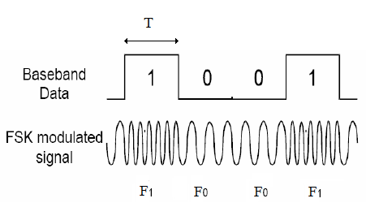
Example BFSK
Bit 0 corresponds to:
Bit 1 corresponds to:
Notes:
<number>

Slide 96
FSK demodulation
Consider a vector space with base vectors
The transmitted & the received signals correspond to different points on this vector space
  This is due to noise & the channel gain
The largest coordinate of the received signal corresponds to the transmitted symbol with high probability
Notes:
<number>

Slide 97
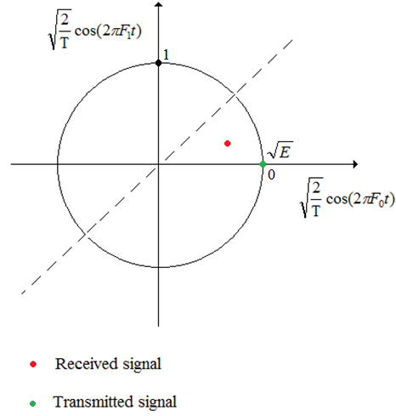
BFSK demodulation
When the received signal is bellow the dashed line, it is assumed that bit 0 is transmitted
Otherwise, it is assumed that bit 1 is transmitted
Due to path loss, there is an energy attenuation
Resulting to a received signal residing in the circle
instead of on the periphery
However, due to constructive phenomena, in other situations, the received signal may reside outside of the circle
Notes:
<number>

Slide 98
Signal Representation
each signal can be written as a linear combination of a sinusoidal and cosusoidal functions
c*sin(2πF_{c} *t+φ)= a*sin(2πF_{c} *t) + b*cos(2πF_{c} *t)
Οι βάσεις του χώρου είναι το ημίτονο και το συνημίτονο. Επομένως το παραπάνω σήμα μπορεί να αντιπροσωπευθεί με ένα σημείο (a,b)
<number>

Slide 99
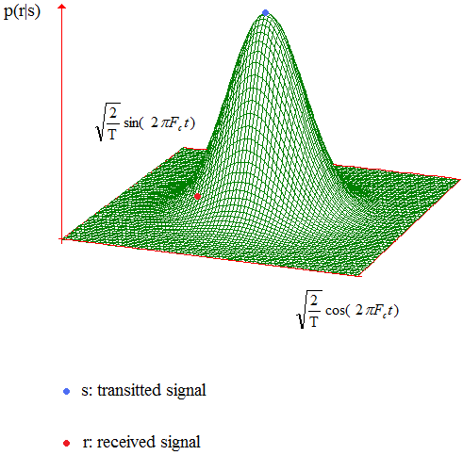
PDF of the received signal
Probability that the received signal would lie at a particular point: 2D Gaussian
The probability space of the PDF is the vector space of the signals
The peak of the distribution corresponds to the transmitted signal
Όσο μεγαλύτερος είναι ο θόρυβος τόσο πιο μεγάλο είναι το standard deviation της Gaussian κατανομής:
Μεγαλύτερη η πιθανότητα να λάβουμε ένα σήμα διαφορετικό από αυτό που έστειλε ο πομπός.
Notes:
<number>

Slide 100
PSK modulation
The alphabet contains M = 2^{K} different symbols
To transmit the i-th symbol, the following signal is transmitted
Signals S_{i}(t) are linearly dependent
they can be represented by linear combination of the vectors:
Notes:
<number>

Slide 101
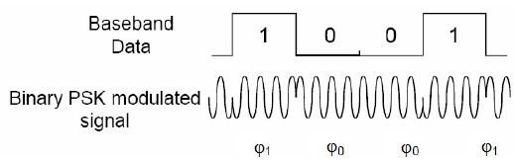
Example BPSK
Bit 0 corresponds to :
Bit 1 corresponds to:
Notes:
<number>

Slide 102
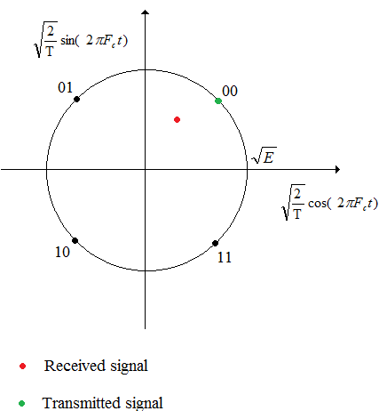
QPSK
  If the received signal lies in the 1st quadrant, assume that the
00 is transmitted
In the 2nd quadrant, assume that 01 is transmitted, etc
Notes:
<number>

Slide 103
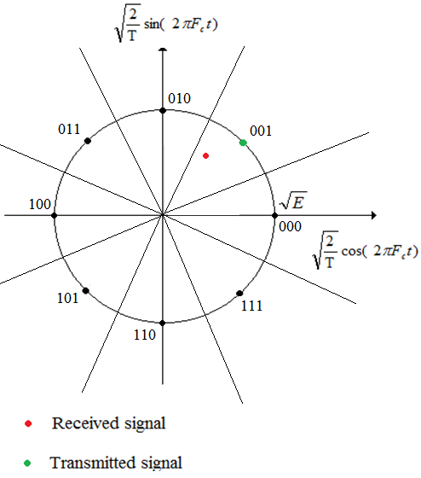
8PSK
If the received signal lies in the 1st area, it is assumed that the 000 is transmitted
If it lies in the 2nd area, it is assumed that 001 is transmitted etc
Notes:
<number>

Slide 104
QAM modulation
This modulation scheme is an expansion of PSK
  A single carrier frequency is used (F_{c})
  The transmitted & received signals are represented as linear combinations of:
The difference is that not only the phase but also the amplitude of the carrier signal may vary
Notes:
<number>

Slide 105
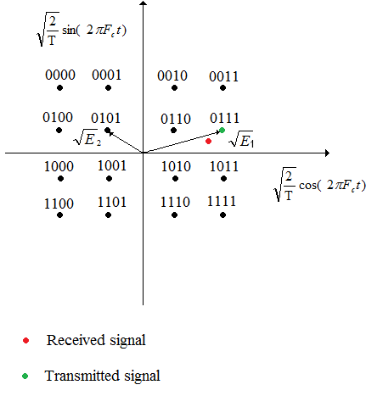
Example: 16QAM
The constellation point, closer to the received signal, is assumed to correspond to the transmitted bit combination
Notes:
<number>

Slide 106
PDF of the received signal
Probability that the received signal would lie at a particular point: 2D Gaussian
The probability space of the PDF is the vector space of the signals
The peak of the distribution corresponds to the transmitted signal
Όσο μεγαλύτερος είναι ο θόρυβος τόσο πιο μεγάλο είναι το standard deviation της Gaussian κατανομής:
Μεγαλύτερη η πιθανότητα να λάβουμε ένα σήμα διαφορετικό από αυτό που έστειλε ο πομπός.
Notes:
<number>

Slide 107
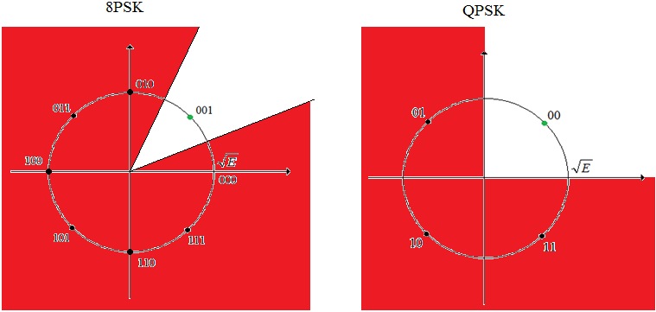
BER calculation
transmitted
symbol
To calculate BER: compute the integral of the signal PDF in red zone
For 8PSK: red zone is larger and yields a higher BER
The additional red zones in 8PSK have large probability mass ~
BER is significantly higher in 8PSK than in QPSK
Notes:
<number>

Slide 108
BER calculation
transmitted
symbol
The peak of the 2D Gaussian corresponds to
The position of the transmitted signal ⇨
the contribution to the BER of these regions is larger
Notes:
<number>

Slide 109
Gaussian frequency shift keying (GFSK)
Encodes data as a series of frequency changes in a carrier
Noise usually changes the amplitude of a signal
Modulation that ignores amplitude (e.g., broadcast FM)
☞ Relatively immune to noise
Gaussian refers to the shape of radio pulses
<number>

Slide 110
2GFSK
Two different frequencies
To transmit 1
  The carrier frequency is increased by a certain deviation
To transmit 0
  The carrier frequency is decreased by the same deviation
<number>

Slide 111
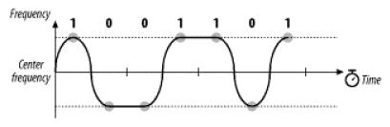
2GFSK of letter M (“1001101”)
When 1 is transmitted, frequency rises to the center frequency plus an offset
When 0 is transmitted, frequency drops by the same offset
The horizontal axis represents time and is divided into symbol periods
Around the middle of each period, the receiver measures the frequency of the transmission and translates that frequency into a symbol
<number>

Slide 112
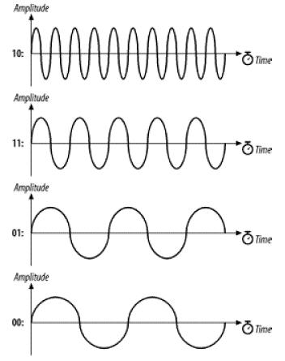
4GFSK
Extending GFSK-based methods to higher bit rates
<number>

Slide 113
2GFSK vs. 4GFSK
Distinguishing between two levels is fairly easy
Four is harder:
Each doubling of the bit rate requires that twice as many levels be present
☞ the RF components distinguish between ever smaller frequency changes
This issue practically limits the FH PHY to 2 Mbps
<number>

Slide 114
Differential Phase Shift Keying (DPSK)
Basis of 802.11 DSSS
Absolute phase of waveform is not relevant
Only changes in the phase encode data
Two carrier waves
  Shifted by a half cycle relative to each other
  Reference wave: encodes 0
  Half-cycle (180º) shifted wave: encodes 1
<number>

Slide 115
Differential quadrature phase shift keying (DQPSK)
Symbol | Phase Shift
00 | 0
01 | 90º
11 | 180º
10 | 270º
<number>

Slide 116
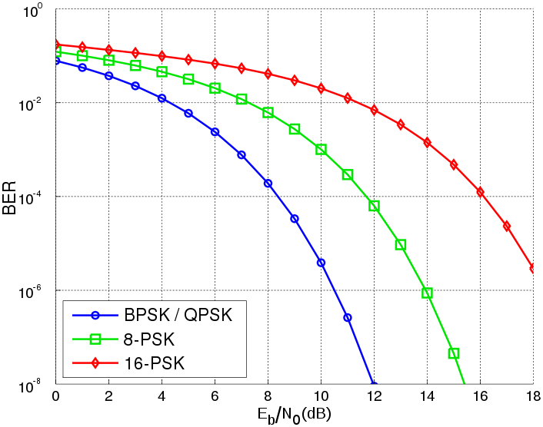
Eb: energy
No: noise
<number>

Slide 117
Multiple Access Techniques
Frequency Division Multiple Access (FDMA)
  Each device is allocated a fixed frequency
  Multiple devices share the available radio spectrum by using different frequencies
Code Division Multiple Access (CDMA)
Direct Sequence Spread Spectrum (DSSS)
Frequency Hopping (FH)
Orthogonal Frequency Division Multiplexing (OFDM)
<number>

Slide 118
Spread spectrum
Traditional radio communications focus on cramming as much signal as possible into as narrow a band as possible
Spread spectrum use mathematical functions to diffuse signal power over large range of frequencies
Spreading the transmission over wide band makes transmission look like noise to a traditional narrowband receiver
<number>

Slide 119
Spread Spectrum Technology
Spread radio signal over a wide frequency range several magnitudes higher than minimum requirement
Use of noise-like carrier waves and bandwidths much wider than that required for simple point-to-point communication at the same data rate
Electromagnetic energy generated in a particular bandwidth is deliberately spread in the frequency domain, resulting in a signal with a wider bandwidth
Used for a variety of reasons
  establishment of secure communications
  increasing resistance to natural interference and jamming
  prevent detection
Two main techniques:
  Direct sequence (DS)
  Frequency hopping (FH)
<number>

Slide 120
Frequency division multiple access
First generation mobile phones used it for radio channel allocation
Each user was given an exclusive channel
Guard bands were used to ensure that spectral leakage from one user did not cause problems for users of adjacent channels
Band 1 | Guard band | Band 2 | Guard band | Band 3
Frequency
<number>

Slide 121
Problems with FDMA ?
Wasting transmission capacity with unused guard bands …
<number>

Slide 122
Code division multiple access (CDMA)
CDMA assigns a different code to each node
Codes orthogonal to each other (i.e inner-product = 0)
Each node uses its unique code to encode the data bits it sends
Nodes can transmit simultaneously
Multiple nodes per channel
Their respective receivers
  Correctly receive a sender’s encoded data bits
    Assuming the receiver knows the sender’s code in spite of interfering transmissions by other nodes
<number>
Notes:
<number>
Has been used extensively in military for some time due to its antijamming properties and is now beginning to find widespread civilian use, particularly for use in wireless multiple access channels.

Slide 123
CDMA Example
Sender
Data
bits
d₀=1
Z_{i,m}=d_{i}*c_{m}
d₁=-1
Spread
code
1
1
1
1
1
1
1
1
-1
-1
-1
-1
-1
-1
-1
-1
Time slot 1
Time slot 0
1
1
1
1
1
1
1
1
Channel output
-1
-1
-1
-1
-1
-1
-1
-1
<number>

Slide 124
CDMA Example (cont’d)
When no interfering senders, receiver would
    Receive the encoded bits
    Recover the original data bit, d_{i}, by computing
d_{i}= — Σ Z_{i,m}*c_{m}
Interfering transmitted bit signals are additive
M
m=1
<number>
Notes:
<number>
CDMA’s assumption that interfering transmitted bit signals are additive

Slide 125
CDMA Philosophy
Interference seen by any user is made as similar to white Gaussian noise as possible
Power of that interference is kept to a minimum level and as consistent as possible
The above are achieved by the following
  Tight power control among users within the same cell
  Making the received signal of every user as random looking as possible via modulating the coded bits onto a long pseudo-noise sequence
  Averaging the interference of many users in nearby cells. This averaging makes the aggregate interference to look as Gaussian
  reduces the randomness of the interference level due to varying locations of the interference
<number>

Slide 126
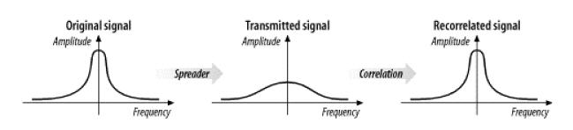
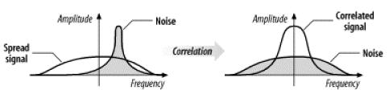
Inverts the “spreading process”
Flatten the amplitude across a relatively wide band
The receiver’s correlation function effectively ignores narrowband noise
<number>

Slide 127
Orthogonal Frequency Division Multiplexing
Related to the Frequency Division Multiplexing (FDM)
Distributes the data over a large number of carriers
  Spaced apart at precise frequencies
Encodes portion of the signal across each sub-channel in parallel
This spacing provides the "orthogonality"
  Preventing demodulators from seeing other frequencies
Provides
  High spectral efficiency
  Resiliency to RF interference
  Lower multi-path distortion
<number>

Slide 128
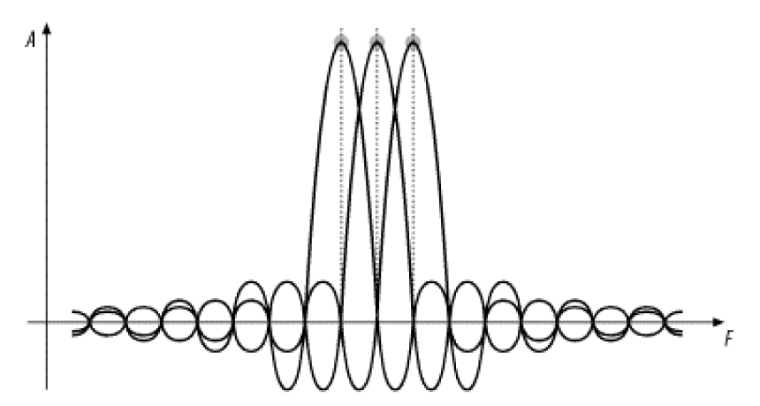
OFDM
OFDM
@ the peak of each of the subcarriers
the other 2 subcarriers have 0 amplitude
Orthogonality is best seen in the frequency domain, looking at a spectral breakdown of a signal
The frequencies of the subcarriers are selected so that at each subcarrier frequency, all other subcarriers do not contribute to the overall waveform
The signal has been divided into its three subcarriers
The peak of each subcarrier, shown by the heavy dot at the top, encodes data
The subcarrier set carefully designed to be orthogonal
<number>

Slide 129
FDM vs. OFDM
<number>

Slide 130
Example of OFDM Transmitter & Receiver
<number>

Slide 131
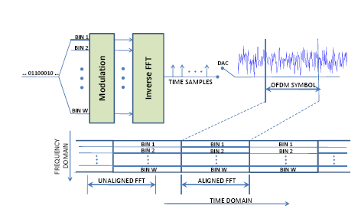
Example of OFDM
<number>

Slide 132
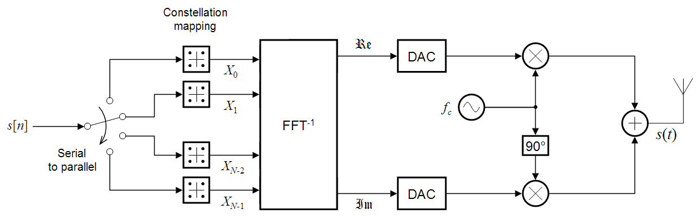
OFDM Modulation
The bit stream is divided into N parallel subflows
The symbols of each subflow are modulated using MPSK or MQAM
Resulting complex numbers are fed to a module that performs FFT⁻¹
Finally the signal is converted from digital to analog, brought to the RF frequencies, and then fed to the antenna of the transmitter
Notes:
<number>

Slide 133
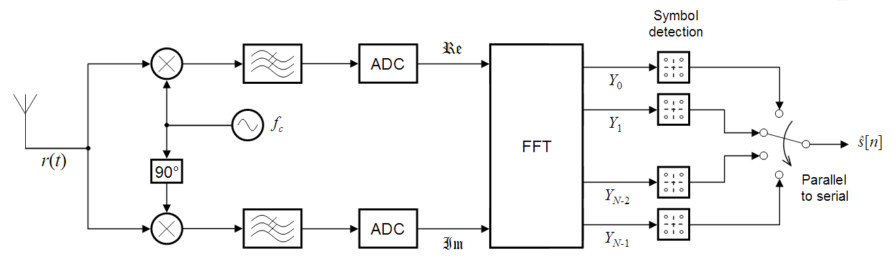
OFDM Demodulation
At the receiver the inverse procedure is followed
The signal is brought down to baseband & is converted from analog to digital
FFT is performed ⇨ produces the transmitted symbols
Notes:
<number>

Slide 134
Frequency Selective Fading
The frequency response of a fading channel is not constant within the available bandwidth
  The channel gain may vary for different frequencies of the transmitted signal
  Channel gain: συντελεστής που εκφράζει την επίδραση στο μεταδιδόμενο σήμα
Square
distortion
H²(f): the square of channel frequency response
Το παραπάνω παράδειγμα δείχνει ένα κακής ποιότητας κανάλι, μια και παραμορφώνει σημαντικά τα φασματικά χαρακτηριστικά του μεταδιδόμενου σήματος (πχ κύριος λοβός
έχει σχεδόν εξαφανιστεί)
Notes:
<number>

Slide 135
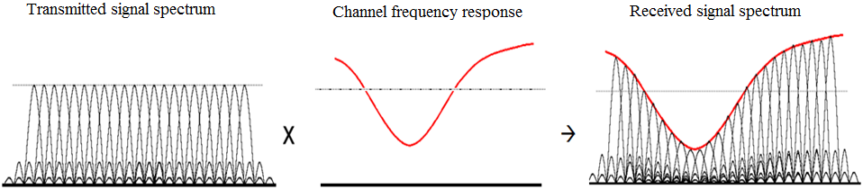
Use OFDM
To reduce the effect of frequency selective fading
  The total available bandwidth is divided into N frequency bins
  The number N is selected such that the channel frequency response is almost constant at each bin (Flat fading)
Υποκανάλια μικρού εύρους συχνότητας ώστε να υπάρχει μόνο εξασθένηση
ή ενδυνάμωση και όχι παραμόρφωση.
Square
Multiple transmitted signals (one symbol per frequency bin)
Note: larger symbol duration per bin (compared to spread spectrum schemes)
There is (a different) attenuation at each bin but the spectral characteristics of the signal remain the same (μόνο το πλάτος του σήματος αλλοιώνεται, αλλά όχι η παρουσία των λοβών/”σχήμα” τους)
Notes:
<number>

Slide 136
CDMA vs. OFDM
OFDM encodes single transmission into multiple subcarriers
CDMA puts multiple transmissions into single carrier
<number>

Slide 137
Frequency Hopping
Timing the hops accurately is the key
Transmitter and receiver in synch
Each frequency is used for small amount of time (dwell time)
Orthogonal hoping sequences
Beacons include timestamp and hop pattern number
Divides the ISM band into a series of 1-MHz channels
No sophisticated signal processing required
  To extract bit stream from the radio signal
<number>

Slide 138
Frequency Hopping
Timing the hops accurately is the challenge
Frequency
slot
5
User A
4
User B
3
2
1
0
Time slot
<number>

Slide 139
Wireless network interfaces
Measure the energy level in a band
Energy detection is cheap, fast, & requires no knowledge of the characteristics of the signal
However, choosing energy thresholds is not robust across a wide range of SNRs
Though more sophisticated mechanisms, such as matched filter detection, are more accurate
  they require knowledge of the transmitted signal (e.g., modulation, packet format, pilots, bandwidth), and thus work only for known technologies
<number>

Slide 140
Network Layers -(TCP/IP stack)
application
How neighboring
devices access
the link
transport
network
link
In IEEE802.11, devices may compete for the broadcast channel
IEEE802.11
physical
Transmission of sequence of bits & signals across a link

Slide 141
IEEE 802.11 Family
802.11b:
Direct Sequence Spread Spectrum (DSSS) or Frequency Hopping (FH), operates at 2.4GHz, 11Mbps bitrate
802.11a: between 5GHz and 6GHz uses orthogonal frequency-division multiplexing, up to 54Mbps bitrate
802.11g: operates at 2.4GHz up to 54Mbps bitrate
All have the same architecture & use the same MAC protocol

Slide 142
Coverage of a Cell
The largest distance between the base-station & a mobile at which communication can reliably take place
Cell coverage is constrained by the fast decay of power with distance
To alleviate the inter-cell interference, neighboring cells use different parts of the frequency spectrum
The rapid signal attenuation with distance is also helpful; it reduces the interference between adjacent cells
Spatial reuse
Frequency is reused at cells that are far enough
<number>

Slide 143


Hidden Node Problem
Node 1
Node 3
Node 2
From the perspective of node 1
  Node 3 is hidden
If node 1 and node 3 communicate simultaneously
  Node 2 will be unable to make sense of anything
Node 1 and node 3 would not have any indication of error
  The collision was local to node2
<number>

Slide 144
Carrier-Sensing Functions
Physical carrier-sensing
  Expensive to build hardware for RF-based media
  Transceivers can transmit and receive simultaneously
    Only if they incorporate expensive electronics
  Hidden nodes problem
  Fading problem
Virtual carrier-sensing
  Collision avoidance:
    Stations delay transmission until the medium becomes idle
  Reduce the probability of collisions
Undetectable collisions
<number>

Slide 145
Next ….
We will talk more about IEEE802.11 MAC
and then about performance issues of wireless networks …
<number>

