Slide 1


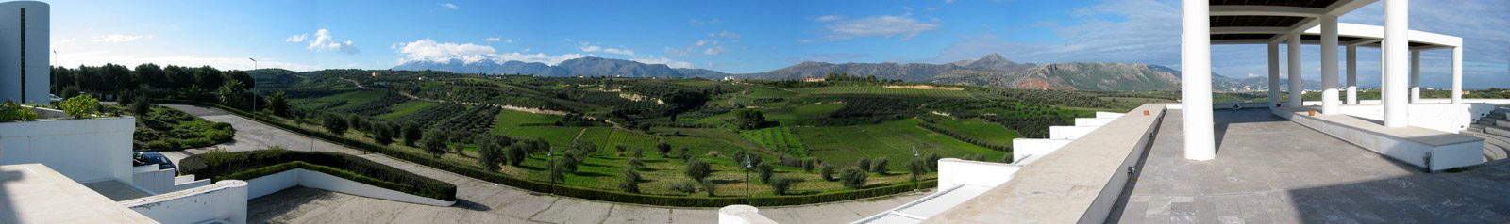
UNIVERSITY OF CRETE
Crowdsourcing, Participatory & Cooperative Systems
Maria Papadopouli
Professor
University of Crete
Foundation for Research & Technology – Hellas (FORTH)
http://www.ics.forth.gr/mobile
Notes:
1

Slide 2
Growth opportunities in Mobile Computing
Trends that cause this growth:
  mobile device capacity growth
  advances in networks
  cloud services
  user-generated content
  mobile services
  virtualization
Service oriented technologies
Business aspects of service composition
People in services
Service innovation management

Slide 3

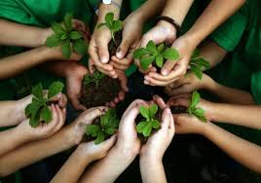

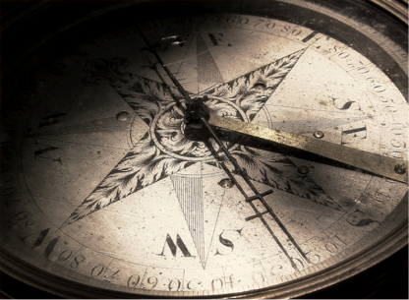

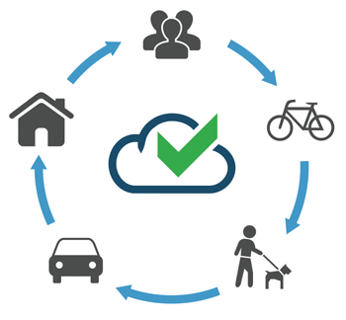
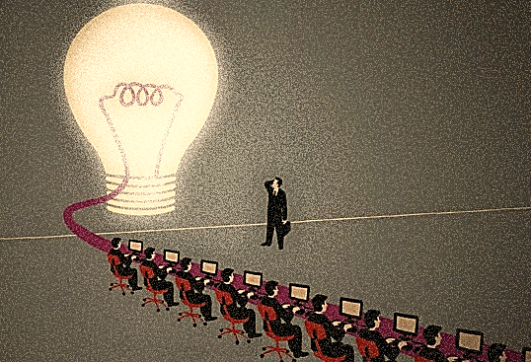

New cooperative business service models
Tech
Innovation
Environmental
Pressure
Economic
Reality
New
Values

Slide 4
Examples of cooperation & resource sharing
Peer-to-peer systems for sharing movies & audio
Sharing network connection
Sharing feedback/reviews about services
  Crowdsourcing/Participatory systems
  Recommendation systems

Slide 5
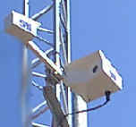

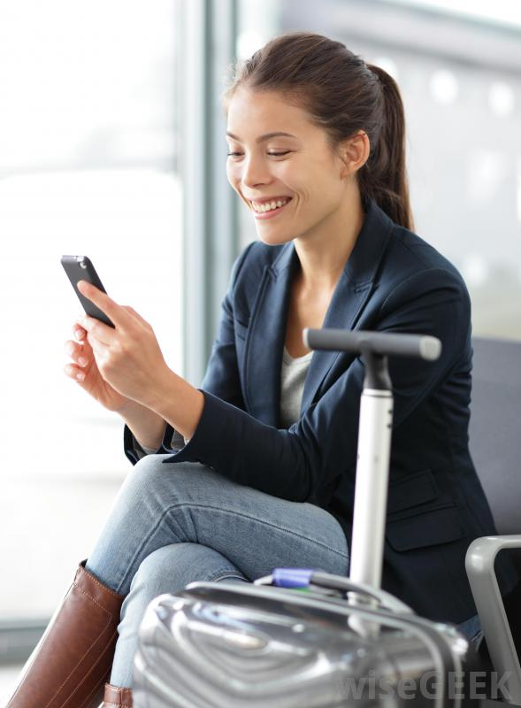


Network Connection Sharing
Henry uses Helen’s cellular interface to connect to the Internet

Slide 6
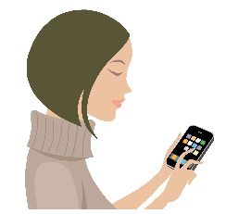


New services based on collaborative paradigms with user participation arise.
The user participates by evaluating the quality of service, sensing (crowd-sensing), and sharing its resources (e.g., measurements, scores).

Slide 7
Incentives for cooperation
Altruism, common values
Financial (micropayment)
Miles, coupons, passes
Social, reputation

Slide 8
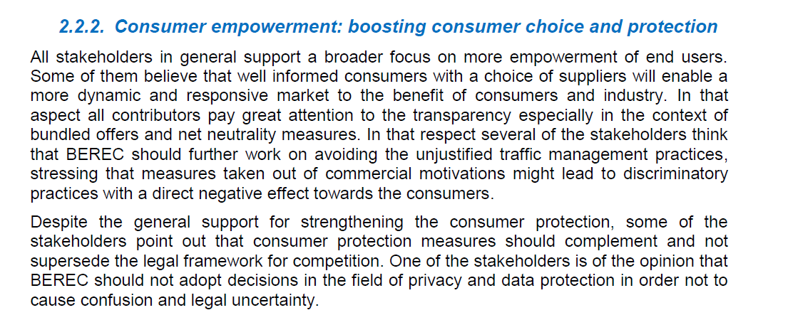
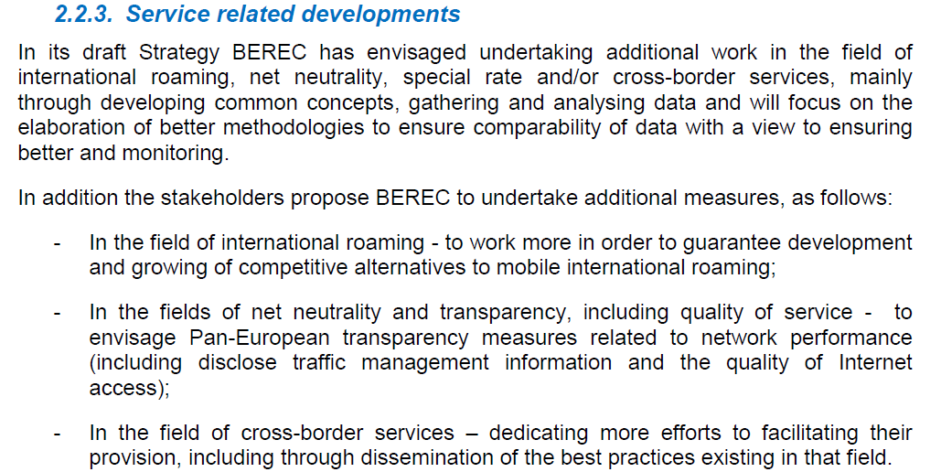


Slide 9
Business
Advertising & marketing
Vision
Monetize mobility & wireless service sessions
Booking
Smarter Commerce
Assess agreements
Pricing
Optimize value-generating mobility & wireless services
Technical
Smarter systems
Improved user satisfaction
Real-time QoE inference
Early-warning
Real-time statistics & trends
Smarter Computing
…
Analytics & Big Data
Improved network performance
Rapidly roll-out new services
Reduce maintenance
…
Convenience
Time
Customer Satisfaction
Money

Slide 10
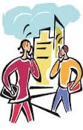


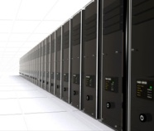
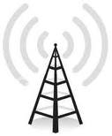
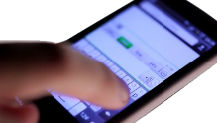



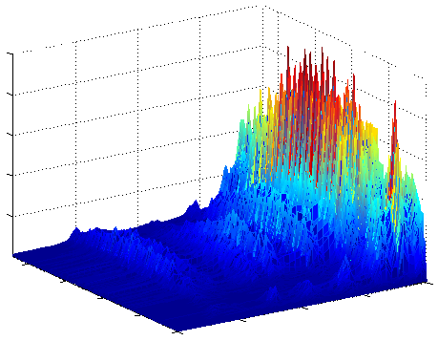
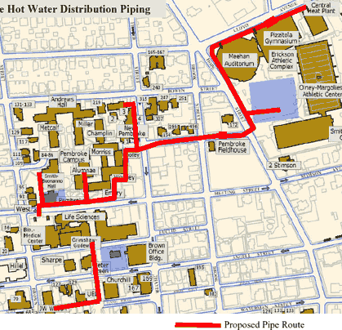
Providers,
regulators
receive alerts, reports
Data
center
Customers
u-map
server
Wireless
Base Station
u-map client
Wireless sensor
Data analytics & modeling
Organizations
Resident customers
1. Monitor infrastructure & upload objective measurements on server
2. Customers upload their feedback using u-map clients on smartphones
3. Analysis of objective measurements & subjective feedback
4. Recommendations, alerts, and reports are sent to all stakeholders

Slide 11
Examples of use of u-map
In telecommunication markets for selecting the best dataplan and telecom operator
Assessment of the quality of water
Assessment of the environmental exposure for pregnancy

Slide 12
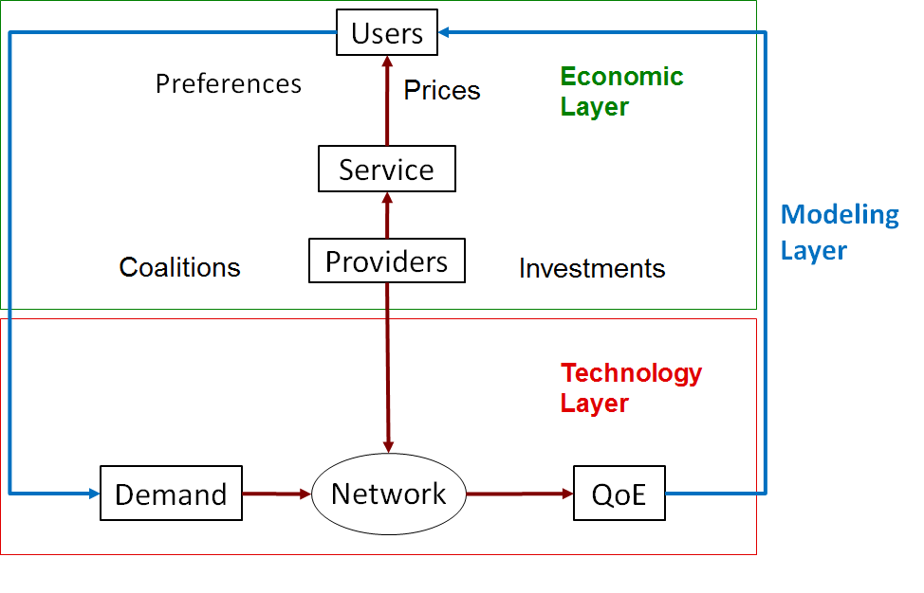
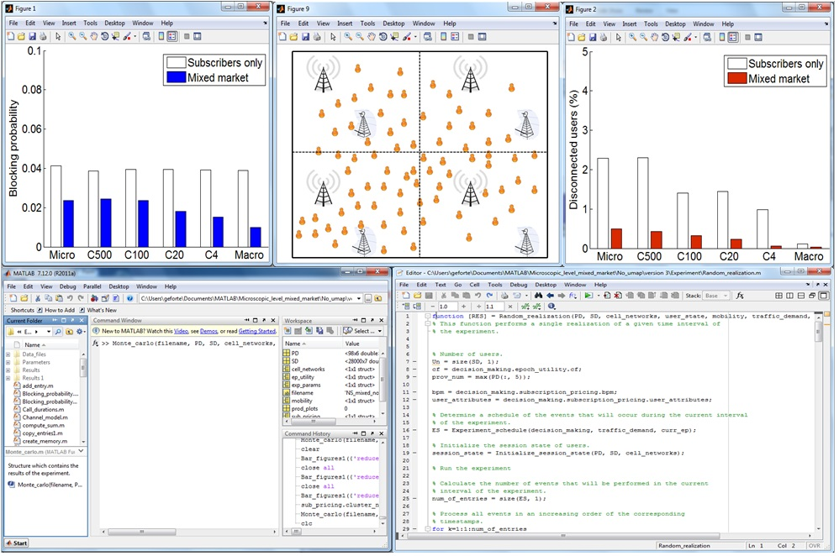
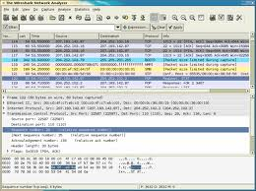
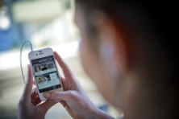
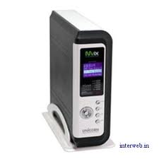
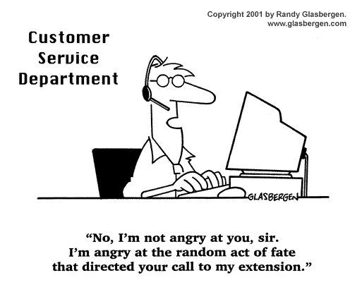
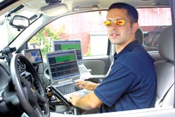
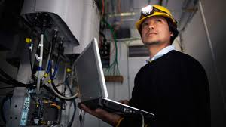
u-map client
Network
Customers
Data center
u-map server
Reduces overhead, administrative support & results in faster responses, better resource management, with lower cost
No extra cost for monitoring

Slide 13
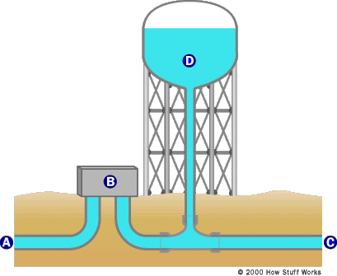
Regulators or providers
QoWater server
Customers provide feedback
about color, odor, appearance, taste
QoWater client
Water Distribution Network
sensors
sensors
sensors
Health Organization
Sensors measure chemical & biological parameters
(e.g, PH, conductivity, Oxidation reduction potential, Ion Chlorine)

Slide 14
Participatory Measurement Studies
“Out in the wild” participatory studies
  Diverse conditions
  Relatively small costs, larger scales
  Limited contextual knowledge
Inferring the user engagement vs. getting explicit feedback

Slide 15
u-map: user-centric QoE geo-database for recommendations & feedback
Client-to-Server architecture
u-map clients on smart-phones
  Collect measurements, opinion scores, customer feedback and store them locally
  Upload traces to u-map server
  Query u-map server
u-map server
  Collects traces & stores them in spatio-temporal geo-DB
  Responds to queries sent by users/customers & service/content providers
Can be designed according to different business models:
  e.g., provider-driven or a third-party
Strong access control that applies privacy rules
Provision of incentives
improved QoE in services
reputation, altruism,
payment (e.g., free SMS, calls)

Slide 16
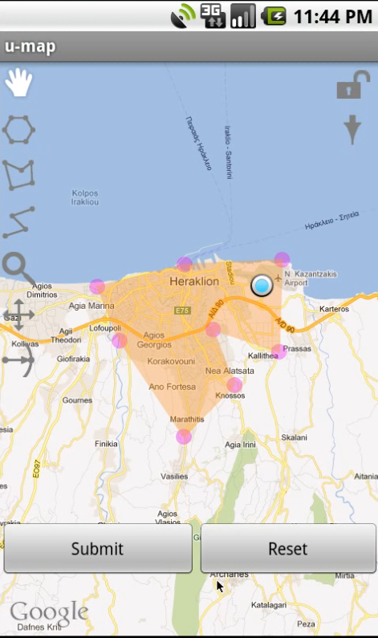
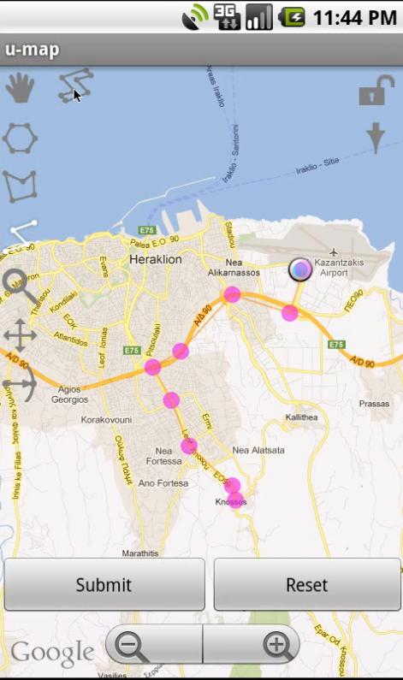
U-map runs a localization system, which positions the user at a Google map.
There are pre-determined regions for the queries (e.g., entire city, island) or
the user can indicate the region of interest using the GUI/ touch screen
and “drawing” a polygong or a path.

Slide 17
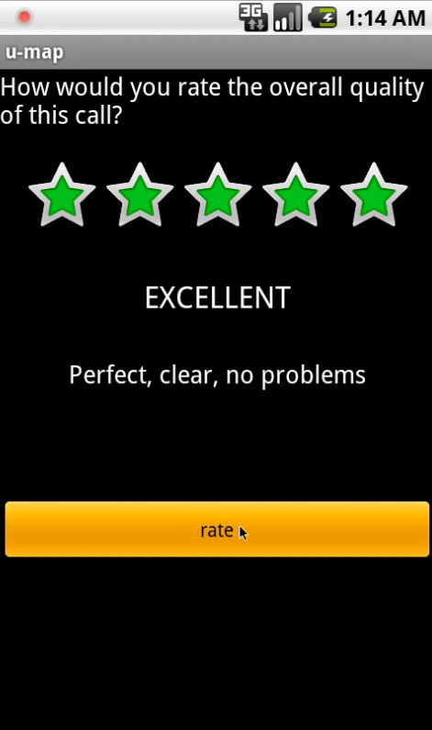
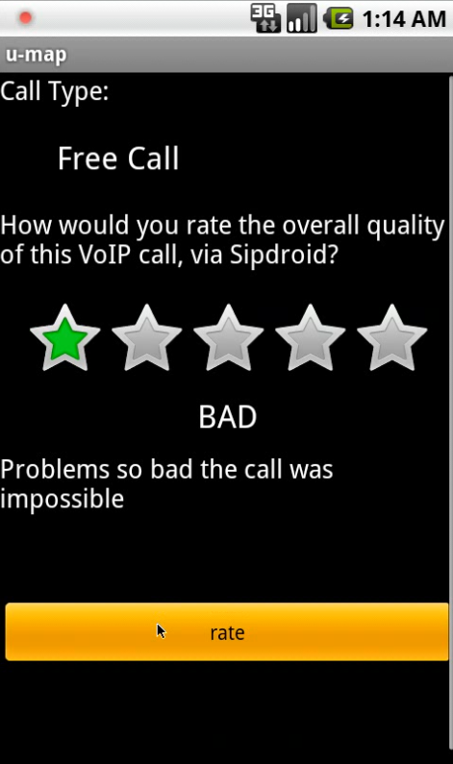
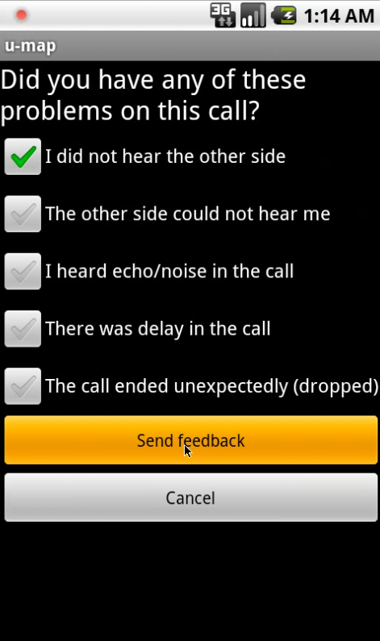
17

Slide 18
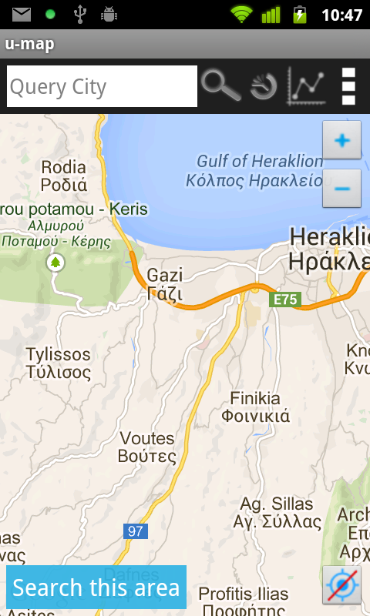
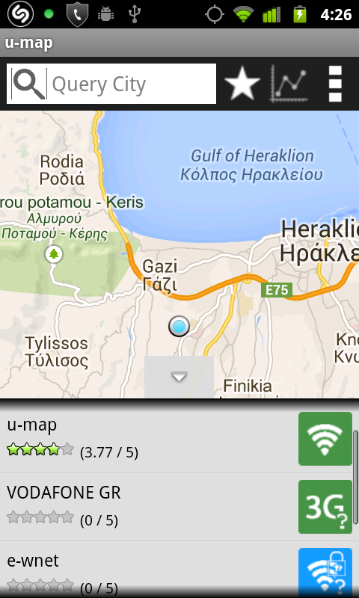
Evolution

Slide 19
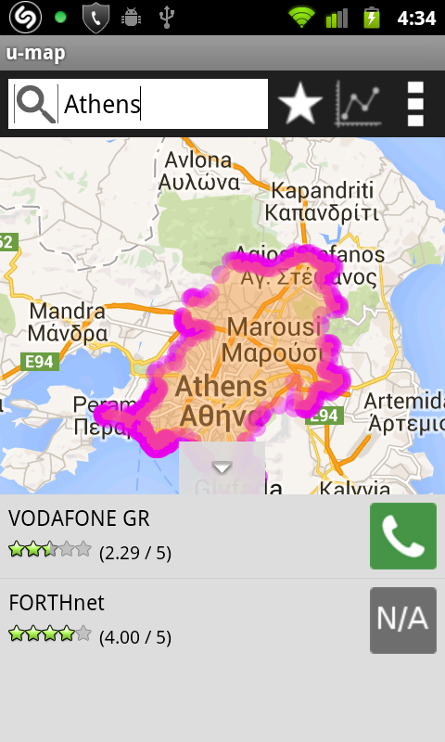
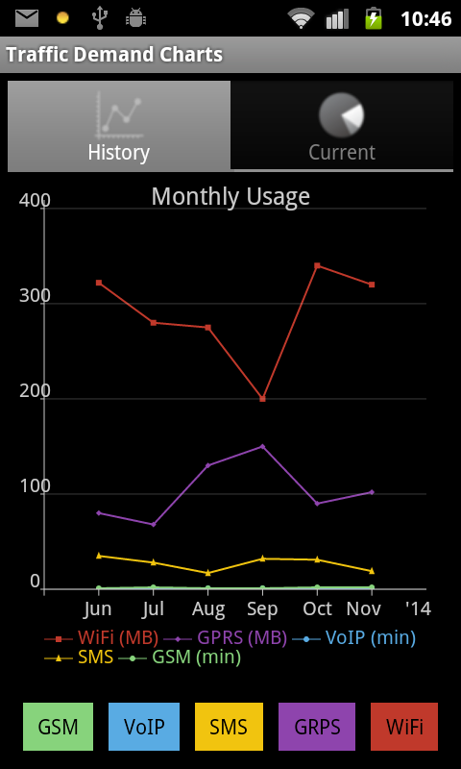
Evolution

Slide 20

u-map feeds the analysis platform with real customer data, so the business-driven assessment becomes more accurate, relevant, faster.
CoRLAB
u-map client
Network
Data center
u-map server
Users

Slide 21
u-map is a cost-saving system.
To ensure scalability, u-map is envisioned as a cloud service, taking advantage of
inexpensive & flexible platforms
No extra cost for monitoring
u-map reduces overhead, administrative support & results in faster responses, better resource management, with lower cost
Cost: u-map software includes
  Personalized recommendations
  QoE prediction
  DB maintenance & access control

Slide 22
u-map feeds the analysis platform with real customer data, so the business-driven assessment becomes more accurate, relevant, faster.
u-map client
Network
Data center
u-map server
Customers

Slide 23
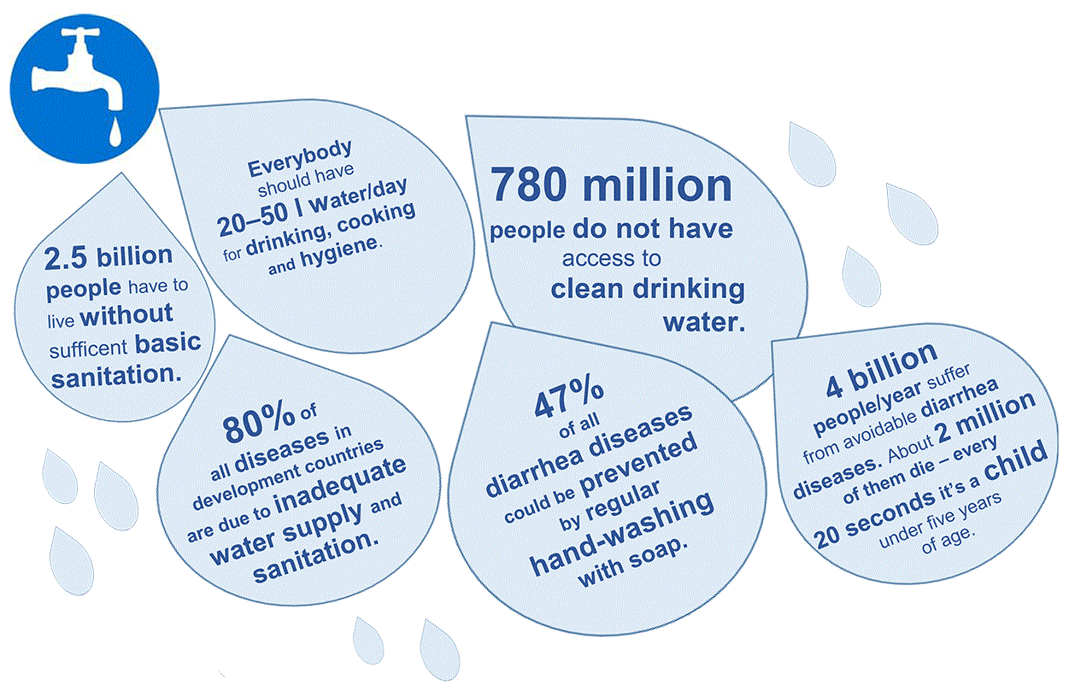
4 billion people/year suffer from avoidable diarrhea diseases.
Sanitation alone can reduce water-related death by 37.5%
780 million people do not have access to clean drinking water
Clean water alone can reduce water-related death by 21%
80% of all diseases in development countries are due to inadequate water supply and sanitation
2.5 billion people have to live without sufficient basic sanitation
Resources WHH-WASH Sector Report, FAO, WHO, UN

Slide 24
Contamination events
  Pressure loss or change may result in backflow incidents during which contaminated soil water enters the water distribution network (WDN) through pipe breaks or leaking joints
  Corrosion of iron, copper, and lead parts of the WDN (e.g., due to free chlorine for disinfection)
  Bioterrorism

Slide 25
Motivation
  Efficient monitoring & management of the infrastructure, including the last-mile access network
  Incorporation of customer feedback
  Increased customer awareness about the water quality & querying mechanisms
  Fast & efficient warning/alerting in the case of contamination
  More accurate models for assessing the quality of the water
7

Slide 26

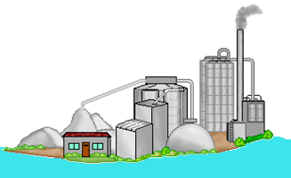


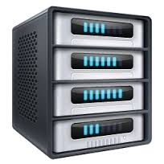
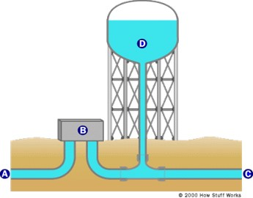

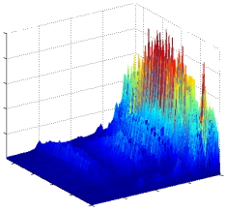
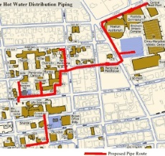
QoWater System
QoWater client
Providers,
regulators
receive alerts, reports
QoWater sensor
QoWater server
26

Slide 27
QoWater Hardware
Libelium Sensor:
Micro-controller that operates at 14MHz frequency
8 KB RAM memory
2 GB SD card
Supports IEEE802.11b/g
Server:
VM with 2 cores at 2.4 GHz
4 GB RAM
27 GB storage
Ubuntu 14.04 OS
Client:
Runs on all Android 2.1 above

Slide 28
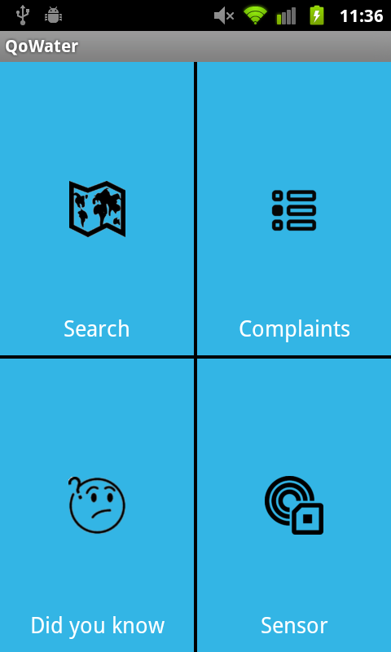
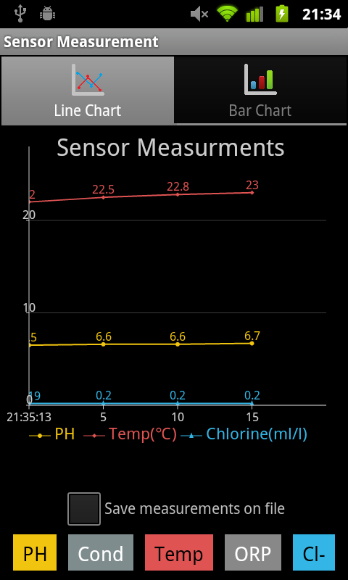
Main screen
Sensor measurements
pH, temperature, conductivity oxidation-reduction potential & Ion Chlorine

Slide 29
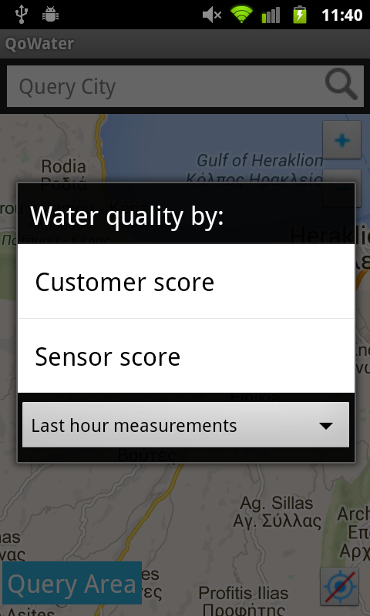
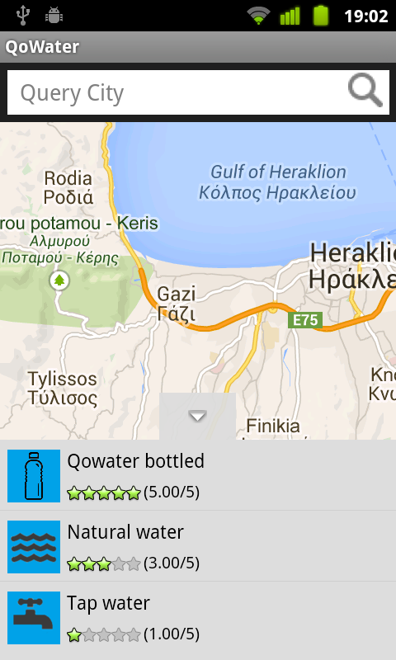
Query based on clients score or sensor measurements
Results for query area, based on clients option eg, customer score
13-Apr-2015
CySWater
29

Slide 30
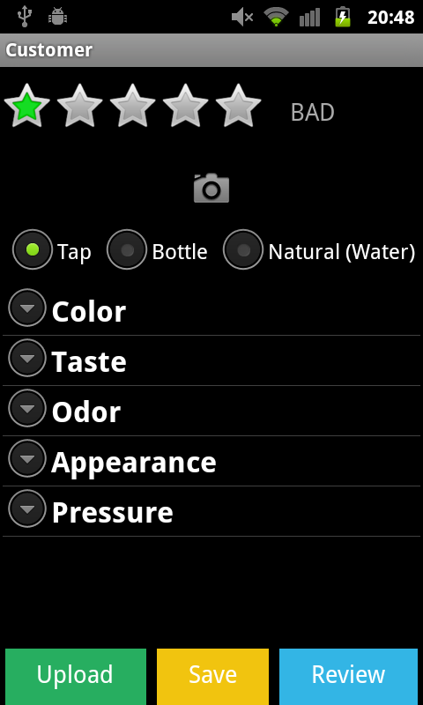
Color: red/brown, green/blue, white, black
Taste: bitter, salty, sweet
Odor: sewer, chlorine, gasoline, chemical
Appearance: floating particles, sand, milky, rusty, stain, animal, plant
Pressure: no water, low, high
13-Apr-2015
CySWater
30

Slide 31
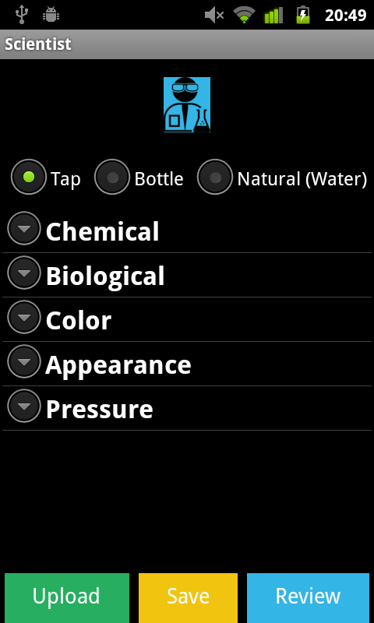
Chemical: turbidity, Br, Cl, Na, K, Mg_{2,} biochemical oxygen demand, acidity, disssolved oxygen, etc
Biological: ephemeroptera, plecoptera, excherichia coli, coliform bacteria, etc
Taste: bitter, salty, sweet
Odor: sewer, chlorine, gasoline, chemical
Appearance: floating particles, sand, milky, rusty, stain, animal, plant
Pressure: no water, low, high
13-Apr-2015
CySWater
31

Slide 32
QoWater Architecture
QoWater server
Access control
PHP application
geoDB
Analyzer
Memcached service
Query handler
Data receiver
Data validator
QoWater sensor node
QoWater client
Broadcast sensor readings
Certificate Authority
Certificae Manager
HTTP service
Eventdetector
Back-end interface
GPS
WiFi
interface
Position
Temperature
Upload
data
Sensor
reading
Camera
Secure sensor readings upload
Conductivity
Energy
Back-end interface
Queries
Data
Recorder
Battery
ORP
Feedback
PH
GUI
Save data
Save sensor readings
Monitor
Chlorine ions
Querying
Customer Form
Scientist Form
CSV
SQLite
Measurement location
Android device
32

Slide 33
Rely on the end-to-end security that protects the integrity & confidentiality by leveraging standard technologies (eg public-private key pairs, TLS)
QoWater server
Access control
PHP application
geoDB
Analyzer
Memcached service
Query handler
Data receiver
Data validator
QoWater sensor node
QoWater client
Broadcast sensor readings
Certificate Authority
Certificate Manager
HTTP service
Event detector
Back-end interface
GPS
WiFi
interface
Temperature
Upload
data
Sensor
reading
Camera
Secure sensor readings upload
Conductivity
Back-end interface
Queries
Data
Recorder
Battery
ORP
Feedback
Use Hadoop Distributed FS & Hbase
for higher aggregate I/O throughput
PH
GUI
Save data
Save sensor readings
Monitor
Chlorine ions
Querying
Customer Form
Scientist Form
CSV
SQLite
Measurement location
Android device
13-Apr-2015
CySWater
33

Slide 34
Preliminary field study
Three sources of drinking water: tap, purified, bottled
Objective measurements by sensor node
  Duration of sampling: 36 minutes
  One data point every 10 seconds
  Collection of 215 data points (omit the first 50 data points)
Subjective measurements (QoE score) by 44 subjects
  Three cups containing tap, purified & bottled water with no indication of the source of the water
  Each subject inspects, smells, tastes the water from each cup and provides its score immediately

Slide 35
QoWater Testbed
Sensor
Equipped with a micro-controller that operates at 14MHz frequency
8 KB RAM memory
2 GB SD card
IEEE802.11b/g WiFi
Server
VM with 2 cores at 2.4 GHz
4 GB RAM
27 GB storage
Ubuntu 14.04 OS
Client
Android 2.1
13-Apr-2015
CySWater
35

Slide 36
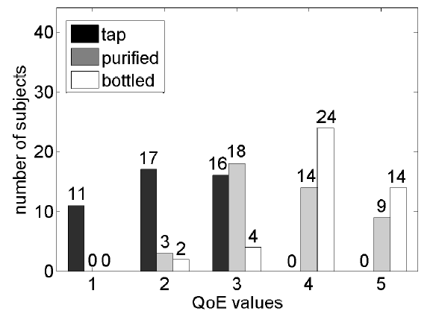
The correlation of QoE with conductivity, ORP, & pH is negative, while with ion Chlorine is positive
13-Apr-2015
CySWater
36

Slide 37
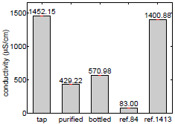
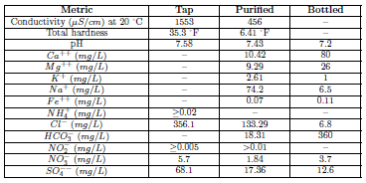
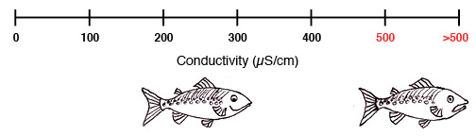
Official Chemical Analysis
Divalent metal ions (i.e., Ca++, Mg++, and Fe++) influence the conductivity & hardness
Conductivity and hardness impacts negatively the perceived water quality
13-Apr-2015
CySWater
37

Slide 38

Official Chemical Analysis
Divalent metal ions (i.e., Ca++, Mg++, and Fe++) influence the conductivity & hardness
Conductivity and hardness impacts negatively the perceived water quality
13-Apr-2015
CySWater
38

Slide 39
Power consumption
Scenario | CPU | Display | GPS | WiFi | Total median (mW)
QoWater: Uploading | 68 (14) | 712 (10) | 0 | 23 (7) | 803
QoWater: Querying | 56 (3) | 548 (15) | 0 | 8 (3) | 612
QoWater: Sensor | 4 (1) | 767 (10) | 0 | 1 (0) | 772
U-map: Uploading | 35 (23) | 567 (1) | 0 | 88 (14) | 690
U-map: Querying | 33 (3) | 563 (15) | 167(16) | 6 (4) | 769
YouTube: Video | 23 (3) | 786 (5) | 0 | 6 (4) | 815
Skype: Call | 111 (14) | 639 (15) | 0 | 57 (20) | 807
Notes:
Table reports the mean and in parenthesis the standard deviation of the power consumption during the 100 repetitions of each scenario (mW).
The Suspended state takes place when the screen is locked and there is no running application (except system operations processes)
The 3G is zero in all scenarios and has been omitted
The changing of the GPS energy on QoWater is due to AppScope limitation/false
Compared to u-map, the uploading of QoWater is more energy demanding, since the number of GUI refreshes is greater and the GUI is colourful.
QoWater querying is less demanding compared to u-map querying, since it relies on WiFi instead of GPS for localization.
u-map dataset is ready (rates, timestamp, location)
Power consumption during the 100 repetitions of each scenario

Slide 40





Response delay: Testbed
internet
AP
QoWater client
(Android)
QoWater server
T₁
Android Delay
Query
T₂
Network Delay
T₃
Response generation
Server Delay
T₅
T₄
Display
Network Delay
Android Delay
T₆
time
29 April 2018
Nikolaos Rapousis
40
Notes:
Note that the timestamps T2, and T5 are recorded at the android smartphone, while T3, and T4 are recorded at the QoWater server.

Slide 41
Response delay: Results
QoWater sensor uploading is the most time consuming (background does not effect response)
U-map better in both scenarios, due to different dataset size and response processing
Scenario | Android/Waspmote | Server | Network | Total (ms)
QoWater: Uploading | 393 (52) | 69 (5) | 249 (47) | 711
QoWater: Querying | 102 (19) | 1451 (83) | 262 (66) | 1815
QoWater: Sensor | 4000 (233) | 32 (1) | 4000 (500) | 8023
U-map: Uploading | 49 (N/A) | 159 (N/A) | 379 (N/A) | 587
U-map: Querying | 43 (N/A) | 135 (N/A) | 8 (N/A) | 186
29 April 2018
Nikolaos Rapousis
41
Notes:
Each scenario was executed 20 times
The Libelium sensor sensitivity relies on seconds instead of milliseconds
Android delay in the QoWater uploading greater due to the difference in the retrieving process
Server delay on QoWater uploading less due to the different number of table reports.
Android delay of QoWater querying greater because of the pre-processing of the server response.
Server delay of QoWater querying greater due to different size of stored data
Network delay on u-map querying smaller because the client is on the same Local Area Network (LAN) with the server, instead of a Wide Area Network (WAN) that QoWater is connected.
The QoWater server contains 100,000 entities
Packet size of sensor scenario is 34KB (200 measurements x 172 bytes each entity), uploading 1.5 MB.
Querying is 2KB (1 KB request, 1KB response)

Slide 42

Notes:
Environmental Exposure: the environmental pollutants and lifestyle factors that affect the health status of urban populations.

Slide 43

Our motivation
Environmental exposure
The environmental pollutants & lifestyle factors affect the health status
of urban populations
WHO: 24% of global disease caused by environmental exposures
Notes:
Environmental Exposure: the environmental pollutants and lifestyle factors that affect the health status of urban populations.

Slide 44
Current approaches for monitoring environmental exposure for general population
Location-based services for monitoring air pollutants
Combination of ambient sensing parameters (e.g. air pollution, noise, radiation) and biosignals on carry-on backpacks (short-term monitoring)
Limitations
Cumbersome equipment to be carried around (vulnerable populations)
Subjective aspects (e.g. dietary & lifestyle aspects) & medical history are not taken into account
Notes:
One of the latest trends of mHealth:
assessment of the environmental exposure, i.e. the environmental pollutants and lifestyle factors that affect individuals’ health status in urban environments
In order to obtain a better understanding of environmental exposure, different sensing parameters (e.g. air pollution, noise, ultra violet radiation, temperature, humidity, biosignals) should be combined
Standalone mobile platform, which can be carried in a backpack and monitors environmental pollutants while people are moving within a city
However these multi-sensing mobile platforms are cumbersome, and as such, are neither suitable for long-term studies, nor appropriate for women during maternity.
In addition, such sensor-oriented solutions often focus on absolute metrics, without considering qualitative aspects, e.g. dietary habits, working/living conditions, and lifestyle choices, which are important for evaluating maternal and fetal status in urban environments.

Slide 45



Assessing the maternal environmental exposure
Current methods for assessing the maternal environmental exposure in modern urban centers are not exploiting mHealth technologies
Paper Questionnaires
Electronic Forms
Face-to-face/telephone interviews
Notes:
Conventional methods to perform epidemiological studies include:
Paper Questionnaires
Laptops
Face-to-face or telephone interviews
Interviewers recruitment → staff cost
Participant recorded activity/habit logs
People restrict their everyday activities to participate in interviews, fill long questionnaires and record theirs activities/habits

Slide 46
Objectives
  Establish benefits of proposed system vs. conventional systems
  Perform large-scale epidemiological studies
  Combine objective sensing (ambient conditions & biosignals) with subjective factors (e.g. daily habits & lifestyle options)
  Methodology for epidemiological studies
    Continuous monitoring with respect the individual’s privacy & free living conditions
    Reduction of operational costs (e.g. no interviews) while remaining scalable
    Reduction of time & complexity, while safeguarding the quality of the information collected
Notes:
mMamee Platform objectives
After development stage:
Perform field study: compare proposed to conventional systems
Extend to large scale epidemiological studies:
Combine heterogeneous data: objective sensing & subjective factors
Propose novel methodology for epidemiological studies

Slide 47



Our Contribution: mMamee Plaform
Monitoring & assessing daily environmental exposures during pregnancy
Users: women in pregnancy & healthcare professionals
Key components
Mobile app for self-reporting & monitoring medical conditions & daily habits (user descriptive input)
Urban sensing data of ambient conditions & potential pollutants
Backbone architecture for heterogeneous data, correlations & reporting
Notes:
mMamee Platform
Aim: monitor and assess daily environmental exposure during pregnancy
System users: pregnant women, healthcare professionals
Architecture: client-to-server
Key Components:
Client: smartphone application to report and monitor medical condition and daily habits
Urban sensing data system: collect data of ambient conditions and pollutants in urban environments
Server: combine heterogeneous data, extract correlation and reporting
This work is in Prototype development stage
Efforts so far are concentrated on the components of the client-server architecture that are essential with the interaction with the end-user
Extension of platform:
a) server functionalities for acquisition and analysis of environmental data
b) design of feasibility study to evaluate the efficacy of the proposed platform

Slide 48


Notes:
Related work on maternal and fetal health monitoring
Gogineni, Jyothsna. "An ingenious decision support system for remote health monitoring of pregnant women." (2012).
designed a Decision Support System which enables the remote monitoring of pregnant women
to prevent pregnancy complications and related later childhood disease due to the insufficient access to healthcare services in rural and remote areas
The approach relies on face-to-face interviews with pregnant women regarding the use of healthcare services, dietary and exercise habits, and medical history
statistical analysis on collected data
Extraction of variables, which were evaluated by gynecologists and employed for exporting the rules of the Decision Support System
Lavariega, Juan C., et al. "Monitoring and Assisting Maternity-Infant Care in Rural Areas (Mamicare)." ICHITA-2013 TRANSACTIONS (2013): 175.
a. the MAMICare platform integrates different types of medical devices into a specialized, wearable, smart medical kit for assisting health volunteers and social workers in rural areas to efficiently monitor the health status of pregnant women
Velikova, M. et al "e-MomCare: a personalised home-monitoring system for pregnancy disorders." Electronic Healthcare. Springer Berlin Heidelberg, 2012. 267-274.
One step further than monitoring raw vital signs and accordingly notifying medical professionals
Intelligent electronic system that allows predicting the evolution of specific pregnancy disorders
raw vital sign collected by wearable sensors, user entries, and medical records are fed to a Bayesian model that allows predicting pre-eclampsia
e-MomCare, besides for updating the health records of the patient, is additionally capable of providing advice to the patient on whether an action should be taken or not.

Slide 49



















System Architecture
Wireless sensors
HTTP
Healthcare professionals
Residential monitoring
CO2
Urban Sensing database system
mMamee
server &
data center
Wireless
Base Station
City monitoring
Subject of study
mMamee client
Notes:
The mMamee platform follows a client-server architecture, employing smart-phones and a sensing infrastructure over a cloud
3 important infrastructures:
Sensing infrastructure
Urban sensing infrastructure, comprised of miniaturized wireless sensors
monitors environmental pollutants & uploads measurements on the Urban Sensing database system
Mobile devices and client-to-server infrastructure
Women in maternity upload their feedback using mMamee clients on smartphones/tablets
System evaluation from healthcare professionals
mMamee analyzes/correlates measurements and
provides information to healthcare professionals and individuals

Slide 50

System Architecture: Sensing Infrastructure
Urban Environment Monitoring
  Temperature
  Humidity
  CO2
  City noise
  Water quality
  Atmospheric dust
Data Acquisition via wireless networks
  IEEE 802.11, IEEE 802.15.4/ZigBee, Bluetooth
Upload to urban sensing db system: cloud services
  OpenStack cloud OS
  OCCI
Wireless sensors
Residential monitoring
CO2
Urban sensing db system
City monitoring
Notes:
The sensing infrastructure is deployed at the urban environment for recording ambient conditions, such as
temperature,
humidity,
CO2 in the atmosphere, and
level of city noise,
as well as specific indices of pollution in residential environments, such as
the quality of potable water and
percentage of dust in the atmosphere.
This information is collected in a self-organized and automated manner over wireless networks (IEEE 802.11, IEEE 802.15.4/ZigBee, Bluetooth),
and is periodically uploaded in the Urban Sensing database system, which relies on cloud services such as OpenStack cloud operating system and the Open Cloud Computing Interface (OCCI).

Slide 51


System Architecture: Mobile Devices
Daily Activity Monitoring
  mMamee Client
    Record location in urban environment
    Questionnaire about daily habits
Data Acquisition
  mMamee Server
    Handle security/privacy
    Extract, analyze, store
      Ambient conditions from Urban Sensing db system
      Daily habits of maternal women from mMamee client
Urban Sensing db system
mMamee
server &
data center
Wireless Base Station
Subject of study
mMamee client
Notes:
The mMamee client is deployed on conventional smartphones and is capable of capturing the daily activity of maternal women, by:
occasionally recording their location within the urban environment using either conventional sensors (i.e., GPS) or IP-based localization
allowing the individuals to complete a properly formed questionnaire, related to their daily habits, at a time of their own convenience.
These sources of heterogeneous information are combined at a cloud-based server, comprised of sophisticated components, responsible for
handling security and privacy issues, as well as for
extracting, analyzing and storing
Ambient conditions from Urban Sensing database system
high-level semantics on daily habits of maternal women from mMamee client

Slide 52

System Architecture: mMamee Server
Urban Sensing Data Handler
  Parse data streams
  Extract spatio-temporal correlations & higher level semantics
Access Control component: users control privacy sensitive information
Geo-database
  Store and process uploaded information
Security and Privacy component
Safeguard data from unauthorized access
Data anonymization
Apache HTTP server
on a Linux machine
Notes:
The mMamee server runs an Apache HTTP server on a Linux machine.
Components:
Urban Sensing Data Handler is responsible for
parsing the streams of urban data,
synchronizing between different points of sensing,
extracting spatio-temporal correlations and higher-level semantics.
Access Control component
a. enables a user-centric access control module, allowing users to control which privacy-sensitive information can be revealed to third parties, through a fine-grained discretionary approach
Geo-database
a. stores and processes the uploaded information provided by users and the Urban Sensing Data Handler
Security and Privacy component
a. safeguards the collected data from unauthorized access and intrusions,
b. relying on standard technologies (e.g., publicprivate key pairs, TLS)
c. for secure connection to the system’s database
d. and data anonymization.

Slide 53


System Architecture: mMamee Client
Back-end interface
  On-demand connection with server
  Handle queries
Monitor component
  Device position (GPS coordinates)
Questionnaire handler
  Load questions on GUI component
Notes:
The mMamee client runs on Android devices
Allows maternal women to register to the platform, securely login to the provided services which entail occasional recording of their location and access to the questionnaire.
Components:
1. Back-end interface is responsible for :
The on-demand connection of the client with the server
handling queries and
retrieval upon abrupt disconnection
2. Monitor component
a. records the time-stamped position information of the device (i.e. GPS coordinates).
3. Questionnaire Handler is responsible for
a. loading the questionnaire on the GUI,

Slide 54
System Architecture: mMamee Client
GUI
Process user responses
Redirect to appropriate next question
Store responses in local database
Enables users to
Change response to questions
Pause Questionnaire
Notes:
Final component of mMamee client:
GUI
Responsible for
processing the user responses,
and accordingly redirecting the user to the appropriate next question.
Important functionalities
Change response to questions
Pause questionnaire and continue at time of convenience

Slide 55



Prototype Development: Login & Sign Up
Secure login
  Via e-mail
  Access to Questionnaire & Localization component
Register to platform
Provide some personal information
Notes:
Short demo of the mMamee client
Login and sign up option:
register to the platform,
securely login to the provided services which entail
a. occasional recording of location and
b. access to the questionnaire.

Slide 56

Prototype Development: Localization & Info
Device position using GPS
Provide useful information to users
  Nearest hospital
  Pharmacies
  Medical Centers
  Emergency phone numbers
Notes:
Localization and info component
Google maps display
Showing users position on map
Useful information about various services such as
Hospitals
Pharmacies
Medical centers
Emergency phone numbers

Slide 57



Prototype Development: Questionnaire
Notes:
Subset of Question categories
Medical history
Environmental
Cosmetics
Water
Lifestyle
Questionnaire follows user-friendly GUI
Save progress
Continue at time of convenience
Show progress status and number of questions answered
Data is stored in local database, which gives the option to change responses to questions
Data is automatically uploaded to mMamee server when the device is connected to the internet. That has the following advantages
Questionnaire can be filled in at any time
the client-server communication is not a prerequisite for filling in the questionnaire, thereby increasing the usage flexibility of the platform.

