Slide 1

Wireless Networks & Mobile Computing
Lecture on Low Power Wide Area Communication
Prof. Maria Papadopouli
University of Crete
ICS-FORTH
http://www.ics.forth.gr/mobile

Slide 2
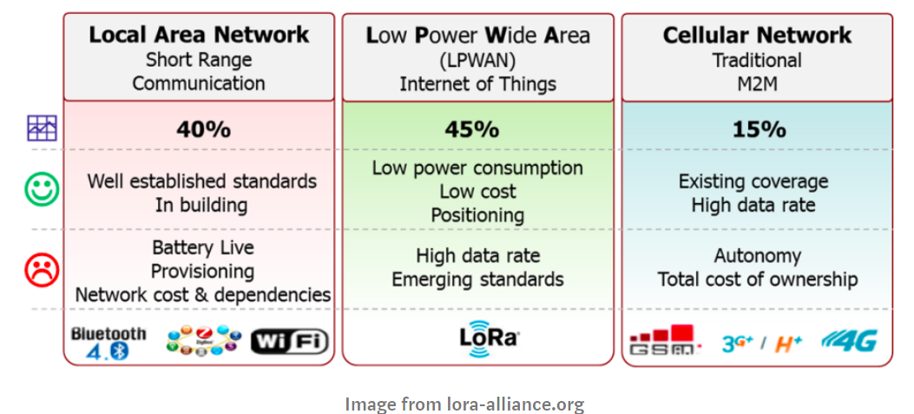

Slide 3
LoRa
Transmits over license-free sub-gigahertz radio frequency bands like 169 MHz, 433 MHz, 868 MHz (Europe) and 915 MHz (North America).
Enables very-long-range transmissions (more than 10 km in rural areas) with low power consumption

Slide 4
LoRaWAN Network Architecture
Deployed in a star-of-stars topology
Have base stations relaying the data between sensor nodes & network server
Communication between sensor nodes & BS goes over the wireless channel utilizing LoRa physical layer, whilst the connection between gateways & central server are over a backbone IP-based network
End Nodes transmit directly to all gateways within range, using LoRa
Gateways relay messages between end-devices & central network server using IP

Slide 5
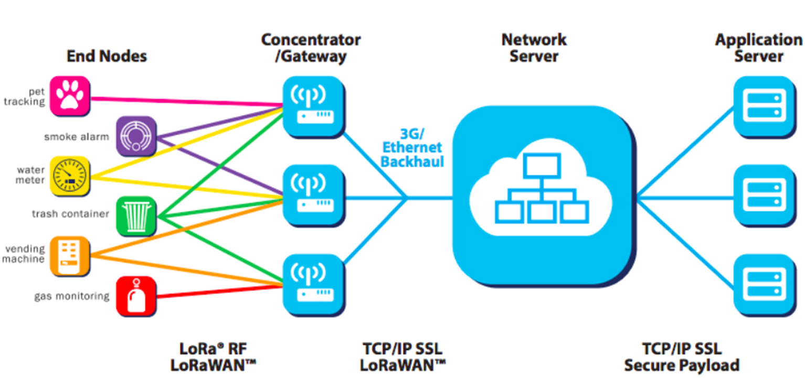
End Nodes are LoRa embedded sensors
End Nodes typically have:
Sensors: detect the changing parameter eg. temperature, humidity, accelerometer, gps)
LoRa transponder: transmit signals over LoRa patented radio transmission method
optionally a micro-controller (with on board Memory)
LoRa sensors can transmit signals over distances from 1km — 10km

Slide 6
Gateways
always connected to power source
connect to network server via standard IP connections
act as a transparent bridge, simply converting RF packets to IP packets & vice versa.
Network servers :
cloud based platform solutions, e.g., The Things Network (TTN) or LoRIOT
connect to gateways & de-dup data packets, and then routes it to the relevant application
can be used for both uplink (i.e. sensor to application) or downlink (i.e. application to sensor) communication

Slide 7
LoRaWAN Security
For the network and for the application
Network security ensures authenticity of the node in the network
Application layer security ensures the network operator does not have access to the end user’s application data
LoRaWAN specification defines two layers of cryptography:
A unique 128-bit Network Session Key shared between the end-device & network server
A unique 128-bit Application Session Key (AppSKey) shared end-to-end at the application level
Data over LoRaWAN is encrypted twice:
  Sensor data is encrypted by the node and then encrypted again by the LoRaWAN protocol; only then is it sent to the LoRa Gateway.
  The Gateway sends data over normal IP network to the network server.
  The Network server has the Network Session Keys & decrypts the LoRaWAN data. It then passes the data to the Application server which decrypts the sensor data, using the Application Session Key.

Slide 8
Low Power Wide Area Networking (LPWAN)
Conventional IoT networking technologies like Zigbee and Bluetooth can only provide a shorter range
LPWAN employs simple network topology & long distance communication with low data rates to attain high energy efficiency
LPWAN technologies can be divided into three categories:
networks based on cellular infrastructure
networks using third-party infrastructure
autonomous LPWAN networks without any third party infrastructure [

Slide 9
LPWAN Technologies in the Market: SigFox, NB-IoT, LoRaWAN
SigFox
  global coverage by means of a single operator network, with roll-outs in different countries performed by a number of member companies
NB-IoT
  offered by telecommunication companies as an IoT communication alternative to sub-GHz LPWAN technologies.
  operates in licensed spectrum → offers higher traffic reliability compared to other sub-GHz technologies
LoRaWAN
  private network deployments & easy integration with a number of world-wide network platforms (e.g., The Things Network)
  open access specification

Slide 10
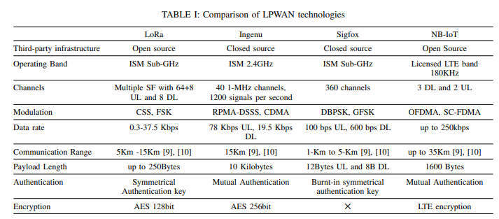

Slide 11
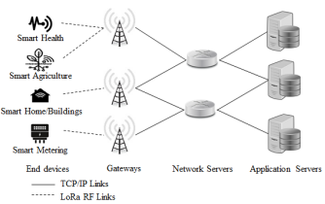

Slide 12
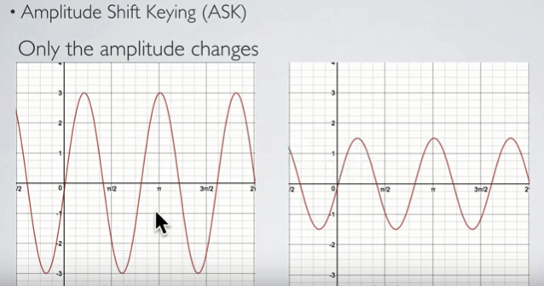
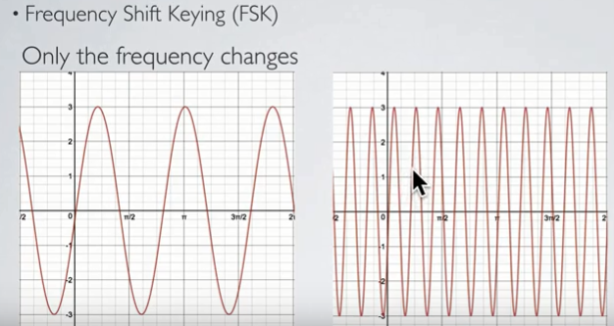
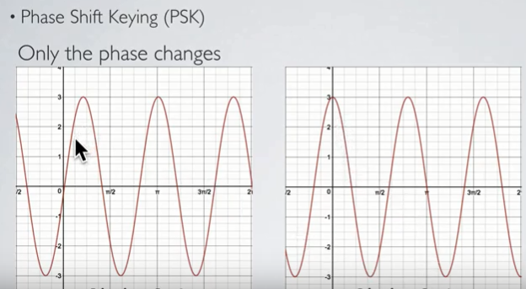

Slide 13
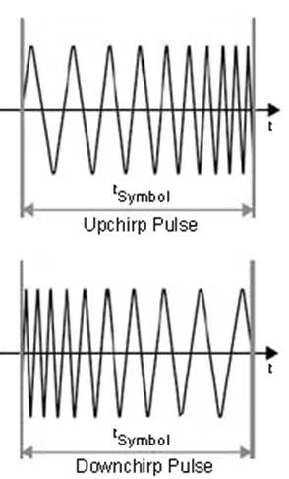
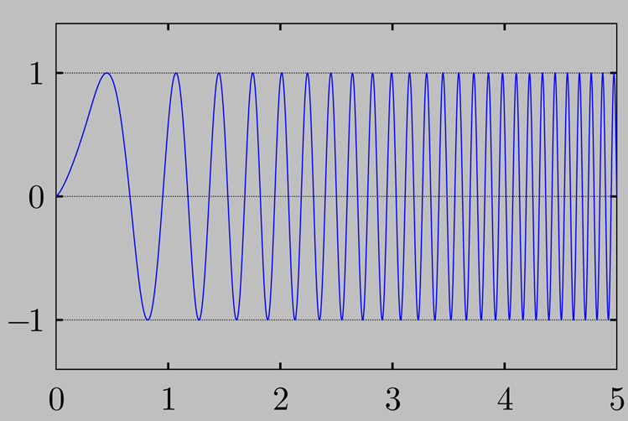

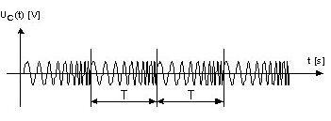
Chirp is a sinusoidal signal of frequency increase or decrease over time (often with a polynomial expression for the relationship between time & frequency)
Upchirp: increases linearly over time

Slide 14
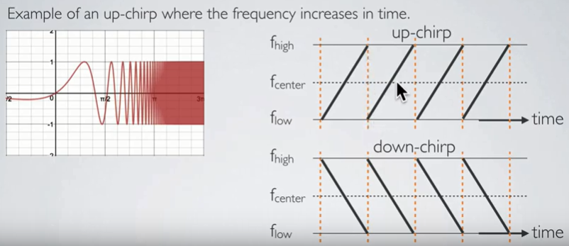

Slide 15
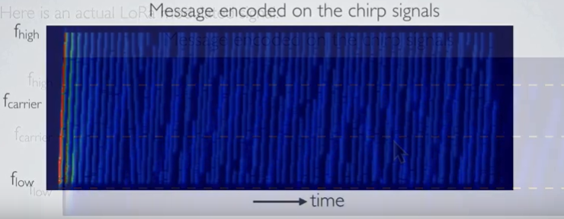

Slide 16
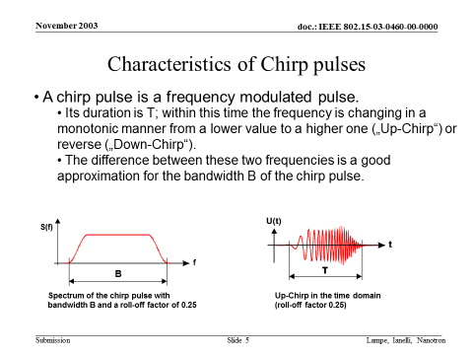

Slide 17
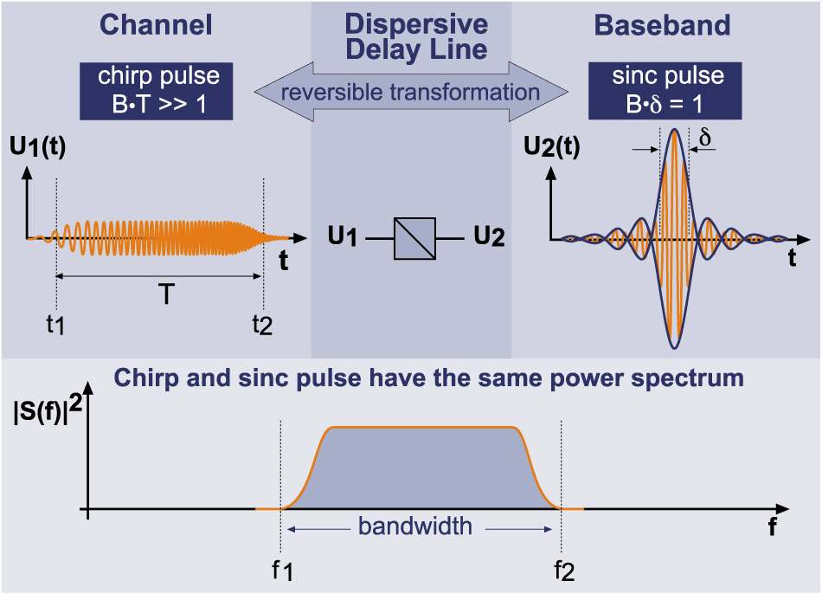
The basic Chirp signal
Chirp pulse:
Sinc pulse (baseband):
Sinc pulse (RF band):
Notes:
Here is the same spectra represented in two extremely different ways.
The sinc pulse is also used in some UWB implementations, so there are some similarities.

Slide 18
LoRa
Physical layer uses Chirp Spread Spectrum (CSS)
Modulation describes how analog or digital information are encoded onto a carrier signal
Chirps: signals whose frequency varies linearly with time within the available bandwidth. This attribute makes the chirp signals resilient to noise, fading and interference.
  Every LoRaWAN packet starts with a preamble of 10 chirps & 6 synchronization chirps followed by the data.
All chirps have practically the same time duration
Each chirp can modulate multiple chips (data bits)
  The number of data bits modulated depends on the parameter Spreading Factor (SF), e.g.,
  nine bits can be encoded in a chirp using SF9.
Higher SF takes more time on air & reduces the data rate but improves resilience to noise.
LoRa modulation parameters
  Bandwidth:125KHz, 250KHz and 500KHz
  Code Rate: 4/5, 4/6, 4/7 or 4/8

Slide 19
Chirp Spread Spectrum is Robust Against Multipath Fading
The original signal from the transmitter reaches the receiver with several echoes & reflections from buildings and other environmental surroundings due to multipath propagation.
Reflections reach the receiver in or out of phase. Some frequencies will be amplified or attenuated depending on the conditions. This leads to a disconnection of the communication link of narrowband transmission systems.
In CSS, however, the amplified & attenuated signals are in balance because all energy shares (which are spread over the bandwidth of 80 MHz) are collected (integrated broadband technique).

Slide 20
Chirp spread spectrum
Uses wideband linear frequency modulated chirp pulses to encode information
Does not add any pseudo-random elements to the signal to help distinguish it from noise on the channel
It relies on the linear nature of the chirp pulse
Resistant to Doppler effect
Ideal for applications requiring low power usage & needing relatively low data rates

Slide 21
Resistance against Doppler effect:
The Doppler effect causes a frequency shift of the chirp pulse, which
introduces a negligible shift of the baseband signal on the time axis.
Example:
  Bandwidth of the chirp 80 MHz
  Duration of the chirp 1 µs
  Center frequency of the chirp (ISM band) 2.442 GHz
  Relative speed between transmitter and receiver 2000 km/h
  Frequency shift due to Doppler effect 4.52 kHz
  Equivalent shift of the message on the time axis 56.5 ps
Note:
  2000 km/h is equivalent to 1243 miles/hour

Slide 22
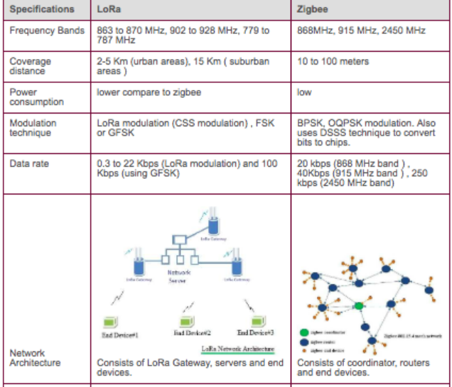

Slide 23
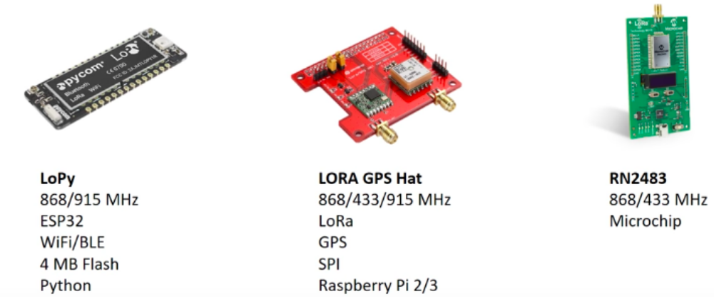
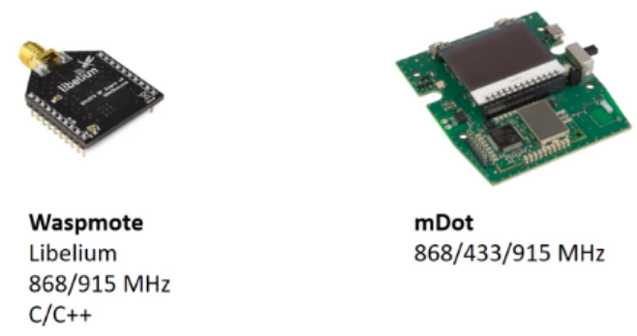

Slide 24
More info
https://www.link-labs.com/blog/what-is-lora

