Slide 1


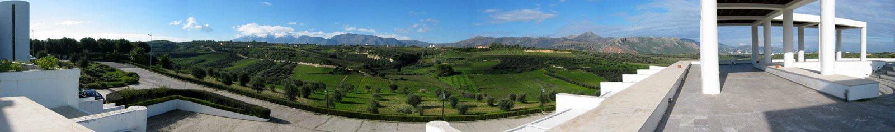
UNIVERSITY OF CRETE
Computer Science
Department
Analysis and prediction of QoE for
video streaming using empirical measurements
University of Crete
Foundation for Research & Technology – Hellas (FORTH)
http://www.ics.forth.gr/mobile
mgp@ics.forth.gr
Funded by Forthnet, the GSRT with a Research Excellence grant, and by a Google Faculty Award, 2013 (PI Maria Papadopouli)

Slide 2
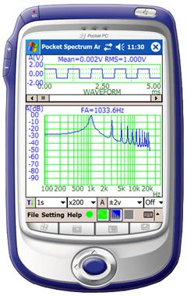
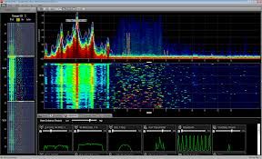
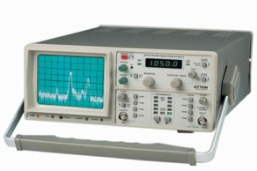

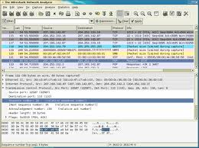


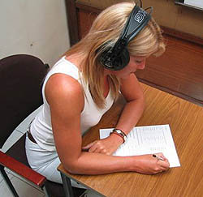
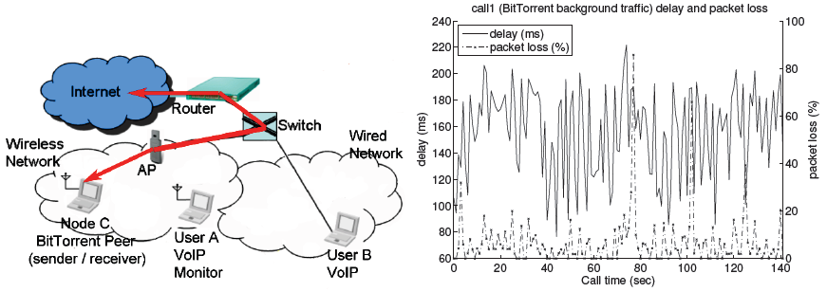
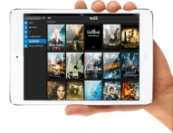
  Monitoring of wireless network environments
Objective measurements
Using various tools: SNMP, syslog, wireshark, spectrum analyzers, Appscope, DAG cards
Subjective measurements
Using questionnaires
performing field studies
Users
2

Slide 3
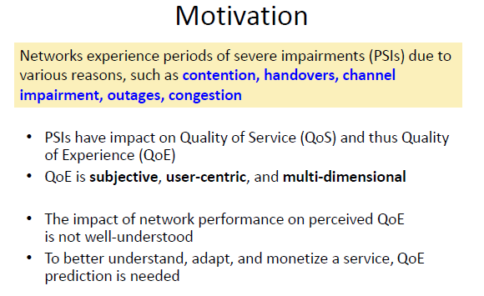

Slide 4
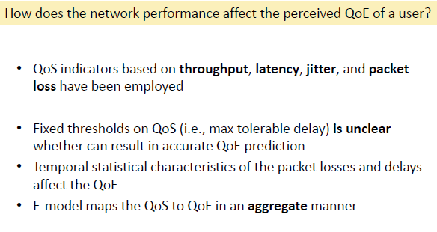
Network QoS metrics: throughput, jitter, round-trip delay, startup delay, packet loss, traffic load
Application metrics: rebuffering events, video resolution, adaptation of video streaming

Slide 5
Definitions of QoE
Overall acceptability of an application or service, as perceived subjectively by the end user includes the complete end-to-end system effects, and may be influenced by user expectations and context [ITU].
The degree of delight or annoyance of a person whose experiencing involves an application, service, or system.
It results from the person's evaluation of the fulfillment of his or her expectations and needs with respect to the utility and/or enjoyment in the light of the person's context, personality and current state [Raake].

Slide 6
QoE metrics are characterized with techno-socio-economic-psychological terms
QoS network metrics and application-based metrics
Preference on QoS or price
Price, willingness to pay
Perceived QoE (e.g., opinion score)
Intrinsic indicators towards a service provider
e.g., its brand name, perceived value/reliability
content (size, searching mechanisms)
To define user experience is a very hard problem & to monetize it even harder!

Slide 7
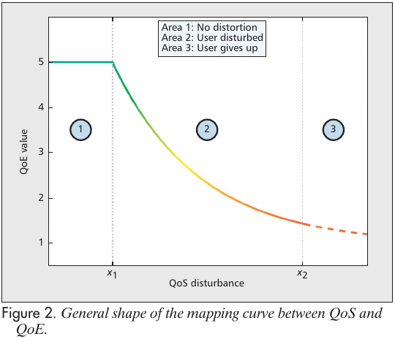

Slide 8
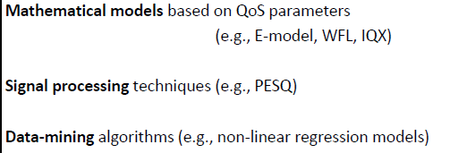
Modeling approaches

Slide 9
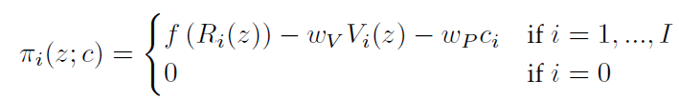
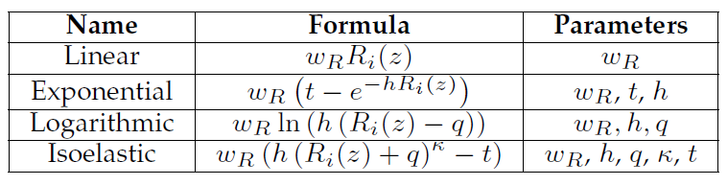
Customer Satisfaction
Examples of QoS metrics for telecom services
Achievable data rate
Throughput, delay, packet loss
Number of resource units
TDMA: time slots
Weber-Fechner Law
IQX hypothesis
QoE metrics
with techno-socio-economic-psychological terms
Preference on QoS or price
Price, willingness to pay
Perceived QoE (e.g., opinion score)
Intrinsic indicators towards a service provider
e.g., its brand name, perceived value/reliability
content (size, searching mechanisms)
To define user experience is a very hard problem & to monetize it even harder!

Slide 10

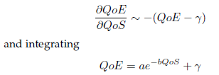

Mathematical models of QoE
Weber-Fechner Law
IQX
OoS: could be a network metric like average data rate, packet loss, delay

Slide 11
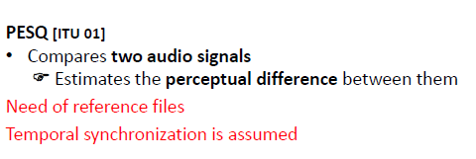

Slide 12
Our approach for predicting the QoE:
Develop user-centric, service-oriented models based on network metrics
Apply machine learning and data mining algorithms, such as:
Decision Trees, Support Vector Regression, Artificial Neural Networks, Gaussian Naïve Bayes
Find the set of predictors that minimizes the mean absolute error of a model (feature selection)
Train the models based on empirical measurements collected from field studies
We have demonstrated this methodology for VoIP, audio & video streaming

Slide 13
MLQoE: QoE prediction based on machine learning (ML) algorithms
Takes as input the training set of the performance estimation loop, cross-validates it, and reports the best model dynamically.
Estimates the performance of the best model in each fold and reports (as output) the mean error for the dataset.
On user-centric modular QoE prediction for VoIP based on machine-learning alg. [IEEE Trans. on Mobile Computing]

Slide 14
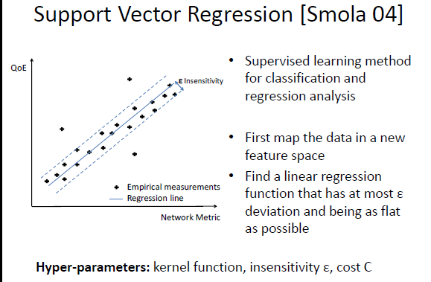

Slide 15
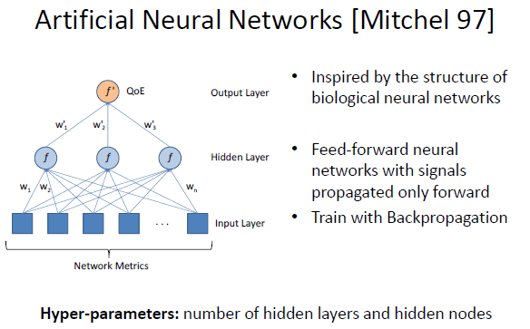

Slide 16
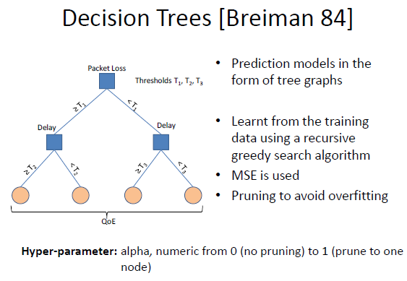

Slide 17
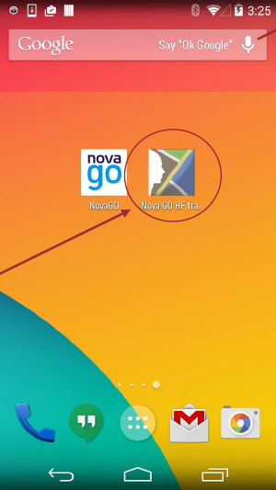
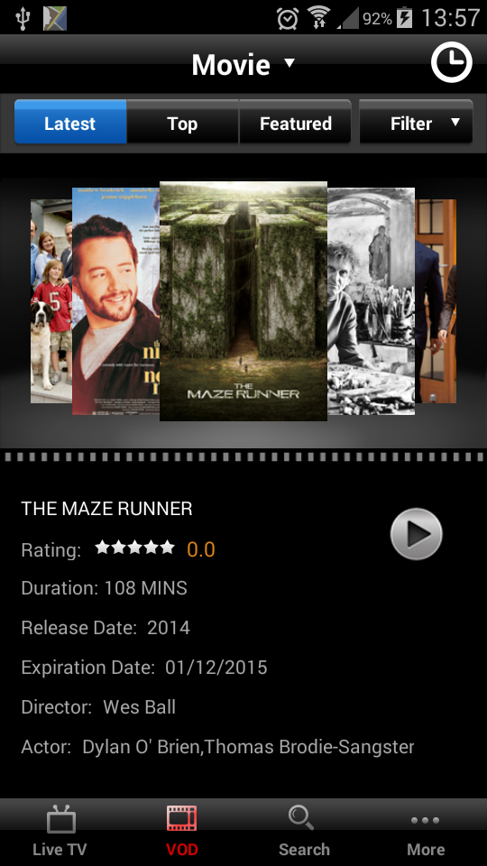
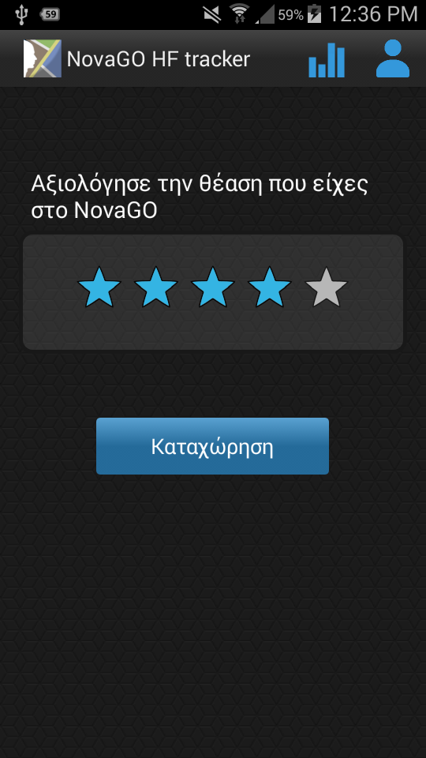
NovaGO HF Tracker: Παράδειγμα Γραφικού Περιβάλλοντος σε έναν Χρήστη

Slide 18
System Architecture

Slide 19
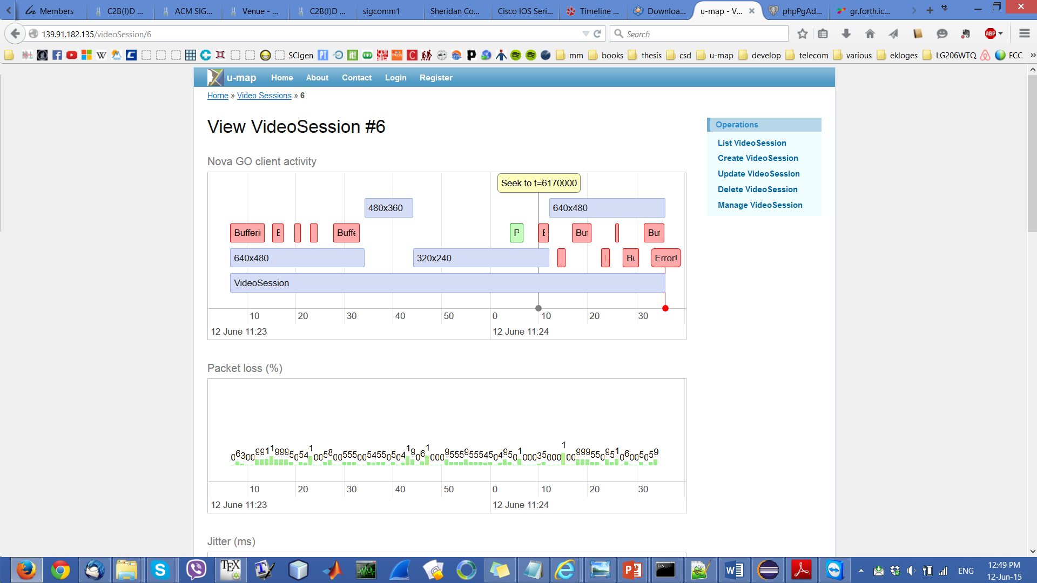
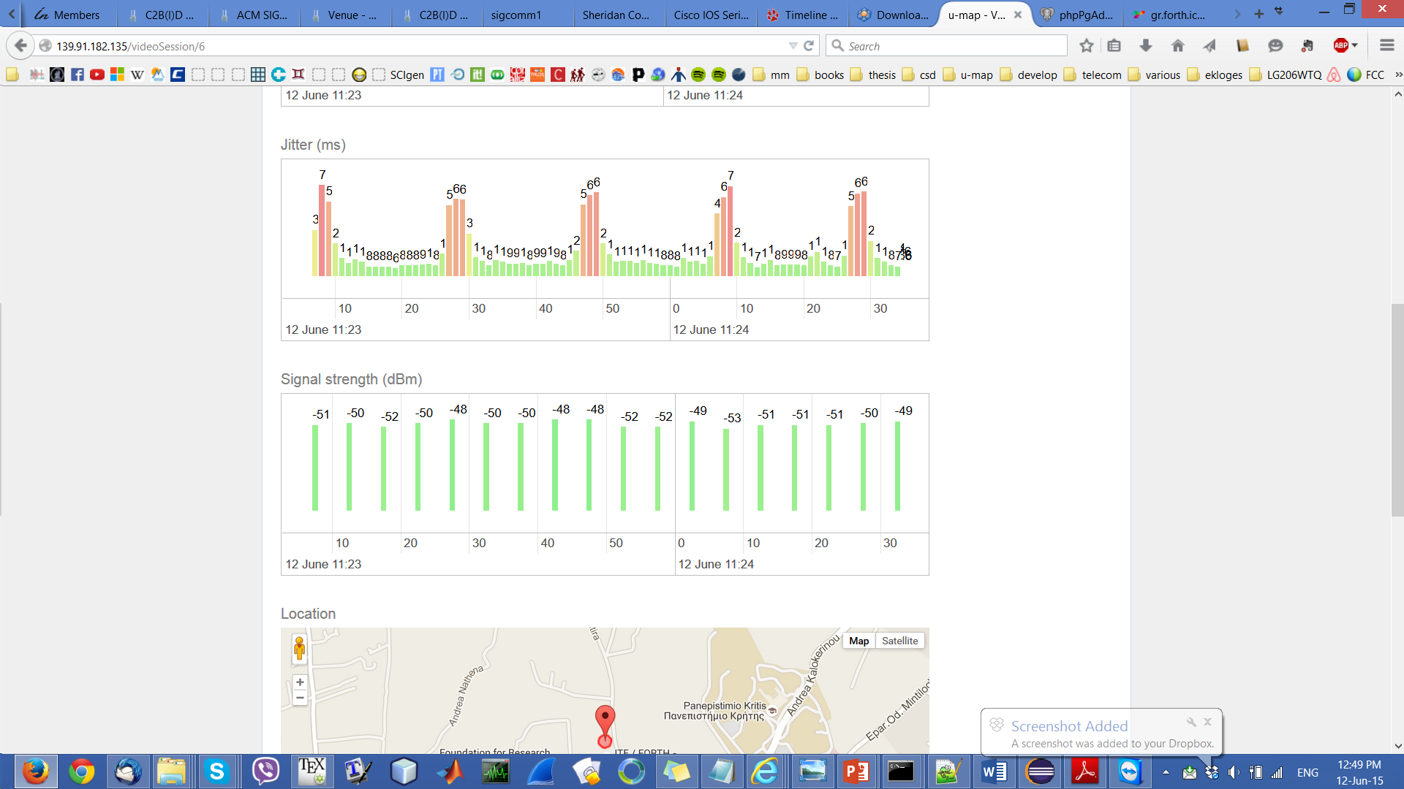
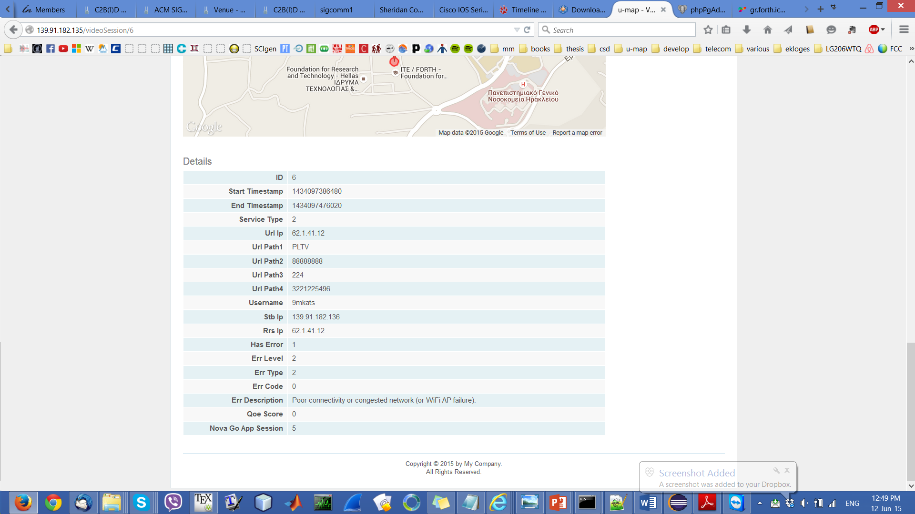
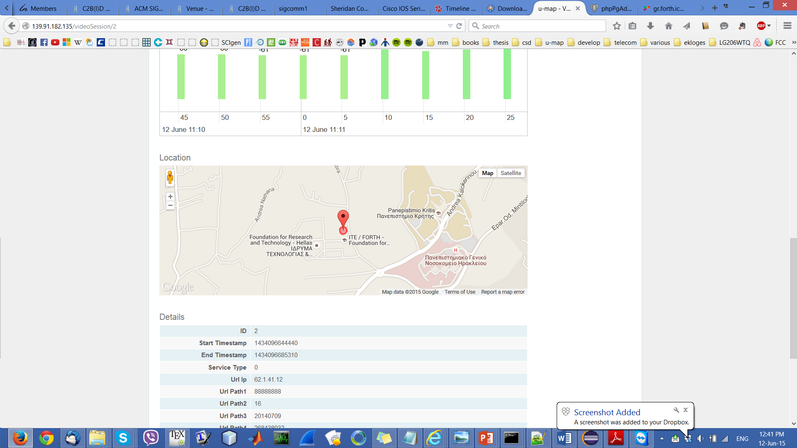
Example of user activity (@ Server GUI)

Slide 20
Field study summary
Duration: 56 days (29 July—12 September)
Clients: 33
  13 users never uploaded video sessions
  20 users with at least 1 labeled video session (sessions rated with QoE score)
  13 users with more than 5 labeled video sessions (considered for QoE prediction)
Video sessions:
  298 from 20 users: visual exploration
  281 from 13 users: QoE prediction

Slide 21
298 video sessions – 20 users
7 users (17 sessions) excluded from QoE prediction
Video sessions per user
QoE histogram
Few sessions with low QoE

Slide 22
Video session features
105 features extracted about the video sessions:
Service type, startup delay, session duration, termination type, QoE score
Buffering events
number, {total, min, max, …} duration
Video resolution
(per-resolution) number of switches, {min, max, mean, …} resolution
Network performance
mean packet loss ratio, mean jitter, {min, max, …} signal strength
User activity (pause, seek, off-screen events)
number, {total, min, max, …} duration
Respective statistics for the last 15, 30, 60 seconds of the session

Slide 23
Stationary Vs. Roaming
Stationary sessions:
Smartphone associated with only 1 AP during the entire session
Roaming sessions:
Smartphone performed handovers between APs during the session
Stationary | 293 (98.32%)
Roaming | 5 (1.68%)
Roaming video sessions are rare

Slide 24
Directly user-perceived parameters
Per-session statistics about the video playback
22 sessions with startup delay > 10 sec
20 sessions with buffering
event duration ratio > 0.1
Weighted mean x-axis video resolution
8 video sessions that never started playing (startup delay = session duration)

Slide 25
Network conditions
Per-session statistics about the network performance
5 video sessions with
packet loss > 20%

Slide 26
Users perceive the degradation (low QoE scores) for startup delay >= 10 sec
Related research reported that a startup delay beyond 2 sec causes viewers to abandon the video
[Krishnan 13]
Our speculation: Smartphone users are more tolerant

Slide 27
The higher the buffering ratio, the smaller the duration of the session
Increase in buffering ratio can decrease viewing time
[Krishnan 13, Dobrian 11]

Slide 28
Improving the data rate adaptation could reduce the buffering ratio
Sessions of high resolution, poor connectivity high buffering duration ratio & low QoE scores
Decreasing resolution might improve QoE

Slide 29
Sessions with higher startup delay, buffering ratio & lower network performance have lower QoE

Slide 30
Poor network performance during the last 15 sec of the session results in termination due to poor connectivity

Slide 31
Interesting Sessions in the Forthnet dataset
Sessions with high buffering ratio, high duration and high score
Sessions with poor connectivity status, rated with high QoE scores
Sessions with degraded performance, rated with high QoE scores
Their presence motivate us to perform a second (more controlled) field study

Slide 32
Different types of field studies for data collection
Tradeoffs between:
small-scale studies with homogeneous settings in non-controlled environments
vs.
larger-scale (potentially crowd-sensing/sourcing participatory) studies that can reach more people, representing a more realistic set of scenarios/conditions but with several unknown difficult to control dynamic exogenous parameters and heterogeneous settings.
Challenges:
Obtaining reliable measurements in such crowd-sourcing/sensing non-controlled field studies
In general, it is difficult to obtain the “ground truth” about the QoE.
The above also highlight the tension between subjectivity and reliability in the collected data.

Slide 33
FORTH dataset
50 produced videos
20 participants
each user viewed all 50 videos
duration 13 days
4 different reference videos (high quality)
4 chunks per video (duration 5 sec each one)

Slide 34
Playback video parameterized based on:
Startup delay
Number of buffering events
Ratio of buffering duration
Times when buffering events occur
Duration of each buffering event
Video resolutions for each chunk
Aggregate resolution of the video

Slide 35
Subjectivity of the assessments & user sensitivity to different types of impairment
Three scenarios:
large startup delay
number of rebuffering events
low resolution
Depending on the type of impairment appeared:
some users are more tolerant/strict than others
some users are more tolerant to some types of impairment & more strict to others
statistically significance difference of the scores of users for the various types of impairment (T-student test)

Slide 36
Parameters with dominant impact on the QoE Forthnet dataset
Aggregate approach:
termination type of the session
buffering events frequency
weighted mean video resolution ratio
packet loss
User-centric approach:
termination type (10 users)
mean jitter for (6 users)
startup delay and its ratio (5 users)
packet loss for (4 users)
the weighted mean video resolution and its ratio (4 users)

Slide 37
Parameters with Dominant Impact on the QoE FORTH dataset
User-centric model:
number of buffering events
buffering ratio consistently

Slide 38
QoE prediction Forthnet dataset
Users with high prediction error:
Users with less than 15 sessions
Users have pathologies (sessions with high degradations & high QoE)
QoE scores are not evenly distributed
Algorithm | Mean | Median | Std
uQoE aggregate | 0.5185 | 0.1392 | 0.7624
uQoE user-centric | 0.8026 | 0.1000 | 1.2672

Slide 39
QoE prediction FORTH dataset
Algorithm | Mean | Median | Std
uQoE user-centric | 0.6133 | 0.5517 | 0.5479

