Slide 1



Introduction on Sensor Networks
CS 439 & 539
Prof. Maria Papadopouli
University of Crete
ICS-FORTH
http://www.ics.forth.gr/mobile

Slide 2
Introduction to Wireless Sensor Networks

Slide 3
Wireless sensor networks (WSNs)
What is a Wireless Sensor Network ?
What is the typical node architecture ?
How is a network organized ?
What are the relevant aspects of networking protocols ?
How to design protocols for control and automation ?

Slide 4
Sensor
  A transducer
  Measures a physical phenomenon e.g. heat, light, motion, vibration, and sound and transmits it
  Sensor node
  Basic unit in sensor network
  Contains on-board sensors, processor, memory, transceiver, and power supply
Sensor network
  Consists of a large number of sensor nodes
  Nodes deployed either inside or close to the phenomenon/parameter being sensed

Slide 5
Sensor node
localization
mobility
sensing
unit
processing
storage
transceiver
power unit
energy scaravenging

Slide 6
Typical sensor characteristics
Consume low power
Autonomous
Operate in high volumetric densities
Adaptive to environment
Cheap
Limited resources & capabilities (e.g., memory, processing, battery)

Slide 7
Wireless sensor and actuator networks (WNSs) make Internet of Things possible
Computing, transmitting and receiving nodes, wirelessly networked for communication, control, sensing and actuation purposes
Characteristics of WNSs
Battery-operated nodes
Limited wireless communication
Reduced coordination
Mobility of nodes

Slide 8
Environmental Applications
Forest fire detection
Bio-complexity mapping of environment
Flood detection
Precision Agriculture
Air and water pollution
Surveillance & monitoring

Slide 9
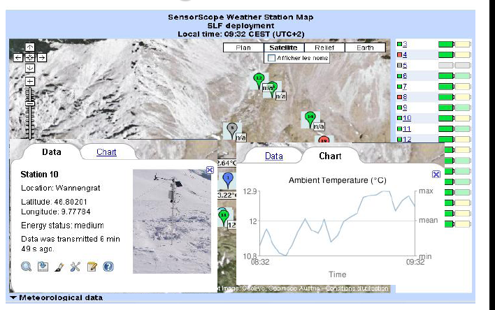
Environmental Monitoring
Source: Joao Da Silva’s talk at Enisa, July 20th, 2008

Slide 10
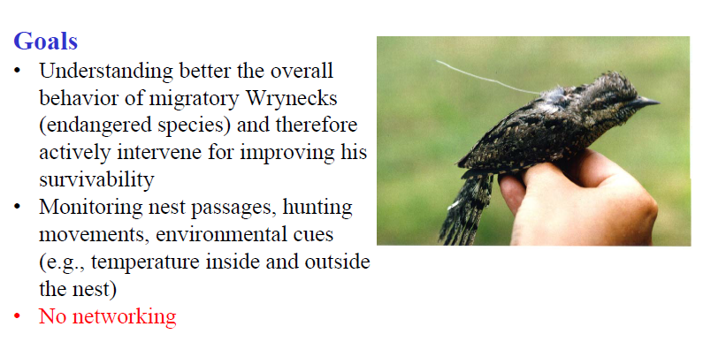

Slide 11


Slide 13
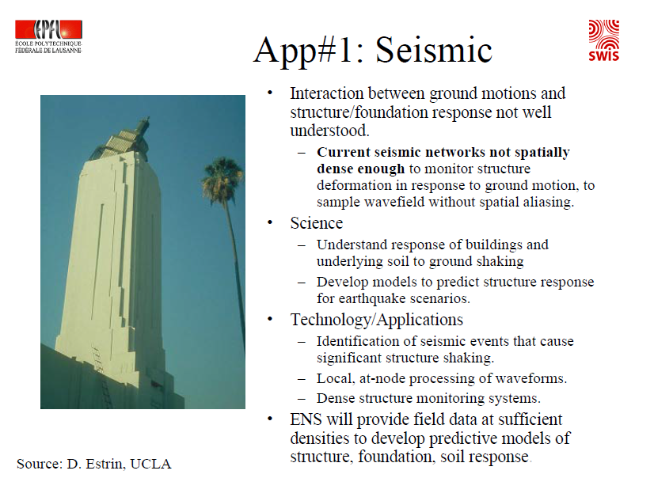

Slide 14
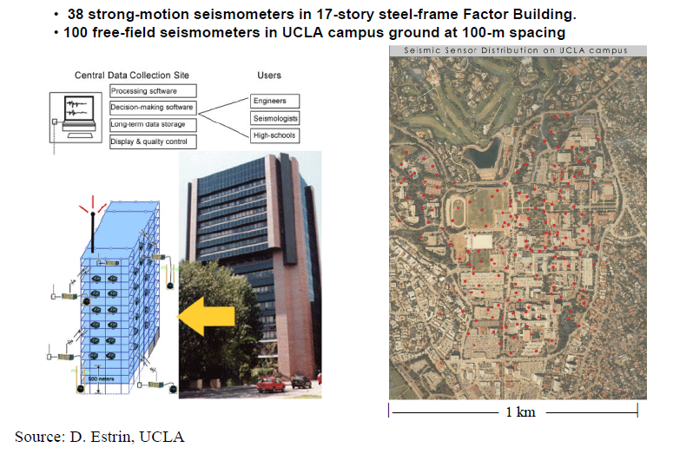

Slide 15
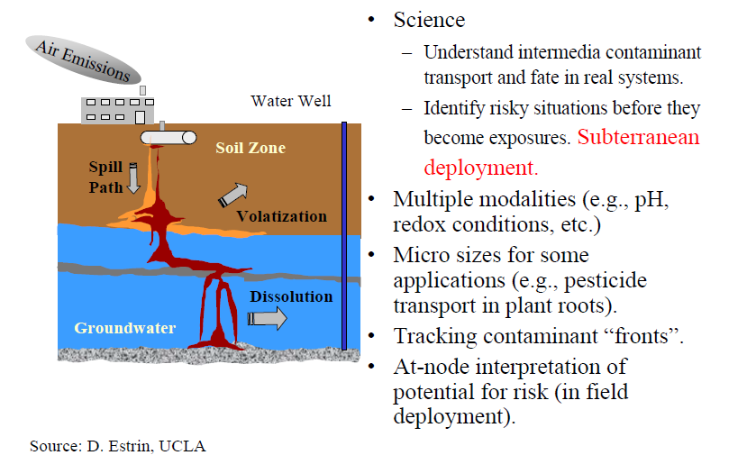

Slide 16
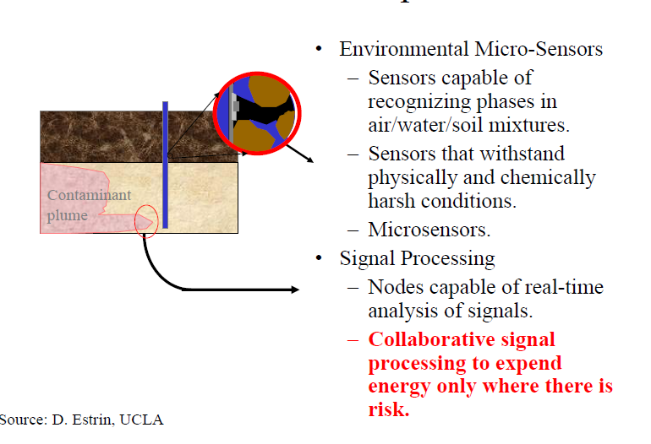

Slide 17
Military Applications
Monitoring friendly forces, equipment, and ammunition
Battlefield surveillance
Reconnaissance of opposing forces and terrain
Targeting
Battle damage assessment
Nuclear, biological, and chemical attack detection

Slide 18
Health Applications
Telemonitoring of human physiological data
Tracking and monitoring doctors and patients inside a hospital
Drug administration in hospitals

Slide 19
Automotive Applications
Reduces wiring effects
Measurements in chambers and rotating parts
Remote technical inspections
Conditions monitoring e.g. at a bearing

Slide 20
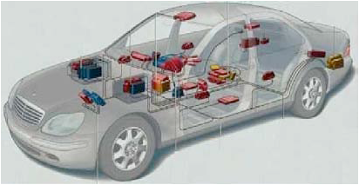
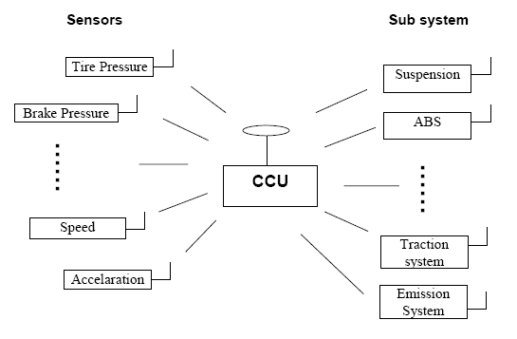
Automotive Applications
20

Slide 21
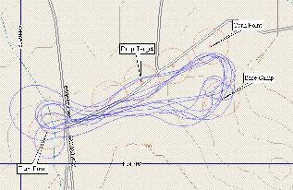
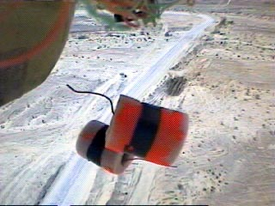
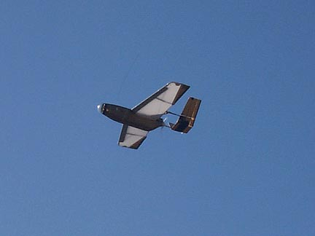

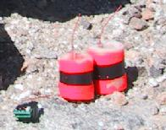
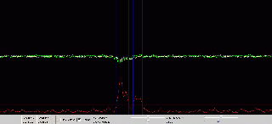
Vehicle Tracking

Slide 22
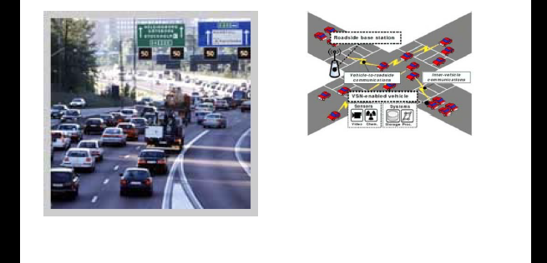
Wireless Sensor Networks in Intelligent Transportation Systems
The wirelless systems are everywhere even in the places that we never thought,one of the its uses is to traffic lights and signs.

Slide 23
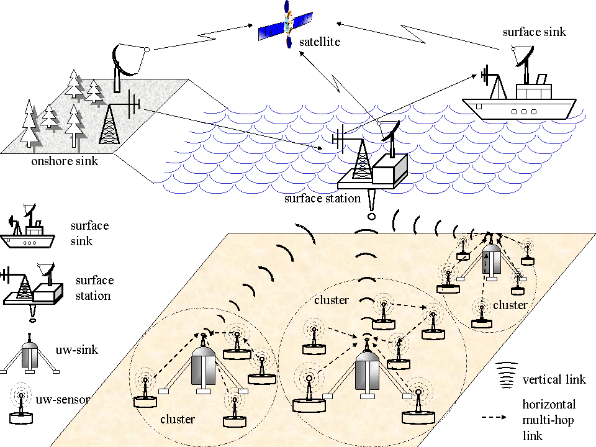
Underwater Acoustic Sensor Networks
Notes:
ref. Georgia Institute of Technology

Slide 24
Other Commercial Applications
Environmental control in office buildings (estimated energy savings $55 billion per year!)
Interactive museums
Detecting and monitoring car thefts
Managing inventory control
Vehicle tracking and detection

Slide 25
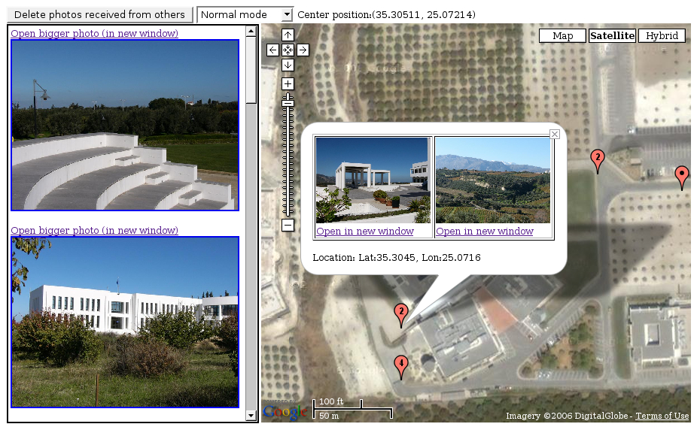

Slide 26
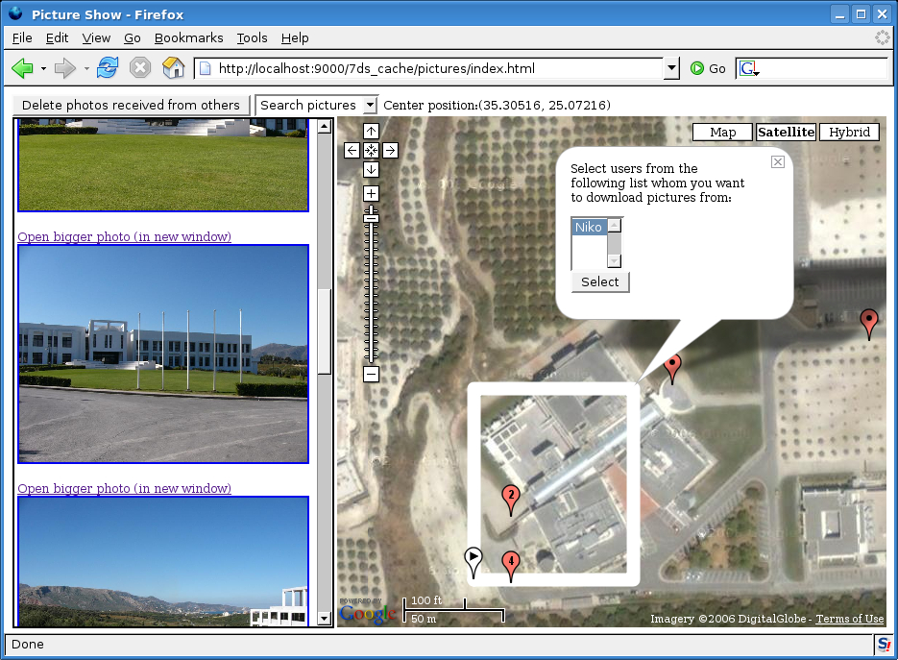
Notes:
Εδώ βλεπετε έναν χρηστη με το googlemap kai fvtograafies poy exei sthn cache tou (aristera).
O xarths deixnei to ITE. Kai tis fwtografies poy kanome display tis exome parei apo ton exwteriko xwro.
Epishs, exei markarei mia perioxh (aspro tetragwno sthn kentrikh o8onh) gia to opoio psaxnei yliko.
Panw apo to tetragvno fainontai oi xrhstes pou einai “online” kai amesa prosvasimoi.
Gia paradeigma blepete ton xrhsth “Niko”.
Tha mporouse na yphrxan para polloi xrhstes, kai o xrhsths kanontas “scrolled” down to para8yro mporei na toys dei.
O kokkinos marker me to noymero panw tou, deixnei posa files yparxoun synedemena me auth thn 8esh, sthn opoia deixnei (o marker).

Slide 27
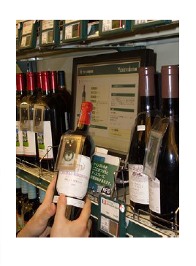
Tagged products
Source: Joao Da Silva’s talk at Enisa, July 20th, 2008

Slide 28
Factors Influencing WSN Design
Fault tolerance
Scalability
Production costs
Hardware constraints
Sensor network topology
Environment
Transmission media
Power Consumption
  Sensing
  Communication
  Data processing
Clock skew
Radio turn-on time

Slide 29
Key Software Requirements
Capable of fine grained concurrency
Small physical size
Efficient Resource Utilization
Highly Modular
Self Configuring
Notes:
29
As a starting point, we went through and came up with a set of key characteristics that distinguishes tiny networked devices from traditional architectures.
The most obvious and fundamental is that these devices have serious constraints on their physical size and power consumption. This make it impractical to have multiple device controllers for each I/O stream. The traditional controller hierarchy seen in most systems must be replaced by a direct-to-device architecture where the single central processor communicates directly with the I/O device. This is in contrast to having a specialized controller – such as a disk drive controller – buffer and preprocess data coming from the I/O device or disk head.
Additionally, the unsynchronized nature of the I/O streams forces the system to be capable of simultaneously dealing with multiple flows of data arriving in real time. This fine grained concurrency is not required when there are dedicated controllers buffering the data streams. This means that the system must be able to continually flow data through it, never shutting down one I/O channel to deal with another. In the case of taking sensor reading, the CPU must be capable of simultaneously reading in data off of the network or data packets will be lost.
A third unique characteristic is that these devices will be incredibly diverse. Each sensor network will have a different purpose and will be customized to fit the task. This will likely take the form of customized hardware platforms as well as applications specific software and protocols. This forces a successful design to be highly modular so that system components can be composed together to efficiently meet the application's needs. Additionally, the divers array of hardware will vary what amount of functionality is provided by the hardware and what must be implemented in software. A truly adaptive system must support this migration of the hardware/software boundary. One device may have a hardware based bus controller while another may have to implement the bus protocols in software.
Finally, once deployed, these devices will be unattended and numerous. This means that a system crash is most likely fatal. The use cannot be expected to run around changing batteries once a week or resetting individual devices. While the large number of devices provides natural redundancy, correlated failures due to software errors could be catastrophic. This makes robust operation a priority and narrow interface to well defined components is a tried and true method for achieving this.

Slide 30
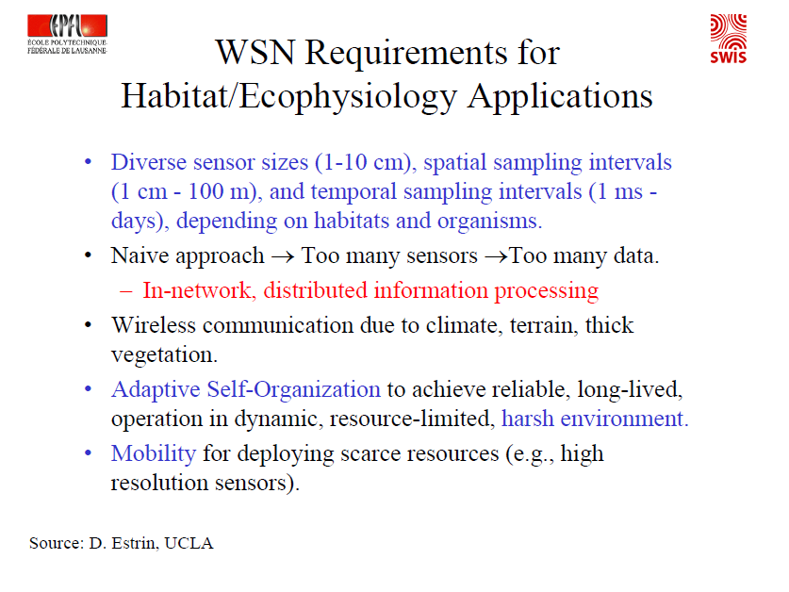

Slide 31
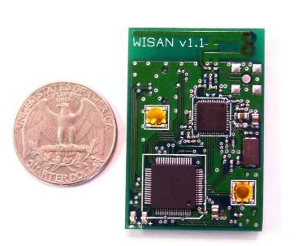
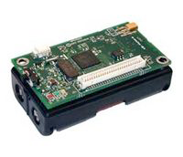
Worldsens Inc. Sensor Node
Crossbow Sensor Node

Slide 32
Example of sensor: camera
Camera networks:
Cameras provide rich information
Have wider and longer sensing range
But
Consume more power
Increased memory/storage requirements

Slide 33
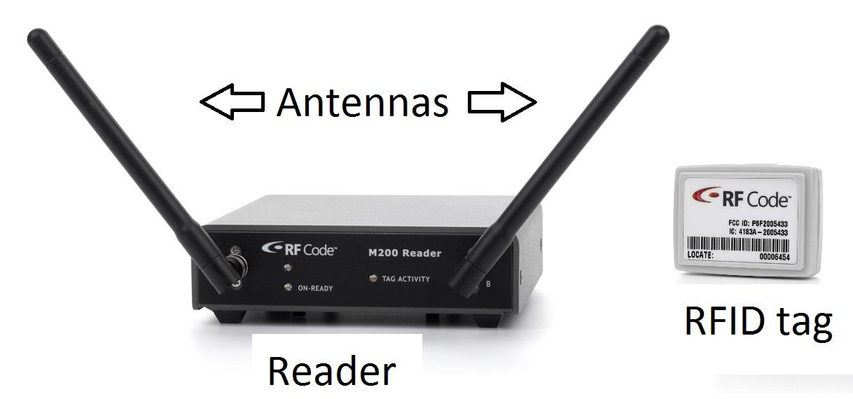
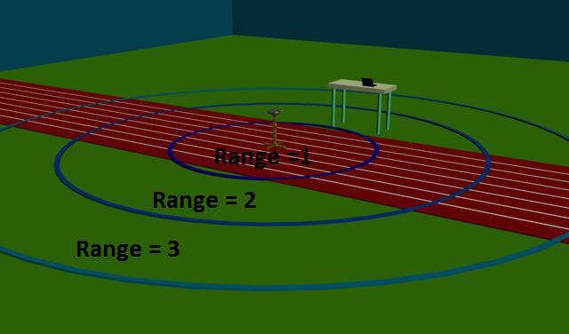
Example of sensors: RF reader & RFID tag
at the size of a modem with 2 Omni-directional Antennas on it.
The M200 reader provides an RS-232 port and an Ethernet RJ-45 port to communicate with a PC.
Managing inventory control
Vehicle tracking and detection

Slide 34
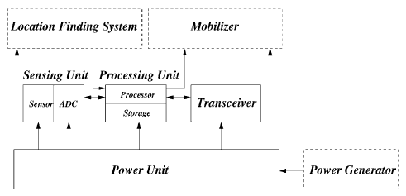
Sensor node components

Slide 35
Sensor Node Components
Sensing Unit
Processing Unit
Transceiver Unit
Power Unit
Location Finding System (optional)
Power Generator (optional)
Mobilizer (optional)

Slide 36
Sensor Node Requirements
Low power
Support multi-hop wireless communication
Self-configuring
Small physical size
Reprogrammable over network
Meets research goals
  Operating system exploration
  Enables exploration of algorithm space
  Instrumentation
  Network architecture exploration

Slide 37
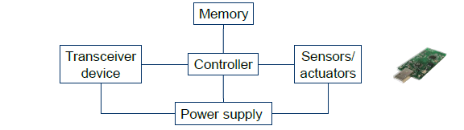

Slide 38
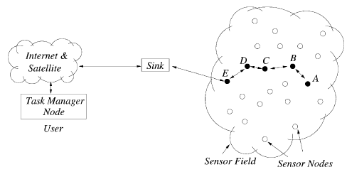
WSN Communication Architecture

Slide 39
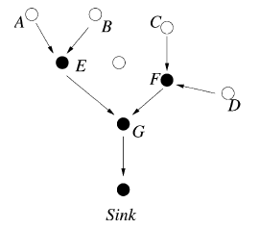
Data measured at different sensor nodes measuring the same parameter/attribute are aggregated

Slide 40
Data aggregation architectures
Cluster heads collect and process data, then they transmit the data to a gateway/server/controller
Gateway collects all data or samples and performs the aggregation, then they send the data to server/controller
Gossiping algorithms or routing algorithms across the WSN
Specific node(s) route data to the gateway

Slide 41
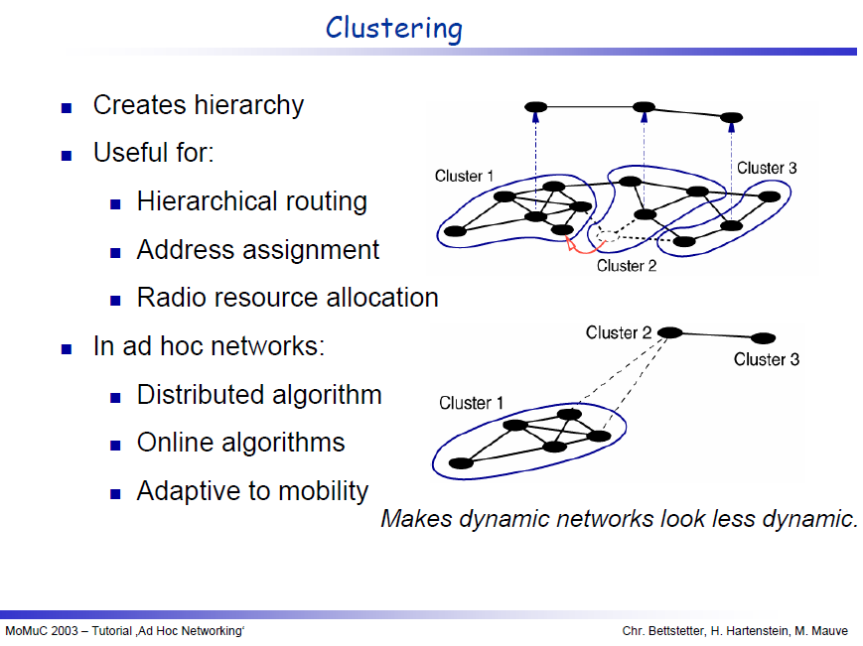

Slide 42
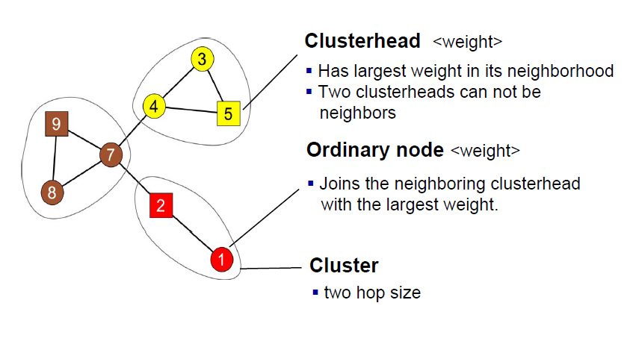

Slide 43
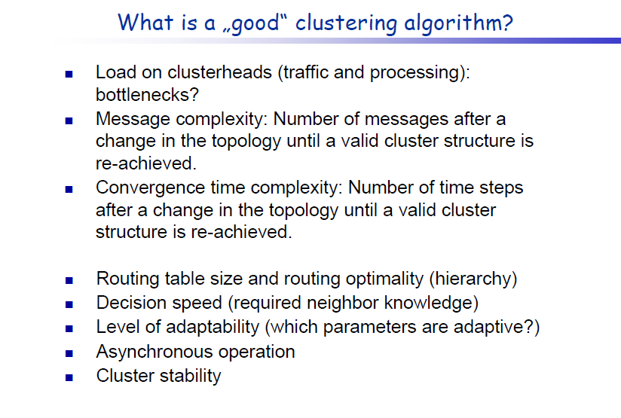

Slide 44
Sensor Network Algorithms
Directed Diffusion – Data centric routing (Estrin, UCLA)
Sensor Network Query Processing (Madden, UCB)
Distributed Data Aggregation
Localization in sensor networks (UCLA, UW, USC, UCB)
Multi-object tracking/Pursuer Evader (UCB, NEST)
Security

Slide 45
Controller
Microcontroller-general purpose processor, optimized for embedded applications, low power consumption
DSPs-optimized for signal processing tasks, not suitable for WSNs
FPGAs-may be good for testing
ASICs-only when peak performance is needed 7,no flexibility
Example microcontrollers
  Exas Instuments MSP430
    16-bit RISC core,up to 4MHz,versions with 2-10 kbytes RAM, several DACs, RT clock, prices start at 0,49$
    Fully operational 1.2 mW
    Deepest sleep mode 0.3μW-only woken up by external interrupts
Atmel ATMega
  8-bit controller, larger memory than MSP430,slower
  Operational mode:15mW active,6 mW idle
  Sleep mode :75μW

Slide 46
WSN Operating Systems
Από τεχνολογικής πλευράς τo κυριότερο πρότυπο που χρησιμοποιείται σήμερα είναι το ΙΕΕΕ 802.15.4.
Το μεγαλύτερο πλεονέκτημά του είναι ότι προσφέρει ικανοποιητική ποιότητα υπηρεσίας με την χαμηλότερη δυνατή κατανάλωση ενέργειας.
Πάνω σε αυτό έχει στηριχθεί το πρωτόκολλο Zigbee το οποίο χρησιμοποιείται κατά κόρον από τα Δίκτυα Αισθητήρων σήμερα.
Τα τελευταία χρόνια όμως έχουν κάνει την εμφάνισή τους και λειτουργικά συστήματα για αισθητήρες ανοιχτού κώδικα, με κυριότερα τα TinyOS και Contiki. Επειδή ακριβώς είναι ανοιχτού κώδικα λογισμικά, έχουν αρχίσει να χρησιμοποιούνται κατά κόρον για ερευνητικούς σκοπούς, με αποτέλεσμα ολοένα και περισσότεροι κατασκευαστές αισθητήρων να τα υποστηρίζουν στα προϊόντα τους.
TinyOS
Contiki
MANTIS
BTnut
SOS
Nano-RK

Slide 47
Cooja & Contiki
Advantages:
Open source
Low learning curve
Full IP networking
Power awareness
Support for IPv6, RPL, threads, Cooja network simulator
Support a variety of hardware platforms (Tsky, MicaZ, Avr-raven, Z1)
Disadvantages:
Lack of detailed documentation
Performance scalability issues when the number of motes is large

Slide 48
Cooja & Contiki
Advantages:
Open source
Low learning curve
Allows direct code loading from Cooja to real motes- > deployment time minimization Support for:
  Different type of radio propagation models
  IEEE 802.15.4, ContikiMAC
  IPv4, IPv6, 6LoWPAN
  RPL, AODV
  TCP/UDP/ICMP
  different types of motes (Z1, Tsky, TelosB, etc)
Disadvantages:
Lack of detailed documentation
Performance scalability issues when the number of motes is large

Slide 49
TinyOS
OS/Runtime model designed to manage the high levels of concurrency required
Gives up IP, sockets, threads
Uses state-machine based programming concepts to allow for fine grained concurrency
Provides the primitive of low-level message delivery and dispatching as building block for all distributed algorithms

Slide 50
TinyOS
Event-driven programming model instead of multithreading
TinyOS and its programs written in nesC
Main (includes Scheduler)
Application (User Components)
Actuating
Sensing
Communication
Communication
Hardware Abstractions

Slide 51
TinyOS Characteristics
Small memory footprint
  non-premptable FIFO task scheduling
Power Efficient
  Puts microcontroller to sleep
  Puts radio to sleep
Concurrency-Intensive Operations
  Event-driven architecture
  Efficient Interrupts and event handling
No Real-time guarantees

Slide 52
Tiny OS Concepts
Scheduler + Graph of Components
  constrained two-level scheduling model: threads + events
Component:
  Commands,
  Event Handlers
  Frame (storage)
  Tasks (concurrency)
Constrained Storage Model
  frame per component, shared stack, no heap
Very lean multithreading
Efficient Layering
Commands
Events
send_msg(addr, type, data)
msg_rec(type, data)
power(mode)
init
msg_send_done)
Messaging Component
internal thread
Internal
State
TX_packet(buf)
Power(mode)
init
TX_packet_done (success)
RX_packet_done (buffer)

Slide 53
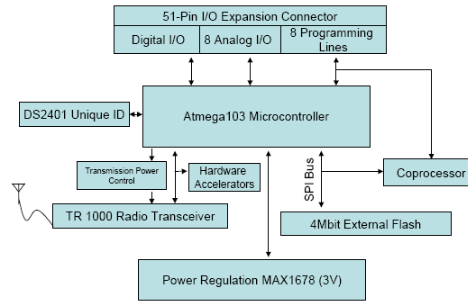
MICA Sensor Mote

Slide 54
WSN Development Platforms
Crossbow
Dust Networks
Sensoria Corporation
Ember Corporation
Worldsens

Slide 55
WSN Simulators
NS-2
GloMoSim
OPNET
SensorSim
J-Sim
OMNeT++
Sidh
SENS

Slide 56
Conclusion
WSNs possible today due to technological advancement in various domains
Envisioned to become an essential part of our lives
Design Constraints need to be satisfied for realization of sensor networks
Tremendous research efforts being made in different layers of WSNs protocol stack

Slide 57
References
Dr. Chenyang Lu Slides on “Berkeley Motes and TinyOS”, Washington University in St. Louis, USA
J. Hill and D. Culler, “A Wireless Embedded Sensor Architecture for System-Level Optimization”, Technical Report, U.C. Berkeley, 2001.
X. Su, B.S. Prabhu, and R. Gadh, “RFID based General Wireless Sensor Interface”, Technical Report, UCLA, 2003.

Slide 58
Examples of radio transceivers
RFM TR1000 family
  916 or 868 Mhz
  400kHz bandwidth
  Up to 115,2 kbps
  On/off keying or ASK
  Dynamically tunable output power
  Maximum power about 1.4 mW
  Low power consumption
Chipcon CC1000
  Range 300 to1000 Mhz, programmable in 250 Hz steps
  PSK modulation
  Provides RSSi
Chipcon CC2400
  Implements 802.15.4
  2.4 Ghz DSSS modem
  250kbps
  Higher power consumption than above transceivers
Infineon TDA 525x family
  E.g., 5250:868MHz
  ASK or FSK modulation
  RSSS, highly efficient power amplifier
  Intelligent power down,'' self-polling'' mechanism
  Excellent blocking performance

Slide 59
How to recharge a battery?
Try to scavenger energy from environment
Ambient energy sources
  Light, solar cells-between 10 μW/cm² and 15mW/cm²
  Temperature gradinets - 80 μW/cm²
  Vibrations – between 0.1 and 10000 μW/cm³
  Pressure varation (piezo-electric), e.g., 330 μW/cm² from the heel of a shoe
  Air/linquid flow(MEMS gas turbines)

Slide 60
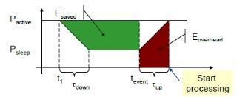

Do not run node at full operation all the time
  If nothing to do, switch to power safe mode
  Question: When to throttle down? How to wake up again?
Typically models
  Controller: Active, idle, sleep
  Radio mode: Turn on/off transmitter/reciever, both

Slide 61
IEEE 802.15.4 is the de-facto reference standard for low data rate and low power WNSs
Characteristics:
  Low data rate for ad hoc self-organizing network of inexpensive fixed, portable and moving devices
  High network flexibility
  Very low power consumption
  Low cost

Slide 62
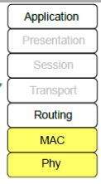
IEEE 802.15.4 specifies two layers:
Physical layer
  2.4GHz global, 250Kbps
  915MHz America,40Kbps
  868MHz Europe,20Kbps
Medium Acces Control (MAC) layer
IEEE 802.15.5 does not specify the routing

Slide 63
IEEE 802.15.4 Physical Layer
Frequency bands:
  2.4-2.4835 Ghz,global,16 channels,250 Kbps
  902.0-928.0MHz,America,10 channels,40 Kbps
  868-868.6 Mhz,Europe,1 channel,20 Kbps
Features of PHY layer
  Activation and deactivation of the radio transceiver
  Energy detection(ED)
  Link quality indication(LQI)
  Clear channel assessment (CCA)
  Transmitting and receiving packet across the wireless channel
  Dynamic channel selection by a scanning a list of channels in search of beacon, ED, LQI and channel switching

Slide 64
IEEE 802.15.4 standard
Properties | 2450 MHz | 915 MHz | 868 MHz
Bit rate | 250 kbps | 40 kbps | 20 kbps
Number of channels | 16 | 10 | 1
Modulation | O-QPSK | BPSK | BPSK
Pseudo noise chip sequence | 32 | 15 | 15
Bits per symbol | 4 | 4 | 1
Symbol period | 16 μs | 24 μs | 49 μs
Latency | >15 ms | >15 ms | >15 ms
Transmission range | 10-20 m | 10-20 m | 10-20 m

Slide 65
IEEE 802.15.4 standard
Supports two network topologies:
Star: a node takes the role of the coordinator and all other nodes send traffic through it (like the role of an AP in IEEE 802.11)
peer-to-peer: a multi-hop network is formed
Supports two medium access modes:
non-beacon-enabled mode: nodes contend through a CSMA/CA mechanism, and
beacon-enabled mode: a PAN coordinator activates a superframe through a beacon.
This superframe has an active and an inactive period, with a total duration of BI (beacon interval). BI and the active period of the superframe are determined by two parameters, BO and SO, respectively. IEEE 802.15.4 does not specify the optimum values for BO and SO

Slide 66
Zigbee
A low-cost, low-power, wireless mesh network standard based on IEEE 802.15.4
four main components: network layer, application layer, ZigBee device objects (ZDOs) and manufacturer-defined application objects which allow for customization and favor total integration
its specification is free for use for non-commercial purposes

Slide 67
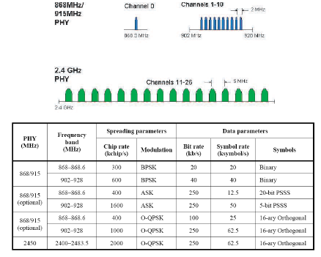

Slide 68
Self-organized communications for WBN
WBN Evaluation Framework
Impact of the environment on the network performance
Impact of co-existing & co-operating clusters of WBN
Communication-specific parameters
(e.g. operational channel, transmission power)
On-demand self-reconfiguration
Monitoring & Reporting
Additionally can be used for:
Realization of the benchmark scenarios
Evaluation of selected protocol stacks and the resutling on-node and cooperative network performance (e.g. lifetime, goodput, latency etc).
Ease the structural design of end-to-end communication between WBN nodes and visualization and control system & the on-the-fly nodes reprogramming
68

Slide 69
Self-organized communications for WBN
Design and Development of WBN Evaluation Framework
Simulation-based framework
Small-scale experimental testbed
Contiki /Cooja simulation-based
Flexibility in terms of network scalability
Allows rapid code development on embedded devices
IEEE 802.15.4 / 2.4GHz –based
Complementary to simulation-based
Tier-1 & tier-2 of network architecture
In 100% hardware compatibility to MKFF’s testbed

Slide 70
WP4. Self-organized communications for WBN
Simulation-based WBN Evaluation Framework
Multiple sources-1 sink architecture
Event-driven communication, initiated from WBN nodes
(compatible to Scenario#1,#4,#5)
UDP (uIP)
Reliable Route Discovery
Reliable Flooding
CSMA
(with Radio-Duty Cycle, based on channel sensing)
Currently looking into:
Implementation of evaluation metrics per layer
On-demand reconfiguration of radio propagation characteristics @ Contiki / Cooja.
WBN Protocol
Stack
(reconfi-
gurable)
IEEE 802.15.4 PHY

Slide 71
WP4. Self-organized communications for WBN
Experimental-based WBN Evaluation Framework
2 WBN clusters / 6 nodes per cluster
Identical WBN protocol stack as simulation-based testbed (& reconfigurable)
Gateway / Visualization and Control
WBN Node
μServer
IEEE 802.15.4
LAN / IEEE 802.11
+ performance of PHY / Antenna w.r.t industrial environment
+ Application Level Gateway, between WBN and Gateway
+ Increased computational efficacy (compared to WBN)
+Portability

Slide 72
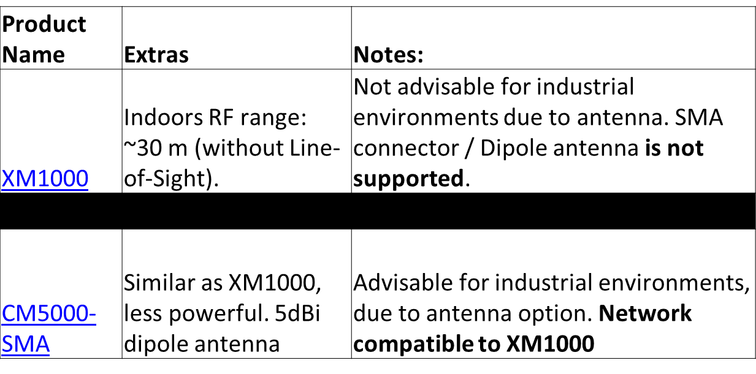
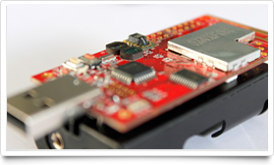
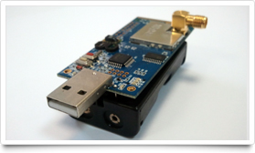
WP4. Self-organized communications for WBN
Experimental-based WBN Evaluation Framework
WBN Nodes
XM1000 carrying the advanced sensing functionalities – CM5000 sensing + relay nodes between XM1000 and μServer

Slide 73
WP4. Self-organized communications for WBN
Experimental-based WBN Evaluation Framework
μServer
2-stages implementation:
Stage 1: Application-Level Gateway Functionality
(implementation on standard host machine, with mounted WBN node)
Stage 2: Transition of functionality at Single-Board-Computer with mounted WBN node (to allow for portability within the industrial plant)

Slide 75

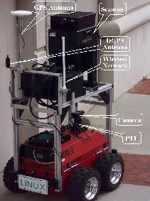





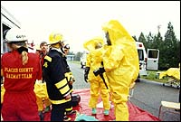

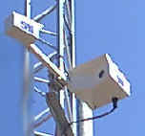
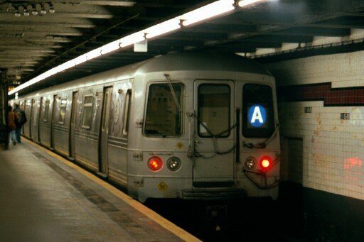

Παραδείγματα με κινητά υπολογιστικά συστήματα που μπορούν να χρησιμοποιήσουν το mobile p2p μοντέλο

Slide 76
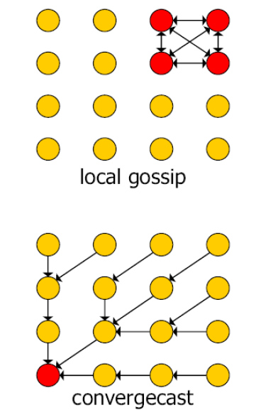
Traffic patterns in WSNs
WSN applications:
Local collaboration when detecting a physical phonomenon
Periodic reporting to sink
Characteristics:
Low data rates < 1000 bps
Small messages (~ 25 bytes)
Fluctuations (in time and space)
Network management
  Periodic reporting
  Event-driven reporting

Slide 77
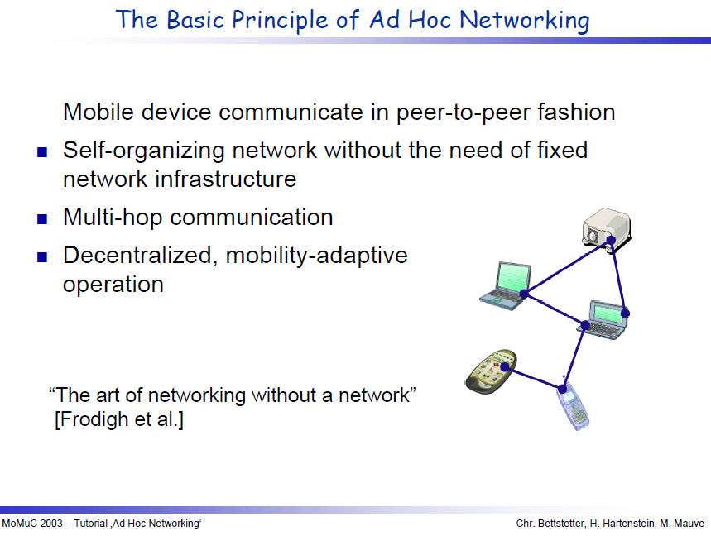

Slide 78
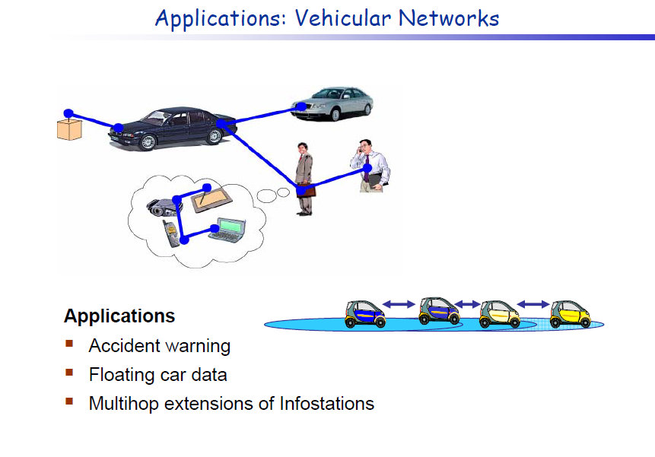

Slide 79
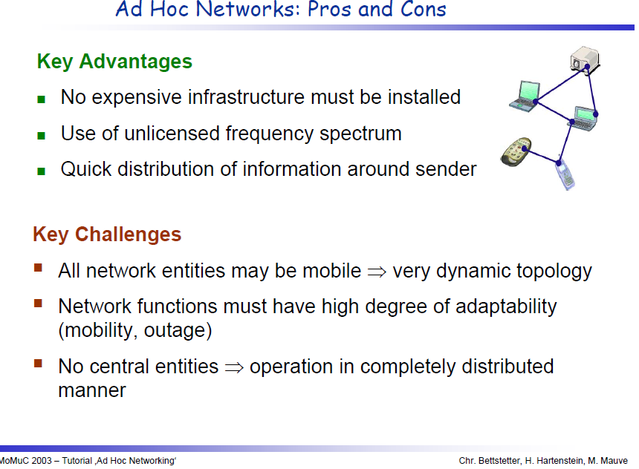

Slide 80
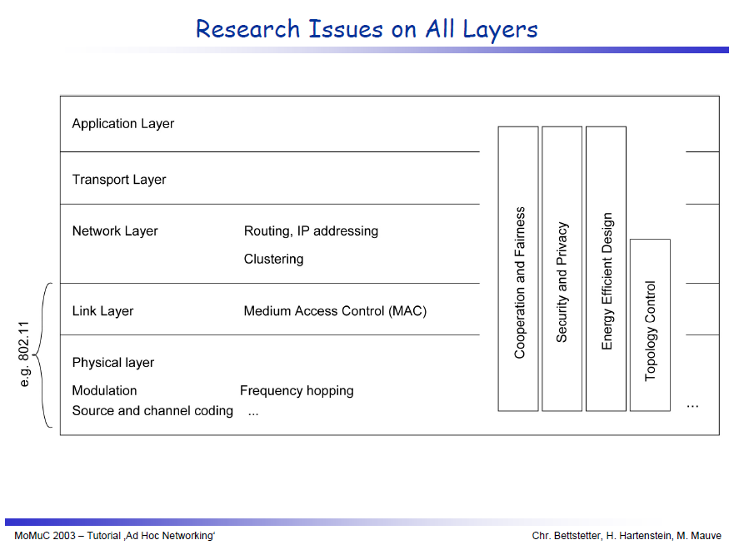

Slide 82
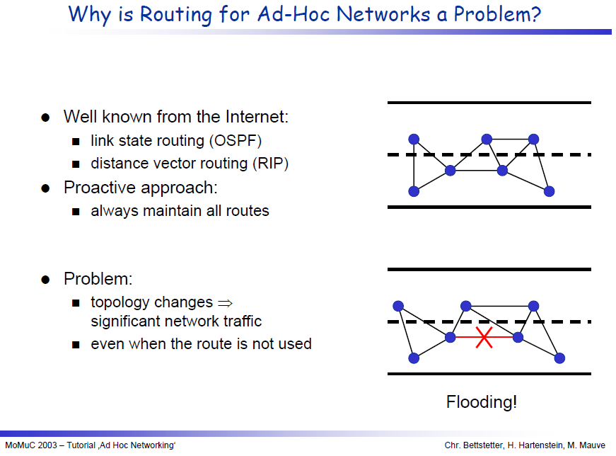

Slide 83
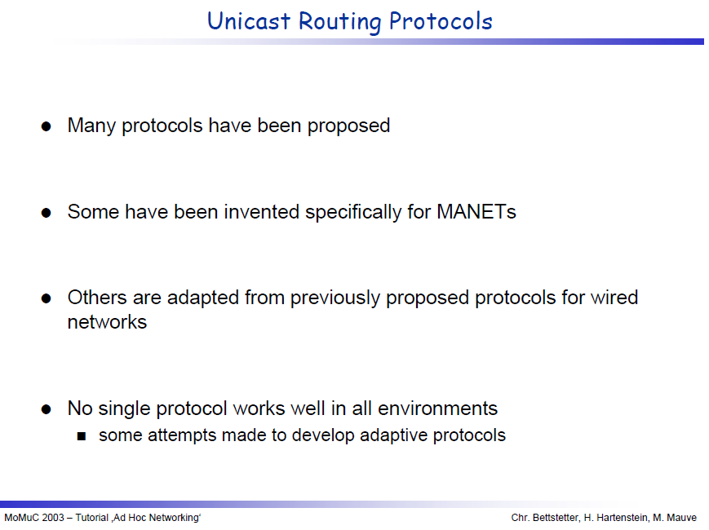

Slide 84
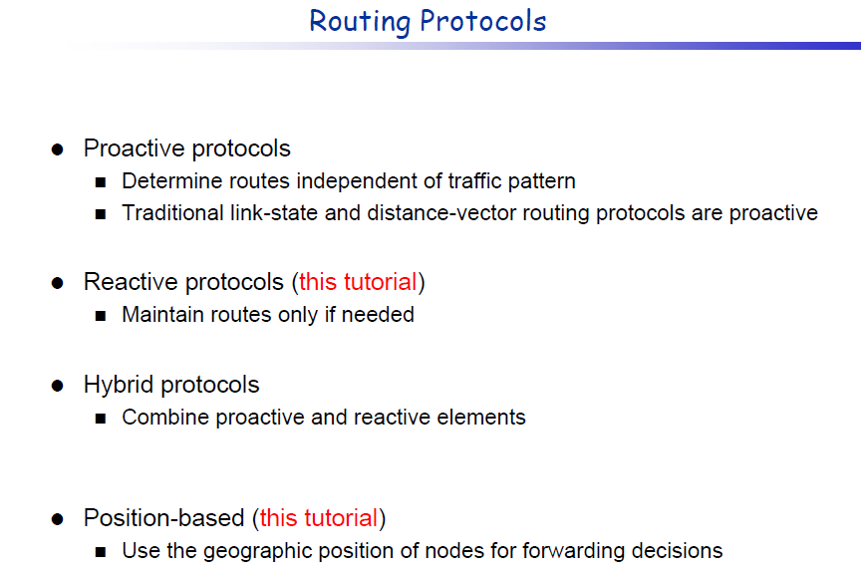

Slide 85
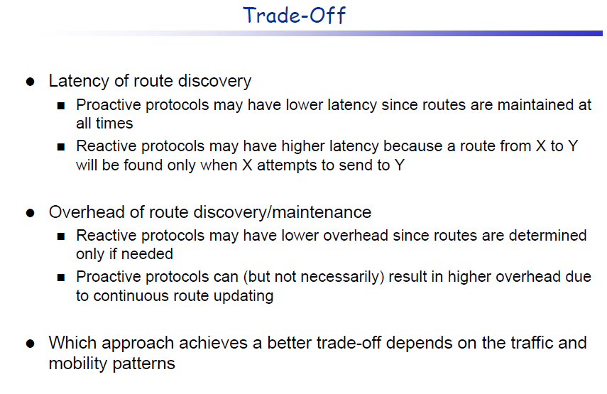

Slide 87


Slide 88


Slide 89


Slide 90


Slide 91


Slide 92


Slide 93


Slide 94


Slide 95


Slide 96


Slide 97


Slide 98


Slide 99
Performance of data dissemination in an ad hoc network
Examples of measurements:
Average throughput for the communication of a random pair of nodes
Total time required for a specific message to be transmitted to all nodes
Average delay for a node to receive a specific message

Slide 100
Capacity in an ad hoc network
Capacity decreases with node density
an ad hoc network with N nodes
Pairs of nodes communicating
Source and destination nodes are randomly chosen
Throughput is in the order of Θ (W/√ (n* log(n)))

Slide 101

Use of simple epidemic models for data dissemination

Slide 102

Use of simple epidemic models for data dissemination
(cont’d)

Slide 103

Use of
Particle kinetics
& classical physics
to model
data dissemination

Slide 104


Slide 106

Simulation/Emulation testbed
TCP flows
UDP
Wired clients: senders
Wireless clients: receivers

Slide 107



Throughput & goodput per flow in a wireless hotspot AP simulated with real-traffic demand
Goodput: only considers the amount of
Bytes delivered from the transport layer
to the application layer

Slide 108


Performance of an AP using emulation and “replaying” real-traffic

Slide 109

Real-life delay measurements

Slide 110


Slide 111


