Slide 1



Lecture on Wireless Network Measurements & Modeling
Prof. Maria Papadopouli
University of Crete ICS-FORTH
http://www.ics.forth.gr/mobile
1

Slide 2
Empirical measurements
Can be beneficial in revealing
  deficiencies of a wireless technology
  different phenomena of the wireless access & workload
Provide data for modelling efforts aiming to produce more realistic models & synthetic traces
Enable meaningful performance analysis studies using such
empirical, synthetic traces and models

Slide 3
Network performance benchmarks include:
Jitter
Latency/delay/response delay
One way, round-trip delay
Packet losses
% packet loss, burstiness of packet loss, relative position of the bursts of packet losses within a flow
Subjective metrics (e.g., opinion score)
Network workload can be characterized based on:
Amount of traffic
Number of packets or bytes
Downloading vs. uploading
Packet or flow arrival process
Interactivity model
Application type
Usage pattern
Network topologies can be described based on
Their connectivity
Link charactertsics
Distribution & density of peers
Degree of clustering
Co-residency time
Inter-contact time
Duration of disconnection for the Internet
Interaction patterns

Slide 4
Modeling Traffic
Sizes of files stored on web servers, data files transferred through the Internet, and files in general purpose Unix file-systems modeled using heavy-tailed distributions
Internet traffic (amount of bytes) exhibits a self-similar nature.
Web traffic also exhibits self-similarity.
The majority of web traffic in wired networks is below 10KB, while a small percentage of vey large flow account for 90% of the total traffic. Power laws can describe web flow sizes.
So Poisson processes cannot accurately model the traffic load. However, they can be used to model the arrival of user sessions (e.g., telnet connections or arrivals at a wireless AP).

Slide 5
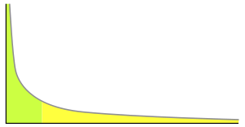

Poisson process
Stochastic process which counts the number of events and the time that these events occur in a given time interval.
The time between each pair of consecutive events has an exponential distribution with parameter λ and each of these inter-arrival times is assumed to be independent of other inter-arrival times
Exponential distribution : PDF X: Prob(X=x)=λ e-^{λx}, x ∈ [0, ∞), E[X] = 1/λ, Var[X] = 1/λ²
Power law, Zipf distribution, Pareto distribution are “heavy-tail” distributions
Pareto:

Slide 6

a self-similar object is exactly or approximately similar to a part of itself (i.e. the whole has the same shape as one or more of the parts).
A self-similar object “looks” roughly the same
on any scale

Slide 7
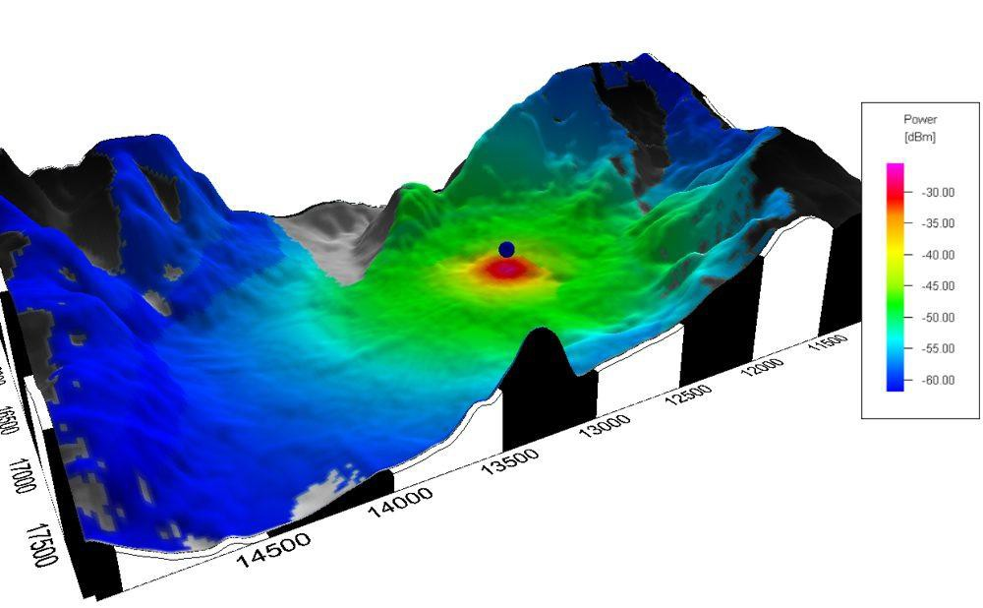
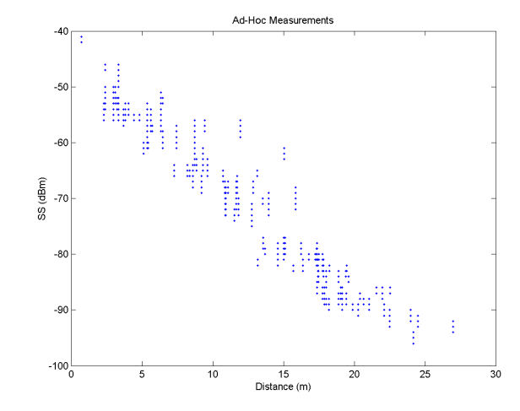
Propagation Models
One of the most difficult part of the radio channel design
Done in statistical fashion based on measurements made specifically for an intended communication system or spectrum allocation
Predicting the average signal strength at a given distance from the
transmitter
3

Slide 8
Signal Power Decay with Distance
A signal traveling from one node to another experiences fast (multipath) fading, shadowing & path loss
Ideally, averaging RSS over sufficiently long time interval
excludes the effects of multipath fading & shadowing ⇨
general path-loss model:
_
P(d) = P₀ – 10n log₁₀ (d/d_{o})
n: path loss exponent
P(d): the average received power in dB at distance d P₀ is the received power in dB at a short distance d₀
_

Slide 9
Signal Power Decay with Distance
In practice, the observation interval is not long enough to mitigate
the effects of shadowing
☞ The received power is commonly modeled to include both path-loss
& shadowing effects, the latter of which are modeled as a zero-mean Gaussian random variable with standard deviation σ_{sh} in the logarithmic scale, P(d), in dB can b_e expressed:
P(d) ~ N (P(d), σ_{sh}²)
This model can be used in both line-of-sight (LOS) & NLOS scenarios with appropriate choice of channel parameters

Slide 10
Important aspects of monitoring
Identification of the dominant parameters
based on the aspects you need to measure, the parameters that need to be monitored are decided …
Strategic placement of monitors
e.g., at routers, APs, clients, and other devices, …
Automation of the monitoring process to reduce human intervention in managing the monitors and collecting data
Aggregation of data collected from distributed monitors to improve the accuracy, while maintaining a low communication and energy overhead
(cross-)validation study to verify that the collected traces correspond to representative conditions

Slide 11
Monitoring
Depending on type of conditions that need to be measured,
monitoring needs to be performed at
  Certain layers
  Spatio-temporal granularities
Monitoring tools
Are not without flaws
Several issues arise when they are used in parallel for
thousands devices of different types & manufacturers:
  Fine-grain data sampling
  Time synchronization
  Incomplete information (missing values, incorrect values)
  Data consistency
  Vendor-specific information & dependencies (often not publicly available)
Notes:
Often monitoring tools are not without flaws and several issues arise when they are used in parallel for thousands devices of different types and manufacturers. They are limited in their capabilities because they cannot capture all the relevant information due to either hardware limitations, the proprietary nature of hardware and software, or hidden terminals.

Slide 12
Monitoring tools
  Fine-grain data sampling
  What is its spatio-temporal granularity?
  Time synchronization
  Clocks have different drifts…
  Incomplete information (missing values, incorrect values)
    How do you handle missing values? Explain what caused them!
    Various techniques to “fill” the gaps, if necessary, such as interpolation, model-prediction, matrix completion and other sophisticated statistical analysis methods …
    Explain the outliers! Are there due to misconfigured devices? Or network anomalies? Or due to the occurrence of “extreme” phenomena?
  Data consistency
  Vendor-specific information & dependencies (often not publicly available)
  e.g., RSSI differs depending on the manufacture
Notes:
Often monitoring tools are not without flaws and several issues arise when they are used in parallel for thousands devices of different types and manufacturers. They are limited in their capabilities because they cannot capture all the relevant information due to either hardware limitations, the proprietary nature of hardware and software, or hidden terminals.

Slide 13
Monitoring & Data Collection
Fine spatio-temporal detail monitoring can
 Improve the accuracy of the performance estimates but also
 Increase the energy spendings and detection delay
Network interfaces may need to
  Monitor the channel in finer & longer time scales
  Exchange this information with other devices

Slide 14
Challenges in Monitoring (1/2)
Identification of the dominant parameters through
  sensitivity analysis studies
Strategic placement of monitors at
  Routers
  APs
  clients and other devices of users
Automation of the monitoring process to reduce human intervention
in managing the
Monitors
Collecting data

Slide 15
Challenges in Monitoring (2/2)
Aggregation of data collected from distributed monitors to improve the accuracy while maintaining low overhead in terms of
  Communication
  Energy
Cross-layer measurements, collected data spanning from the physical layer up to the application layer, are required

Slide 16
Wireless Networks
Are extremely complex
Have been used for many different purposes
Have their own distinct characteristics due to radio propagation characteristics & mobility
e.g., wireless channels can be highly asymmetric and time varying
Note:
Interaction of different layers & technologies creates many situations that cannot be foreseen during design & testing stages of technology development

Slide 17
Empirically-based Measurements
Real-life measurement studies can be particularly beneficial in
revealing
  deficiencies of a wireless technology
  different phenomena of the wireless access and the workload
Rich sets of data can
  Impel modeling efforts to produce more realistic models
  Enable more meaningful performance analysis studies

Slide 18
It is important to assess whether
typical assumptions are realistic!
Typical assumptions in performance analysis of wireless networks
Models & analysis of wired networks are valid for wireless networks
Wireless links are symmetric
Link conditions are static
The density of devices in an area is uniform
The communication pairs are fixed
User mobility is based on random-walk models

Slide 19
Wireless Access Parameters
Traffic workload
  In different time-scales
  In different spatial scales (e.g., AP, client, infrastructure)
  In bytes, number of packets, number of flows, application-mix
Delays
  Jitter and delay per flow
  Statistics at an AP and/or channel
Packet losses
%packet loss & burstiness of packet losses
User mobility patterns
Link conditions & channel quality
Network topology

Slide 20
Traffic Load Analysis
As the wireless user population increases, the
characterization of traffic workload can facilitate
  More efficient network management
  Better utilization of users’ scarce resources
Application-based traffic characterization

Slide 21
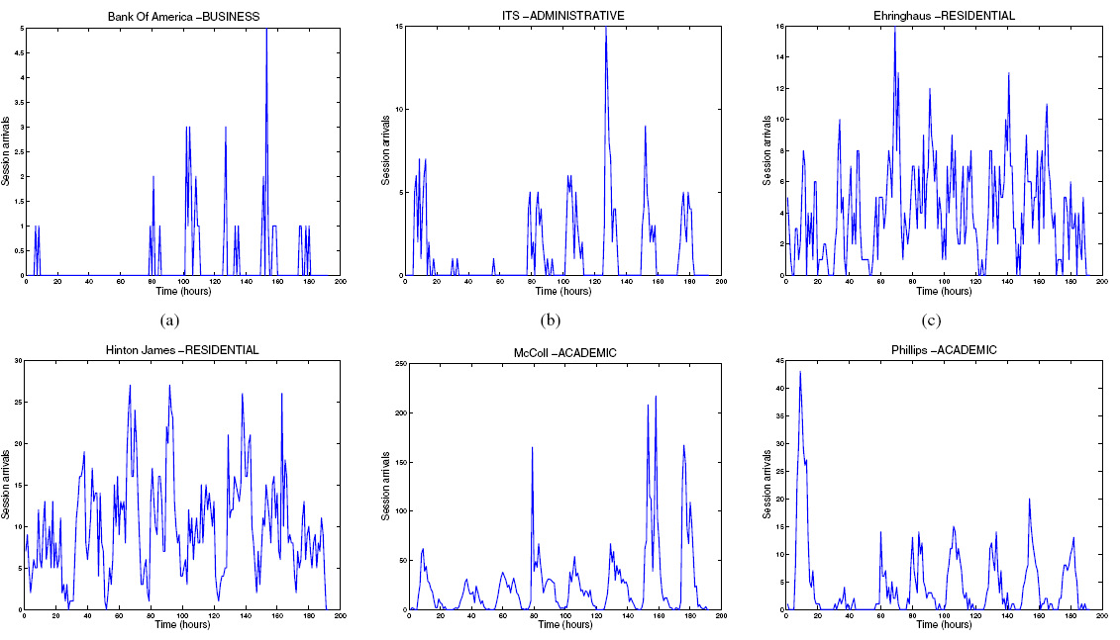
Hourly Session arrival rates
15

Slide 22
Traffic Load at APs
Wide range of workloads that log-normality is prevalent
In general, traffic load is light, despite the long tails
No clear dependency with type of building the AP is located exists
  Although some stochastic ordering is present in
    Tail of the distributions
Dichotomy among APs is prominent in both infrastructures:
APs dominated by uploaders
APs dominated by downloaders
As the total received traffic at an AP ↑
  There is also ↑ in its total traffic sent
  ↓ in the sent-to-received ratio

Slide 23
Traffic load at APs
Substantial number of non-unicast packets
Number of unicast received packets strongly correlated with
number of unicast sent packets (in log-log scale)
Most of APs send & receive packets of relatively small size
Significant number of APs show rather asymmetric packet sizes
  APs with large sent & small receive packets
  APs with small sent & large receive packets
Distributions of the number of associations & roaming operations are heavy-tailed
Correlation between the traffic load & number of associations
in log-log scale

Slide 24
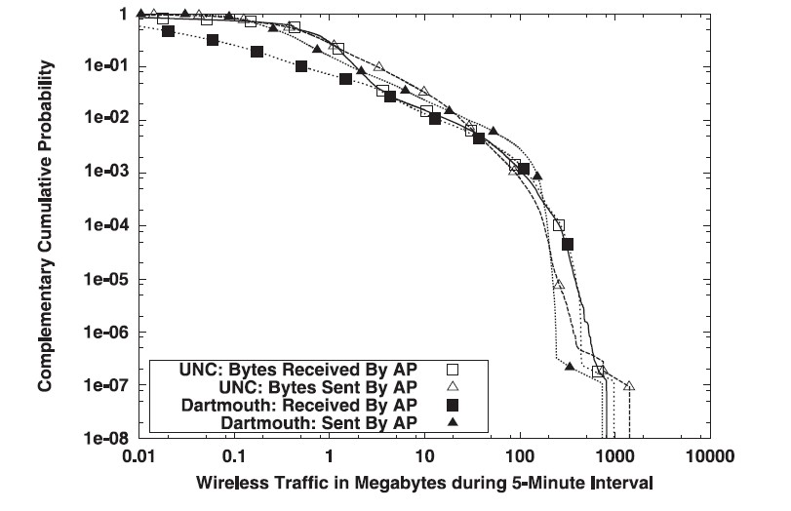
In general, the traffic load is light
☞ long tails
RARE EVENTS OF LARGE
SIZE

Slide 25
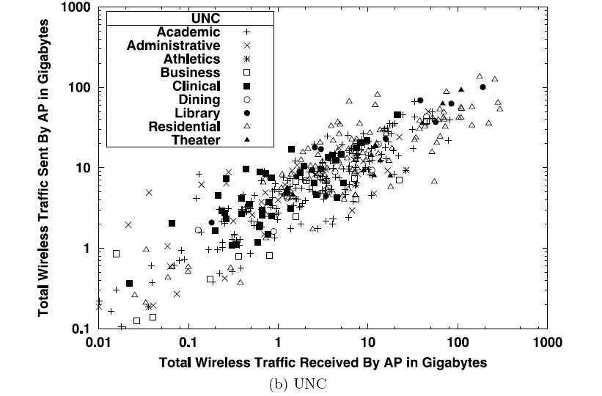
Wide-range of workloads
As total received traffic at an AP ↑
⇨ its total traffic sent ↑

Slide 26
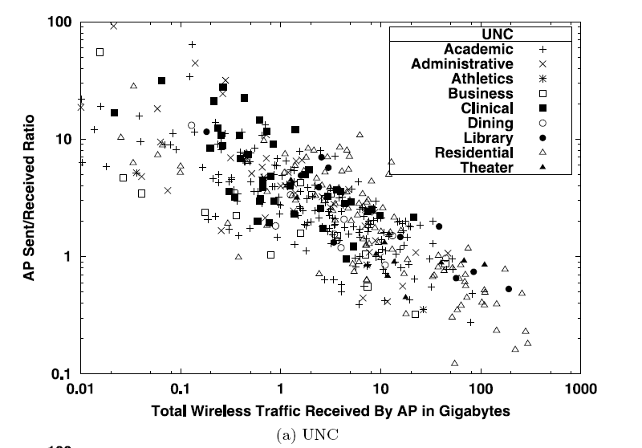
Light traffic load
Wide ranges & dichotomies
APs with uploaders
APs with downloaders
Rare events of large size
Notes:
Collected from several campus-wide wireless infrastructures over different periods in 2005 & 2006 using syslog, snmp, tcpdump.
The data, models, scripts are available online for the community to use at http://netserver.ics.forth.gr/datatraces/

Slide 28
Application-based Traffic Characterization
 Using port numbers to classify flows may lead to significant amounts
of misclassified traffic due to:
Dynamic port usage
Overlapping port ranges
Traffic masquerading
Often peer-to-peer & streaming applications:
  Use dynamic ports to communicate
  Port ranges of different applications may overlap
  May try to masquerade their traffic under well-known “non-
suspicious” ports, such as port 80

Slide 29
Desirable Properties for Models
Accuracy
Tractability
Scalability
Reusability
“Easy” interpretation

Slide 30
Related work
Rich literature in traffic characterization in wired networks
  Willinger, Taqqu, Leland, Park on self-similarity of Ethernet LAN traffic
  Crovela, Barford on Web traffic
  Feldmann, Paxson on TCP
  Paxson, Floyd on WAN
  Jeffay, Hernandez-Campos, Smith on HTTP
•
•
•
Traffic generators for wired traffic
  Hernandez-Campos, Vahdat, Barford, Ammar, Pescape, …
P2P traffic
  Saroiu, Sen, Gummadi, He, Leibowitz, …
On-line games
  Pescape, Zander, Lang, Chen, …
Modelling of wireless traffic
  Meng et al.

Slide 31
Dimensions in Modeling Wireless Access
Intended user demand
User mobility patterns
  Arrival at APs
  Roaming across APs
Channel conditions
Network topology

Slide 32
Mobility models
Group or individual mobility
Spontaneous or controlled
Pedestrian or vehicular
Known a priori or dynamic
Random-walk based models
– Randway model in ns-2
Markov-based model

Slide 33
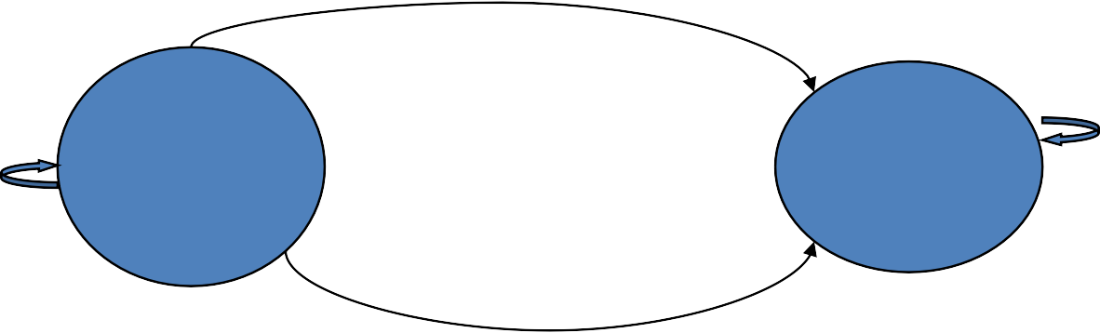
A Very Simple Channel Model
Gilbert model
☺ Compute stationary probabilities
^{P}ib
Idle
Busy
^{P}bb
^{P}ii
^{P}bi
A channel can be in the idle or busy state
Markov-based model allows us to determine:
  How much time the system spends in each state
  Probability of being in a particular state
☞ In real rife, there is non-stationarity due dynamic phenomena

Slide 34
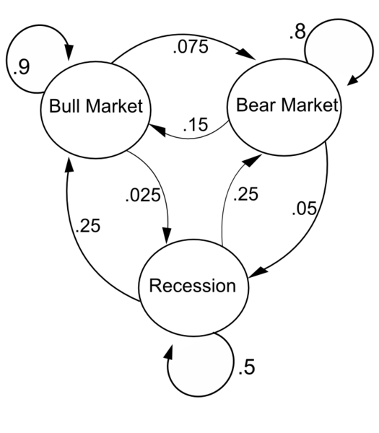

Markov chain model:
(definition) random process usually characterized as memoryless: the next state depends only on the current state and not on the sequence of events that preceded it.
Example:
The states represent whether the economy is in a bull market, a bear market, or a recession, during a given week:
a bull week is followed by another bull week 90% of the time, a bear market 7.5% of the time, and a recession the other 2.5%.
Label the state space
{1=bull, 2=bear, 3=recession}
Define the transition matrix:
Notes:
Bull market: ανατιμητική αγορά, bear market: depression… recession:ύφεση, (recession is generally considered less severe than a depression).

Slide 35
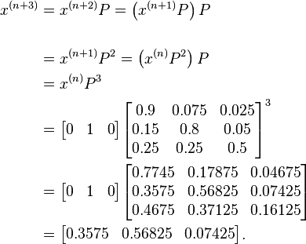
(Continuing from the previous slide)
From this figure, it is possible to calculate the long-term fraction of time during
which the economy is in a recession, or on average, how long it will take to go
from a recession to a bull market
The distribution over states can be written as a stochastic row vector x with the relation x^{(n + 1)} = x^{(n)} P.
So if at time n the system is in the state 2 (“bear”) then , at time n + 3 the distribution is

Slide 36
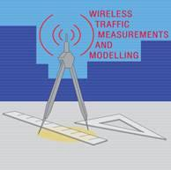

UNC/FORTH web archive
 Online repository of models, tools, and traces
– Packet header, SNMP, SYSLOG, synthetic traces, …
http://netserver.ics.forth.gr/datatraces/
 Free login/ password to access it
☞ Simulation & emulation testbeds that replay synthetic traces for various traffic conditions
Mobile Computing Group @ University of Crete/FORTH
http://www.ics.forth.gr/mobile/
 maria@csd.uoc.gr

