Slide 1
Routing Protocols for Ad-Hoc Networks
Ad-hoc On-Demand Distance Vector Routing
&
DSR: The Dynamic Source Routing Protocol for Multi-Hop Wireless Ad Hoc Networks
November 2011,
Giorgos Papadakis & Manolis Surligas

Slide 2
Outline
Ad-Hoc networks
Ad-hoc routing algorithms
Ad-Hoc on-demand Distance Vector Routing (AODV)
Dynamic Source Routing (DSR)
Comparison of AODV and DSR

Slide 3
Ad Hoc Networks
Wireless networks can be divided in two fundamental categories:
Infrastructure-based
Wireless clients connecting to a base-station (APs, Cell Towers) that provides all the traditional network services (routing, address assignment)
Infrastructure-less
The clients themselves must provide all the traditional services to each other

Slide 4
Ad Hoc Networks
Ad-hoc networks main features:
Decentralized
Do not rely on preexisting infrastructure
Each node participates in routing by forwarding data to neighbor nodes
Fast network topology changes due to nodes’ movement

Slide 5
Ad Hoc Networks
Why do we need ad-hoc networks?
More laptop users
More smartphones users (e.g.. Android phones, iPhones)
More devices with Wi-Fi-support (e.g.. televisions, hi-fi, home-theaters, media servers etc.)
Moving users, vehicles, etc.
Outdoors places
In all these occasions there is no centralized infrastructure (such APs)
So ad-hoc network is a necessity

Slide 6
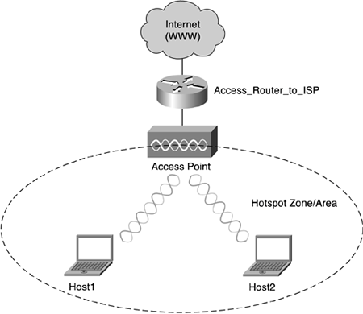
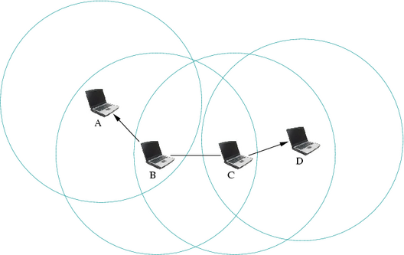
Ad Hoc Networks
An infrastructure wireless network
An Ad-hoc network
Notes:
An real time example will be shown at the end
Explained the circles at the ad hoc
Emphasize the existence of the Access Point

Slide 7
Outline
Ad-Hoc networks
Ad-hoc routing algorithms
Ad-Hoc on-demand Distance Vector Routing (AODV)
Dynamic Source Routing (DSR)
Comparison of AODV and DSR

Slide 8
Ad-hoc routing algorithms
Hottest routing algorithm categories:
Pro-active (table-driven) routing
Maintains fresh lists of destinations & their routes by periodically distributing routing tables
Disadvantages:
Respective amount of data for maintenance
Slow reaction on restructuring and failures
(e.g. OSLR, DSDV)
Reactive (on-demand) routing
On demand route discovery by flooding the network with Route Request packets
Disadvantages:
High latency time in route finding
Flooding can lead to network clogging
(e.g. AODV, DSR)
Notes:
Pro-active (table-driven) routing
This type of protocols maintains fresh lists of destinations and their routes by periodically distributing routing tables throughout the network. The main disadvantages of such algorithms are:
Respective amount of data for maintenance.
Slow reaction on restructuring and failures.
Reactive (on-demand) routing
This type of protocols finds a route on demand by flooding the network with Route Request packets. The main disadvantages of such algorithms are:
High latency time in route finding
Excessive flooding can lead to network clogging

Slide 9
Ad-hoc routing algorithms
Discuss and comparison
Ad-Hoc on-demand Distance Vector Routing (AODV)
Dynamic Source Routing (DSR)
Notes:
Pro-active (table-driven) routing
This type of protocols maintains fresh lists of destinations and their routes by periodically distributing routing tables throughout the network. The main disadvantages of such algorithms are:
Respective amount of data for maintenance.
Slow reaction on restructuring and failures.
Reactive (on-demand) routing
This type of protocols finds a route on demand by flooding the network with Route Request packets. The main disadvantages of such algorithms are:
High latency time in route finding
Excessive flooding can lead to network clogging

Slide 10
Outline
Ad-Hoc networks
Ad-hoc routing algorithms
Ad-Hoc on-demand Distance Vector Routing (AODV)
General info
Path Discovery
Path Maintenance
Local Connectivity Maintenance
Conclusion
Dynamic Source Routing (DSR)
Comparison of AODV and DSR

Slide 11
(AODV) General info
Reactive algorithms like AODV create routes on-demand. They must however, reduce as much as possible the acquisition time
We could largely eliminate the need of periodically system-wide broadcasts
AODV uses symmetric links between neighboring nodes. It does not attempt to follow paths between nodes when one of the nodes can not hear the other one
Notes:
For the 1st bullet , As we noticed before …… High latency time in route finding , so , ….. ,

Slide 12
(AODV) General info
Nodes that have not participate yet in any packet exchange (inactive nodes), they do not maintain routing information
They do not participate in any periodic routing table exchanges
Notes:
2nd bullet : instead of Distance Vector for Wired networks & OSLR (an Ad-hoc pro-active algorithm) that both participate in periodic table exchanges.
Each node does not have to discover or maintain a route to another node until the two need to communicate, unless one of the nodes offering its services as intermediate forwarding station to maintain connectivity between two other nodes

Slide 13
(AODV) General info
Each node can become aware of other nodes in its neighborhood by using local broadcasts known as hello messages
neighbor routing tables organized to :
optimize response time to local movements
provide quick response time for new routes requests
Notes:
*** NO SPACE , 1st bullet paei sthn 12 , 2nd deleted.

Slide 14
(AODV) General info
AODV main features:
Broadcast route discovery mechanism
Bandwidth efficiently (small header information)
Responsive to changes in network topology
Loop free routing

Slide 15
Outline
Ad-Hoc networks
Ad-hoc routing algorithms
Ad-Hoc on-demand Distance Vector Routing (AODV)
General info
Path Discovery
Path Maintenance
Local Connectivity Maintenance
Conclusion
Dynamic Source Routing (DSR)
Comparison of AODV and DSR

Slide 16
(AODV) Path Discovery
Initiated when a source node needs to communicate with another node for which it has no routing info
Every node maintains two counters:
node_sequence_number
broadcast_id
The source node broadcast to the neighbors a route request packet (called RREQ)

Slide 17
(AODV) Path Discovery
RREQ structure
<src_addr, src_sequence_#, broadcast_id, dest_addr, dest_sequence_#, hop_cnt>
src_addr and broadcast_id uniquely identifies a RREQ
broadcast_id is incremented whenever source node issues a RREQ
Each neighbor either satisfy the RREQ, by sending back a routing reply (RREP), or rebroadcast the RREQ to its own neighbors after increasing the hop_count by one.

Slide 18
(AODV) Path Discovery
If a node receives a RREQ that has the same <src_addr, broadcast_id> with a previous RREQ it drops it immediately
If a node cannot satisfy the RREQ, stores:
Destination IP
Source IP
broadcast_id
Expiration time (used for reverse path process)
src_sequence_#

Slide 19
(AODV) Path Discovery
Reverse Path Setup
In each RREQ there are:
src_sequence_#
the last dest_sequence_#
src_sequence_# used to maintain freshness information about the reverse route to the source
dest_sequnece_# indicates how fresh a route must be, before it can be accepted by the source

Slide 20
(AODV) Path Discovery
Reverse Path Setup (continue)
As RREQ travels from source to many destinations, it automatically sets up the reverse path, from all nodes back to the source.
But how does it work?
Each node records the address of the neighbor from which it received the first copy of the RREQ
These entries are maintained for at least enough time, for the RREQ to traverse the network and produce a reply

Slide 21
(AODV) Path Discovery
Reverse Path Setup (continue)
RREQ reached destination
Reversed path is fully set up
From which RREP can travel back to S
S
Source node
D
Destination node
D
W
Z
Neighbor nodes
Z
Z
V
W, Y can not satisfy RREQ
Set up reverse path
Rebroadcast RREQ to neighbors
Z, V, U can not satisfy RREQ
Set up reverse path
Rebroadcast RREQ to neighbors
W
W
Y
U
S sends RREQ
S
Figure 1

Slide 22
(AODV) Path Discovery
2. Forward Path Setup
A node receiving a RREP propagates the first RREP for a given source towards the source (using the reverse path that has already established)
Nodes that are not in the path determined by the RREP will time out after 3000 ms and will delete the reverse pointers

Slide 23
(AODV) Path Discovery
2. Forward Path Setup (continue)
S
Source node
D replies with a RREP to Z
D
Destination node
D
Z
W
Z has a reversed path to W
Z receives RREP and set up a forward pointer
Z
Z
W
W
Z
W has a forward path to Z
V
The same for the other nodes
W
Time out
Y
U
S
Figure 2

Slide 24
(AODV) Path Discovery
2. Forward Path Setup (Conclusion)
Minimum number of RREPs towards source
The source can begin data transmission as soon as the first RREP received and update later its routing information if it learns of a better route

Slide 25
Outline
Ad-Hoc networks
Ad-hoc routing algorithms
Ad-Hoc on-demand Distance Vector Routing (AODV)
General info
Path Discovery
Path Maintenance
Local Connectivity Maintenance
Conclusion
Dynamic Source Routing (DSR)
Comparison of AODV and DSR

Slide 26
(AODV) Path Maintenance
Movement of nodes not lying along an active path does NOT affect the route to that path's destination
If the source node moves, it can simply re-initiate the route discovery procedure
If the destination or some intermediate node moves, a special RREP is sent to the affected nodes
To find out nodes movements periodic hello messages can be used, or (LLACKS) link-layer acknowledgments (far less latency)
Notes:
Moves means that we change a neighborhood due to position change

Slide 27
(AODV) Path Maintenance
When a node is unreachable the special RREP that is sent back towards the source, contains a new sequence number and hop count of ∞
D
Link between Z and D fails
Z sents a special RREP
Z
Z
V
So do W
W
Y
U
Figure 3
S
So now source must find a new path. To do that, it sents a RREQ with a new greater sequence number

Slide 28
Outline
Ad-Hoc networks
Ad-hoc routing algorithms
Ad-Hoc on-demand Distance Vector Routing (AODV)
General info
Path Discovery
Path Maintenance
Local Connectivity Maintenance
Conclusion
Dynamic Source Routing (DSR)
Comparison of AODV and DSR

Slide 29
(AODV) Local Connectivity Maintenance
Nodes learn of their neighbors in one or two ways:
1. Whenever a node receives a broadcast from a neighbor it update its local connectivity information about this neighbor
2. If a neighbor has not sent any packets within hello_interval it broadcasts a hello message, containing its identity and its sequence number

Slide 30
(AODV) Local Connectivity Maintenance
How hello messages work:
Hello messages do not broadcasted outside the neighborhood because the contain a TTL (time to leave) value of 1.
Neighbors that receive the hello message update their local connectivity information to the node that have broadcasted the hello message

Slide 31
(AODV) Local Connectivity Maintenance
How hello messages work: (continue)
Receiving a hello from a new neighbor, or failing to receive allowed_hello_loss (typically 2) consecutive hello messages from a node previously in the neighborhood, indicates that the local connectivity has changed

Slide 32
Outline
Ad-Hoc networks
Ad-hoc routing algorithms
Ad-Hoc on-demand Distance Vector Routing (AODV)
General info
Path Discovery
Path Maintenance
Local Connectivity Maintenance
Conclusion
Dynamic Source Routing (DSR)
Comparison of AODV and DSR

Slide 33
(AODV) Conclusion
AODV main features:
Nodes store only the routes they need
Need for broadcast is minimized
Reduces memory requirements and needless duplications
Quick response to link breakage in active routes
Loop-free routes maintained by use of destination sequence numbers
Scalable to large populations of nodes

Slide 34
AODV

Slide 35
Outline
Ad-Hoc networks
Ad-hoc routing algorithms
Ad-Hoc on-demand Distance Vector Routing (AODV)
Dynamic Source Routing (DSR)
General
Basic Route Discovery
Basic Route Maintenance
Conclusion
Comparison of AODV and DSR

Slide 36
(DSR) General
Two main mechanisms that work together to allow the discovery and maintainance of source routes:
Route discovery
Route maintainance

Slide 37
(DSR) General
Route discovery:
Is the mechanism by which a source node S, obtains a route to a destination D
Used only when S attempt to send a packet to D and does not already knows a route to D

Slide 38
(DSR) General
Route maintainance:
Is the mechanism by which source node S is able to detect if the network topology has changed and can no longer use its route to D
If S knows another route to D, use it
Else invoke route discovery process again to find a new route
Used only when S wants to send a packet to D

Slide 39
(DSR) General
Each mechanism operate entirely on demand
DSR requires no periodic packets of any kind at any level
Uni-directional and asymmetric routes support
(e.g. send a packet to a node D through a route and receive a packet D from another route)

Slide 40
Outline
Ad-Hoc networks
Ad-hoc routing algorithms
Ad-Hoc on-demand Distance Vector Routing (AODV)
Dynamic Source Routing (DSR)
General
Basic Route Discovery
Basic Route Maintenance
Conclusion
Comparison of AODV and DSR

Slide 41
(DSR) Basic Route Discovery
When S wants to sent a packet to D:
it places in the header of the packet a source route giving the sequence of hops that the packet should follow on its way to D
S obtains a suitable source route by searching its route table
If no route found for D, S initiate the Route Discovery protocol to dynamically find a new route to D

Slide 42
(DSR) Basic Route Discovery
Sender
Broadcasts a Route Request Packet (RREQ)
RREQ contains a unique Request ID and the address of the sender
Receiver
If this node is the destination node, or has route to the destination send a Route Reply packet (RREP)
Else if is the source, drop the packet
Else if is already in the RREQ's route table, drop the packet
Else append the node address in the RREQ's route table and broadcast the updated RREQ

Slide 43
(DSR) Basic Route Discovery
Id=2, {S, W, Z}
D
S
Source node
D
Destination node
Z
Id=2, {S, Y}
Z
W
Z
Neighbor nodes
Id=2, {S, W}
V
RREQ packet
W
W
Y
Id=2, {S}
U
S
Id=2, {S, Y}
Id=2, {S}
S sends RREQ
Figure 4

Slide 44
(DSR) Basic Route Discovery
When a RREQ reaches the destination node, a RREP must be sent back to source
The destination node:
Examine its own Route Cache for a route back to source
If found, it use this route to send back the RREP
Else, the destination node starts a new Route Discovery process to find a route towards source node
In protocols that require bi-directional links like 802.11, the reversed route list of the RREQ packet can be used, in order to avoid the second Route Discovery

Slide 45
Outline
Ad-Hoc networks
Ad-hoc routing algorithms
Ad-Hoc on-demand Distance Vector Routing (AODV)
Dynamic Source Routing (DSR)
General
Basic Route Discovery
Basic Route Maintenance
Conclusion
Comparison of AODV and DSR

Slide 46
(DSR) Basic Route Maintenance
Each node transmitting a packet:
is responsible for confirming that the packet has been received by the next hop along the source route
The confirmation it is done with a standard part of MAC layer (e.g. Link-level ACKs in 802.11)
If none exists, a DSR-specific software takes the responsibility to sent back an ACK
When retransmissions of a packet in a node reach a maximum number, a Route Error Packet (RERR) is sent from the node back to the source, identifying the broken link

Slide 47
(DSR) Basic Route Maintenance
The source:
Removes from the routing table the broken route
Retransmission of the original packet is a function of upper layers (e.g. TCP)
It searches the routing table for another route, or start a new Route Discovery process

Slide 48
(DSR) Basic Route Maintenance
S
Source node
Link fails
D
Destination node
D
W
Z
Neighbor nodes
Intermediate node sents a RERR
Z
Z
RERR packet
RERR(Z, D)
V
W
W
RERR(Z, D)
Y
U
Route Table
D: S, W, Z, D
V: S, Y, V
S
Figure 5

Slide 49
Outline
Ad-Hoc networks
Ad-hoc routing algorithms
Ad-Hoc on-demand Distance Vector Routing (AODV)
Dynamic Source Routing (DSR)
General
Basic Route Discovery
Basic Route Maintenance
Conclusion
Comparison of AODV and DSR

Slide 50
(DSR) Conclusion
Excellent performance for routing in multi-hop wireless ad hoc networks
Very low routing overhead even with continuous rapid motion, which scales to :
zero when nodes are stationary
2. the affected routes when nodes are moving
Completely self-organized & self-configuring network
Entirely on-demand operation. No periodic activity of any kind at any level

Slide 51
DSR

Slide 52
Outline
Ad-Hoc networks
Ad-hoc routing algorithms
Ad-Hoc on-demand Distance Vector Routing (AODV)
Dynamic Source Routing (DSR)
Comparison of AODV and DSR

Slide 53
Comparison of AODV and DSR
Main common features:
On-demand route requesting
Route discovery based on requesting and replying control packets
Broadcast route discovery mechanism

Slide 54
Comparison of AODV and DSR
Main common features: (continue)
Route information is stored in all intermediate nodes along the established path
Inform source node for a broken links
Loop-free routing
Notes:
Remember what happened when a node receives a RREQ that contains itself (DSR)
Source_addr, broadcast_id unique identifies the RREQ (AODV)

Slide 55
Comparison of AODV and DSR
Main differences:
DSR can handle uni and bi-directional links, AODV uses only bi-directional
In DSR, using a single RREQ - RREP cycle, source and intermediate nodes can learn routes to other nodes on the route
DSR maintains many alternate routes to the destination, instead of AODV that maintains at most one entry per destination
Notes:
Remember what happened when a node receives a RREQ that contains itself (DSR)
Source_addr, broadcast_id unique identifies the RREQ (AODV)

Slide 56
Comparison of AODV and DSR
Main differences: (continue)
DSR doesn’t contain any explicit mechanism to expire stale routes in the cache , In AODV if a routing table entry is not recently used , the entry is expired
DSR can’t prefer “fresher” routes when faced multiple choices for routes. In contrast, AODV always choose the fresher route (based on destination sequence numbers)
Notes:
Remember what happened when a node receives a RREQ that contains itself (DSR)
Source_addr, broadcast_id unique identifies the RREQ (AODV)

Slide 57
Comparison of AODV and DSR
Main differences: (continue)
DSR’s RREQ has variable length depending on the nodes that the packet has traveled. AODV’s RREQ size is constant
As a result DSR’s header overhead may increase as more nodes become active, so we expect that AODV throughput in those scenarios to be better
Notes:
Remember what happened when a node receives a RREQ that contains itself (DSR)
Source_addr, broadcast_id unique identifies the RREQ (AODV)

Slide 58
Comparison of AODV and DSR
Test bench set up:
100 nodes, some of them as sources
Nominal bit rate of 2 Mb/s
Nominal node range of 250 m
Continuously moving nodes
Notes:
Remember what happened when a node receives a RREQ that contains itself (DSR)
Source_addr, broadcast_id unique identifies the RREQ (AODV)

Slide 59
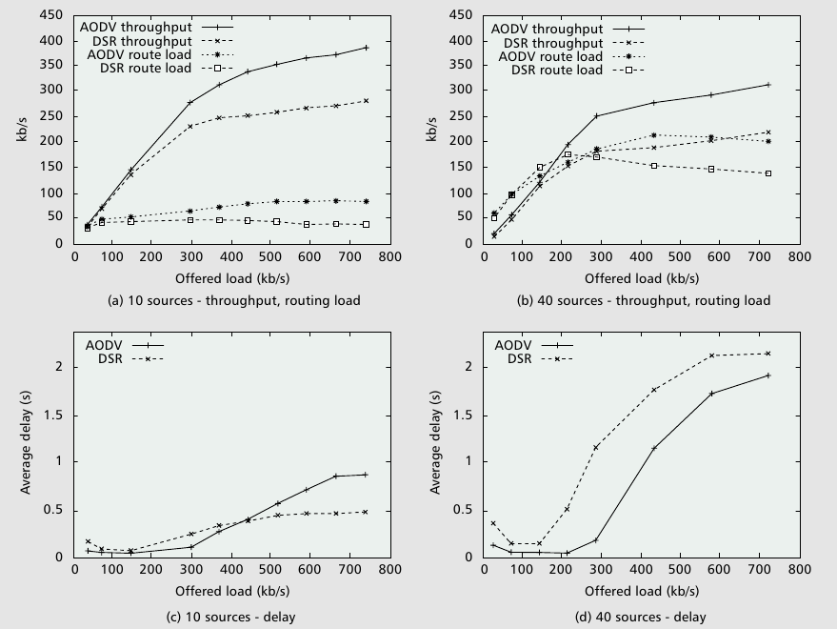
Comparison of AODV and DSR
Notes:
Average end-to-end delay of data packets — This includes all
possible delays caused by buffering during route discovery
latency, queuing at the interface queue, retran
“offered load” in the performance plots indicate the combined
sending rate of all data sources

Slide 60
Comparison of AODV and DSR
Performance metrics | DSR | AODV
Packets delivered /Packets sent (%) | 56.88 | 83.66
Average delay (s) | 1.36 | 0.26
Routing Packets | DSR | AODV
Route requests | 37774 | 228094
Route replies | 82710 | 17753
Route errors | 26591 | 9808
Total | 147075 | 255655
Application and routing statistics for an example scenario for a network of 100 nodes with continuous mobility and 40 sources
Notes:
DSR have less route requests -> multiple routes & source and intermediate nodes can learn routes to other nodes on the route
DSR have more route replies -> multiple routes to the destination , AODV one route
DSR have more route errors because of fresh & stale and expired entries

Slide 61
Conclusion
DSR outperforms AODV in less stressful situations
(i.e., smaller number of nodes and lower load and/or mobility)
AODV outperforms DSR in more stressful situations
(e.g., more load, higher mobility)
DSR commonly generates less routing load than AODV
Poor delay and throughput of DSR due to lack of any mechanism to expire stale routes or determine the freshness of routes
Notes:
Remember what happened when a node receives a RREQ that contains itself (DSR)
Source_addr, broadcast_id unique identifies the RREQ (AODV)

