Slide 1
Git
Sébastien Cevey <seb@cine7.net>
http://bytes.inso.cc/
Purple Scout presentation (April 17, 2009)
Swiss Federal Institute of Technology, Lausanne
XMMS2 Music Player
Playlouder MSP

Slide 2
Outline
Introduction
Concepts & Local Workflow
Distributed Work
Advanced Features
Conclusion
2

Slide 3
1. Introduction
3

Slide 4
Version Control Systems
Record history
Facilitate team work
Expose source code
Branch/merge development paths
4

Slide 5
Centralized VCS
Repository
permissions
branches
Master
commit
checkout
update
Working Copy
Working Copy
Working Copy
Copies
Alice
Bob
Charlie
5

Slide 6
Distributed VCS
Repository
Repository
Remote
(public/private)
Repository
push
clone
pull
Working Copy
Working Copy
Working Copy
Repository
Repository
Repository
Local
Alice
Bob
Charlie
6

Slide 7
Centralized vs Distributed
synchronous - unique reference - fixed hierarchy
centralized access control
simpler
asynchronous - copy = repository - loose hierarchy
offline: - history - commit - branches
more powerful
7

Slide 8
Centralized vs Distributed
synchronous - unique reference - fixed hierarchy
centralized access control
simpler
tråkig... ;_;
asynchronous - copy = repository - loose hierarchy
offline: - history - commit - branches
more powerful
fun! ^_^
8

Slide 9
Git History
Linus Torvalds needed a replacement for BitKeeper to maintain the Linux kernel
Requirements:
Distributed
Scalable & Fast
Integrity guarantee
First prototype on April 7, 2005
Now used by many FOSS projects: Linux kernel, Freedesktop (X.org), Ruby on Rails, XMMS2, Android, Gnome, GCC, etc.
Non-linear, custom workflows
Talk over HTTP, SSH, FTP, rsync, email, etc
9

Slide 10
Why “Git” ?
git (plural gits)
2. (British, slang, pejorative) A silly, incompetent, stupid, annoying or childish person.
“Jacko is a git.”
Linus Torvalds:
“I'm an egotistical bastard, and I name all my projects after myself. First Linux, now git.”
Alternatively: “Global Information Tracker”
10

Slide 11
Git vs. other DVCS (Mercurial, Darcs, Bazaar, Monotone, etc)
Fast, scalable (execution and setup)
Powerful small tools (Unix spirit)
Lively development
Linus (smart design)
11

Slide 12
Git vs. other DVCS (Mercurial, Darcs, Bazaar, Monotone, etc)
Fast, scalable (execution and setup)
Powerful small tools (Unix spirit)
Lively development
Linus (smart design)
Learning curve (grasp concepts)
Imperfect on MS Windows
Linus (no library)
12

Slide 13
Why Git is better than X?
Cheap Local Branching
Everything is Local
Git is Fast
Git is Small
The Staging Area
Distributed
Any Workflow
Easy to Learn
Source: http://whygitisbetterthanx.com/
13

Slide 14
2. Concepts & Local Workflow
14

Slide 15
Git Repository
repository = object database
.git/objects/
15

Slide 16
Git Repository
id(object) = SHA1(object content)
335e
a23f
6679
601a
5592
3347
efa4
34fe
cca6
dd85
57bc
cc39
3e93
8e9b
1798
2211
5390
332e
23a7
1432
1260
f943
eab4
93a4
cc5e
b3ca
.git/objects/8e/9b...
16

Slide 17
Git Repository
content is stored in blob objects ⇒ File
#include <stdio.h>
int main ()
{
printf(”Hello World”);
return 0;
}
335e
a23f
6679
601a
5592
3347
efa4
34fe
cca6
dd85
57bc
cc39
3e93
8e9b
1798
2211
5390
git cat-file -p 93a4
332e
23a7
1432
1260
f943
eab4
93a4
cc5e
b3ca
17

Slide 18
Git Repository
structure is stored in tree objects ⇒ Directory
040000 tree cc5e src
100644 blob 93a4 hw.c
335e
a23f
6679
601a
5592
3347
efa4
34fe
cca6
dd85
57bc
cc39
3e93
8e9b
1798
2211
5390
git cat-file -p 1260
332e
23a7
1432
1260
f943
eab4
93a4
cc5e
b3ca
18

Slide 19
Git Repository
history is stored in commit objects ⇒ Authenticated hierarchical snapshots
tree 1260...
parent f943...
author Tom <tom@...>
1204666883 +0100
committer Max
<max@...>
1204666883 +0100
Fixed a major bug in Hello World.
335e
a23f
6679
601a
5592
Note: identity is a function of the whole history!
i.e. build-in integrity check
3347
efa4
34fe
cca6
dd85
57bc
cc39
3e93
8e9b
1798
2211
5390
git cat-file -p 1432
332e
23a7
1432
1260
f943
eab4
93a4
cc5e
b3ca
19

Slide 20
Git Repository
references are stored as tag objects ⇒ (Signed) symbolic link
object a23f...
type commit
tag v1.0.7
tagger Jack <jack@...>
1136523576 -0800
GIT 1.0.7
-----BEGIN PGP SIGNATURE-----
Version: GnuPG v1.4.2 (GNU/Linux)
iD8D…
-----END PGP SIGNATURE-----
335e
a23f
6679
601a
5592
3347
efa4
34fe
cca6
dd85
57bc
cc39
3e93
8e9b
1798
2211
5390
332e
23a7
git cat-file -p 335e
1432
1260
f943
eab4
93a4
cc5e
b3ca
20

Slide 21
Git Repository
practical repository entry points ⇒ symbolic links
branches
point to a commit in the graph
git branch
master
feature-X
335e
a23f
6679
tags
601a
5592
v1.0
3347
efa4
34fe
cca6
alpha-3
dd85
57bc
cc39
3e93
point to an object (usually a commit)
8e9b
1798
2211
5390
332e
23a7
1432
1260
git tag
f943
eab4
93a4
cc5e
b3ca
21

Slide 22
History Graph
branches
master
feature-X
HEAD
a23f
tags
601a
v1.0
3347
alpha-3
cc39
8e9b
1432
f943
22

Slide 23
Git workflow
$ find../src./src/Makefile./src/helloworld.c./src/helloworld.h./Makefile./IDEAS./README
IDEAS
MakefileREADMEsrc|-- Makefile
|-- helloworld.c`-- helloworld.h
23

Slide 24
initialize
$ git initInitialized empty Git repository in /path/example/.git/
IDEAS
MakefileREADMEsrc|-- Makefile
|-- helloworld.c`-- helloworld.h
24

Slide 25
check status
$ git status# On branch master## Initial commit## Untracked files:# (use "git add <file>..." to include in what will be committed)## IDEAS# Makefile# README# src/nothing added to commit but untracked files present (use "git add" to track)
IDEAS
MakefileREADMEsrc|-- Makefile
|-- helloworld.c`-- helloworld.h
25

Slide 26
add files
$ git add .
IDEAS
MakefileREADMEsrc|-- Makefile
|-- helloworld.c`-- helloworld.h
26

Slide 27
check status
$ git status
# On branch master## Initial commit## Changes to be committed:# (use "git rm --cached <file>..." to unstage)## new file: IDEAS# new file: Makefile# new file: README# new file: src/Makefile# new file: src/helloworld.c# new file: src/helloworld.h
IDEAS
MakefileREADMEsrc|-- Makefile
|-- helloworld.c`-- helloworld.h
27

Slide 28
commit
$ git commit -a -m "First import"Created initial commit 04f087b: First import 0 files changed, 0 insertions(+), 0 deletions(-) create mode 100644 IDEAS create mode 100644 Makefile create mode 100644 README create mode 100644 src/Makefile create mode 100644 src/helloworld.c create mode 100644 src/helloworld.h
master
IDEAS
MakefileREADMEsrc|-- Makefile
|-- helloworld.c`-- helloworld.h
04f087b
28

Slide 29
hack
$ echo "Blah blah" >> README
$ rm IDEAS
master
MakefileREADME <- editedsrc|-- Makefile
|-- helloworld.c`-- helloworld.h
04f087b
29

Slide 30
check status
$ git status# On branch master# Changed but not updated:# (use "git add/rm <file>..." to update what will be committed)## deleted: IDEAS# modified: README#no changes added to commit (use "git add" and/or "git commit -a")
master
MakefileREADME <- editedsrc|-- Makefile
|-- helloworld.c`-- helloworld.h
04f087b
30

Slide 31
commit
$ git commit -a -m "More stuff"Created commit 54eda77: More stuff 1 files changed, 1 insertions(+), 0 deletions(-) delete mode 100644 IDEAS
master
MakefileREADMEsrc|-- Makefile
|-- helloworld.c`-- helloworld.h
54eda77
04f087b
31

Slide 32
view commit
$ git show commit 54eda77a85b0e5d1891653a36ff08faf133df030Author: Sebastien Cevey <seb@cine7.net>Date: Mon Apr 13 21:23:02 2009 +0200 More stuffdiff --git a/IDEAS b/IDEASdeleted file mode 100644index e69de29..0000000diff --git a/README b/READMEindex e69de29..579c5b1 100644--- a/README+++ b/README@@ -0,0 +1 @@+Blah blah
master
MakefileREADMEsrc|-- Makefile
|-- helloworld.c`-- helloworld.h
54eda77
04f087b
32

Slide 33
view commit
$ git show --pretty=rawcommit 54eda77a85b0e5d1891653a36ff08faf133df030tree 524f0cfe293064d18ac0c12a55baaf2b34d42e8dparent 04f087b23ce96c2b24f9f6b5f7cf437af33e19c6author Sebastien Cevey <seb@cine7.net> 1239650582 +0200committer Sebastien Cevey <seb@cine7.net> 1239650582 +0200 More stuff[...]
master
MakefileREADMEsrc|-- Makefile
|-- helloworld.c`-- helloworld.h
54eda77
524f0c
04f087b
33

Slide 34
view history
$ git logcommit 54eda77a85b0e5d1891653a36ff08faf133df030Author: Sebastien Cevey <seb@cine7.net>Date: Mon Apr 13 21:23:02 2009 +0200 More stuffcommit 04f087b23ce96c2b24f9f6b5f7cf437af33e19c6Author: Sebastien Cevey <seb@cine7.net>Date: Mon Apr 13 21:11:58 2009 +0200 First import
master
MakefileREADMEsrc|-- Makefile
|-- helloworld.c`-- helloworld.h
54eda77
04f087b
34

Slide 35
hack again
$ echo "/* End of fil */" >> src/helloworld.c
master
MakefileREADMEsrc|-- Makefile
|-- helloworld.c <- edited`-- helloworld.h
54eda77
04f087b
35

Slide 36
diff modifs
$ git diffdiff --git a/src/helloworld.c b/src/helloworld.cindex e69de29..54a606d 100644--- a/src/helloworld.c+++ b/src/helloworld.c@@ -0,0 +1 @@+/* End of fil */
master
MakefileREADMEsrc|-- Makefile
|-- helloworld.c <- edited`-- helloworld.h
54eda77
04f087b
36

Slide 37
commit
$ git commit -a -m “Hasty commit”Created commit 3b5ba16: Hasty commit 1 files changed, 1 insertions(+), 0 deletions(-)
master
3b5ba16
MakefileREADMEsrc|-- Makefile
|-- helloworld.c`-- helloworld.h
54eda77
04f087b
37

Slide 38
rewind history
$ git reset --hard HEAD^ # parent of HEADHEAD is now at 54eda77 More stuff
$ git status
# On branch masternothing to commit (working directory clean)
master
MakefileREADMEsrc|-- Makefile
|-- helloworld.c`-- helloworld.h
54eda77
04f087b
38

Slide 39
rewind history
$ git reset HEAD^ # parent of HEADsrc/helloworld.c: locally modified
$ git diff
diff --git a/src/helloworld.c b/src/helloworld.cindex e69de29..54a606d 100644--- a/src/helloworld.c+++ b/src/helloworld.c@@ -0,0 +1 @@+/* End of fil */
master
MakefileREADMEsrc|-- Makefile
|-- helloworld.c <- edited`-- helloworld.h
54eda77
04f087b
39

Slide 40
new history
$ $EDITOR src/helloworld.c
$ git commit -a -m "Proper commit"
Created commit 0657c63: Proper commit 1 files changed, 1 insertions(+), 0 deletions(-)
master
0657c63
MakefileREADMEsrc|-- Makefile
|-- helloworld.c`-- helloworld.h
54eda77
04f087b
40

Slide 41
tag
$ git tag stable
master
stable
0657c63
MakefileREADMEsrc|-- Makefile
|-- helloworld.c`-- helloworld.h
54eda77
04f087b
41

Slide 42
new branch
$ git branch feature-X 54eda77
$ git branch
feature-X* master
master
feature-X
stable
0657c63
MakefileREADMEsrc|-- Makefile
|-- helloworld.c`-- helloworld.h
54eda77
04f087b
42

Slide 43
switch branch
$ git checkout feature-XSwitched to branch "feature-X"$ git branch
* feature-X master
master
feature-X
stable
0657c63
MakefileREADMEsrc|-- Makefile
|-- helloworld.c`-- helloworld.h
54eda77
04f087b
43

Slide 44
commit branch
$ $EDITOR src/helloworld.c$ git commit -a -m "Work on X"
Created commit 6195849: Work on X 1 files changed, 1 insertions(+), 0 deletions(-)
master
feature-X
stable
0657c63
MakefileREADMEsrc|-- Makefile
|-- helloworld.c`-- helloworld.h
6195849
54eda77
04f087b
44

Slide 45
commit branch
$ $EDITOR README$ git commit -a -m "Edit README for X"
Created commit 20fbfdd: Edit README for X 1 files changed, 1 insertions(+), 0 deletions(-)
master
feature-X
20fbfdd
stable
0657c63
MakefileREADMEsrc|-- Makefile
|-- helloworld.c`-- helloworld.h
02bbf10
54eda77
04f087b
45

Slide 46
diff branches
$ git checkout master
Switched to branch "master"$ git diff feature-X
diff --git a/README b/READMEindex 29a6a68..579c5b1 100644--- a/README+++ b/README@@ -1,2 +1 @@ Blah blah-foo
[...]
master
feature-X
1e4cfe4
stable
0657c63
MakefileREADMEsrc|-- Makefile
|-- helloworld.c`-- helloworld.h
02bbf10
54eda77
04f087b
46

Slide 47
merge
$ git merge feature-X
Merge made by recursive. README | 1 + src/helloworld.h | 1 + 2 files changed, 2 insertions(+), 0 deletions(-)
master
feature-X
69e105
1e4cfe4
stable
0657c63
MakefileREADMEsrc|-- Makefile
|-- helloworld.c`-- helloworld.h
02bbf10
54eda77
04f087b
47

Slide 48
view merge commit
$ git show
commit 69e105f3d1991c34d74d079197d5f1b1917d3120Merge: 0657c63... 20fbfdd...Author: Sebastien Cevey <seb@cine7.net>Date: Mon Apr 13 22:49:16 2009 +0200 Merge branch 'feature-X'
master
feature-X
69e105
1e4cfe4
stable
0657c63
MakefileREADMEsrc|-- Makefile
|-- helloworld.c`-- helloworld.h
02bbf10
54eda77
04f087b
48

Slide 49
undo
$ git reset --hard stable # undo last merge
HEAD is now at 0657c63 Proper commit
$ git checkout feature-XSwitched to branch "feature-X"
master
feature-X
20fbfdd
stable
0657c63
MakefileREADMEsrc|-- Makefile
|-- helloworld.c`-- helloworld.h
02bbf10
54eda77
04f087b
49

Slide 50
rebase
$ git rebase master
First, rewinding head to replay your work on top of it...Applying: Work on XApplying: Edit README for X
$ git show-branch * [feature-X] Edit README for X ! [master] Proper commit- -* [feature-X] Edit README for X* [feature-X^] Work on X*+ [master] Proper commit
master
feature-X
aeaf0a
2e309b
stable
0657c63
MakefileREADMEsrc|-- Makefile
|-- helloworld.c`-- helloworld.h
54eda77
04f087b
50

Slide 51
trivial merge
$ git checkout master
Switched to branch "master"
$ git merge feature-X Updating 0657c63..aeaf0a9Fast forward README | 1 + src/helloworld.h | 1 + 2 files changed, 2 insertions(+), 0 deletions(-)
master
feature-X
aeaf0a
2e309b
stable
0657c63
MakefileREADMEsrc|-- Makefile
|-- helloworld.c`-- helloworld.h
54eda77
04f087b
51

Slide 52
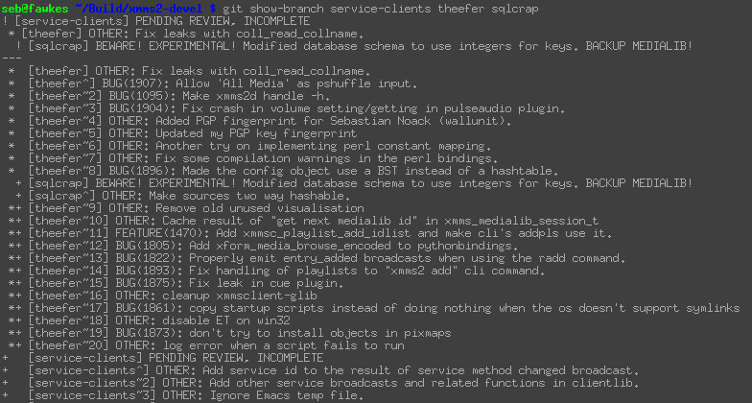
git show-branch
52

Slide 53
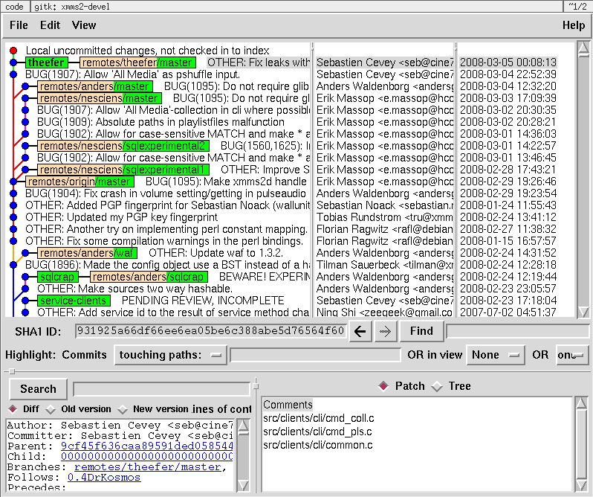
gitk
53

Slide 54
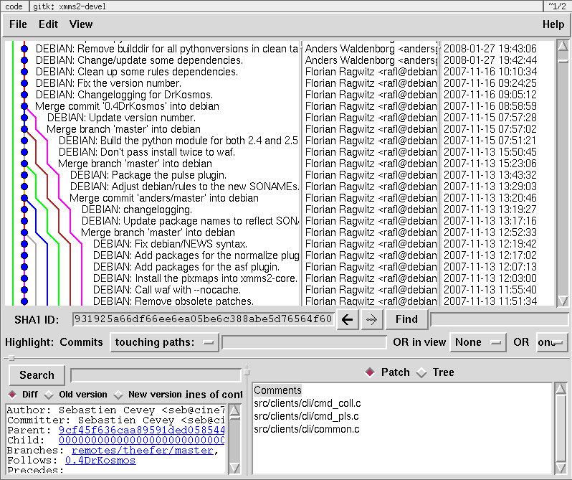
gitk
54

Slide 55
3. Distributed Work
55

Slide 56
public repository
master
fix-segfault
public repo
D
C
E
B
A
56

Slide 57
clone
master
fix-segfault
(over local filesystem, ssh://, git://, rsync://, ftp://etc)
public repo
D
C
E
B
master
fix-segfault
A
local repo
$ git clone $URL
Initialized empty Git repository in local/copy/.git/
D
C
E
B
A
57

Slide 58
branch namespace
master
fix-segfault
public repo
D
origin/
C
E
B
master
master
fix-segfault
A
local repo
$ git branch --all
*master origin/HEAD origin/fix-segfault origin/master
D
C
E
B
A
58

Slide 59
public repository updated
master
fix-segfault
public repo
D
F
origin/
C
E
B
master
master
fix-segfault
A
local repo
D
C
E
B
A
59

Slide 60
fetch update
master
fix-segfault
public repo
D
F
origin/
C
E
B
master
master
fix-segfault
A
local repo
$ git fetch origin
remote: Counting objects: 5, done.remote: Compressing objects: 100% (2/2), done.remote: Total 3 (delta 0), reused 0 (delta 0)Unpacking objects: 100% (3/3), done.From /public/repo E..F fix-segfault -> origin/fix-segfault
D
F
C
E
B
A
60

Slide 61
checkout tracking branch
master
fix-segfault
public repo
“topic branch”
“tracking branches”
D
F
origin/
C
E
B
master
work
master
fix-segfault
A
local repo
$ git checkout -b work \ origin/fix-segfault
Branch work set up to track remote branch refs/remotes/origin/fix-segfault.Switched to a new branch "work"
D
F
C
E
B
A
61

Slide 62
commit topic branch
master
fix-segfault
public repo
origin/
D
F
C
E
master
work
master
fix-segfault
B
local repo
$ $EDITOR
$ git commit -a -m "Another fix"
[...]
G
D
F
C
E
B
62

Slide 63
push new commit
master
fix-segfault
public repo
G
origin/
D
F
C
E
master
work
master
fix-segfault
B
local repo
$ git push origin work:fix-segfault
Total 0 (delta 0), reused 0 (delta 0)To /public/repo F..G work -> feature-X
G
D
F
C
E
B
63

Slide 64
public repository updated
master
fix-segfault
public repo
H
origin/
G
D
F
master
work
master
fix-segfault
C
E
local repo
G
D
F
C
E
B
64

Slide 65
fetch update
master
fix-segfault
public repo
H
origin/
G
D
F
master
work
master
fix-segfault
C
E
local repo
$ git fetch origin
[...]From /public/repo G..H fix-segfault -> origin/fix-segfault
H
G
D
F
C
65

Slide 66
pull to merge update
master
fix-segfault
public repo
H
origin/
G
D
F
master
work
master
fix-segfault
C
E
local repo
$ git pull origin
Updating G..HFast forward README | 1 + 1 files changed, 1 insertions(+), 0 deletions(-)
H
G
D
F
C
66

Slide 67
Basic multi-repo commands
git clone: init a copy of a repository
git fetch: sync remote repo R with local branches R/*
git pull: fetch + merge
git push <repo> [<local-branch>:<remote-branch>]
67

Slide 68
Real-life layout
master
test
buggy-crap
master
experimental
fix-segfault
master
fix-segfault
dev
anna
stable
dev/
stable/
master
work
pre-merge
master
master
fix-segfault
local repo
68

Slide 69
Real-life layout
master
test
buggy-crap
master
experimental
fix-segfault
master
fix-segfault
dev
anna
stable
git remote add anna $URL
dev/
anna/
stable/
master
work
pre-merge
master
master
fix-segfault
local repo
69

Slide 70
Real-life layout
master
test
buggy-crap
master
experimental
fix-segfault
master
fix-segfault
dev
anna
stable
git fetch anna
dev/
anna/
stable/
master
work
pre-merge
master
experimental
master
fix-segfault
master
fix-segfault
local repo
70

Slide 71
Real-life layout
“just a repo,
not in .git/”
git --bare init
master
test
buggy-crap
master
experimental
fix-segfault
master
fix-segfault
mine
dev
anna
stable
dev/
anna/
stable/
master
work
pre-merge
master
experimental
master
fix-segfault
master
fix-segfault
local repo
71

Slide 72
Real-life layout
master
test
buggy-crap
master
experimental
fix-segfault
master
fix-segfault
mine
dev
anna
stable
git remote add mine $URL
dev/
anna/
stable/
master
work
pre-merge
master
experimental
master
fix-segfault
master
fix-segfault
local repo
72

Slide 73
Real-life layout
master
master
test
buggy-crap
master
experimental
pre-merge
fix-segfault
master
fix-segfault
mine
dev
anna
stable
git push mine work:master pre-merge
“remotes”
mine/
dev/
anna/
stable/
master
work
pre-merge
master
experimental
master
pre-merge
master
fix-segfault
master
fix-segfault
local repo x
73

Slide 74
git remote
Help track remote (i.e. other) repositories
Pull from / push to them
Use tracking branches like any branch (merge, rebase, diff, log, show, etc)
74

Slide 75
e.g. XMMS2 trees
stable
devel
Official trees
Developer public trees
public
theefer
public
tru
Joe Sixpack
tru
anders
theefer
Local trees
user
maintainers
developer
75

Slide 76
e.g. XMMS2 trees
stable
devel
olof’s server
public
olof
public
theefer
public
tru
olof
Joe Sixpack
tru
anders
theefer
contributer
user
maintainers
developer
76

Slide 77
4. Advanced Features
77

Slide 78
Between the working directory and the repository
Repository
Working
Directory
master
IDEAS
MakefileREADMEsrc|-- Makefile
|-- helloworld.c`-- helloworld.h
04f087b
78

Slide 79
The Index (or “Staging Area”)
Index
IDEAS
MakefileREADMEsrc|-- Makefile
|-- helloworld.c`-- helloworld.h
Repository
Working
Directory
master
IDEAS
MakefileREADMEsrc|-- Makefile
|-- helloworld.c`-- helloworld.h
04f087b
79

Slide 80
Committing using the index
Index
IDEAS
MakefileREADMEsrc|-- Makefile
|-- helloworld.c`-- helloworld.h
Repository
Working
Directory
master
IDEAS
MakefileREADMEsrc|-- Makefile
|-- helloworld.c`-- helloworld.h
git add/rm
git commit
04f087b
80

Slide 81
Bypassing the Index
Index
IDEAS
MakefileREADMEsrc|-- Makefile
|-- helloworld.c`-- helloworld.h
Repository
Working
Directory
master
IDEAS
MakefileREADMEsrc|-- Makefile
|-- helloworld.c`-- helloworld.h
git commit -a
04f087b
81

Slide 82
new file
Index
IDEAS
MakefileREADMEsrc|-- Makefile
|-- helloworld.c`-- helloworld.h
Repository
Working
Directory
master
IDEAS
MakefileREADMEsrc|-- Makefile
|-- helloworld.c`-- helloworld.h
test.c <- new file
TODO <- new file
04f087b
82

Slide 83
new file
$ git status# On branch master# Changed but not updated:# (use "git add <file>..." to update what will be committed)## modified: test.c# modified: TODO#no changes added to commit (use "git add" and/or "git commit -a")
Index
IDEAS
MakefileREADMEsrc|-- Makefile
|-- helloworld.c`-- helloworld.h
Repository
Working
Directory
master
IDEAS
MakefileREADMEsrc|-- Makefile
|-- helloworld.c`-- helloworld.h
test.c <- new file
TODO <- new file
04f087b
83

Slide 84
new file: add to index
Index
IDEAS
MakefileREADMEsrc|-- Makefile
|-- helloworld.c`-- helloworld.h
TODO <- new file
Repository
Working
Directory
master
IDEAS
MakefileREADMEsrc|-- Makefile
|-- helloworld.c`-- helloworld.h
test.c <- new file
TODO
git add TODO
04f087b
84

Slide 85
new file: add to index
$ git status# On branch master# Changes to be committed:# (use "git reset HEAD <file>..." to unstage)## modified: TODO## Changed but not updated: [...]
Index
IDEAS
MakefileREADMEsrc|-- Makefile
|-- helloworld.c`-- helloworld.h
TODO <- new file
Repository
Working
Directory
master
IDEAS
MakefileREADMEsrc|-- Makefile
|-- helloworld.c`-- helloworld.h
test.c <- new file
TODO
git add TODO
04f087b
85

Slide 86
new file: commit index
Index
IDEAS
MakefileREADMEsrc|-- Makefile
|-- helloworld.c`-- helloworld.h
TODO
Repository
Working
Directory
master
IDEAS
MakefileREADMEsrc|-- Makefile
|-- helloworld.c`-- helloworld.h
test.c <- new file
TODO
deadbeef
git commit
04f087b
86

Slide 87
edited file
Index
IDEAS
MakefileREADMEsrc|-- Makefile
|-- helloworld.c`-- helloworld.h
TODO
Repository
Working
Directory
master
IDEAS
MakefileREADME <- editedsrc|-- Makefile
|-- helloworld.c`-- helloworld.h
test.c <- new file
TODO
deadbeef
04f087b
87

Slide 88
edited file: update index
Index
IDEAS
MakefileREADME <- editedsrc|-- Makefile
|-- helloworld.c`-- helloworld.h
TODO
Repository
Working
Directory
master
IDEAS
MakefileREADMEsrc|-- Makefile
|-- helloworld.c`-- helloworld.h
test.c <- new file
TODO
deadbeef
git add README
04f087b
88

Slide 89
edited file: commit index
Index
IDEAS
MakefileREADMEsrc|-- Makefile
|-- helloworld.c`-- helloworld.h
TODO
Repository
Working
Directory
master
IDEAS
MakefileREADMEsrc|-- Makefile
|-- helloworld.c`-- helloworld.h
test.c <- new file
TODO
f4ec56
deadbeef
git commit
04f087b
89

Slide 90
edited file
Index
IDEAS
MakefileREADMEsrc|-- Makefile
|-- helloworld.c`-- helloworld.h
TODO
Repository
Working
Directory
master
IDEAS <- 3 hunks
MakefileREADMEsrc|-- Makefile
|-- helloworld.c`-- helloworld.h
test.c <- new file
TODO
f4ec56
deadbeef
04f087b
90

Slide 91
add selected hunks to index
Index
IDEAS <- 1 hunk
MakefileREADMEsrc|-- Makefile
|-- helloworld.c`-- helloworld.h
TODO
Repository
Working
Directory
master
IDEAS <- 2 hunks
MakefileREADMEsrc|-- Makefile
|-- helloworld.c`-- helloworld.h
test.c <- new file
TODO
f4ec56
(also see git add --interactive)
deadbeef
git add -p IDEAS
04f087b
91

Slide 92
add selected hunks to index
$ git add -p src/xmms/testclient.c [...]@@ -44,7 +44,7 @@ int main (int argc, char **argv) fd = xmms_ipc_transport_fd_get (transport); - msg = xmms_ipc_msg_string_new (42, "korv!");+ msg = xmms_ipc_msg_string_new (42, "apan!"); i = 5; Stage this hunk [y/n/a/d/j/J/?]?
Index
IDEAS <- 1 hunk
MakefileREADMEsrc|-- Makefile
|-- helloworld.c`-- helloworld.h
TODO
Repository
Working
Directory
master
IDEAS <- 2 hunks
MakefileREADMEsrc|-- Makefile
|-- helloworld.c`-- helloworld.h
test.c <- new file
TODO
f4ec56
(also see git add --interactive)
deadbeef
git add -p IDEAS
04f087b
92

Slide 93
diff’ing options
Index
IDEAS <- 1 hunk
MakefileREADMEsrc|-- Makefile
|-- helloworld.c`-- helloworld.h
TODO
Repository
Working
Directory
git diff --cached
master
IDEAS <- 2 hunks
MakefileREADMEsrc|-- Makefile
|-- helloworld.c`-- helloworld.h
test.c <- new file
TODO
git diff
f4ec56
deadbeef
git diff HEAD
04f087b
93

Slide 94
Conflicts: marked in index
Index
IDEAS <- conflicted
MakefileREADMEsrc|-- Makefile
|-- helloworld.c`-- helloworld.h
TODO
Repository
Working
Directory
master
IDEAS <- merged
MakefileREADMEsrc|-- Makefile
|-- helloworld.c`-- helloworld.h
TODO
f4ec56
deadbeef
04f087b
94

Slide 95
Reset changes: 3 options
Index
IDEAS
MakefileREADMEsrc|-- Makefile
|-- helloworld.c`-- helloworld.h
TODO
Repository
Working
Directory
master
IDEAS
MakefileREADMEsrc|-- Makefile
|-- helloworld.c`-- helloworld.h
TODO
f4ec56
deadbeef
04f087b
95

Slide 96
reset --hard
reset the repository HEAD, the index and the working directory.
Index
deadbeef
IDEAS
MakefileREADMEsrc|-- Makefile
|-- helloworld.c`-- helloworld.h
TODO
Repository
Working
Directory
master
deadbeef
IDEAS
MakefileREADMEsrc|-- Makefile
|-- helloworld.c`-- helloworld.h
TODO
f4ec56
git reset --hard deadbeef
deadbeef
Warning: any uncommitted change is lost!
04f087b
96

Slide 97
reset --soft
only reset the repository HEAD.
Index
f4ec56
IDEAS
MakefileREADMEsrc|-- Makefile
|-- helloworld.c`-- helloworld.h
TODO
Repository
Working
Directory
master
f4ec56
IDEAS
MakefileREADMEsrc|-- Makefile
|-- helloworld.c`-- helloworld.h
TODO
f4ec56
git reset --soft deadbeef
deadbeef
Previous commit becomes “changes to be committed”.
04f087b
97

Slide 98
reset --mixed (default)
reset the repository HEAD and the index, but not the working directory.
Index
deadbeef
IDEAS
MakefileREADMEsrc|-- Makefile
|-- helloworld.c`-- helloworld.h
TODO
Repository
Working
Directory
master
f4ec56
IDEAS
MakefileREADMEsrc|-- Makefile
|-- helloworld.c`-- helloworld.h
TODO
f4ec56
git reset --mixed deadbeef
deadbeef
Keep changes but not marked for commit.
04f087b
98

Slide 99
Using the Index (or not)
“Invisible” area to prepare commits
Interact with: - working directory (add, rm) - repository (reset, commit)
Analyze state (status, diff)
Can usually be bypassed (using -a)
Warning: - Can commit files in inconsistent state (e.g. not tested)
99

Slide 100
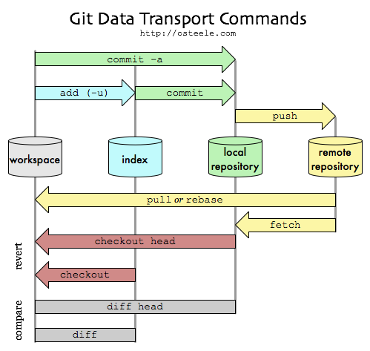
Git layers
Source: http://osteele.com/archives/2008/05/commit-policies
100

Slide 101
Rewrite history!
Changing the history = point to a new history
Correct mistakes
Cleanup messy iterative development
Warning: - Changes commit ids - (Possibly) creates conflicts if when people merge the rewritten branch - Best used locally, not on an important tree
101

Slide 102
Rewrite history! (1)
git commit --amend
“Replace the latest commit by the current state of the index”
Allows to keep or edit the commit message
master
K
D
C
B
A
102

Slide 103
Rewrite history! (1)
git commit --amend
“Replace the latest commit by the current state of the index”
Allows to keep or edit the commit message
master
D
K
C
B
A
103

Slide 104
Rewrite history! (2)
git rebase --interactive
Rewrite a sequence of commits: - omit - squash with parent - edit
master
F
E
D
C
B
A
104

Slide 105
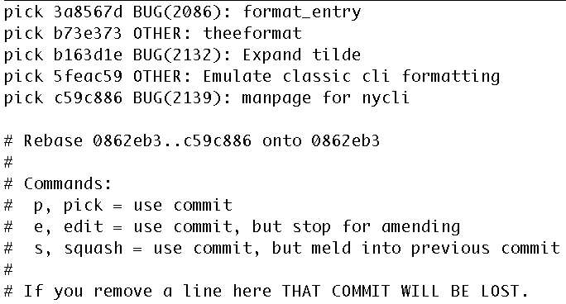
Rewrite history! (2)
git rebase --interactive
Rewrite a sequence of commits: - omit - squash with parent - edit
master
F
T (E+F)
E
D
S (D)
C
B
B
A
105

Slide 106
Rewrite history! (3)
git filter-branch
Rewrite history using functions/scripts
Edit author infos, commit message, directories, commits, tags, etc.
RTFM...
106

Slide 107
git bisect
Useful to find the commit that introduces a problem
git bisect start <bad> [<good>]
master
H
HEAD
D
C
B
A
107

Slide 108
git bisect
Useful to find the commit that introduces a problem
git bisect start <bad> [<good>]
git bisect bag|good
master
H
D
C
B
A
HEAD
108

Slide 109
git bisect
Useful to find the commit that introduces a problem
git bisect start <bad> [<good>]
git bisect bag|good
master
H
D
C
HEAD
B
A
109

Slide 110
git bisect
Useful to find the commit that introduces a problem
git bisect start <bad> [<good>]
git bisect bag|good
master
H
D
HEAD
C
B
A
110

Slide 111
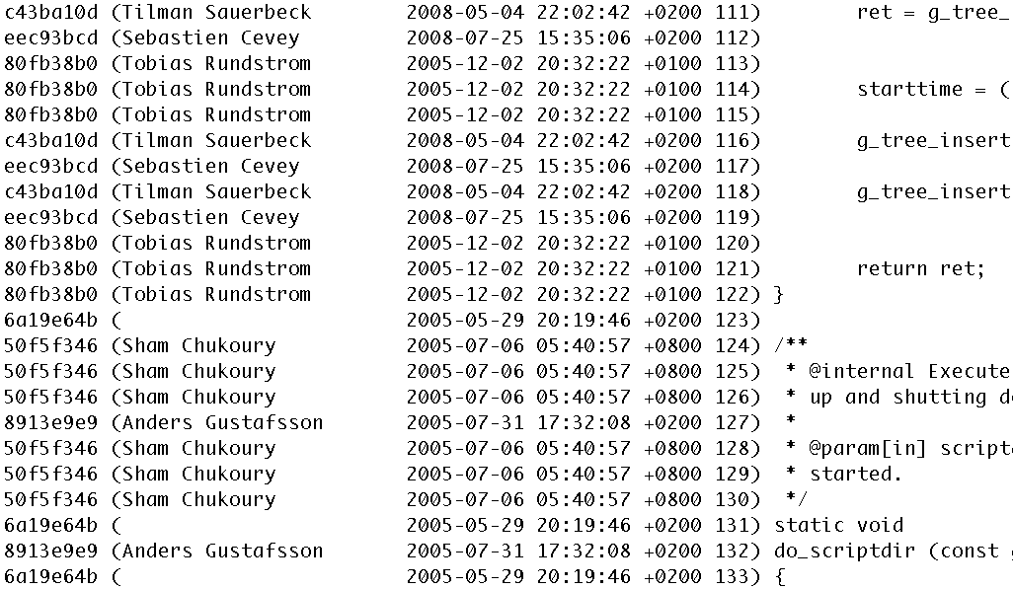
git blame
git blame D <file>
master
H
D
HEAD
C
B
A
111

Slide 112
git stash
git stash [save [message]]
git stash apply
git stash pop # apply and drop
Can also preserve the state of the index
master
modifs
112

Slide 113
git stash
git stash [save [message]]
git stash apply
git stash pop # apply and drop
Can also preserve the state of the index
master
stash@{0}
modifs
113

Slide 114
git stash
git stash [save [message]]
git stash apply
git stash pop # apply and drop
Can also preserve the state of the index
master
stash@{0}
modifs
114

Slide 115
git stash
git stash [save [message]]
git stash apply
git stash pop # apply and drop
Can also preserve the state of the index
master
stash@{0}
modifs
modifs
115

Slide 116
git svn
Import an SVN repository into a local Git repository
Use Git features (branches, merge, log, etc)
Talk to SVN from Git
Requires streamlined Git history
:-)
Git
Working Copy
:-(
Git
SVN
SVN
Working Copy
git svn
SVN
Repository
svn
Git
Repository
116

Slide 117
And also...
Submodules
Cherry-pick
Shallow copies
Bundles
Reflog
Git daemon
Hooks
etc...
117

Slide 118
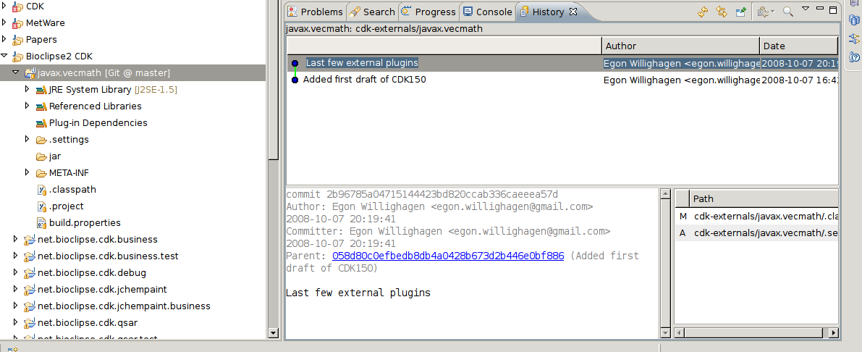
Eclipse Git plugin
Source: http://chem-bla-ics.blogspot.com/2008/10/git-eclipse-integration.html
118

Slide 119
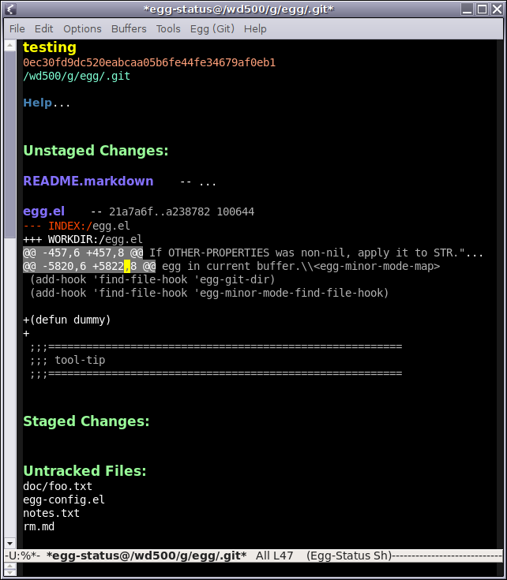
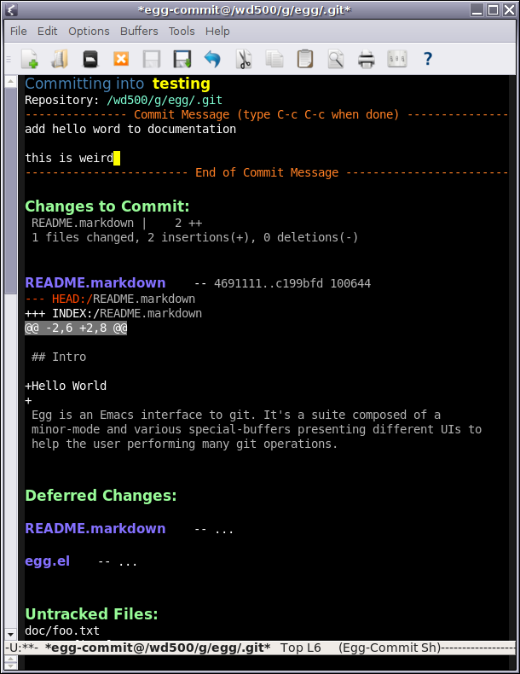
egg-mode (emacs)
Source: http://bogolisk.blogspot.com/
119

Slide 120
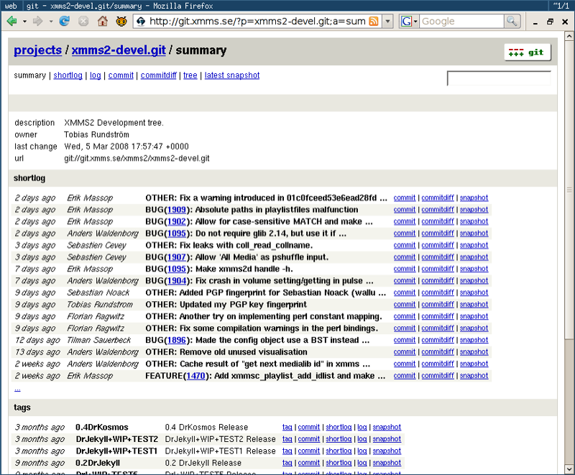
Gitweb – Web repo browser
120

Slide 121
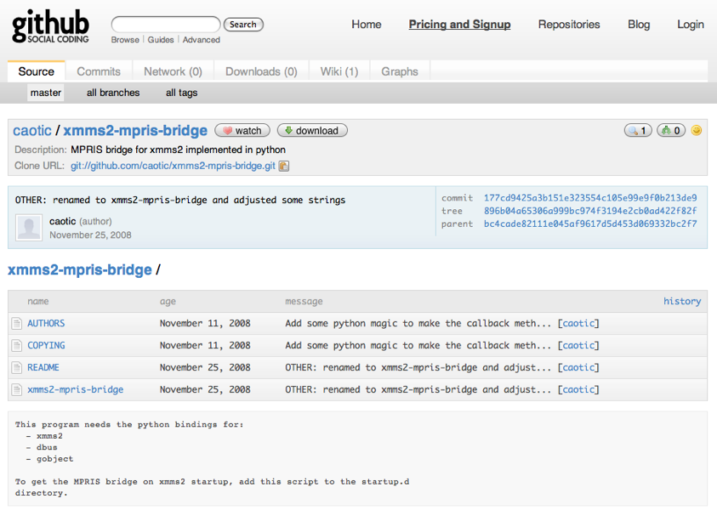
Github – Git Social Network
121
Url: http://github.com/

Slide 122
Reference links
Official site: http://git-scm.com/
man gittutorial / git <command> --help
Randal Schwartz Google Tech Talk: http://www.youtube.com/watch?v=8dhZ9BXQgc4
Linus Torvalds Google Tech Talk: http://www.youtube.com/watch?v=4XpnKHJAok8
Why Git Is Better Than X? http://whygitisbetterthanx.com/
122

Slide 123
5. Conclusion
123

Slide 124
Conclusion
Different approach to VCS
Custom and flexible workflow
Power vs. Learning curve
“Smart tool to manipulate versioned information and throw it around.”
124

Slide 125
Questions? http://git-scm.com/
125

