Slide 1
CS345
Operating Systems
Φροντιστήριο Άσκησης 1

Slide 2
Processes

Slide 3
The fork() System Call (1)
A process calling fork() spawns a child process.
The child is almost an identical clone of the parent:
  Program Text (segment .text)
  Stack (ss)
  PCB (eg. registers)
  Data (segment .data)
#include <sys/types.h>
#include <unistd.h>
pid_t fork(void);

Slide 4
The fork() System Call (2)
The fork() is one of the those system calls, which is called once, but returns twice!
After fork() both the parent and the child are executing the same program.
On error, fork() returns -1
After fork() the execution order is not guaranteed.
Consider a piece of program
...
pid_t pid = fork();
printf(“PID: %d\n”, pid);
...
The parent will print:
PID: 34
And the child will always print:
PID: 0
PID=28
PID=28
PID=34
fork()
p1
p1
c1

Slide 5
The exec()System Call (1)
The exec() call replaces a current process’ image with a new one (i.e. loads a new program within current process).
The new image is either regular executable binary file or a shell script.
There’s no a syscall under the name exec(). By exec() we usually refer to a family of calls:
  int execl(char *path, char *arg, ...);
  int execv(char *path, char *argv[]);
  int execle(char *path, char *arg, ..., char *envp[]);
  int execve(char *path, char *argv[], char *envp[]);
  int execlp(char *file, char *arg, ...);
  int execvp(char *file, char *argv[]);
Here's what l, v, e, and p mean:
  l means an argument list,
  v means an argument vector,
  e means an environment vector, and
  p means a search path.

Slide 6
The exec()System Call (2)
Upon success, exec() never returns to the caller. If it does return, it means the call failed. Typical reasons are: non-existent file (bad path) or bad permissions.
Arguments passed via exec() appear in the argv[] of the main() function.
For more info: man 3 exec;
PID=28
PID=28
exec()
p1
p1
Legend:
Old Program
New Program

Slide 7
fork() and exec() Combined
Often after doing fork() we want to load a new program into the child. E.g.: a shell.
tcsh
tcsh
tcsh
PID=28
PID=28
fork()
PID=34
p1
p1
c1
tcsh
ls
PID=34
PID=34
exec(ls)
c1
c1

Slide 8
The System wait() Call
Forces the parent to suspend execution, i.e. wait for its children or a specific child to die (terminate is more appropriate terminology, but a bit less common).

Slide 9
The System wait() Call (2)
#include <sys/types.h>
#include <sys/wait.h>
pid_t wait(int *status);
pid_t waitpid(pid_t pid, int *status, int options);
The wait() causes the parent to wait for any child process.
The waitpid() waits for the child with specific PID.
The return value is:
  PID of the exited process, if no error
  (-1) if an error has happened

Slide 10
The exit() System Call
#include <stdlib.h>
void exit(int status);
This call gracefully terminates process execution. Gracefully means it does clean up and release of resources, and puts the process into the zombie state.
By calling wait(), the parent cleans up all its zombie children.
exit() specifies a return value from the program, which a parent process might want to examine as well as status of the dead process.

Slide 11
The pause() system call
#include <unistd.h>
int pause(void);
Used to suspend process until a signal arrives
Signal action can be the execution of a handler function or process termination
only returns (-1) when a signal was caught and the signal-catching function returned

Slide 12
Process states
Zombie: has completed execution, still has an entry in the process table
Orphan: parent has finished or terminated while this process is still running
Daemon: runs as a background process, not under the direct control of an interactive user

Slide 13
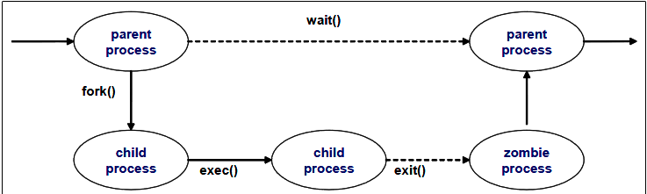
Zombie process

Slide 14
Signals

Slide 15
Process interaction with signals
Unix supports a signal facility, looks like a software version of the interrupt subsystem of a normal CPU
Process can send a signal to another
Kernel can send signal to a process (like an interrupt)
Process can handle or ignore a given call
Handle a signal by binding a function to the arrival of a designated signal

Slide 16
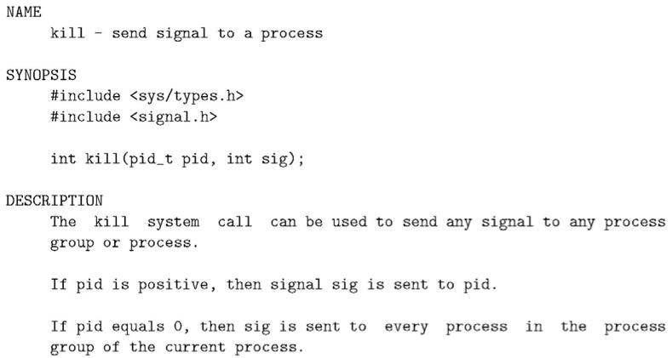
Sending a signal: kill() system call

Slide 17
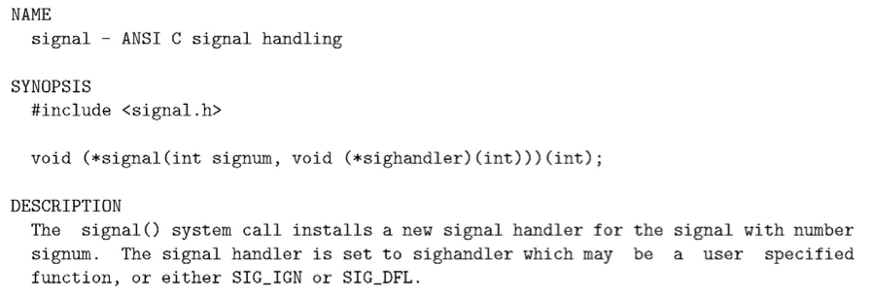
Handling signals: signal()

Slide 18
Assignment 1 tips
First experiment with fork() and getpid(), getppid()
Use simple printf statements to distinguish parent from child (through pid)
Send simple signal to child
Create signal handlers
  For 1st time called ( “starting – pid’)
  For all other times called (“process – pid”)
  To handle Ctrl-C
  For termination of child process
Create logic for alternating execution

