Slide 1
Introduction to probability theory and statistics
HY 335
Presented by: George Fortetsanakis

Slide 2
Roadmap
Elements of probability theory
Probability distributions
Statistical estimation
Reading plots

Slide 3
Terminology
Event: every possible outcome of an experiment.
Sample space: The set of all possible outcomes of an experiment
Example: Roll a dice
Every possible outcome is an event
Sample space: {1, 2, 3, 4, 5, 6}
Example: Toss a coin
Every possible outcome is an event
Sample space: {head, tails}

Slide 4
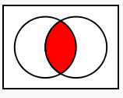
Probability axioms of Kolmogorov
Probability of an event A is a number assigned to this event such that:
: all probabilities lie between 0 and 1
P(Ø) = 0 : the probability to occur nothing is zero
: The probability of the sample space is 1
A
A∩B
B

Slide 5
Theorems from the axioms
Proof:

Slide 6
Theorems from the axioms
Proof:
(From axiom 3)
(From axiom 4)
(From axiom 2)

Slide 7
Independence
A and B are independent if
Outcome A has no effect on outcome B and vice versa.
Example: Probability of tossing heads and then tails is 1/2*1/2 = 1/4

Slide 8
Conditional probabilities
Definition of conditional probability:
The chain rule:
If A, B are independent:

Slide 9
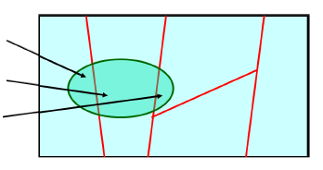
Total probability theorem
Assume that B₁, B₂, …, B_{n} form a partition of the sampling space:
Then:
A∩B₁
B₁
B₂
B₃
A∩B₂
A
A∩B₃
B₄
B₅

Slide 10
Roadmap
Elements of probability theory
Probability distributions
Statistical estimation
Reading plots

Slide 11
Probability mass function
Defined for discrete random variable X with domain D.
Maps each element x∈D to a positive number P(x) such that
P(x) is the probability that x will occur.
P(x)
Probability mass function of fair dice
1
2
3
4
5
6
x

Slide 12
Geometric distribution
Distribution of number of trials until desired event occurs.
Desired event: d∈D
Probability of desired event: p
Number of trials
Probability of k-1 failures
Probability of success

Slide 13
Continuous Distributions
Continuous random variable X takes values in subset of real numbers D⊆R
X corresponds to measurement of some property, e.g., length, weight
Not possible to talk about the probability of X taking a specific value
Instead talk about probability of X lying in a given interval

Slide 14
Probability density function (pdf)
Continuous function p(x) defined for each x∈D
Probability of X lying in interval I⊆D computed by integral:
Examples:
Important property:

Slide 15
Cumulative distribution function (cdf)
For each x∈D defines the probability
Important properties:
Complementary cumulative distribution function (ccdf)

Slide 16
Expectations
Mean value
Variance: indicates depression of samples around the mean value
Standard deviation

Slide 17
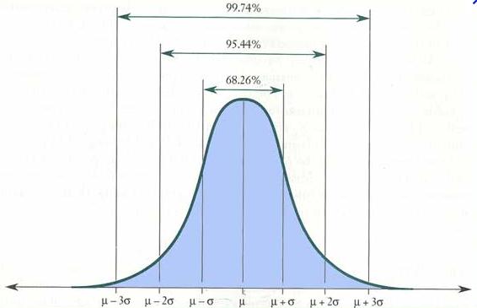
Gaussian distribution
Probability density function
Parameters
mean: μ
standard deviation: σ
Notes:
΅ηυ ισ ιτ ιμπορταντ

Slide 18
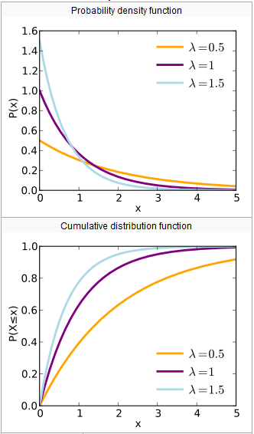
Exponential distribution
Probability density function
Cumulative distribution function
Memoryless property:

Slide 19
Poisson process
Random process that describes the timestamps of various events
Telephone call arrivals
Packet arrivals on a router
Time between two consecutive arrivals follows exponential distribution
Time intervals t₁, t₂, t₃, … are drawn from exponential distribution
Arrival 1
Arrival 2
Arrival 3
Arrival 4
Arrival 5
Arrival 6
Arrival 7
…
t₁
t₂
t₃
t₄
t₅
t₆

Slide 20
Problem definition
Dataset D={x₁, x₂, …, x_{k}} collected by network administrator
Arrivals of users in the network
Arrivals of packets on a wireless router
☞ How can we compute the parameter λ of the exponential distribution that better fits the data?

Slide 21
Maximum likelihood estimation
Maximize likelihood of obtaining the data with respect to parameter λ
Likelihood function
Due to independence of samples

Slide 22
Estimate parameter λ
Probability density function
Define the log-likelihood function
Set derivative equal to 0 to find maximum

Slide 23
Roadmap
Elements of probability theory
Probability distributions
Statistical estimation
Reading plots

Slide 24
Basic statistics
Suppose a set of measurements x = [x₁ x₂ … x_{n}]
Estimation of mean value: (matlab m=mean(x);)
Estimation of standard deviation: (matlab s=std(x);)

Slide 25
Estimate pdf
Suppose dataset x = [x₁ x₂ … x_{n}]
Can we estimate the pdf that values in x follow?

Slide 26
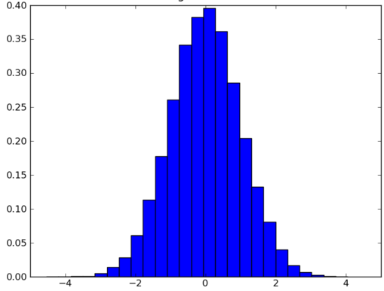
Estimate pdf
Suppose dataset x = [x₁ x₂ … x_{n}]
Can we estimate the pdf that values in x follow?
☞ Produce histogram

Slide 27
Step 1
Divide sampling space into a number of bins
Measure the number of samples in each bin
-4
-2
0
2
4
3 samples
5 samples
6 samples
2 samples
-4
-2
0
2
4

Slide 28
Step 2
E = total area under histogram plot = 2*3 + 2*5 + 2*6 +2*2 = 32
Normalize y axis by dividing by E
6
5
Frequency
3
2
-4
-2
0
2
4
x
6/32
P(x)
5/32
3/32
2/32
-4
-2
0
2
4
x

Slide 29
Matlab code
function produce_histogram(x, bins)
% input parameters
% X =[x₁; x₂; … x_{n}]: a column vector containing the data x1, x2, …, xn.
% bins = [b₁; b₂; …b_{k}]: A vector that Divides the sampling space in bins
% centered around the points b1, b2, …, bk.
figure; % Create a new figure
[f y] = hist(x, bins); % Assign your data points to the corresponding bins
bar(y, f/trapz(y,f), 1); % Plot the histogram
xlabel('x'); % Name axis x
ylabel('p(x)'); % Name axis y
end

Slide 30
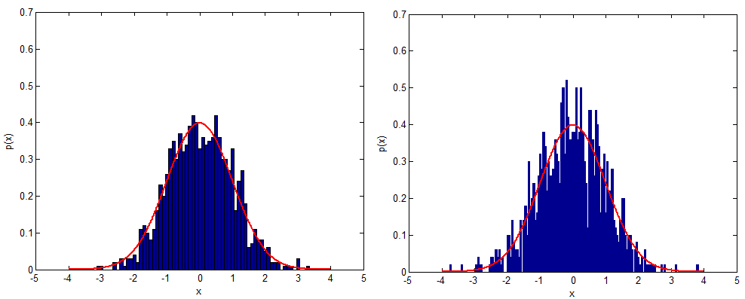
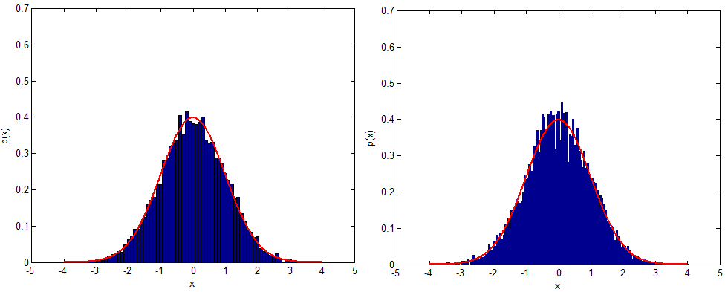
Histogram examples
Bin spacing 0.1
Bin spacing 0.05
1000 samples
10000 samples

Slide 31
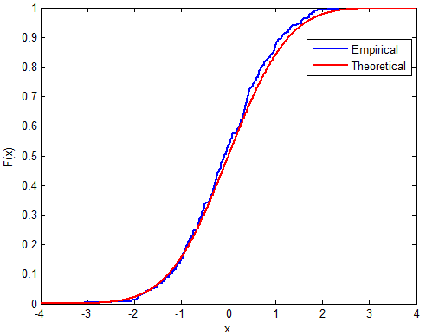
Empirical cdf
How can we estimate the cdf that values in x follow?
Use matlab function ecdf(x)
Empirical cdf estimated with 300 samples from normal distribution

Slide 32
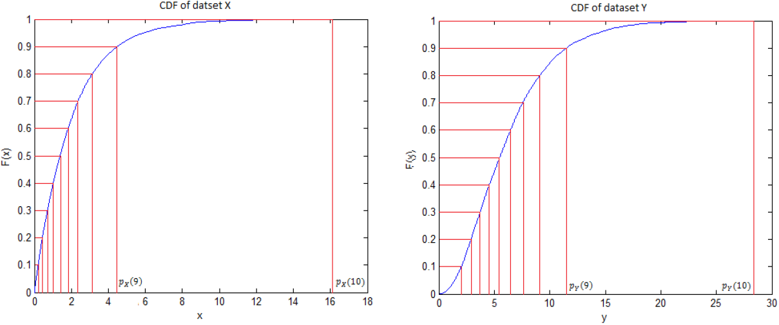
Percentiles
Values of variable below which a certain percentage of observations fall
80th percentile is the value, below which 80 % of observations fall.
80th percentile

Slide 33
Estimate percentiles
Percentiles in matlab: p = prctile(x, y);
y takes values in interval [0 100]
80th percentile: p = prctile(x, 80);
Median: the 50th percentile
med = prctile(x, 50); or
med = median(x);
Why is median different than the mean?
Suppose dataset x = [1 100 100]: mean = 201/3=67, median = 100

Slide 34
Roadmap
Elements of probability theory
Probability distributions
Statistical estimation
Reading plots

Slide 35
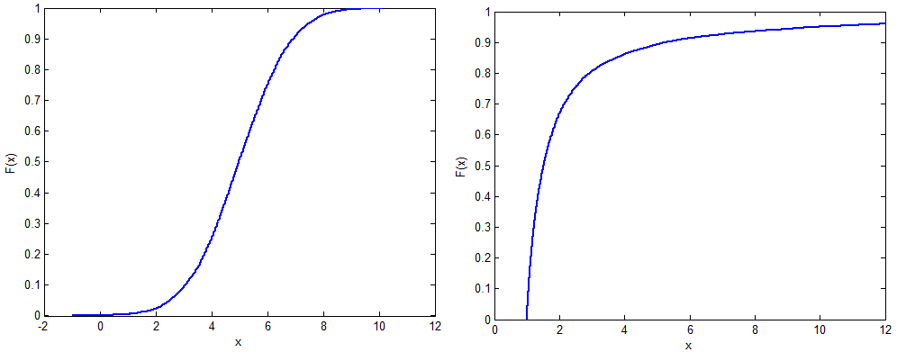
Reading empirical cdfs
Short tails
Long tails

Slide 36
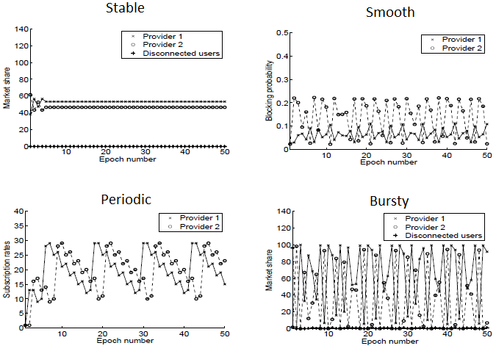
Reading time series

