Slide 1
Java Packages Make/Ant and Java code testing/debugging

Slide 2
Make files

Slide 3
Make (1/2)
set TWINSTACK_HOME=C:"\JAVA\ASKHSH2\Twinstack"
set JAVA_HOME=C:"\Java\jdk1.5.0_04\bin"
%JAVA_HOME%\javac -d %TWINSTACK_HOME%\class %TWINSTACK_HOME%\src\*.java
%JAVA_HOME%\java %TWINSTACK_HOME%\class\Main myfilein.txt myfileout.txt
pause

Slide 4
Make (2/2)
#This is the Way that we place comments in our Makefiles
#We run this by typing "make" in our command prompt
#This Makefile runs the Twinstack ADT
# The path for TWINSTACK
TWINSTACK_HOME /home/tsispar/twinstack
# Set the path to java 1.4 or later
JAVA_HOME /home/jdk1.5.0_04/bin
#Compiling the packages.
all:
$JAVA_HOME/javac -d TWINSTACK_HOME/class {TWINSTACK_HOME}/src/*.java
$JAVA_HOME/java $TWINSTACK_HOME/class/Main myfilein.txt myfileout.txt

Slide 5
Ant
http://ant.apache.org/
Read Installation
http://ant.apache.org/manual/index.html
http://ant.apache.org/manual/index.html

Slide 6
Compile and Run Hello World with pure Java
We have to create only the src directory: md src
write this code into src\oata\HelloWorld.java.
  package oata;
  public class HelloWorld
  {
    public static void main(String[] args)
    { System.out.println("Hello World"); }
  }
Now just try to compile and run that
Create a dir build\classes: md build\classes
Compile java source: javac -sourcepath src -d build\classes src\oata\HelloWorld.java
Run the java program: java -cp build\classes oata.HelloWorld
The result is : HelloWorld

Slide 7
Compile and Run Hello World with Ant!
Create a file build.xml
<project>
<target name="clean">
<delete dir="build"/>
</target>
<target name="compile">
<mkdir dir="build/classes"/>
<javac srcdir="src" destdir="build/classes"/>
</target>
<target name="jar">
<mkdir dir="build/jar"/>
<jar destfile="build/jar/HelloWorld.jar" basedir="build/classes">
<manifest>
<attribute name="Main-Class" value="oata.HelloWorld"/>
</manifest>
</jar>
</target>
<target name="run">
<java jar="build/jar/HelloWorld.jar" fork="true"/>
</target>
</project>

Slide 8
Enhance the build file
(properties)
<project name="HelloWorld" basedir="." default="main">
<property name="src.dir" value="src"/>
<property name="build.dir" value="build"/>
<property name="classes.dir" value="${build.dir}/classes"/>
<property name="jar.dir" value="${build.dir}/jar"/>
<property name="main-class" value="oata.HelloWorld"/>
<target name="clean">
<delete dir="${build.dir}"/>
</target>
<target name="compile">
<mkdir dir="${classes.dir}"/>
<javac srcdir="${src.dir}" destdir="${classes.dir}"/>
</target>
<target name="jar" depends="compile">
<mkdir dir="${jar.dir}"/>
<jar destfile="${jar.dir}/${ant.project.name}.jar" basedir="${classes.dir}">
<manifest>
<attribute name="Main-Class" value="${main-class}"/>
</manifest>
</jar>
</target>
<target name="run" depends="jar">
<java jar="${jar.dir}/${ant.project.name}.jar" fork="true"/>
</target>
<target name="clean-build" depends="clean,jar"/>
<target name="main" depends="clean,run"/>
</project>

Slide 9
Using external libraries(1/2)
Java code :
package oata;
import org.apache.log4j.Logger;
import org.apache.log4j.BasicConfigurator; public class HelloWorld {
static Logger logger = Logger.getLogger(HelloWorld.class);
public static void main(String[] args) { BasicConfigurator.configure();
logger.info("Hello World"); // the old SysO-statement }
}

Slide 10
Using external libraries(2/2)
<project name="HelloWorld" basedir="." default="main"> ...
<property name="lib.dir" value="lib"/>
<path id="classpath">
<fileset dir="${lib.dir}" includes="**/*.jar"/>
</path>
...
<target name="compile">
<mkdir dir="${classes.dir}"/>
<javac srcdir="${src.dir}" destdir="${classes.dir}" classpathref="classpath"/>
</target>
<target name="run" depends="jar">
<java fork="true" classname="${main-class}">
<classpath>
<path refid="classpath"/>
<path location="${jar.dir}/${ant.project.name}.jar"/>
</classpath>
</java>
</target>
...
</project>

Slide 11
Using Ant
> ant –projecthelp
Buildfile: build.xml
Main targets:
build-jar Makes jar
clean Cleans build files and creates appropriate directories
compile Compiles everything
run Runs program
run-jar Runs jar
Default target: compile
ant compile
ant build-jar
ant run
ant run-jar

Slide 12
OO Code Testing

Slide 13
Objectives
To cover the strategies and tools associated with object oriented testing
  Analysis and Design Testing
  Class Tests
  Integration Tests
  Validation Tests
  System Tests
analysis
design
code
test

Slide 14
Object-Oriented Testing
When should testing begin?
Analysis and Design:
  Testing begins by evaluating the OOA and OOD models
  How do we test OOA models (requirements and use cases)?
  How do we test OOD models (class and sequence diagrams)?
  Structured walk-throughs, prototypes
  Formal reviews of correctness, completeness and consistency
Programming:
  How does OO make testing different from procedural programming?
  Concept of a ‘unit’ broadens due to class encapsulation
  Integration focuses on classes and their execution across a ‘thread’ or in the context of a use case scenario
  Validation may still use conventional black box methods

Slide 15
Strategic Issues
Issues to address for a successful software testing strategy:
  Specify product requirements long before testing commences
  For example: portability, maintainability, usability
  Do so in a manner that is unambiguous and quantifiable
  Understand the users of the software, with use cases
  Develop a testing plan that emphasizes “rapid cycle testing”
  Get quick feedback from a series of small incremental tests
  Build robust software that is designed to test itself
  Use assertions, exception handling and automated testing tools (Junit).
  Conduct formal technical reviews to assess test strategy & test cases “Who watches the watchers?”

Slide 16
Testing OO Code
Class tests
Integration
tests
System
tests
Validation
tests

Slide 17
[1] Class Testing
Smallest testable unit is the encapsulated class
Test each operation as part of a class hierarchy
because its class hierarchy defines its context of use
Approach:
  Test each method (and constructor) within a class
  Test the state behavior (attributes) of the class between methods
How is class testing different from conventional testing?
Conventional testing focuses on input-process-output,
whereas class testing focuses on each method, then designing sequences of methods to exercise states of a class

Slide 18
Class Testing Process
How to test?
class
to be
tested
results
software
engineer
test cases
Why a loop?

Slide 19
Challenges of Class Testing
Encapsulation:
  Difficult to obtain a snapshot of a class without building extra methods which display the classes’ state
Inheritance and polymorphism:
  Each new context of use (subclass) requires re-testing because a method may be implemented differently (polymorphism).
  Other unaltered methods within the subclass may use the redefined method and need to be tested
White box tests:
  Basis path, condition, data flow and loop tests can all apply to individual methods, but don’t test interactions between methods

Slide 20
INHERITANCE
RESULT CLASS
PARENT CLASS
+
MODIFIER

Slide 21
INHERITANCE
A
C
A
B
+
A
M1
B
+
C
M1
B
C
+
+
M2
M2

Slide 22
Random Class Testing
Identify methods applicable to a class
Define constraints on their use – e.g. the class must always be initialized first
Identify a minimum test sequence – an operation sequence that defines the minimum life history of the class
Generate a variety of random (but valid) test sequences – this exercises more complex class instance life histories
Example:
  An account class in a banking application has open, setup, deposit, withdraw, balance, summarize and close methods
  The account must be opened first and closed on completion
  Open – setup – deposit – withdraw – close
  Open – setup – deposit –* [deposit | withdraw | balance | summarize] – withdraw – close. Generate random test sequences using this template

Slide 23
[2] Integration Testing
OO does not have a hierarchical control structure so conventional top-down and bottom-up integration tests have little meaning
Integration applied three different incremental strategies:
  Thread-based testing: integrates classes required to respond to one input or event
  Use-based testing: integrates classes required by one use case
  Cluster testing: integrates classes required to demonstrate one collaboration
What integration testing strategies will you use?

Slide 24
Random Integration Testing
Multiple Class Random Testing
  For each client class, use the list of class methods to generate a series of random test sequences.
  Methods will send messages to other server classes.
  For each message that is generated, determine the collaborating class and the corresponding method in the server object.
  For each method in the server object (that has been invoked by messages sent from the client object), determine the messages that it transmits
  For each of the messages, determine the next level of methods that are invoked and incorporate these into the test sequence

Slide 25
[3] Validation Testing
Are we building the right product?
Validation succeeds when software functions in a manner that can be reasonably expected by the customer.
Focus on user-visible actions and user-recognizable outputs
Details of class connections disappear at this level
Apply:
  Use-case scenarios from the software requirements spec
  Black-box testing to create a deficiency list
  Acceptance tests through alpha (at developer’s site) and beta (at customer’s site) testing with actual customers
How will you validate your term product?

Slide 26
[4] System Testing
Software may be part of a larger system. This often leads to “finger pointing” by other system dev teams
Finger pointing defence:
  Design error-handling paths that test external information
  Conduct a series of tests that simulate bad data
  Record the results of tests to use as evidence
Types of System Testing:
  Recovery testing: how well and quickly does the system recover from faults
  Security testing: verify that protection mechanisms built into the system will protect from unauthorized access (hackers, disgruntled employees, fraudsters)
  Stress testing: place abnormal load on the system
  Performance testing: investigate the run-time performance within the context of an integrated system

Slide 27
Automated Testing
Junit at Junit.org
Differentiates between:
  Errors (unanticipated problems caught by exceptions)
  Failures (anticipated problems checked with assertions)
Basic unit of testing:
  assetEquals(Bool) examines an expression

Slide 28
Testing Summary
Testing affects all stages of software engineering cycle
One strategy is a bottom-up approach – class, integration, validation and system level testing
Other techniques:
  white box (look into technical internal details)
  black box (view the external behaviour)
  debugging (systematic cause elimination approach is best)

Slide 29
OO Code Debugging

Slide 30
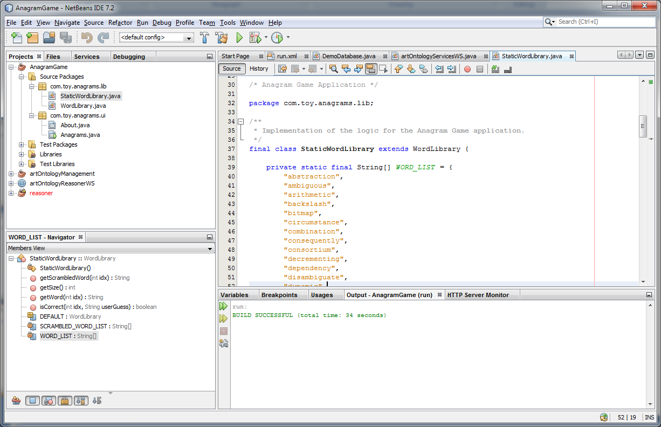
NetBeans IDE
Debug Project

Slide 31
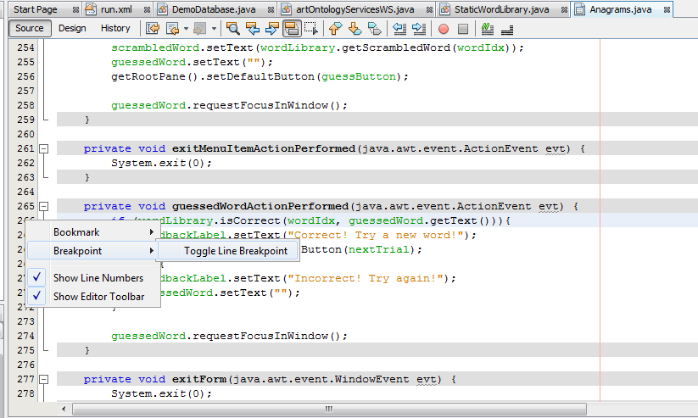
Breakpoints
Code breakpoints are tied to a particular line of code. When execution reaches a line of code with a code breakpoint, it will halt.
From this point on the developer can control the code execution
Inserting a breakpoint

Slide 32
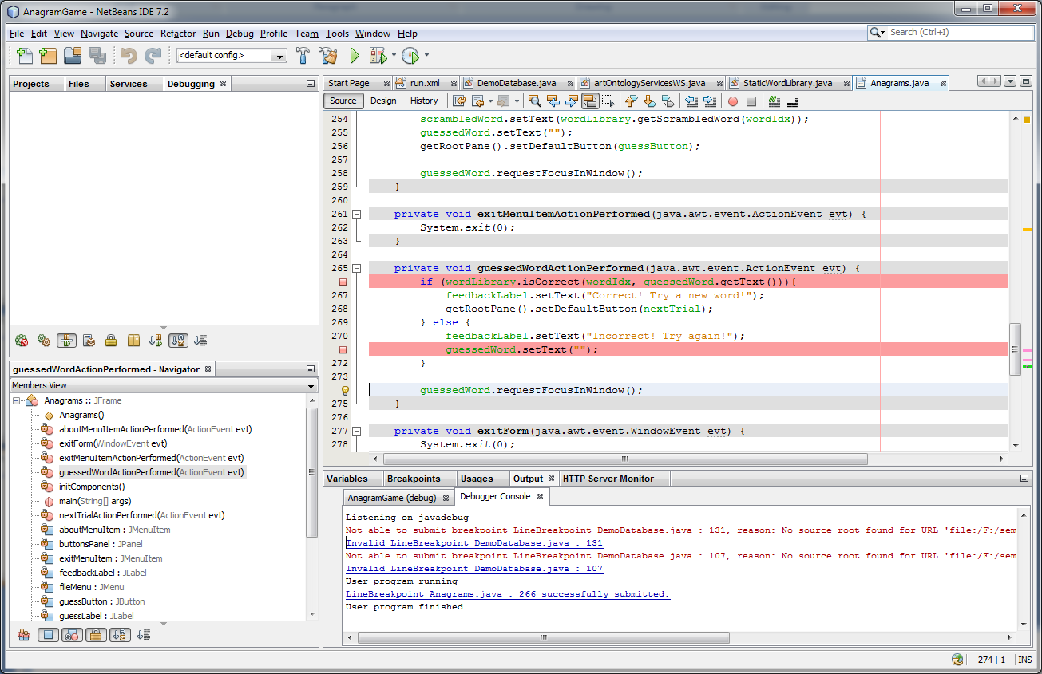
Lines assigned with Breakpoints

Slide 33
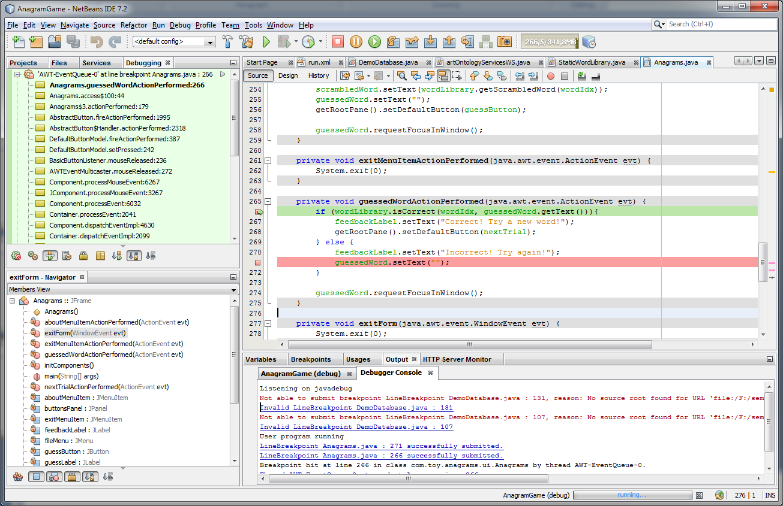
Breakpoint reached while running a project
Debugging action buttons

Slide 34
Debugging operations
Pause
Step over
Step out
Stop
Continue
Step into
Run to cursor
Step over expression

Slide 35
Debugging operations definitions
Continue: Resumes debugging until the next breakpoint or the end of the program is reached.
Step Over: Executes one source line of a program. If the line is a method call, executes the entire method then stops.
Step Over Expression: Steps over the expression and then stops the debugging.
Step Into: Executes one source line of a program. If the line is a method call, executes the program up to the method's first statement and stops.
Step Out: Executes one source line of a program. If the line is a method call, executes the methods and returns control to the caller.
Run to Cursor: Runs the current project to the cursor's location in the file and stop program execution.

Slide 36
Customizing Breakpoints
Sometimes while debugging your program, you want to simply log the value of certain expression at a certain point in your program's logic. You do not want to necessarily look at it every time a breakpoint is hit. In fact you may not even want the program to stop at the breakpoint at all. This is possible in Netbeans Debugger by customizing the breakpoint the following way:
set Print Text: to what ever you want to print. The text is printed in the Debug Console tab of the Output window.
set Suspend: to No Thread (continue). This makes the program to continue running after performing the Print Text: action.

Slide 37
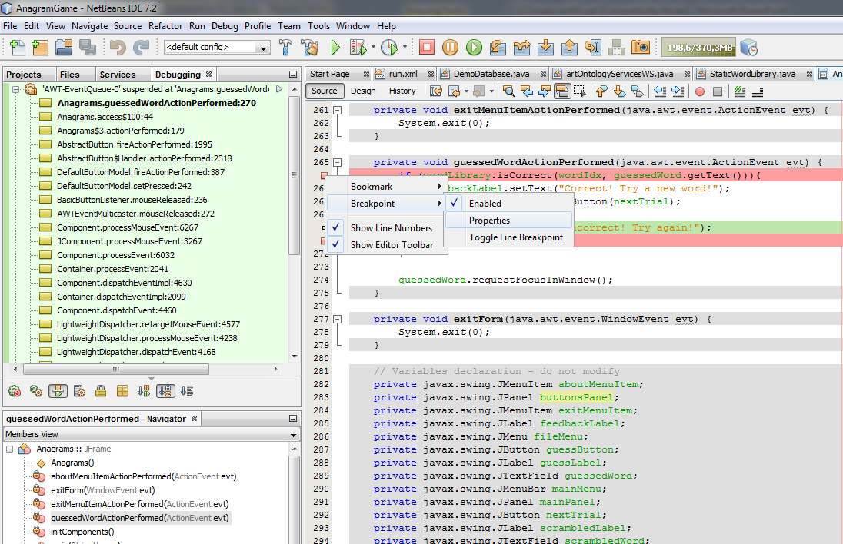
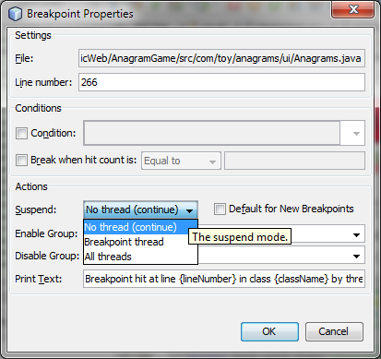
Customizing Breakpoints
1
2
Value print expression

Slide 38
Monitoring the values of variables
You can monitor the values of variables or expressions during the execution of your program.
An easy way to inspect the value of a variable during step-by-step execution of your program is to hover your mouse over the variable, the debugger will display the value of the variable close to where the cursor is placed.
Another way to examine the value of a variable is by adding a watch on the variable.

Slide 39
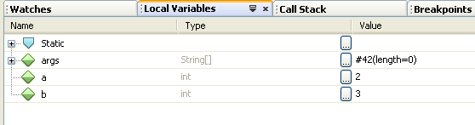
Monitoring the values of variables
Local Variables Window
The local variables displays the name, data type and values of all the values in the current scope as well as static member variables among others. To activate the Local Variables window, select Debugging > Local Variables in the Windows menu. The debugger allows you to change the value of a variable in the Local Variable window and then continue the execution of your program using that new variable's value.

Slide 40
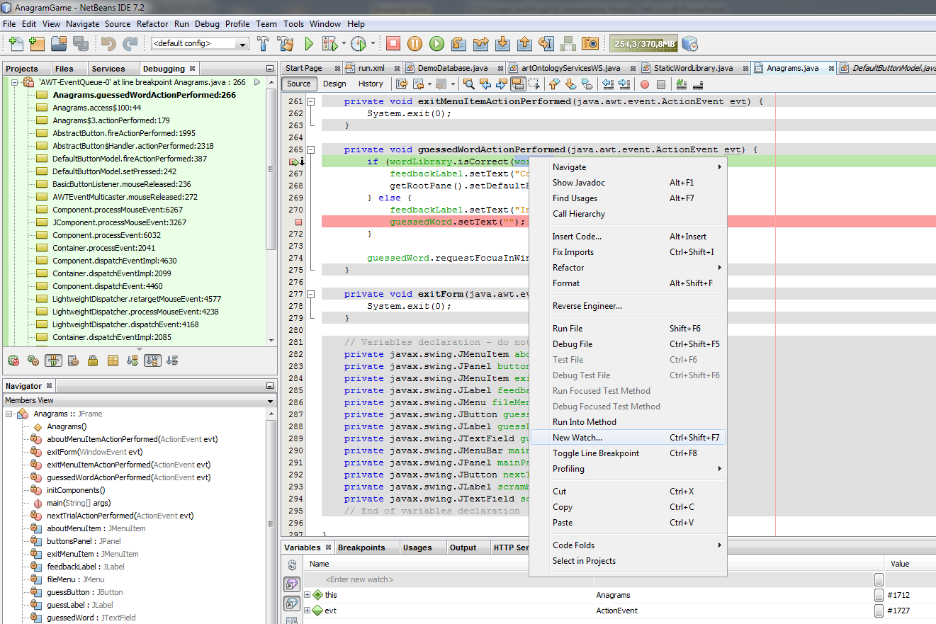
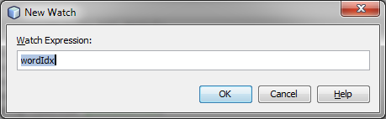
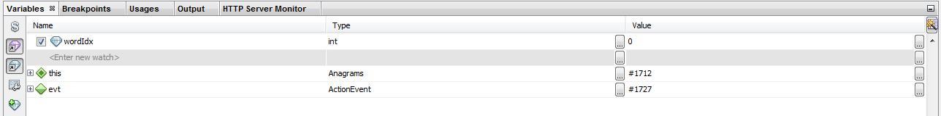
Watches
1
2
3
The value of the watched variable

Slide 41

Expression evaluation
Evaluate Java-syntax expressions assigned to watches and conditional breakpoints "live" while stepping through your code. Moving the pointer over the variable and the current value is evaluated and displayed in a tool tip.

Slide 42
Examples
All the examples are based on the Anagram Game sample application that is available as a sample in the New Project wizard.
Choose File > New Project from the main menu to open the New Project wizard.
Select Anagram Game in the Samples > Java category. Click Next.
Specify a location for the project. Click Finish. When you click Finish, the IDE creates the project and opens the project in the Projects window.
Click the Debug button in the toolbar to start the debugging session. Alternatively, right-click the project node in the Projects window and choose Debug.

Slide 43
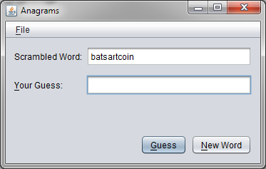
Examples: UI elements
My program crashes right after clicking a UI element

Slide 44
Examples: UI elements
Switch to NetBeans
On the Designer go to the event handler
Add a breakpoint
Debug the program
Emulate the crass (make the same steps that resulted to the crass)
On the critical moment the Debugger will stop the execution when the breakpoint has been reached
Continue by executing the program step-by-step
Add watches if needed
Locate the line of code where the crass occurs

Slide 45
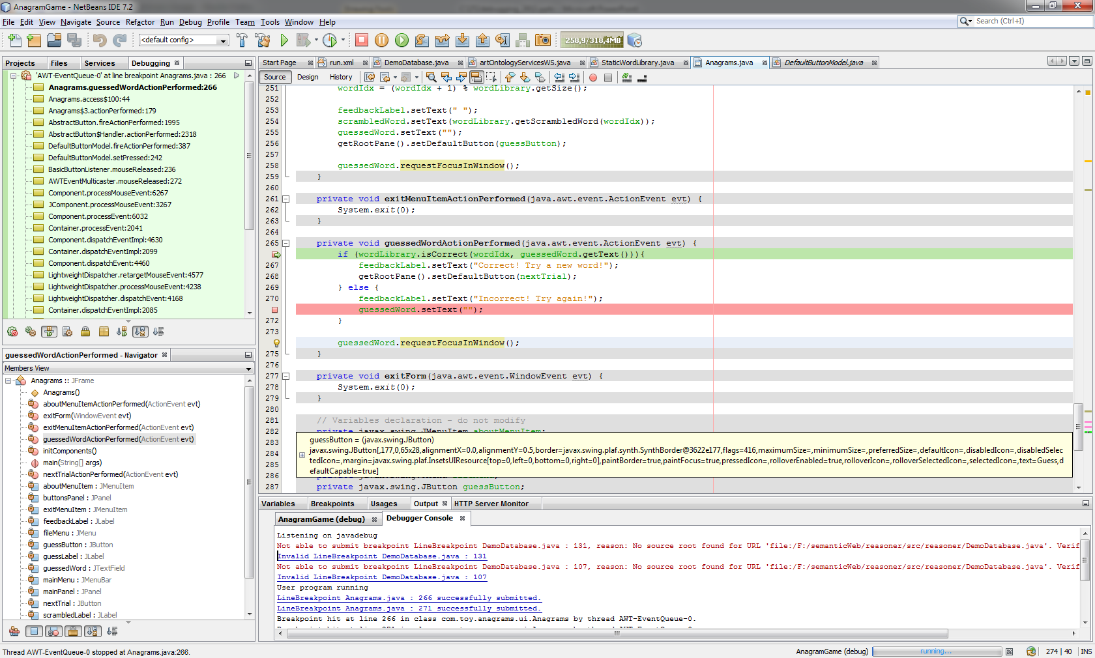
Examples: UI elements

Slide 46
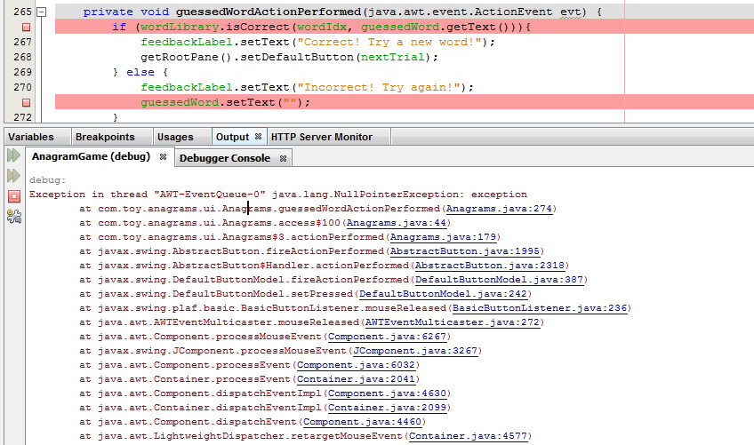
Examples: Random Crass
My program crashes randomly
In NetBeans IDE view the output
Locate from the output the location within your program that the crass occurs

Slide 47
Examples: Random Crass
Switch to NetBeans
Add a breakpoint to the function producing the crass
Debug the program
Use your program until the breakpoint is hit
Continue by executing the program step-by-step
Add watches if needed
Locate the line of code where the crass occurs

Slide 48
Examples: My program is not starting
My program crashes right after I press the Run Button
In NetBeans IDE view the output
Locate from the output the location within your program that the crass occurs

Slide 49
Examples: My program is not starting
If you cannot locate the position add a breakpoint to the first function called when starting the application (main)
Debug the program
Use your program until the breakpoint is hit
Continue by executing the program step-by-step
Add watches if needed
Locate the line of code where the crass occurs

Slide 50
Examples: My program cresses when calling a function from an external library
In NetBeans IDE add a breakpoint to the line where the error occurs
Make sure that the external library is properly initialised
Debug the program
Use your program until the breakpoint is hit
Add watches to the arguments of the function call
Check the arguments value and make sure that they have a valid for the context of use value

Slide 51
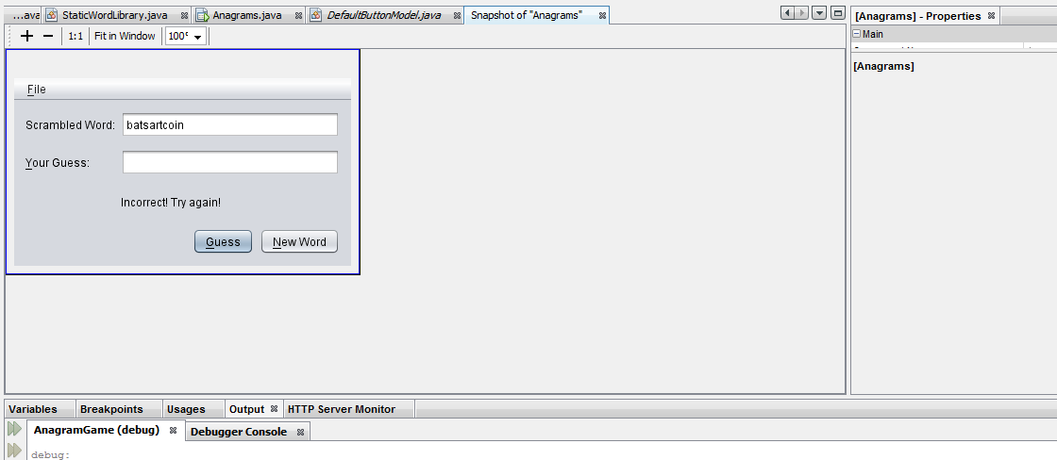
The NetBeans Visual Debugger
Visual Debugger helps you locate and debug the code for visual elements in your GUI application. You can use the visual debugger in Java and JavaFX GUI applications.
Choose Debug > Take GUI Snapshot from the main menu. When you choose Take GUI Snapshot, the IDE will take a snapshot of the GUI and will open the snapshot in the main window.

Slide 52
Example: Locating the source code of UI components
The GUI snapshot is a visual debugging tool that can help you locate the source code for GUI components. The source code for GUI components can sometimes be difficult to locate and the snapshot provides a way for you to locate the code based on the GUI instead of searching through the code. You can select components in the snapshot and invoke tasks from the popup menu to view the source code for the component, show the listeners and set breakpoints on components.
Locating the Source Code for Components
  In the GUI snapshot, select the Guess button. When you select a component in the snapshot, the IDE displays details about the selected component in the Properties window. If the Properties window is not visible you can choose Window > Properties from the main menu to open the window.

Slide 53
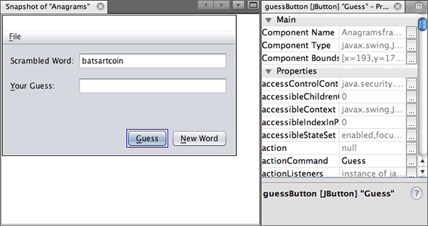
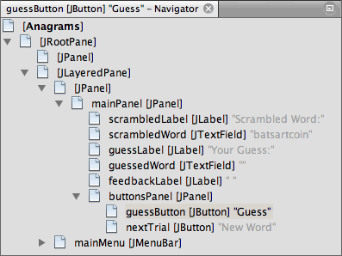
Example: Locating the source code of UI components
The IDE also displays the location of the component in the form hierarchy in the Navigator window.

Slide 54
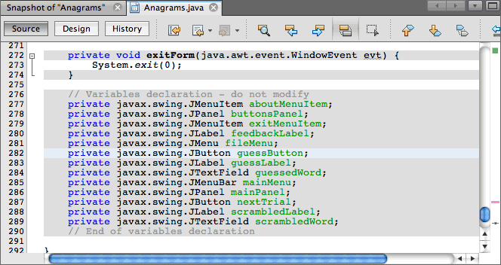
Example: Locating the source code of UI components
Right-click the Guess button in the snapshot and choose Go to Component Declaration from the popup menu. When you choose Go to Component Declaration the IDE opens the source file in the editor and moves the cursor to the line in the code where guessButton is declared.

Slide 55
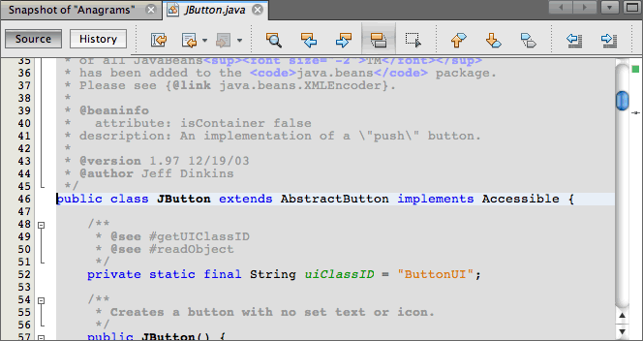
Example: Locating the source code of UI components
Right-click the Guess button in the snapshot again and choose Go to Component Source. When you choose Go to Component Source the IDE opens the source file in the editor and moves the cursor to the line in the source code for the JButton component.

Slide 56
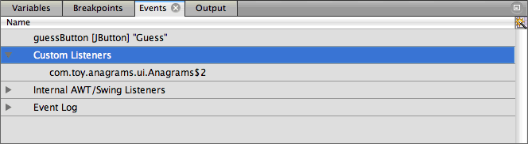
Example:Exploring Component Events
Right-click the Guess button in the snapshot and choose Show Listeners from the popup menu. When you choose Show Listeners, the IDE opens the Events window. You can see that the Custom Listeners node is expanded.

Slide 57
Example:Exploring Component Events
Right-click com.toy.anagrams.ui.Anagrams$2 below the Custom Listeners node and choose Go to Component Source in the popup menu. The source code opens in the editor at the line where the listener is defined.
Select the empty text field in the snapshot. Alternatively, you can select the guessedWord text field in the Navigator window.
When you select the text field, the items in the Events window will change automatically to display the listeners for the selected component.
In the Events window, double-click the Event Log node to open the Select Listener window. Alternatively, you can right-click the Event Log node and choose Set Logging Events from the popup menu.
Select the java.awt.event.KeyListener listener from the dialog. Click OK.

Slide 58
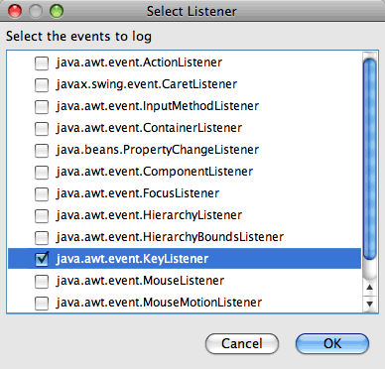
Example:Exploring Component Events
This listener is now listening for keyboard events in the text field.

Slide 59
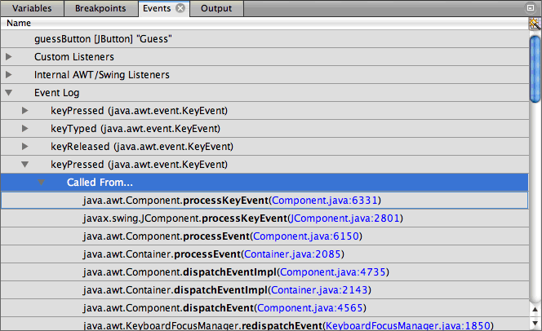
Example:Exploring Component Events
In the Anagram Game application, type some characters in the text field. When you type a character in the text field, the event is recorded in the events log. If you expand the Event Log node you can see that each keystroke is now logged. New events appear each time that you type in the Anagram Game application text field. If you expand an individual event, for example keyPressed, you can see the properties of that event in the log.

Slide 60
Example: Resources Usage
My application uses allot the CPU
My application allocates allot of memory
My application is very slow
…

Slide 61
Profiling Java Applications in NetBeans IDE
When profiling a project, you use the Select Profiling Task dialog box to choose a task according to the type of profiling information you want to obtain. The following table describes the profiling tasks and the profiling results obtained from running the task.
Profiling Task Results
Monitor Application Choose this to obtain high-level information about properties of the target JVM, including thread activity and memory allocations.
Analyze CPU Performance Choose this to obtain detailed data on application performance, including the time to execute methods and the number of times the method is invoked. Analyze Memory Usage Choose this to obtain detailed data on object allocation and garbage collection.

Slide 62
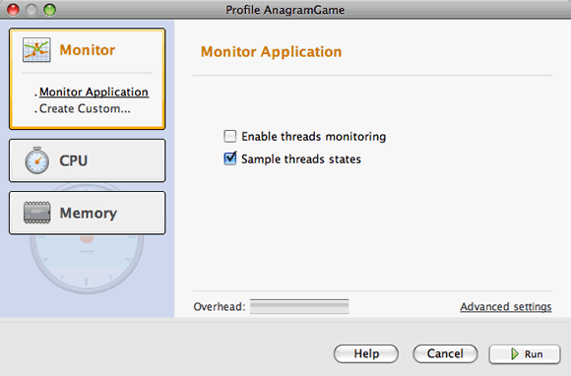
Profiling Java Applications in NetBeans IDE

Slide 63
Example: Analyzing CPU performance
You will now use the IDE to analyze the CPU performance of the Anagram Game application. You will choose the Part of Application option and then select WordLibrary.java as the profiling root. By selecting this class as the profiling root, you limit the profiling to the methods in this class.
  Click the Stop button in the Profiler window to stop the previous profiling session (if still running).
  Choose Profile > Profile Main Project from the main menu.
  Select CPU in the Select Profiling Task dialog box.
  Select Advanced (Instrumented). To use this option you also need to specify a profiling root method.
  Click customize to open the Edit Profiling Roots dialog box.
  In the Edit Profiling Roots dialog box, expand the AnagramGame node and select Sources/com.toy.anagrams.lib/WordLibrary.

Slide 64
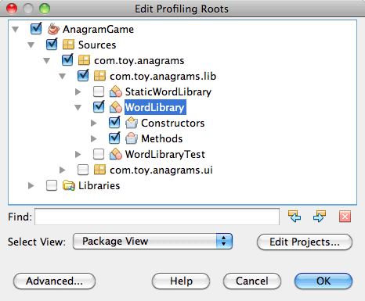
Example: Analyzing CPU performance

Slide 65
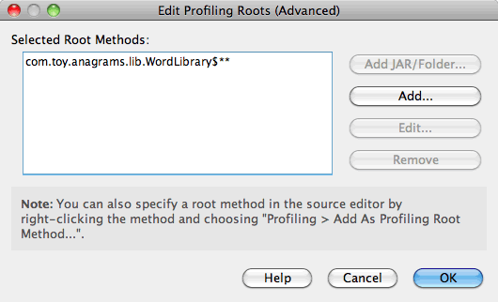
Example: Analyzing CPU performance
Click the Advanced button to open the Edit Profiling Roots (Advanced) dialog box which provides more advanced options for adding, editing and removing root methods.
You can see that WordLibrary is listed as the root method.
Click OK to close the Edit Profiling Roots (Advanced) dialog box. After you select the profiling root you can click edit in the Select Profiling Task dialog to modify the selected root method.

Slide 66
Example: Analyzing CPU performance
Select Profile only project classes for the Filter value. The filter enables you to limit the classes that are instrumented. You can choose from the IDE's predefined profiling filters or create your own custom filters. You can click Show filter value to see a list of the classes that will be profiled when the selected filter is applied.
Click Run in the Select Profiling Task dialog box to start the profiling session.

Slide 67
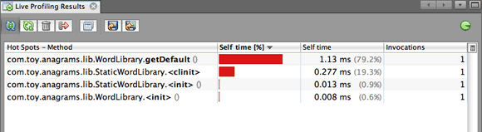
Example: Analyzing CPU performance
When you click Run, the IDE launches the application and starts the profiling session. To view the profiling results, click Live Results in the Profiler window to open the Live Results window. The Live Results window displays the profiling data collected thus far. The data displayed is refreshed every few seconds by default. When analyzing CPU performance, the Live Results window displays information on the time spent in each method and the number of invocations of each method. You can see that in the Anagram Game application only the selected root methods are invoked initially.

Slide 68
Java Applications in NetBeans IDE
For more information:
  http://profiler.netbeans.org/
  http://www.netbeans.org/kb/60/java/profiler-intro.html
  http://www.netbeans.org/community/magazine/html/04/profiler.html
  http://www.javapassion.com/handsonlabs/nbprofilerperformance/index.html
  http://www.netbeans.org/kb/docs/java/profiler-profilingpoints.html
  http://blogs.oracle.com/nbprofiler/

