Slide 1

University of Crete
Security and Privacy
Prof. Vangelis Markatos
markatos@csd.uoc.gr
Notes:
<title> = Prof., Dr., etc
Xxxxxxx Yyyyyyyy = name of the presenter
<Full Laboratory Name> = e.g. Computational Vision and Robotics
<Lab short name> = e.g. CVRL
e.t.c.

Slide 2



Mission
Inspire and Educate
students to become
tomorrow’s leaders in the area

Slide 3

Why?
We want to make this world better:
via education and research

Slide 4

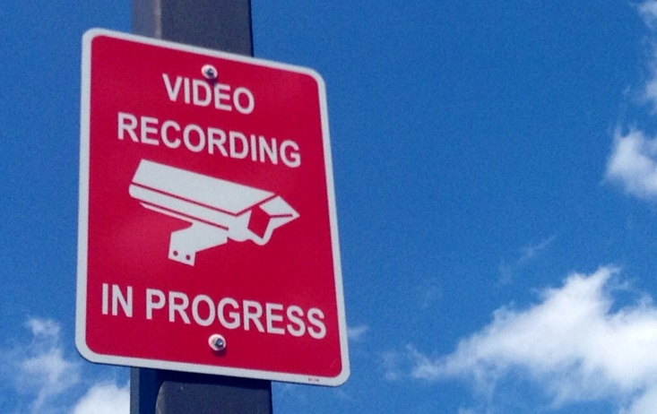
What is our focus?
Security and Privacy

Slide 5
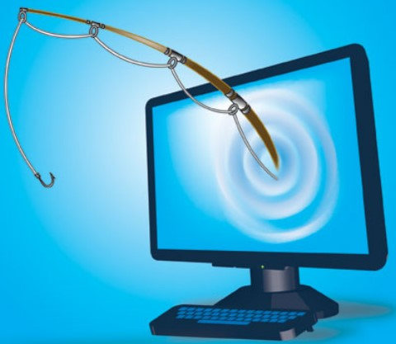


Why Security?
We depend on the Internet for most/all activities
  Chat, friends, banking, shopping, movies, songs
  Everything is on the Internet
We need security
  We will not be able to function properly
  We will always be afraid and concerned

Slide 6
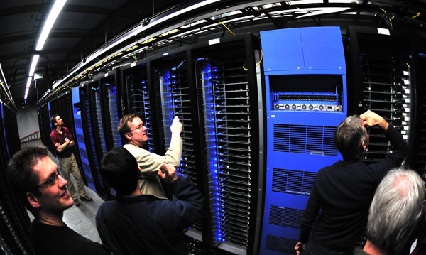
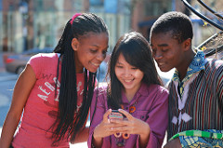
Why Privacy?
Most of our data are on-line
  Photos, emails, texts, messages
Most of our actions are somewhere on-line
The rest of them may be inferred
  Easy to find who dates whom
    Just correlate the location of their smartphones
  TARGET was able to find pregnant teens
    Form their purchasing patterns
It is like someone stealing your smartphone and reading all the information there
  Including pictures and text messages
  And sharing it with everybody
    Parents, teachers, relatives, “friends”

Slide 7
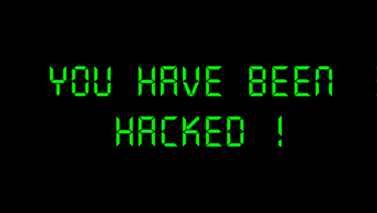

What do we do?
Security
  Intrusion Detection
    Detect attackers when they try to enter a system
  Intrusion Prevention
    Prevent attackers from hacking a system
  Viruses
    What is a virus? How do they hide?
  Malware
    Detect advanced malware
    Polymorphic malware (tries to avoid detection)

Slide 8
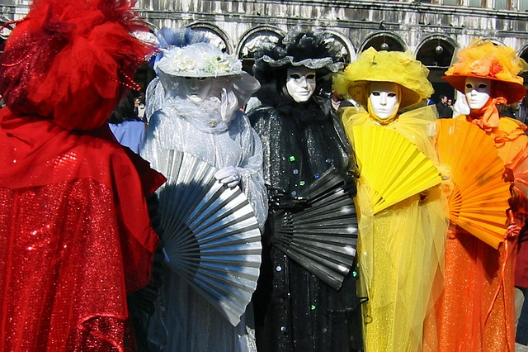
What do we do?
Privacy
  Understand Anonymity
  The onion router
  Digital forensics
  Provide privacy even when anonymity is not possible
    obfuscation

Slide 9
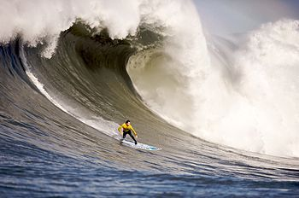
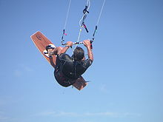
Why study Security/Privacy?
It is fun!
  We break things
  We build things
  We learn things!

Slide 10
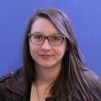
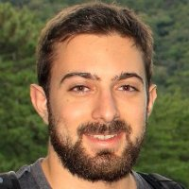
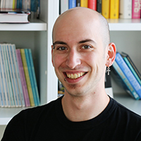
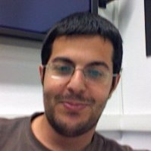
Where are our students today?
Industry
  Facebook: Eleni Gessiou, Michalis Athanasakis
  Google: Michalis Polychronakis (intern)
  IBM: Spyros Antonatos
  Microsoft: Lazaros Koromilas (intern)
  Intel: Grigoris Magklis
  Symantec: Giorgos Vasiliadis (intern)
  and in various startups in Greece and US

Slide 11
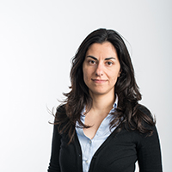
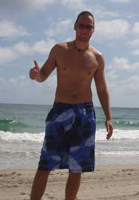
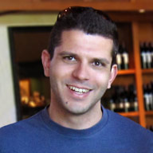
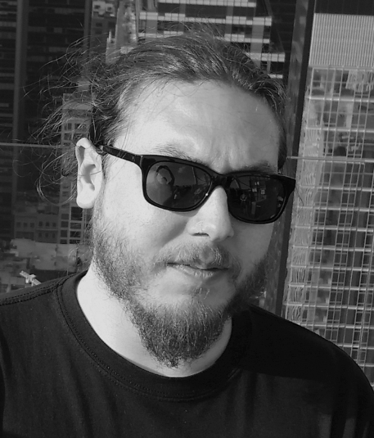
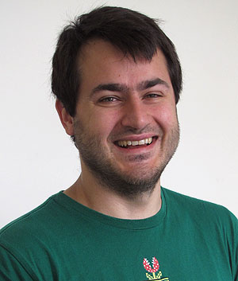
Where are our students today?
Academia
  Eva Kalyviannaki : City University London
  Mike Polychronakis: Stony Brook
  Elias Athanasopoulos: VU Amsterdam
  Alex Kapravelos: NCSU
  Iason Polakis: Columbia U
  Nick Nikiforakis: Stony Brook

Slide 12
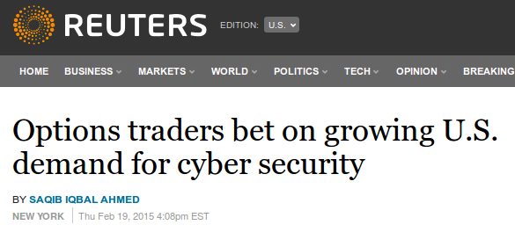
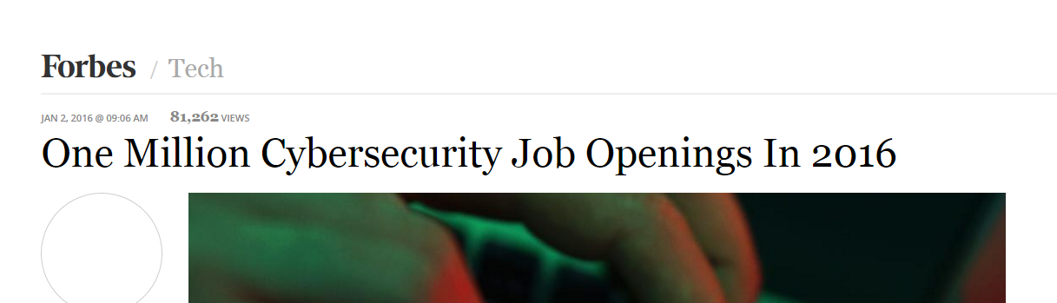
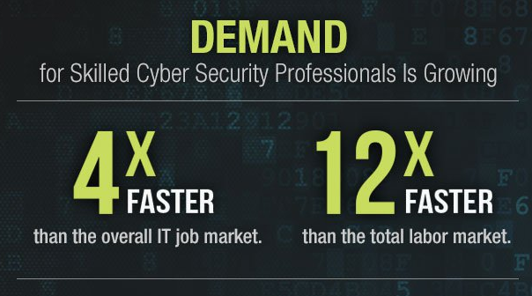
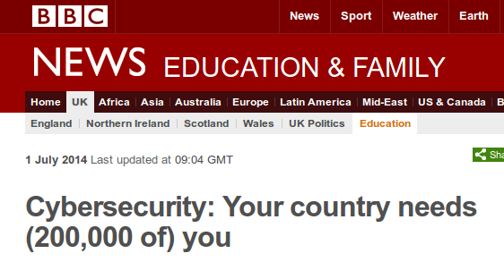
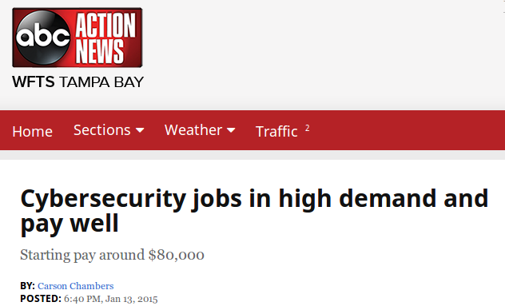
What are the job prospects?

Slide 13
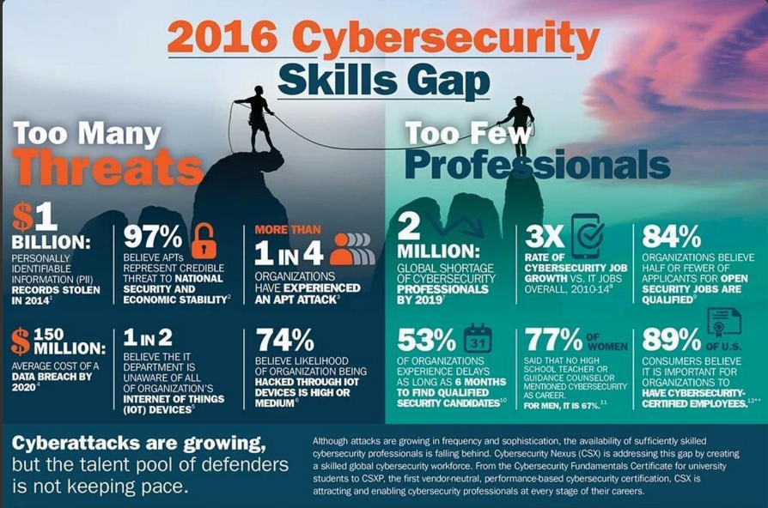

Slide 14
University of Crete
Security and Privacy
Prof. Vangelis Markatos
markatos@csd.uoc.gr
Notes:
<title> = Prof., Dr., etc
Xxxxxxx Yyyyyyyy = name of the presenter
<Full Laboratory Name> = e.g. Computational Vision and Robotics
<Lab short name> = e.g. CVRL
e.t.c.

