Slide 1
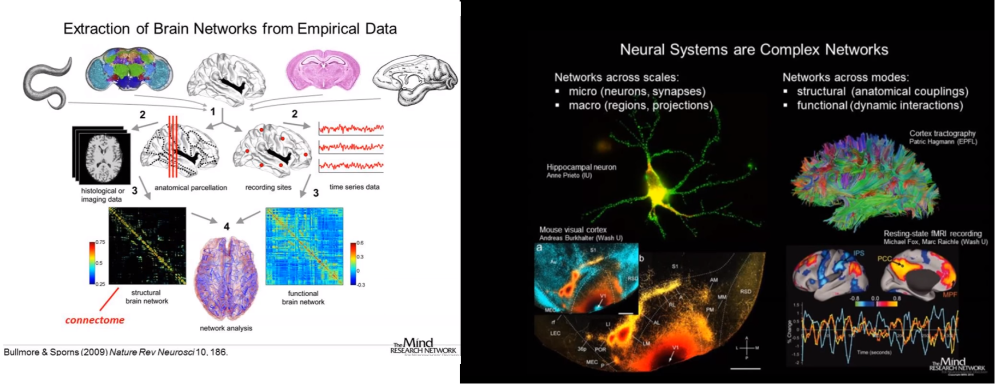

Introductory Lecture on Complex Systems
Prof. Maria Papadopouli
CS – 590.21 Analysis and Modeling of Brain Networks Department of Computer Science University of Crete

Slide 2
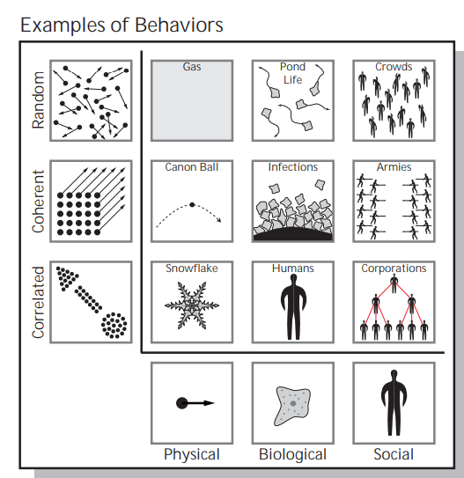
Random
Each column contains three examples of systems consisting of the same components (from left to right: molecules, cells, people) but with different relations between them.
Each row contains systems in which the relationship
among the components is the same.
Coherent
Correlated
molecules
cells
people
Notes:
https://static1.squarespace.com/static/5b68a4e4a2772c2a206180a1/t/5df3ee072087793e4a6df129/1576267272688/1912.05088.pdf

Slide 3
Random systems: the behavior of each component is independent from the behavior of all other components.
Coherent systems: all
components exhibit the same behavior; e.g., the behavior (location, orientation, and velocity) of one part of the
cannon ball completely determines the behavior of the other parts.
Correlated systems lie between these two extremes:
the behaviors of the system’s components do depend on one another, but not so strongly that every component acts in the same way;
e.g., the shape of one part of a snowflake is correlated with but
does not completely determine the shape of the other parts.
Notes:
https://static1.squarespace.com/static/5b68a4e4a2772c2a206180a1/t/5df3ee072087793e4a6df129/1576267272688/1912.05088.pdf

Slide 4
Complex System
A system of large networks of components with no central control & simple rules of operation give rise to complex collective behavior, sophisticated information processing & adaptation via learning or evolution
does not yield to compact form of representation & description (e.g., elegant mathematical descriptions, like Maxwell or Newton’s equations)
“encodes long histories” (so it is difficult to find compact forms)
extracts this information from the environment & uses it to behave adaptively
As the system evolves, its components interact, are learning, potentially modifying their behavior, leading to interesting dynamics, emergent behavior
In some cases, unpredictable behavior
Have scaling properties (e.g., power laws) or fractal structures
Notes:
https://www.youtube.com/watch?v=rVw5lRe1PMA&list=PLF0b3ThojznRyDQlitfUTzXEXwLNNE-mI&index=6&t=0s
A random walk is not complex system. There is one entity that moves according to simple rules. A percolation is complex because there is a lattice that changes in parallel and independently. In the lattice (in the percolation), there is also interactivity…

Slide 5
A theoretical computer scientist approach:
give me a quantity of the system and I can try to tell you
how hard is to computationally estimate this quantity in terms of resources, e.g., time, memory, message exchanged (communication), energy.
Notes:
https://www.youtube.com/watch?v=rVw5lRe1PMA&list=PLF0b3ThojznRyDQlitfUTzXEXwLNNE-mI&index=6&t=0s
A random walk is not complex system. There is one entity that moves according to simple rules. A percolation is complex because there is a lattice that changes in parallel and independently. In the lattice (in the percolation), there is also interactivity…

Slide 6
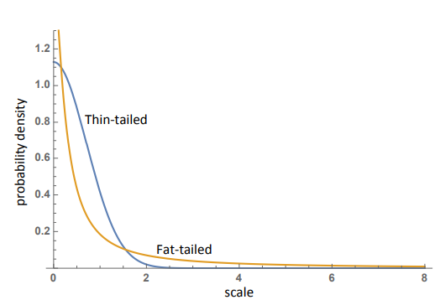
When the underlying probability distributions have fat tails, standard statistical methods often break down, leading to potentially severe underestimates of the probabilities of extreme events.
normal distribution (thin-tailed) &
a power-law decay distribution (fat-tailed)
The axes of this graph are truncated; the fat-tailed distribution can, with small but non-negligible probability (0.04%), produce events with a scale of one million or more.
The fat-tailed distribution may appear more stable due to the lower probability of
small-scale fluctuations and the fact that samples from the distribution may not contain any extreme events.
However, sooner or later, a fat-tailed distribution will produce an extreme event,
while one could wait thousands of lifetimes of the universe before a normal distribution produces a similarly extreme event.
Notes:
As a thought experiment, imagine 100 ladders, each with a 1/10 probability of falling. If the ladders are independent from one another, the probability that all of them fall is astronomically low (literally so: there is about a 1020 times higher chance of randomly selecting a particular atom out of all of the atoms in the known universe). If we tie all the ladders together, we will have made them safer, in the sense that the probability of any individual ladder falling will be much smaller, but we will have also created a non-negligible chance that all of the ladders might fall down together.

Slide 7
Thermodynamic & Statistical Mechanics Entropy
Measures the amount of heat loss when energy is transformed to work
Heat loss ~ “disorder”
Theory is specific to heat
Measures the number of possible microstates that lead to a macrostate
Number of microstates ~ disorder
A more general theory
System’s entropy: a measure of its number of possible states

Slide 8
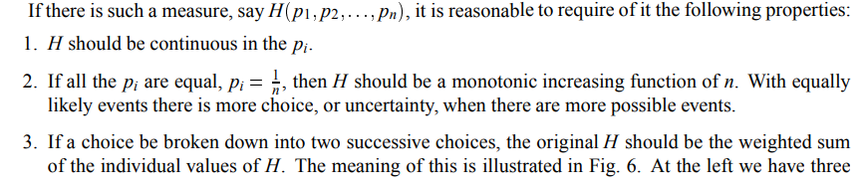
Introduction to Entropy
Suppose a set of events whose probabilities of occurrence are
These probabilities are known but that is all we know concerning which event will occur.
Can we find a measure of how uncertain we are of the outcome?
That is, what is the surprise factor?

Slide 9

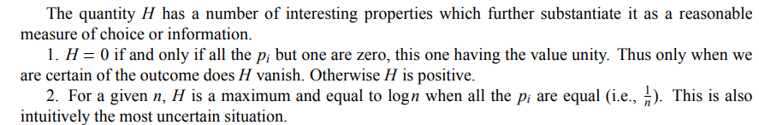
Theorem
Amount of information per symbol
The constant K merely amounts to a choice of a unit of measure

Slide 10

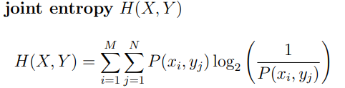

Joint & Conditional Entropy
Measures how uncertain we are of y on the average when we know x
The uncertainty (or entropy) of the joint event x; y is the uncertainty of x plus the uncertainty of y when x is known.
The uncertainty of y is never increased by knowledge of x:
it decreases, unless x & y are independent events, in which case it does not change.

Slide 11
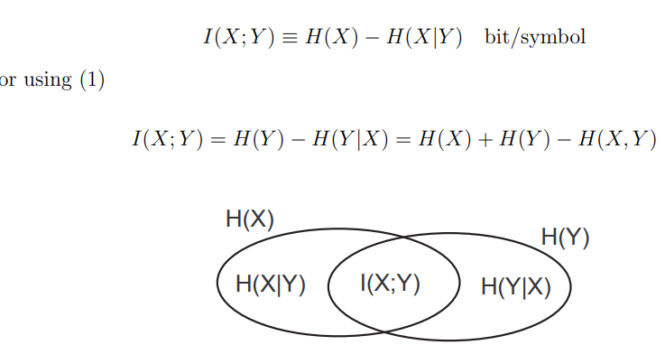
Mutual Information
Quantifies the reduction of uncertainty relative to a X given the knowledge of Y

Slide 12
Complexity vs. Entropy
Complexity measures related to organizational aspects, the difficulty of describing organizational structure
Entropy does not capture the correlation & structure of a system but rather its disorder & inhomogeneity

Slide 13
Regular, Complex & Random Systems: Complexity vs. Entropy
Highly regular systems present identical structure at all levels: low complexity & low entropy
Complex systems present non-repeating structure at multiple levels: high complexity & intermediate entropy
Random systems present no structure at any level: low complexity & high entropy

Slide 14
Challenges for Measuring Organized Complexity
Macroscopic predictions for organized complex systems are impossible due to the interactions between a large number of dynamic variables at the microscopic level
The emergent, self-organizing whole created by the system parts is dependent & comprised of multiple causal models
Organized complex systems can not be simply modeled by mathematical formulas, qualitative description or statistics.
Instead, new approaches along with new modeling methods of the relationship between complexity metrics & the emergent behavior of those systems are needed to connect the system organization on the micro & macro level.

Slide 15
Before quantifying the complexity of a system:
How hard is it to describe?
How hard is it to create?
What is its degree of organization?

Slide 16
Organization Measures
Excess entropy, hierarchical complexity, tree subgraph diversity, correlation, mutual information

Slide 17


Slide 18
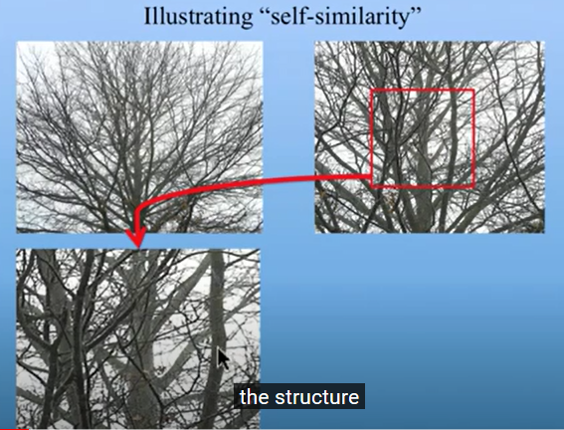
Fractals
Scale invariance is an exact form of self-similarity where at any magnification there is a smaller piece of the object that is similar to the whole.
A time developing phenomenon exhibits self-similarity, if the numerical value of certain observable quantity f(x, t), measured at different times are different but the corresponding dimensionless quantity at given value x/t^z remain invariant.
Extension of the idea of similarity of two triangles: two triangles are similar if the numerical values of their sides are different but the corresponding dimensionless quantities, such as their angles, coincide.
Notes:
Example: assume that we measure the number of branches of the tree (x) (διακλαδώσεις στο δέντρο). The time developing phenomenon is the zooming. It may exist a z, such that the number of brances over t^z remains constant.

Slide 19
Chaotic Behavior
Refers to a system whose dynamical is very sensitive to the initial conditions.
Given a set of the initial conditions for the chaotic system, we can always find other initial conditions arbitrarily nearby that lead to drastic changes in the eventual behavior of the system
Vast number, theoretically infinite, of decorrelated signals can be generated with a small variation in the initial conditions of the system.

Slide 20
Excess Entropy
Neural Complexity
Measures the amount of apparent randomness at the micro-level that is “explained away“ by considering correlations over larger & larger blocks.
Completely random & fully structured system configurations exhibit low excess entropy, whereas structures with a certain level of organization without pattern repetition on different system scales exhibit high excess entropy
Measures the amount & heterogeneity of statistical correlations within a neural system in terms of the mutual information between subsets of its units.
Captures the interplay between global integration & functional segregation, resulting in:
high complexity when functional segregation coexists with integration
low complexity when the components of a system are either completely independent (segregated) or completely dependent (integrated).
Notes:
Rigid structure at micro level but larger freedom in larger scales, results to high (positive) excess entropy. Similarly, when we have large freedom in small scales but rigid structure in macro level, we have high (negative) excess entropy. The different density of entropy across different scales is what results in excess entropy.

Slide 21
Rigid structure at micro level but larger freedom in larger scales, results to high (positive) excess entropy.
Similarly, when we have large freedom in small scales but rigid structure in macro level, we have high (negative) excess entropy.
The different density of entropy across different scales is what results in excess entropy.

Slide 22
Excess Entropy
Neural Complexity
Measures the amount of apparent randomness at the micro-level that is “explained away“ by considering correlations over larger & larger blocks.
Completely random & fully structured system configurations exhibit low excess entropy, whereas structures with a certain level of organization without pattern repetition on different system scales exhibit high excess entropy
Measures the amount & heterogeneity of statistical correlations within a neural system in terms of the mutual information between subsets of its units.
Captures the interplay between global integration & functional segregation, resulting in:
high complexity when functional segregation coexists with integration
low complexity when the components of a system are either completely independent (segregated) or completely dependent (integrated).
Notes:
Long range interactions vs. short-range interactions.
When you have long-range interactions, you have more flexibility for scale invariance. In our visual system, we do observe objects, independent on the size.

Slide 23
Self-dissimilarity
Matching Complexity
The degrees of self-dissimilarity between the patterns of a system observed at various scales (e.g. the average matter density of a physical body for volumes at different orders of magnitude).
Measures the amount of extra information using a maximum entropy inference of the pattern at one scale, based on the provided pattern on another scale
Characterizes the complexity in terms of how the inferences about the whole system differ from one another as one varies the information-gathering space.
Scaling of density of entropy…
Reflects the change in neural complexity that occurs after a neural system receives signals from the environment.
Measures how well the ensemble of intrinsic correlations within a neural system fits the statistical structure of the sensory input.
Low when the intrinsic connectivity of a simulated cortical area is randomly organized
High when the intrinsic connectivity is modified so as to differently amplify those intrinsic correlations that happen to be enhanced by sensory input.

Slide 24
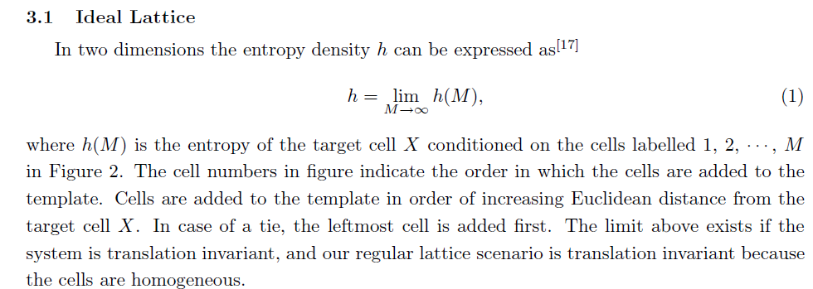
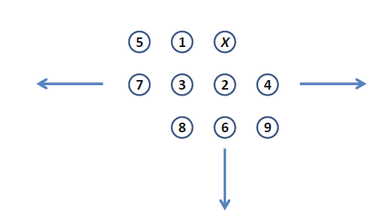


Slide 25
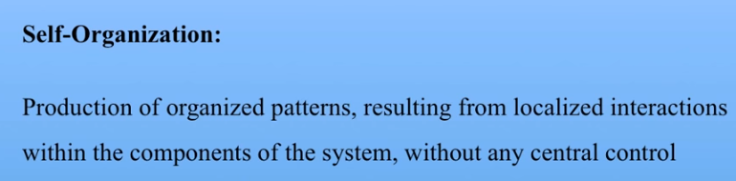


Slide 26


Slide 27
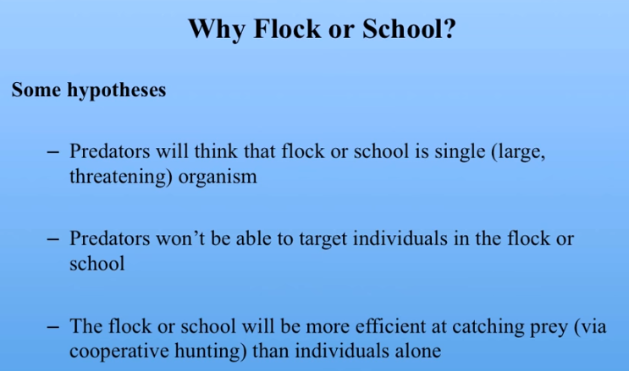
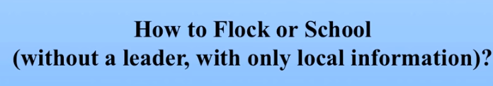

Slide 28
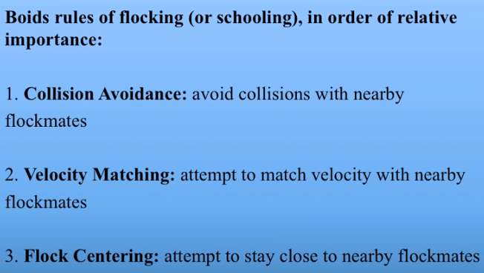

Complex behaviors from simple rules…

Slide 29
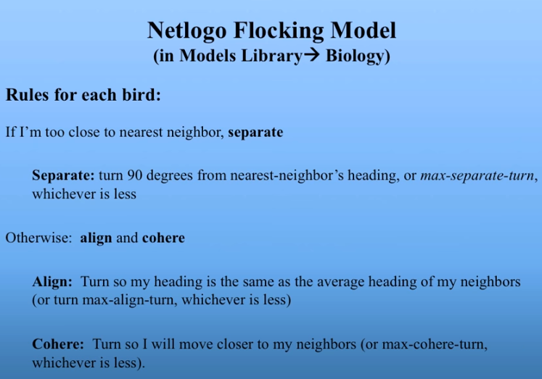

Slide 30
Examples of Synchronization in Nature
Fireflies flashing
Crickets chirping
Neurons firing
Heart cells beating

Slide 31
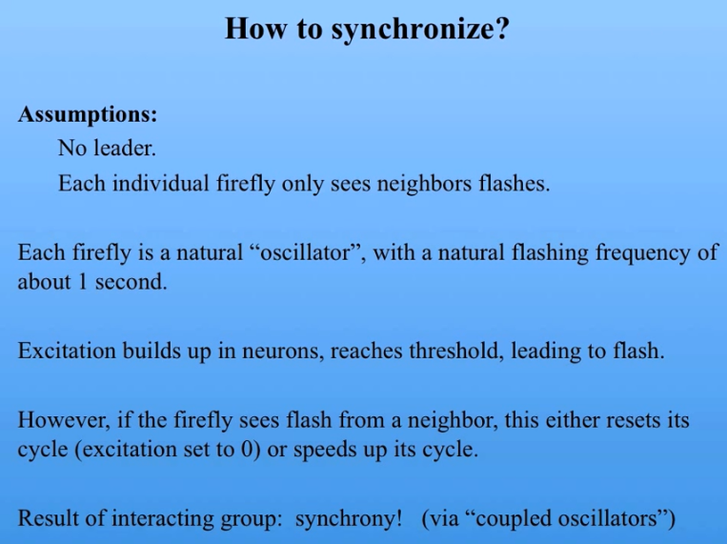

Slide 32
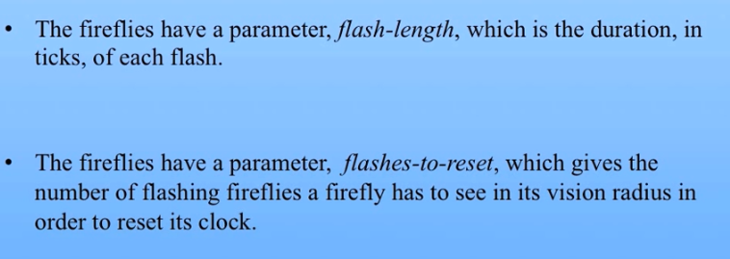

Slide 33
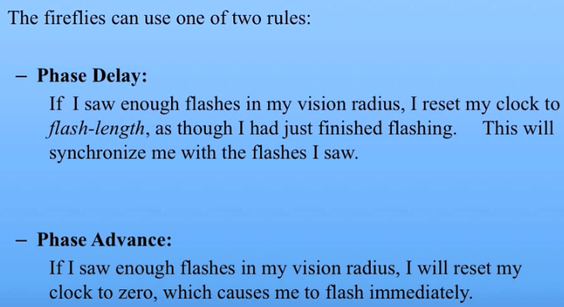
Notes:
Phase locking: It exist for the recognition of sounds.

