Slide 1



Supporting Wireless Access Markets
with a User-centric QoE-based Geo-database
UNIVERSITY OF CRETE
Team: Michalis Katsarakis, Maria Plakia, Nick Syntychakis, Vasilis Theodosiadis, Nikolaos Rapousis
Under the supervision: Maria Papadopouli
University of Crete
Foundation for Research & Technology – Hellas (FORTH)
KTH Royal Institute of Technology
http://www.ics.forth.gr/mobile
Funded by GSRT with a Research Excellence, Investigator-driven grant (ΑΡΙΣΤΕΙΑ/ΕΣΠΑ)
Notes:
1

Slide 2
Roadmap
Motivation
Related work
U-map system
Modeling and simulation
Conclusions and future work

Slide 3
By 2014 mobile data traffic over 3.6 exabytes/month worldwide
Spectrum: a scarce resource of high economic value (~1 trillion USD)
Constraints due to traditional spectrum allocation
Shannon’s law sets the limits on the achievable transmission rate
Technological advancements on spectral efficiency
MIMOs
Intelligent & directional antennas
Channel assignment, topology control, MAC protocols
Cognitive radio networks (CRNs)
☞ New access markets & service paradigms & architectures

Slide 4
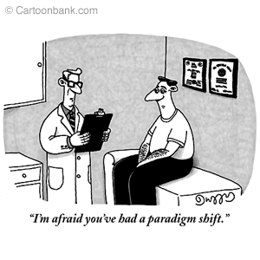
Paradigm shift in wireless access markets

Slide 5
Traditional cellular markets
Long-term licenses with exclusive access rights
Client is associated with certain provider
Long-term customer subscription
New wireless access markets
Larger sizes in number of clients & providers, data rates, demand
More heterogeneous & diverse in populations, services, preferences, deployments, environments
More complex (e.g., spectrum allocation, infrastructure, pricing/billing, QoE)
Coalitions among providers on nformation, services, infrastructure (MVNOs)
Open spectrum, spectrum DB, grass-root efforts, crowdsourcing
Multiple scales

Slide 6
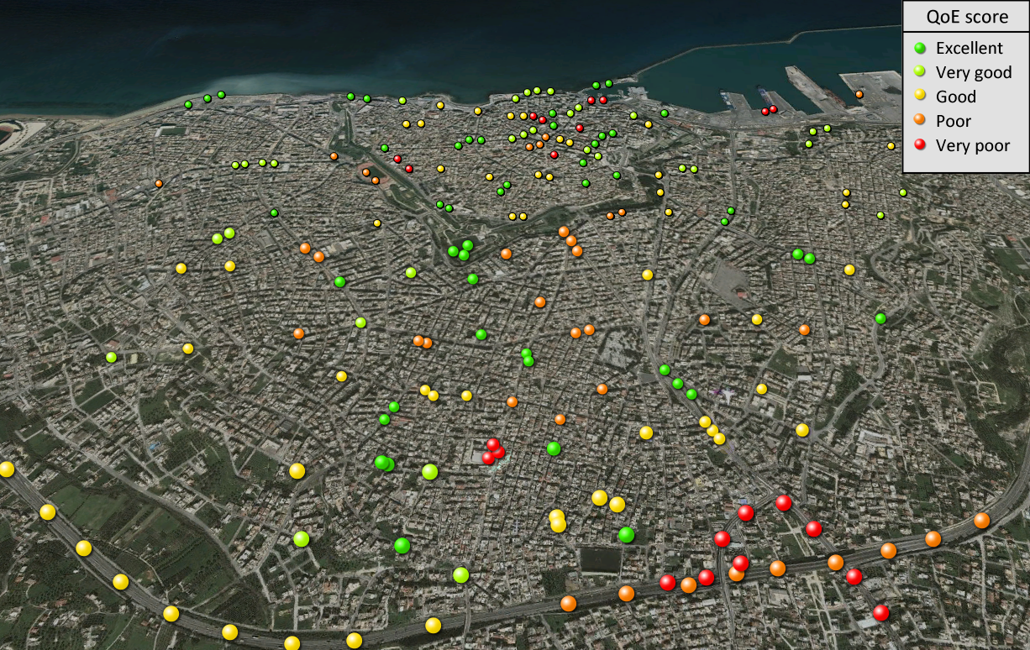
You map: Power to You!
u-map: a user-centric QoE geo-database, feedback system.

Slide 7
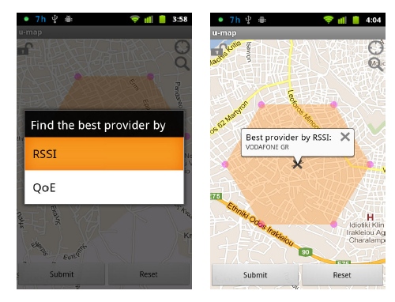

Slide 8
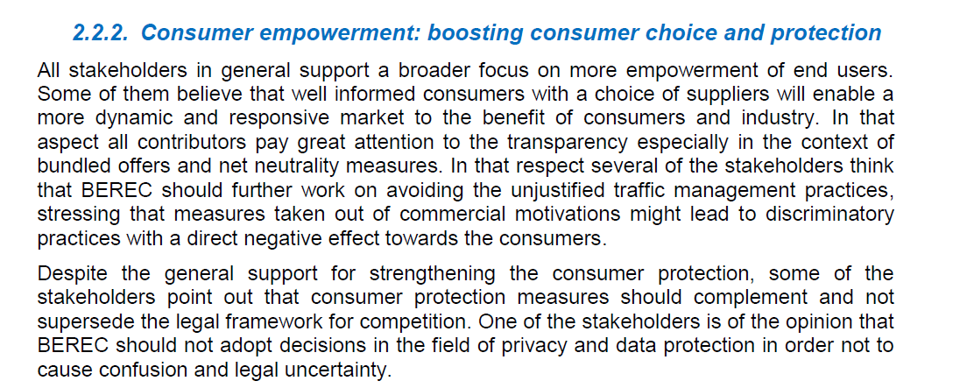
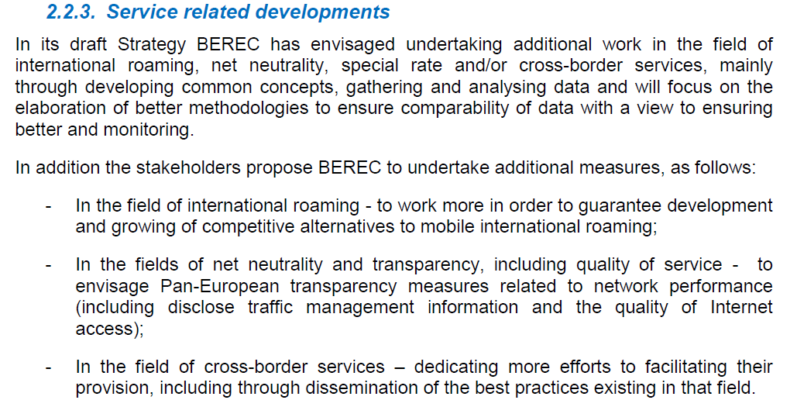


Slide 9
u-map: user-centric QoE geo-database.
Client-to-Server architecture
u-map clients on mobile devices
Collect network measurements and store them locally
Upload traces to the u-map server
Query the u-map server
u-map server
Collects traces & stores them in spatio-temporal geo-DB
Responds to queries sent by users, providers, regulators
Can be designed according to different business models
grass-root service
operator-driven
third-party/provider
Under appropriate access control & privacy rules
Provision of incentives
reputation, altruism,
payment (e.g., free SMS, calls)

Slide 10


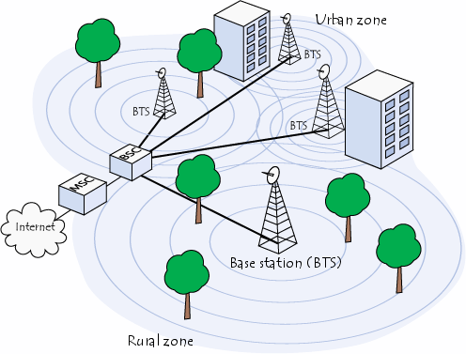
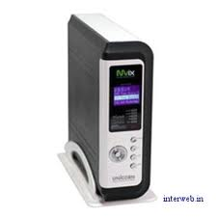
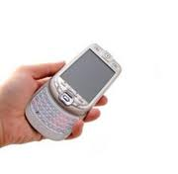


Query for the
best provider
in a region
Upload
network & QoE measurements
u-map server
u-map client
Providers query about network condition, coverage, customers
Regulators query about coverage of providers
Provider 2
BS
Provider 1
BS

Slide 11
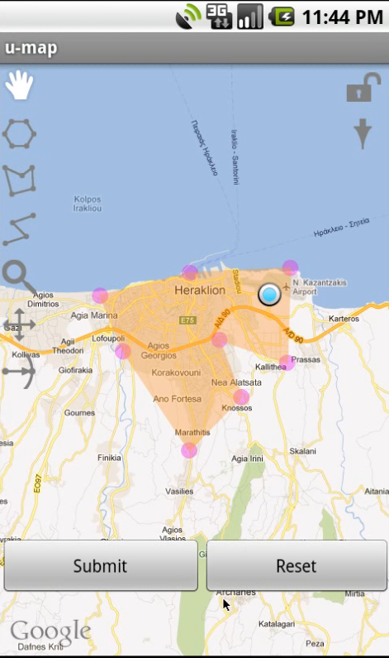
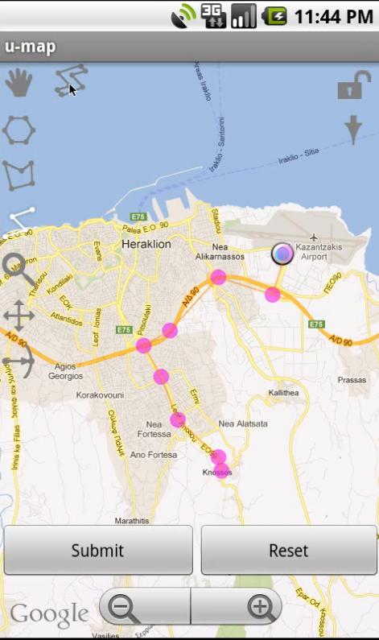

Slide 12
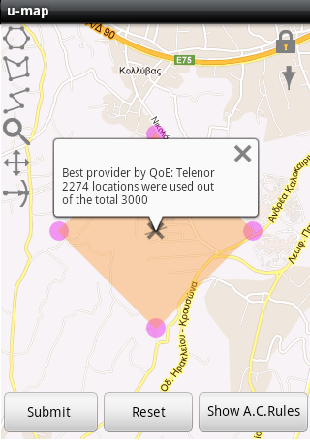
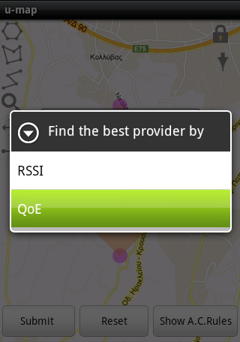
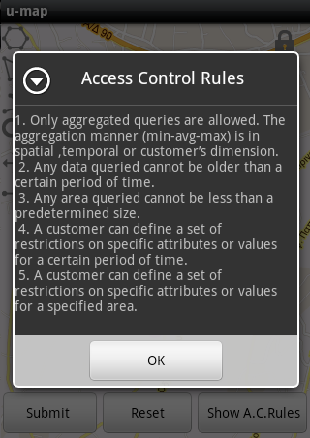

Slide 13
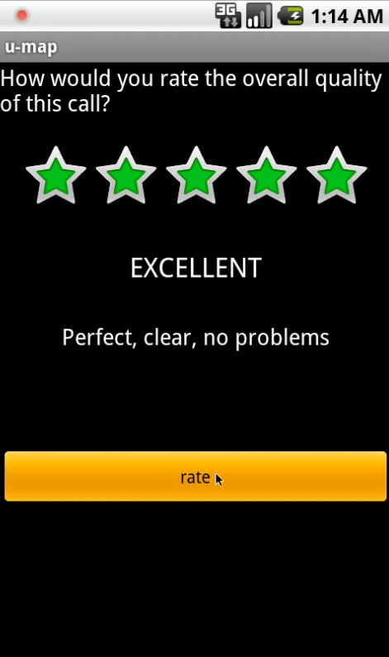
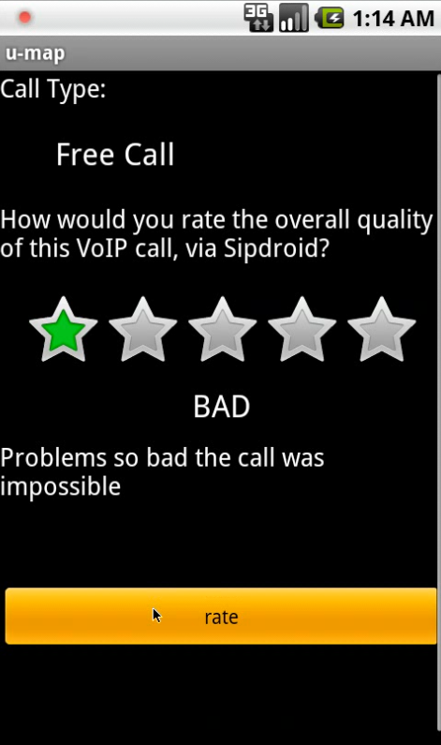
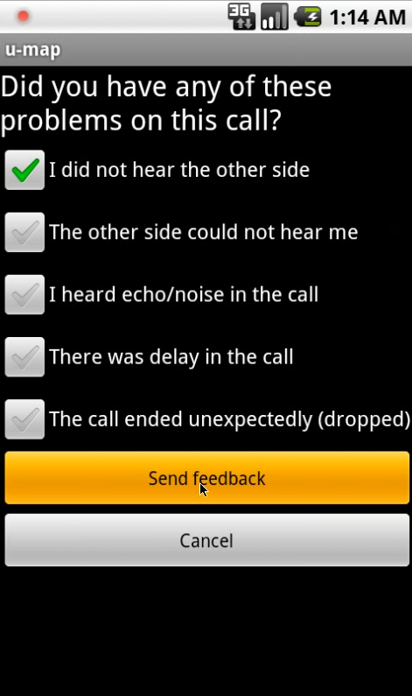
Evaluating services, reporting problems, sharing experience.

Slide 14
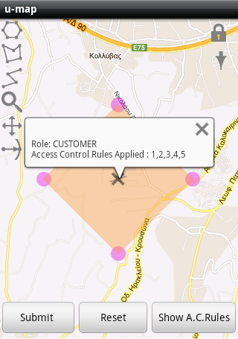

Slide 15
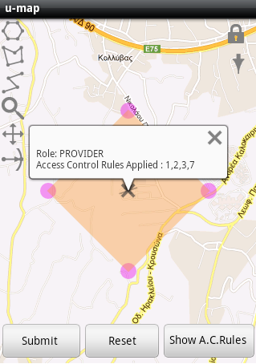
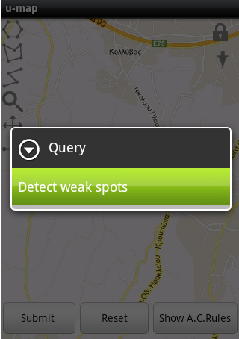
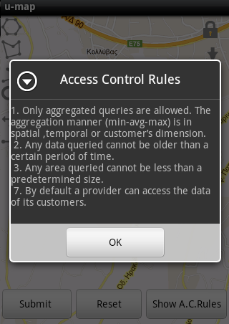

Slide 16
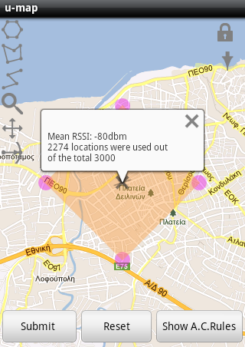

Slide 17
Via the u-map, an operator can learn its strengths & weaknesses, adapt, & evolve.
Customer profiling, clustering …
Technical: QoS & QoE issues …
Business: marketing, pricing, strategy, …
advertise its performance
Transparency: the “good operator” model
Notes:
Using the data collected from the roaming devices as they were visiting a "foreign" network, they can assess the performance of that service provider (since the collected information could indicate possible weakness/problems of the infrastructure of that operator). This information can reveal cues about how to change/extend/strengthen their "coalitions" with other operators.

Slide 18
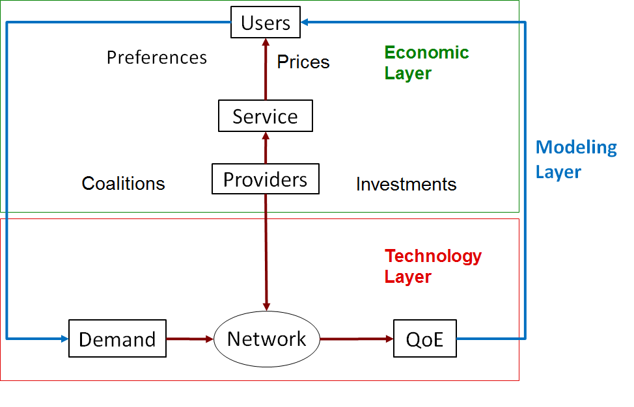
Based on the requirements for realism, accuracy, scalability,
model the entities at the appropriate scale.
[Ref. diagram by Walrand. ]

Slide 19
Motivation
Customers perform educated selection of appropriate provider
Improve wireless access
Providers are aware of user opinion for their services
Enhance capacity planning, design appropriate services
Regulators analyze network measurements
Check if providers/customers comply with spectrum access rules

Slide 20
Main contributions
Develop u-map, a geo-database with customer feedback on:
QoE of services
Traffic demand
User profile
Spectrum conditions
Position
Introduce flex service: Users select provider/BS on a per session basis
Develop modeling framework & simulation platform to assess impact of u-map and flex service on wireless access markets

Slide 21
Related work (1/2)
Databases with physical layer information:
Open spectrum approach (Karlsson et al. [ACM CFI 10])
User feedback: Providers improve infrastructure/reduce interference
Geo-database for TV-bands (Gurney et al. [IEEE DySPAN 08])
Regulators correct interference problems
U-map integrates a richer set of data
Cross-layer measurements, user preferences and constraints

Slide 22
Related work (2/2)
Mobile phones sharing measurements:
Micro-blog (Gaonkar et al.[ACM MobiSys 08])
Cameras, GPS, accelerometers, health monitors
MyExperience (Froehlich et al. [ACM MobiSys 07])
Device usage, user context info, environmental measurements
U-map aims to improve wireless access markets

Slide 23
Roadmap
Motivation
Related work
U-map system
Architecture
Testbed
Performance evaluation
Modeling and simulation
Conclusions and future work

Slide 24
U-map
Follows client-to-server architecture
U-map client: Runs on mobile devices
Collects network measurements
Stores measurements in traces locally
Uploads traces to u-map server
Performs queries to u-map server to obtain information
U-map server:
Collects traces from mobile devices
Stores traces in spatio-temporal geo-database
Responds to queries sent by users, providers, and regulators
Applies appropriate access control and user privacy rules

Slide 25
Example of u-map
To start a session, select any BS of either provider in range
Flex User
Provider 2
1. Users query u-map
for the best provider
in a region
2. Response
to query
U-map server
A2. Regularly upload
traces with network
& QoE measurements
BS of Provider 1
U-map client
A1. Record network performance & QoE scores locally
Provider 1
Subscriber
of Provider 1
Providers query for their QoS &
coverage in regions
Regulators query about QoS &
coverage of various providers
To start a session
select any BS of
provider 1 in range
Provider 2
BS
Provider 1
BS

Slide 26
U-map architecture
PHP
application
PostgreSQL
Server
Storing
Certificate authority
Access control
Retrieval
Security & privacy
Database
U-map server
Back-end interface
Energy
Battery consumption
Position
GPS
Monitor
RSSI(802.11)
Wireless network
Performance
estimator
RSSI (GSM)
Phone state listener
GSM receiver
QoE
Sipdroid App
Sipdroid receiver
Upload traces
Save traces
. . .
Streaming service
1
OrmLite
. . .
Queries
Other services
SQLite
GUI
QoE score
U-map client
User feedback
Android device

Slide 27
U-map architecture
PHP
application
PostgreSQL
Server
Storing
Certificate authority
Access control
Retrieval
Security & privacy
Database
U-map server
Back-end interface
Energy
Battery consumption
Position
GPS
Monitor
RSSI(802.11)
Wireless network
Performance
estimator
RSSI (GSM)
Phone state listener
GSM receiver
QoE
Sipdroid App
Sipdroid receiver
Upload traces
Save traces
. . .
Streaming service
1
OrmLite
. . .
Queries
Other services
SQLite
GUI
QoE score
U-map client
User feedback
Android device

Slide 28
U-map architecture
PHP
application
PostgreSQL
Server
Storing
Certificate authority
Access control
Retrieval
Security & privacy
Database
U-map server
Back-end interface
Energy
Battery consumption
Position
GPS
Monitor
RSSI(802.11)
Wireless network
Performance
estimator
RSSI (GSM)
Phone state listener
GSM receiver
QoE
Sipdroid App
Sipdroid receiver
Upload traces
Save traces
. . .
Streaming service
1
OrmLite
. . .
Queries
Other services
SQLite
GUI
QoE score
U-map client
User feedback
Android device

Slide 29
U-map server
PHP
application
PostgreSQL
server
Storing
Certificate authority
Retrieval
Access control
Security & privacy
Database
U-map server
U-map client

Slide 30
U-map client
Back-end interface
Energy
Battery consumption
Position
GPS
Monitor
RSSI(802.11)
Wireless network
Performance
estimator
RSSI (GSM)
Phone state listener
GSM receiver
Sipdroid App
QoE
Sipdroid receiver
Save traces
Upload traces
. . .
Streaming service
1
OrmLite
. . .
Queries
Other services
SQLite
GUI
QoE score
U-map client
User feedback
Android device

Slide 31
U-map client
Back-end interface
Energy
Battery consumption
Position
GPS
Monitor
RSSI(802.11)
Wireless network
Performance
estimator
RSSI (GSM)
Phone state listener
GSM receiver
Sipdroid App
QoE
Sipdroid receiver
Save traces
Upload traces
. . .
Streaming service
1
OrmLite
. . .
Queries
Other services
SQLite
GUI
QoE score
U-map client
User feedback
Android device

Slide 32
U-map client
Back-end interface
Energy
Battery consumption
Position
GPS
Monitor
RSSI(802.11)
Wireless network
Performance
estimator
RSSI (GSM)
Phone state listener
GSM receiver
Sipdroid App
QoE
Sipdroid receiver
Save traces
Upload traces
. . .
Streaming service
1
OrmLite
. . .
Queries
Other services
SQLite
GUI
QoE score
U-map client
User feedback
Android device

Slide 33
U-map client
Back-end interface
Energy
Battery consumption
Position
GPS
Monitor
RSSI(802.11)
Wireless network
Performance
estimator
RSSI (GSM)
Phone state listener
GSM receiver
Sipdroid App
QoE
Sipdroid receiver
Save traces
Upload traces
. . .
Streaming service
1
OrmLite
. . .
Queries
Other services
SQLite
GUI
QoE score
U-map client
User feedback
Android device

Slide 34
U-map client
Back-end interface
Energy
Battery consumption
Position
GPS
Monitor
RSSI(802.11)
Wireless network
Performance
estimator
RSSI (GSM)
Phone state listener
GSM receiver
Sipdroid App
QoE
Sipdroid receiver
Save traces
Upload traces
. . .
Streaming service
1
OrmLite
. . .
Queries
Other services
SQLite
GUI
QoE score
U-map client
User feedback
Android device

Slide 35
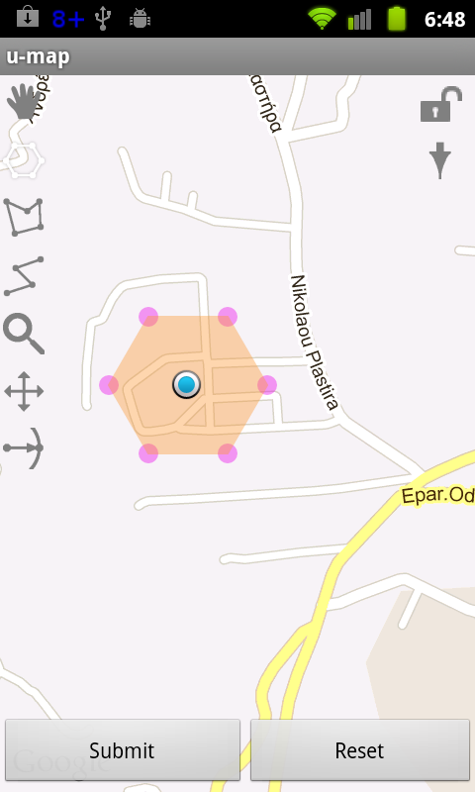
U-map client GUI: Define area for query to discover the best provider
Notes:
To discover the best provider

Slide 36
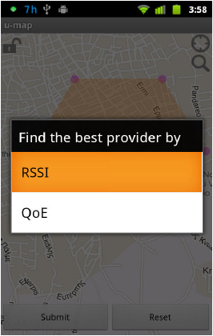
U-map client GUI: Choose criterion

Slide 37
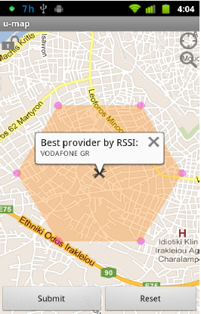
U-map client GUI: Display result

Slide 38







U-map performance evaluation: Delays, scalability, power consumption
WLAN
switch
u-map client
(Android)
External monitor
AP
u-map server
T₁
client request generation
T₂
T₃
response generation
T₅
T₄
response display generation
T₆
time

Slide 39
WLAN
switch
u-map client
(Android)
External monitor
AP
u-map server
T₁
client request generation
T₂
T₃
T₃
response generation
T₄
T₄
T₅
response display generation
T₆
time
Server delay: Time for reception of request & transmission of response (T₄-T₃)

Slide 40
WLAN
switch
u-map client
(Android)
External monitor
AP
u-map server
T₁
client request generation
T₂
T₂
T₃
T₃
response generation
T₄
T₄
T₅
T₅
response display generation
T₆
time
Network delay: Time for request to reach server & response to reach client
(T₃-T₂ + T₅-T₄)

Slide 41
WLAN
switch
u-map client
(Android)
External monitor
AP
u-map server
T₁
T₁
client request generation
T₂
T₂
T₃
response generation
T₅
T₄
T₅
response display generation
T₆
T₆
time
Android delay: Time for request generation & display of response (T₂-T₁ + T₆-T₅)

Slide 42
WLAN
switch
u-map client
(Android)
External monitor
AP
u-map server
T₁
T₁
client request generation
T₂
T₃
response generation
T₄
T₅
response display generation
T₆
T₆
time
Total Delay: Total delay user experiences (T₆-T₁)

Slide 43
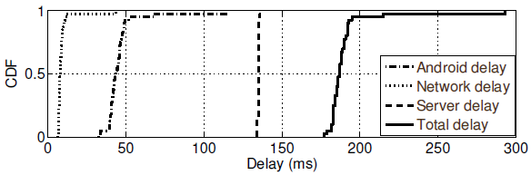
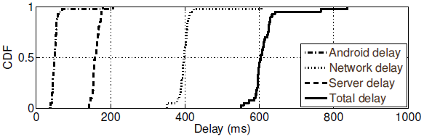
U-map performance: Delays
Sending queries
Uploading traces

Slide 44
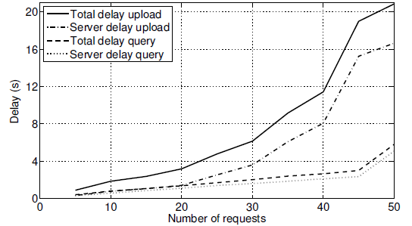
U-map performance: Scalability
Desktop PC emulating concurrent u-map clients
Prominent increase due to memory requirements

Slide 45
U-map performance: Power consumption
Recorded with PowerTutor application
IEEE802.11 wireless interface
OLED display
CPU
Power consumption under operations
transmitting queries
OLED display prevails by 97% (401 mW)
uploading traces
Wireless interface prevails by 97% (412 mW)

Slide 46
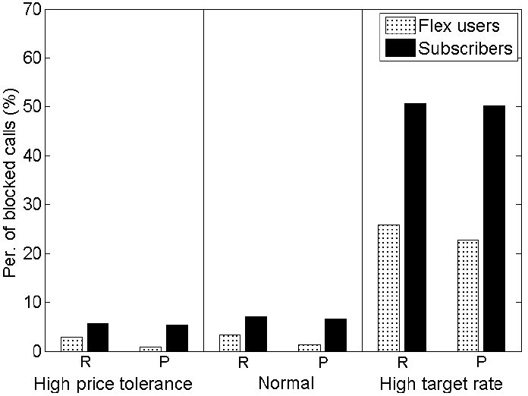
Per. of blocked sessions (%)
☞ Flex users: Almost half blocking probability compared to subscribers

Slide 47
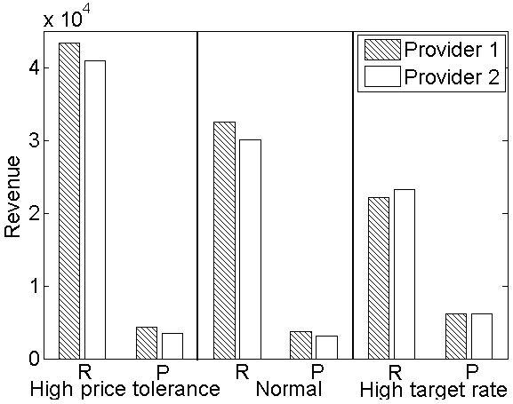
Rate preference: revenue increases
Rate preference: Revenue decreases
Price preference: Revenue increases
☞ Higher revenue in rate preference compared to price preference

Slide 48
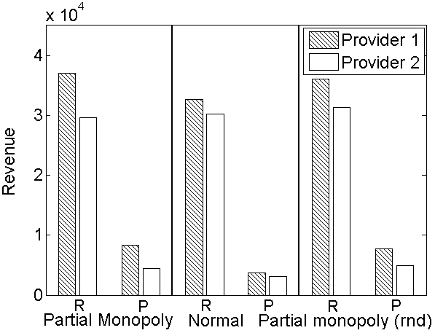
.
Price preference: Revenue increases
☞ Higher revenue in rate preference compared to price preference

Slide 49
Conclusions
Performance evaluation of u-map
Low delays and power consumption
Feasibility of u-map in real environment
Modeling and simulation
U-map is beneficial to users
Flex service improves performance of users

Slide 50
Ongoing and future work
Extend modeling framework
Various spatial distribution, mobility, and traffic demand patterns
More realistic modeling of the u-map
Develop the access control mechanism
Study the impact of incentives for users to contribute to the u-map
Altruism, reputation, payment, free services
Extend the performance analysis of the u-map
Software-defined radio to emulate “virtual providers”
Perform statistical analysis of historical u-map traces
Detect “weak spots” of providers coverage

Slide 51
Thank you for your attention !
More info:
Relevant publications at
http://www.ics.forth.gr/mobile

Slide 52
Backup Slides

Slide 53
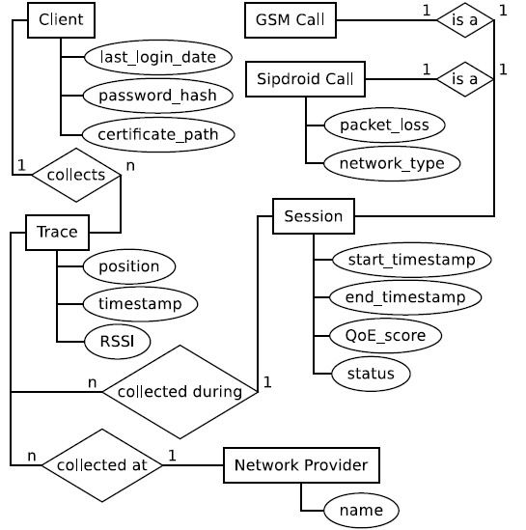
U-map database ER Model

Slide 54
U-map queries
Customers
Best provider by RSSI value in specified area/time period
Best provider by QoE score of a service in specified area/time period
Providers
Average QoE score of their customers in specified area/time period
Average RSSI value of their customers in specified area/time period
Regulators
Average RSSI value of any provider in specified area/time period

Slide 55
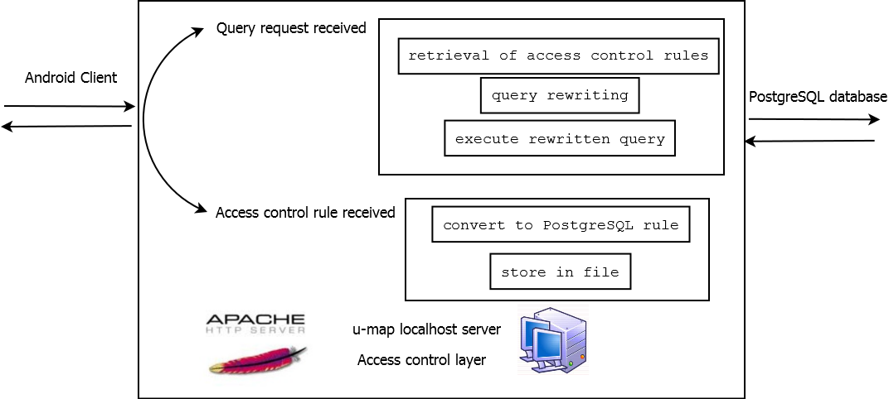
Notes:
For the implementation of the access control rules the query rewriting technique is applied over the PostgreSQL queries of the android u-map client. This technique adds a layer of protection to the user’s data by adding the appropriate PostgreSQL code. This change to the PostgreSQL queries is done without the knowledge or choice of the android u-map client.
To achieve this change to the PostgreSQL queries the use of PostgreSQL EXCEPT command is used to restrict the access to the tables of the database which have the information for the signal strength measurements in the mobile device in a specified area and for a specified period of time.

Slide 56
SELECT AVG(traces) FROM table.traces
WHERE area_contains(traces.position) AND area> predetermined_size
SELECT AVG(traces) FROM table.traces WHERE area_contains(traces.position) AND area> predetermined_size AND TimePeriod(recent)

