Slide 1



Performance issues on wireless networks
CS 439 & 539
Prof. Maria Papadopouli
University of Crete
ICS-FORTH
http://www.ics.forth.gr/mobile

Slide 2
Wireless network topologies can be controlled by
Data rate
Channel allocation: different devices communicate at different channels
In some cases, there is a channel dedicated for the control (management) and message exchange
Transmission power (power control)
Carrier sense threshold
Directional antennas
Cognitive intelligent radios & software defined radios
Node placement
Different network architectures/deployments (e.g., mesh networks, infrastructure-based, ad hoc)

Slide 3
IEEE 802.11 Rate Adaptation
The 802.11 a/b/g/n standards allow the use of multiple transmission rates
  802.11b, 4 rate options (1,2,5.5,11Mbps)
  802.11a, 8 rate options (6,9,12,18,24,36,48,54 Mbps)
  802.11g, 12 rate options (11a set + 11b set)
The method to select the transmission rate in real time is called “Rate Adaptation”
Rate adaptation is important yet unspecified by the 802.11 standards

Slide 4
IEEE 802.11 Rate Adaptation
IEEE802.11b
11, 5.5, 2, 1 Mbps
IEEE802.11a
6, 9, 12, 18, 24, 36, 48, 54 Mbps
IEEE802.11g
802.11b rates + 802.11a rates
Most of existing wireless radios are able to support multiple transmission rates by a combination of different modulation and coding rates

Slide 5
IEEE802.11 Bitrate Adaptation
When a sender misses 2 consecutive ACK
Drops sending rate by changing modulation or channel coding method
When 10 ACKs are received successfully
☞ Transmission rate is upgraded to the next higher data rate

Slide 6
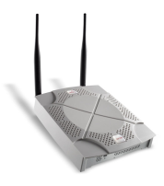

Rate adaptation example
Signal becomes weaker
54Mbps
Signal is good
12Mbps
Sender
Receiver
Ideally, the transmission rate should be adjusted according to the channel condition

Slide 7
Throughput Degradation due to
Rate Adaptation
Example
Some hosts may be far way from their AP so that the quality of their radio transmission is low
Current IEEE802.11 clients degrade the bit rate from the nominal 11Mbps to 5.5, 2, 1Mbps
 Such degradation also penalizes fast hosts and privileges the slow one

Slide 8
Throughput Degradation due to
Rate Adaptation - Intuition
In 802.11b: every node gets the same chance to access the network
When a node grabs the medium, it can send the same sized packet
(regardless of its rate)
So fast and slow senders will both experience low throughput
CSMA/CA:
Basic channel access method guarantees the long-term channel access probability to be equal among all hosts
When one host captures the channel for a long time,
because its bit rate is low, it penalizes other hosts that use the
higher rate

Slide 9
Example
N nodes transmitting at 11 Mb/s
1 node transmitting at 1 Mb/s
 All the node only transmit at a bitrate < 1 Mbps !

Slide 10
Performance Degradation due to Bit Rate Adaptation of the IEEE802.11
The throughput is not related to the sending rate of a node because
  All nodes have the same transmission time &frame size
☞ Thus fast hosts see their throughput decreases roughly to the order of magnitude of the slow host’s throughput
The fair access to the channel provided by CSMA/CA causes
  Slow host transmitting at 1Mbps to capture the channel eleven times longer than hosts emitting at 11Mbps
☞ This degrades the overall performance perceived by the users in the considered cell

Slide 11
Possible Improvements
☞ Keep good aspects of DCF
No explicit information exchange
Backoff process
Proposed modifications
No exponential backoff procedure
Make hosts use similar values of CW
Adapt CW to varying traffic conditions
☞ More hosts, bigger CW; less hosts smaller CW

Slide 12
IEEE 802.11 Rate Adaptation
The 802.11 a/b/g/n standards allow the use of multiple transmission rates
  802.11b, 4 rate options (1,2,5.5,11Mbps)
  802.11a, 8 rate options (6,9,12,18,24,36,48,54 Mbps)
  802.11g, 12 rate options (11a set + 11b set)
The method to select the transmission rate in real time is called “Rate Adaptation”
Rate adaptation is important yet unspecified by the 802.11 standards

Slide 13
Rate adaptation example
Signal becomes weaker
54Mbps
Signal is good
12Mbps
Sender
Receiver
Ideally, the transmission rate should be adjusted according to the channel condition

Slide 14
Importance of rate adaptation
Rate adaptation plays a critical role to the throughput performance
  Rate too high → loss ratio increases → throughput decreases
  Rate too low → under-utilize the capacity → throughput decreases

Slide 15
Impact of Rate Adaptation
Rate adaptation plays a critical role to the throughput performance:
Rate too high → loss ratio ↑ → throughput ↓
Rate too low → capacity utilization ↓ → throughput ↓

Slide 16
Client AP selection
Select the appropriate AP based on various criteria to optimize the service
For that the client needs to
Perform probing/measurements to estimate various criteria

Slide 17
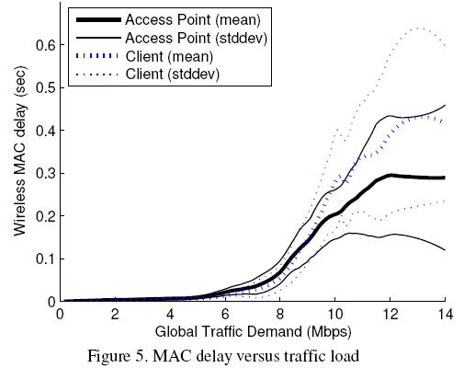
Measuring Network Load
Dynamic nature of traffic
  Dynamic number of clients & bandwidth demand
Channel Utilization
Transmit Queue Length
  Easy to measure
  Highly variable
MAC/Packet Delay
  Transmit queue and channel contention time measured
  Most attractive – very steady readings

Slide 18
Measuring network load – tuning parameters
Load average
Calculated using a moving average to negate small changes
Shrinking the averaging interval
  Causes the system to converge on the maximum global throughput quickly
  excessive channel switching
Increasing the averaging interval
  Slower convergence
  Less time wasted switching channels

Slide 19
Heterogeneous wireless networks
Crowded ISM band
e.g., coexistence of wireless LANs and wireless sensor networks

Slide 20
IEEE802.15.4 wireless sensor network coexisting with an IEEE 802.11 WLAN
The transmission power of WLAN terminals is orders of magnitude higher
than that of co-existing WSN
The WLAN terminals are “blind” towards WSN transmissions
WSN transmissions: lower power, narrow band
WLAN causes harmful interference in the WSN, while itself remains
unaffected from the WSN interferers
WSN nodes can avoid WLAN interference, and thus, costly packet retransmissions,
only if they are armed with cognitive capabilities
i.e., optimize their transmission parameters and communication protocols accordingly
In the case of WLAN interferers, the sensors force the WLAN to
backoff by sending short, high power jamming signals

Slide 21
Wireless channel exhibits rich channel dynamics in practical scenarios
  Random channel error
  Mobility-induced change
  Collisions induced by
    Hidden-terminals
    Multiple contending clients

Slide 22
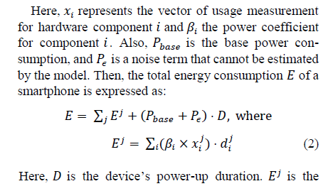
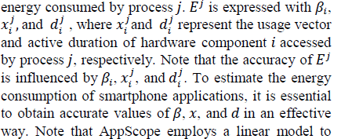
Power & energy models
Power consumption P of a device is expressed:
x_{i}: usage vector
d_{i}: active duration
Pbase: base power consumptions

Slide 23
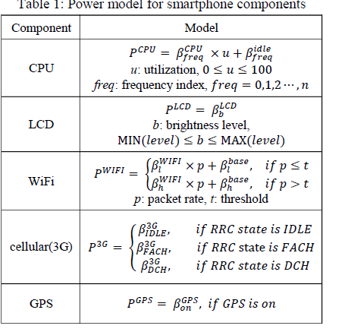
FACH: forward access channel
Reaches this state when data communication starts
IDLE: when there is no data being sent or receive
DCH: while data is being sent or received

Slide 24
Reference: Snooze: Energy Management in 802.11n WLANs
A discussion on Energy Management with
IEEE 802.11n
by Ki-Young Jang, Shuai Hao, Anmol Sheth, Ramesh Govindan
Notes:
24

Slide 25
The purpose of IEEE 802.11n is to improve network throughput over the previous standards IEEE 802.11a and 802.11g
with a significant increase in the maximum net data rate from 54 Mbit/s to 600 Mbit/s.
Notes:
Nowadays, Wi-Fi technology has become commonplace in our daily lives.
We have seen several generations of Wi-Fi with each generation improving performance. Most recently, 802.11n, which has a data rate upto 450 Mbps or 8x speedup compared to 11a/g, is becoming available in many mobile consumer devices like the iPad, iPhone 4, and Samsung Galaxy S.
As their performance has increased, the energy usage of 802.11 interfaces increased. In order to improve usability and lifetimes of mobile devices, we need to manage performance and energy usage carefully.
25

Slide 26
IEEE 802.11n features
Multiple-input multiple-output(MIMO)
Frame aggregation on MAC layer
40 MHz channels to the physical layer
Security improvements
MIMO uses multiple antennas to coherently resolve more information than possible using a single antenna

Slide 27
IEEE 802.11n energy usage
Has additional power states
Beyond a low-power sleepmode, it offers the possibility of selectively disabling one or more RF-front ends (RF-chains) associated with its antennas, thereby saving energy
Micro-sleeping: enables the IEEE 802.11n NIC to be put into low-power sleep state for small intervals of time (often a few milliseconds)
Antenna configuration management which dynamically adapts the number of powered RF-chains.
Notes:
To understand our work, it is important to understand how 11n differs from and how it is similar to previous generations in terms of energy usage.
First, like previous generations, 11n sleep energy usage is very small compared to transmit, receive or idle costs. So, one way to save energy is to put the network interface to sleep whenever it is not being used.
11n is different from previous generations in the use of MIMO technology: multiple input multiple output. As its name suggests, MIMO can use multiple antennas for both transmission and reception. Such hardware advances not only provide much higher transmit data rates but also improve wireless reception rate.
On the other hand, these additional antennas also draw more power from the device in an interesting way, compared to the legacy 11a/b/g NICs.
Here is the energy consumption table for Intel Wi-Fi card with 3x3 MIMO. When more than one antenna is used, the power consumption for tx is 1.5x higher for two antennas and 1.6 for 3. Similarly, the power profile for rx state is 1.3 and 1.7 times higher for 2 and 3 antennas, respectively, which translates upto 30 percent of peak power consumption of the whole platform like tablets.
Thus, unlike its previous generations, for 802.11n, energy savings can be obtained by carefully managing the number of antennas used.
We now quantify the benefits obtainable by putting the interface to sleep, and by managing the number of antennas.
27

Slide 28
Key idea: Antenna configuration should be adaptive
based on traffic demand and link quality.
Shapes traffic to create sleep opportunities
  Minimal impact on traffic
  Minimizes the number of active clients
Manages antenna configurations
  Minimizes antennas needed

Slide 29
General advice: An approach for systems research
Hypothesize about requirements based on potential applications
Explore design space based on these requirements
Develop hardware platform for experimentation
Build test applications on top of hardware platform
Evaluate performance characteristics of applications
GOTO step 1 (hopefully you’ll come up with a better set of requirements)

Slide 30
Autonomous Networking Systems
Operate with minimum human intervention
Capable of
  Detecting impending violations of the service requirements
  Reconfiguring themselves
  Isolating failed or malicious components

Slide 31
Issues in Wireless Networks
Performance
throughput, delay, jitter, packet losses, “user satisfaction”
(i.e., QoE)
Connectivity
roaming, coverage, capacity planning
Security
various types of attacks, vulnerabilities, privacy issues

Slide 32
Issues in Wireless Communications
Deal with fading and interference
Increase the reliability of the air interface
increase the probability of a successful transmission
Increase the spectral efficiency

Slide 33
Wireless Network – Performance Improvement
Parameters for Control
Data rate
Channel
Network interfaces & overlay networks
Transmission power
Carrier sense threshold
Directional antennas, cognitive intelligent radios, software-defined radios
Node placement
Architectures
MAC protocols
Markets, coallitions among operators, various services
Mechanisms
Dynamic adaptation
  Online, on-the-fly
Capacity planning
  Proactive, offline

Slide 34
Increasing capacity
Efficient spectrum utilization issue of primary importance
Increase capacity and mitigate impairments caused by
  Fading, delay spread co-channel interference
  Use multiple-antenna systems
At the physical layer, advanced radio technologies, such as
  Physical layer techniques (e.g., OFDM, and for small distances UWB)
  reconfigurable and frequency-agile radios
  multi-channel and multi-radio systems
  directional and smart antennas (e.g., multiple antenna)
  Antenna diversity
Need to be integrated with the MAC and routing protocols
New access paradigms & markets!

Slide 35
Performance of Wireless Networks
Spectrum
Limited wireless spectrum
Capacity limits (Shannon theorem)
Parts of the spectrum are underutilized
The spectrum is a valuable resource
Wireless networks are more vulnerable than the wired ones
Large growth of applications & services with real-time constraints and demand of high bandwidth

Slide 36
Wireless Networks - Challenges
☞ Wireless networks are very complex
Have been used for many different purposes
Non-deterministic nature of wireless networks due to
  Exogenous parameters
  Mobility
  Radio propagation characteristics
  wireless channels can be highly asymmetric and time varying
Difficult to
  Capture their impact on its performance
  Monitor large-scale wireless networks
  Predict wireless demand
☹Interaction of different layers & technologies creates many situations that cannot be foreseen during design & testing stages of technology development

Slide 37
Spectrum Utilization (1/2)
Studies have shown that there are frequency bands in the spectrum largely unoccupied most of the time while others are heavily used
Cognitive radios have been proposed to enable a device to access a spectrum band unoccupied by others at that location and time

Slide 38
Spectrum Utilization (2/2)
Cognitive radio: intelligent wireless communication system that is
    Aware of the environment
    Adapt to changes aiming to achieve:
      reliable communication whenever needed
      efficient utilization of the radio spectrum
Their commercialization has not yet been fully realized
  Most of them still in research & development phases
  Cost, complexity, and compatibility issues

Slide 39
Improvement at MAC layer
To achieve higher throughput and energy-efficient access, devices may use multiple channels instead of only one fixed channel
Depending on the number of radios & transceivers, wireless network interfaces can be classified:
Single-radio MAC
  Multi-channel single-transceiver
  Multi-channel multi-transceiver
Multi-radio MAC

Slide 40
Multiple Radio/Transceivers
Multi-channel single-transceiver MAC
  One tranceiver available at network device
  Only one channel active at a time in each device
Multi-channel multi-transceiver MAC
  Network device with multiple RF front-end chips & baseband processing modules to support several simultaneous channels
  Single MAC layer
  controls & coordinates the access to multiple channels
Multi-radio MAC
  network device with multiple radios
  each with its own MAC & physical layer

Slide 41
Spectrum Division
Non-interfering disjoint channels using different techniques:
  Frequency division
    Spectrum is divided into disjoint frequency bands
  Time division
  channel usage is allocated into time slots
  Code division
    Different users are modulated by spreading codes
  Space division
    Users can access the channel at
      the same time
      the same frequency
      by exploiting the spatial separation of the individual user
Multibeam (directional) antennas
used to separate radio signals by pointing them along different directions

Slide 42
Dynamic Adaptation
Monitor the environment
Relate low-level information about resource availability with network conditions to higher-level functional or performance specifications
Select the appropriate
  Network interface
  Channel
  AP
  Power transmission
  Bitrate

Slide 43
Channel Switching
Fast discovery of devices across channels
Fairness across active flows & participants
Accurate measurements of varying channel conditions
Infrequent changes in the connectivity between devices

Slide 44
Channel or Network Selection
Static or dynamic
Based on various criteria
  Traffic demand
  Channel quality
  Bandwidth and round-trip-time estimations
  Application requirements
  Registration cost
  Admission control

Slide 45
Challenges in Channel & Network Selection
☞ In order to be effective, channel/network selection require accurate estimation of channel conditions in the presence of dynamics caused by
      fading
      mobility
      hidden terminals
This involves:
  distributed and collaborative monitoring
  analysis of the collected measurements
Their realization in an energy-efficient on-the-fly manner opens up several research challenges

Slide 46
Capacity Planning Objectives
Provide sufficient coverage and satisfy demand
  consider the spatio-temporal evolution of the demand
Typical objectives:
  minimization of interference
  maximization of coverage area & overall signal quality
  minimization of number of APs for providing sufficient coverage
While over-provisioning in wired networks is acceptable,
it can become problematic in wireless domain

Slide 47
Capacity planning (1/2)
Unlike device adaptation that takes place dynamically,
  capacity planning determines proactively the
  AP placement
  Configuration (frequency, transmission power, antenna orientation)
  AP administration
  On power transmission
  ☞ trade-off between energy conservation & network connectivity

Slide 48
Capacity Planning: Power Control
Reducing transmission power, lowers the interference
  Reduces
    Number of collisions
    Packet retransimissions due to interference
  Results in a
    Smaller number of communication links
    Lower connectivity
☞ trade-off between energy conservation & network connectivity

Slide 49
Power Control
Integral component of capacity planning
Aims to control
spectrum spatial reuse, connectivity, and interference
Adjust the transmit power of devices, such that their SINR meets a certain threshold required for an acceptable performance

Slide 50
Connectivity Problems
Reflect lack of sufficient wireless coverage
An end user may observe degraded performance
  e.g., low throughput or high latency
due to:
  Wired or wireless parts of the network
  Congestion in different networking components
  Slow servers

Slide 51
Roaming (1/2)
Handoff between APs and across subnets in wireless LANs can consume from one to multiple seconds as associations and bindings at various layers need to be re-established
Examples of sources of delay include
  Acquiring new IP addresses, with duplicate address detection
  Re-establishing associations
  Discovering possible APs
    Without scanning the whole frequency range

Slide 52
Roaming (2/2)
The scanning in a handoff
  Primary contributor to the overall handoff latency
  Can affect the quality of service for many applications
  Can be 250ms or more
  Far longer than what can be tolerated by highly interactive applications (i.e. voice telephony)

Slide 53
Security Issues
Involve the presence of rogue APs & malicious clients
In mobile wireless networks, it is easier to
  disseminate worms, viruses, false information
  eavesdrop
  deploy rogue or malicious software or hardware
  attack, or behave in a selfish or malicious manner
Attacks may
  occur @ different layers aiming to exhaust the resources
  promise falsely to relay packets
  not respond to requests for service

Slide 54
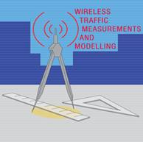
Monitoring
Depending on type of conditions that need to be measured, monitoring needs to be performed at
    Certain layers
    Spatio-temporal granularities
Monitoring tools
  Are not without flaws
  Several issues arise when they are used in parallel for thousands devices of different types & manufacturers:
    Fine-grain data sampling
    Time synchronization
    Incomplete information
    Data consistency

Slide 55
Issues in Data Collection
Synchronization
Skew of the clocks
  affected via various external parameters
  e.g., temperature, voltage, electromagnetic interference
Synchronization can be done using Network Time Protocol (NTP) & Precision Time Protocol (PTP)
Data Consistency
Differences in how various monitoring tools record the data
Incomplete information
Monitoring tools fail to capture different parameters due to misconfigurations, failures, limited functionality

Slide 56
Challenges in Monitoring (1/2)
Identification of the dominant parameters through
  sensitivity analysis studies
Strategic placement of monitors at
  Routers
  APs, clients, and other devices
Automation of the monitoring process to reduce human intervention in managing the
    Monitors
    Collecting data

Slide 57
Challenges in Monitoring (2/2)
Aggregation of data collected from distributed monitors to improve the accuracy while maintaining low overhead in terms of
    Communication
    Energy
Cross-layer measurements, collected data spanning from the physical layer up to the application layer, are required

