Slide 1


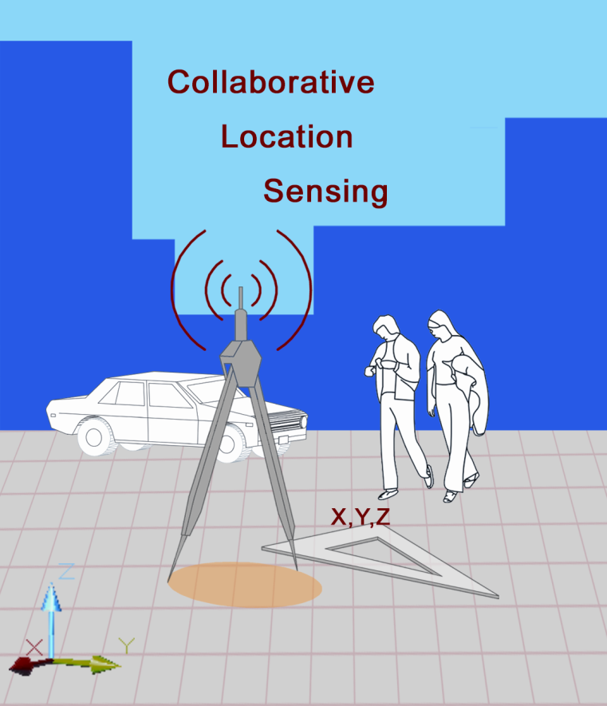


Fingerprint-based
Maria Papadopouli
Associate Professor
University of Crete, FORTH, and KTH
http://www.ics.forth.gr/mobile/
mgp@ics.forth.gr
Joint research with
D. Milioris, A. Papakonstantinou G. Tzagkarakis, and Panos Tsakalides
University of Crete and FORTH
Seminar at SICS, September 18th, 2012

Slide 2
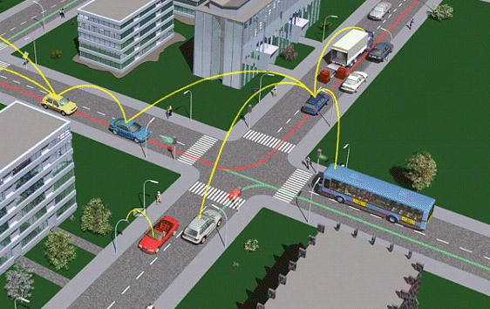
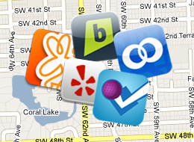
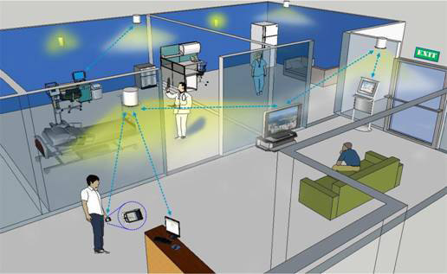
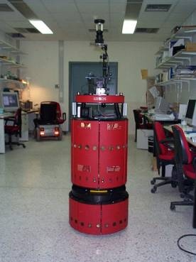
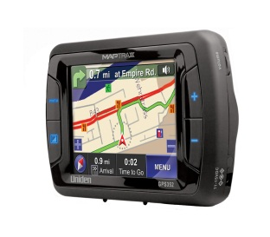
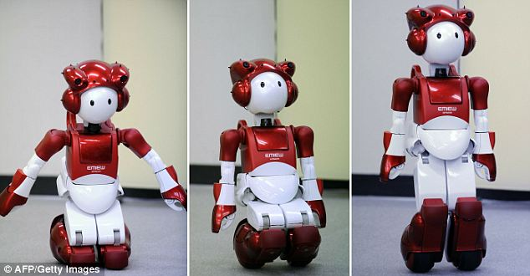
Plethora of social networking location-based applications
Fast growth of location-based services
e.g., 74% of US smartphone owners use location-based services
Several positioning systems have been proposed

Slide 3
Taxonomy of Positioning Systems
Infrastructure & hardware
Signal modalities
Models & algorithms for estimating distances, orientation, position
Coordination system, scale and position description
Localized or remote computations
Mechanisms for device identification, classification or recognition
Cost, accuracy & precision requirements
  Radio (Radar, Ubisense, Ekahau)
  Infrared (Active Badge)
  Ultrasonic (Cricket, Active Bat)
  Bluetooth
  Vision (EasyLiving)
  Physical contact with pressure (smart floor) or touch sensors

Slide 4
The main points of our research in positioning.
Use fingerprinting & design various statistical fingerprints
Not all fingerprints are created equal !
Getting real!
Challenges when experimenting under real-world scenarios
The power of compressive sensing

Slide 5
Received Signal Strength Indicator
No standardized relationship of any particular physical parameter to RSSI
No defined relationship between RSSI value & power level in mW or dBm
Vendors provide their own accuracy, granularity, and range for the actual power (measured as mW or dBm) and their range of RSSI values (from 0 to RSSI_Max).
RSSI is acquired during only the preamble stage of receiving an 802.11 frame, not over the full frame
Received Channel Power Indicator(RCPI) measures the received RF power in a selected channel over the preamble and the entire received frame, and has defined absolute levels of accuracy and resolution

Slide 6
The simplicity of RSSI Fingerprinting
Grid-based representation of physical space (cells)
RSSI measurements collected from various APs @ cells of the space
Design of the fingerprint
Two phases: the training and the runtime
  Generation of fingerprints based on measurements collected at each phase
Estimated position: the cell whose training fingerprint has the minimum distance from the runtime one

Slide 7
RSSI Statistical Fingerprinting for Positioning
Signal-strength measurements per AP
AP₁
AP_{k}
cell
Training-phase fingerprint
User
position
comparison
Distance of that cell
Run-time fingerprint

Slide 8
Examples of RSSI Statistical Fingerprints
  Confidence intervals
  Percentiles
  Empirical distribution of the RSSI measurements
  Theoretical distributions (e.g., Multivariate Gaussian)
  Compressive sensing

Slide 9
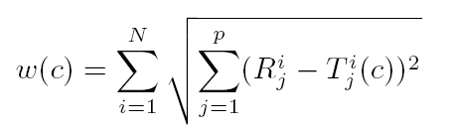
Fingerprint based on Percentiles
i
T
(c) : vector with the percentiles based on the RSSI measurements
collected during the training phase from i-th AP at cell c
j
Euclidian distance
number of percentiles
j^{th} training percentile from the i^{th} AP for cell c
number of APs
Distance of cell c
j^{th} run-time percentile from the i^{th} AP
Alternatively, K-Top weighted percentiles:
Weighted centroid of the K cells with the smallest distance

Slide 10
Fingerprint based on Empirical Distribution
A vector whose entries correspond to APs
Each entry composed by all the RSSI measurements collected per AP
Only APs that appear in both training and runtime are used
Distance: average Kullback-Leibler Divergence (KLDs)
Reported position: the cell with the smallest distance

Slide 11
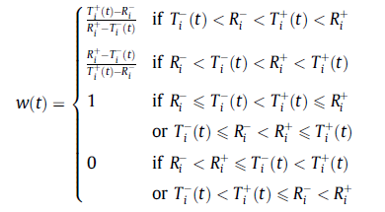
Statistical Fingerprint based on Confidence Interval
Each AP assigns a weight to cells based on the
relative “placement” of the training vs. runtime confidence intervals
AP i assigns weight w(t) to cell t

Slide 12
Fingerprint based on Multivariate Gaussian
Multivariate Gaussian for RSSI measurements collected from APs
Closed-form Kullback-Leibler Divergence (KLD) for distance estimation
Exploits the 2nd order spatial correlations between APs
Improves accuracy by iterating in multiple spatial scales (regions)

Slide 13



Multivariate Gaussian Distribution
Signature of cell i in training phase:
  mean values of the received RSSI measurements per AP
  : covariance matrix (measure of spatial correlation)
Signature of a cell in runtime phase:
APs from which measurements were collected at both training & runtime phases

Slide 14
Multi-layer Multivariate Gaussian Approach
Main idea:
Divide physical space into overlapping regions
Apply multivariate Gaussian model in each region
Select the region with the minimum distance
Iteratively
Divide the selected region into sub-regions
Repeat the process in that region
  until the current region becomes a cell
The region-based aggregation and iterative process helps to
eliminate an incorrect region
increase the weight of the correct region

Slide 15
Experiment
and it will lead you to the light
Cole Porter, 1930

Slide 16
Getting Real: Deployment of Testbeds.
At different premises:
Lab & hallway at FORTH: 7m x 12m
10 APs (~ 5.4 on average @ cell)
cell size 55cm x 55cm
Aquarium: 1760m², 40 tanks
7 APs (~ 3.4 on average @ cell)
cell size 1m x 1m
Under different conditions:
Presence of people or visitors
quiet vs. busy periods
Topological layout

Slide 17
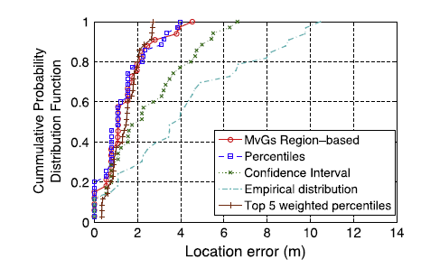
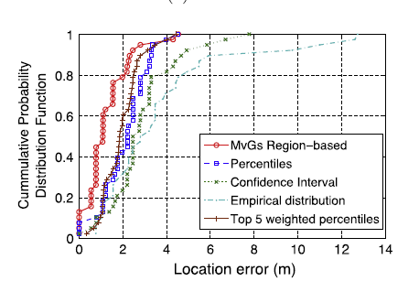
Evaluation of RSSI Fingerprint Approaches
But what do we REALLY learn from these experiments ?

Slide 18
Fingerprinting is nice, but the devil is in the detail.

Slide 19
Pathologies in fingerprint comparisons
Sensitivity to the variations in RSSI measurements
Large size of data that need to be sent by energy-constrained devices
When you suppress the noise-like features, do you still maintain the prominent information content?!
Complexity and convergence issues

Slide 20
Pathology in the comparison of confidence interval fingerprints:
Robustness with respect to RSSI Variations
Not all fingerprints are created equal: some are less robust than others.
Sensitivity to the relative position of their endpoints (boundaries) :
Even a small “displacement” may affect the value of the contribution
assigned to a specific cell

Slide 21
Second thoughts are–in most cases–wiser.
Euripides, 480-306 BC
Αι δεύτεραι πως φροντίδες σοφώτεραι.
Ευριπίδης, 480-306 π.Χ.

Slide 22
Lots of Measurements: Energy consumption vs. Accuracy
Sparsity: the transform coefficients vector has a small number of large amplitude coefficients and a large number of small amplitude coefficients
Several natural signals are often sparse in a discrete cosine transformation or in a Fourier basis
Example:
The 50 Hz powerline signal is sparse in the frequency-domain
Notes:
g είναι non-adpative γιατί ο τρόπος κατασκευής τους δεν εξαρτάται από τα χαρακτηριστικά του
σήματος, g = Φx, όπου ο Φ δε σχετίζεται π.χ. με τις στατιστικές του σήματος x.

Slide 23
Warming-up with Compressive Sensing
x: the vector with measurements
x : expressed in terms of the Ѱ basis x = Ѱ w, w: coefficients vector
x is K-sparse in Ѱ if it can be represented by K elements of this basis
Theorem:
if x is K-sparse, it can be reconstructed from M non-adaptive linear projections onto a second measurement basis (M = r K << N)
Notes:
g είναι non-adpative γιατί ο τρόπος κατασκευής τους δεν εξαρτάται από τα χαρακτηριστικά του
σήματος, g = Φx, όπου ο Φ δε σχετίζεται π.χ. με τις στατιστικές του σήματος x.

Slide 24

Compressive sensing in context
x: the vector with the RSSI measurements – x is not sparse
x can be expressed in terms of the Ѱ basis: x = Ѱ w
Ѱ: created at training
Φ: measurement matrix
Standard Gaussian
Fixed
w: indicator vector {0,1}
w is sparse
compressed form of x
Optimization problem: find the
w: indicator vector {0,1}

Slide 25
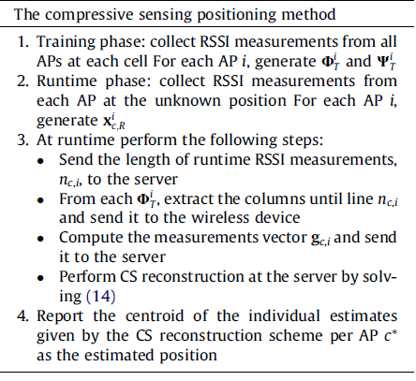


run-time
RSSI measurements
run-time
measurement matrix
compressed form
of run-time
measurements

Slide 26
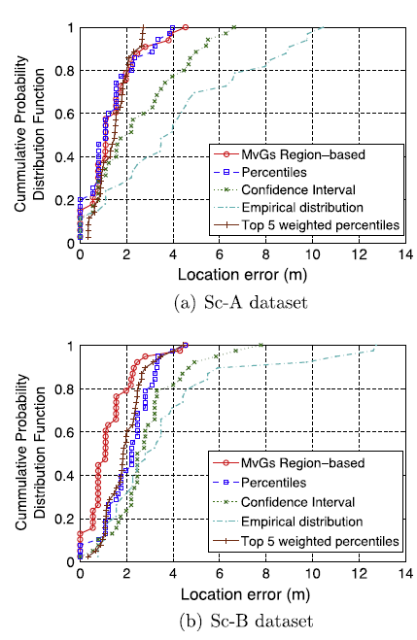
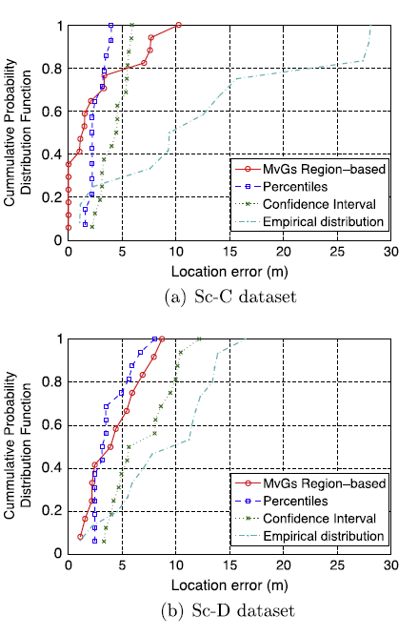

Slide 27
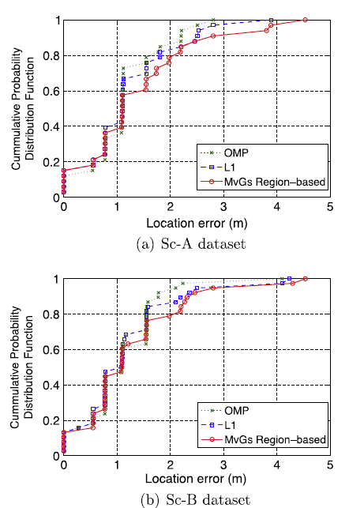
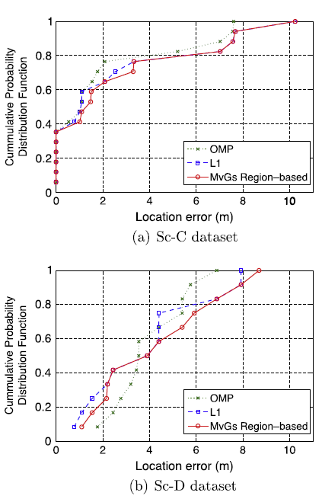

Slide 28
Lessons Learned; Thou shalt not ignore radio propagation.
The prominent impact of the presence of people and AP placement on accuracy.
A proper pre-processing of the RSSI measurements is required.
The ability to suppress the noise-like features is important.
Reduce the amount of data sent to suppress the noise-like features but maintain the prominent information content!
The iterative multi-layer spatial approach improves the accuracy by
  eliminating distant incorrect cells
  considering the neighboring cells around the user position

Slide 29
Summarizing the performance results …
With less than 20% measurements, a reasonable accuracy can be achieved
using compressive sensing (e.g., OMP)
For the L1-norm optimization problem:
Select an algorithm based on the convergence vs. accuracy tradeoff
Quiet Period
Busy Period
Premise | MvG | OMP | MvG | OMP
FORTH | 1.09 | 1.08 | 1.10 | 1.08
Aquarium | 1.48 | 1.09 | 4.15 | 3.59

Slide 30
Δεί τά μέλλοντα τοίς γεγενημένοις τεκμαίρεσθαι.
Ισοκράτης, 436-338 π.Χ.
Insight into future events is based on what happened in the past.
Isocrates, 436-338 BC

Slide 31
Exploring the Power of Compressive Sensing
New transform & measurement bases that are adaptive to the specific characteristics of the RSSI data
Exploit the random nature of the measurement vectors for encryption without the extra computational cost of a separate encryption protocol
Exploring other directions
Employing various modalities to enhance the accuracy
Reconsidering the problem of cooperative localization …

Slide 32
More information at
http://www.ics.forth.gr/mobile/
Thank you!

Slide 33
Who is afraid of real-life measurements?
At different premises:
FORTH: 7m x 12m
10 APs (~ 5.4 on average @ cell)
cell size 55cm x 55cm
Aquarium: 1760m², 40 tanks
7 APs (~ 3.4 on average @ cell)
cell size 1m x 1m
Under different conditions:
Presence of people or visitors
relatively quiet vs. busy periods
Topological layout
Quiet Period
Busy Period
Premise | MvG | OMP | MvG | OMP
FORTH | 1.09 | 1.08 | 1.10 | 1.08
Aquarium | 1.48 | 1.09 | 4.15 | 3.59

Slide 34
Lessons Learned;
How the estimations per AP are used
CS-based approach is carried out for each AP separately, using the compressed RSSI measurements, and the final estimate is given by the centroid of the individual estimated positions
The confidence interval, percentiles, and empirical distributions perform an averaging over all APs of the values of the corresponding distance function before the final location estimation
E.g., in the case of empirical distribution:
Each cell is assigned a weight which corresponds to the average KLD of each AP (at that cell) from the runtime measurements collected at the unknown position from the same AP.
Two cells with different KLD values between the individual APs may be reported erroneously to be close to each other after taking the average KLD, since the average operator eliminates the distinct contribution of each separate AP

Slide 35


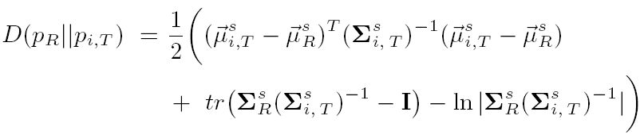
Fingerprinting based on Multivariate Gaussian (cnt’d)
Mean sub-vectors and covariance sub-matrices are extracted according to
Multivariate Gaussian density function:
KLD between runtime and training of the i^{th} cell:
Estimated position: cell with minimum KLD

Slide 36
Design of new transform and measurement bases that are adaptive to the specific characteristics of the RSSI data.
A new sparsifying basis being able to increase the degree of sparsity of an RSSI measurements vector, represented in terms of this basis, is critical in the framework of CS, since the reconstruction accuracy increases as the sparsity increases.
An improved performance can be guaranteed with high probability by employing an appropriate measurement matrix, which is highly incoherent with the sparsifying basis.

Slide 37
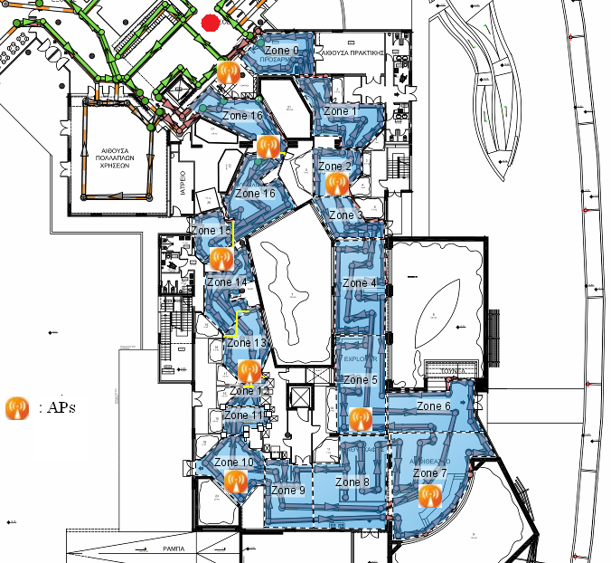
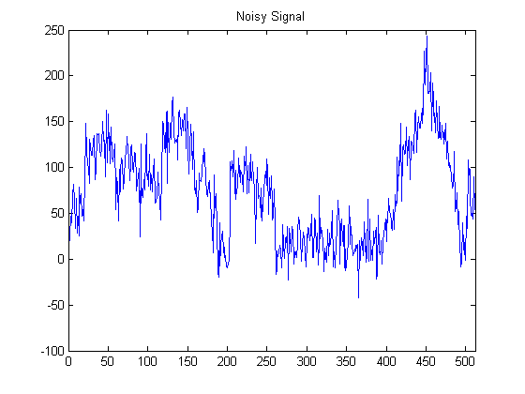
Who is afraid of real-life measurements?

Slide 38
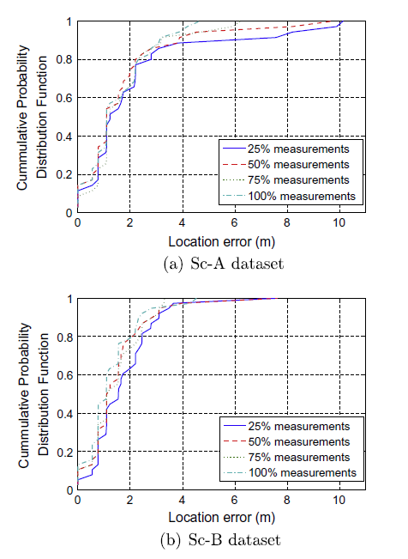

Slide 39
Evaluation of RSSI Fingerprint Approaches
Fingerprinting is nice, but the devil is in the detail.
Pathologies in fingerprint comparisons
Sensitivity to the variations in RSSI measurements
Size of data that need to be exchanged!
energy constraints of mobile devices

