Slide 1
Orthogonal Frequency Division Multiplexing

Slide 2
Basics: Frequency of Signals
Sinusoidal signals have a distinct (unique) frequency
An arbitrary signal does not have a unique frequency but can be decomposed into many sinusoidal signals with different frequencies, each with different magnitude and phase
The spectrum of a signal refers to the plot of the magnitudes and phases of different frequency components
The bandwidth of a signal is the spread of the frequency components with significant energy existing in a signal
Fourier series and Fourier transform are ways to find spectrums for periodic and aperiodic signals, respectively

Slide 3
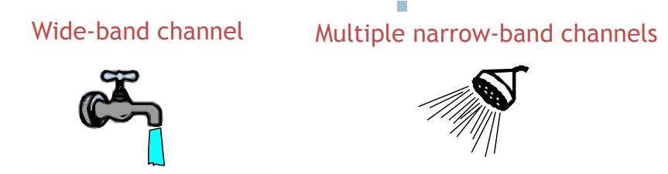
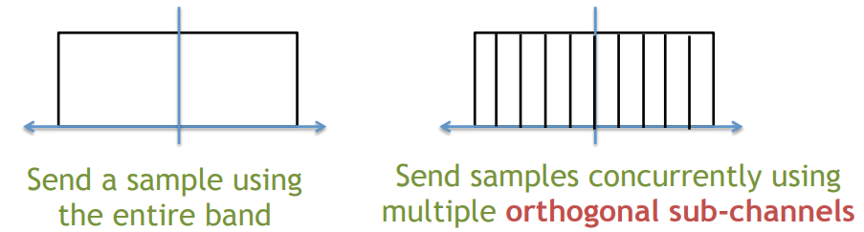
Using a large number of parallel narrow-band subcarriers instead of a single wide-band carrier to transport information

Slide 4
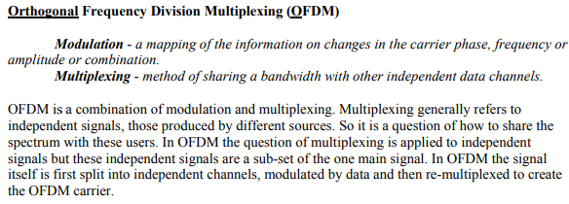

Regular FDM single carrier
Orthogonal-FDM
Same amount of water is coming from a lot of small streams

Slide 5
Advantages
Very easy and efficient in dealing with multi-path
Robust again narrow-band interference
Disadvantages
Sensitive to frequency offset and phase noise
Issues with the power efficiency of RF amplifier at the transmitter
Adopted for various standards – DSL, 802.11a, Digital audio broadcasting, digital video broadcasting

Slide 6
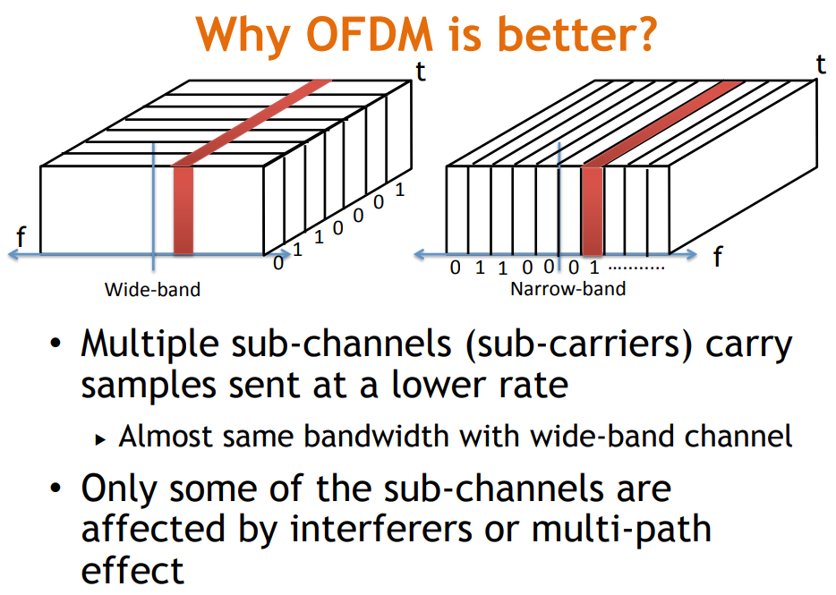

Slide 7
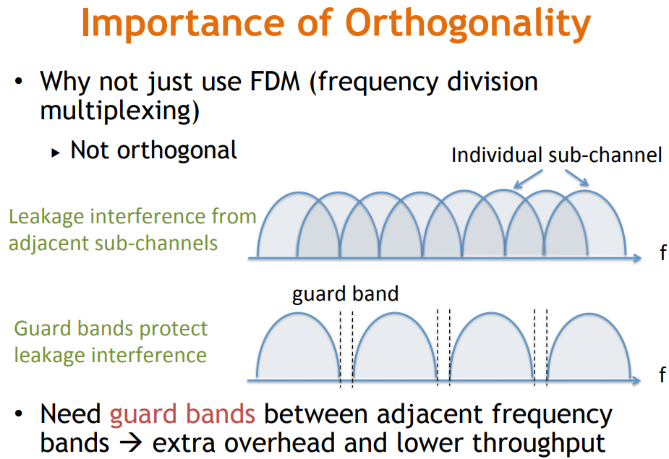

Slide 8
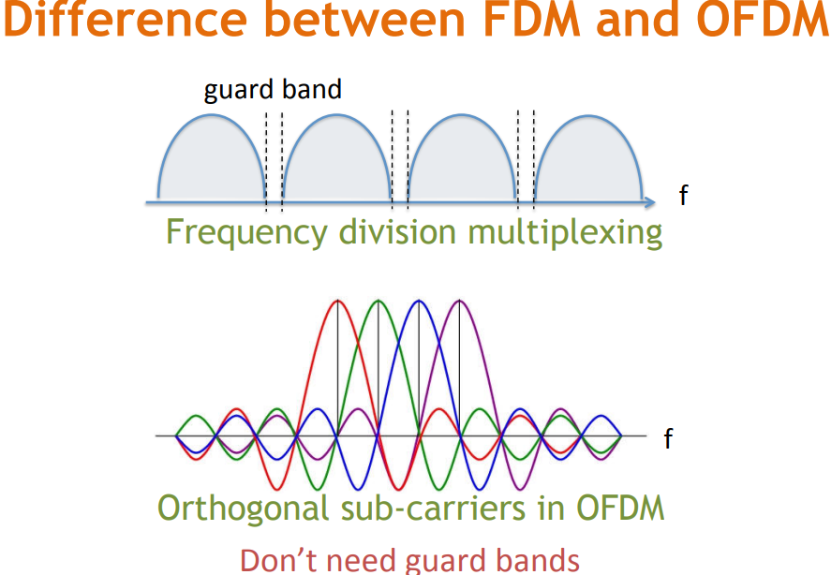

Slide 9
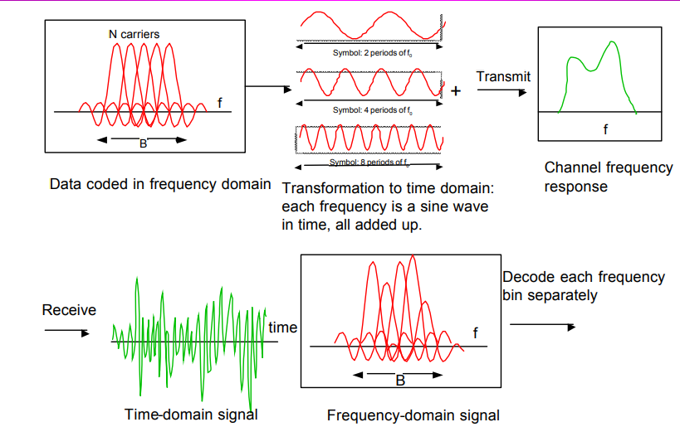

Slide 10
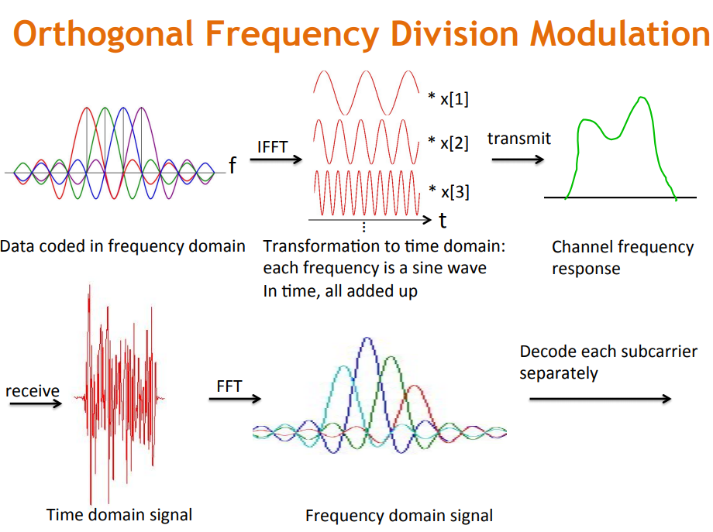

Slide 11
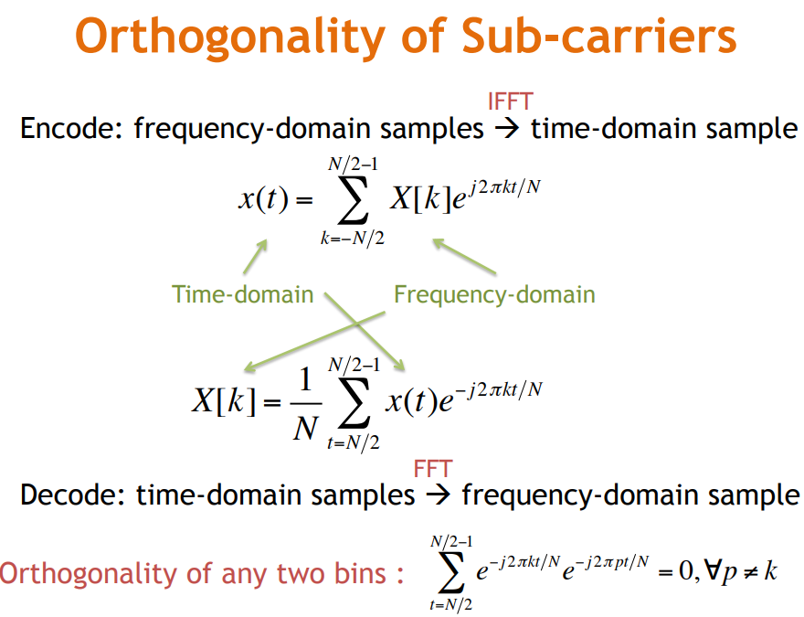

Slide 12
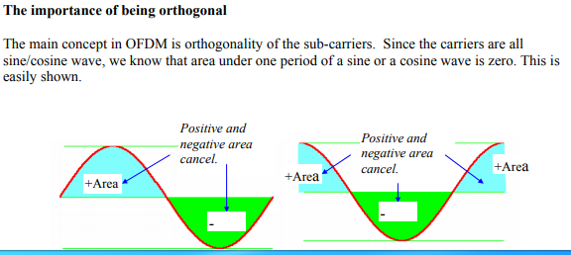
The area under a sine and a cosine wave over one period is always zero.

Slide 13

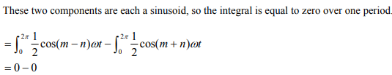
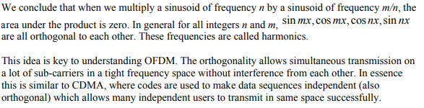

Slide 14
A harmonic of a sinusoidal wave is a wave with a frequency that is a positive integer multiple of the frequency of the original wave
Original wave also called fundamental frequency or the 1st harmonic
The following harmonics are known as higher harmonics
As all harmonics are periodic at the fundamental frequency, the sum of harmonics is also periodic at that frequency.

Slide 15
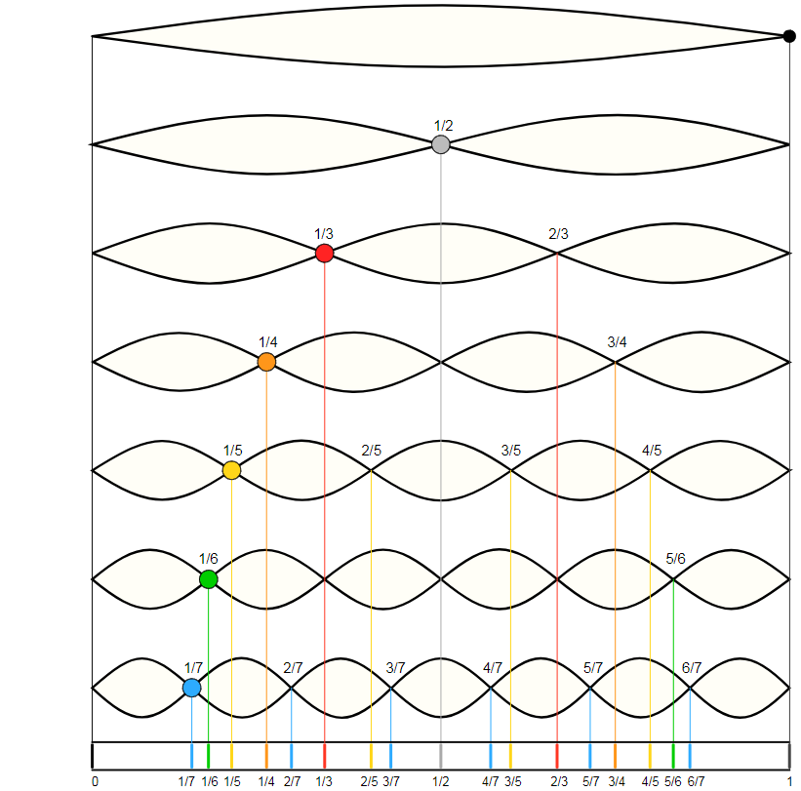

Slide 16
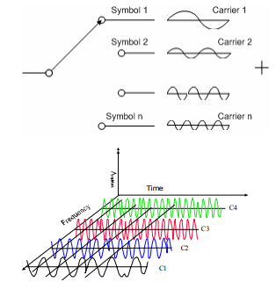

Slide 17
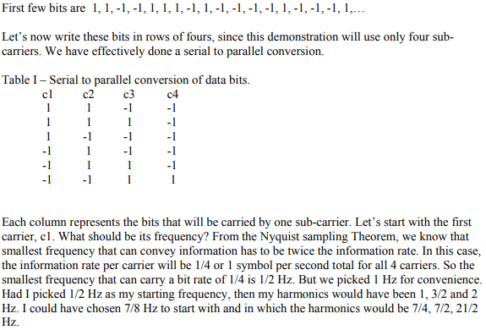
Example
We can then pick any modulation
scheme of interest, e.g., BPSK, 8PHSK,
32-QAM

Slide 18


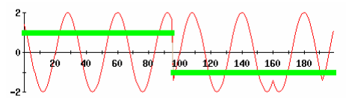
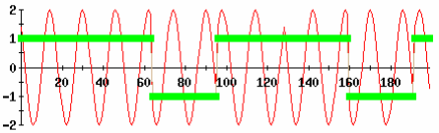
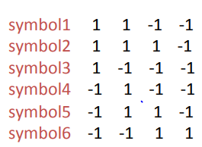

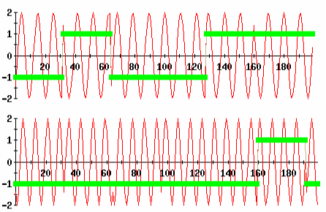

Subcarrier 1 (c1) and the bits it is modulating
Frequency 1Hz
Bin 1
Bin2
Subcarrier 2 (c2) and the bits it is modulating
Frequency 2Hz
Bin 3
Subcarrier 3 and the bits it is modulating
Frequency 3Hz
Bin 4
Subcarrier 4 and the bits it is modulating
Frequency 4Hz

Slide 19
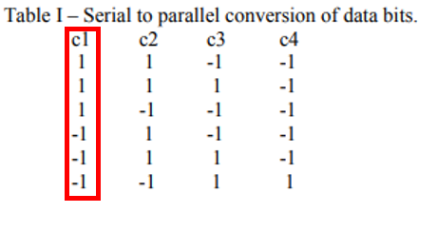
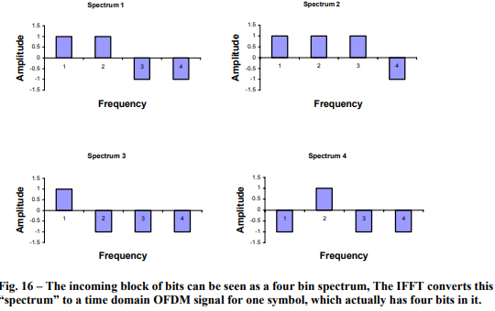

Slide 20
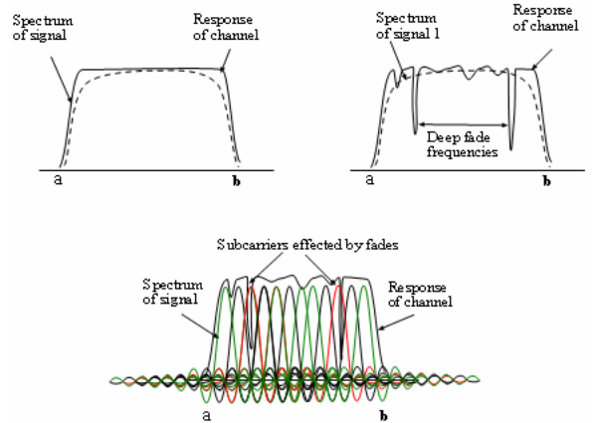
The signal we want to send and the channel frequency response are well matched
A fading channel has frequencies that do not allow anything to pass.
Data is lost sporadically.
Advantages in a channel with
frequency selective fading response
OFDM uses many little subcarriers, so only a small subset of the data is lost due to fading.
Only two subcarriers are affected

Slide 21
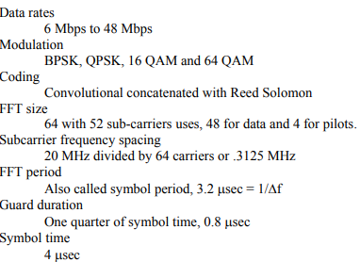

Slide 22
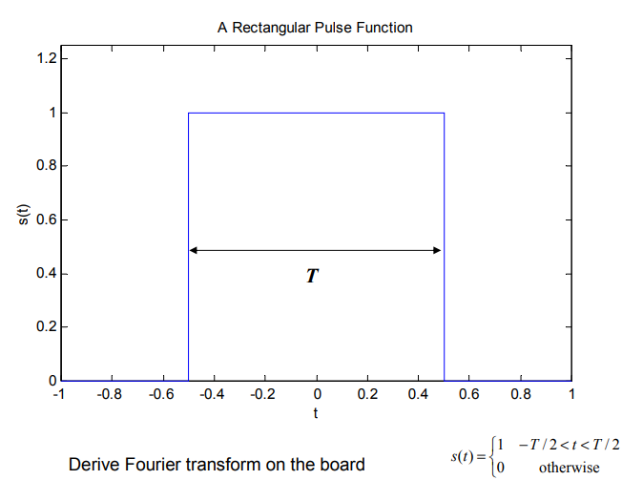

Slide 23
