Slide 1

Wireless Networks & Mobile Computing
Lecture on Routing in Mobile Wireless Networks
Prof. Maria Papadopouli
University of Crete
ICS-FORTH
http://www.ics.forth.gr/mobile

Slide 2
ACKNOWLEDGEMENT:
Slides used from presentations by
Manolis Spanakis, Michalis Faloutsos
P.R. Kumar, Charles Perkins, Kurose & Ross

Slide 3
Issues
Limited wireless transmission range
Broadcast nature of the wireless medium
Hidden terminal problem
Packet losses due to transmission errors
Mobility-induced route changes
Mobility-induced packet losses
Battery constraints
Potentially frequent network partitions
Ease of snooping on wireless transmissions (security hazard)

Slide 4
Diversity in Mobile Ad Hoc Networks
Traffic characteristics, wireless link quality, bit rate, mobility
Reliability & delay requirements, unicast, multicast
Host-based/ content-based/ capability-based addressing
Co-exist and Co-operate with infrastructure-based networks
Symmetric vs. Asymmetric (nodes’ capabilities and responsibilities)
Pervasive (cheap) devices: Power constraints
Security/Confidentiality issues

Slide 5
Mobile Ad Hoc Networks (MANET)
Formed by a collection of wireless mobile hosts
Without any pre-existing infrastructure or the aid of any centralized administration
Network characteristics change over time
Routes between nodes may potentially contain multiple hops
Number of hosts in the network

Slide 6
Routing Issues
Which is the best path?
  Shortest path (fewest hops)
  Lowest latency
  Shortest weighted path (utilize available bandwidth, battery)?
Who decides? Source, intermediate, or destination nodes?
  Source (“path”) routing [Like airline travel]
  Source specifies entire route
  Intermediate nodes just forward to specified next hop
  Destination (“hop-by-hop”) routing [Like postal service]
  Source specifies only destination in message header
  Intermediate nodes look at destination in header, consult internal tables to determine appropriate next hop

Slide 7
Proactive Protocols
Proactive: maintain routing information independently of need for communication
Update messages send throughout the network periodically or when network topology changes
Low latency, suitable for real-time traffic
Bandwidth might get wasted due to periodic updates
They maintain O(N) state per node, N = #nodes

Slide 8
On-Demand or Reactive Routing
Reactive: discover route only when you need it
Saves energy and bandwidth during inactivity
Can be bursty -> congestion during high activity
Significant delay might occur as a result of route discovery
Good for light loads, collapse in large loads

Slide 9
Hybrid Routing
Proactive for neighborhood, reactive for far away
Proactive for long distance, reactive for neighborhood
Attempts to strike balance between the two

Slide 10
Hierarchical Routing
Nodes are organized in clusters
Cluster head “controls” cluster
Trade off
  Overhead and confusion for leader election
  Scalability: intra-cluster vs intercluster
One or Multiple levels of hierarchy

Slide 11
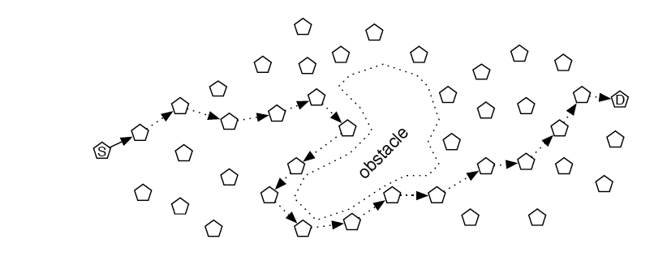
Geographical Routing
Nodes know their geo coordinates (GPS)
Route to move packet closer to end point
Protocols DREAM, GPSR, LAR
Propagate geo info by flooding (decrease frequency for long distances)

Slide 12
IETF MANET Working Group
The purpose of the MANET working group is to standardize IP routing protocol functionality suitable for wireless routing application within both static & dynamic topologies with increased dynamics due to node motion or other factors.
Approaches are intended to be
  lightweight in nature,
  suitable for multiple hardware and wireless environments, and
  address scenarios where MANETs are deployed at the edges of an IP infrastructure.
Hybrid mesh infrastructures (e.g., a mixture of fixed and mobile routers) should also be supported by MANET specifications and management features.
Using mature components from previous work on experimental reactive and proactive protocols, the WG will develop two Standards track routing protocol specifications:
Reactive MANET Protocol (RMP) & Proactive MANET Protocol (PMP)
The charter and official IETF Home Page for manet are found at https://datatracker.ietf.org/wg/manet/charter

Slide 13
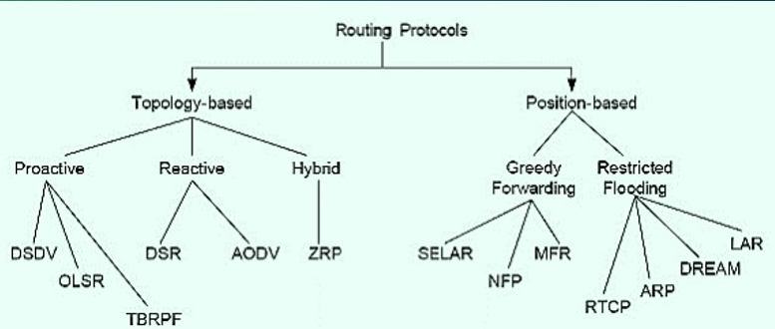
A Taxonomy of Routing Protocols

Slide 14
Trade offs
Latency of route discovery
  Proactive protocols may have lower latency since routes are maintained at all times
  Reactive protocols may have higher latency because a route from X to Y will be found only when X attempts to send to Y
Overhead of route discovery/maintenance
  Reactive protocols may have lower overhead since routes are determined only if needed
  Proactive protocols can (but not necessarily) result in higher overhead due to continuous route updating
Which approach achieves a better trade-off depends on the traffic & mobility patterns

Slide 15
Dynamic Source Routing (DSR)
By David Johnson, David Maltz, Josh Broch
Source routing: entire path to destination supplied by source in packet header
Utilizes extension header following standard IP header to carry protocol information (route to destination)
Route discovery: Undertaken when source needs a route to a destination
Route maintenance: Is used only when the source is actually sending packets & detect network topology changes
Intermediate nodes cache overheard routes
  “Eavesdrop” on routes contained in headers
  Reduces need for route discovery
  Intermediate node may return Route Reply to source, if it already has a path stored

Slide 16
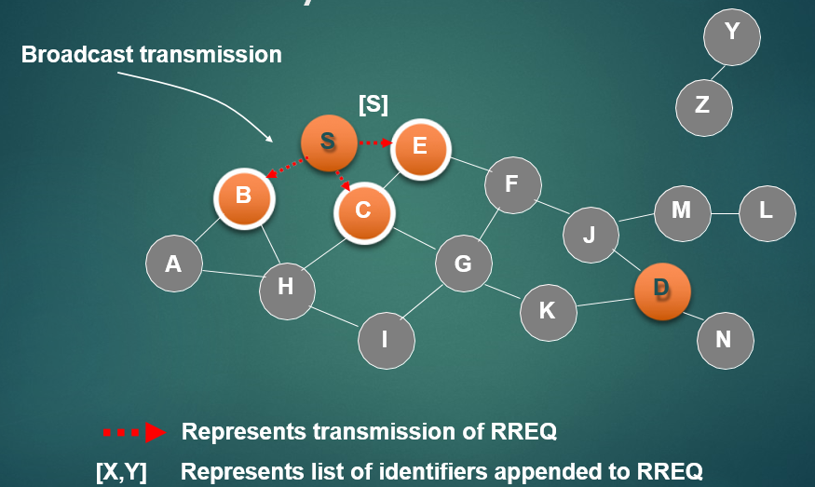
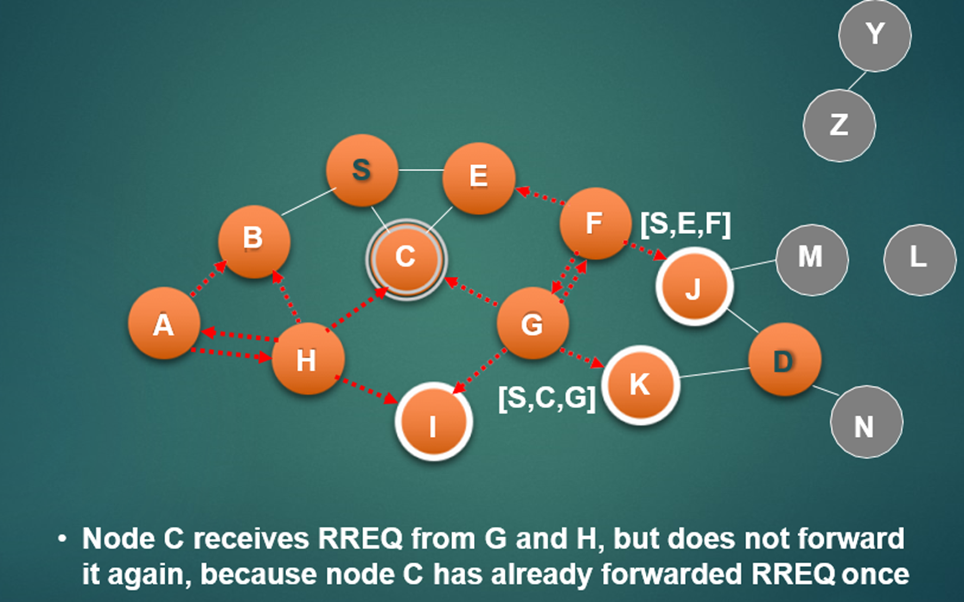

Slide 17
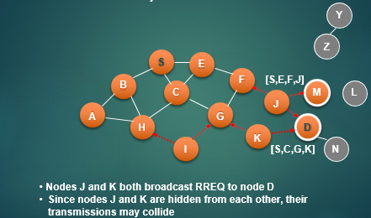
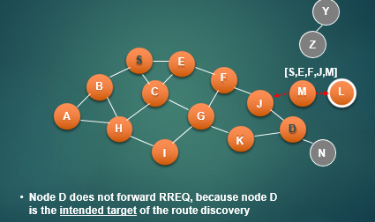

Slide 18
Route Reply can be sent by reversing the route in Route Request (RREQ) only if links are guaranteed to be bi-directional
To ensure this, RREQ should be forwarded only if it received on a link that is known to be bi-directional
If unidirectional (asymmetric) links are allowed, then RREP may need a route discovery for S from node D
Unless node D already knows a route to node S
If a route discovery is initiated by D for a route to S, then the Route Reply is piggybacked on the Route Request from D
If IEEE 802.11 MAC is used to send data, then links have to be bi-directional (since Ack is used)

Slide 19
Key points
Node S on receiving RREP, caches the route included in the RREP
When node S sends a data packet to D, the entire route is included in the packet header (hence the name source routing)
Intermediate nodes use the source route included in a packet to determine to whom a packet should be forwarded

Slide 20
DSR – Advantages Disadvantages
Routes maintained only between nodes who need to communicate
  Reduces overhead of route maintenance
Route caching can further reduce route discovery overhead
A single route discovery may yield many routes to the destination due to intermediate nodes replying from local caches
Automatic route shortening, if one or more of their intermediate hops become unnecessary
Packet header size grows with route length due to source routing
Flood of route requests may potentially reach all nodes in the network
Care must be taken to avoid collisions between route requests propagated by neighboring nodes
  Insertion of random delays before forwarding RREQ

Slide 21
Ad-hoc On-demand Distance Vector (AODV)
By Charles Perkins, Elizabeth Royer
Routes are discovered on an as-needed basis
When a node needs a route to a destination, it broadcasts a RREQ
Any node with a current route to that destination can unicast a RREP back to the source node
Route info is maintained by each node in its route table
Information obtained through RREQ & RREP messages is kept with other routing info in the routing table
Sequence numbers are used to eliminate stale routes
Routes with old sequence numbers are aged out of the system

Slide 22
Ad-hoc On-demand Distance Vector (AODV) Protocol
Hop-by-hop protocol: intermediate nodes use lookup table to determine next hop based on destination
Utilizes only standard IP header
Route discovery
Undertaken whenever a node needs a “next hop” to forward a packet to a destination
Route maintenance
Used when link breaks, rendering next hop unusable
Route Discovery
1. Route Request:
Source broadcasts Route Request (RREQ) message for specified destination
Intermediate node Forward message toward destination
2. Route Reply
Destination unicasts Route Reply msg to source
Intermediate node creates next-hop entry for destination & forwards the reply
If source receives multiple replies, it uses the one with lowest hop count

Slide 23
Zone Routing Protocol (ZRP)
By Zygmunt Haas, Marc Pearlman
A zone is defined around each node: k-neighborhood, which consists of all nodes within k hops of the node
Border nodes are nodes which are exactly k hops away from a source node
Hybrid Scheme
Proactively maintains routes within a local region (routing zone)
Also a globally reactive route query/reply mechanism available
If a packet's destination is in the same zone as the origin, the proactive protocol using an already stored routing table is used to deliver the packet immediately
If the route extends outside the packet's originating zone, a reactive protocol takes over to check each successive zone in the route to see whether the destination is inside that zone
This reduces the processing overhead for those routes. Once a zone is confirmed as containing the destination node, the proactive protocol, or stored route-listing table, is used to deliver the packet.

Slide 24
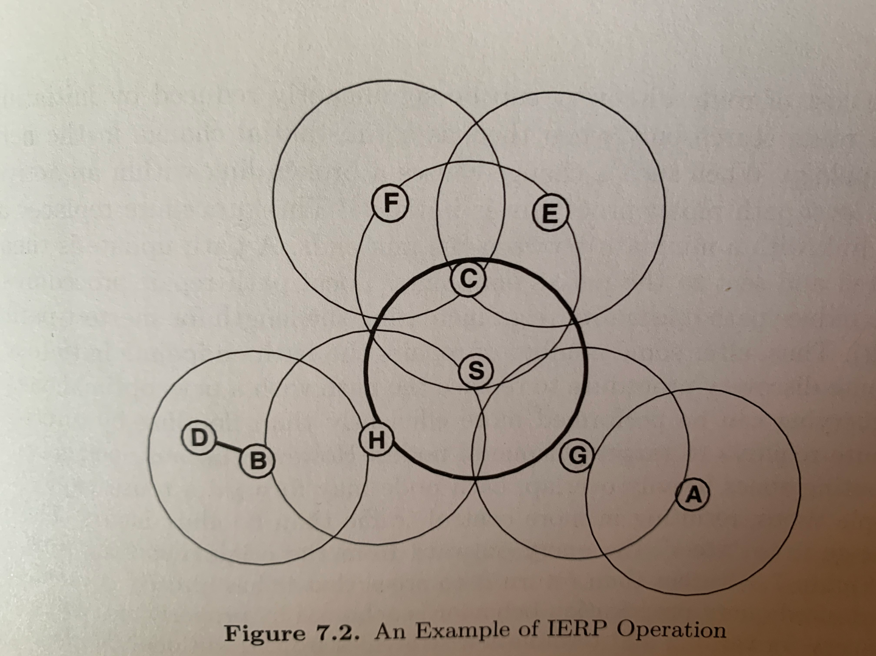
Inter-zone Routing
For routes beyond the local zone, route discovery happens reactively.
Source node sends a route request to the border nodes of its zone, containing its own address, the destination address and a unique sequence number.
Each border node checks its local zone for the destination.
If the destination is not a member of this local zone, the border node adds its own address to the route request packet and forwards the packet to its own border nodes.
If the destination is a member of the local zone, it sends a route reply on the reverse path back to the source.
The source node uses the path saved in the route reply packet to send data packets to the destination.
One of H’s border nodes, B, recognizes D as being in its routing zone and responds to the route request of S, indicating the forwarding path S-> H-> B -> D

Slide 25
Location-Aided Routing (LAR) - Basic Idea
Route discovery using flooding algorithm has large overhead
When nodes know their location, improve routing by minimizing search zone & reducing routing overhead
Use last known location information & average speed for route discovery
  Limited destination zone (expected zone)
  Restricted flooding (request zone)
Route discovery is initiated when source does not know a route to a destination or previous route is broken
Further reduction of the search zone, when speed & direction information is available
  Also increases the probability to find a node
Notes:
Instead of using flooding algorithm, LAR uses location information to reduce the size of search zone (originally, entire network) and the number of routing messages.
LAR: Specifically LAR predicts the location of the destination by using the location information.
By adding more information, such as speed and direction, we can further reduce the size of search zone and increase the probability to find a node.

Slide 26
Rules for selecting the next relay N
S: Source, D: destination, N: candidate relay/neighbor
N is the node closest to D (Greedy Routing)
N is the node with the minimum angle with the destination (Compass Routing)
N has the largest progress (i.e. projection of SN on SD line is largest) (MFR)
N is the closest to S that is also towards D (good when channel is noisy) (NFP)
N is randomly chosen among those neighbors closer to D
N maximizes progress over cost

Slide 27
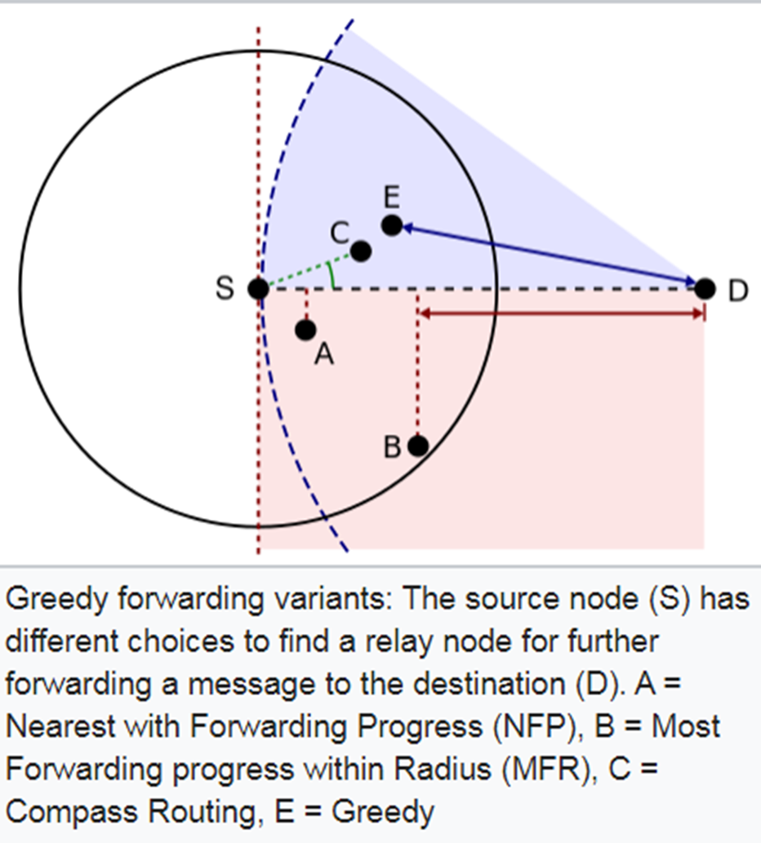

Slide 28
An example
Might be selected
under random selection
Selected by
Greedy Routing
D
Cannot be selected
Selected by
NFP
Selected by
Compass Routing

Slide 29
Advantages of Geographic Routing
Robust with respect to change of topology
  Who handles the packet is unimportant, and can be decided at the very last moment.
Very little state is needed
  With traditional routing, nodes need to keep (and update) routing tables and/or packets need to carry the routes they will follow
It scales very well with network size.
Local Maximum Problem Challenge: While forwarding, it is possible that the best node to receive the packet is the current holder.

Slide 30
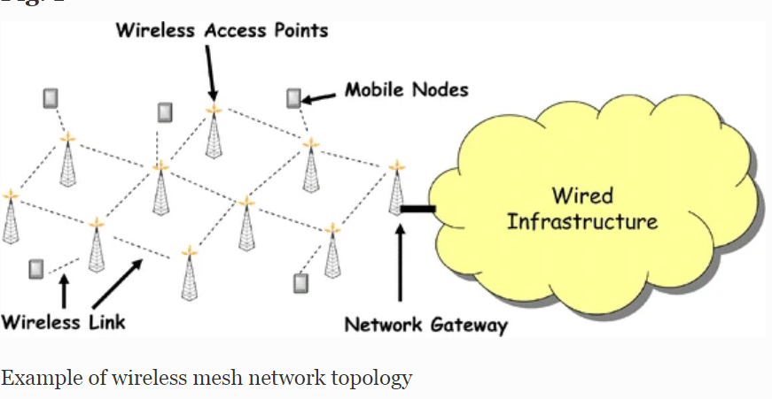
Mesh networks: hybrid technology, blends a fixed wireless backbone with an edge network consisting of mobile users.

Slide 31
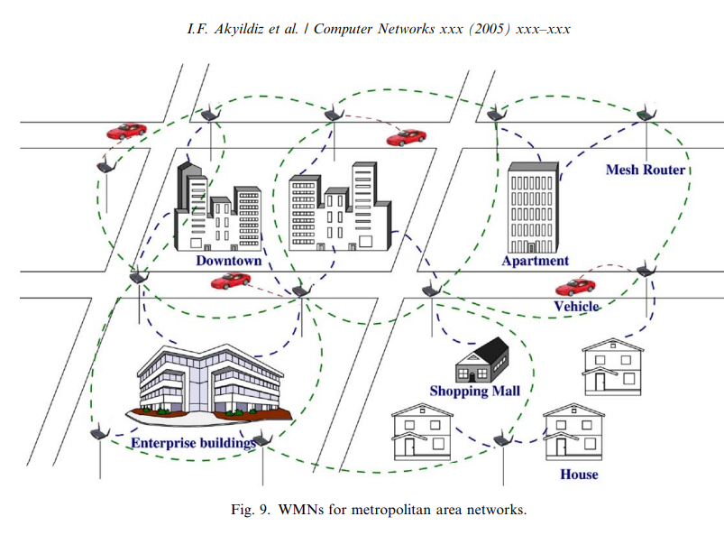
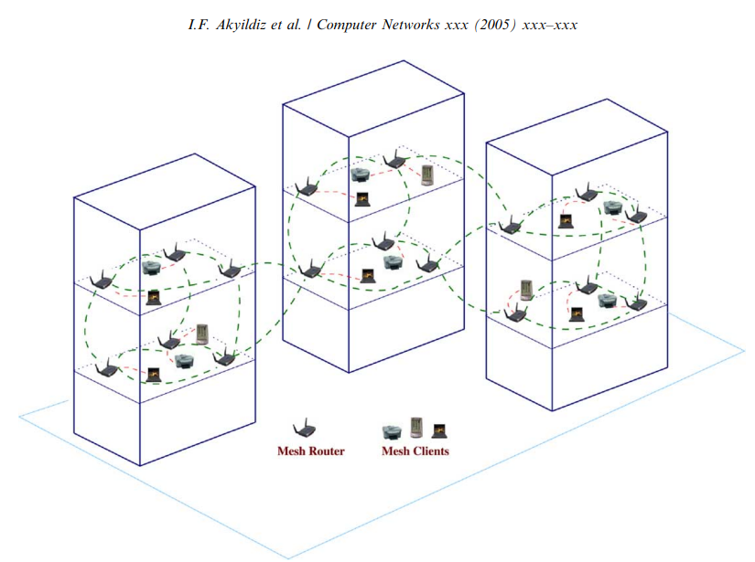
Mesh Networks

Slide 32
Mesh Networks
Multi-hop wireless network. Aim to extend the coverage range without sacrificing the channel capacity as well as provide non-line-of-sight (NLOS) connectivity among the users without direct line-of-sight.
Mesh routers usually have minimal mobility, while mesh clients can be stationary or mobile nodes. Mesh routers usually do not have strict constraints on power consumption. However, mesh clients may require power efficient protocols.
In WMNs, both backhaul access to the Internet and peer-to-peer (P2P) communications are supported. In addition, the integration of WMNs with other wireless networks and providing services to end-users of these networks can be accomplished through WMNs.
Support for ad hoc networking, and capability of self-forming, self-healing, and self-organization. WMNs enhance network performance, because of flexible network architecture, easy deployment and configuration, fault tolerance, and mesh connectivity, i.e., multipoint-to-multipoint communications.
Dedicated routing and configuration. Unlike ad hoc networks, in which end-user devices perform routing, in WMNs, mesh routers perform this functionality.

Slide 33
Routing Metrics
Hop Count: Number of hops between the source and the destination.
Expected Transmission Count (ETX): Accounts for data loss due to medium access contention & environmental hazards, and considers the number of retransmissions needed to successfully transmit a packet over a link
Expected Transmission Time (ETT): enhancement of ETX; further includes the bandwidth of the link in its computation.
Energy consumption: A node energy level can be considered as a routing metric if some nodes are energy-constrained and their involvement in the routing process can lead to path failure if they suffer from energy depletion.
Path availability/reliability: Percentage of time a path is available. Node mobility effect can be captured by this metric; Particularly important in MANET.

Slide 34
Routing in Mesh Networks
Variation of DSR using the expected transmission time as a metric instead of the number of hops (i.e., the shortest paths are determined based on least packet loss)
Enhancing existing routing protocols with new routing metrics more appropriate for WMNs.
The fixed wireless backbone allows a better estimation of the link quality through regular measurements.
Employ channel diversity in the network infrastructure so as to reduce interference and increase overall throughput.

Slide 35
A fundamental Cost/Delay Tradeoff
C/DEGs capture a fundamental tradeoff of DTNs: the cost of transporting a packet from node A to node B with a delay of at most T is a decreasing function of T.
  If we are willing to wait for more time, the topology might become more favorable.
  In the C/DEG setting, the smallest-cost journey of delay at most T is found considering all C/DEG paths of delay at most T. Increasing T implies more paths are considered.

Slide 36
Portable mobile networking
Requires connection to same provider (ISP)
Cellular systems, Bluetooth, Wireless Ethernet

Slide 37
Mobility & Standard IP Routing
IP assumes end hosts are in fixed physical locations
IP addresses enable IP routing algorithms to get packets to the correct network
IP address has network part and host part
Host part should not be in routing tables
What if a user roams between networks?
Want transparency
Routing information becomes invalid
Why can’t mobile users change IP when running an application?

Slide 38
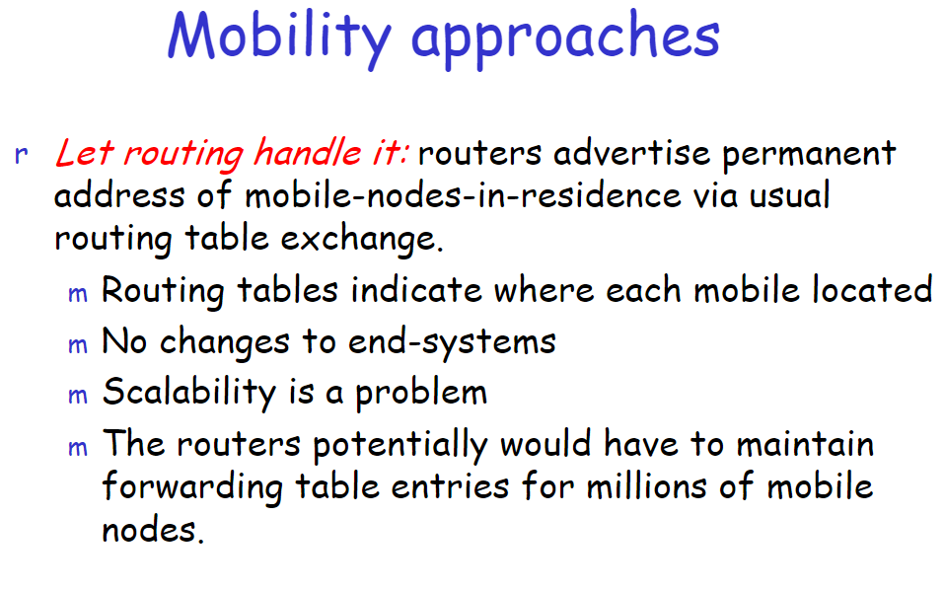

Slide 39
Mobile IP Architecture - Entities
Mobile Node (MN) - node moving to different network, with permanent HΑ
Home Agent (HA) - router on a MN’s home network which tunnels datagrams for delivery to MN when away from home, maintains current location information for MN
Home Address - static fixed IP address allocated to a MN by HA
Home Network – MN’s home network with a specific prefix/network id-matching address
Foreign Network - the MN’s visiting network other than home network
Foreign Agent - router in visiting network that provides CoA & tunneling with HA to forward packets to MN
Care-of Address (CoA) - termination point of a tunnel toward a MN in the foreign network
Mobility Binding - the association of a home address with a care-of address (CoA)
Correspondent Node (CN) - a peer node with which a MN is communicating

Slide 40
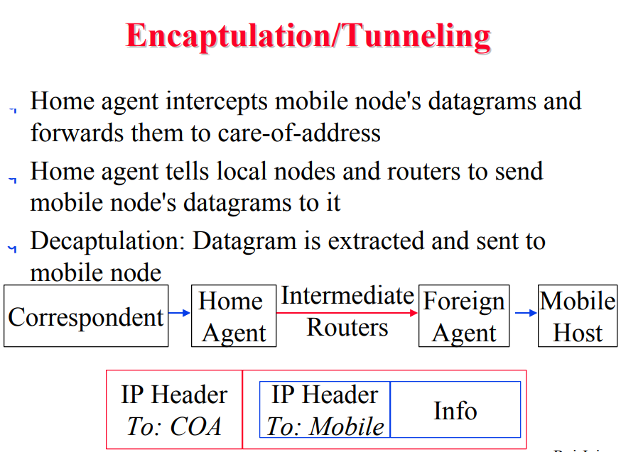

Slide 41
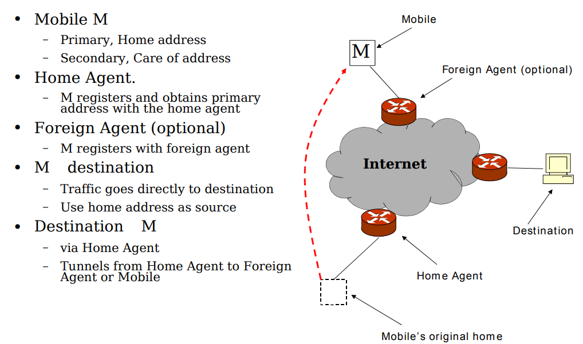

Slide 42
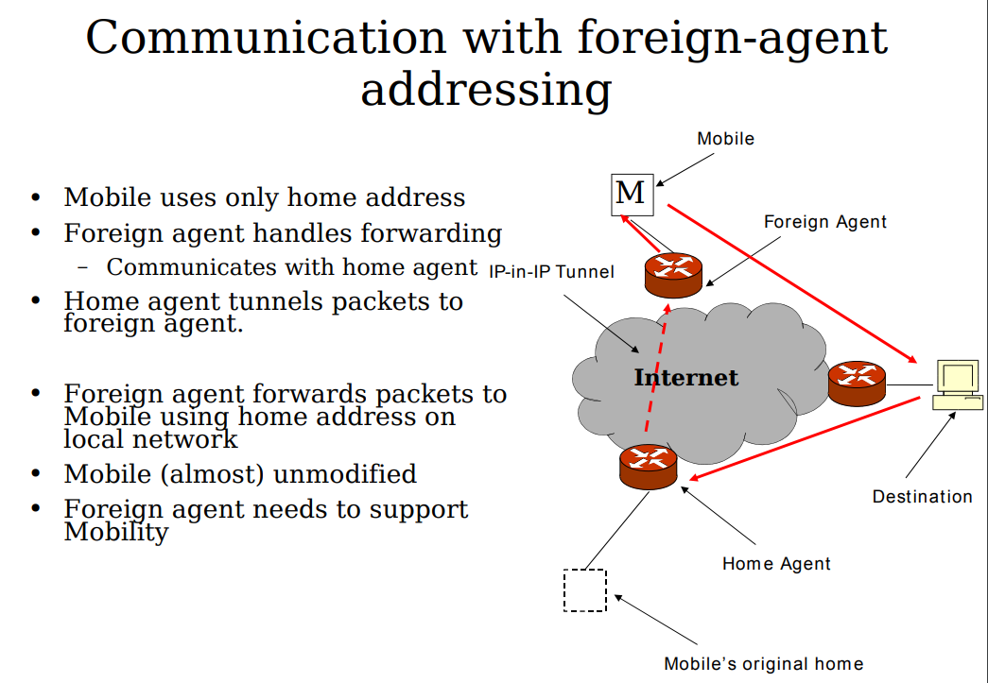

Slide 43
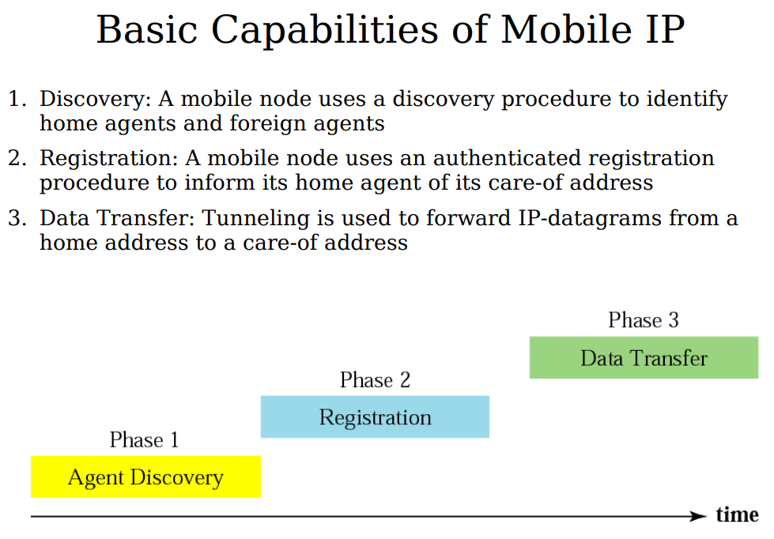

Slide 44
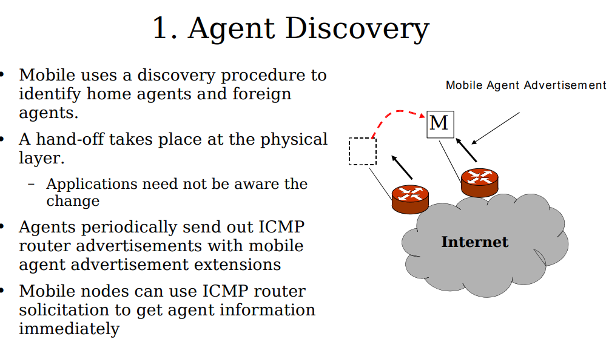

Slide 45
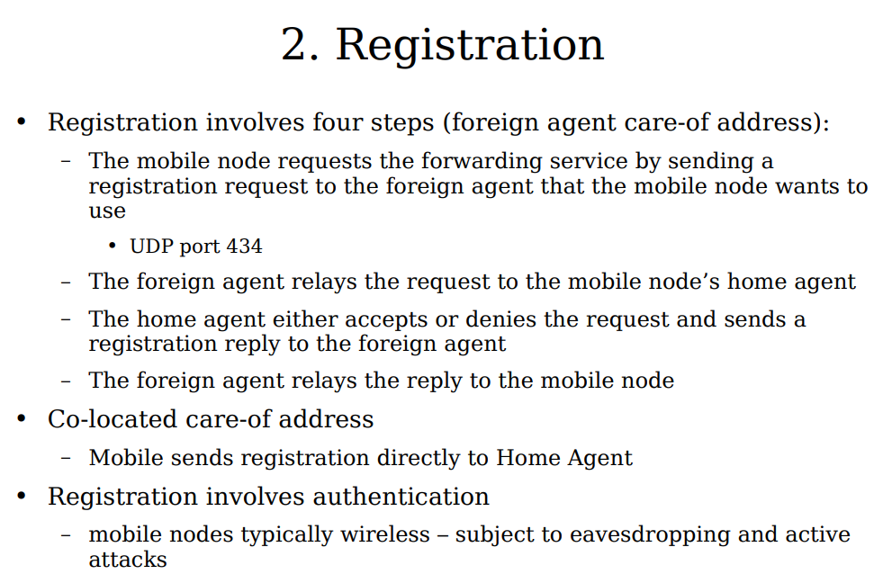

Slide 46
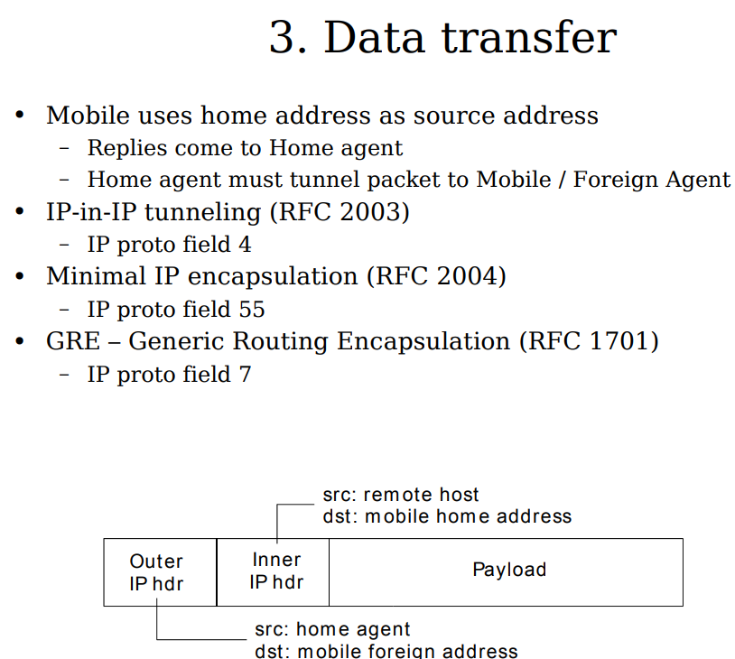

Slide 47
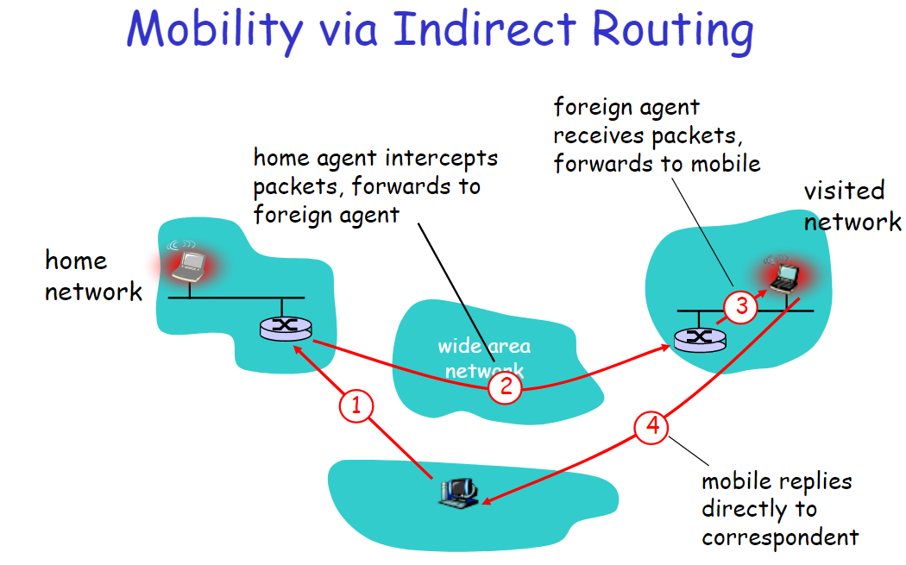

Slide 48
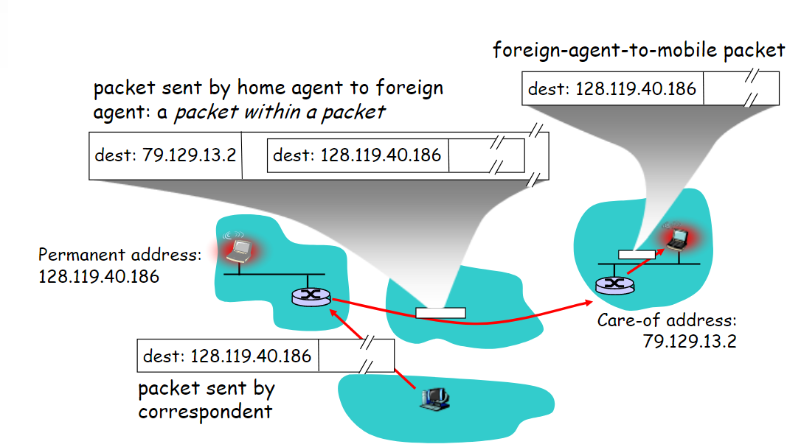

Slide 49
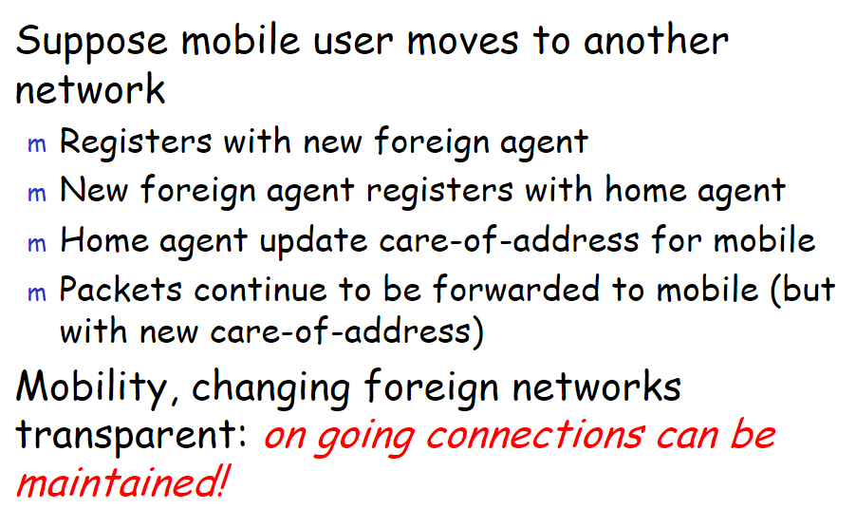

Slide 50
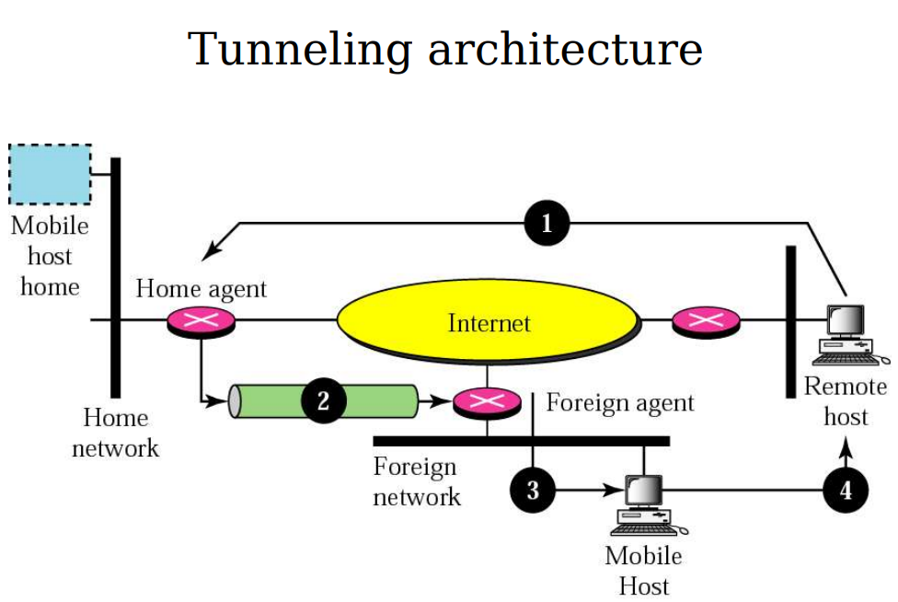

Slide 51
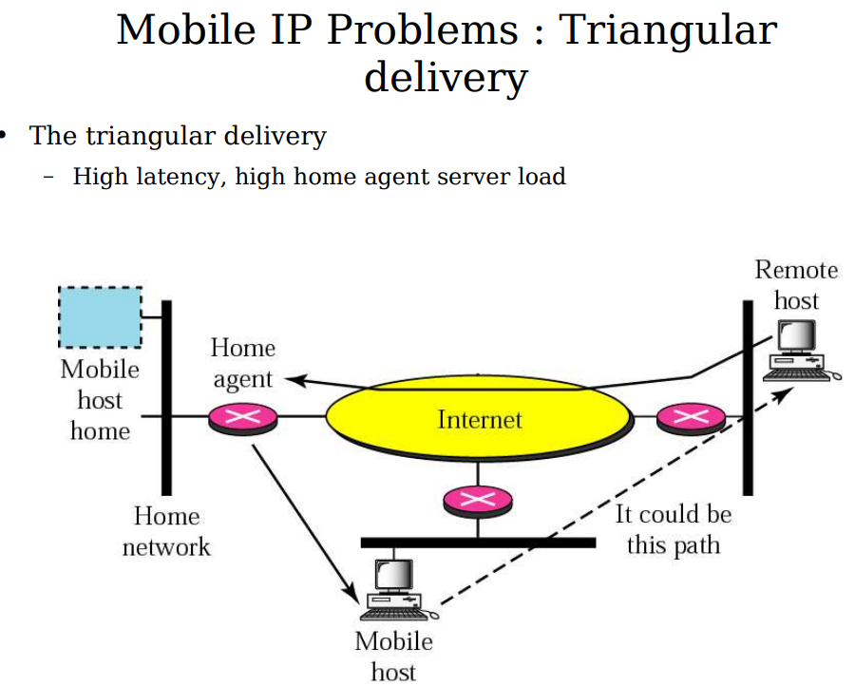

Slide 52
Security Challenges in Mobile IP
Packet Sniffing, Denial Of service, and Hijacking of session
Firewalls block all classes of incoming packets that do not meet specified criteria.
Enterprise firewalls are typically configured to block packets from entering via the Internet that appear to emanate from internal computers.
  Although this permits management of internal Internet nodes without great attention to security, it presents difficulties for mobile nodes wishing to communicate with other nodes within their home enterprise networks. Such communications, originating from the mobile node, carry the mobile node's home address, and would thus be blocked by the firewall.

Slide 53
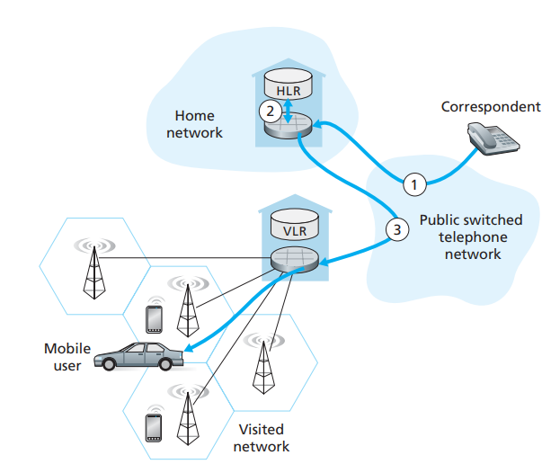
Mobility in cellular networks
1. The call is routed from the correspondent through the PSTN to the home MSC in the mobile’s home network.
2. The home MSC receives the call and interrogates the HLR to determine the location of the mobile user.
3. The HLR returns the mobile station roaming number (MSRN) (similar to the care-of-address in Mobile IP)
Temporarily assigned to a mobile when it enters a visited network
Different from the permanent phone number of the mobile
maintains a database known as the visitor location register
VLR contains an entry for each mobile user that is currently in its network
4. Home MSC sets up the second leg of the call through the network to the MSC in the visited network. The call is completed, being routed from the correspondent to the home MSC, and from there to the visited MSC, and from there to the base station serving the mobile user.

Slide 54
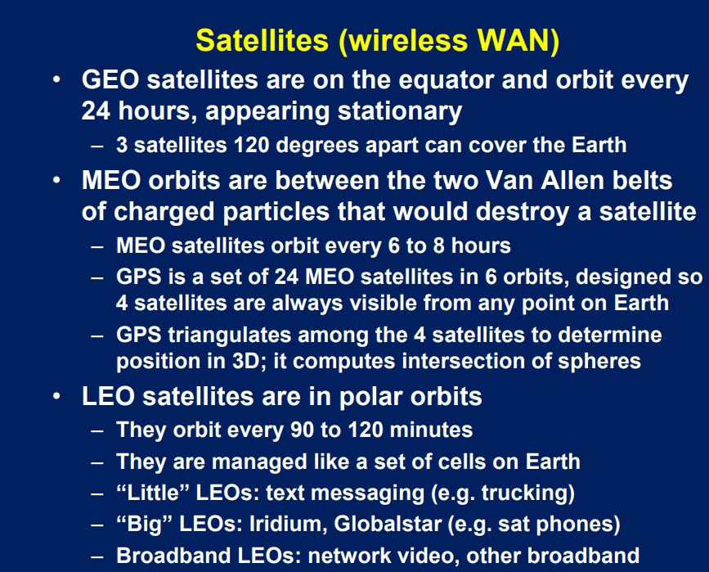

Slide 55
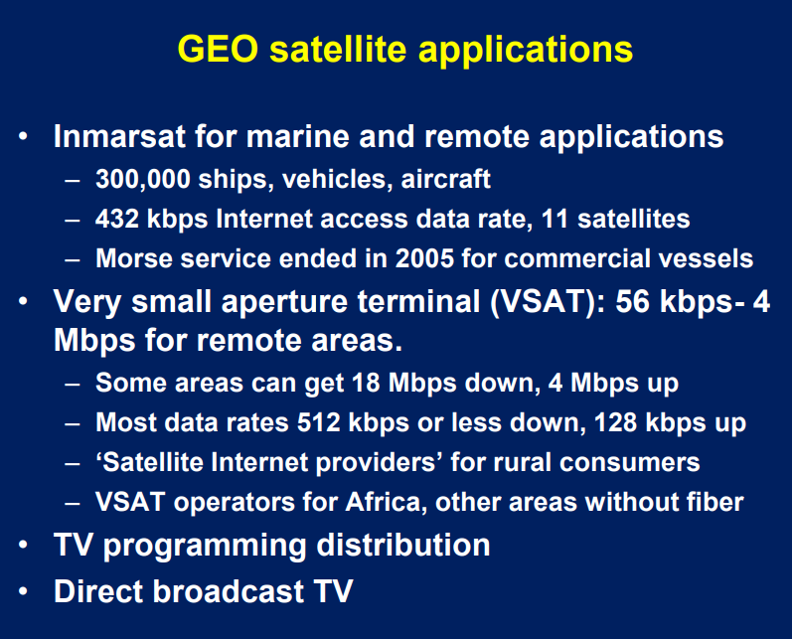

Slide 56
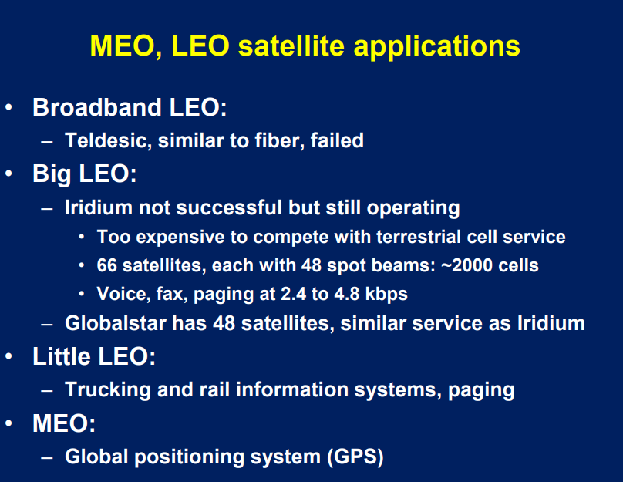

Slide 57
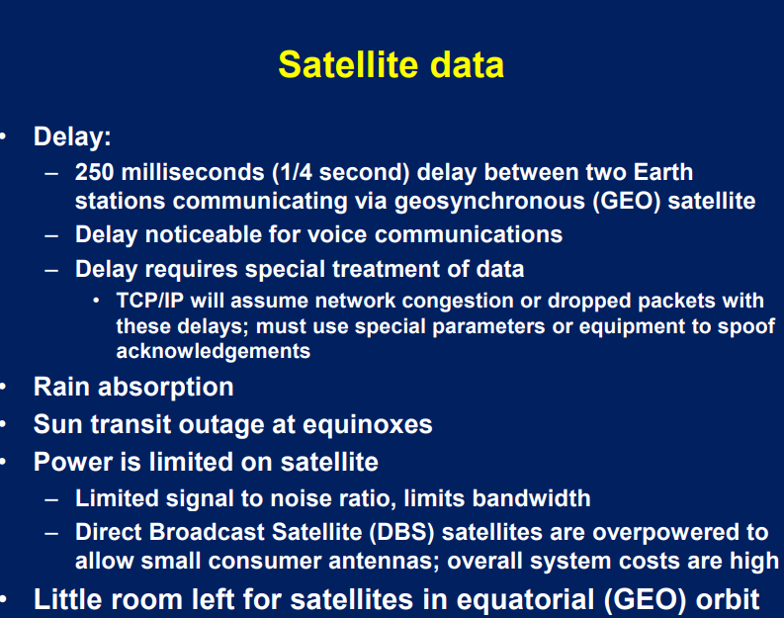

Slide 58


The Capacity of Wireless Network
Theoretical perspective, Gupta Kumar seminal paper
The capacity of a wireless network is
where n nodes, W channel capacity, and the nodes are optimally placed in a disk of unit area,
the range of each transmission is optimally selected.
The throughput capacity diminishes as the number of nodes increases.
As the number of nodes per unit area increases, the throughput per source-to-destination (S–D) pair decreases like
Fundamentally, it is the need for every node all over the domain to share whatever portion of the channel it is utilizing with nodes in its local neighborhood that is the reason for the constriction in capacity.
Splitting the channel into several subchannels does not change any of the results.

Slide 59
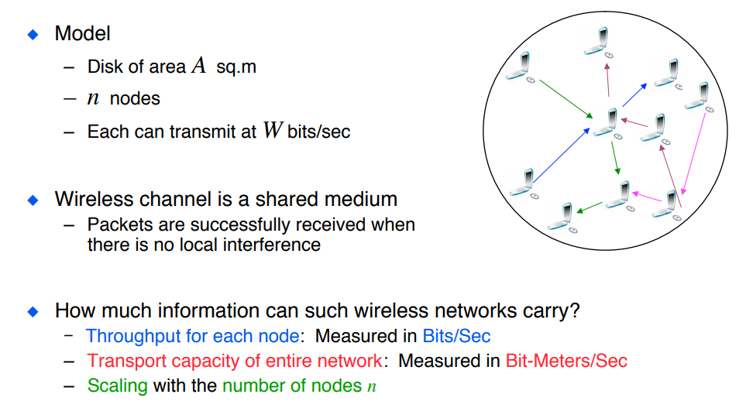

Slide 60
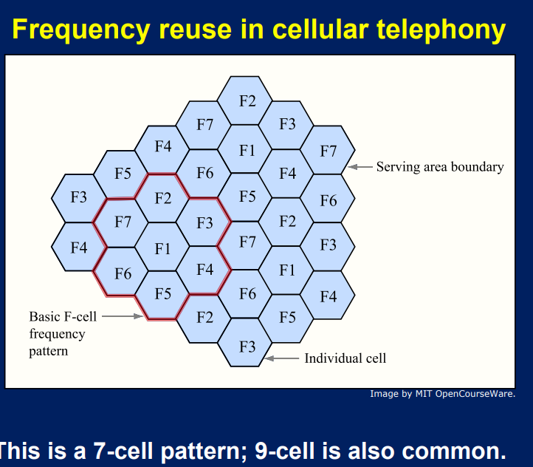

Slide 61

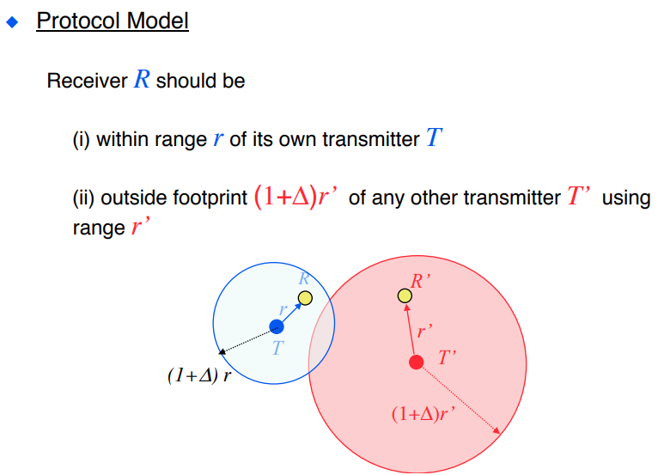
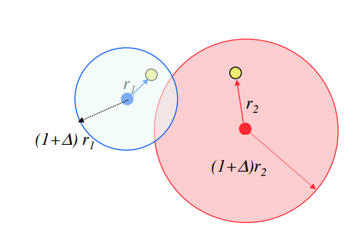
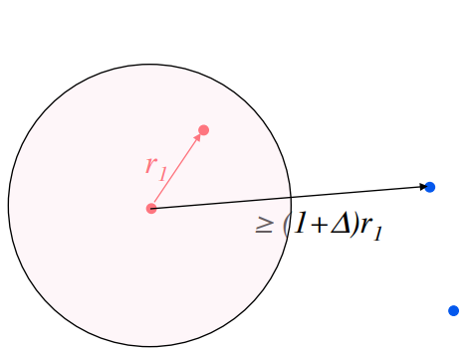
Spatial Reuse of Spectrum (in Cellular Systems)
Receiver not in vicinity of an interfering transmission
Transmissions consume area

Slide 62
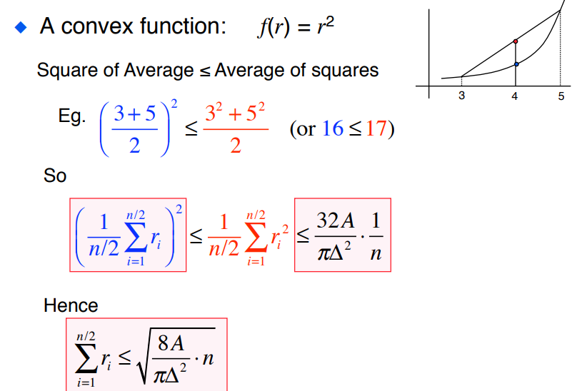
Convexity

Slide 63
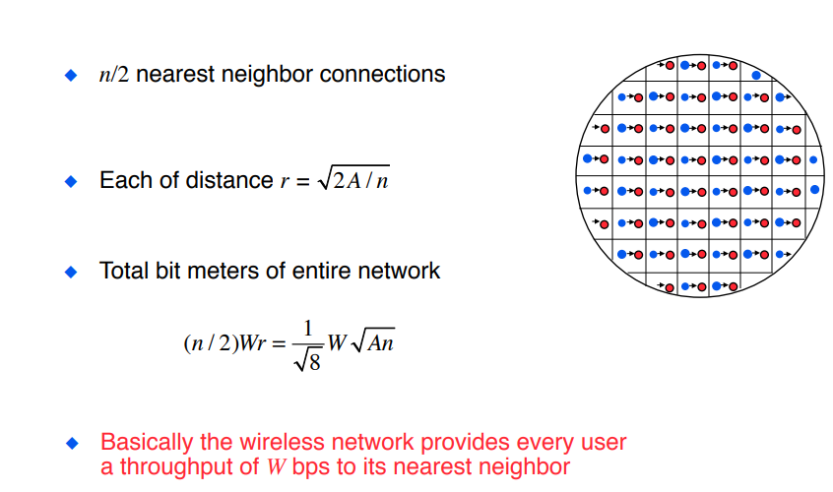
Feasibility of U(W√An) bit-meter/sec
Disk of area A sq.m
n nodes
Each can transmit at W bits/sec
2

Slide 64
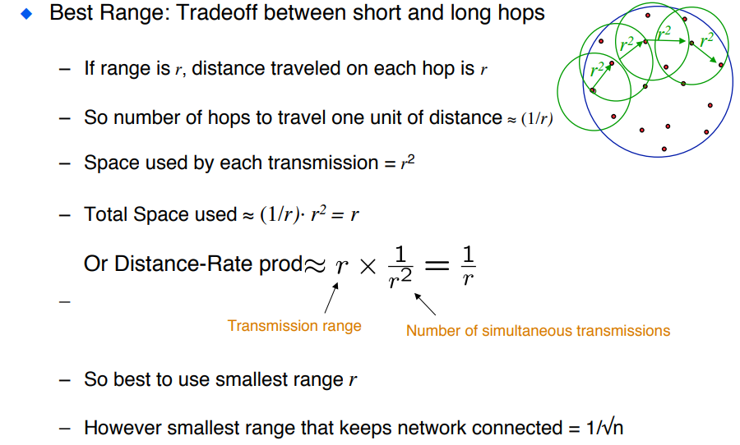

Slide 65
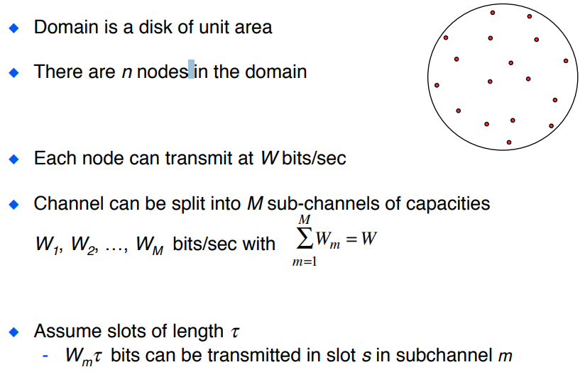
Same result also holds if channel is split into several sub-channels

Slide 66
Mobility Increases the Capacity of Ad Hoc Wireless Networks
Matthias Grossglauser and David N. C. Tse
Spread the traffic to intermediate relay nodes to exploit the multiuser diversity benefits of having additional “routes” between a source and a destination.
Two-hop routes are sufficient to achieve the maximum throughput capacity of the network within the limits imposed by the interference model.
Appropriate only for delay tolerant applications
The performance depends strongly on the mobility pattern

