Slide 1
Network management, measurements and analysis
Michalis Katsarakis katsarakis@csd.uoc.gr
Tutorial: HY-439 http://www.csd.uoc.gr/~hy439/
24 March 2014

Slide 2
Outline
Network management
  The SNMP protocol
  snmpget, snmpwalk, polling an Access Point
Wireless network interface commands
  ifconfig, iwconfig, iwlist
  airmon-ng
  Tcpdump
  Wireshark

Slide 3
Network Management
Network Management
Network management includes the deployment, integration and coordination of the hardware, software and human elements to monitor, test, poll, configure, analyze, evaluate and control the network and element resources to meet the real-time, operational performance and Quality of Service requirements at a reasonable cost.
T. Saydam and T. Magedanz

Slide 4
Network Management
Network Management
Benefits from network management
  Detect failure of an interface card at a host
  Monitor traffic to aid in resource deployment
  Detect rapid changes in routing tables
  Intrusion Detection

Slide 5
Architecture of a network management system
Network Management
Managing entity: the central “area” of activity. Controls the collection, processing, analysis and display of network management information.
Managed device: a piece of network equipment that resides on a managed network
Network management protocol: The protocol that runs between the managing entity and the managed devices.
  In our case SNMP

Slide 6
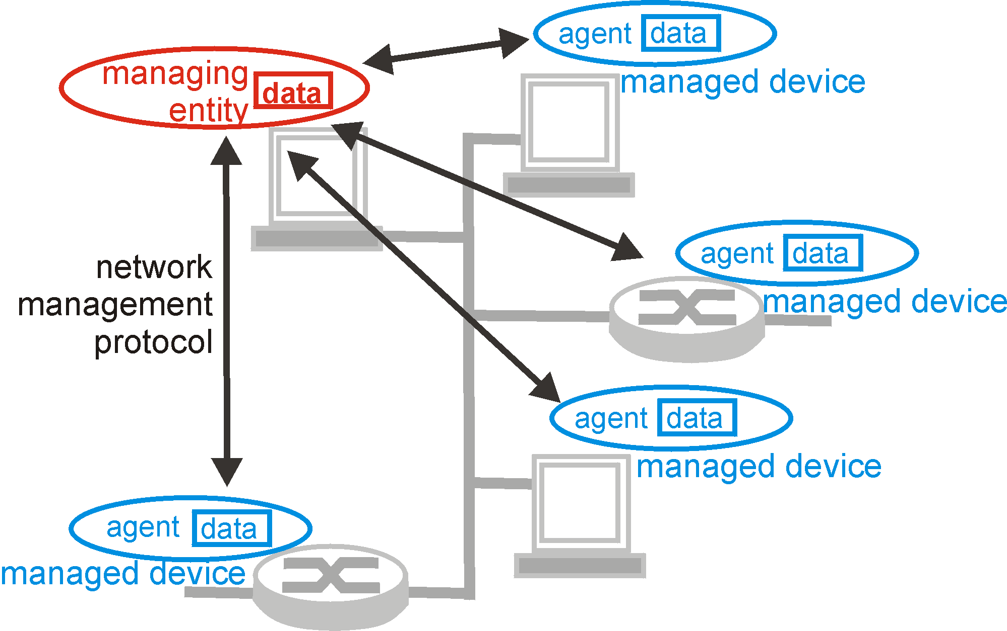
Architecture of a network management system
Network Management

Slide 7
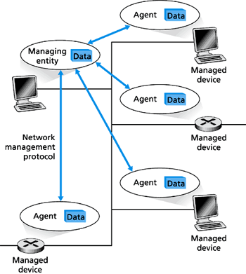
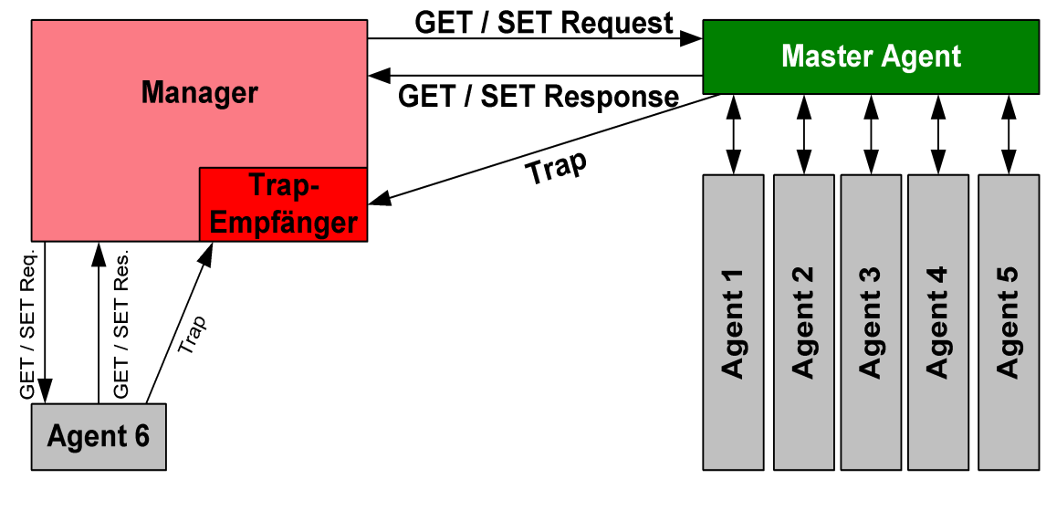
Simple Network Management Protocol
Network Management
Simple Network Management Protocol (SNMP) is an Internet-standard protocol for managing devices on IP networks.
Each managed system executes, at all times, a software component called an agent which reports information via SNMP to the manager.
SNMP agents expose management data on the
managed systems as variables.

Slide 8
Simple Network Management Protocol
Network Management
Management Information Base (MIB)
  Information “database” holding managed objects whose values collectively reflect the current “state” of the network
A MIB Object might be:
  The number of IP datagrams discarded at the router.
  The number of carrier sense errors in an Ethernet Interface.
  Descriptive information such as the server software running on a DNS server.
  Protocol specific information.
  Information whether a particular device is functioning correctly or not.

Slide 9
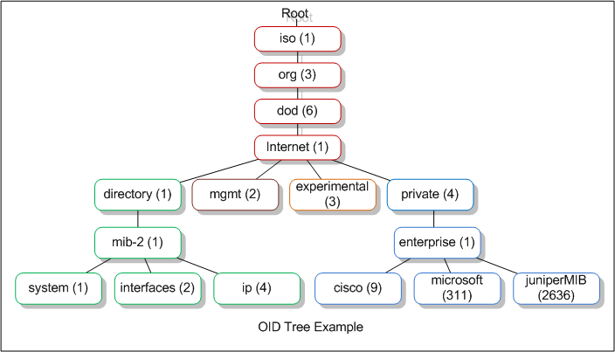
Simple Network Management Protocol
Network Management
Management Information Base (MIB)

Slide 10
Simple Network Management Protocol
Network Management
7 types of SNMP Messages known as Protocol Data Units (PDU):
  GetRequest
  A manager-to-agent request to retrieve the value of a variable.
  SetRequest
  A manager-to-agent request to change the value of a variable.
  GetNextRequest
  A manager-to-agent request to discover available variables and their values
  GetBulkRequest
  A manager-to-agent request for multiple iterations of GetNextRequest.
  Response
  Returns variable bindings and acknowledgement from manager-to-agent requests mentioned above.
  Trap
  Asynchronous notification from agent-to-manager.
  InformRequest
  Acknowledged asynchronous notification.

Slide 11
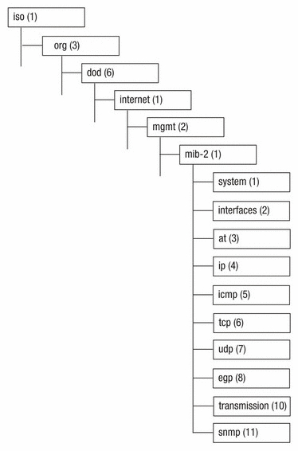
Simple Network Management Protocol
Network Management
snmpget:
communicates with a network entity
using SNMP GET requests.
snmpwalk:
Retrieves a subtree of management values
using SNMP GETNEXT requests.
Retrieve the interfaces sub-tree:
# snmpwalk -v1 -c public [IP addr] 1.3.6.1.2.1.2
MIB discovery:
http://cric.grenoble.cnrs.fr/Administrateurs/Outils/MIBS/?oid=1.3.6.1.2.1.2

Slide 12
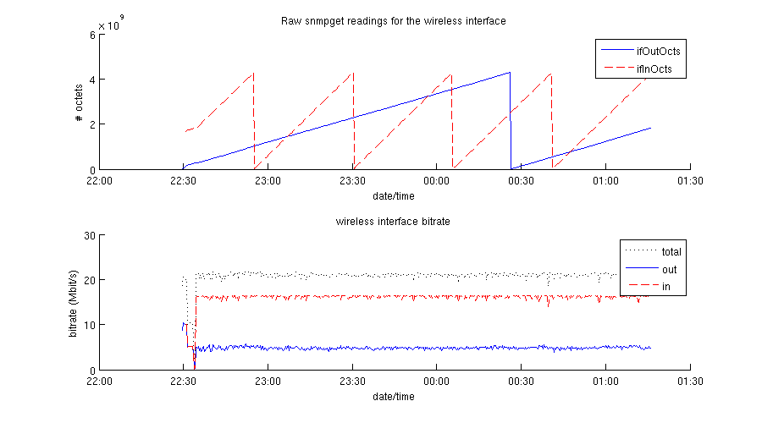
Simple Network Management Protocol
Network Management
while (true) {
snmpget -v1 -c public [IP addr] 1.3.6.1.2.1.2.2.1.10.5 // ifInOctets, 32 bit unsigned int
snmpget -v1 -c public [IP addr] 1.3.6.1.2.1.2.2.1.16.5 // ifOutOctets, 32 bit unsigned int
sleep 1 minute
}

Slide 13
Outline
Network management
  The SNMP protocol
  snmpget, snmpwalk, polling an Access Point
Wireless network interface commands
  ifconfig, iwconfig, iwlist
  airmon-ng
  tcpdump
  Wireshark

Slide 14
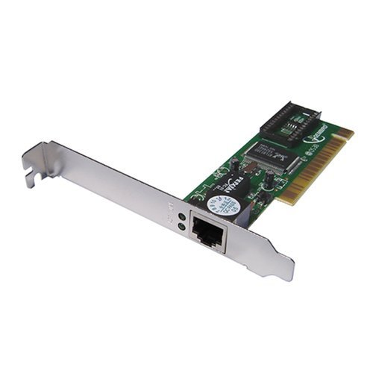
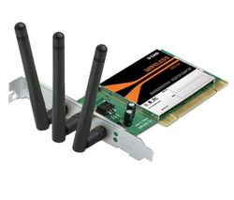
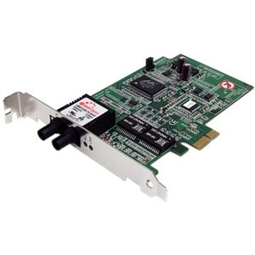
Network interface controller
Wireless interface commands
A network interface controller (NIC) (also known as a network interface card, network adapter, LAN adapter and by similar terms) is a computer hardware component that connects a computer to a computer network.
Ethernet interface
802.11 interface
Optical Ethernet interface
(1000Base-SX)

Slide 15
interface configuration
Wireless interface commands
Name
ifconfig - configure a network interface
Synopsis
ifconfig [interface]
ifconfig interface [aftype] options | address …
Description
Ifconfig is used to configure the kernel-resident network interfaces. It is used at boot time to set up interfaces as necessary. After that, it is usually only needed when debugging or when system tuning is needed.

Slide 16
interface configuration
Wireless interface commands
View Network Settings of an Ethernet Adapter:
katsarakis@jagermeister:# ifconfig eth0
eth0 Link encap:Ethernet HWaddr 00:c0:9f:98:27:05
inet addr:139.91.182.207 Bcast:139.91.182.255 Mask:255.255.255.0 inet6 addr: fe80::2c0:9fff:fe98:2705/64 Scope:Link
UP BROADCAST RUNNING MULTICAST MTU:1500 Metric:1
RX packets:414053 errors:0 dropped:9 overruns:0 frame:0
TX packets:78523 errors:0 dropped:0 overruns:0 carrier:0
collisions:0 txqueuelen:1000
RX bytes:246815934 (246.8 MB) TX bytes:47642161 (47.6 MB)
Interrupt:16

Slide 17
interface configuration
Wireless interface commands
Display Details of All interfaces Including Disabled Interfaces
# ifconfig –a
Disable an Interface
# ifconfig eth0 down
Enable an Interface
# ifconfig eth0 up
Assign ip-address, netmask and broadcast at the same time to interface eht0.
# ifconfig eth0 192.168.2.2 netmask 255.255.255.0 broadcast 192.168.2.255

Slide 18
Interface wireless configuration
Wireless interface commands
NAME
iwconfig - configure a wireless network interface
SYNOPSIS
iwconfig [interface]
iwconfig interface [essid X] [nwid N] [mode M] [freq F] [channel C][sens S ]
[ap A ][nick NN ] [rate R] [rts RT] [frag FT] [txpower T]
[enc E] [key K] [power P] [retry R]
[commit] iwconfig --help iwconfig –version
DESCRIPTION
Iwconfig is similar to ifconfig, but is dedicated to the wireless interfaces. It is used to set the parameters of the network interface which are specific to the wireless operation (for example : the frequency).

Slide 19
Interface wireless configuration
Wireless interface commands
Register to the network with Extended Service Set Identification (ESSID) “eduroam”
# iwconfig wlan0 essid “eduroam”
Associate with the Access Point (AP) with MAC address D4:D7:48:B0:87:C1
# iwconfig wlan0 ap D4:D7:48:B0:87:C1
Set the operating frequency or channel in the interface.
# iwconfig wlan0 freq 2422000000
A value below 1000 indicates a channel number, a value greater than 1000 is a frequency in Hz.
Set the transmit power to 15 dBm
# iwconfig wlan0 txpower 15
For cards that support multiple transmit powers.

Slide 20
Interface wireless list
Wireless interface commands
NAME
iwlist - Get more detailed wireless information from a wireless inter- face
SYNOPSIS
iwlist interface scanning iwlist interface frequency
iwlist interface rate iwlist interface key
iwlist interface power iwlist interface txpower
iwlist interface retry iwlist interface event
iwlist –help iwlist –version
DESCRIPTION
Iwlist is used to display some additional information from a wireless network interface that is not displayed by iwconfig.

Slide 21
Interface wireless list
Wireless interface commands
Trigger a scan: the interface will switch channels and listen for beacon frames
# iwlist wlan0 scanning
wlan0 Scan completed :
Cell 01 - Address: 00:11:93:03:1E:32
Channel:1
Frequency:2.412 GHz (Channel 1)
Quality=60/70 Signal level=-50 dBm
Encryption key:off
ESSID:"forth public access"
Bit Rates: 1 Mb/s; 2 Mb/s; 5.5 Mb/s; 6 Mb/s; 9 Mb/s; 11 Mb/s; 12 Mb/s; 18 Mb/s
24 Mb/s; 36 Mb/s; 48 Mb/s; 54 Mb/s
Mode:Master
Cell 02 - Address: 00:11:93:03:1E:33
…

Slide 22
Interface wireless list
Wireless interface commands
Select only the lines with Address or Signal level
# iwlist wlan0 scanning | grep ‘Address\|Signal’
Cell 01 - Address: 00:11:93:03:1E:32
Quality=51/70 Signal level=-59 dBm
Cell 02 - Address: 00:11:93:03:1E:31
Quality=50/70 Signal level=-60 dBm
Cell 03 - Address: 00:11:93:03:1E:30
Quality=49/70 Signal level=-61 dBm
Cell 04 - Address: 00:11:93:03:1E:34
Quality=51/70 Signal level=-59 dBm
…

Slide 23
airmon-ng
Wireless interface commands
Name
airmon-ng - a bash script designed to turn wireless cards into monitor mode
Synopsis
airmon-ng <start|stop> <interface> [channel]
Description
airmon-ng is a bash script designed to turn wireless cards into monitor mode. It autodetects which card you have and run the right commands.

Slide 24
tcpdump
Wireless interface commands
NAME
tcpdump - dump traffic on a network
SYNOPSIS
tcpdump [ -AdDeflLnNOpqRStuUvxX ] [ -c count ] [ -C file_size ] [ -F file ]
[ -i interface ] [ -m module ] [ -M secret ] [ -r file ] [ -s snaplen ]
[ -T type ] [ -w file ] [ -W filecount ] [ -E spi@ipaddr algo:secret,... ]
[ -y datalinktype ] [ -Z user ] [ expression ]
DESCRIPTION
Tcpdump prints out the headers of packets on a network interface that match the boolean expression. It can also be run with the -w flag, which causes it to save the packet data to a file for later analysis.

Slide 25
airmon-ng + tcpdump
Wireless interface commands
“The quieter you become, the more you are able to hear…”
Usually a Wi-Fi interface will, even in promiscuous mode, only capture the traffic on the BSS to which it is associated. In order to capture all traffic that the interface can receive and see the IEEE 802.11 headers, we must turn the interface in monitor mode.
Turn the interface wlan0 in monitor mode and call it mon0.
# airmon-ng start wlan0
Capture, in promiscuous mode, all traffic received by mon0, and write it in files with
  max size 10*10⁶ Bytes
  file names: wifi-capture1.pcap, wifi-capture2.pcap, …
# tcpdump –i mon0 –C 10 –w wifi-capture.pcap

Slide 26
Wireshark
Wireless interface commands
Description
Wireshark is a GUI network protocol analyzer. It lets you interactively browse packet data from a live network or from a previously saved capture file. Wireshark's native capture file format is libpcap format, which is also the format used by tcpdump and various other tools.
With Wireshark we can open a .pcap file created with tcpdump, apply filters to inspect specific packets and export network traffic statistics.
Some 802.11-related Wireshark filters can be found here:
http://sharkfest.wireshark.org/sharkfest.10/B-5_Parsons%20HANDS-ON%20LAB%20-%20WLAN%20Analysis%20with%20Wireshark%20&%20AirPcap%20Exercises.pdf

Slide 27
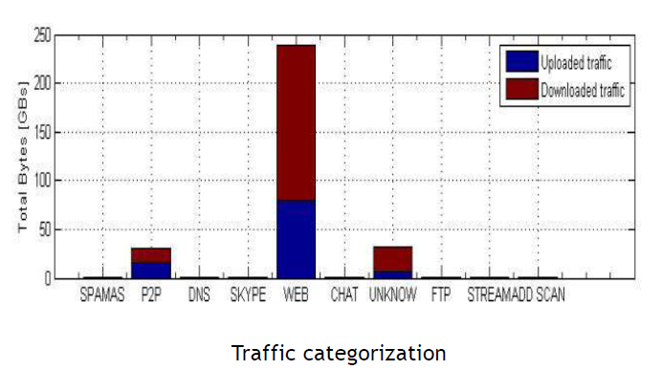
Wireshark
Wireless interface commands
General traffic statistics
  Traffic volume
  Burstiness
  Traffic volume by types
End to end statistics
  Connection throughput
  Round trip delay
  Loss rate

Slide 28
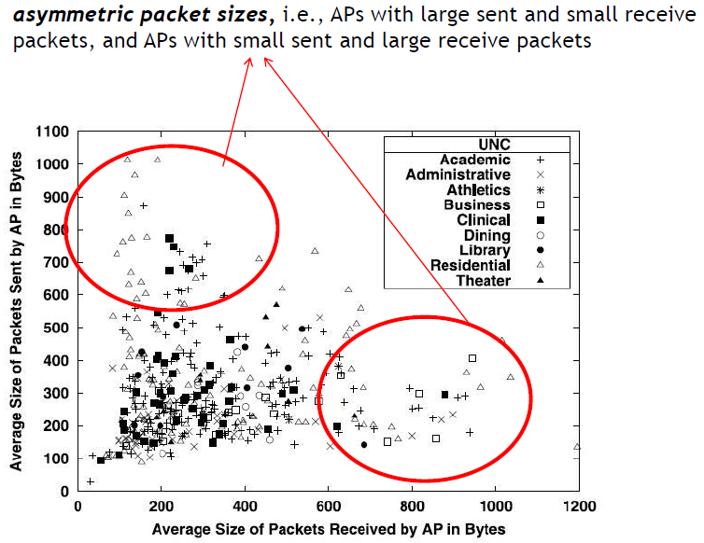
Wireshark
Wireless interface commands
General traffic statistics
  Traffic volume
  Burstiness
  Traffic volume by types
End to end statistics
  Connection throughput
  Round trip delay
  Loss rate

Slide 29
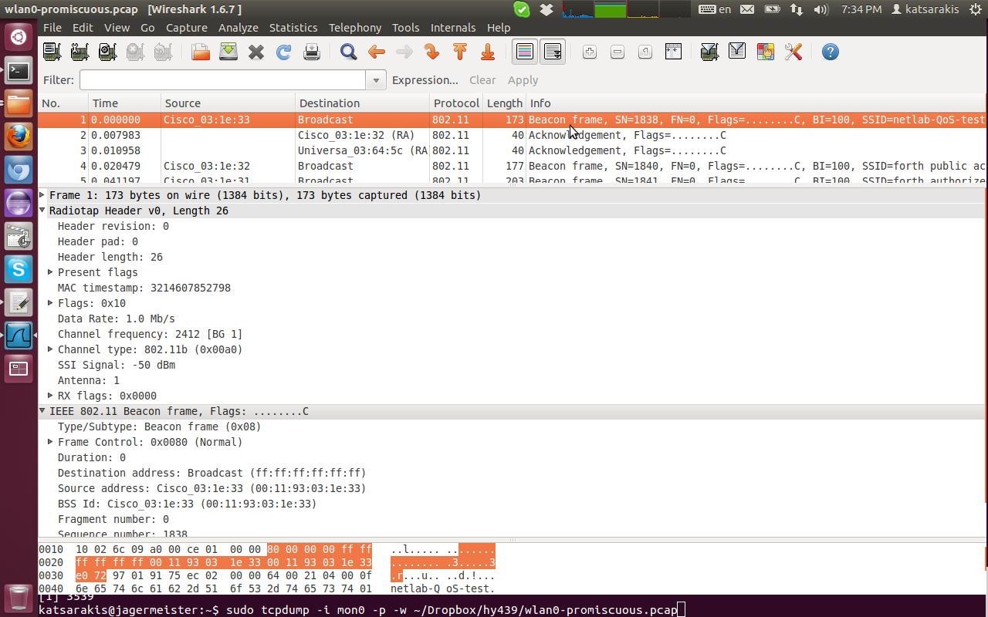
Wireshark: beacon frame
Wireless interface commands

Slide 30
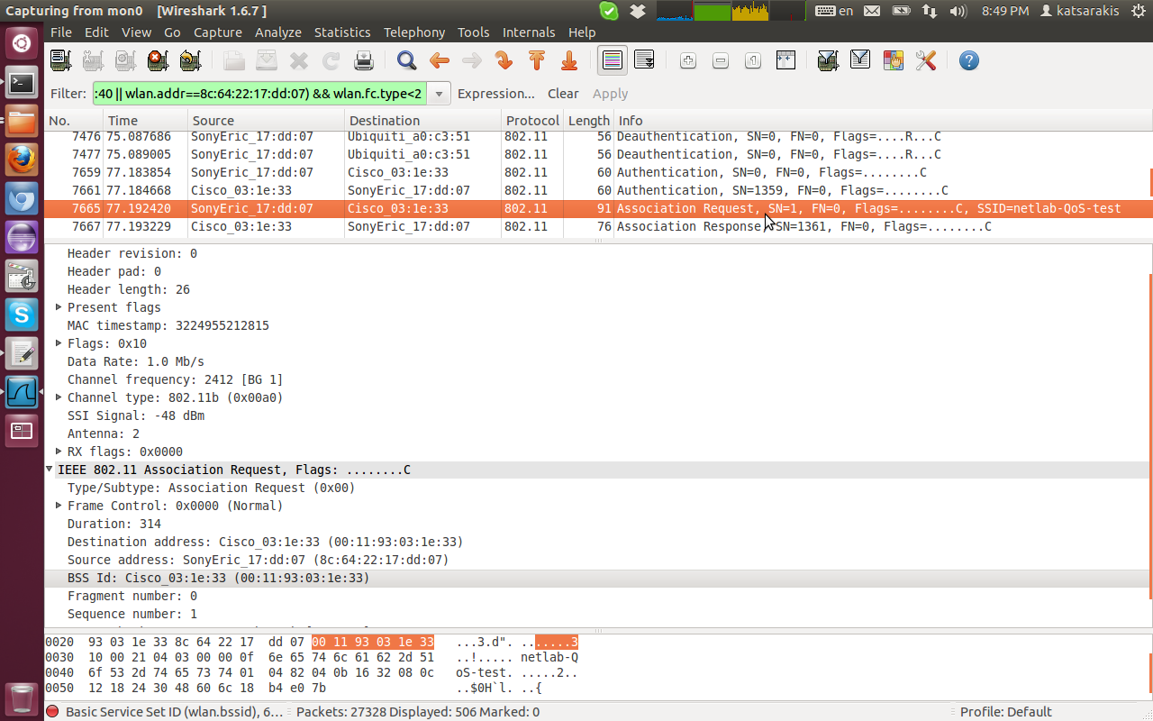
Wireshark: association request
Wireless interface commands

Slide 31
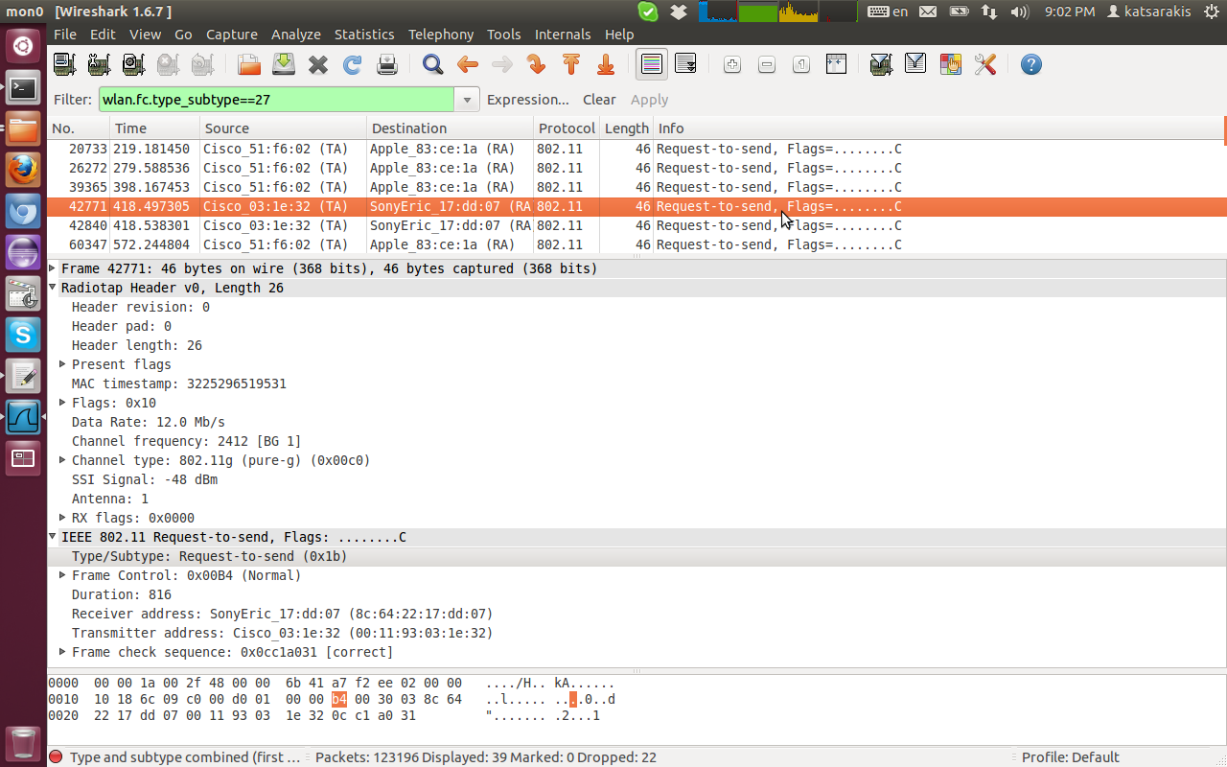
Wireshark: RTS
Wireless interface commands

Slide 32
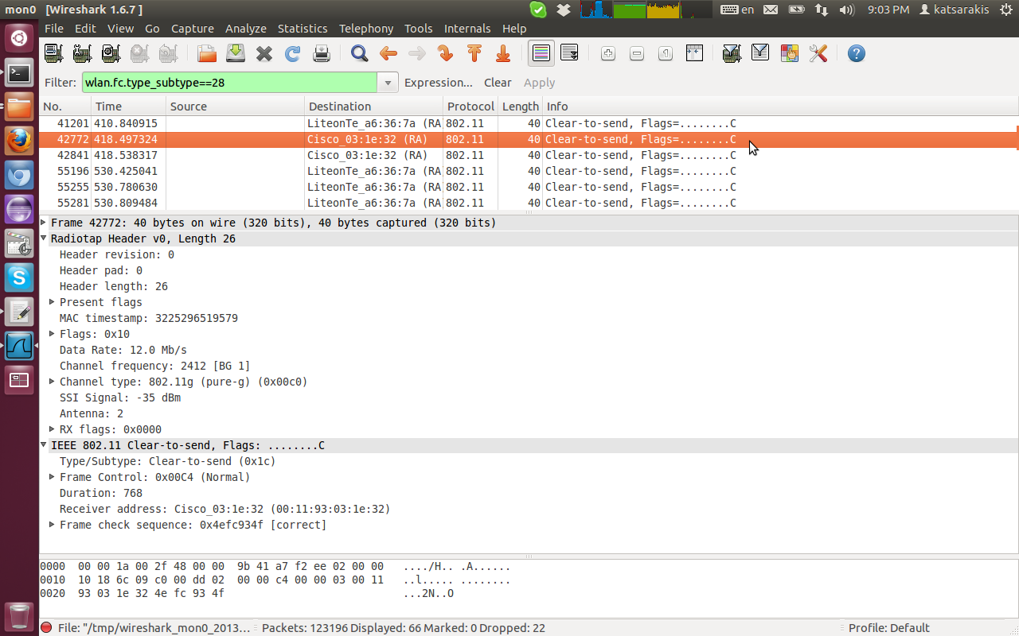
Wireshark: CTS
Wireless interface commands

Slide 33
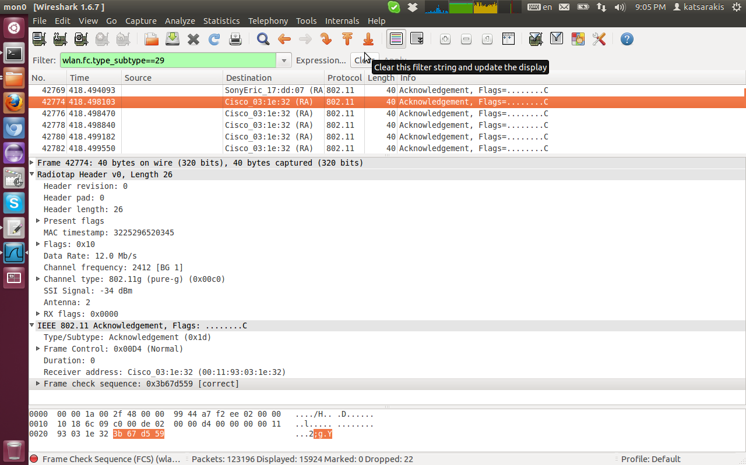
Wireshark: 802.11 ACK
Wireless interface commands

Slide 34
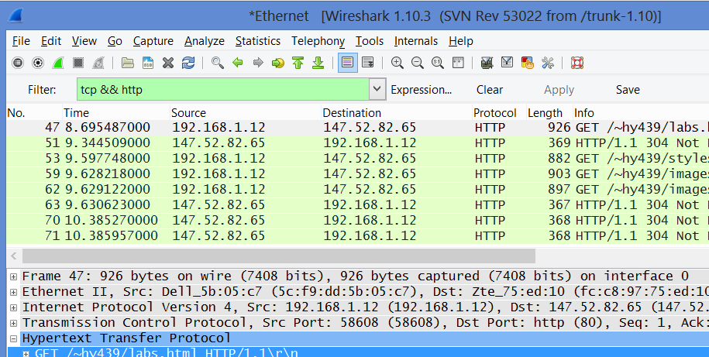
Wireshark: guides for Project 1
Wireless interface commands
1. Apply the appropriate Wireshark filter

Slide 35
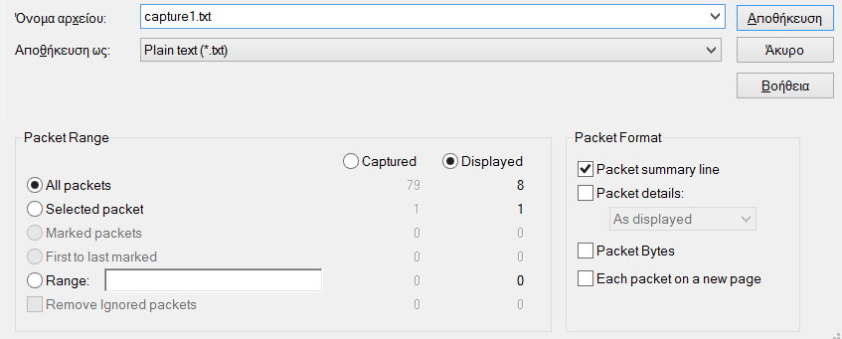
Wireshark: guides for Project 1
Wireless interface commands
2. Save captured data in text file
  File --> Export (Packet Dissections) --> As “Plain Text” file
  Packet Range: Select “All packets” & “Displayed”
  Packet Format: Check only “packet summary line”.

Slide 36
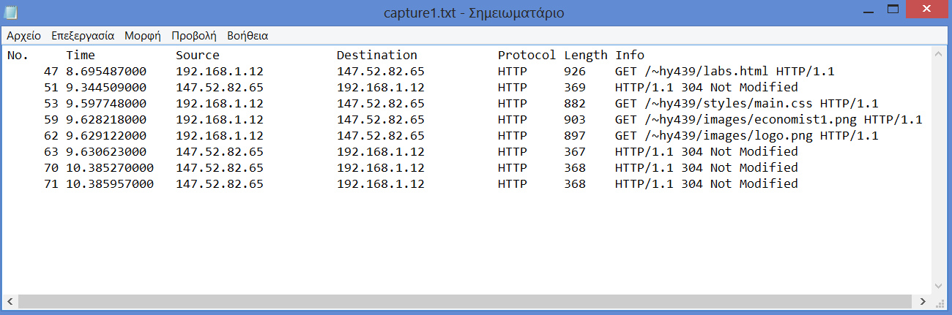
Wireshark: guides for Project 1
Wireless interface commands
2. Save captured data in text file
  File --> Export (Packet Dissections) --> As “Plain Text” file
  Packet Range: Select “All packets” & “Displayed”
  Packet Format: Check only “packet summary line”.

Slide 37
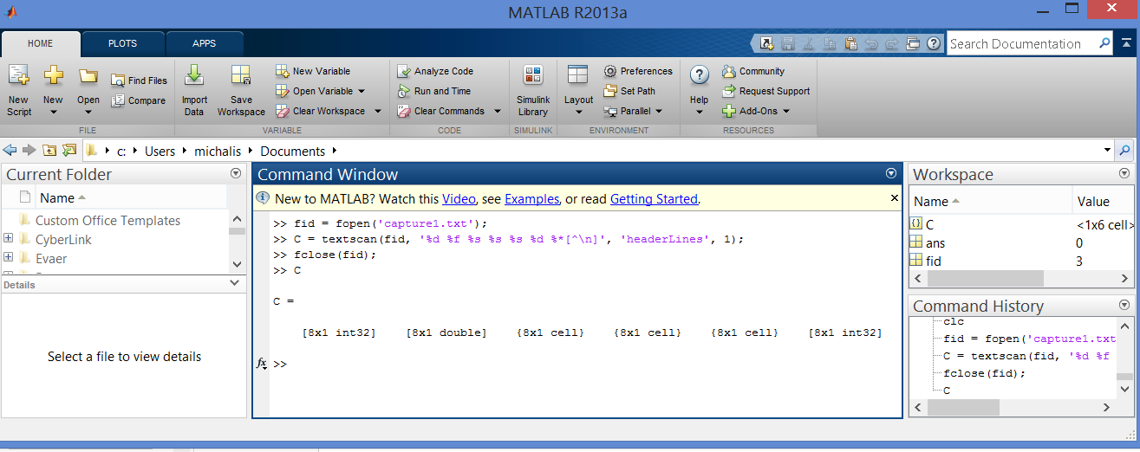
Wireshark: guides for Project 1
Wireless interface commands
3. Load saved text file in matlab
  fid = fopen('capture1.txt');
  C = textscan(fid, '%d %f %s %s %s %d %*[^\n]', 'headerLines', 1);
  fclose(fid);
Means: Ignore everything until “\n”.
No.
Time
Source
Dest.
Protocol
Length

