Slide 1
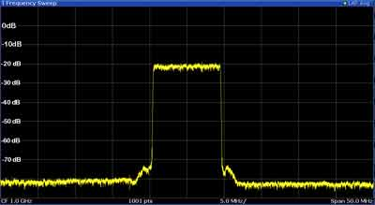
Spectrum analyser basics

Slide 2
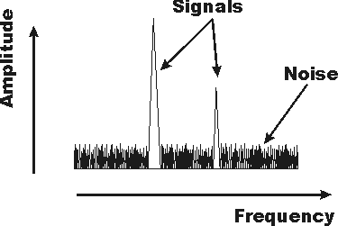
Functionality
Analyse the frequency spectrum of a radio frequency signal.
Display the spectrum in the format of amplitude (vertical) vs. frequency (horizontal) axes.
Many telecoms applications, e.g. transmitter monitoring
for interference avoidance.

Slide 3
Types
-Swept-tuned: sweep the frequency that is analysed across
the required band. Detecting up to GHz, but relatively slow
and no phase information given.
-Fast Fourier Transform (FFT): digital analysis using FFT.
Fast response (e.g. for one-shot phenomena), but lower
frequency range and more expensive.
-Real-time: special type of FFT spectrum analyser, which
analyses the spectrum in real-time.
-Audio: focused on audio frequencies (20 Hz - 20 KHz) and
much cheaper.

Slide 4
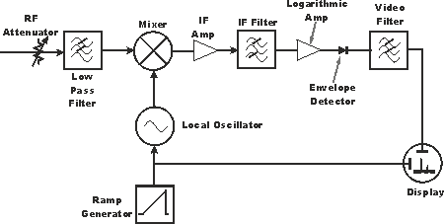
Swept-tuned type
Uses a mixer and a local oscillator to translate the input
frequency:
(i)
(i)
(i)
(i)
(i)
(i)
(i)
(i)
(i)
(i)

Slide 5
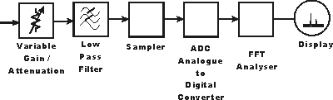
FFT type
(i)
(i)
(i)
(i)
(i)
(i)
The speed of the Analog-to-Digital Converter places a limit
on the input frequency range supported.

Slide 6
Spectrum analyser specifications
- Frequency coverage: determines the lowest and highest
input frequency that can be viewed.
- Amplitude accuracy: usually of the order of 0.4 dB, can
be in excess of 100 dB with the use of a power meter.
- Frequency accuracy: depends on the reference source of
the synthesizer and the peak detection circuitry.

Slide 7
Spectrum analyser specifications (2)
- Sensitivity: represents the low signal performance in
dBm/Hz at a given frequency.
- Phase noise: should be at least 10 dB better than the phase
noise (of the signal source) that needs to be measured.
-Dynamic range: determines the ability of the device to look
at small signals in the presence of close strong signals.

Slide 8
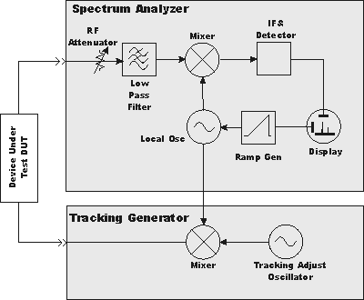
Tracking generator
Enables a spectrum analyser to make response or network
measurements (e.g. frequency response, conversion loss,
return loss):
(i)
(i)
(i)
(i)
(i)
(i)
(i)
(i)
(i)

Slide 9
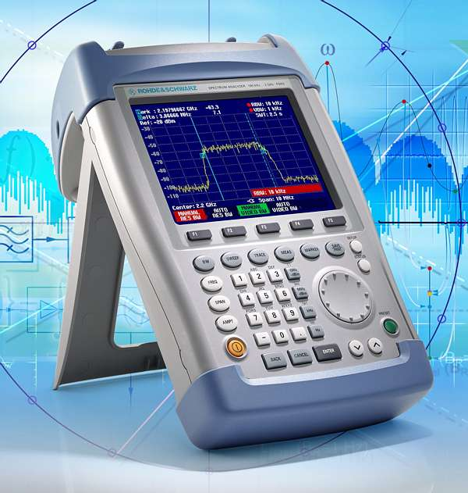
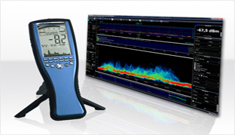
Spectrum analysers
Rohde & Schwarz FSH-6
Spectran Data Logger HF6060
Spectran Data Logger HF6080
Spectran Data Logger HF60100
Spectran Data Logger NF5030

Slide 10
Specifications
Model | FSH-6 | HF6060 | HF6080 | HF60100 | NF5030
Frequency range | 100 KHz – 6 GHz | 10 MHz – 6 GHz | 10 MHz – 8 GHz | 1 MHz – 9.4 GHz | 1 Hz – 1 MHz
Sweep time | 1 ms – 100 s | down to 10 ms | down to 10 ms | down to 1 ms | down to 10 ms
Resolution bandwidth | 100 Hz – 1 MHz | 3 KHz – 50 MHz | 1 KHz – 50 MHz | 200 Hz – 50 MHz | 0.3 Hz – 1 MHz
Displayed average noise level | -135 dBm | -135 dBm | -145 dBm | -155 dBm | -150 dBm
Accuracy | 0.5 dB | 2 dB | 2 dB | 1 dB | 3 %
Interface | RS-232-C | USB | USB | USB | USB
Mobility | Handheld (2.5 kg) | Handheld (430 gram) | Handheld (430 gram) | Handheld (430 gram) | Handheld (420 gram)
Cost | $10,000 | €1,000 | €1,300 | €1,500 | €1,000

Slide 11
Elements of a swept-tuned analyser
RF attenuator: adjusts the level of the signal entering the mixer so that the latter is not damaged and the system
falls into its nominal operation region.
Low-pass filter: removes out-of-band signals before the
mixer.
Mixer: shifts the input frequencies to the desired range.
IF amplifier: ensures the IF stage provide the required
gain. Used in conjuction with the RF attenuator.

Slide 12
Elements of a swept-tuned analyser (2)
IF filter: restricts the bandwidth viewed, effectively
increasing the frequency resolution.
Local oscillator: must support wide range of frequencies and produce very low phase noise.
Ramp generator: used to link the horizontal axis of the display to the frequency.
Envelope detector: converts the signal from the IF filter into a voltage signal that is sent to the display.

Slide 13
Elements of a swept-tuned analyser (3)
Video filter: used to smooth the display by removing noise from the envelope.
Display: where signal spectra are viewed. Usually made from liquid crystals.

Slide 14
Elements of an FFT analyser
Attenuator/gain controller: adjusts the signal level prior to the analog-to-digital conversion.
Low-pass filter: filter out too high frequencies to satisfy the Nyquist criterion.
Sampler & ADC: samples are taken at discrete time intervals and a digital format is produced.
FFT analyser: converts the data from the time into the
frequency domain.

Slide 15
Elements of an FFT analyser (2)
Display: where signal spectra are viewed.

Slide 16
Tracking generator
RF attenuator: adjusts the level of the signal entering the mixer so that the latter is not damaged and the system
falls into its nominal operation region.
Low-pass filter: removes out-of-band signals before the
mixer.
Mixer: shifts the input frequencies to the desired range.
Local oscillator: must support wide range of frequencies and produce very low phase noise.

Slide 17
Tracking generator (2)
IF amplifier: ensures the IF stage provide the required
gain. Used in conjuction with the RF attenuator.
Envelope detector: converts the signal from the IF filter into a voltage signal that is sent to the display.
Ramp generator: used to link the horizontal axis of the display to the frequency.
Display: where signal spectra are viewed. Usually made from liquid crystals.

