Slide 1
On the (Glottal) Inverse Filtering of Speech Signals
An introduction
CS578-Digital speech signal processing
Invited lecture

Slide 2
On the (Glottal) Inverse Filtering of Speech Signals
Introduction
Inverse Filtering Techniques
Conclusions

Slide 3
Introduction

Slide 4
On the (Glottal) Inverse Filtering of Speech Signals
The human speech production system is a complicated system
From an engineering point of view, it can be roughly divided into three parts [1]
The vocal folds, which is the source of the system
The vocal tract filter, which is the path from the vocal folds to the lips
The lip radiation, which is the final bound before system output

Slide 5

On the (Glottal) Inverse Filtering of Speech Signals
Based on this simplification, voiced speech can be modeled as a linear filtering operation:
$$s\left(n\right)=g\left(n\right)∗h\left(n\right)∗r\left(n\right) ↔S\left(z\right)=G\left(z\right)H\left(z\right)R\left(z\right)$$
where $∗$ denotes convolution and
$g(n)$ is the glottal airflow velocity waveform
$h(n)$ is the vocal tract filter
$r(n)$ is the lip radiation filter

Slide 6
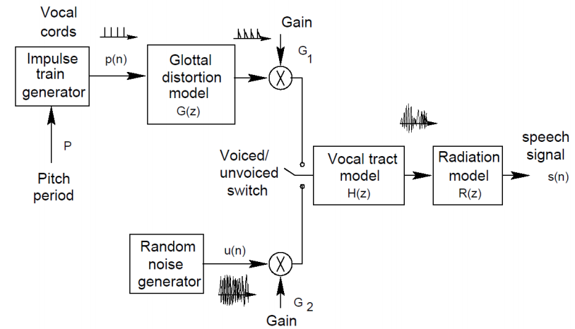
On the (Glottal) Inverse Filtering of Speech Signals

Slide 7
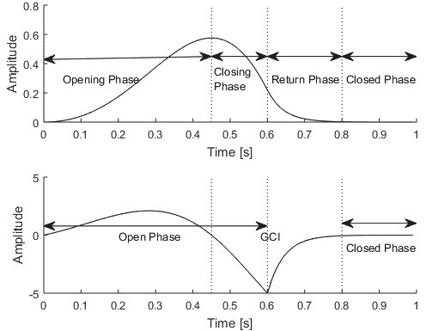
On the (Glottal) Inverse Filtering of Speech Signals
What is Glottal Inverse Filtering (GIF)?
GIF refers to techniques for obtaining the source of voiced speech, the glottal airflow velocity waveform, from voiced speech itself [10]
How does this signal look like?
Open phase: air flows through the glottis
Return phase: vocal folds are snapping shut
Closed phase: glottis is shut and airflow velocity is zero

Slide 8

On the (Glottal) Inverse Filtering of Speech Signals
While radiation occurs after the vocal tract filter, we often combine $G(z)$ and $R(z)$ into a single expression
This applies the radiation effect to the glottal source before it enters the vocal tract
Effect of differentiation on the source
The resulting signal is the so-called glottal flow derivative
Very commonly used in literature

Slide 9
On the (Glottal) Inverse Filtering of Speech Signals
Why bother?
Basic research of speech production
Applications to speech analysis, synthesis, and modification
Environmental voice care
Voice pathology detection
Analysis of the emotional content of speech
Voice source modeling for TTS

Slide 10

On the (Glottal) Inverse Filtering of Speech Signals
Basic idea:
Form a computational model for the vocal tract filter, $H(z)$
Cancel its effect from the speech waveform by filtering the speech signal through the inverse of the model, $\frac{1}{H\left(z\right)}$

Slide 11
On the (Glottal) Inverse Filtering of Speech Signals
Problem:
The actual glottal flow waveform IS NOT AVAILABLE!
…at least in a non-invasive manner [18]
Approaches:
“Visual” inspection of the resulting glottal flow waveform
Use of synthetic speech signal produced by a known artificial excitation
Compare the results of different GIF algorithms
None of the previous approaches is truly objective

Slide 12
On the (Glottal) Inverse Filtering of Speech Signals
One solution is to build a physical model of the speech production mechanism
Generate waveforms from such model
Time-varying waveforms are simulated
Such waveforms are expected to provide a more firm and realistic test of GIF methods
Both the speech output and the source are available
A well known dataset of such signals is described in [2,6]

Slide 13
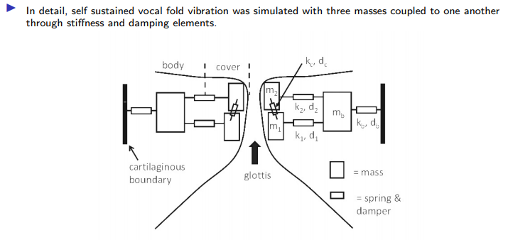
On the (Glottal) Inverse Filtering of Speech Signals

Slide 14
On the (Glottal) Inverse Filtering of Speech Signals
The model has a parametrized input such as
Lung pressure
Prephonatory glottal half-width (adduction)
Vocal fold length and thickness
Activation levels of the cricothyroid and thyroarytenoid muscles

Slide 15
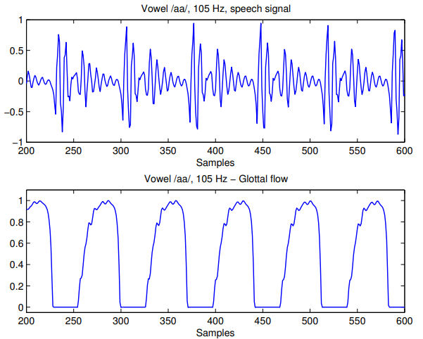

On the (Glottal) Inverse Filtering of Speech Signals

Slide 16
GIF techniques

Slide 17
On the (Glottal) Inverse Filtering of Speech Signals
Since we already know about Linear Prediction (LP), we will discuss GIF methods based only on that
You already know two methods for estimating LP coefficients
Autocorrelation method: zero samples outside prediction error interval –minimize MSE everywhere
Covariance method: non-zero samples outside prediction error interval – minimize MSE inside prediction error interval

Slide 18

On the (Glottal) Inverse Filtering of Speech Signals
LP is used to produce all-pole models of the vocal tract filter $H\left(z\right)=\frac{G}{1−\sum_{k=1}^{p}{a_{k}z^{−k}}}$
where $p$ is the filter order and $a_{k}$ are the LP coefficients
In general, LP minimizes the MSE over a region R $E=\sum_{R}{e^{2}[n]}$
where $e\left[n\right]=s\left[n\right]−\sum_{k=1}^{p}{a_{k}s[n−k]}$

Slide 19

On the (Glottal) Inverse Filtering of Speech Signals
How can we find the source excitation through LP analysis?
If we consider speech as an AR process $s\left[n\right]=Ag\left[n\right]+\sum_{k=1}^{p}{a_{k}s[n−k]}⇒Ag\left[n\right]=s\left[n\right]−\sum_{k=1}^{p}{a_{k}s[n−k]}$
then minimization of the MSE leads to $e\left[n\right]≈Ag[n]$
Thus, the prediction error (or residual) can be thought of an estimation of the source excitation
But how are glottal source and residual related?

Slide 20
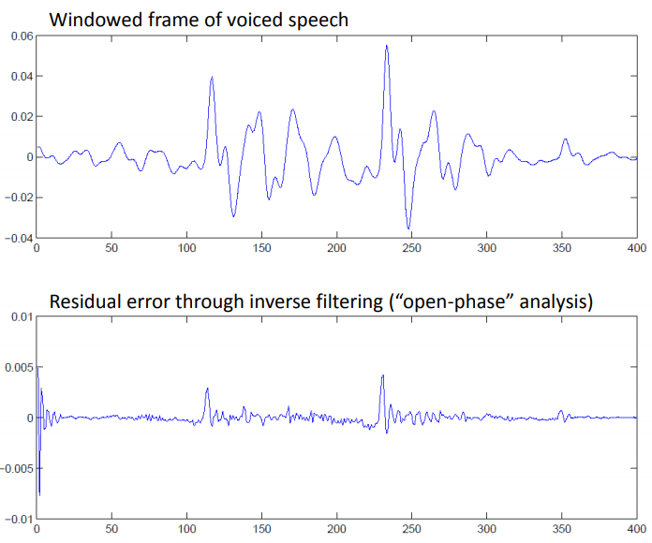
On the (Glottal) Inverse Filtering of Speech Signals
Speech frame
Residual (prediction error)

Slide 21

On the (Glottal) Inverse Filtering of Speech Signals
But how are glottal source and residual related?
As you’ve seen, the two signals do not quite match
The reason is that the Z transform of speech is a combined transfer function
$$Y\left(z\right)=G\left(z\right)R\left(z\right)H(z)$$
$G(z)$ can be further decomposed as an impulse sequence passed through a glottal filter: $G\left(z\right)=I\left(z\right)U\left(z\right)$, where $I\left(z\right)$ is the impulse sequence
Thus $Y(z)$ contains
Zeros from the glottal source and lip radiation
Poles from the glottal filter and the vocal tract filter

Slide 22

On the (Glottal) Inverse Filtering of Speech Signals
LP analysis provides an overall transfer function $\hat{H}(z)$ where all these contributions are combined!
…not to mention that we’re using an all-pole method for a pole-zero signal…
So what we are cancelling via simple LP-based GIF is this overall estimation
…resulting into something that looks like a series of impulses!
So how can we work this out?
Identify instants where there is no interaction between the source and the filter!

Slide 23

On the (Glottal) Inverse Filtering of Speech Signals
Closed-phase analysis
Identify regions where the vocal folds are closed
No contribution from $G(z)$, the speech signal should contain vocal tract and radiation factors $H\left(z\right)R(z)$
$R(z)$ can be modeled as a differentiator (single-zero FIR filter), so it can be cancelled by a simple integrator
Vocal tract estimation in the closed phase region leads to a more precise result
Estimation in the closed phase → cancelling vocal tract via GIF over the whole pitch period
Use of covariance-based LP on the closed-phase [9]

Slide 24
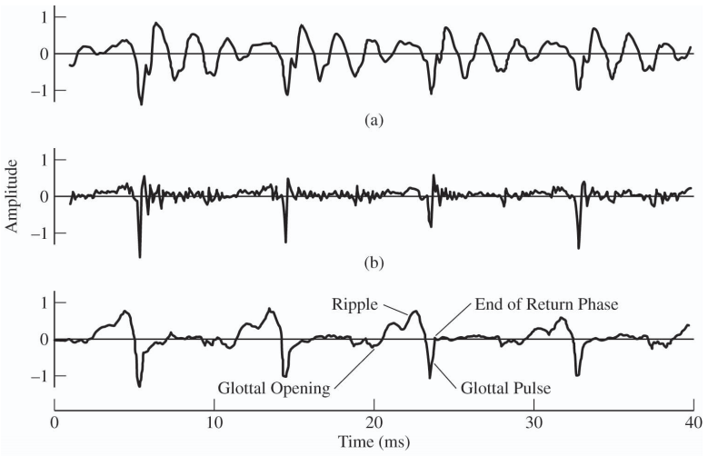
On the (Glottal) Inverse Filtering of Speech Signals
Closed-phase analysis

Slide 25
On the (Glottal) Inverse Filtering of Speech Signals
However, standard closed-phase covariance LP suffers from certain shortcomings
Short closed phase duration (especially for high pitched speakers)
Too few samples to obtain a good estimation
Sensitivity to the exact position of the covariance frame
Small variation from the exact closed phase interval produces artifacts
Vocal tract filter instability
Covariance-based LP does not guarantee a stable filter
Inverse filter might not be minimum phase

Slide 26
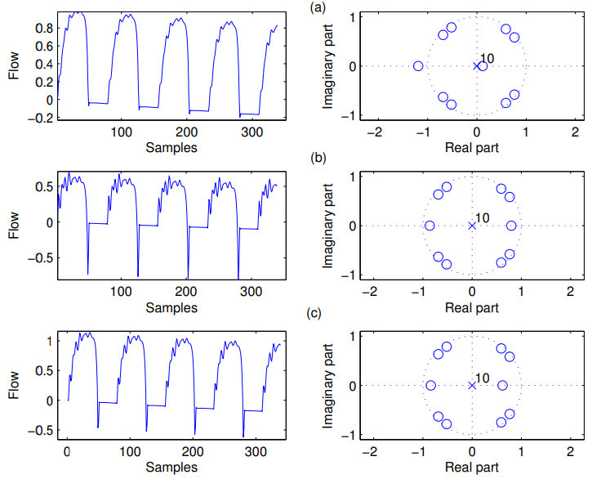
On the (Glottal) Inverse Filtering of Speech Signals
Frame position sensitivity

Slide 27
On the (Glottal) Inverse Filtering of Speech Signals
The effect of an inverse filter root which is located on the positive real axis has the properties of a first order differentiator, when the root approaches the unit circle
A similar effect is also produced by a pair of complex conjugate roots at low frequencies
This distortion is more apparent at the time instants where the glottal flow changes more rapidly, that is, near glottal closure
The presence of such roots are in contrast to the source-filter suggested theory
The removal of such roots results in less dependency on the covariance frame location

Slide 28
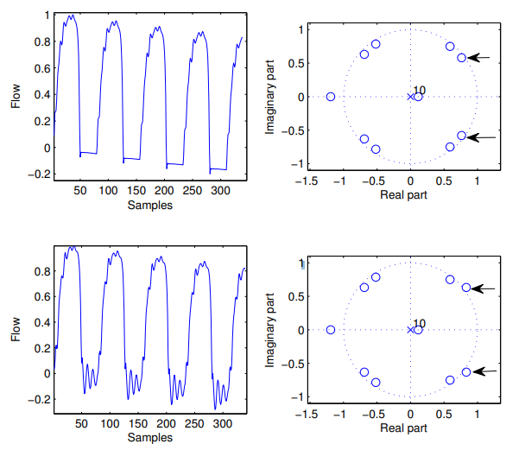
On the (Glottal) Inverse Filtering of Speech Signals
Non-minimum phase inverse filter

Slide 29

On the (Glottal) Inverse Filtering of Speech Signals
The inverse filter $1/H(z)$ might not be minimum phase
As we know from basic DSP, it can become minimum phase by replacing each zero by its mirror image partner
That leaves the magnitude spectrum unchanged
The phase characteristics change, though

Slide 30
On the (Glottal) Inverse Filtering of Speech Signals
Still, the computational load of covariance-based LP along with its shortcomings (cases of very small CP, frame dependent, CP identification) might make the method not appropriate
Idea: use autocorrelation method with “enhancements”
Fast & stable
Not optimal but good enough
Try to introduce “enhancements”
Try to approach performance of CP analysis without detecting CP

Slide 31
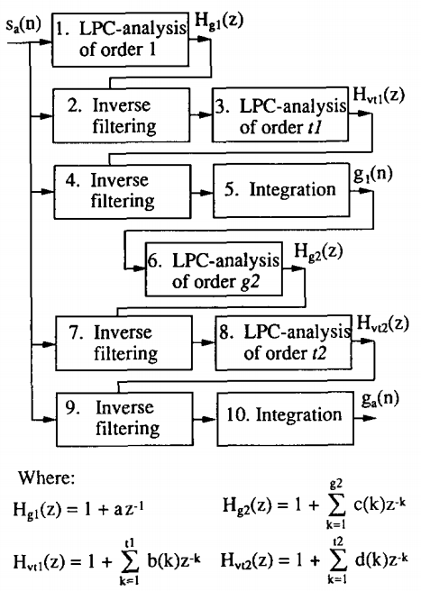
On the (Glottal) Inverse Filtering of Speech Signals
Iterative Adaptive Inverse Filtering [4]
An iterative method for obtaining the glottal source
Motivation:
A priori knowledge of the overall shape of the vocal tract
Cancel the tilting effect of the glottal source
Estimate vocal tract filter

Slide 32
On the (Glottal) Inverse Filtering of Speech Signals
Iterative Adaptive Inverse Filtering [4]
First iteration
1. LPC of order 1 to model the effect of the glottal source on the speech spectrum
2. Cancel 1.
3.LPC of high order to model the vocal tract
4&5. Cancel vocal tract and lip radiation

Slide 33
On the (Glottal) Inverse Filtering of Speech Signals
Iterative Adaptive Inverse Filtering [4]
Second iteration
6. LPC of order 2-4 to more accurately model the effect of the glottal source on the speech spectrum
7. Cancel 6.
8.LPC of high order to model the vocal tract
9&10. Cancel vocal tract and lip radiation

Slide 34
On the (Glottal) Inverse Filtering of Speech Signals
Stabilized Weighted Linear Prediction [5,7]
An all-pole method based on Weighted Linear Prediction (WLP)
Idea: use standard autocorrelation method but give more weight to some samples of the autocorrelation matrix compared to others
How to give more weight?

Slide 35
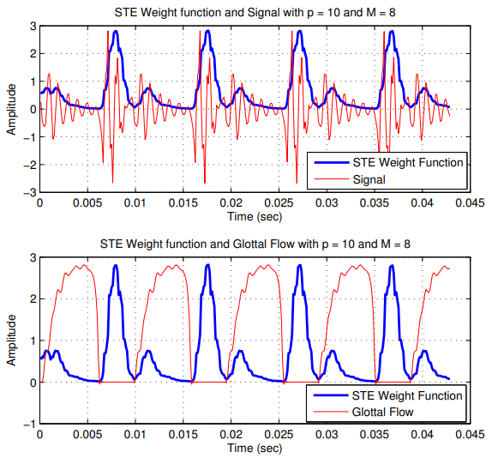
On the (Glottal) Inverse Filtering of Speech Signals
Stabilized Weighted Linear Prediction
Compute the short time energy (STE) of the signal
High energy samples fall in the closed phase region!

Slide 36

On the (Glottal) Inverse Filtering of Speech Signals
Stabilized Weighted Linear Prediction
STE function emphasizes the speech samples of large amplitude, which typically occur during the closed phase interval
By emphasizing on error samples that occur during the glottal closed phase, it is likely to yield more robust acoustical cues for the formants
The method depends on a parameter $M$, the energy window length
A high value of $M$ increases the sharpness of the resonances of the spectrum, whereas a low value of M increases the smoothness of the spectrum

Slide 37

On the (Glottal) Inverse Filtering of Speech Signals
Stabilized Weighted Linear Prediction
STE:
$$w_{n}=\sum_{i=0}^{M−1}{x^{2}[n−i−1]}$$
Prediction error energy:
$$E=\sum_{n=1}^{N+p}{e^{2}[n]}w_{n}=a^{T}\left(\sum_{n=1}^{N+p}{w_{n}x\left[n\right]x^{T}\left[n\right]}\right)a=a^{T}Ra$$
where
$$R=\sum_{n=1}^{N+p}{w_{n}x\left[n\right]x^{T}\left[n\right]}$$

Slide 38

On the (Glottal) Inverse Filtering of Speech Signals
Stabilized Weighted Linear Prediction
Constrained minimization problem (again ☺)
Minimize $E$ subject to $a^{T}u=1$, where $u={\left[1,0,0,…,0\right]}^{T}$
It can be shown that a satisfies the linear equation
$$Ra=σ^{2}u$$
where $σ^{2}$ is the error energy
Stability is ensured by a specific algorithm

Slide 39
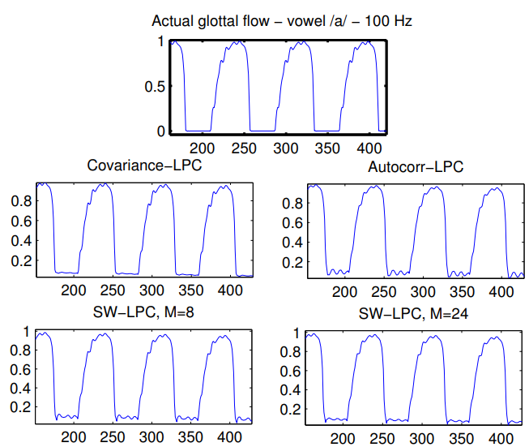
On the (Glottal) Inverse Filtering of Speech Signals
Results

Slide 40
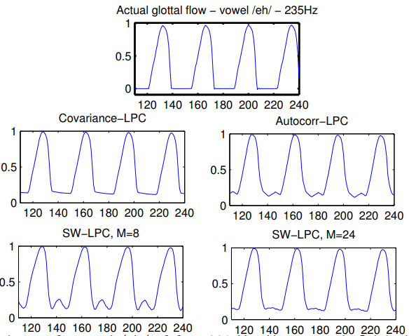
On the (Glottal) Inverse Filtering of Speech Signals
Results

Slide 41

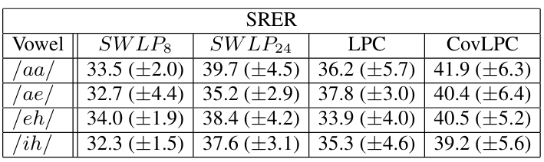
On the (Glottal) Inverse Filtering of Speech Signals
Results

Slide 42

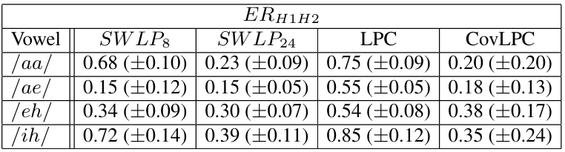
On the (Glottal) Inverse Filtering of Speech Signals
Results

Slide 43
Conclusions

Slide 44
On the (Glottal) Inverse Filtering of Speech Signals
GIF has been around for more than five decades
Attractive analysis method
Non-invasive
Using only speech signal
Mostly automatic
Applications in many speech technologies
Still improving! (QCP Analysis [16])
Software: OPENGlot, Aparat, etc

Slide 45
On the (Glottal) Inverse Filtering of Speech Signals
GIF has been around for more than five decades
Shortcomings
Recording should be made with caution
Introducing non-linearities that distort GIF result
“Ground truth” is very rarely available
Synthetic speech or physiologically modeled data is used
Unreliable analysis of certain voice types [11,12]
High-pitch speech, low F1, vulnerability of best method (closed-phase CP)
Based on all-pole methods → speech is pole-zero (nasal sounds)
Fixed filter coefficients over successive periods

Slide 46
References
[1] Fant G., Acoustic Theory of Speech Production (Mouton, The Hague).
[2] Story, B. and Titze, I. Voice simulation with a body-cover model of the vocal folds,” J. Acoust. Soc. Am., 97, 1249–1260, 1995.
[3] Alku, P., Magi, C., Santeri, Y., Backstrom, T., Story, B., Closed phase covariance analysis on constrained linear prediction for glottal inverse filtering, Journal of Acoustical Society of America, 125(5):3289-3305, 2009.
[4] Alku, P., Glottal wave analysis with Pitch Synchronous Iterative Adaptive Inverse Filtering. Speech Communication, 11(2-3), 109–118, 1992.
[5] Magi, C. , Pohjalainen, J., Backstrom, T., Alku, P., Stabilised Weighted Linear Prediction, Speech Communication, 51:401-411, 2009.
[6] Alku P., Story B., Airas M., Estimation of the voice source from speech pressure signals: Evaluation of an inverse filtering technique using physical modelling of voice production, Folia Phoniatr. Logo. 58(1): 102–113, 2006.

Slide 47
References
[7] Kafentzis, G., Stylianou, Y. and Alku, P.,International Conference on Acoustics, Speech, and Signal Processing, Prague, Czech Republic, May 22-27, 2011. p. 5408-5411, 2011.
[8] Airaksinen, M., Raitio, T., Story, B., & Alku, P., Quasi Closed Phase Glottal Inverse Filtering Analysis With Weighted Linear Prediction. IEEE/ACM Transactions on Audio, Speech, and Language Processing, 22(3), 596-607, 2014.
[9] M. Plumpe, T. Quatieri, and D. Reynolds, Modeling of the glottal flow derivative waveform with application to speaker identification, IEEE Transactions on Speech and Audio Processing, 7:569-586, 1999.
[10] Wong D., Markel J., Gray A., Least squares glottal inverse filtering from the acoustic speech waveform, IEEE Trans. Acoust. Speech Signal Process. 27: 350–355, 1979.

Slide 48
Other references
[11] Childers D., Ahn C., Modeling the glottal volume-velocity waveform for three voice types, J. Acoust. Soc. Am. 97(1): 505–519, 1995.
[12] Childers D., Lee C., Vocal quality factors: Analysis, synthesis, and perception. J. Acoust. Soc. Am. 90(5): 2394–2410, 1991.
[13] Milenkovic P., Glottal inverse filtering by joint estimation of an AR system with a linear input model, IEEE Trans. Acoust. Speech Signal Process. 34(1): 28–42, 1986.
[14] Raitio T., Suni A., Yamagishi Y., Pulakka H., Nurminen J., Vainio M., Alku P., HMM-based speech synthesis utilizing glottal inverse filtering, IEEE Trans. Audio Speech Lang. Process. 19(1): 153– 165, 2011.
[15] Shiga Y., King S., Estimation of voice source and vocal tract characteristics based on multi-frame analysis. CD Proc. Eurospeech, 1749–1752, 2003.

Slide 49
Other references
[16] J. Pohjalainen, R. Saeidi, T. Kinnunen, and P. Alku, Extended weighted linear prediction (XLP) analysis of speech and its application to speaker verification in adverse conditions, in Proc. Interspeech, 2010, pp. 1477–1480.
[17] T. Drugman, B. Bozkurt, and T. Dutoit, A comparative study of glottal source estimation techniques, Comp. Speech & Lang., vol. 26, no. 1, pp. 20–34, 2012.
[18] Kitzing, P., & Löfqvist, A., Subglottal and oral air pressures during phonation—preliminary investigation using a miniature transducer system. Medical & Biological Engineering, 13(5), 644–648, 1975.

