Slide 1
Voice Conversion
Dipjyoti Paul
University of Crete, Greece

Slide 2
Information in Speech

Slide 3
Voice Conversion (VC)
Technique to convert the utterance of a source speaker to create the perception as if spoken by a specified target speaker.
Only transform the speaker timbre (para-linguistic information) and keep the linguistic message in the utterance unchanged.

Slide 4
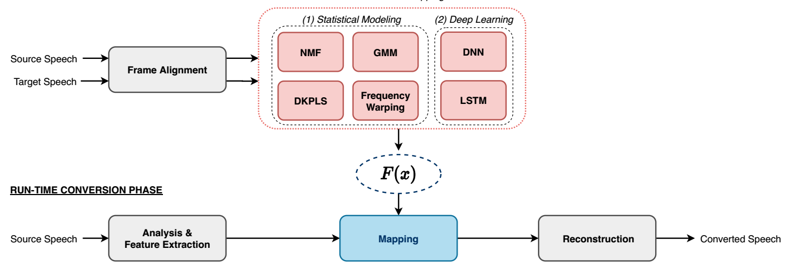
Voice Conversion

Slide 5
Applications
Text-To-Speech (TTS) customization
Film dubbing
Design of speaking aids
Education etc

Slide 6
Statistical VC

Slide 7
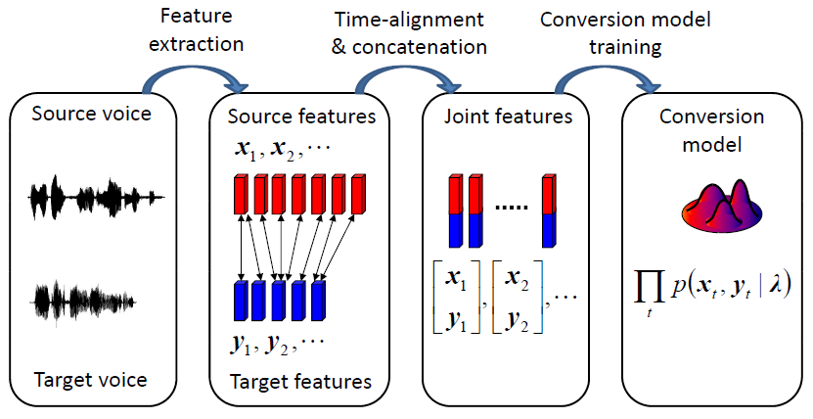
VC Training

Slide 8
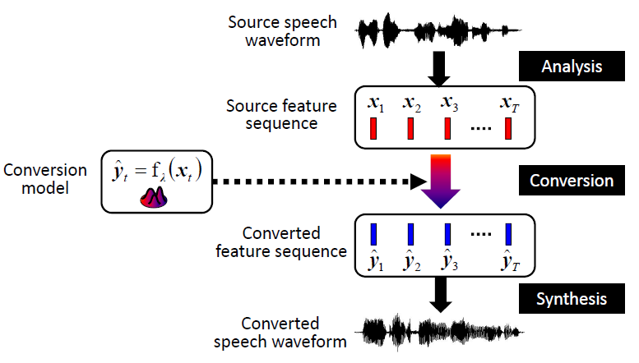
VC Inference

Slide 9
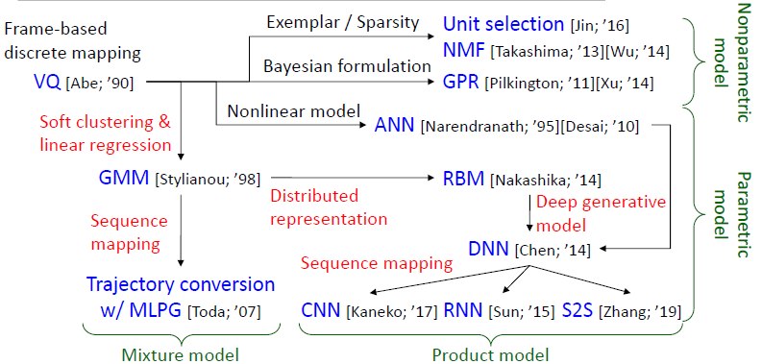
Timeline of VC Research

Slide 10
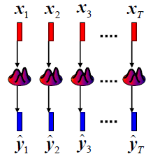
Frame-based VC
Source feature: x
Target feature: y
Converted feature: ŷ

Slide 11
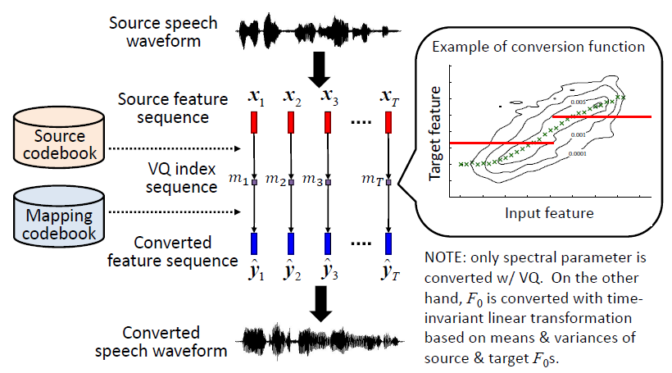
Vector Quantization-based VC
[Abe et. al. 1990]

Slide 12
Discontinuous to Continuous Conversion

Slide 13
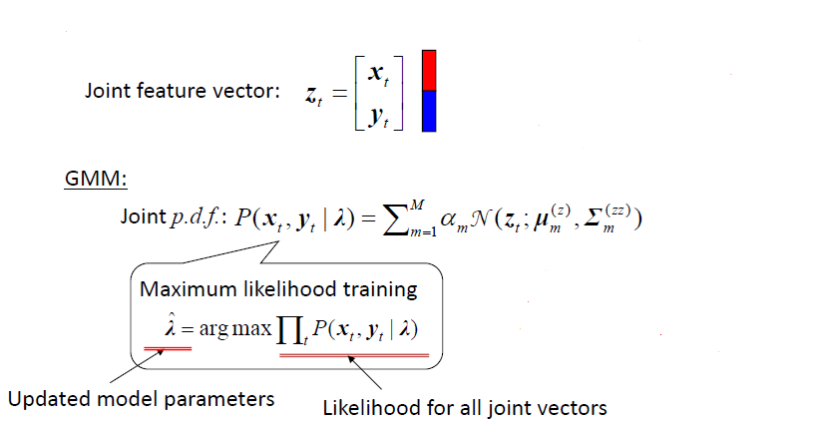
GMM based Conversion

Slide 14
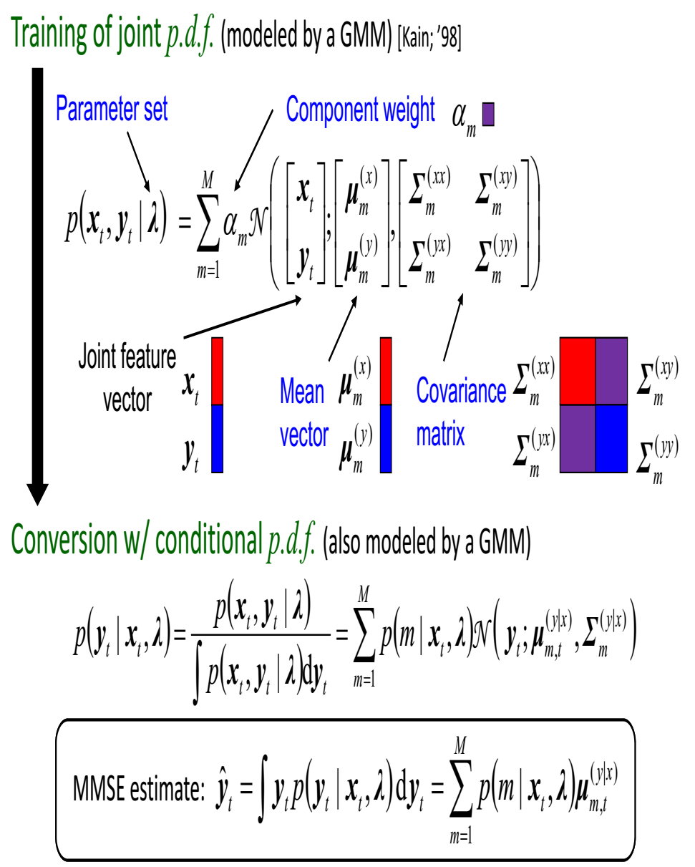
GMM based Conversion
[Stylianou et. al. 1998]

Slide 15
Sequence-based VC
[Toda et. al. 2007]

Slide 16
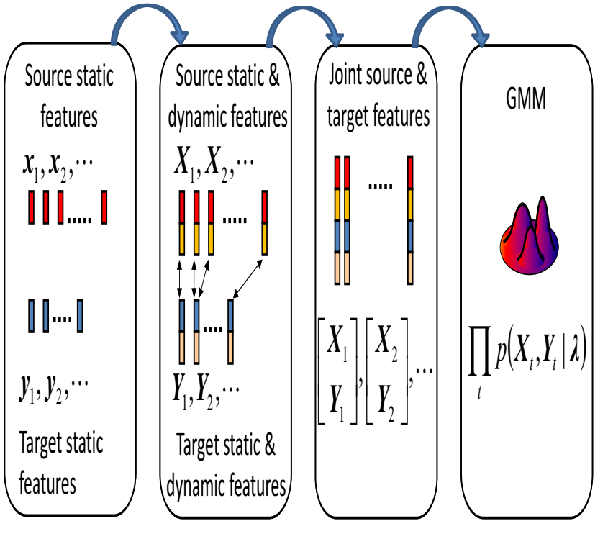
Sequence-based VC

Slide 17
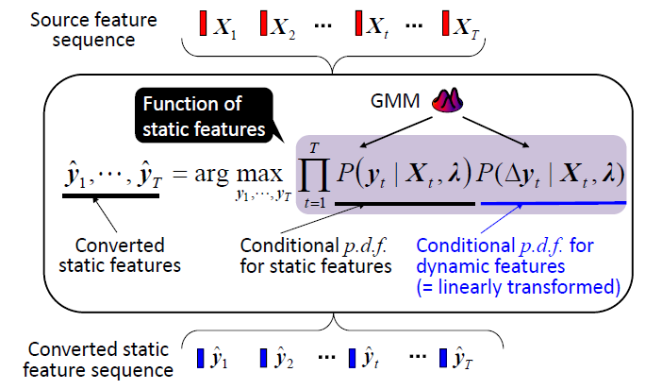
Sequence-based VC

Slide 18
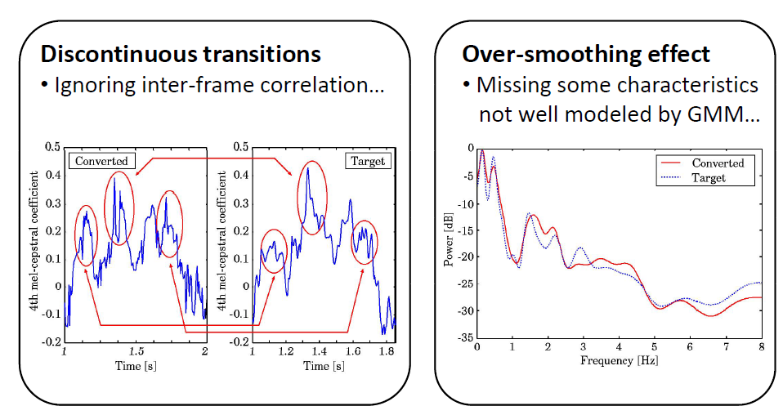
Limitations of JD-GMM

Slide 19
VC based on Deep Neural Networks

Slide 20
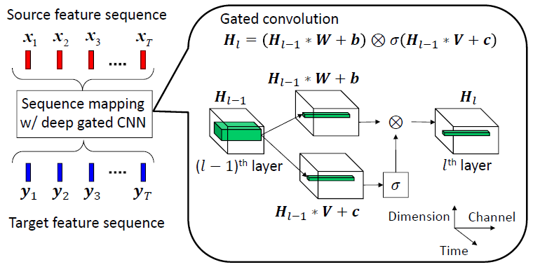
Sequence‐based VC
[Kaneko et. al. 2017]

Slide 21
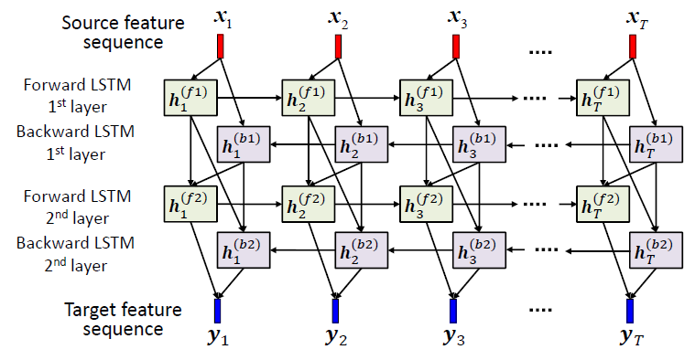
Sequence‐based VC
[Sun et. al. 2015]

Slide 22
Variational Autoencoder (VAE)-VC
The core of VAE-VC is an encoder-decoder network.
During training, given an observed (source or target) spectral frame x, a speaker-independent encoder E_{θ} with parameter set θ encodes x into a latent code:
The speaker code y of the input frame is then concatenated with the latent code, and passed to a conditional decoder G_{Φ} with parameter set Φ to reconstruct the input.
[Hsu et al, 16]

Slide 23
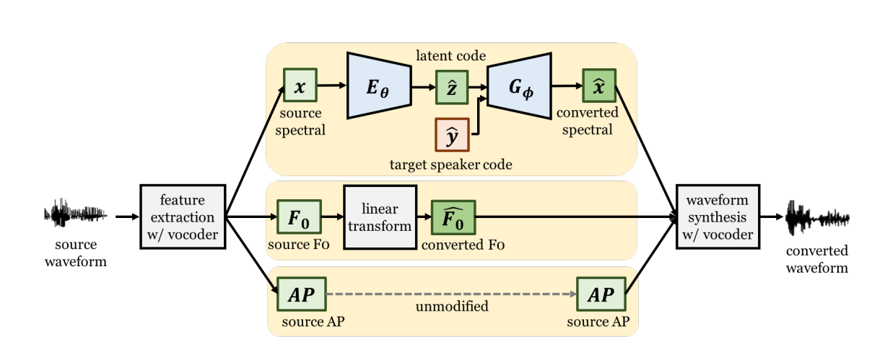
VAE-VC

Slide 24
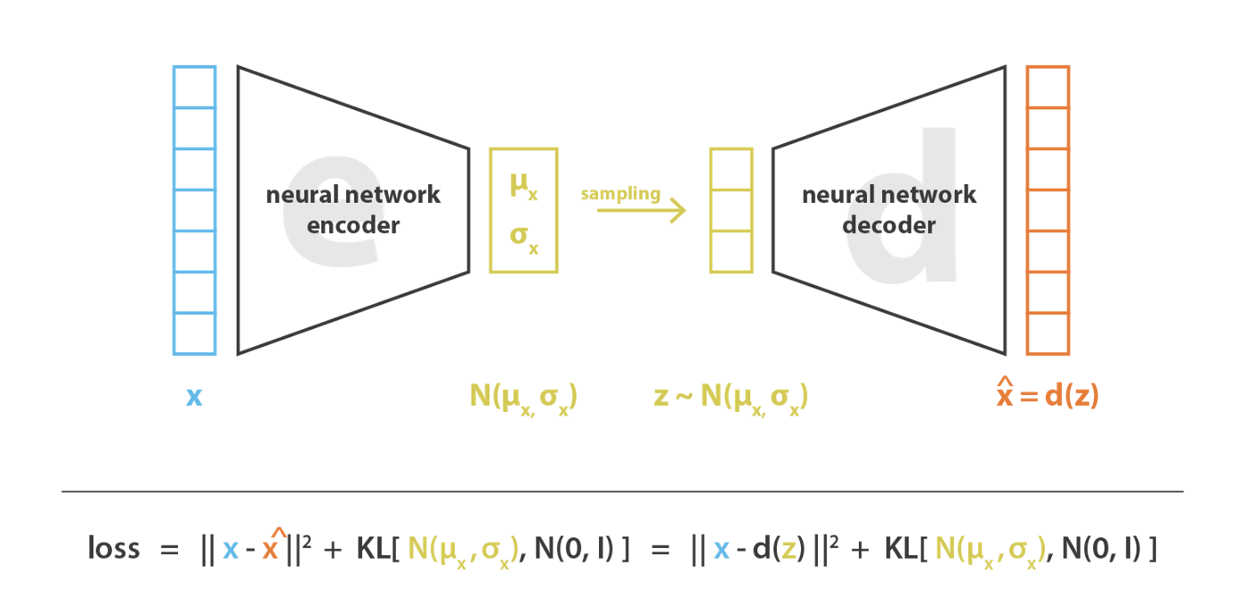
VAE

Slide 25
VAE
The model parameters can be obtained by maximizing the variational lower bound:
: approximate posterior.
: data likelihood.
: prior distribution of the latent space.
Conversion phase:
[Hsu et al, 16]

Slide 26
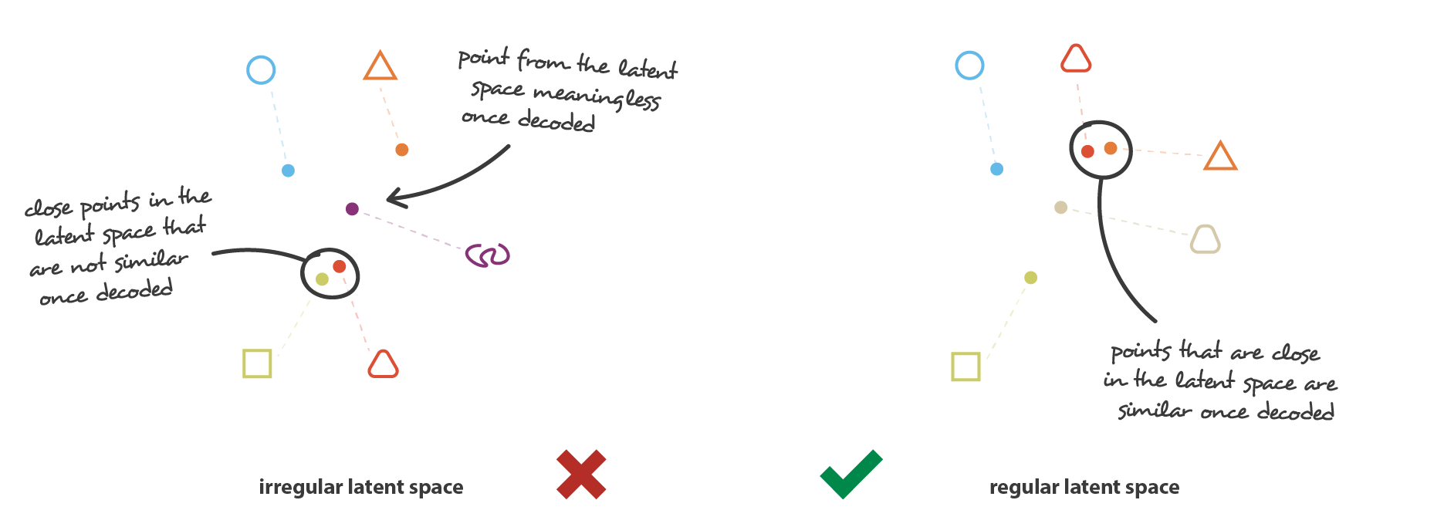
Intuitions about Regularization

Slide 27
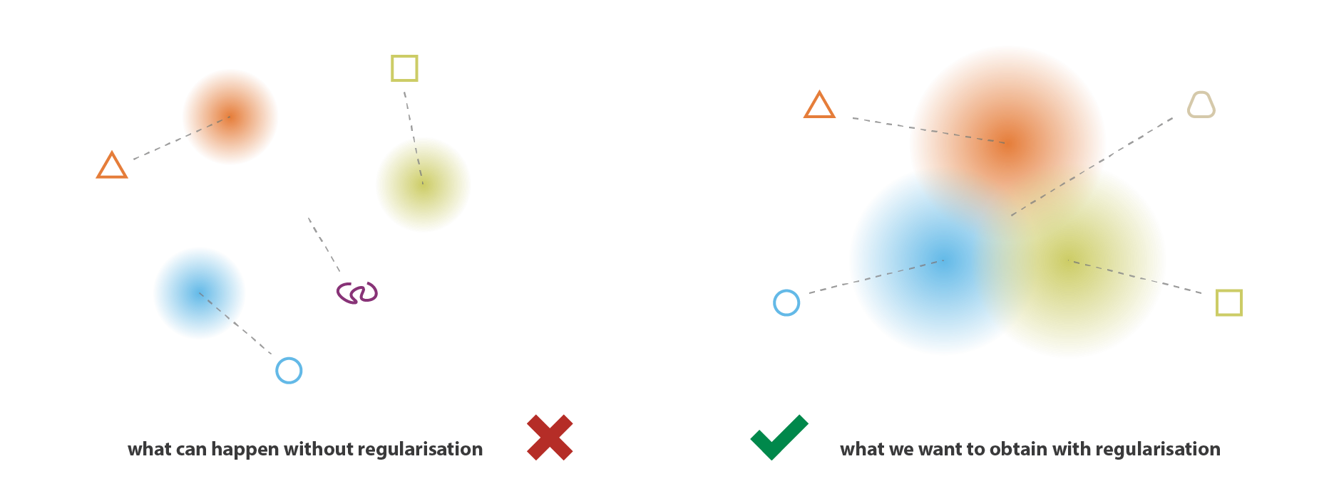

Slide 28
Vector Quantization VAE (VQ-VAE)
Directly encode speech waveform into a discrete symbol sequence capturing long‐term dependencies (including prosodic features!) by using a dilated convolution network
[van den Oord; ’17]

Slide 29
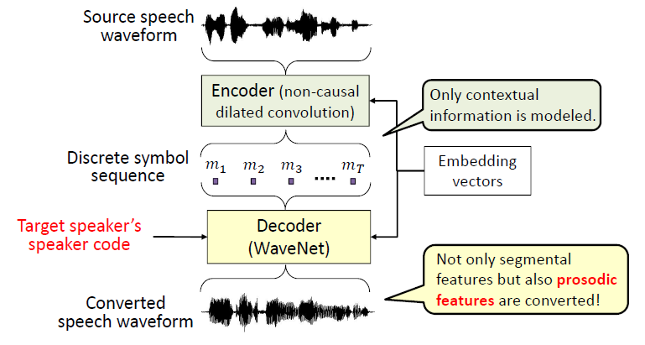
VC based on VQ VAE
Extract phoneme posteriorgram (PPG) as speaker‐independent contextual features.

Slide 30
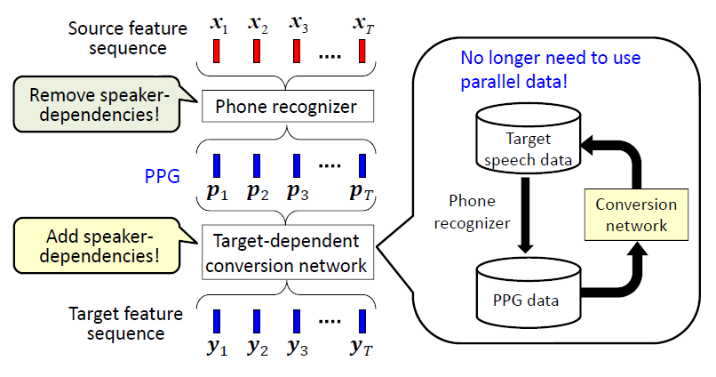
Phoneme Posteriogram VC
Extract phoneme posteriorgram (PPG) as speaker‐independent contextual features and use them as input of the conversion network.
[Sun et. al. 16]

Slide 31
VC based on Generative Adversarial Networks

Slide 32
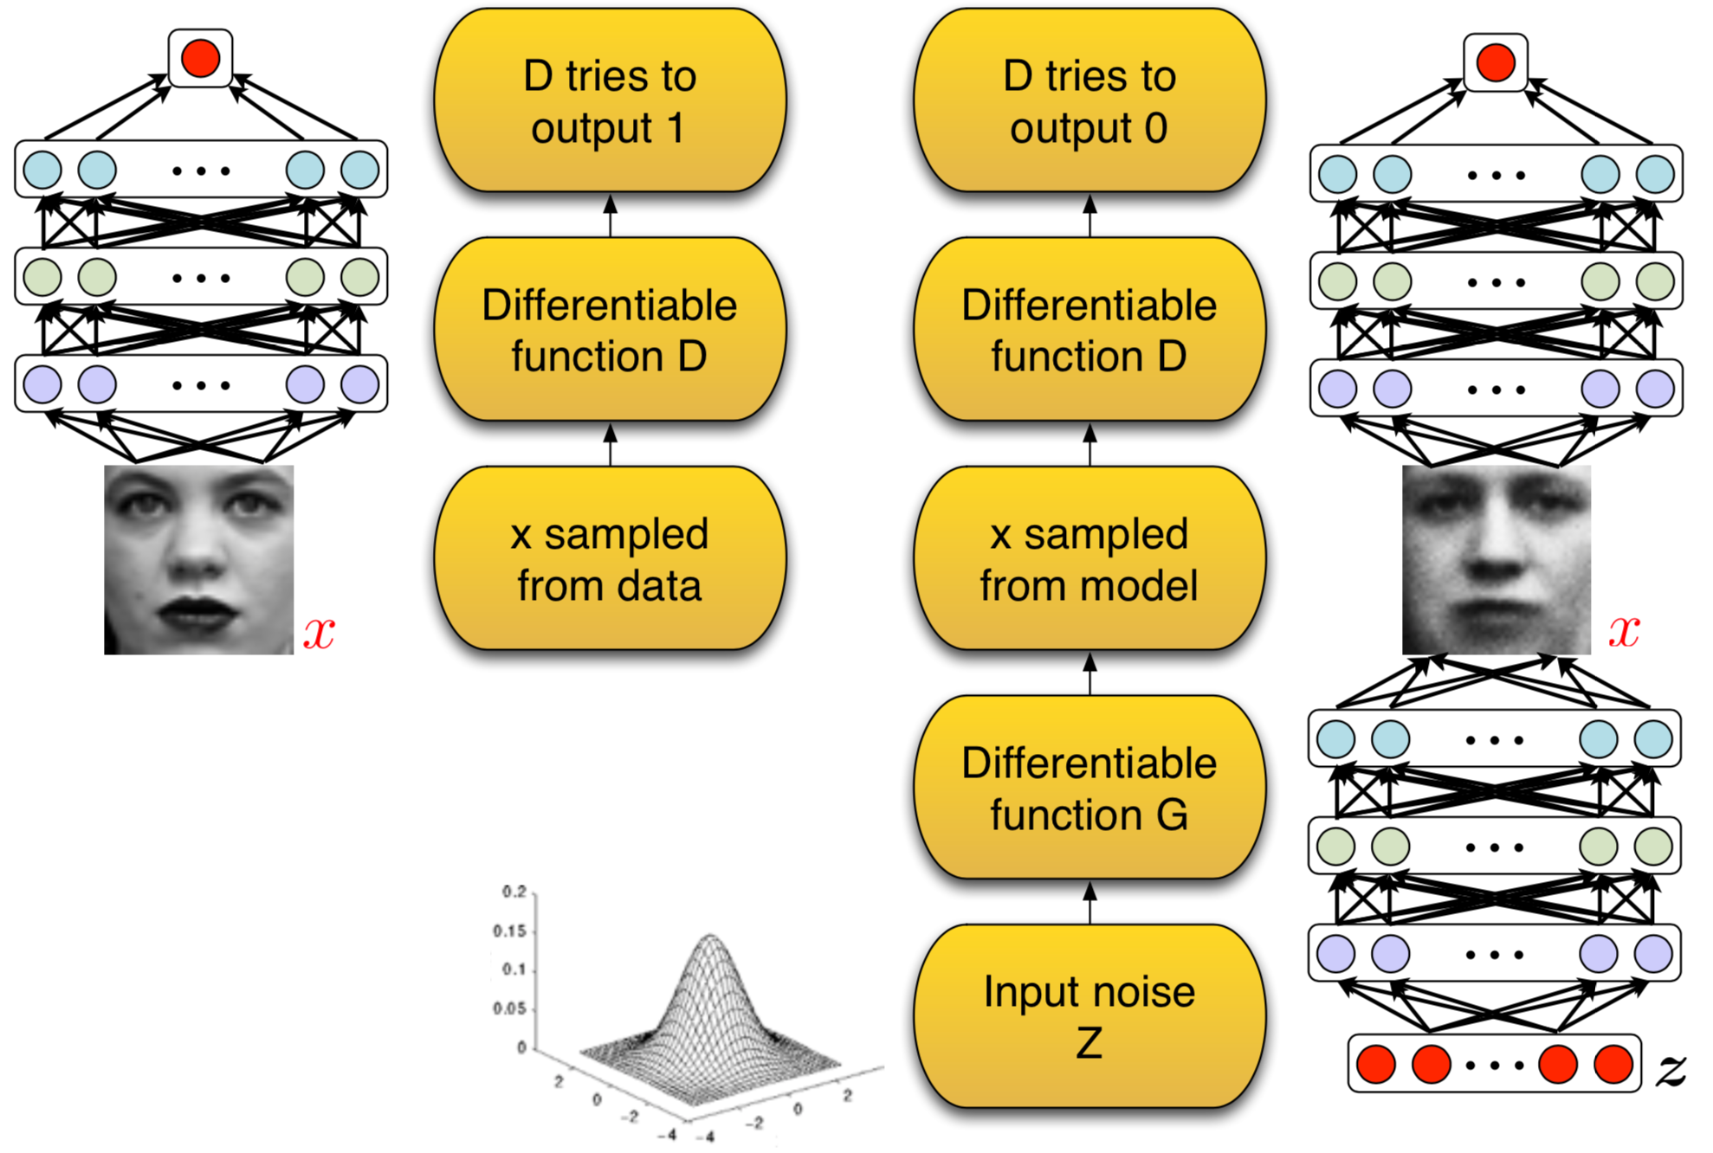
GAN Formulation

Slide 33
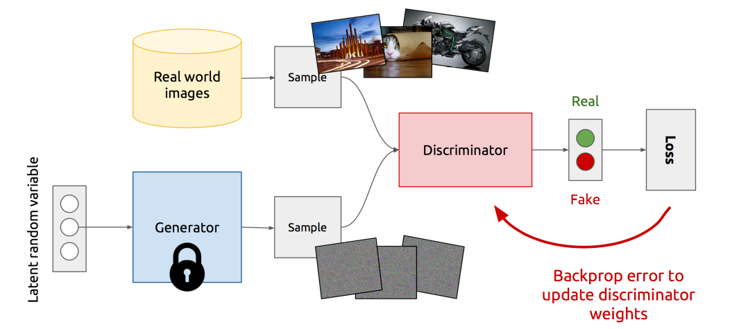
Discriminator Training

Slide 34
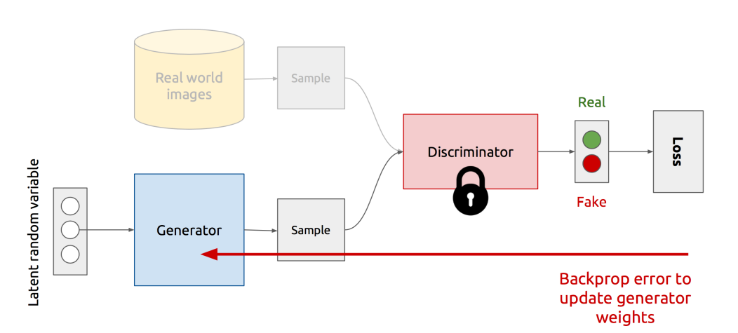
Generator Training

Slide 35
Mathematical Notations

Slide 36
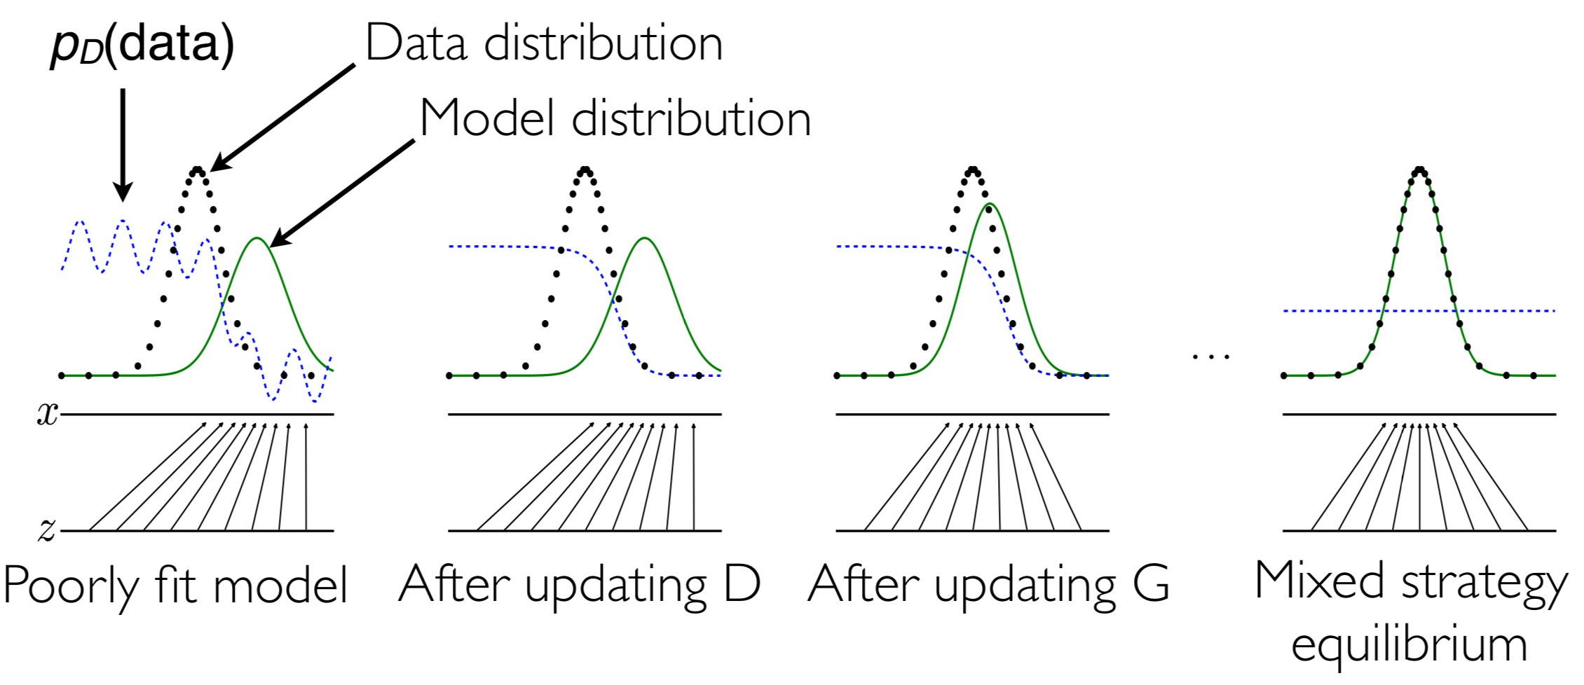
Learning GANs

Slide 37
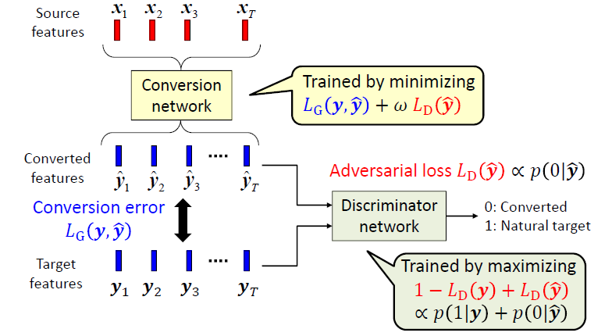
GAN-based VC
[Saito et. al. 2018]

Slide 38
CycleGAN Voice Conversion
A non-parallel voice-conversion (VC) method that can learn a mapping from source to target speech without relying on parallel data.
In a CycleGAN, forward and inverse mappings are simultaneously learned using an adversarial loss and cycle-consistency loss.
Two important losses are introduced:
Adversarial loss
cycle-consistency loss
identity-mapping loss

Slide 39
CycleGAN losses
Adversarial loss
Adversarial loss
[Kaneko et. al. 2018]

Slide 40
CycleGAN losses
Two mapping function (Adversarial loss): G and F.
Cycle-consistency loss:
Forward:
Backward:
Adversarial loss + cycle-consistency loss:

Slide 41
Identity-mapping loss
To encourage linguistic-information preservation, an identity-mapping loss is implemented.
It encourages the generator to find the mapping that preserves composition between the input and output.

Slide 42
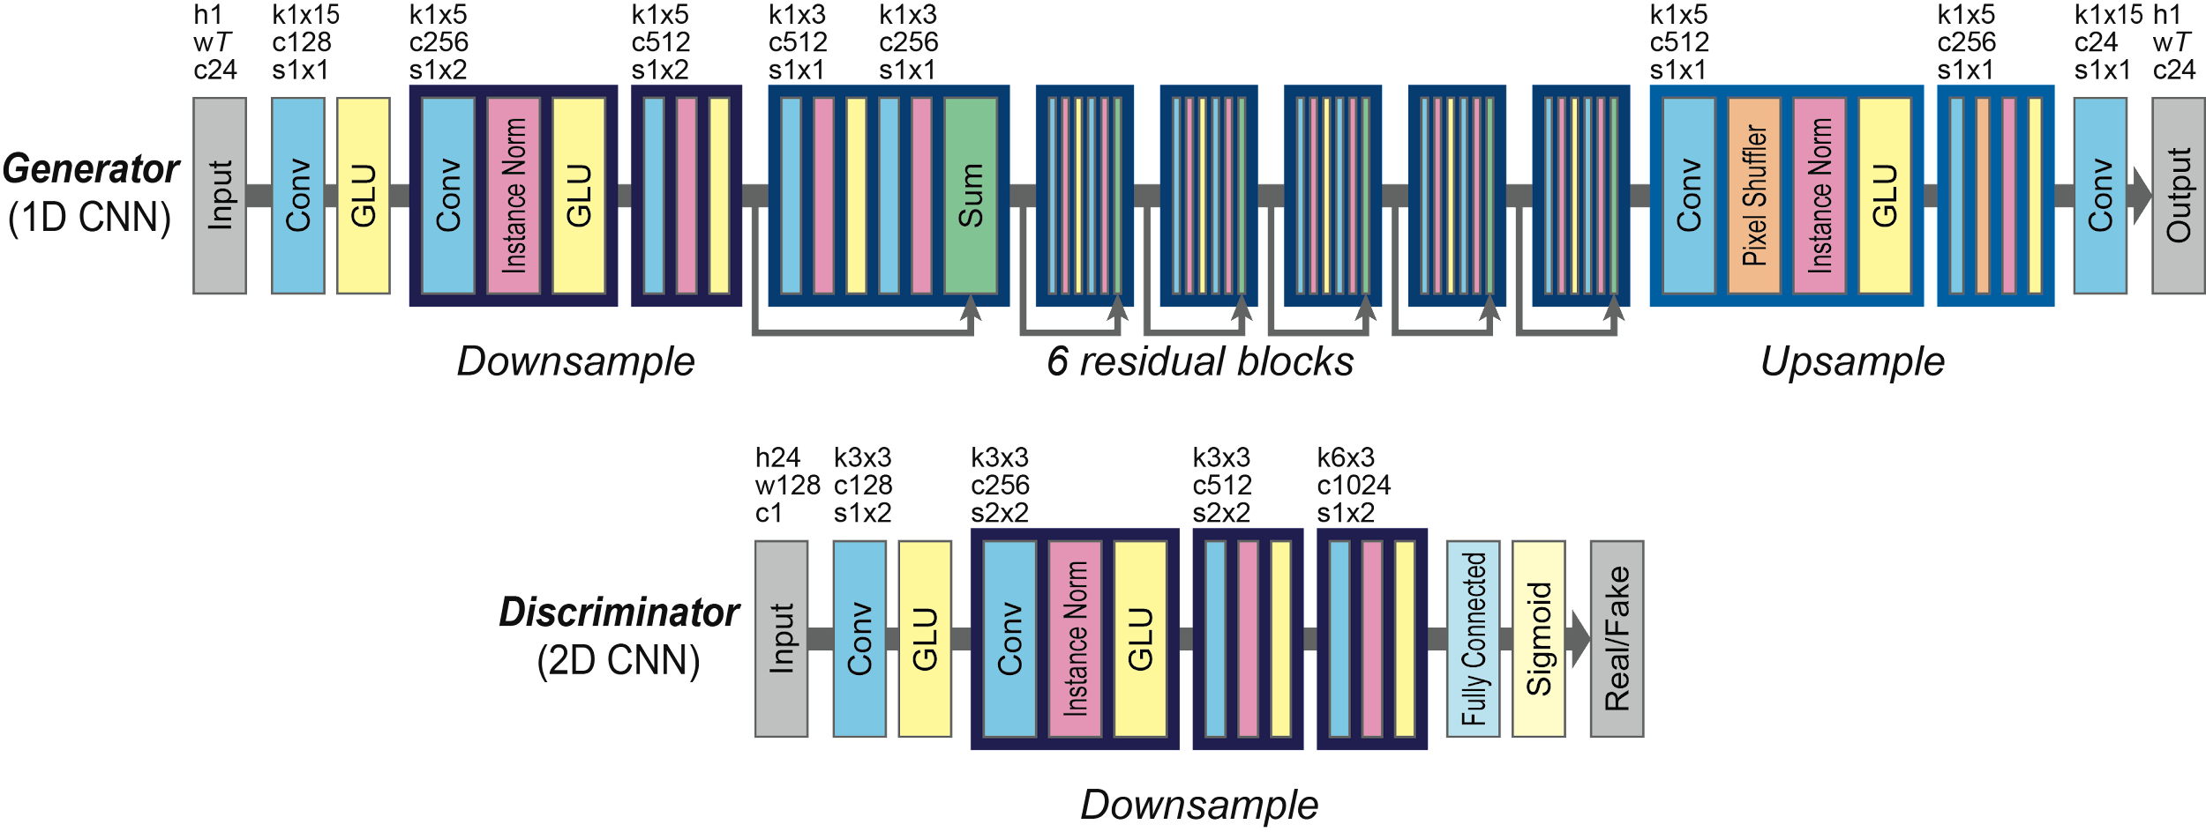
CycleGAN Architecture

Slide 43
Sound Samples
http://www.kecl.ntt.co.jp/people/kaneko.takuhiro/projects/cyclegan-vc/

Slide 44
StarGAN Voice Conversion
A non-parallel many-to-many voice conversion (VC) by using a variant of a genitive adversarial network called StarGAN.
Generator (G) takes an acoustic feature with an attribute c as the inputs and generates an acoustic feature sequence y′ = G(x, c).
Discriminator (D) is designed to produce a probability D(y, c) that an input y is a real speech feature.
A domain classifier (C) predicts classes of the input.

Slide 45
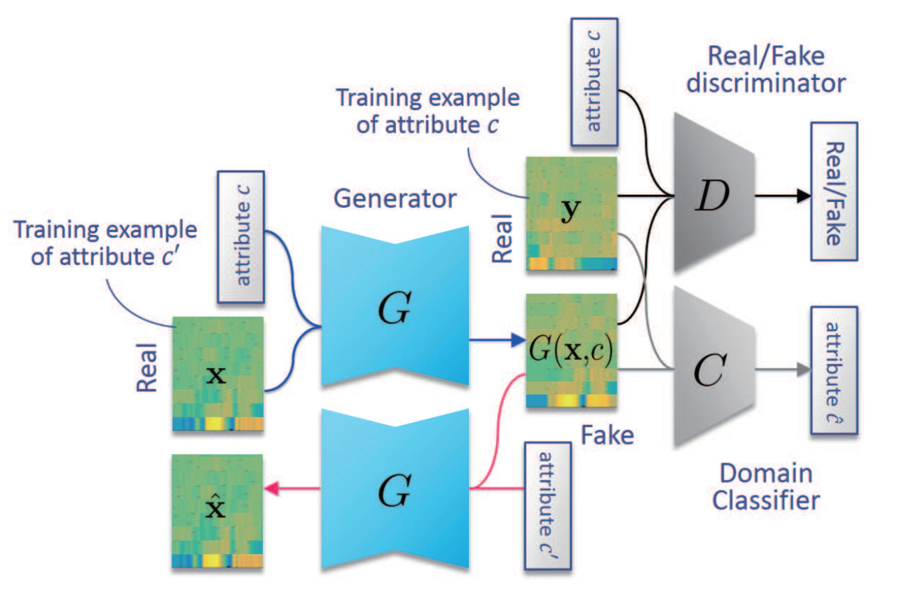
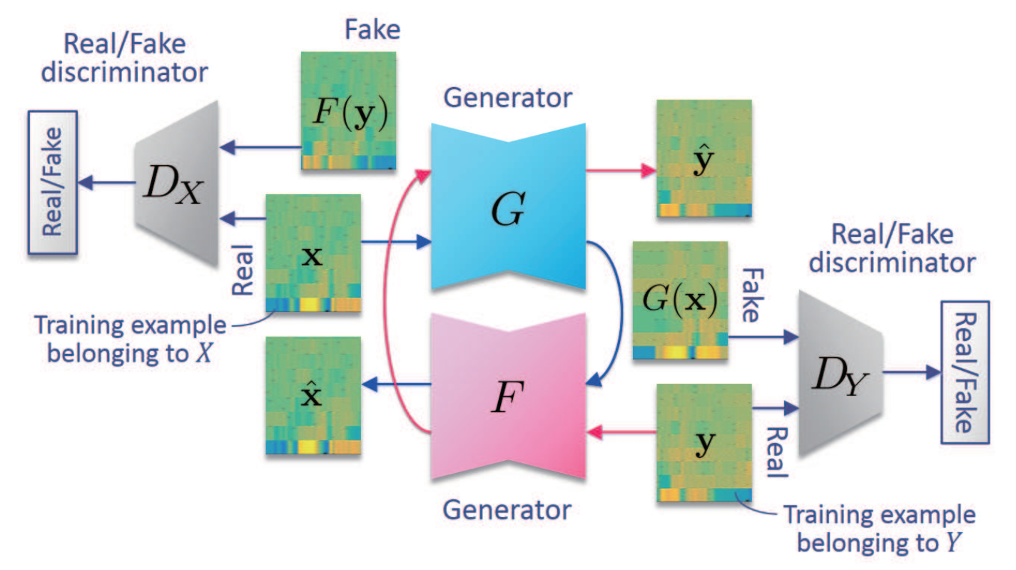
StarGAN training
CycleGAN
StarGAN
[Kameoka et. al. 2018]

Slide 46
StarGAN training losses
Adversarial losses for discriminator D and generator G, respectively, where y denotes a training example of an acoustic feature sequence of real speech with attribute c and x denotes that with an arbitrary attribute.

Slide 47
StarGAN training losses
Domain classification losses for classifier C and generator G is described.

Slide 48
StarGAN training losses
To encourage G(x, c) to be a bijection, a cycle consistency loss is implemented, where x denotes an acoustic feature sequence of real speech with attribute c′.

Slide 49
StarGAN training losses
Ensure that an input into G will remain unchanged when the input already belongs to the target attribute c′.

Slide 50
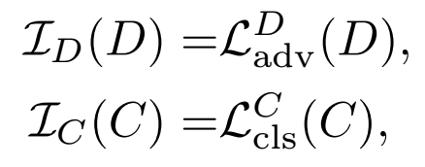
StarGAN Objective Function
The full objectives of StarGAN-VC to be minimized with respect to G, D and C are

Slide 51
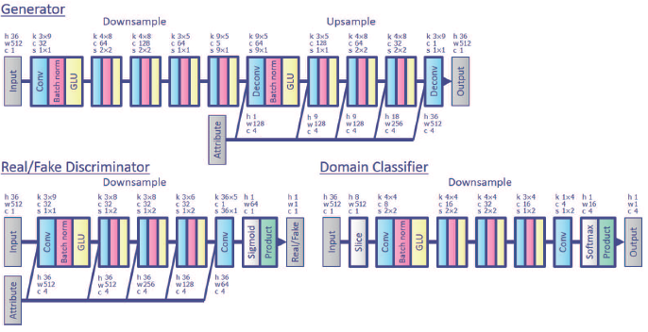
[Kameoka et. al. 2018]

Slide 52
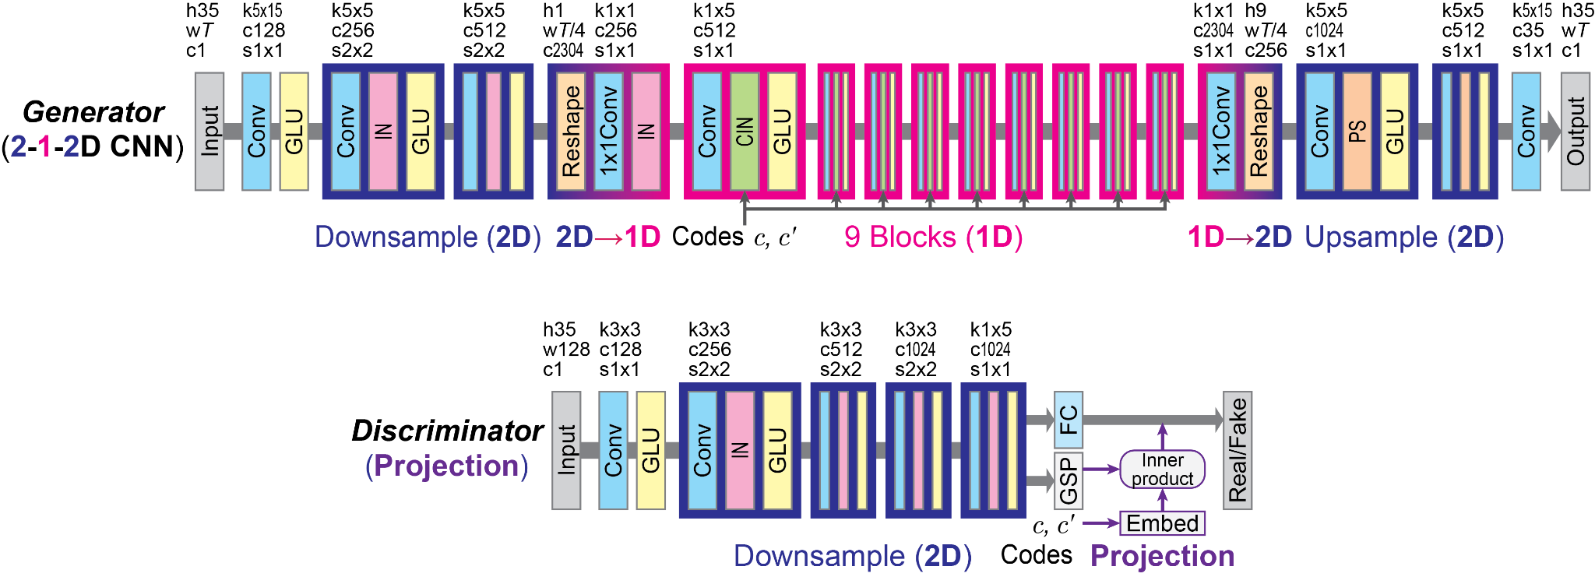
Modified StarGAN
[Kaneko et. al. 2019]

Slide 53
Rethinking Conditional Methods
source-and-target conditional adversarial loss defined as

Slide 54
Rethinking Conditional Methods
Given the feature f, conditional instance normalization (CIN) conducts the following procedure:
where µ(f) and σ(f) are the average and standard deviation of f that are calculated over for each instance.
γc' and βc' are domain-specific scale and bias parameters that allow the modulation to be transformed in a domain-specific manner.
[Kaneko et. al. 2019]

Slide 55
Sound Samples
http://www.kecl.ntt.co.jp/people/kameoka.hirokazu/Demos/stargan-vc/
http://www.kecl.ntt.co.jp/people/kaneko.takuhiro/projects/stargan-vc2/index.html

Slide 56
Style Conversion (VoiceGAN)
Voice style impersonation, where one person attempts to mimic the voice of another to sound like the other person, is a complex phenomenon.
The original GAN model
Style transfer by GAN
Mathematical notations:

Slide 57
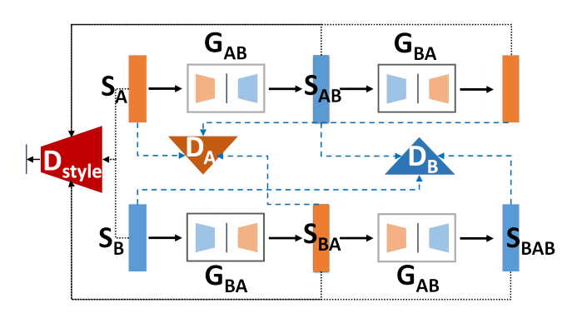
Style Conversion (VoiceGAN)
D_{A} and D_{B} discriminate between real and fake data.
G_{AB} transforms for style A to style B, where as G_{BA} is the opposite.
The discriminator D_{style} determines if the original and transformed signals match the desired style.

Slide 58
Style Conversion (VoiceGAN)
Training objectives to be minimized for the generator and discriminator are represented by L_{G} and L_{D} respectively as follows:
Reconstruction loss:
The discriminator D_{S} determines if the original and transformed signals match the desired style:

Slide 59
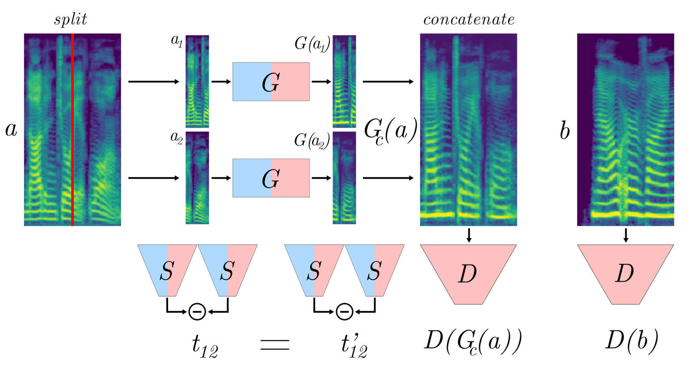
MelGAN VC
TraVeL (Transformation Vector Learning loss) loss
[Pasini 2020]

Slide 60
Various Vocoders in VC

Slide 61
General Framework
Vocoders
GMM
CNN
WaveNet
WaveRNN
GANs
VAEs
MelGAN
WORLD

Slide 62
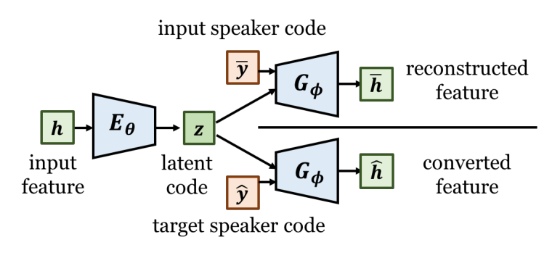
WaveNet Vocoder in VAE-VC
WaveNet
Converted waveform
A general framework of WaveNet vocoder in voice conversion.
[Huang et. al. 2019]

Slide 63
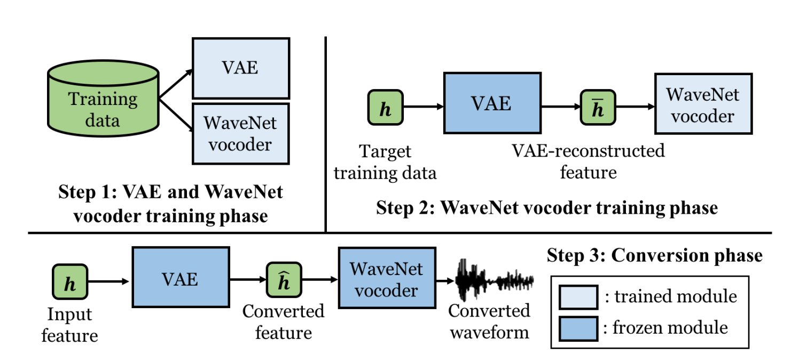
Training Protocol

Slide 64
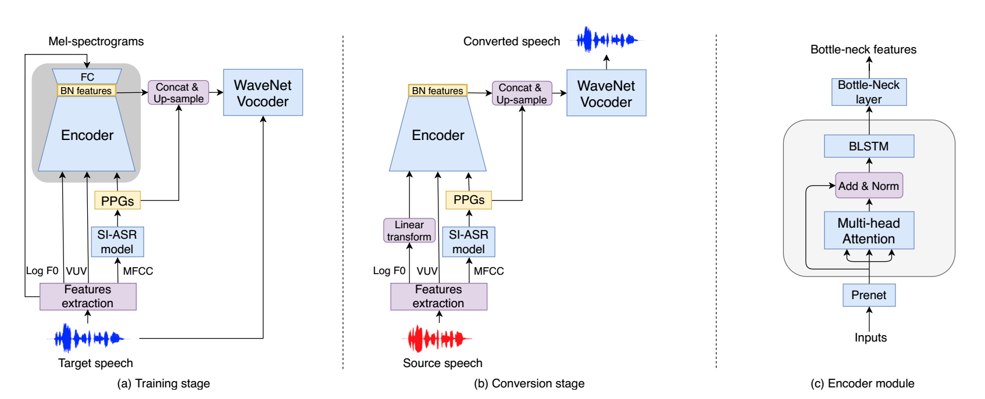
Jointly Trained Conversion Model and Vocoder
[Liu et. al. 2019]

Slide 65
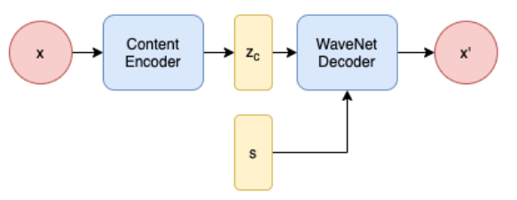
WaveNet Auto-encoders
WaveNet is used as the decoder and to generate waveform data directly from the latent representation.
[Chen et. al. 2020]

Slide 66
One-shot Voice Conversion

Slide 67
One-shot VC
The target speaker is unseen in training dataset or both source and target speakers are unseen in the training dataset.
An universal embedding vector is used to represent speaker ID.
The idea is to represent any arbitrary unseen speaker ID with an embedding vector.
Such embedding vector represents unseen speaker’s timbre would be a weighted combination of the timbres the speakers seen in the dataset.

Slide 68
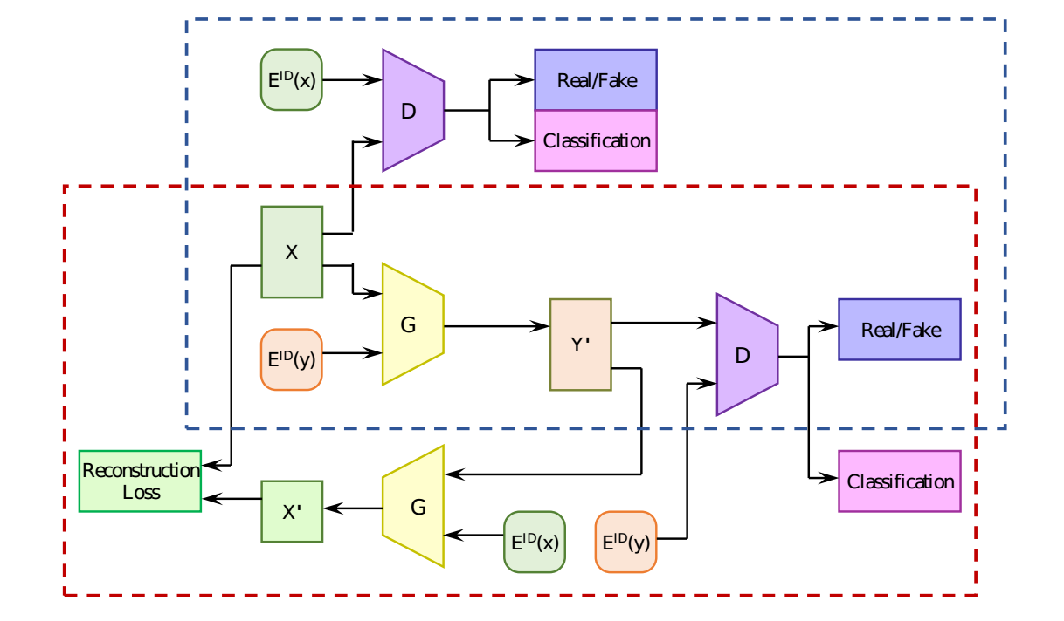
One-shot StarGAN VC
[Wang et. al. 2020]

Slide 69
Bibliography
I. Goodfellow et al. “Generative adversarial nets,” in Proc. NIPS, 2014.
Arjovsky et al. “Wasserstein GAN,” arXiv preprint arXiv:1701.07875, 2017.
I. Gulrajani et al., “Improved training of Wasserstein GANs,” in Advances in Neural Information Processing Systems, 2017, pp. 5767–5777.
Hung-yi Lee, and Yu Tsao. ”Generative Adversarial Network and its Applications to Speech Signal and Natural Language Processing.” tutorial in ICASSP, 2018.
Hsu, Chin-Cheng, Hsin-Te Hwang, Yi-Chiao Wu, Yu Tsao, and Hsin-Min Wang. "Voice conversion from non-parallel corpora using variational auto-encoder." In 2016 Asia-Pacific Signal and Information Processing Association Annual Summit and Conference (APSIPA), pp. 1-6. IEEE, 2016.
A. Kain and M. W. Macon. Spectral voice conversion for text‐to‐speech synthesis. Proc. IEEE ICASSP, pp. 285–288, 1998.
T. Kaneko, H. Kameoka. CycleGAN‐VC: non‐parallel voice conversion using cycle‐consistent
adversarial networks. Proc. EUSIPCO, pp. 2114–2118, 2018.
H. Kameoka, T. Kaneko, K. Tanaka, N. Hojo. StarGAN‐VC: non‐parallel many‐to‐many voice conversion using star generative adversarial networks. Proc. IEEE SLT, pp. 266–272, 2018.
Kaneko, T., Kameoka, H., Tanaka, K. and Hojo, N., 2019. StarGAN-VC2: Rethinking Conditional Methods for StarGAN-Based Voice Conversion}}. Proc. Interspeech 2019, pp. 679-683.

Slide 70
Bibliography
Gao, Yang, Rita Singh, and Bhiksha Raj. "Voice impersonation using generative adversarial networks." In 2018 IEEE International Conference on Acoustics, Speech and Signal Processing (ICASSP), pp. 2506-2510. IEEE, 2018.
Huang, Wen-Chin, Yi-Chiao Wu, Hsin-Te Hwang, Patrick Lumban Tobing, Tomoki Hayashi, Kazuhiro Kobayashi, Tomoki Toda, Yu Tsao, and Hsin-Min Wang. "Refined wavenet vocoder for variational autoencoder based voice conversion." In 2019 27th European Signal Processing Conference (EUSIPCO), pp. 1-5. IEEE, 2019.
Liu, Songxiang, Yuewen Cao, Xixin Wu, Lifa Sun, Xunying Liu, and Helen Meng. "Jointly Trained Conversion Model and WaveNet Vocoder for Non-Parallel Voice Conversion Using Mel-Spectrograms and Phonetic Posteriorgrams." In INTERSPEECH, pp. 714-718. 2019.
Pasini, Marco. "Melgan-vc: Voice conversion and audio style transfer on arbitrarily long samples using spectrograms." arXiv preprint arXiv:1910.03713 (2020).
Chen, Mingjie, and Thomas Hain. "Unsupervised acoustic unit representation learning for voice conversion using wavenet auto-encoders." arXiv preprint arXiv:2008.06892 (2020).
Wang, Ruobai, Yu Ding, Lincheng Li, and Changjie Fan. "One-Shot Voice Conversion Using Star-Gan." In ICASSP 2020-2020 IEEE International Conference on Acoustics, Speech and Signal Processing (ICASSP), pp. 7729-7733. IEEE, 2020.
Chou, Ju-chieh, and Hung-Yi Lee. "One-Shot Voice Conversion by Separating Speaker and Content Representations with Instance Normalization}}." Proc. Interspeech 2019 (2019): 664-668.

Slide 71
Bibliography
M. Abe, S. Nakamura, K. Shikano, H. Kuwabara. Voice conversion through vector quantization. J. Acoust. Soc. Jpn (E), Vol. 11, No. 2, pp. 71–76, 1990.
Y. Stylianou, O. Cappe, E. Moulines. Continuous probabilistic transform for voice conversion. IEEE Trans. Speech & Audio Process., Vol. 6, No. 2, pp. 131–142, 1998.
L. Sun, K. Li, H. Wang, S. Kang, H.M. Meng. Phonetic posteriorgrams for many‐to‐one voice conversion without parallel data training. Proc. IEEE ICME, 6 pages, 2016.
T. Toda, A.W. Black, K. Tokuda. Voice conversion based on maximum likelihood estimation of spectral parameter trajectory. IEEE Trans. Audio, Speech & Lang. Process., Vol. 15, No. 8, pp. 2222–2235, 2007.
http://spcc.csd.uoc.gr/SPCC2019/Lectures/SPCC2019_VC_Lecture_TomokiTODA.pdf
Pantazis et al. , ” https://www.csd.uoc.gr/~spcc/ ”

