Slide 1



UNIVERSITY OF CRETE
Modeling Tools for Null Hypothesis Testing & Correlation
Maria Papadopouli
Professor
University of Crete
Foundation for Research & Technology – Hellas (FORTH)
http://www.ics.forth.gr/mobile
.
Notes:
1

Slide 2
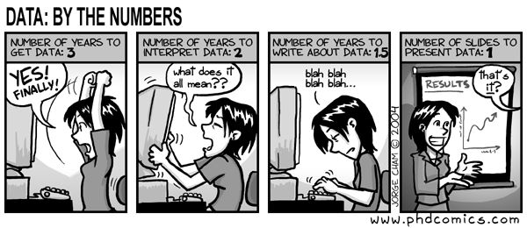
2. Obtain data….

Slide 3
Acknowledgement – Resources used in the slides
On statistical hypothesis test
  Yiannis Tsamardinos (University of Crete)
  William Morgan (Stanford University)
On clustering
Jiawei Han, University of Illinois at Urbana-Champaign

Slide 4
Agenda
Basic data analysis & modeling tools that can be employed in the projects
Null Hypothesis Test
Temporal correlation metrics
  Pearson correlation
  STTC
Kolmogorov-Smirnov Test
Clustering
k-means
Regression
  Linear regression
  Lasso & Ridge regression

Slide 5
Proving Your Hypothesis
Mathematics
  We already know a set of axioms & theorems, say K
  We want to show the theorem (hypothesis) H
  We show: K, ¬H ⇒ False (contradiction)
  Thus, if we trust that K holds indeed, ¬H cannot hold, and
  H must hold
Real World
  We already “know” K
  We want to show a hypothesis H, e.g., “H: medicine A reduces the mortality of disease B”
  We gather data from the real world.
  We show that K, ¬H makes it
  very unlikely to observe our data
  We conclude that
  ¬H is very unlikely
  We reject ¬H, and accept H
Symbol “¬” indicates the negation of a statement

Slide 6
Notation for the following slides
Random variables are denoted with a capital letter, e.g., X
Observed quantities of random variables are denoted with their corresponding small letter x
Example:
  G is the expression level of a specific gene in a patient
  g is the measured expression level of the game in a specific patient

Slide 7
The Null Hypothesis
The hypothesis we hope to accept is called the Alternative Hypothesis
  Sometimes denoted as H₁
The hypothesis we hope to reject, the negation of the Alternative Hypothesis, is called the Null Hypothesis
  Usually denoted by H_{o}
  _{Think of the} H_{o} _{as the “status quo”}

Slide 8
Standard Single Hypothesis Testing
Form the Null & Alternative Hypothesis
Obtain related data
Find a suitable test statistic T
Find the distribution of T given the null
Depending on the distribution of T & the observed t_{o} = T ( x)
  decide to reject or not H₀

Slide 9
Test Statistics
Test statistic is a function of our data X: T(X) ( X: random variable )
  e.g., if X contains a single quantity (variable) T(X) the mean value of X
T is a random variable (since it depends on X , our data which is random variable)
Denote with t_{o} = T(x) the observed value of T in our data
Instead of calculating P ( obtaining data similar to X | H₀ )
Calculate P ( T similar to t_{o} | H₀ )
If P ( T similar to t_{o} | H₀) is very low, reject H₀

Slide 10
Statistical significance tests
Let’s just think about a two-tailed test: “difference” or “no difference”
Null hypothesis: there is no difference between A vs. B
Assume that o_{A} & o_{B} are “sampled” independently from a “population”
Test statistic: a function of the sample data on which the decision is to be based
t ( o₁, o₂ ) = |e (o₁) − e (o₂)|
e: evaluation metric
Find the distribution of t under the null hypothesis
Assume that the null hypothesis is true
Where does the t ( o_{A}, o_{B} ) lie in this distribution?
If it’s somewhere unlikely, that’s evidence that the null hypothesis is false

Slide 11


Slide 12
The Lake Wobegon Example: “Where all the children are above average!”
Let X represent Weschler Adult Intelligence scores (WAIS)
Typically, X ~ N(100, 15) (μ₀ = 100, σ = 15)
Obtain data: 9 children from Lake Wobegon population
Their scores: {116, 128, 125, 119, 89, 99, 105, 116, 118}
Average of the observations x = 112.8
Does sample mean provide strong evidence that population mean μ > 100?
-

Slide 13
One-Sample z Test
1. Hypothesis statements
H₀: µ = µ₀
H_{a}: µ ≠ µ₀ (two-sided) or
H_{a}: µ < µ₀ (left-sided) or
H_{a}: µ > µ₀ (right-sided)
3. Test statistic
4. P-value: convert z_{stat} to P value
Significance statement (usually not necessary)

Slide 14
Example: Two-Sided Hypothesis Test “Lake Wobegon”
1. Formulation of the Hypotheses:
H₀: μ = 100
H_{a}: µ > 100 (one-sided)
H_{a}: µ ≠ 100 (two-sided)

Slide 15
2. Obtain data …
Obtain data: 9 children from Lake Wobegon population
Their scores: {116, 128, 125, 119, 89, 99, 105, 116, 118}
Average of the observations = 112.8

Slide 16
Example: Two-Sided Hypothesis Test “Lake Wobegon”
3. Test statistic

Slide 17
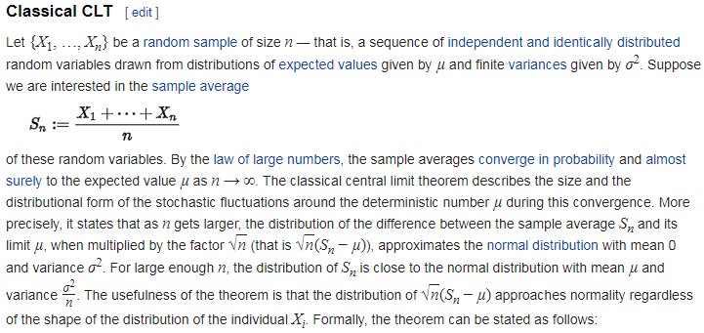

Slide 18
Central Limit Theory
Establishes that, in most situations, when independent random variables are added, their properly normalized sum tends toward a normal distribution even if the original variables themselves are not normally distributed.
A sample is obtained containing a large number of observations, each observation being randomly generated in a way that does not depend on the values of the other observations.
If step 1 is performed many times, the computed values of the average will be distributed according to a normal distribution.
Example: Flip a coin many times. The probability of getting a given number of heads in a series of K flips will approach the normal distr. with mean =K/2

Slide 20
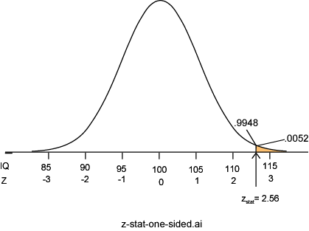
P-value: P = Pr( Z ≥ 2.56 ) = 0.0052
Sample distribution follows the
Normal distribution
according to the Central Limit Theorem
P =.0052 ⇒ it is unlikely the sample came from this null distribution ⇒ strong evidence against H₀

Slide 21
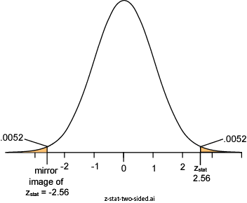
Example - Two-Sided P-value: Lake Wobegon
H_{a}: µ ≠100
Considers random deviations “up” & “down” from μ₀ ⇒ tails above & below ± z_{stat}
Thus, two-sided P
= 2 × 0.0052
= 0.0104

Slide 22
Conditions for z Test
Population approximately Normal or large sample (central limit theorem)
The population variance is known!
If the population variance is unknown (and therefore has to be estimated from
the sample itself) & the sample size is not large (n < 30),
the Student's t-test may be more appropriate.

Slide 23
Another Example

Slide 24
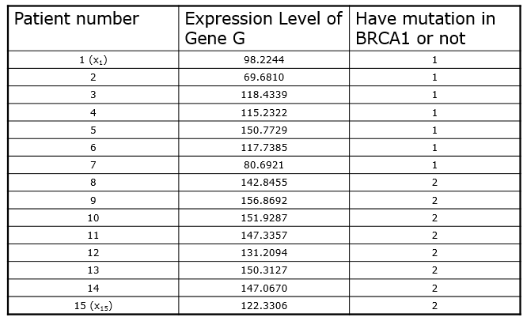
Background knowledge: Breast Cancer is related to mutations in genes BRCA1 & BRCA2
Hypothesis: Gene G is expressed differently in breast cancer patients with mutation in BRCA1 than BRCA2
Data: Obtained 7 patients with BRCA1 mutation & 8 with BRCA2 mutation
Hedenfalk et al. N Engl J Med. 2001 Feb 22;344(8):539-48.

Slide 25
1. Form the Null Hypothesis
Gene G is expressed differently in breast cancer patients with mutation in BRCA1 than BRCA2
Mathematically
  μ₁ : be the mean expression level of gene G in patients with BRCA1 mutation
  μ₂ : be the mean expression level of gene G in patients with BRCA2 mutation
  H₀ : μ₁ = μ₂
  H₁ : μ₁ ≠ μ₂

Slide 26
2. Obtain data….

Slide 27
3. Find a suitable test statistic T (Example)
Unpaired Two Sample t-test
The larger the difference of the two means, the larger the statistic
The larger our sample, the larger the statistic
The smaller the sample variance, the larger the statistic
So T will be quite large (in absolute value), when we can confidently say H₀ does not hold

Slide 28
3. Find a suitable test statistic T (cont’d)
Unpaired Two Sample t-test

Slide 29
3. Find the distribution of T (cont’d)
For the test of this specific example, we will make the following assumptions:
  The data in both groups are distributed normally around a mean value μ₁ , μ₂ respectively
  Their variance is the same in both groups
  Each patient was sampled independently
and most importantly that THE NULL HYPOTHESIS HOLDS
This is an assumption for ALL tests!
Then
  T(X) has a probability density function of:
where the degrees of freedom of the test v is
15 – 2 = 13 (number of patients – 2)

Slide 30
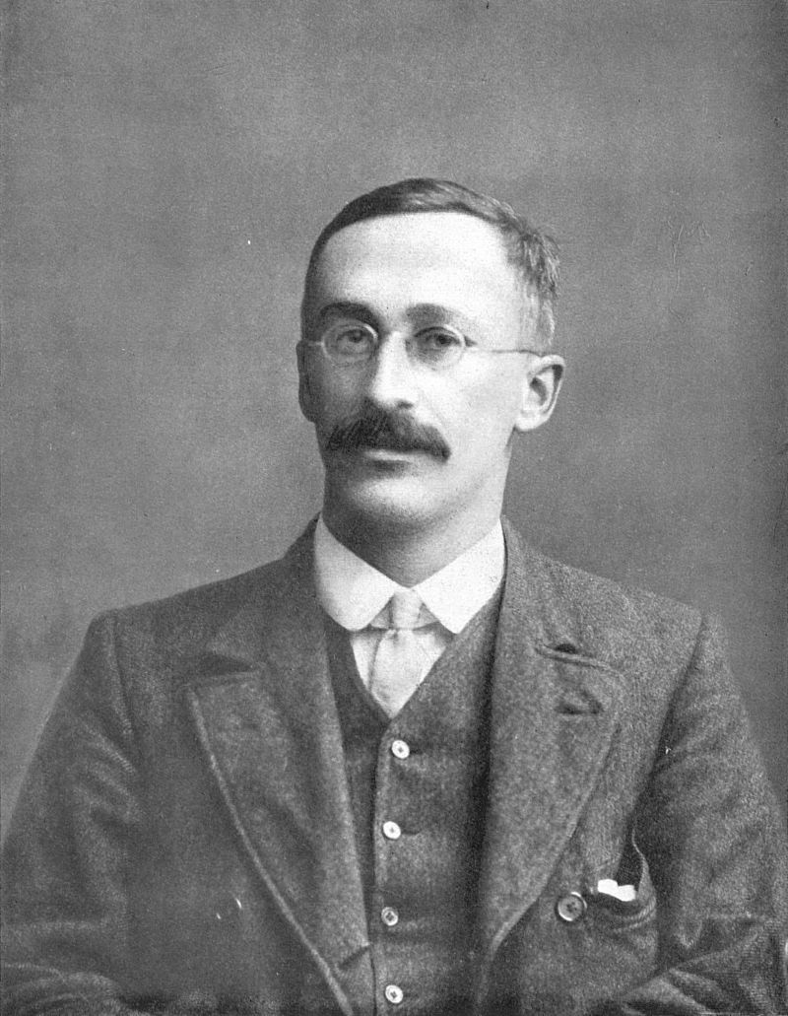
The t-statistic was introduced in 1908 by William Sealy Gosset,
a chemist working for the Guinness brewery in Dublin. "Student" was his pen name.

Slide 31
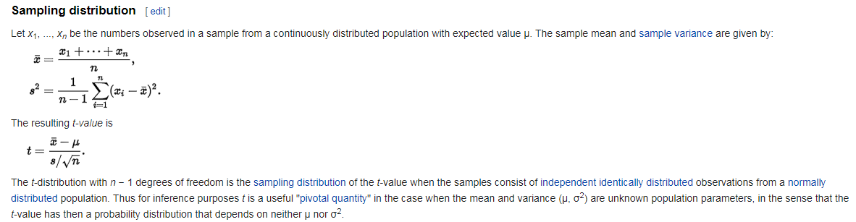
One sample T-distribution

Slide 32
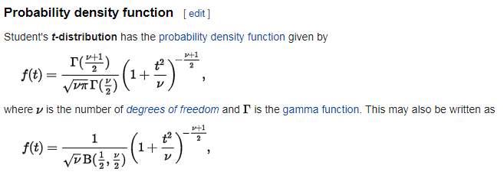
Student t-distribution (basics)

Slide 33
Central Limit Theory
Establishes that, in most situations, when independent random variables are added, their properly normalized sum tends toward a normal distribution even if the original variables themselves are not normally distributed.
A sample is obtained containing a large number of observations, each observation being randomly generated in a way that does not depend on the values of the other observations.
If step 1 is performed many times, the computed values of the average will be distributed according to a normal distribution.
Example: Flip a coin many times.The probability of getting a given number of heads in a series of K flips will approach the normal distr. with mean =K/2

Slide 35
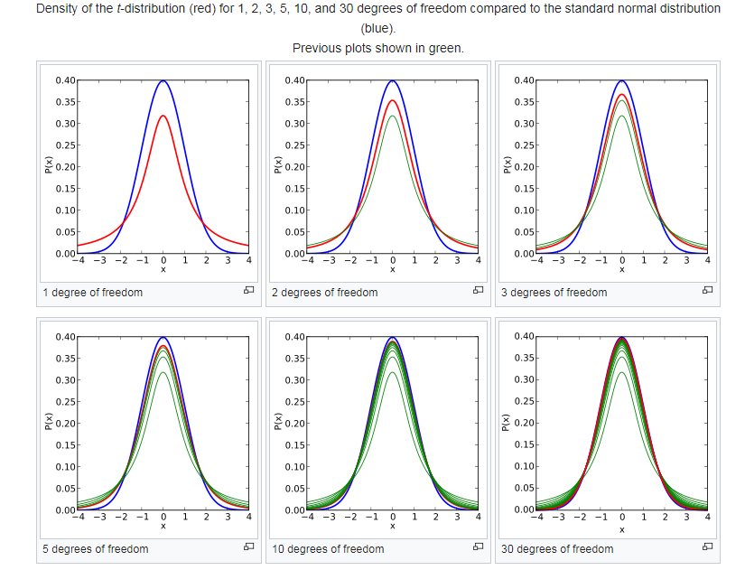
t-distribution
(basics)

Slide 36
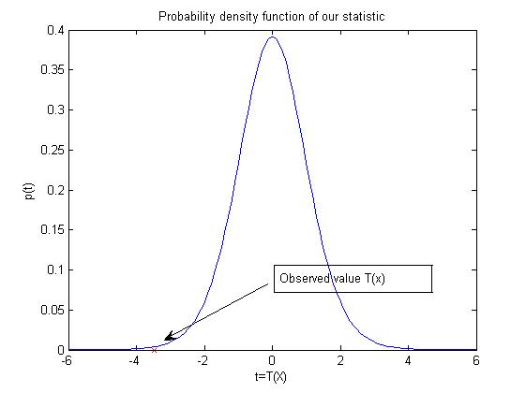
3. Find the distribution of T
Example
x

Slide 37
4. Decide on a Rejection Region
Decide on a rejection region Γ in the range of our statistic
If t_{o} ∈ Γ , then reject H₀
If t _{o} ∉ Γ , then do not reject H₀
  accept H₁ ?
Since the pdf of T when the null hypothesis holds is known,
P( T ∈ Γ | H₀ ) can be calculated

Slide 38
4. Decide on a Rejection Region
If P( T ∈ Γ | H₀ ) is too low, we know we are safely rejecting H₀
What should be our rejection region in our example?

Slide 39
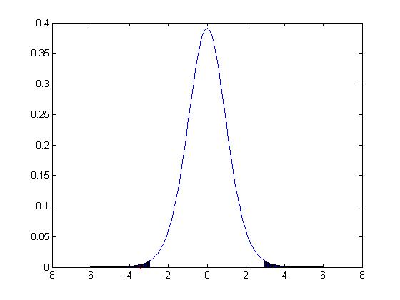
4. Decide on a Rejection Region
Where extreme values of t_{o} are:
  unlikely to come from when H₀ is true
  could come with high probability, when H₀ is false
P( T ∈ Γ | H₀ ) is the area of the shaded region (can be calculated)
Γ region of rejection
X

Slide 40
Rejection Procedure
Pre-select a probability threshold a
Find a rejection region Γ = { t: |t|>c }, such that P( T ∈ Γ | H₀ ) = a
Decide
  Reject H₀ , if t_{o} ∈ Γ (recall: t_{o} is the observed T in our data)
  Accept H₀ , otherwise
What values do we usually use for a in science?
  0.05 is typical
  Smaller ones are also used: 0.01 , 0.001
When t_{o} ∈ Γ we say the finding is statistically significant at significance level a

Slide 41
Issues to be Considered
When there exist two or more tests that are appropriate in a given situation,
how can the tests be compared to decide which should be used?
If a test is derived under specific assumptions about the distribution of the population being sampled,
how well will the test procedure work when the assumptions are violated?

Slide 42
Parametric versus non-Parametric Tests
Parametric test
  Makes the assumption that the data are sampled from a particular class of distributions
It then becomes easier to derive the distribution of the test statistic
Non-Parametric test
  No assumption about a particular class of distributions

Slide 43
Permutation Testing
Often in biological data, we do not know much about the data distribution
How do we obtain the distribution of our test statistic?
Great idea in statistics: permutation testing
Recently practical because it requires computing power (or a lot of patience)

Slide 44
Permutation Testing
In our first example, we want to calculate p ( t | H₀ )
If H₀ , then it does not matter which group each value x_{i}¹ comes from
Then, if we permute the group labels, we would get a value for our test statistic given the null hypothesis holds
If we get a lot of such values, we can estimate (approximate) p( t | H₀ )

Slide 45
Permutation Testing Revisited
Decide what can be permuted, if the null hypothesis is true
For all (as many as possible) permutations of the data, calculate the test statistic on the permuted data: t_{B}
Estimated p-value = # { |t_{B}| ≥ |t_{o}| } / #B

Slide 46
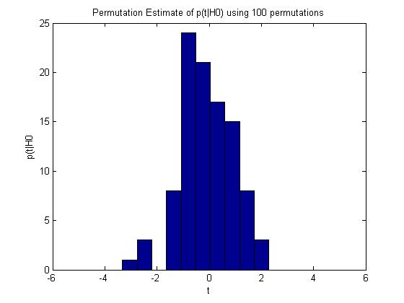
Estimated distribution from our data: 100 permutations
True distribution calculated theoretically

Slide 47
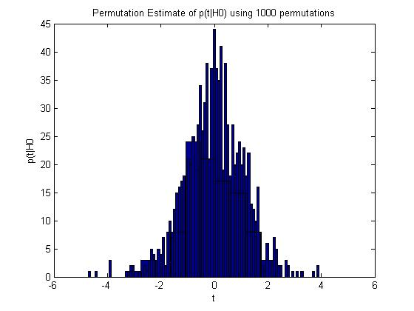
Does It Really Work?
True distribution calculated theoretically
Estimated distribution from our data: 1,000 permutations

Slide 48
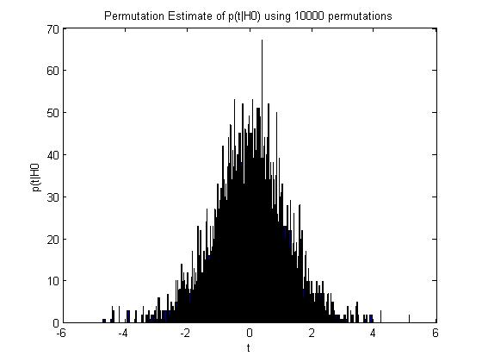
Does It Really Work?
Estimated distribution from our data: 10,000 permutations
True distribution calculated theoretically

Slide 49
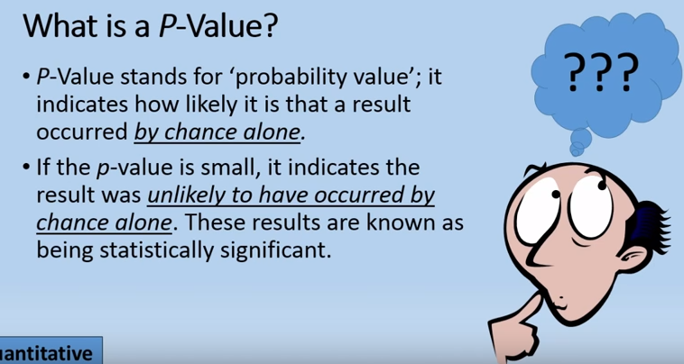
p-value:
a measure of the strength of the evidence against the null hypothesis

Slide 50
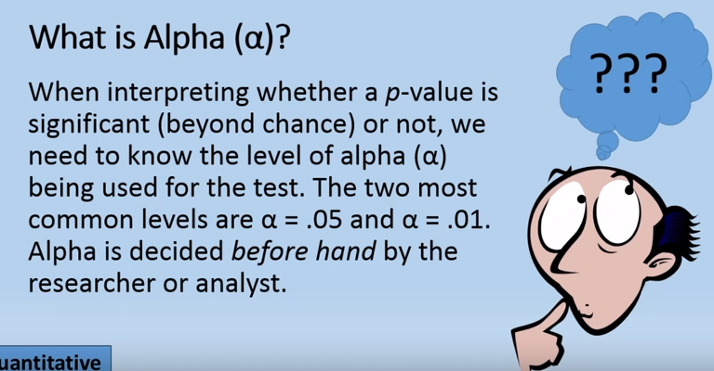

Slide 51
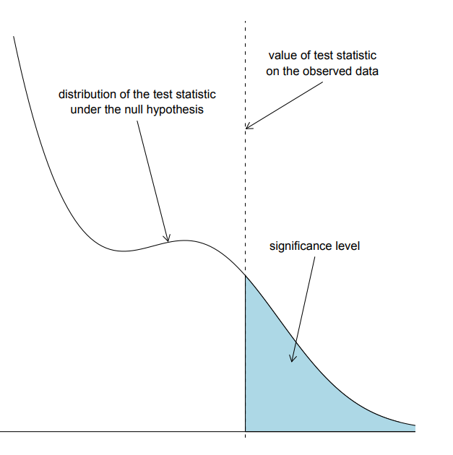
p-value is defined as the probability of obtaining a result equal to or more extreme than what was actually observed

Slide 52
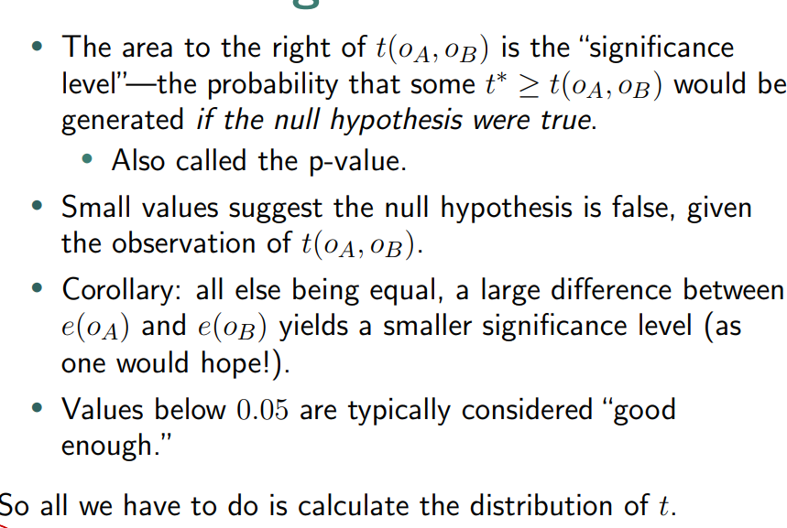
The Significance Level

Slide 53
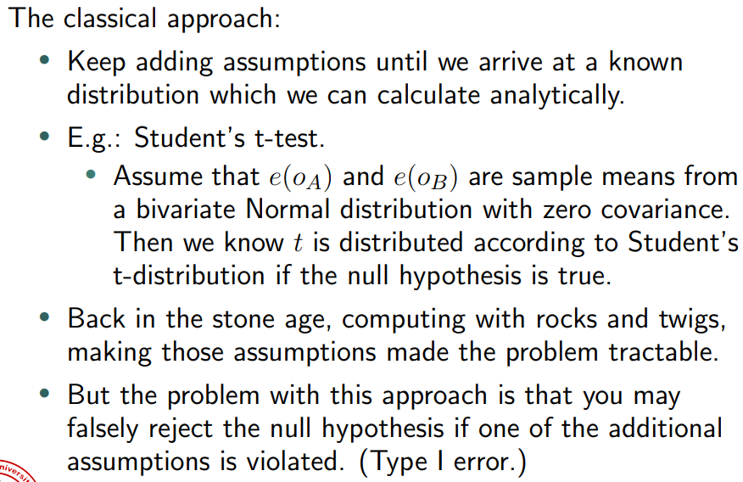
Calculating the Distribution

Slide 54
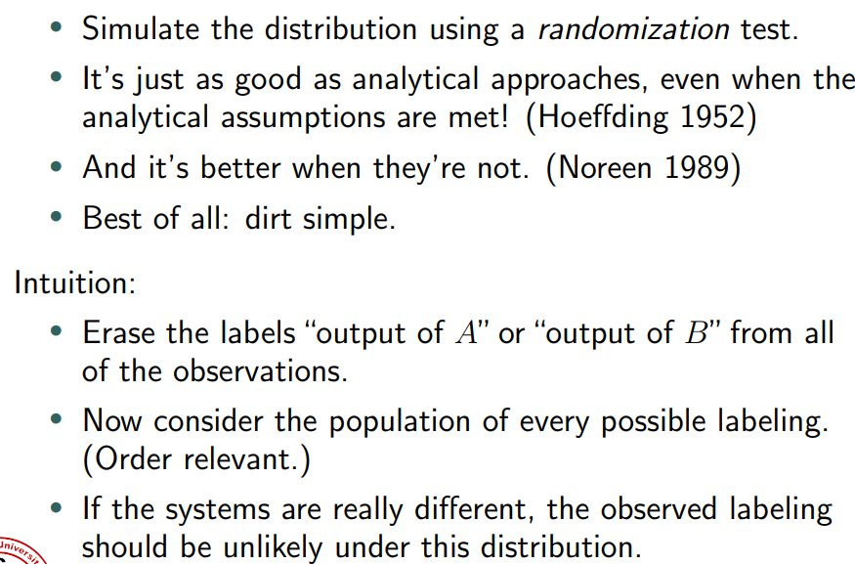
What you SHOULD do

Slide 55
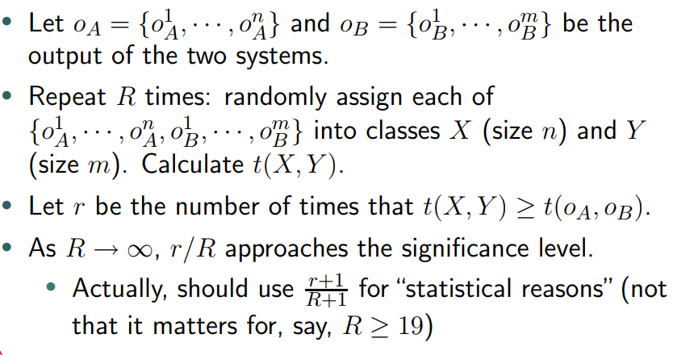

Slide 56
Statistical Errors
Type 1 Errors
-Rejecting H₀ when it is actually true
-Concluding a difference when one does not actually exist
Type 2 Errors
-Accepting H₀ when it is actually false (e.g. previous slide)
-Concluding no difference when one does exist
Errors can occur due to biased/inadequate sampling, poor experimental design or the use of inappropriate/non-parametric tests.

Slide 57
Regarding the Choice of a Test
When we cannot reject H_{0,} it does not mean H₁ holds!
It could be that we do not have enough power, i.e.,
  H₁ is not that “different enough” from H₀ to distinguish it with the given sample size
  of all possible tests for a hypothesis choose the one with the maximum power
Power analysis methods need to be employed.

Slide 58


Slide 59
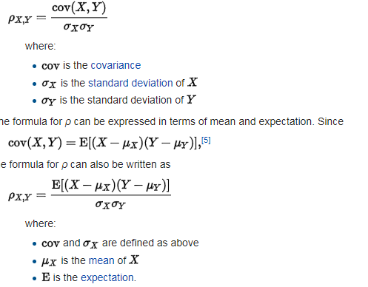
Pearson Correlation
of two variables X & Y (ρ_{Χ,Υ})

Slide 60
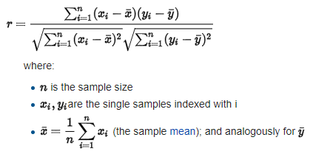
Sample Pearson correlation coefficient
Datasets {x₁,...,x_{n}} & {y₁,...,y_{n}}
containing n values

Slide 61
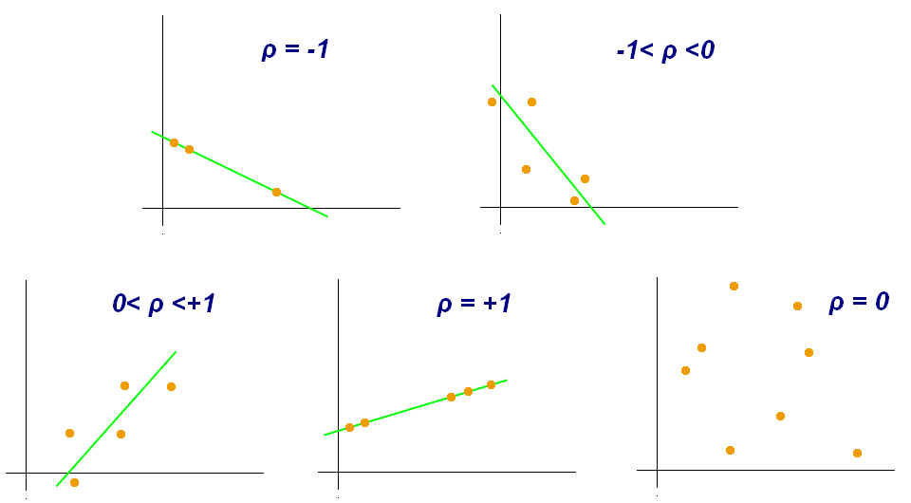
Pearson correlation: widely-used measure of the linear correlation between variables
No linear correlation
Positive linear correlation

Slide 62
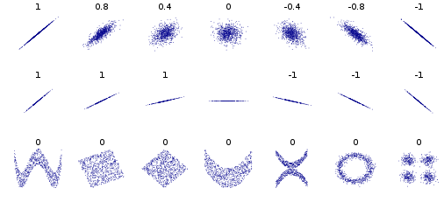
Examples of Pearson Correlation

Slide 63
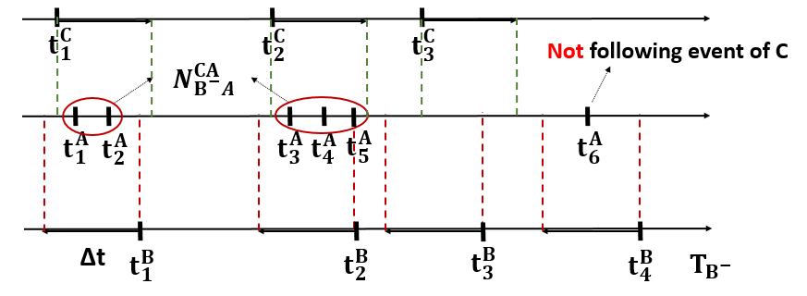
Conditional STTC (A->B |C) represents a measure of the chance that firing events of A will precede firing events of B, given the presence of firing of C
CA

Slide 64
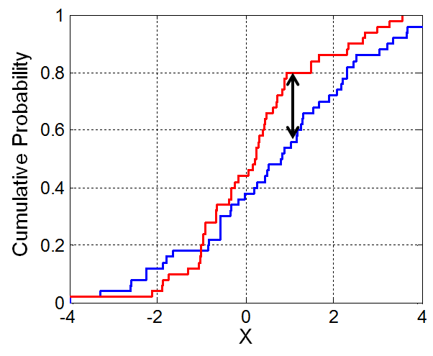
Kolmogorov-Smirnov (K-S) Test
Non-parametric test of the equality of continuous 1D probability distributions
Quantifies a distance between two distribution functions
Can serve as a goodness of fit test
Null hypothesis
H₀: Two samples drawn from populations
with same distribution
The maximum absolute difference between
the two CDFs

Slide 65
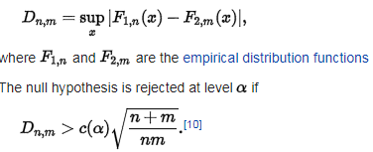
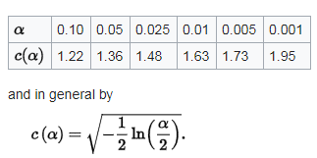
Kolmogorov-Smirnov (K-S) Test
n & m: size of the sample datasets

Slide 66
Kolmogorov-Smirnov (K-S) Test
Kolmogorov computed the expected distribution of the distance of the two CDFs when the null hypothesis is true.

Slide 67
Example: Kolmogorov-Smirnov Test
Decision p-value Distance
Lag True Null Null Null True Null Null Null True Null Null Null
1 1 0 0 0.5427 0.79 0.0076
2 1 0 0 0.2126 0.78 0.0100
3 1 0 0 0.98485 0.75 0.0043
4 1 0 0 0.9937 0.72 0.0040
5 1 0 0 0.9769 0.68 0.00453
Distance of two distributions
in sup norm
For all neuron pairs (A, B), populate the following distributions with
  Population 1: real STTC of the pair (A,B)
  Population 2: random circular shift in one of the two spike trains of (A,B)
  Population 3: random circular shift in one of the two spike trains of (A,B)
True Null: Population 1 vs. Population 2
Null Null: Population 2 vs. Polulation 3

Slide 68


Lecture on Modeling Tools for Regression & Clustering
CS – 590.21 Analysis and Modeling of Brain Networks
Department of Computer Science
University of Crete

Slide 69
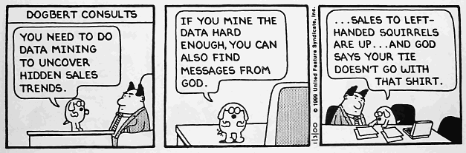

Slide 70
Data Clustering – Overview
Organizing data into sensible groupings is critical for understanding and learning.
Cluster analysis: methods/algorithms for grouping objects according to measured or perceived intrinsic characteristics or similarity.
Cluster analysis does not use category labels that tag objects with prior identifiers, i.e., class labels.
The absence of category labels distinguishes data clustering (unsupervised learning) from classification (supervised learning).
Clustering aims to find structure in data and is therefore exploratory in nature.

Slide 71
Clustering has a long rich history in various scientific fields.
K-means (1955): One of the most popular simple clustering algorithms
Still widely-used.
The design of a general purpose clustering algorithm is a difficult task

Slide 72
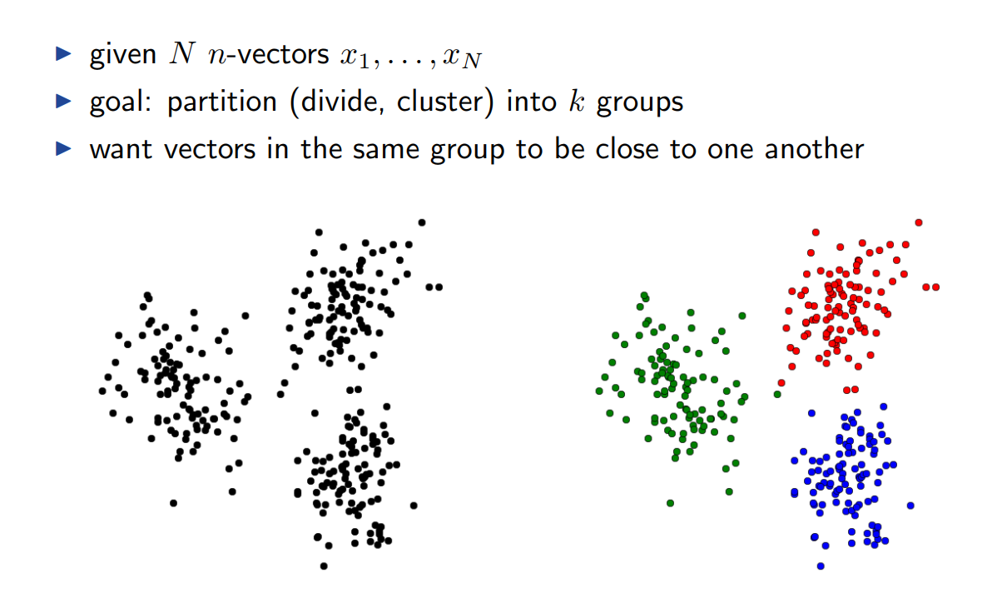
Clustering

Slide 73
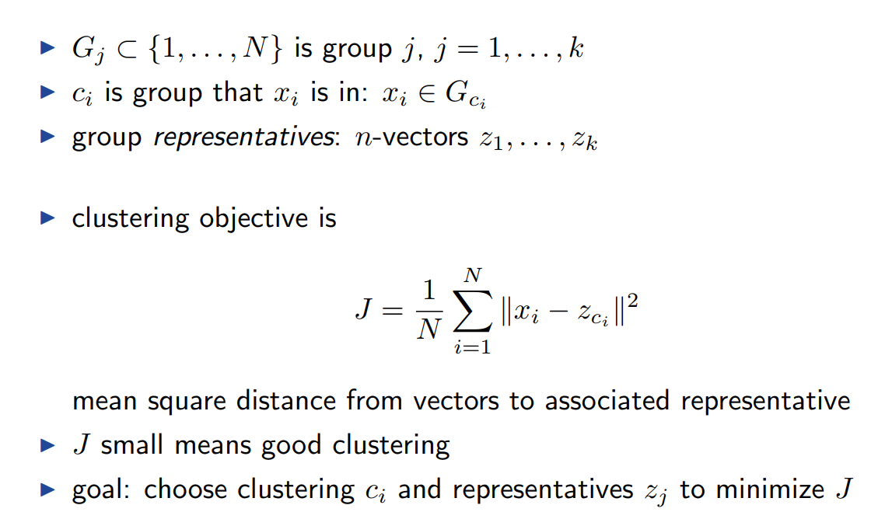
Clustering objectives

Slide 74
k-means: simplest unsupervised learning algorithm
Iterative greedy algorithm (K):
Place K points into the space represented by the objects that are being clustered
These points represent initial group centroids (e.g., start by randomly selecting K centroids)
Assign each object to the group that has the closest centroid (e.g., Euclidian distance)
When all objects have been assigned, recalculate the positions of the K centroids
Repeat Steps 2 and 3 until the centroids no longer move.
It converges but does not guarantee optimal solutions.
It is heuristic!

Slide 75
Criteria for Assessing a Clustering
Sec. 16.3
Internal criterion analyzes intrinsic characteristics of a clustering
External criterion analyzes how close is a clustering to a reference
Relative criterion analyzes the sensitivity of internal criterion during clustering generation
The measured quality of a clustering depends on both the object representation and the similarity measure used

Slide 76
Properties of a good clustering according to the internal criterion
Sec. 16.3
  High intra-class (intra-cluster) similarity
  Cluster cohesion: measures how closely related are objects in a cluster
  Low inter-class similarity
  Cluster separation: measures how well-separated a cluster is from other clusters
  The measured quality depends on the object representation & the similarity measure used

Slide 77
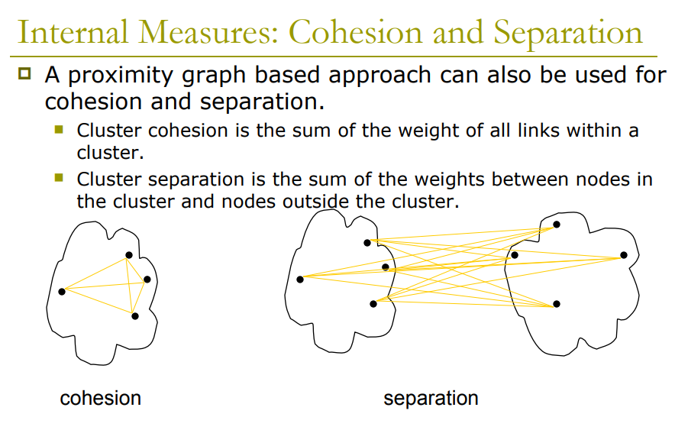

Slide 78

Silhouette value measures cohesion compared to separation
How similar an object is to its own cluster (cohesion) compared to other clusters (separation)
Ranges from −1 to +1: a high value indicates that the object is well matched to its own cluster & poorly matched to neighboring clusters
If most objects have a high value, then the clustering configuration is appropriate
If many points have a low or negative value, then the clustering configuration may have too many or too few clusters
α(i) average dissimilarity of i with all other data within the same cluster.
b(i): lowest average dissimilarity of i to any other cluster, of which i is not a member

Slide 79
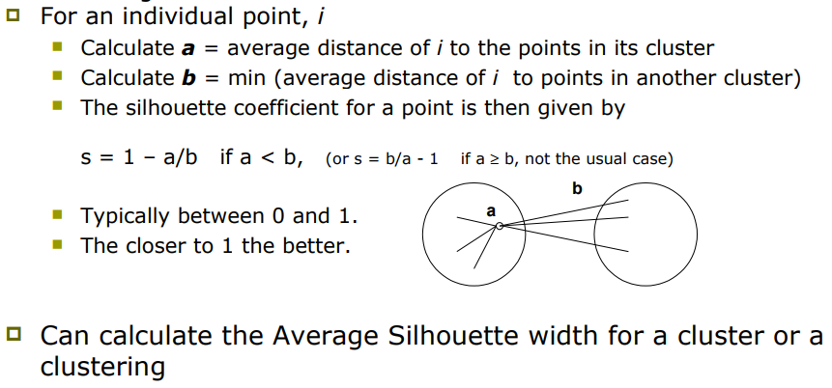
Silhouette Coefficient

Slide 80
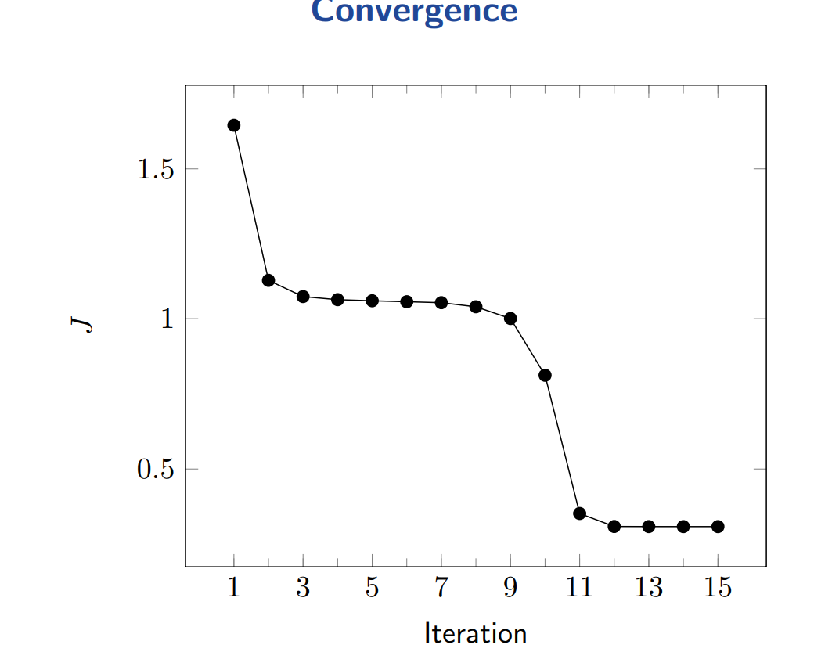

Slide 81
External criteria for clustering quality
Sec. 16.3
External criteria: analyze how close is a clustering to a reference
Quality measured by its ability to discover some or all of the hidden patterns or latent classes in gold standard data
Assesses a clustering with respect to ground truth requires labeled data
Assume items with C gold standard classes, while our clustering algorithms produce K clusters, ω₁, ω₂, …, ω_{K} with n_{i} members.

Slide 82
External Evaluation of Cluster Quality (cont’d)
Sec. 16.3
Assume items with C gold standard classes, while our clustering produces K clusters, ω₁, ω₂, …, ω_{K} with n_{i} members.
Purity: the ratio between the dominant class in the cluster π_{i} and the size of cluster ω_{i}
Biased because having n clusters maximizes purity
Entropy of classes in clusters
Mutual information between classes and clusters

Slide 83
Purity example
Sec. 16.3
• •
• •
• •
• •
• •
• •
• •
• •
•
Cluster I
Cluster II
Cluster III
Cluster I: Purity = 1/6 (max(5, 1, 0)) = 5/6
Cluster II: Purity = 1/6 (max(1, 4, 1)) = 4/6
Cluster III: Purity = 1/5 (max(2, 0, 3)) = 3/5

Slide 84
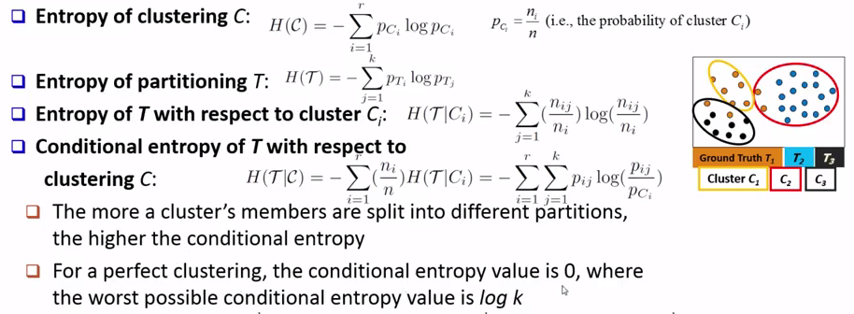
Entropy-based Measure of the Quality of Clustering

Slide 85
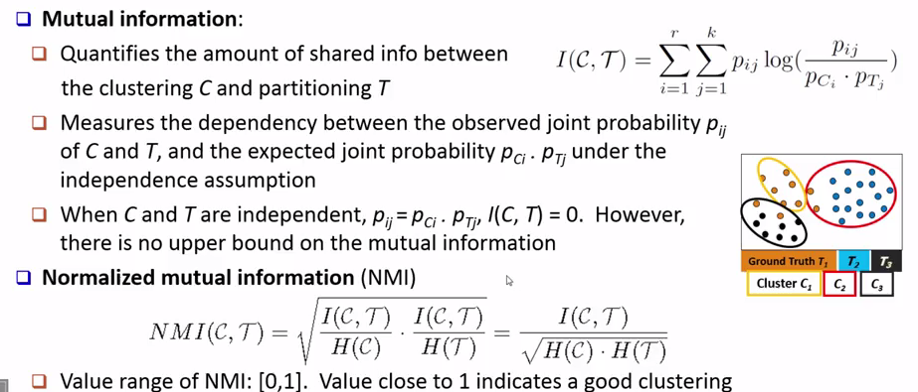
Mutual-information based Measure of Quality of Clustering

Slide 86
Example
Clustering of neurons at positions A, B and C in the conditional STTC (A, B|C)
1st cluster: neurons with approximately equal participation at each position
2nd cluster: neurons with high presence in the position B

Slide 87
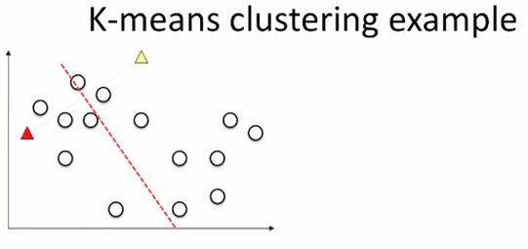
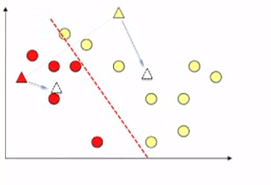

Slide 88
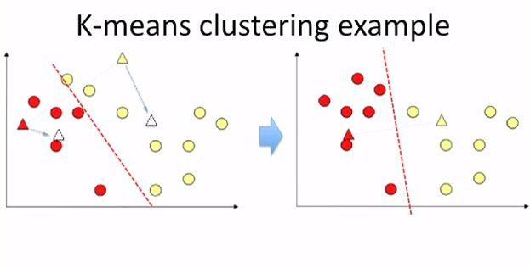

Slide 89
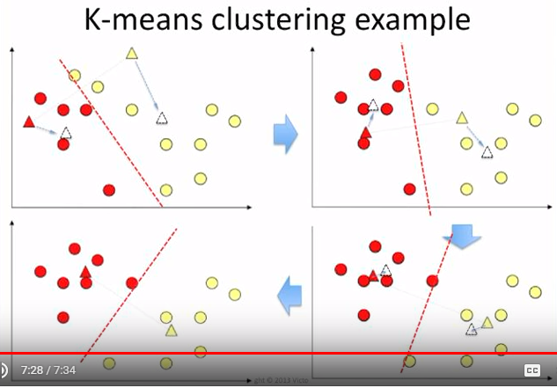

Slide 90
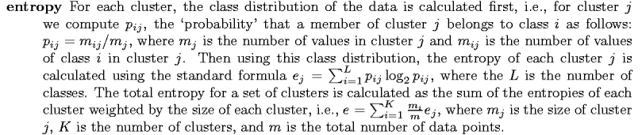

Slide 91
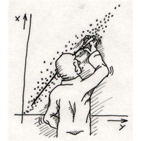




Linear Regression for Predictive Modeling
Suppose a set of observations
& a set of explanatory variables (i.e., predictors)
We build a linear model
where are the coefficients of each predictor
given as a weighted sum of the predictors, with the weights being the coefficients

Slide 92
Why using linear regression?
Strength of the relationship between y and a variable x_{i}
  Assess the impact of each predictor x_{i} on y through the magnitude of β_{i}
  Identify subsets of X that contain redundant information about y

Slide 93
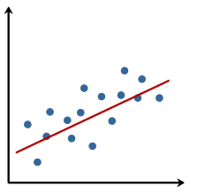


Simple linear regression
Suppose that we have observations
and we want to model these as a linear function of
To determine which is the optimal β ∊ R^{n} , we solve the least squares problem:
where β is the optimal β that minimizes the Sum of Squared Errors (SSE)

Slide 94


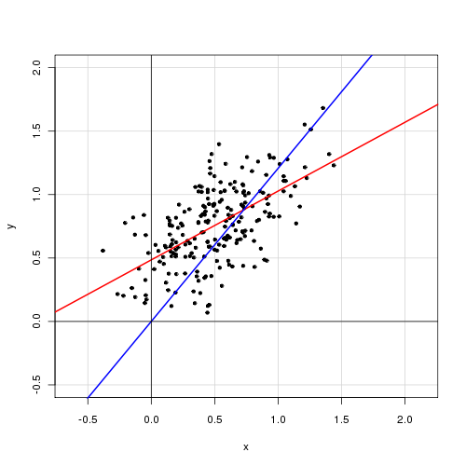
An intercept term β₀ captures the noise not caught by predictor variable
Again we estimate using least squares
without intercept term
with intercept term

Slide 95
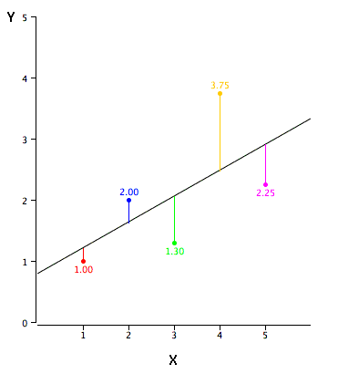
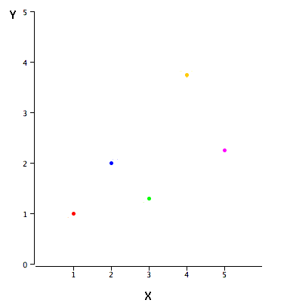
Example 2
Intercept term improves the accuracy of the model
SSE = 3.55
SSE = 2.67
Predicted Y | Squared Error
0.70 | 0.09
1.40 | 0.36
2.10 | 0.64
2.80 | 0.90
3.50 | 1.56
Predicted Y | Squared Error
1.20 | 0.04
1.60 | 0.16
2.00 | 0.49
2.50 | 1.56
2.90 | 0.42

Slide 96
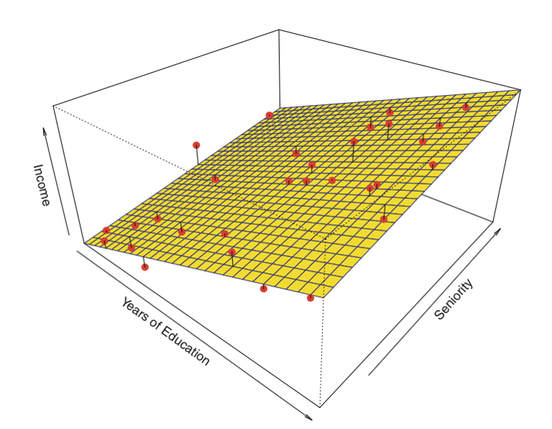


Multiple linear regression
Models the relationship between
two or more predictors & the target
where are the optimal coefficients
β₁, β₂, ..., β_{p} of the predictors x₁, x₂,..., x_{p} respectively,
that minimize the above sum of squared errors

Slide 97

Regularization
Process of introducing additional information in order to prevent overfitting
λ controls the importance of the regularization

Slide 98
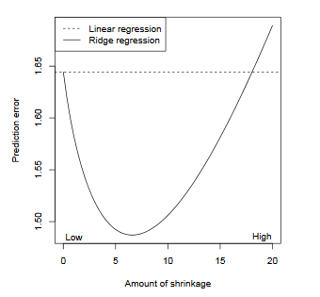
Regularization
Shrinks the magnitude of coefficients
Bias: error from erroneous assumptions about the training data
- Miss relevant relations between predictors & target (high bias, underfitting)
Variance: error from sensitivity to small fluctuations in the training data
- Model noise, not the intended output (high variance, overfitting)
Bias – variance tradeoff: Ignore some small details to get a more general “big picture”

Slide 99


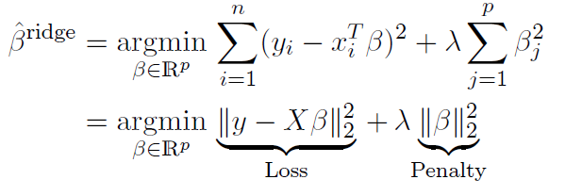
Ridge regression
Given a vector with observations & a predictor matrix
the ridge regression coefficients are defined as:
Not only minimizing the squared error but also the size of the coefficients!

Slide 100
Ridge regression as regularization
If the β_{j} are unconstrained, they can explode …
and hence are susceptible to very high variance!
To control variance, we might regularize the coefficients
i.e., might control how large they can grow

Slide 101

Example 3
Underfitting
Overfitting
Increasing size of λ

Slide 102
Variable selection
Problem of selecting the most relevant predictors from a larger set of predictors
In linear model setting, this means estimating some coefficients to be exactly zero
This can be very important for the purposes of model interpretation
Ridge regression cannot perform variable selection
- Does not set coefficients exactly to zero, unless λ = ∞

Slide 103

Example 4
Suppose that we study the level of prostate-specific antigen (PSA), which is often elevated in men who have prostate cancer.
We look at n = 97 men with prostate cancer & p = 8 clinical measurements.
We are interested in identifying a small number of predictors, say 2 or 3, that drive PSA.
We perform ridge regression over a wide range of λ
This does not give us a clear answer...
Solution: Lasso regression

Slide 104



Lasso regression
The lasso coefficients are defined as:
The only difference between lasso vs. ridge regression is the penalty term
Ridge uses l₂ penalty
Lasso uses l₁ penalty

Slide 105

Lasso regression
λ ≥ 0 is a tuning parameter for controlling the strength of the penalty
The nature of the l₁ penalty causes some coefficients to be shrunken to zero exactly
As λ increases, more coefficients are set to zero → less predictors are selected
Can perform variable selection

Slide 106

Example 5: Ridge vs. Lasso
lcp, age & gleason: the least important predictors → set to zero

Slide 107

Example 6: Ridge vs. Lasso

Slide 108

Constrained form of lasso & ridge
For any λ and corresponding solution in the penalized form, there is a value of t such that the above constrained form has this same solution. The imposed constraints constrict the coefficient vector to lie in some geometric shape centered around the origin
Type of shape (i.e., type of constraint) really matters!

Slide 109


Why lasso sets coefficients to zero?
The elliptical contour plot represents sum of square error term
The diamond shape in the middle indicates the constraint region
Optimal point: intersection between ellipse & circle
Corner of the diamond region, where the coefficient is zero
Instead
with ridge:

Slide 110
Regularization penalizes hypothesis complexity
L2 regularization leads to small weights
L1 regularization leads to many zero weights (sparsity)
Feature selection tries to discard irrelevant features

Slide 111
Matlab code & examples
% Lasso regression
B = lasso(X,Y); % returns beta coefficients for a set of regularization parameters lambda
[B, I] = lasso(X,Y) % I contains information about the fitted models
% Fit a lasso model and let identify redundant coefficients
X = randn(100,5); % 100 samples of 5 predictors
r = [0; 2; 0; -3; 0;]; % only two non-zero coefficients
Y = X*r + randn(100,1).*0.1; % construct target using only two predictors
[B, I] = lasso(X,Y); % fit lasso
% examining the 25th fitted model
B(:,25) % beta coefficients
I.Lambda(25) % lambda used
I.MSE(25) % mean square error

Slide 112
Matlab code & examples
% Ridge regression
X = randn(100,5); % 100 samples of 5 predictors
r = [0; 2; 0; -3; 0;]; % only two non-zero coefficients
Y = X*r + randn(100,1).*0.1; % construct target using only two predictors
model = fitrlinear(X,Y, ’Regularization’, ’ridge’, ‘Lambda’, 0.4));
predicted_Y = predict(model, X); % predict Y, using the X data
err = mse(predicted_Y, Y); % compute error
model.Beta % fitted coefficients

Slide 113

Simple Linear Regression
Suppose that we have n pairs of observations (x₁, y₁), (x₂, y₂), …, (x_{n}, y_{n}).
Deviations of the data from the estimated regression model.

Slide 114

Simple Linear Regression - Least Squares
The method of least squares is used to estimate the parameters, β₀ and β₁ by minimizing the sum of the squares of the vertical deviations
Deviations of the data from the estimated regression model.

